Slide 1
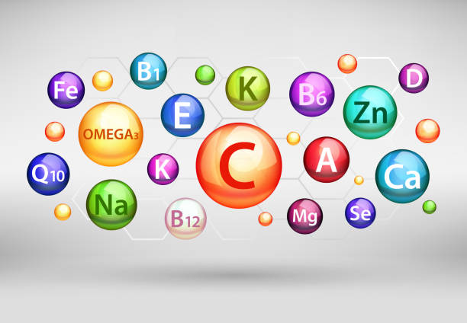
Vitamins:
Biochemical Roles
Biochemistry 3070

Slide 2
Vitamins
Vitamins are necessary components of healthy diets and play important roles in cellular metabolism.
Vitamins are considered “micronutrients.”
Although these substances occur in only very small amounts within cells, they are critically important. Their absence is usually manifested as some deficiency disease.
What are vitamins?

Slide 3
Vitamins
Vitamins are organic compounds necessary in small amounts for the normal growth and function of humans and some animals.
The term vitamin was first used to describe the “vital amine,” thiamine, which is needed to prevent beriberi (once a common disease amoung people who depended upon white rice for their main source of food.)
“Vitamin” as a generalized name survived.

Slide 4
Vitamins
Vitamins are relatively small molecules that function most often as coenzymes.
Humans must consume at least 12 vitamins in their diet, because we lack the ability to synthesize them.
A well-balanced diet from a variety of food sources usually provides all these vitamins. However, many people supplement their diet with extra vitamins.
Most vitamins are chemically altered in some way so they can function in the body.

Slide 5
Vitamins – I.U.’s
Some vitamins are measured in I.U.s (International Units), which is a measure of biological activity.
This measuring system is needed because these vitamins have several natural forms that have different activities on an equal weight basis.
Other vitamins are measured on the basis of weight (mg or μg).

Slide 6
Vitamins - US FDA
In the United States, the Food and Drug Administration (FDA) sets “Daily Reference Intakes,” which are the highest amounts of daily vitamins that are needed by 95% of the population.
Dietary Reference Intakes (DRI) and
Recommended Dietary Allowances (RDA)
The DRIs are actually a set of four reference values: Estimated Average Requirements (EAR), Recommended Dietary Allowances (RDA), Adequate Intakes (AI), and Tolerable Upper Intake Levels, (UL) that have replaced the 1989 Recommended Dietary Allowances (RDAs)
http://www.nal.usda.gov/fnic/etext/000105.html

Slide 7
Vitamins
Researchers identified newly discovered vitamins by letters because the exact chemical structures were unknown. Later, what was thought to be one single vitamin often turned out to be many, and they added numerical subscripts to idenitify each different member of the group.
Consider the B-vitamins:
  B₁, B₂, B₃, B₆, B₁₂

Slide 8
Vitamins
Some confusion also arose as to which vitamins were really necessary, resulting in gaps between numerical subscripts.
For example,
  B₈ (adenylic acid),
  B₁₃ (orotic acid), and
  B₁₅ (parigamic acid)
were removed from the list of essential vitamins.

Slide 9
Vitamins
Other vitamins, originally designated as different, were later found to be the same compound. Vitamins H, M, S, W, and X were all eventually shown to be biotin.
Vitamin G became B₂ (riboflavin).
Vitamin Y became B₆ (pyridoxine).
At one time, vitamin M seems to have been used for three different vitamins: folic acid, pantothenic acid, and biotin.
Today, chemical names are used to help prevent confusion.

Slide 10
Vitamins
Vitamins are categorized into two groups:
Water soluble:
  The “B”-vitamins
  Vitamin C
  Pantothenic acid
  Biotin
  Folic acid
Fat-soluble Vitamins:
  Vitamins A, D, E, K

Slide 11
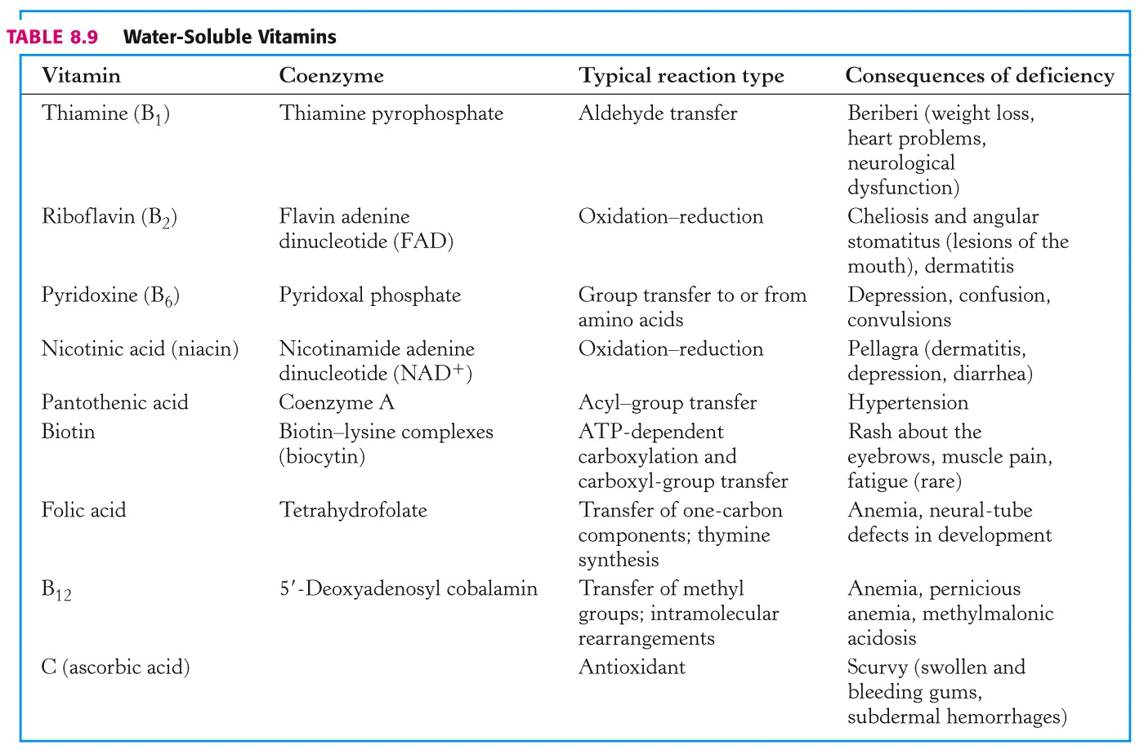
Water soluble Vitamins

Slide 12
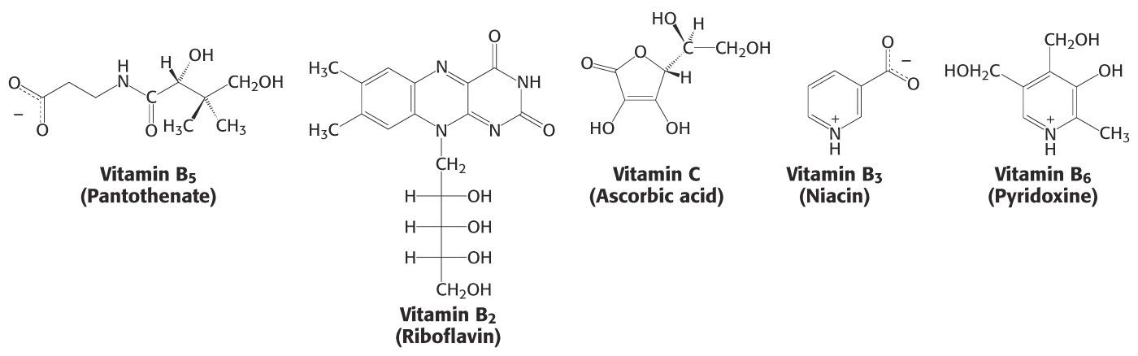
Water-soluble Vitamins
Structures of Water-soluble Vitamins

Slide 13
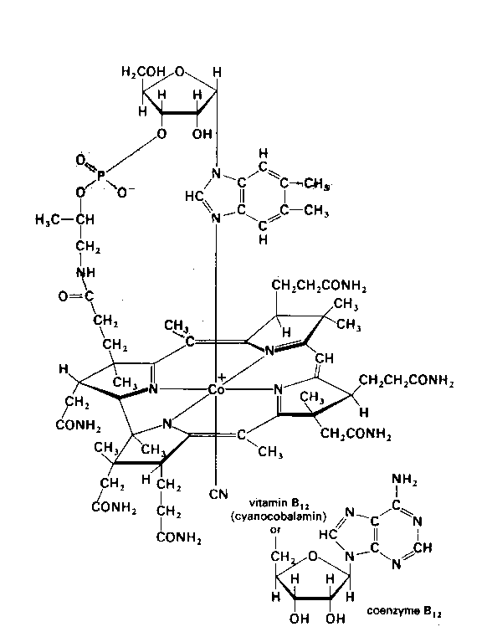
Vitamin B₁₂ – The most complex structure of all vitamins
Vitamin B₁₂ is the most complex vitamin (with respect to its structure.)
A colbalt ion is chelated at the center of this vitamin.
Only 6μg/day for an average adult helps prevent pernicious anemia. (One gram can supply 166,000 people!)
Note:
The current cost for this vitamin runs approximately $6,500 per kg.

Slide 14
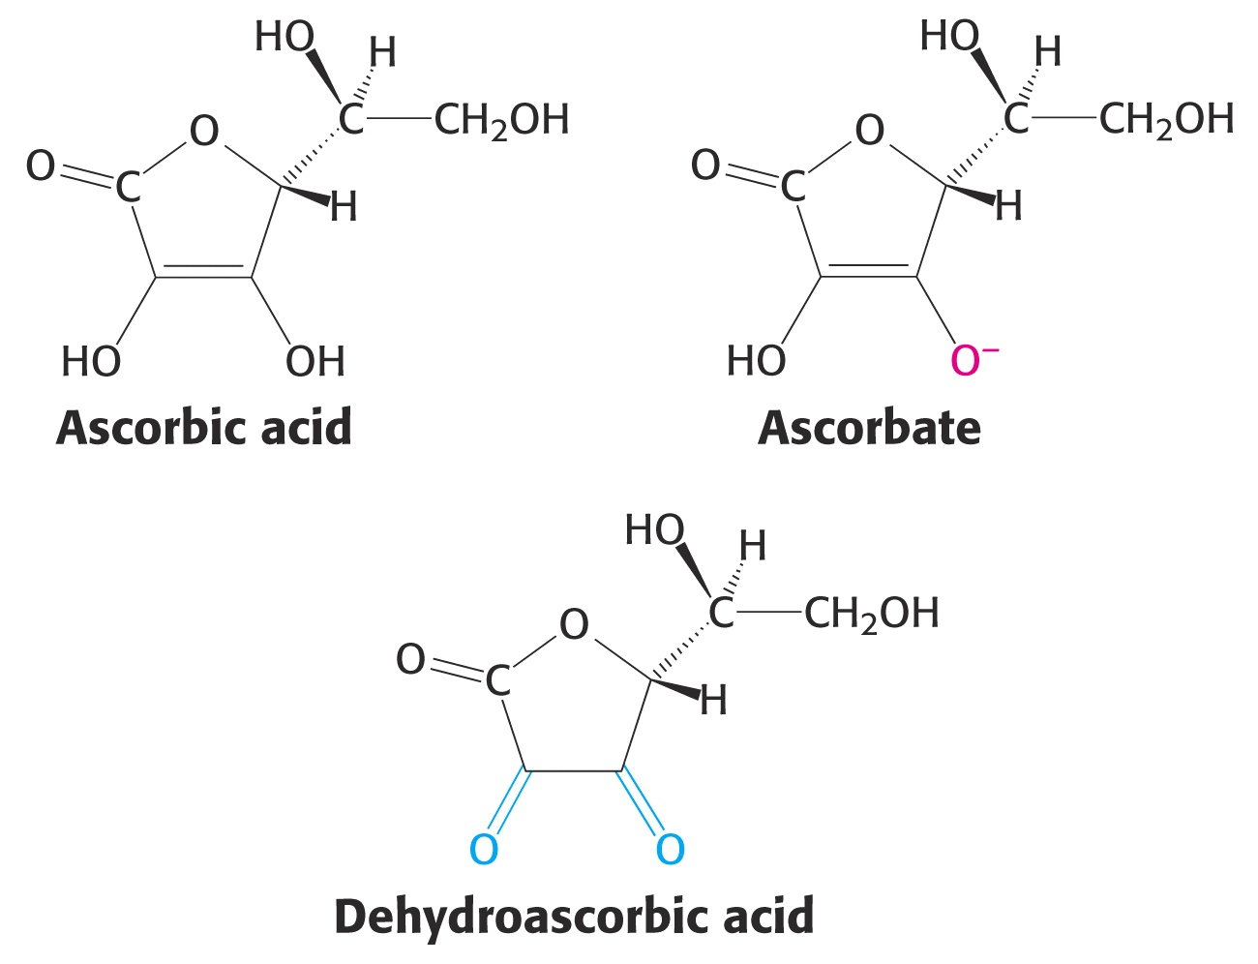
Vitamin C
The most recognized of all vitamins is Vitamin C (ascorbic acid):

Slide 15
Vitamin C
Ascorbic acid helps prevent scurvy, hence its name as the “anti-scurvy” or “a-scorbic” vitamin.
Scurvy is characterized by swollen and bleeding gums and subdermal hemorrhages.
Connective tissue contains collagen protein. Collagen is a triple polypeptide helix that is strengthened by a significant quantity of 4-hydroxyproline.
Vitamin C is required to synthesize this important amino acid. Without it, connective tissues weaken, a condition often manifested as bleeding gums and other hemorrhagic tissues.

Slide 16
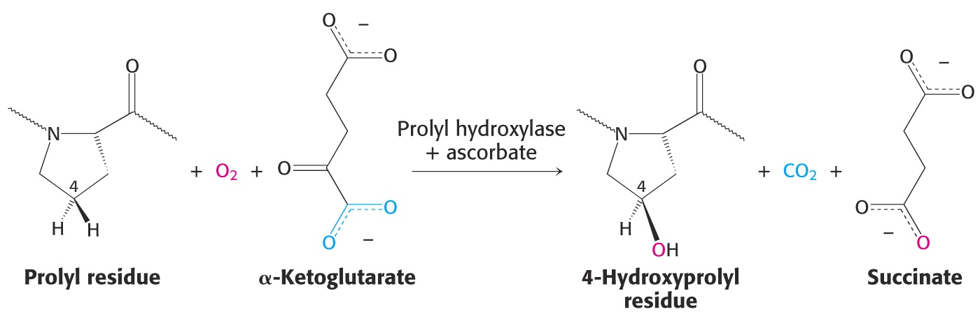
Vitamin C
Formation of 4-hydroxyproline:
During this reaction, the enzyme prolyl hydroxylase is assisted by an Fe²⁺ cofactor, which is converted to the oxidized Fe³⁺ form during the reaction.
The Fe³⁺ is reduced back to Fe²⁺ by ascorbic acid, which acts as the reducing agent and is converted into dehydroascorbic acid during the process.
Hence, ascorbic acid is an “antioxidant.”

Slide 17
Vitamin C
Scurvy on the St. Lawrence River:
“Some did lose all their strength, and could not stand on their feet… Others also had all their skins spotted with spots of blood of a purple colour: then did it ascend up to their ankles, knees, thighs, shoulders, arms, and necks. Their mouths became stinking, their gums so rotten, that all the flesh did fall off, even to the roots of the teeth, which did also almost all fall out.
- Jacques Cartier, 1536

Slide 18
Vitamin C
James Lind, a Scottish physician published a paper in 1747 that clearly linked the prevention of scurvy to the consumption of citrus fruits in the diet.
Following his suggestions, The Royal Navy issued lime rations to sailors, resulting in their nickname, “limeys.”
Seven years earlier, a British task force of six ships lost almost 1,000 sailors to scurvy during an extended sea voyage.

Slide 19
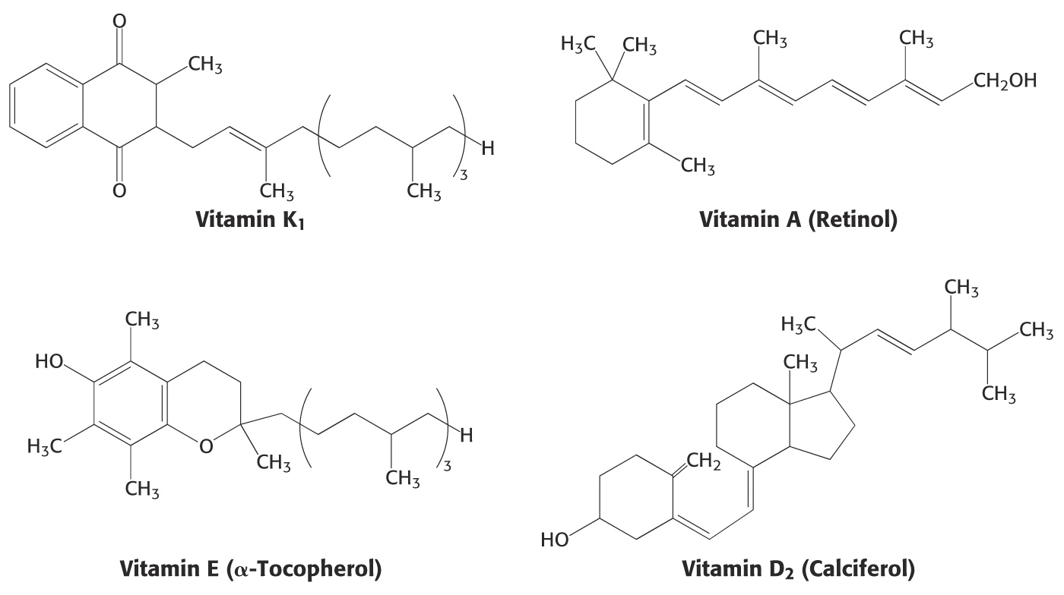
Fat-soluble Vitamins
The fat-soluble vitamins share some structural and solubility similarities.

Slide 20
Fat-soluble Vitamins
Vitamin | Function | Deficiency
A | Roles in vision, growth, reproduction | Night blindness, cornea damage, damage to respiratory tract and gastrointestinal tract
D | Regulation of calcium and phosphate metabolism | Rickets (children): skeletal deformities, impaired growth Osteomalacia (adults): soft, bending bones
E | Antioxidant | Lesions in muscles and nerves (rare)
K | Blood coagulation | Subdermal and cerebral hemorrhaging

Slide 21
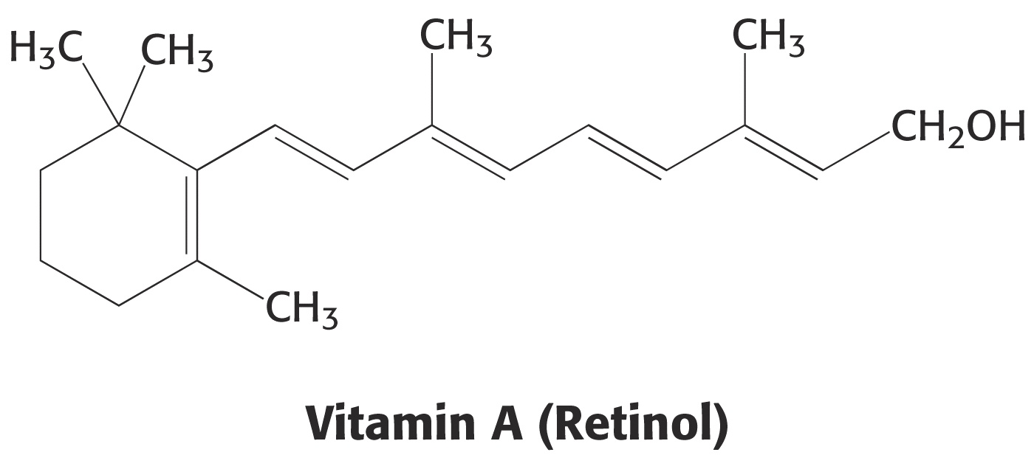
Vitamin A
Vitamin A – Our visual pigment:

Slide 22
Vitamin A - Retinol
Vitamin A helps with our vision.
Too much Vitamin A can cause serious side effects, hence larger doses of this pure vitamin are controlled by prescription.
An excellent natural source of vitamin A is the pigment, β-carotene. The body splits this molecule into two molecules of vitamin A. A person can consume so much β-carotene that their skin turns orange, but the body only converts enough of it into vitamin A to meet its needs, hence avoiding an excess of this vitamin and its deleterious effects.
Note: Eating carrots can actually help some low-light [“night”] vision problems by supplying vitamin A in the form of β-carotene .

Slide 23
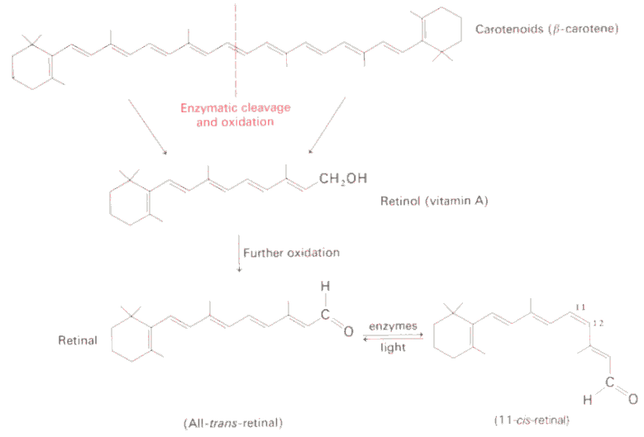
Vitamin A from beta-Carotene

Slide 24
Vitamin A and Vision
After conversion to the appropriate form (11-cis retinal), Vitamin A acts as a visual pigment in our eyes, by absorbing photons.
To function, it is connected to the protein “opsin” via a Shiff’s base. Together, the protein-pigment complex is called “rhodopsin.”
The 11-cis double bond absorbs light, resulting in a conversion of the 11-cis to the 11-trans form. The light reaction takes only a few picoseconds and it starts a complex signal transduction pathway that leads to light being perceived in the brain.

Slide 25
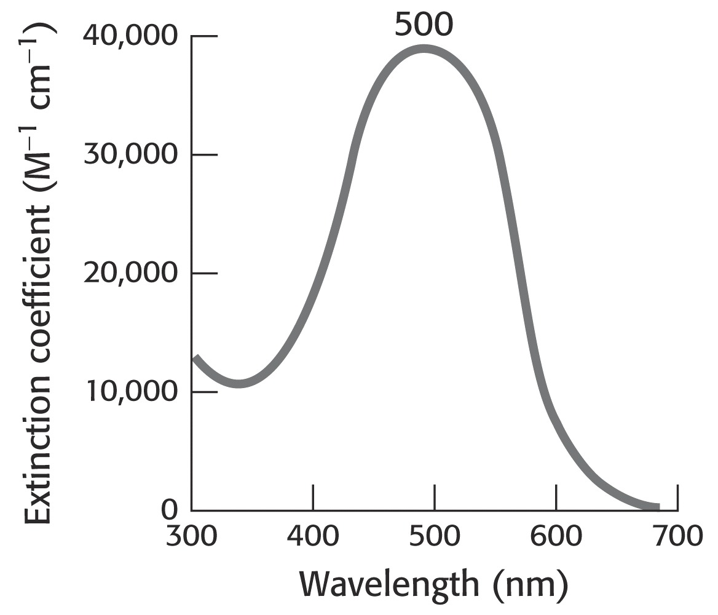
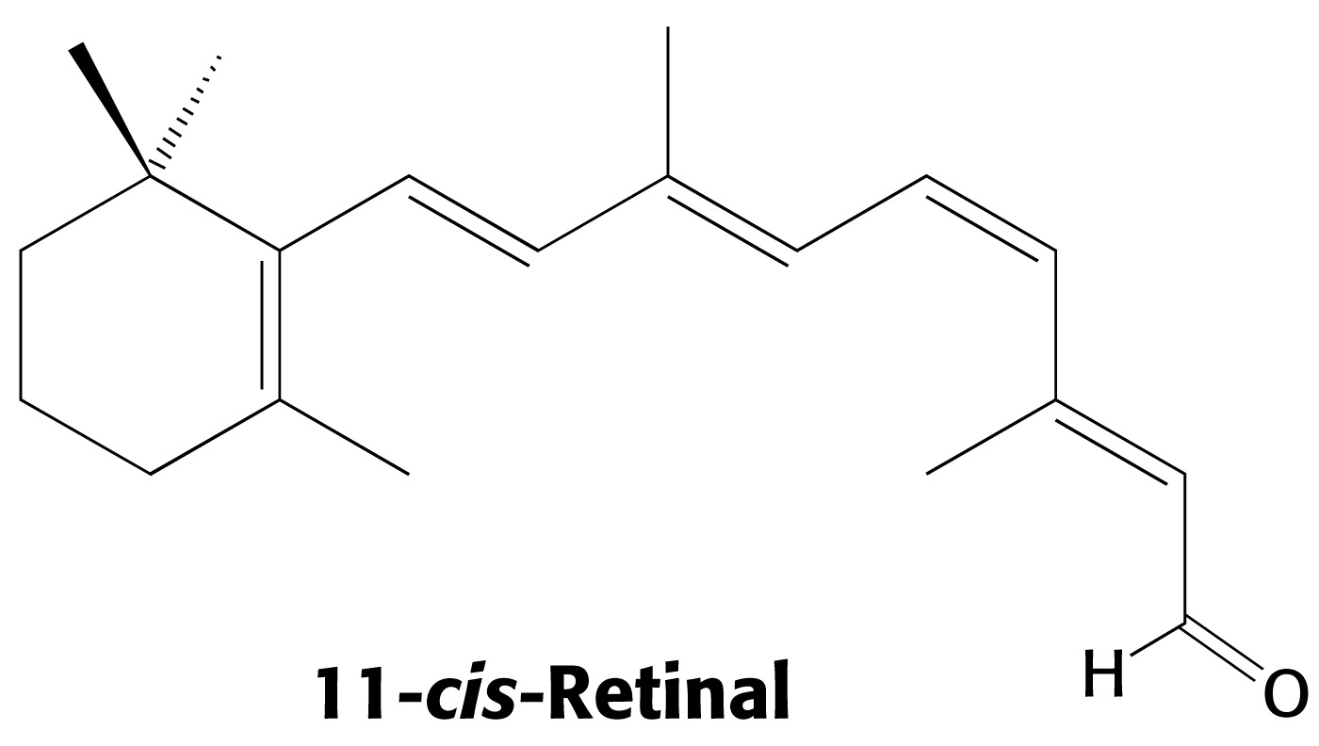
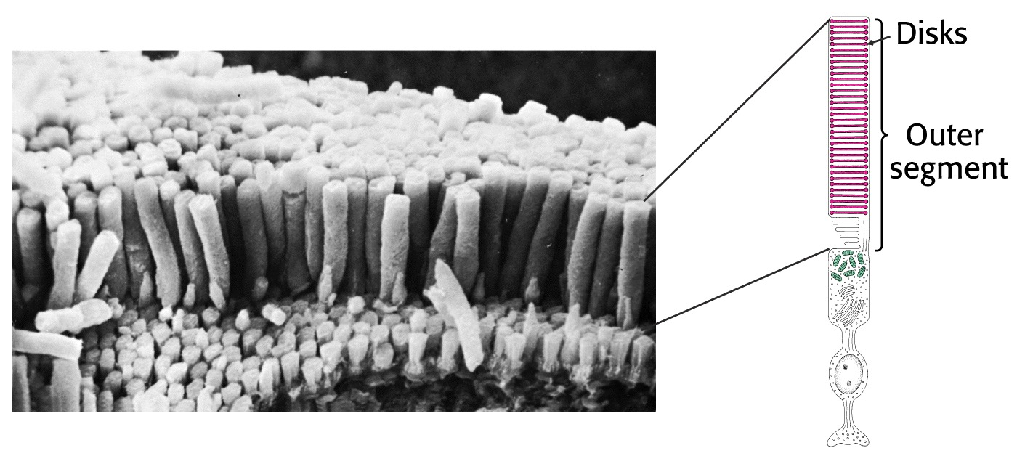
Vitamn A as the Visual Pigment

Slide 26
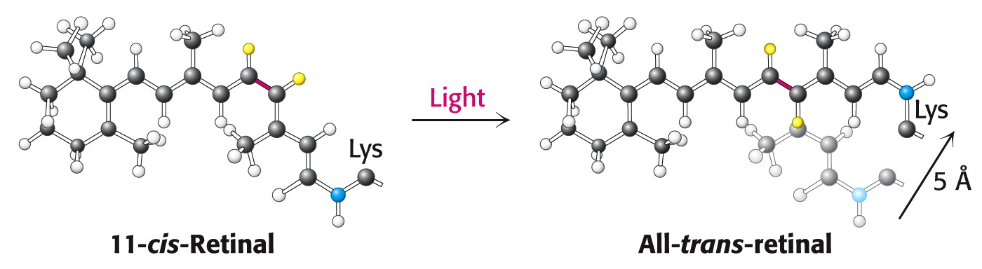
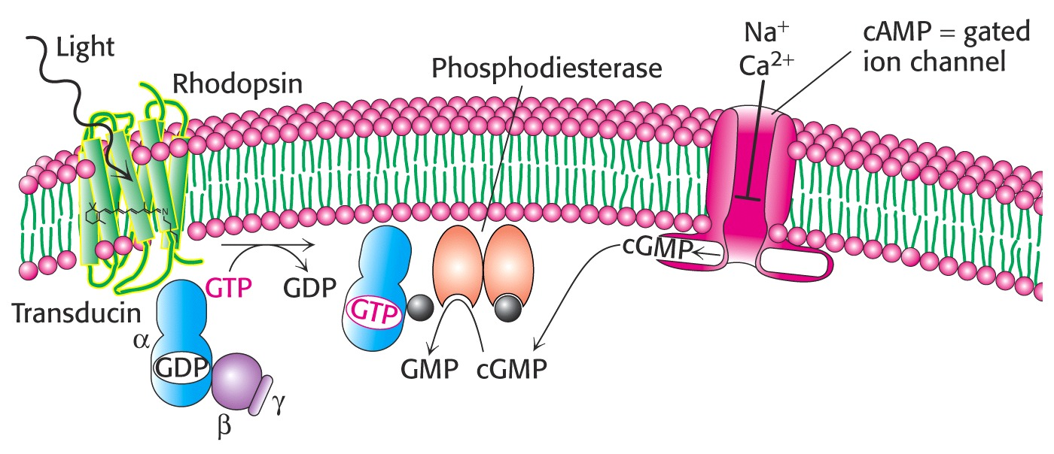
Vitamin A – Retinal’s Role in Vision

Slide 27
Vitamin A – Retinal’s Role in Vision
Color Vision is possible because of three rhodopsin binding to three different opsin proteins in three different types of cone cells.
Each protein has a slightly different amino acid composition, changing the environment of the 11-cis-retinal pigment.
This change shifts the absorption spectrum of these three proteins to the “blue,” “green,” and ‘red” regions. Signals from each of these three different types of cells are the basis for our color perception.

Slide 28
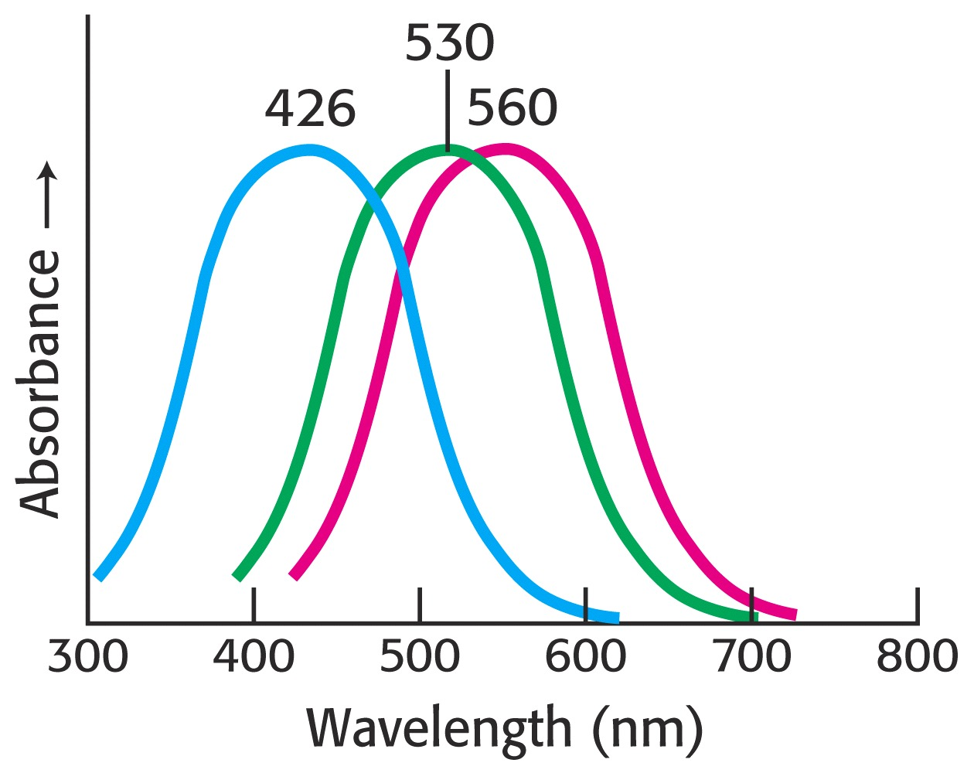
Vitamin A – Retinal’s Role in Vision

Slide 29
Retinal and Color Vision
The genes for the color-shifted opsin proteins lie adjacent to each other on the human X chromosome and share a high degree of similarity.
Slight changes in the base sequences of these genes result in spectral shifts for light absorption, leading to perceptual differences in the color of light we see.
Human X chromosomes carry various numbers of color pigments genes. In the general population, the X-chromosome gene content varies significantly:
  2% - 1 color pigment gene
  20% - 2 color pigment genes
  50% - 3 color pigment genes
  20% - 4 color pigment genes
  5% - 5 color pigment genes

Slide 30
Color Blindness
Due to the loci of these genes on the X chromomsome, most colorblindness is sex-linked, with predominant expression in males.
~ 5% of males lack the green pigment gene. The resulting hybrid gene absorbs light between red and green, making differentiation of these two colors difficult.

Slide 31
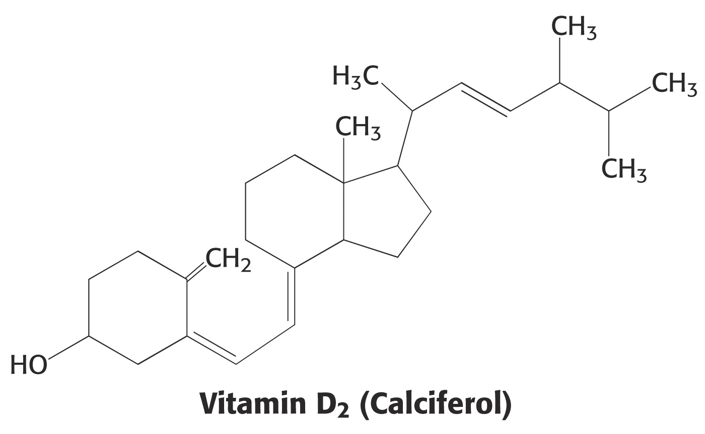
Vitamin D
Vitamin D acts as a hormone, helping regulate the uptake of calcium from the intestines by promoting the synthesis of calcium-binding protein in the mucosal cells.
Deficiency of this vitamin causes “rickets,” a condition of low levels of calcium, which results in soft and pliable bones, leading to bending and distortion.

Slide 32
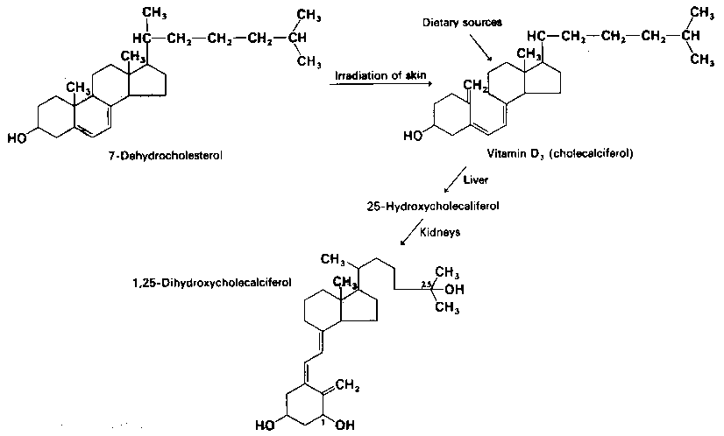
Vitamin D
Vitamin D is sometimes called the “sunshine vitamin.” This is due to its unique biosynthetic route that requires UV light to complete its synthesis.

Slide 33
Vitamin D – The Sunshine Vitamin
By law, milk sold in the USA must be fortified with Vitamin D. It is obtained primarily from irradiated yeast extracts.
Fish oils are also a good source of vitamin D.
You can synthesize your own vitamin D by simply exposing your skin to UV light. (This is always a good excuse to get some sunshine.)

Slide 34
Russian children in the artic tundra were often afflicted with rickets, due to lack of sunshine and/or adequate dietary sources (e.g., availability of fish oils).
Years ago, (and still today?) the Russian government sent UV lights to the elementary schools in this region and required students to absorb UV light from these lamps to help synthesize vitamin D and reduce the occurence of rickets.
(A National Geographic story a few years ago showed a picture of the students getting their daily dose of UV light.)

Slide 35
Vitamin E
Vitamin E helps promote male virility in rats and enhances birth rates. Hence, many believe it must therefore be important for humans…
Its role in humans is not completely understood, hence it is difficult to determine a minimum recommended daily intake.
However, premature infants fed on formulas low in vitamin E often develop a form of hemolytic anemia that can be corrected by vitamin E supplementation. Most manufacturers of infant formulas fortify their preparations with this vitamin.

Slide 36
Vitamin E is an excellent antioxidant. Therefore its primary use is in helping to promote shelf life of commercially important oils like cooking oils, lotions, etc.
Much more Vitamin E is sold as a preservative than for use in vitamin supplements.

Slide 37
End of Lecture Slides
for
Vitamins
Credits: Many of the diagrams used in these slides were taken from Stryer, et.al, Biochemistry, Freeman

