Slide 1
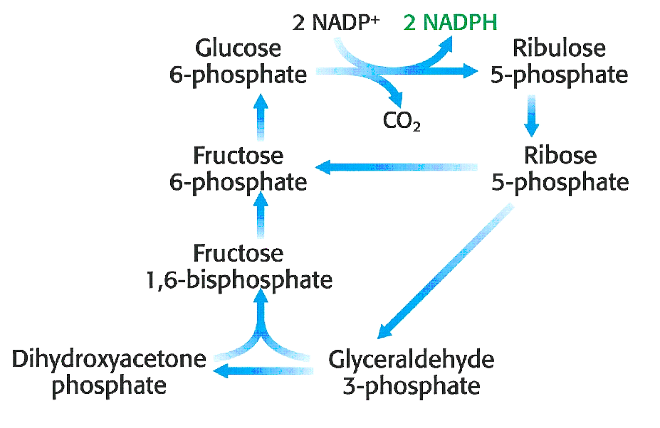
Biochemistry 3070
Hexose Monophosphate Shunt

Slide 2
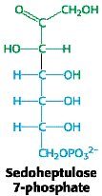
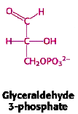
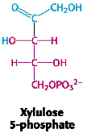
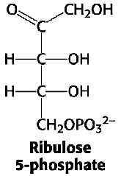
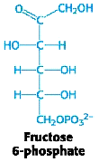
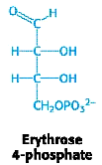
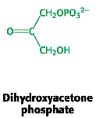
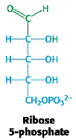
Hexose Monophosphate Shunt
Biological systems utilize a variety of simple sugars which must be synthesized by the cell.
These sugars range in carbon number from C₃ to C₇:
C₃
C₅
C₄
C₆
C₇

Slide 3
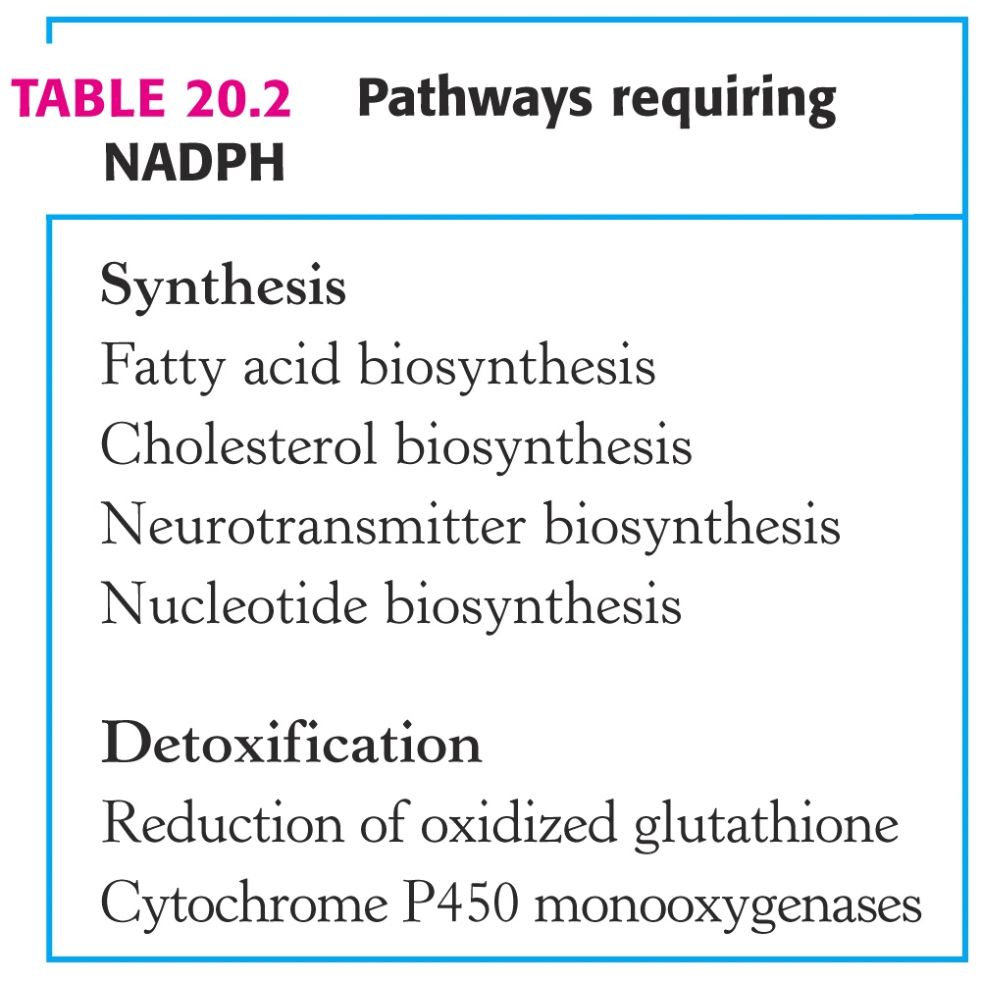
Hexose Monophosphate Shunt
In addition to the need for these sugars, the cell also needs an ample supply of NADPH for many cellular processes:

Slide 4
Hexose Monophosphate Shunt
A unique pathway fills both these needs (sugar variety and NADPH supply). This pathway has a variety of names associated with it:
“Pentose Phosphate Pathway,”
“Hexose Monophosphate Shunt,” or simply
“Phosphate Shunt”
The reactions of this pathway occur in the cytoplasm of almost all cells.
Because copious amounts of NADPH are needed for fatty acid synthesis, this pathway is particularly active in adipose tissues.

Slide 5
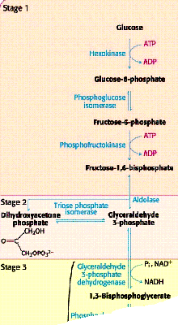
Hexose Monophosphate Shunt
The Hexose Monophosphate Shunt begins as a branch in the glycolysis pathway. Glucose-6-phosphate is oxidized and decarboxylated in a series of reactions, forming NADPH and ribose-5-phosphate:
Glycolysis
NADPH & CO₂
C₅
C₃, C₄, C₅, C₆, C₇
C₆ & C₃
Hexose Monophosphate Shunt

Slide 6
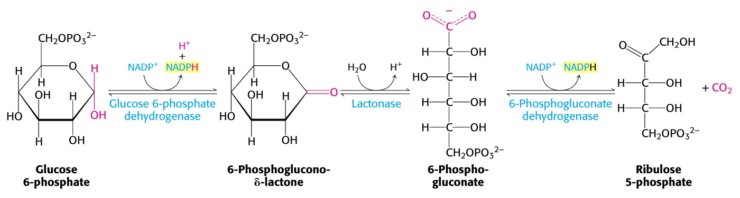
Hexose Monophosphate Shunt
When PFK (the controlling enzyme for glycolysis) is inactive, glucose 6-phosphate is diverted or “shunted” into this pathway.
It is first oxidized to a lactone (cyclic ester) and then opened to form 6-phosphogluconate. This is followed by an oxidative decarboxylation to form ribulose 5-phosphate (a five-carbon sugar):
Two molecules of NADPH and one CO₂ are formed for every molecule of glucose 6-phosphate that enters this pathway.

Slide 7
Hexose Monophosphate Shunt
Two unique enzymes now go to work by transferring C₂ and C₃ groups from one sugar to another. These enzymes are transketolase and transaldolase:
Tranketolase: (C₂): C₅ + C₅ → C₃ + C₇
Tranaldolase: (C₃): C₃ + C₇ → C₆ + C₄
Tranketolase: (C₂): C₄ + C₅ → C₆ + C₃
Let’s examine the specifics of these enzymatic reactions.

Slide 8
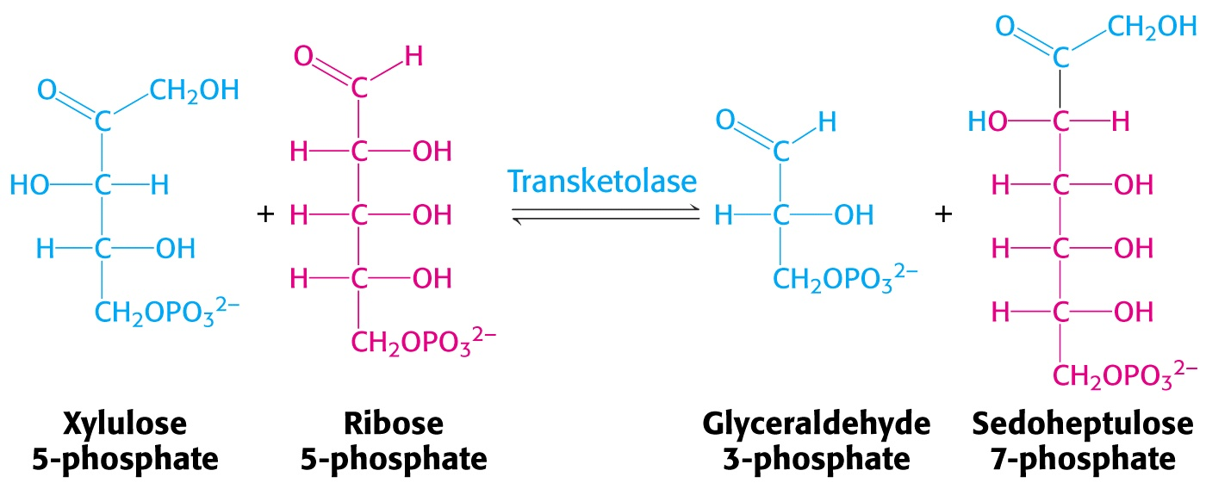
Hexose Monophosphate Shunt
Ribulose 5-P is easily epimerized to xylulose-5-P.
One molecule of each epimer (two C₅ sugars) react to form glyceraldehyde-3-P and sedoheptulose-7-P (C₃ and C₇). This reaction is catalyzed by transketolase, which transfers a two-carbon unit (from xyulose-7-P to ribose-5-P.)

Slide 9
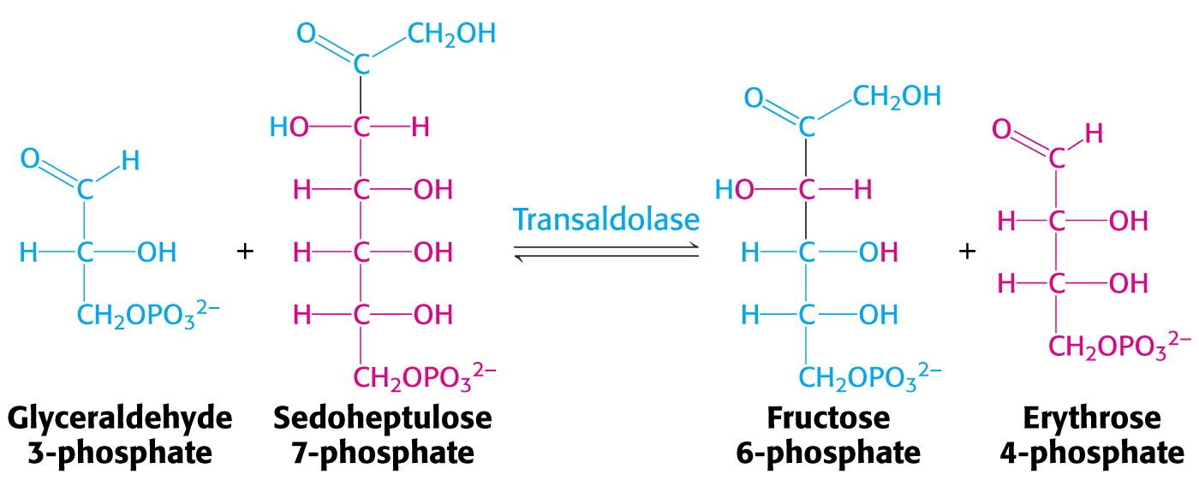
Hexose Monophosphate Shunt
These two products (C₃ & C₇) can further react, transferring a C₃ unit from sedoheptulose-7-P back to glyceraldehyde-3-P forming fructose-6-P and erythrose-4-P. This C₃-transfer is catalyzed by transaldolase.

Slide 10
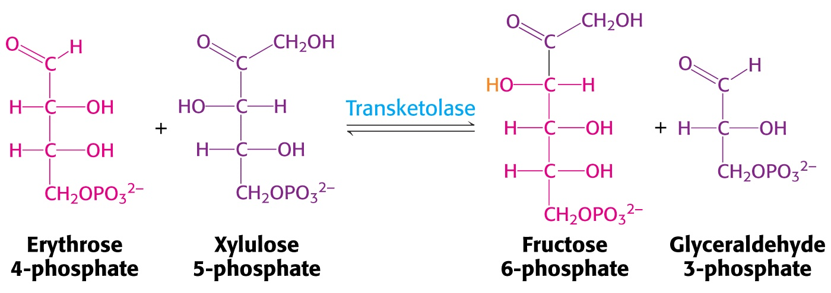
Hexose Monophosphate Shunt
Finally, in another transketolase-catalyzed transfer of a C2-unit from a second molecule of xylulose-5-P to erythrose-4-P, another fructose-6-P is formed together with another glyceraldehyde-3-P.
These products are all part of the glycolytic pathway.
Hence, the relatively few reactions in this hexose monophosphate shunt, provide for a variety of sugars with 3, 4, 5, 6, and 7 carbons.

Slide 11
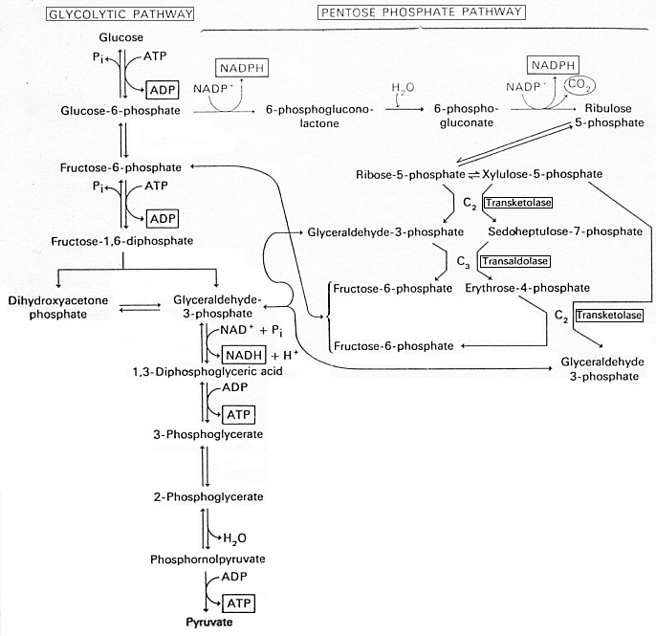

Slide 12
Hexose Monophosphate Shunt
How can we tell which pathway (glycolysis or pentose shunt) is working in cells?
One unique and creative method is to prepare a single homogenate of the tissue and split it into two separate containers. Glucose with different radioactive ¹⁴C isotopic labels are added to each praparation.
Glucose with a ¹⁴C label at carbon #1 is added to preparation.
Glucose with a ¹⁴C label at carbon #6 is added to the other preparation.
The rates of ¹⁴CO₂ evolution signal which pathway if functioning.
Questions:
1. Explain the logic behind this experimental design.
2. Describe the experimental results observed for each pathway.
Hint:
Consider the first few steps of this pathway.

Slide 13
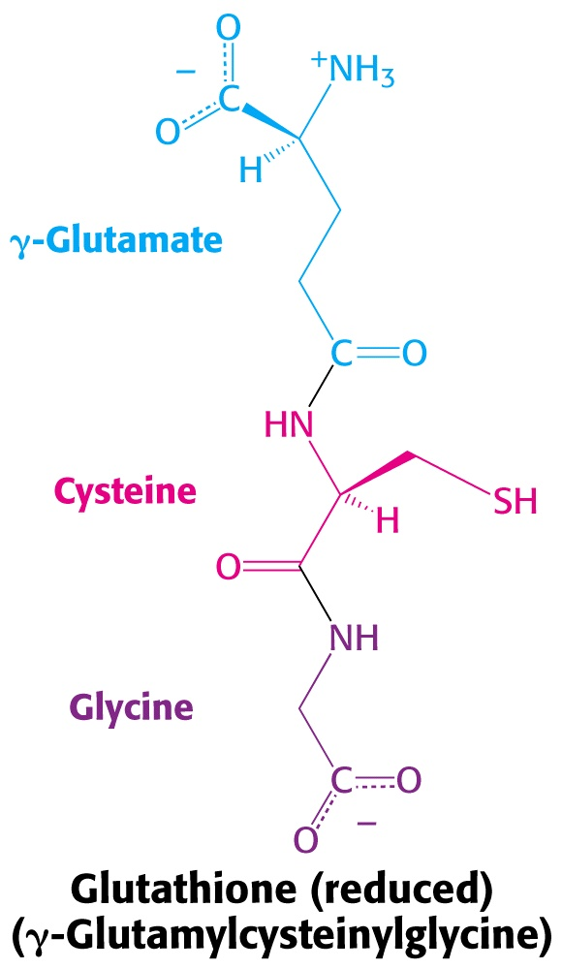
Hexose Monophosphate Shunt
Glucose-6-P dehydrogenase, the first enzyme in the hexose monophosphate shunt, is an important enzyme for healthy cells, especially in the circulatory system.
Defects or deficiency of this enzyme leads to reduced levels of NADPH.
An important reductive role for NADPH is to maintain glutathione in a reduced state. Reduced glutathione (GSH) is a tripeptide that contains cysteine. The reduced, free –SH group is necessary to help combat reactive oxygen species (ROS) often present in cells.
One example is erythrocytes, which lack mitochondria and depend completely upon the shunt for their supply of reducing power. Low supplies of NADPH weaken erythrocytes, making them more susceptible to damage from ROS or general oxidation.

Slide 14
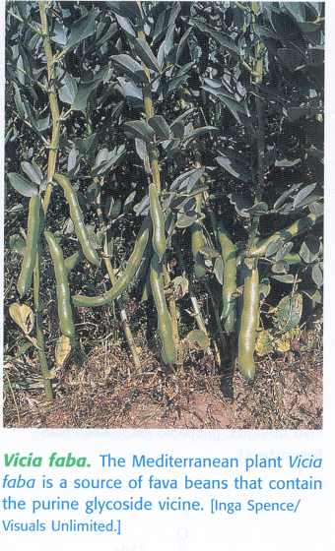
Hexose Monophosphate Shunt
During construction of the Panama Canal (1904-1914) and the nearby Madden Dam, which stores additional water for the locks (completed in 1935), falciparum malaria was a major problem for workers. This stimulated researchers to find a medicine to help those afflicted.
An antimalarial drug, pamaquine, was introduced in 1926 to help combate this parasitic disease. Pamaquine is a purine glucoside (initially isolated from fava beans) that is capable of generating peroxides.

Slide 15
Hexose Monophosphate Shunt
Severe side effects were observed in a small percentage of subjects who took the drug: their urine turned black, jaundice developed, and their hematocrits dropped sharply. In some cases, massive destruction of red blood cells caused death.
Thirty years later, these symptoms were linked to a deficiency of glucose-6-P dehydrogenase and associated low levels of NADPH. NADPH is needed to maintain reduced GSH which in turn serves as a sulfydryl buffer that maintains the cysteine residues of hemoglobin and other erythrocyte proteins in the reduced state. Reduced GSH also is needed to keep hemoglobin in the ferrous state and detoxify peroxides in cells.
Those lacking an ample supply of NADPH (and subsequently reduced GSH) suffer the resulting side effects of the peroxide-generating activity of the pamaquine.

Slide 16
Hexose Monophosphate Shunt
In an interesting turnabout, this same genetic trait can be advantageous for people living in malarial infested regions of the world. The falciparum malaria parasite requires reduced GSH and the products of the hexose monophosphate shunt to survive.
Approximately 11% of Americans of African heritage have a deficiency in glucose-6-P dehydrogenase. This deficiency is actually a protection mechanism against malarial infection.
This selective advantage shows up at higher frequency among populations where malaria historically has been a recurring problem, especially in equatorial regions of the world.

Slide 17
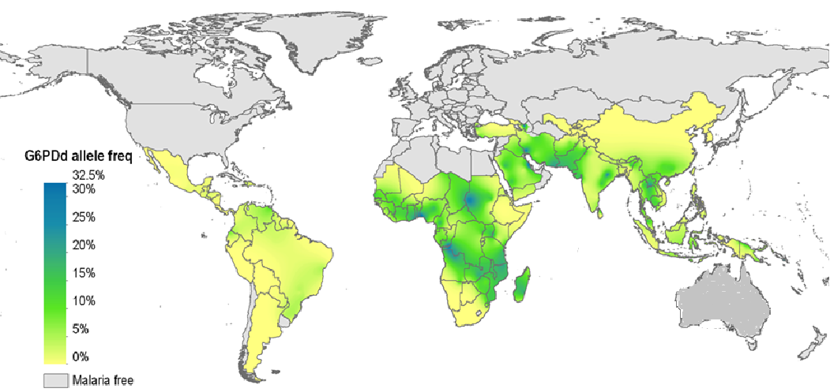
glucose-6-P dehydrogenase deficiency map

Slide 18
End of Lecture Slides
for
Hexose Monophosphate Shunt
Credits: Many of the diagrams used in these slides were taken from Stryer, et.al, Biochemistry, 5th Ed., Freeman Press (in our course textbook) and from prior editions of this text.

