Slide 1
Oxygen Transport Proteins: Myoglobin & Hemoglobin Chapter 3, Berg 10th ed.
Biochemistry 3070

Slide 2
Myoglobin
Myoglobin functions as an oxygen transport protein in tissues. It also provides a local oxygen storage site by enhancing the solubility of oxygen.
Hemoglobin is also an oxygen transport protein, but functions in erythrocytes, enhancing the solubility of oxygen in the blood.
Both these proteins are excellent examples to study the relationship between protein structure and function.

Slide 3
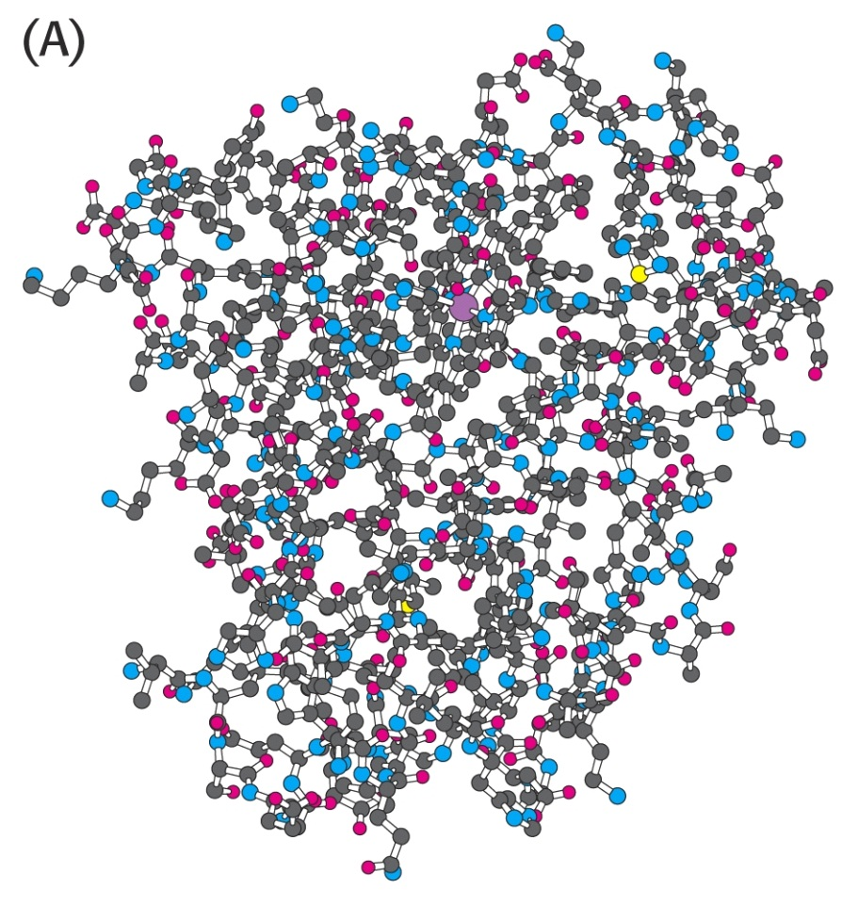
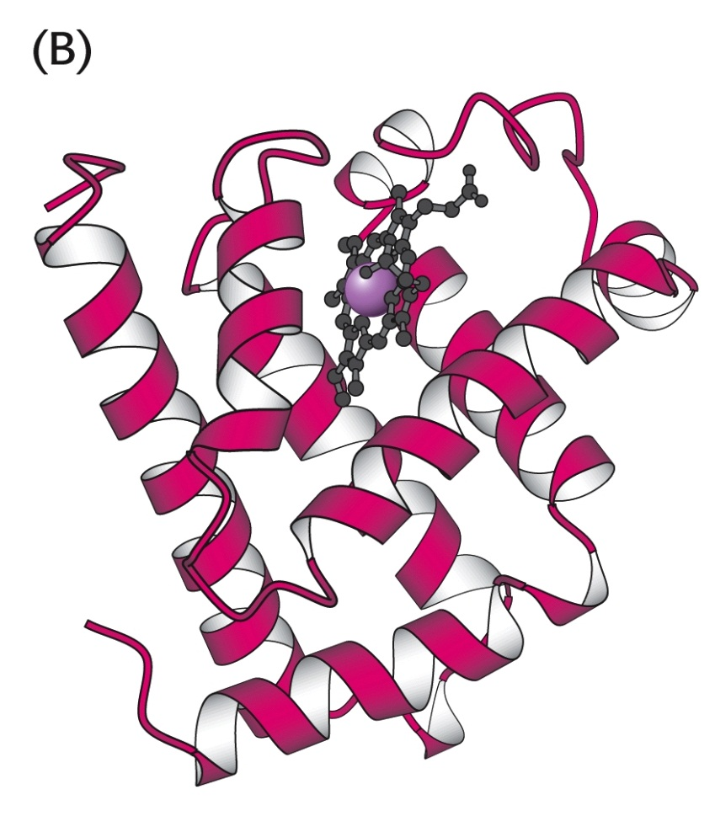
Myoglobin Structure
Myoglobin is composed of a single polypeptide chain with 153 amino acid residues.. It measures 45x35x25 angstroms with about 70% alpha-helix content.
Each myoglobin molecule contains a prosthetic (helper) group: a Protoporphyrin IX and a central iron atom collectively called “heme.”:

Slide 4
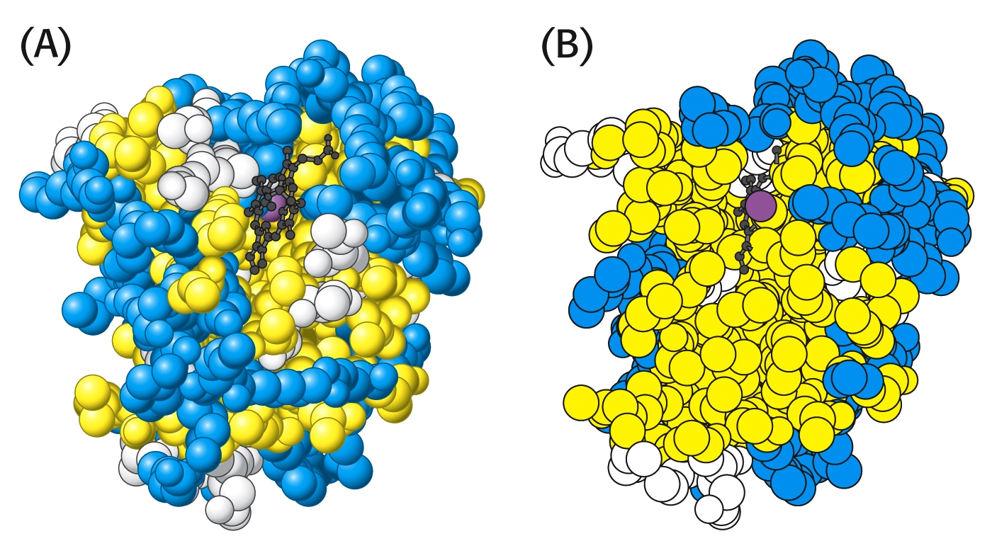
Myoglobin Structure
As with most water-soluble proteins, its polar amino acids are located on the external surface of the protein, to maximize interactions with water. Non-polar amino acids are located almost entirely on the interior of the protein, leaving very little space inside. (Blue = charged amino acids; Yellow = hydrophobic amino acids.)

Slide 5
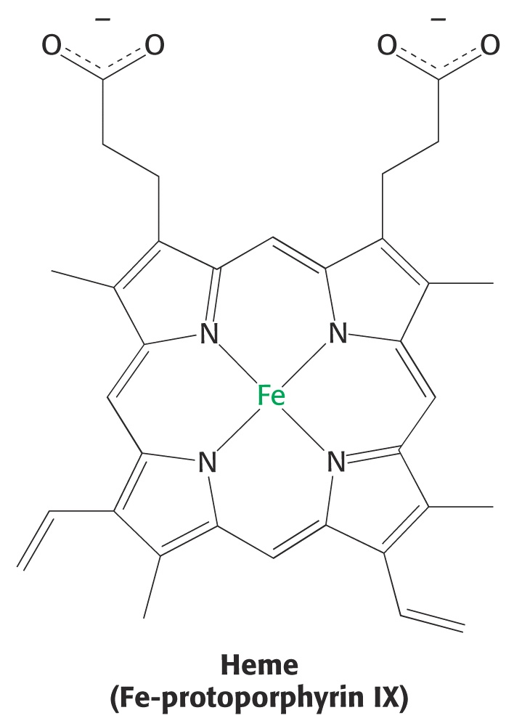
Myoglobin Structure
The heme group is held in place by hydrophobic interactions to the non-polar interior region of the protein. It is not attached by any covalent linkages. (In fact, it may be removed, leaving the “apoprotein” behind.)
An iron ion fits perfectly into the center of the protoporphyrin, chelated by four nitrogen atoms of a tetrapyrole ring sytem.

Slide 6
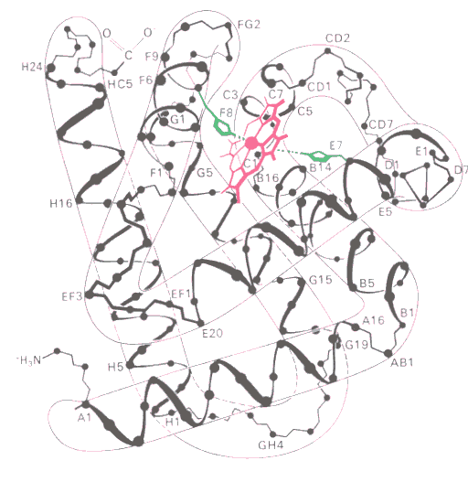
Myoglobin Structure
Since iron ions are hexadentate, each has six coordination sites. One of these two other sites forms a coordinate covalent bond to a nitrogen atom in histidine F8 (proximal). Another histidine E7 (distal) is close to the sixth coordination position.

Slide 7
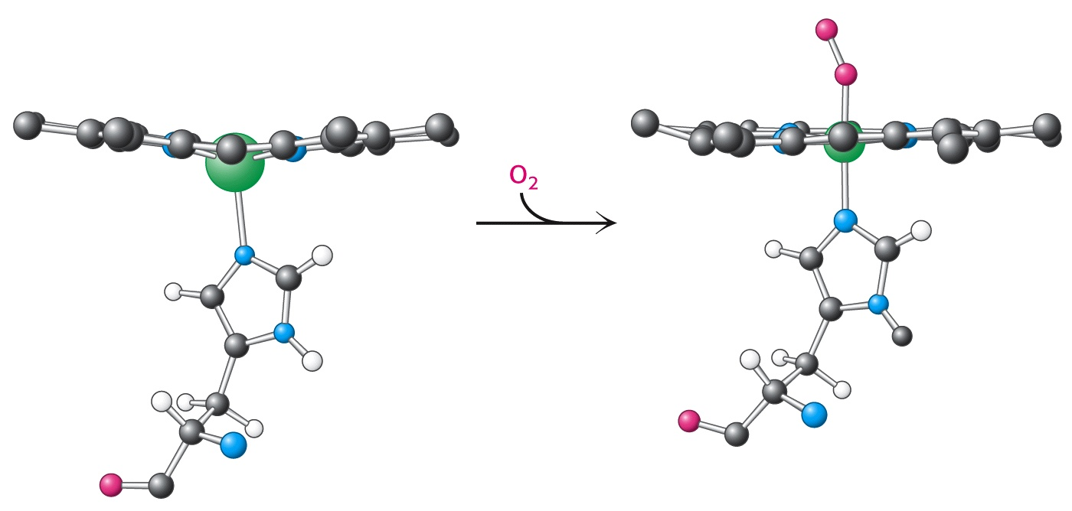
Myoglobin Structure
The iron ion is the binding site for oxygen molecules. The iron ion often converts between the free Fe²⁺ (ferrous ion) state and the bound Fe³⁺ (ferric ion) state.
In the unbound state, the iron atom is slightly proximal (above) the plane of the protoporphyrin. As oxygen binds to the distal side of the ring, it pulls the iron atom about 0.2 angstrom closer to the plane of the ring.
Although this distance is small, the movement is amplified, causing significant shifts throughout the teritary structure of the protein.

Slide 8
Myoglobin Structure
The position of the distal histidine (E7) prevents O₂ from binding too strongly to the iron atom.
Maximal binding strength is achieved when the three atoms [Fe-O=O] form a linear sequence. However, the distal histidine prevents this from occurring, and the diatomic oxygen binds in a “bent” configuration.
Carbon monoxide also binds to the iron atom in myoglobin. In fact, it will displace oxygen and form a much tighter bond than oxygen, due to its more polar bond.
Even low concentrations of CO can displace O₂. This explains how even low concentrations of CO can cause asphyxiation in the presence of O₂!

Slide 9
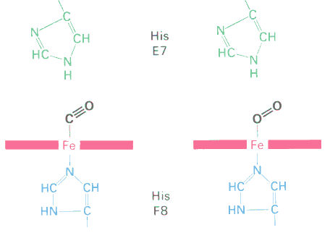
Myoglobin Structure
Fortunately, CO also binds in a “bent” configuration. This weakens the attraction, such that eventually the CO will dissociate over time, allowing recovery.

Slide 10
Hemoglobin
Hemoglobin is a much more complex molecule than myoglobin.
The protein is nearly spherical with a 55 angstrom diameter and molecular mass of 64.45 kD.
It is a tetrahedron containing:
4 protein subunits,
4 protoporphyrins, and
4 iron atoms.
Each hemoglobin molecule can transport four oxygen molecules (one per Fe atom).

Slide 11
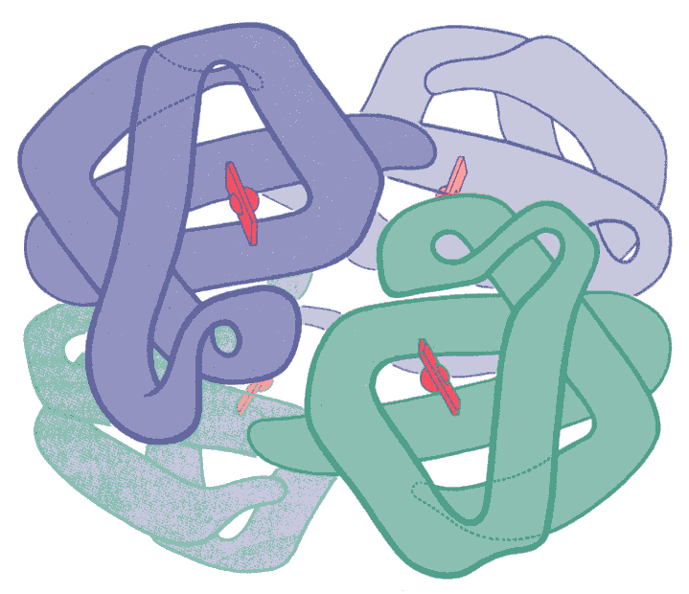
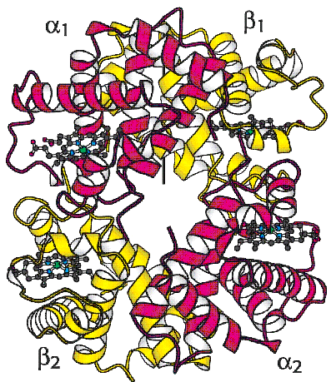
Hemoglobin – Tetrameric Structure
The two alpha subunits have 141 amino acids, while the two beta subunits contain 146 residues.

Slide 12
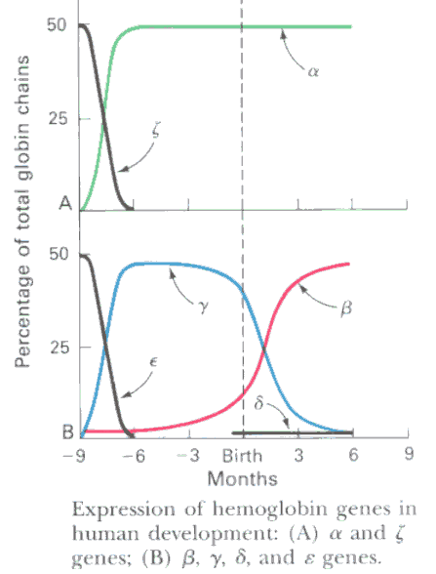
Hemoglobin – Tetrameric Structure
Adult hemoglobin subunit composition differs from embryonic hemoglobin.
Embryonic hemoglobin exhibits a higher affinity for oxygen than adult hemoglobin.

Slide 13
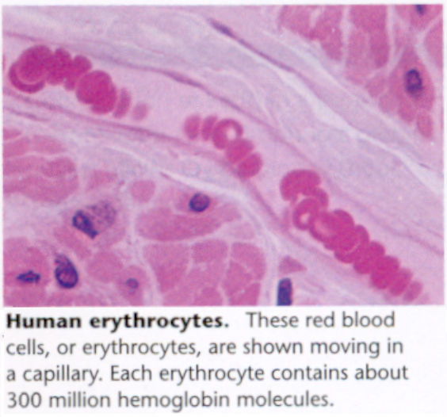
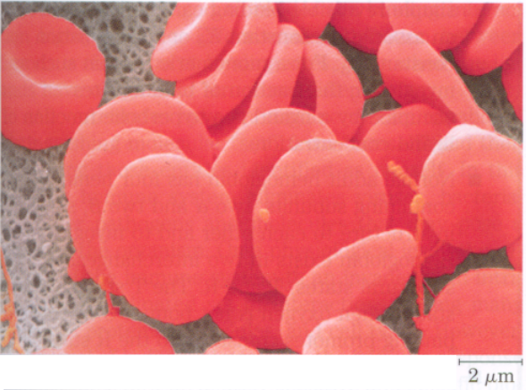
Hemoglobin – Tetrameric Structure
Hemoglobin is located in erythrocytes, where it greatly increases oxygen solubility, facilitating as much as 68 times higher oxygen concentrations than in water alone.

Slide 14
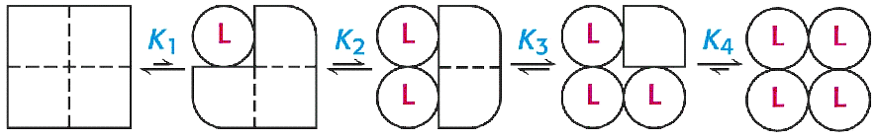
Hemoglobin - Oxygen Transport
Oxygen binds to hemoglobin each of the four iron atoms.
This occurs sequentially, with the affinity of each the four sites changing as the sites become occupied with oxygen.
L = “ligand” of molecular oxygen (O₂).
The hemoblogin molecule exhibits lower affinity for the first molecule of oxygen to bind. It’s affinity increases as subsequent oxygen molecules bind.

Slide 15
Hemoglobin - Oxygen Transport
Plotting oxygen binding to hemoglobin at various oxygen concentrations shows this change in affinity:

Slide 16
Hemoglobin - Oxygen Transport
When the binding curve for myoglobin is compared to hemoglobin, a distinctly different binding profile is observed:

Slide 17
Oxygen Binding: Myoglobin vs. Hemoglobin
At lower concentrations of oxygen (as in the capillary), myoglobin has higher affinity for oxygen than does hemoglobin:

Slide 18
Oxygen Binding: Myoglobin vs. Hemoglobin
Questions:
When Mb and Hb are present in the same solution, which would compete more effectively for oxygen?
What if Mb and Hb solutions were separated by a semi-permeable membrane?
What if a solution of O₂-saturated Hb were placed on one side of a membrane and a soolution of free (unbound) Mb were placed on the other side of the membrane. (pO2=10Torr)?

Slide 19
Hemoglobin – Oxygen Transport
Discussion Questions:
Why is it beneficial for hemoglobin to exhibit such different affinities for oxygen?
What good is an oxygen “transport” protein that never delivers its oxygen to the tissues?

Slide 20
Hemoglobin – Oxygen Transport
Transport of oxygen by both myoglobin and hemoglobin can be modeled mathematically.
This relatively simple algebraic formula is:
pO₂^{n}
Y =
pO₂^{n} + p50^{n}
Where
Y = fraction of heme sites bound to oxygen,
pO₂ = partial pressure of oxygen,
P₅₀ = partial pressure of oxygen at which 50% of sites are bound
N = cooperativity coefficient (Hill coefficient)

Slide 21
Hemoglobin – Oxygen Transport
Oxygen Binding In the Pulmonary System:
Assume that p50 = 35 Torr in the alveolar capillaries: pO2 = 100 Torr: 100³
Yalv = = 0.985
100³ + 35³
Oxygen Binding in the Perphieral Tissues:
Assume that p50 = 35 Torr in the capillaries and pO2 = 20 Torr:
20³
Yalv = = 0.157
20³ + 35³
^{Difference: (“Delta Y”) =} ^{0.985 – 0.157 = 0.828}
This means that 82.8% of the hemoglobin sites transported oxygen to the tissues.

Slide 22
Myoglobin – Oxygen Transport
What if myoglobin were utilized to transport oxygen? (n=1)
Oxygen Binding In the Pulmonary System:
Assume that p50 = 35 Torr in the alveolar capillaries: pO2 = 100 Torr: 100¹
Yalv = = 0.741
100¹ + 35¹
Oxygen Binding in the Perphieral Tissues:
Assume that p50 = 35 Torr in the capillaries and pO2 = 20 Torr:
20¹
Yalv = = 0.364
20¹ + 35¹
^{Difference: (“Delta Y”) =} ^{0.741 – 0.364 = 0.377}
In this case only 37.7% of the myoglobin sites transported oxygen to the tissues!

Slide 23
Hemoglobin – Oxygen Binding “Cooperativity”
The key to the dramatic difference in oxygen transport effeciency is hemoglobin’s “cooperativity.”
The exponent in the prior equation is often called the “Hill Cooperativity Coefficient.”
As “n” changes, so does the sigmoidal shape of the oxygen binding curve.
Let’s examine the graphical effect of changing values of n:

Slide 24
Hemoglobin – Oxygen Binding “Cooperativity”

Slide 25
Hemoglobin – Oxygen Binding “Cooperativity”
Assignment: Calculate four values for the oxygen binding to hemoglobin. Assume the following set of variables:
p₅₀ = 20Torr
 | n=1 | n=3
pO₂ = 100 Torr Y_{alv}= (Alveolar Capillaries)
pO₂ = 20 Torr Y_{cap}= (Peripheral Capillaries)
Difference Delta Y = (Fraction Transporting O₂)

Slide 26
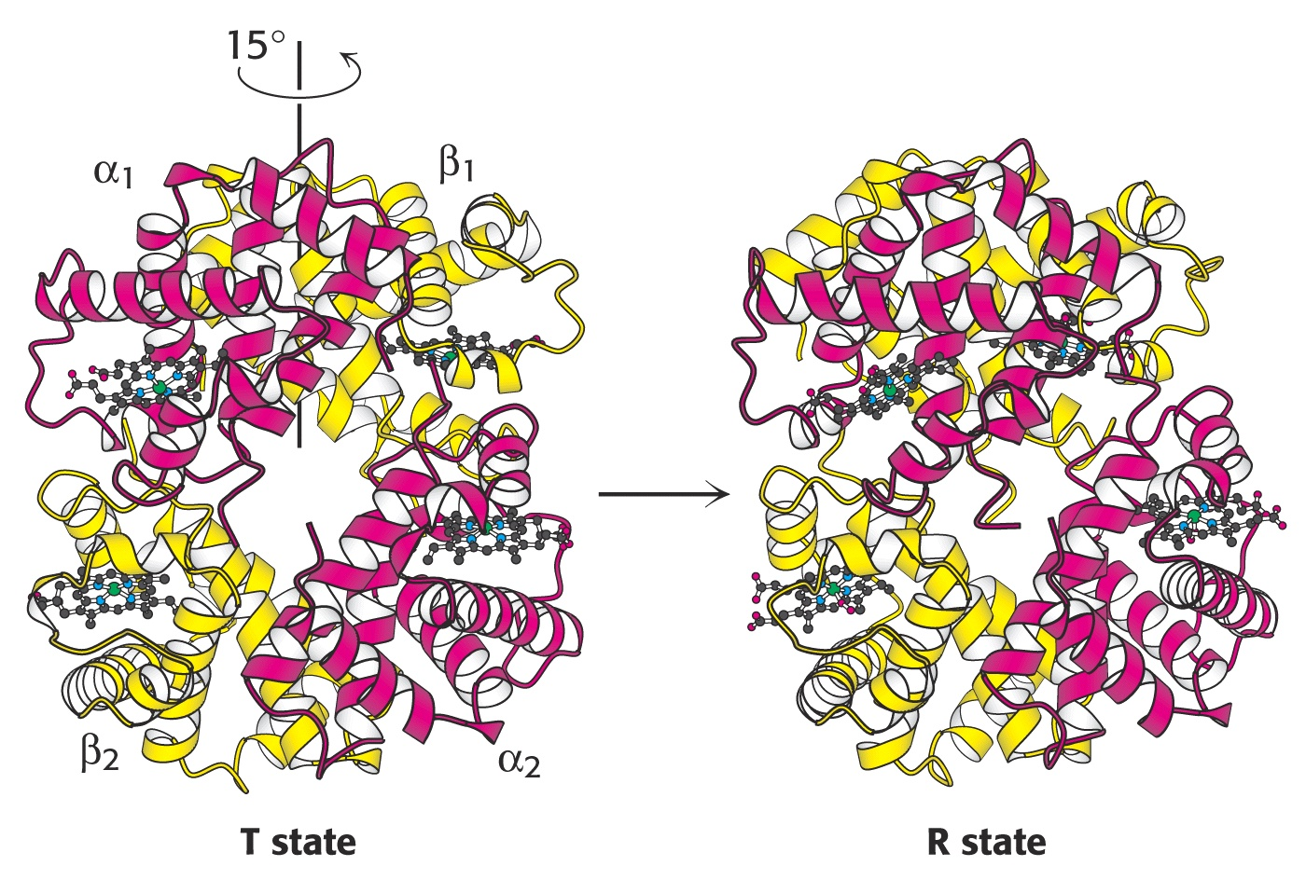
Hemoglobin – Oxygen Binding “Cooperativity”
What causes cooperativity in Hb?
The key to understanding this is understanding the changes in Hb’s tetrameric structure when O₂ binds.

Slide 27
Hemoglobin – Oxygen Binding “Cooperativity”
When the first O₂ molecule binds to one of the four heme groups a number of structural changes occur:
The movement of the Fe atom into the heme plane also draws in the F8 [proximal] histidine, leveraging a big change in its subunit.
The alpha and beta groups rotate ~ 15° with respect to one another, disrupting non-covalent linkages between its neighboring subunits.
The open “channel” in the center of the subunits becomes much smaller, bringing the beta chains much closer than before
These structural changes increase affinity for oxygen in the remaining three subunits.

Slide 28
Hemoglobin – Oxygen Binding “Cooperativity”
Simple dialysis revealed a key mechanism in Hb cooperativity:
When erythrocyte contents are dialyzed, the Hill coeffecient drops to n=1! When the permeate is remixed with hemoglobin, the value of n returns to normal (~ 3.3).
What conclusion can be drawn from this experiment?

Slide 29
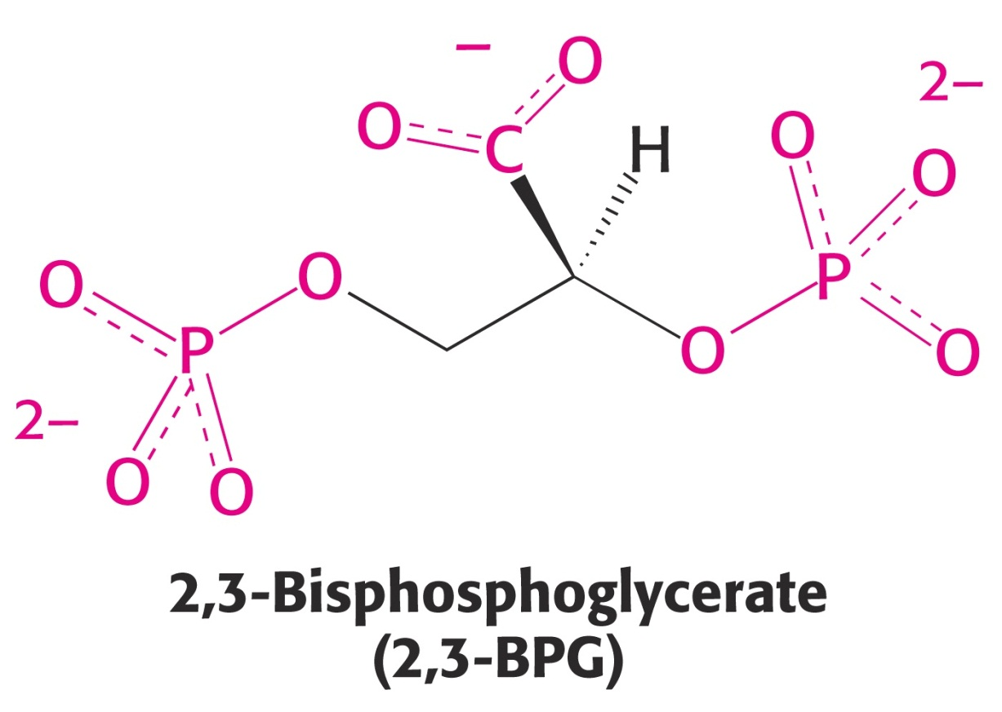
Hemoglobin – Oxygen Binding “Cooperativity”
A small, highly polar molecule, 2,3-bisphosphoglycerate is responsible for much of the cooperativity in Hb.

Slide 30
Hemoglobin – Oxygen Binding “Cooperativity”
2,3-BPG binds inside the cavity between the four subunits of Hb.
2,3-BPG binds only to deoxygenated Hb, when there is room in the cavity.
When one or more O₂ molecules are bound, 2,3-BPG can not fit into the smaller cavity.
Therefore, the binding of O₂ and 2,3-BPG is mutually exclusive (only one or the other). Both can not bind at the same time.

Slide 31
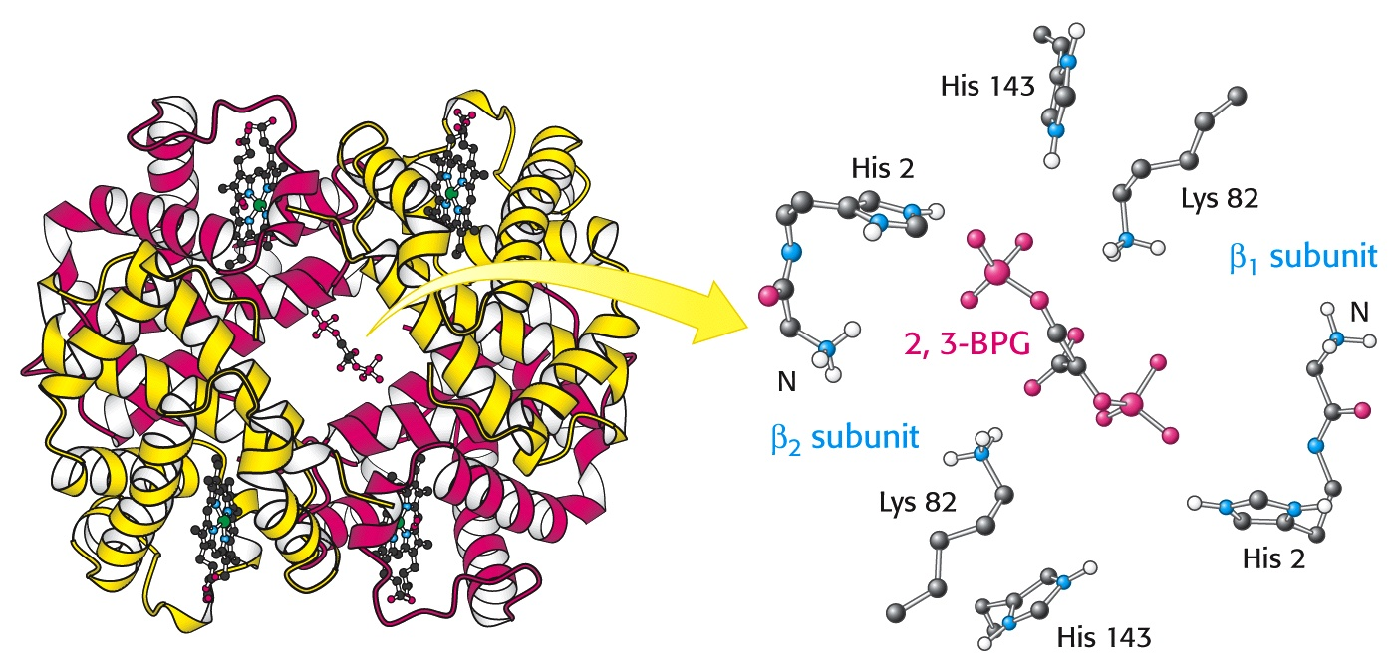
Hemoglobin – Oxygen Binding “Cooperativity”

Slide 32
Hemoglobin – Oxygen Binding “Cooperativity”
Increasing the concentration of 2,3-BPG shifts the plot of oxygen binding to Hb. This increases the dissociation of O₂ in the peripheral tissues.

Slide 33
Hemoglobin – Oxygen Binding “Cooperativity”
Assignment Question:
When we change altitude, during the next few days, the body responds by adjusting Hb cooperativity. This can be accomplished by changing the concentration of 2,3-BPG in the blood.
After moving from a low altitude to a higher altitude, does 2,3,-BPG increase or decrease?
Explain how this affects oxygen transport capacity.

Slide 34
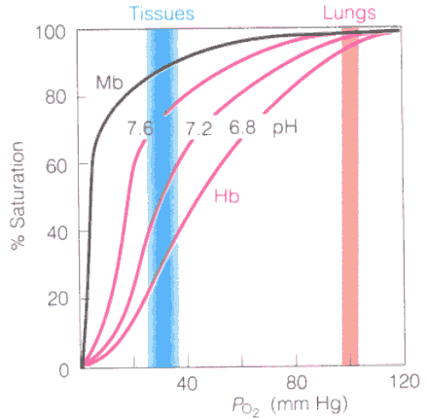
Hemoglobin – Oxygen Binding “Cooperativity”
pH of the blood also affects oxygen affinity for Hb.
Lower pH decreases oxygen affinity.
This automatically releases oxygen in peripheral tissues where active respiration has produced increased levels of carbon dioxide, resulting in lower pH caused by carbonic acid: CO₂ + H₂O → H₂CO₃
This phenomenon is often call the “Bohr Effect.”

Slide 35
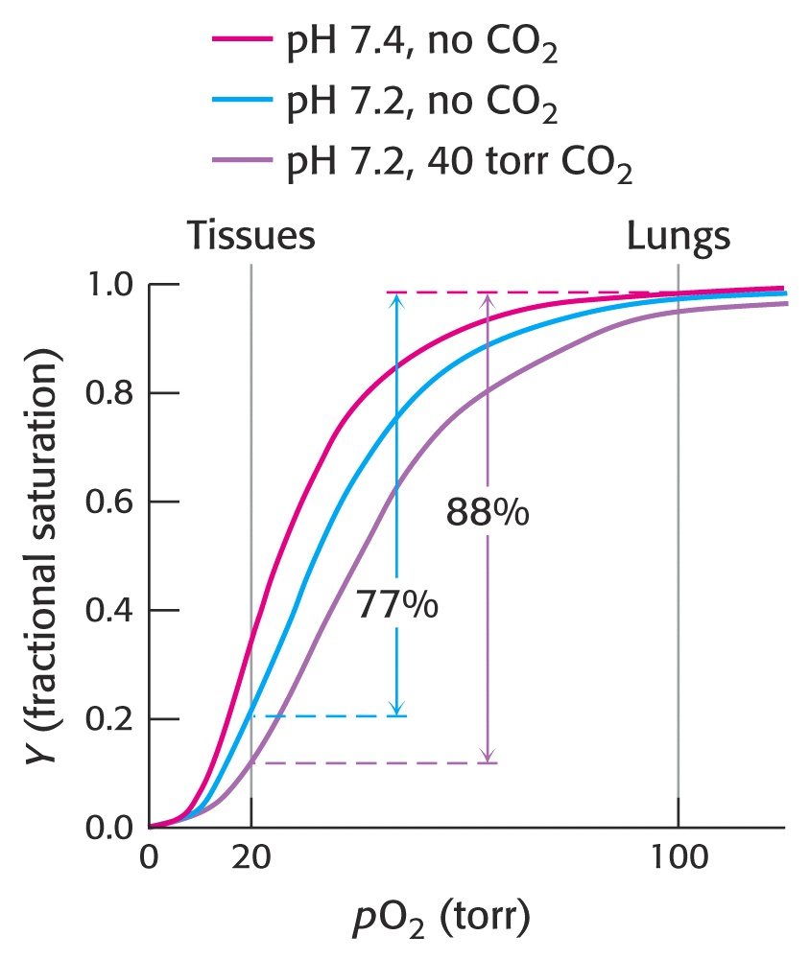
Hemoglobin – Oxygen Binding “Cooperativity”
The result of the Bohr Effect is to deliver more total oxygen between the lungs and the peripheral tissues at lower pH:

Slide 36
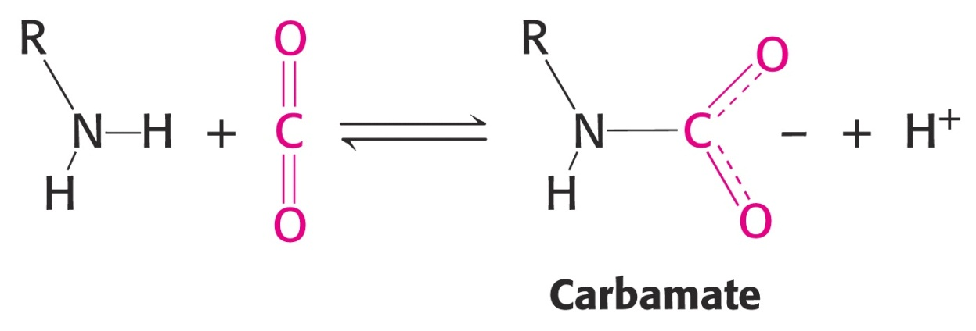
Hemoglobin - Carbon Dioxide Transport
In addition to its role in oxygen transport, hemoglobin also transports CO₂ from the tissues back to the lungs for disposal.
CO₂ is not transported by the heme group. Rather, it binds to the terminal amino groups by forming “carbamates.”
In the alveolae, the equilibrium shifts and the carbamates revert to free amines, releasing CO₂.

Slide 37
Hemoglobin – Oxygen Binding “Cooperativity”
Fetal hemoglobin’s “gamma” chains have serine in place of histidine 143 (adult beta chains). This serine is near the binding site for 2,3-BPG and reduces the affinity of fetal Hb for 2,3-BPG.
The result of this change in fetal hemoglobin is reduced affinity for 2,3-BPG, leading to an increased affinity for oxygen.
Therefore, a fetus can effectively draw oxygen across the placental membrane.

Slide 38
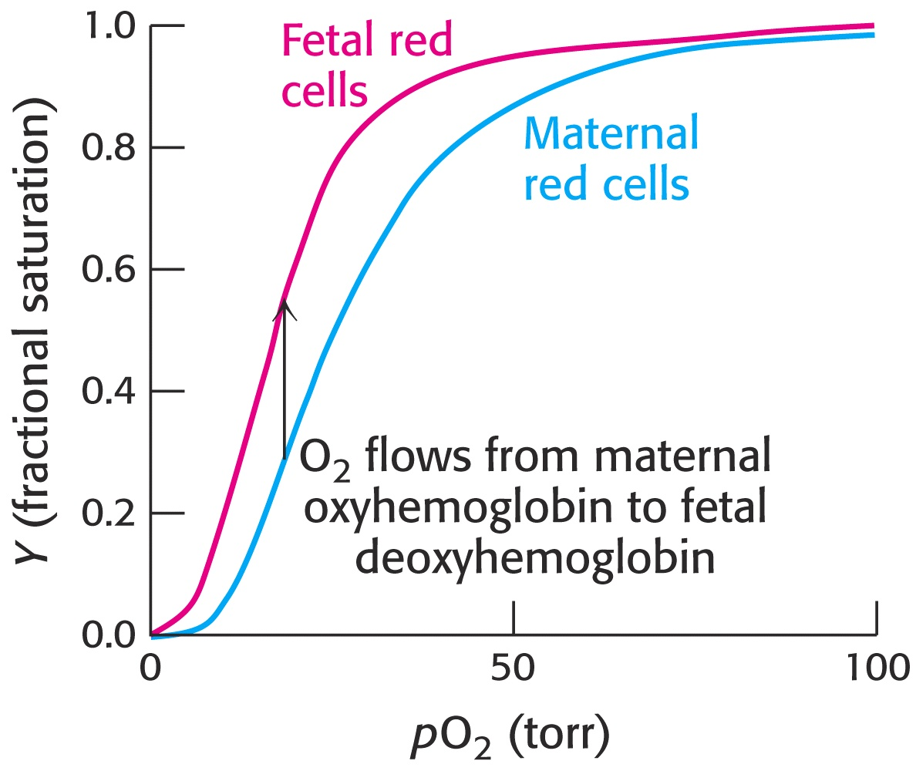
Hemoglobin – Oxygen Binding “Cooperativity”

Slide 39
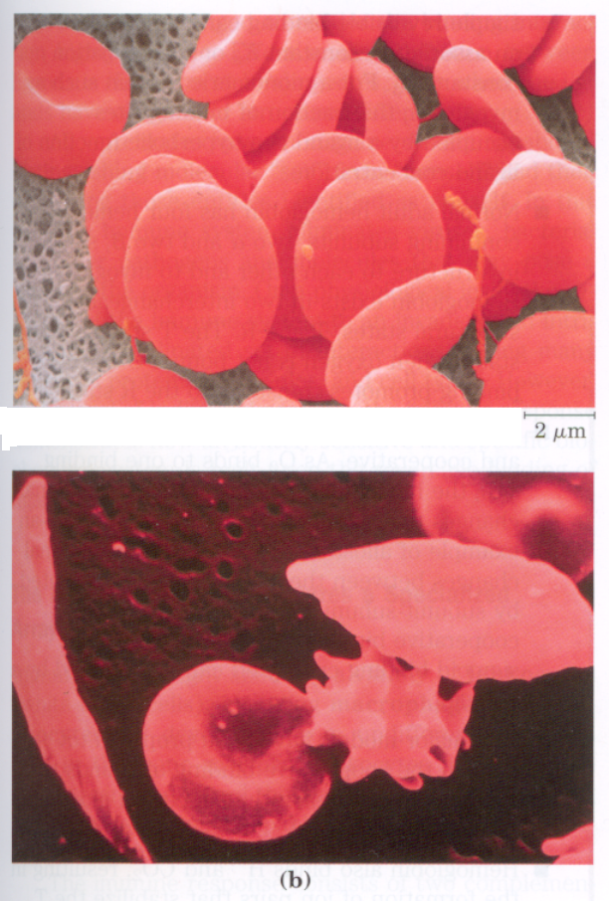
Hemoglobin – Sickle Cell Anemia
A slight change in amino acid composition causes “Sickle Cell Anemia.”
This genetic disease drastically impedes oxygen transport and is manifested as distorted “sickled ” erythrocyte shapes:

Slide 40
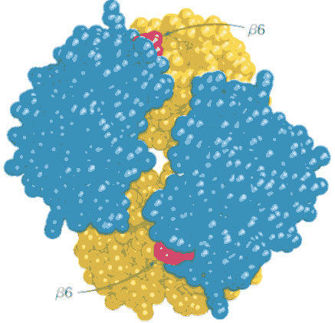
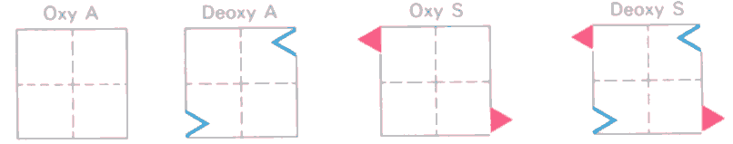
Hemoglobin – Sickle Cell Anemia
In Hemoglobin “S,” valine is substituted for glutamate at position #6 of the beta chains. This β6 location is at the surface of the protein:
This results in “sticky” sites on the deoxy beta chains:

Slide 41
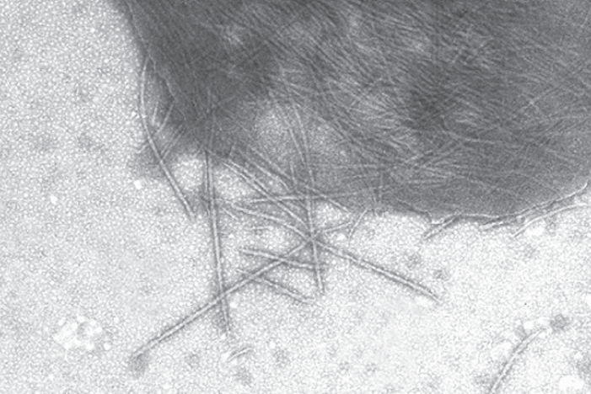
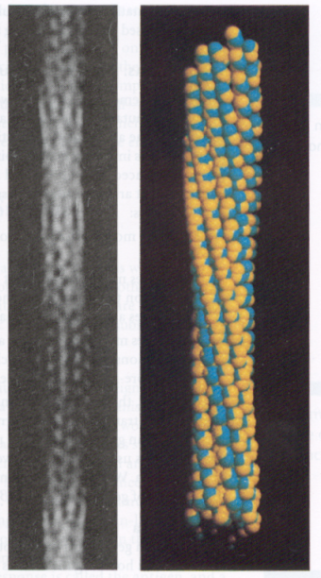

Hemoglobin – Sickle Cell Anemia
At low concentrations of O₂, Hemoglobin-S molecules stick to one another forming long polymeric aggregates.
These long polymeric forms are “locked” into deoxy forms, and can not bind oxygen.
10th ed. FIGURE 3.33 An electron micrograph depicting a ruptured sickled red blood cell is shown with fibers of sickle-cell hemoglobin emerging.

Slide 42
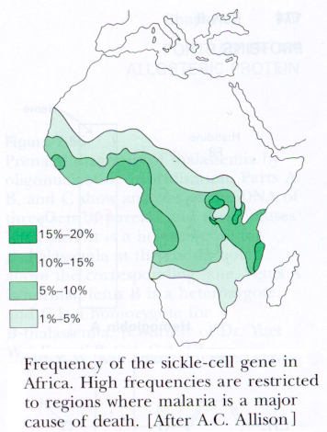
Hemoglobin – Sickle Cell Anemia
The frequency of the sickle gene is as high as 40% in certain parts of Africa.
The sickle cell trait confers a small but highly significant degree of protection against the most lethal form of malaria.
In a malaria-infested region, the reproductive fitness of a person with sickle-cell trait is about 15% higher than that of someone with normal hemoglobin.

Slide 43
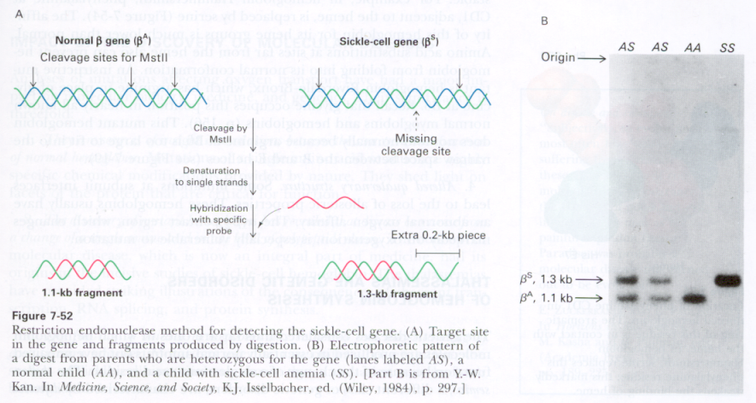
Hemoglobin – Sickle Cell Anemia
The Sickle Cell trait can be identified through DNA testing:
Restriction enzyme digestion with MstII yields three fragments for a normal β gene, but only two for the sickle-cell gene:

Slide 44
End of Lecture Slides
for
Oxygen Transport Proteins
Credits: Most of the diagrams used in these slides were taken from Stryer, et.al, Biochemistry, 5th Ed., Freeman Press, Chapter 10 (in our course textbook) and from prior editions of this work.

