Slide 1
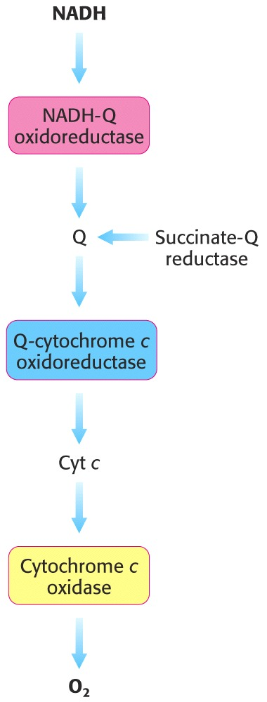
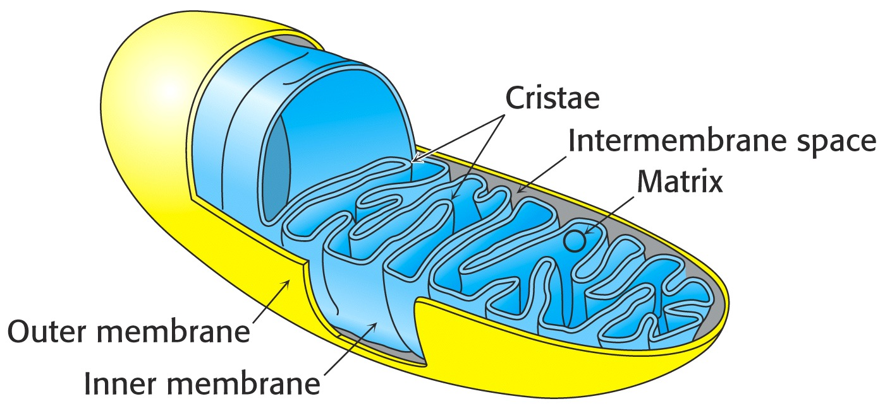
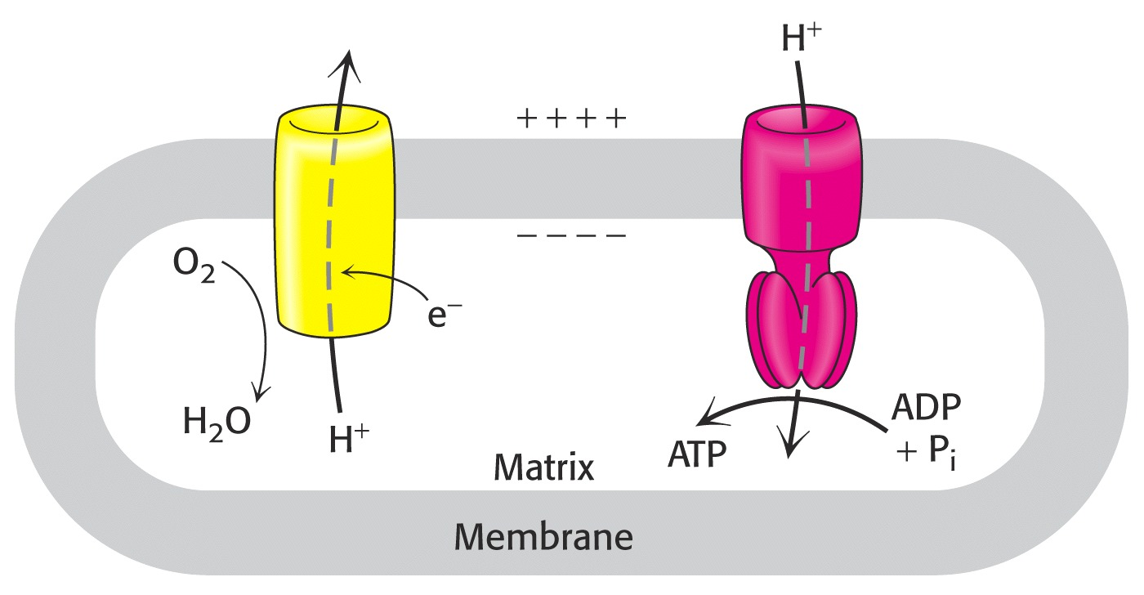
Biochemistry 3070
Oxidative Phosphorylation

Slide 2
Oxidative Phosphorylation
Glycolysis and the citric acid cycle yield NADH and FADH₂.
Both these electron carriers are energy-rich molecules because their electrons have a high transfer [redox] potentials.
Oxidative phosphorylation is the process of converting this high redox potential into energy-rich ATP molecules.
This process, together with the reactions that form the electron carriers is often called respiration.

Slide 3
Oxidative Phosphorylation
ATP synthesis via oxidative phosphorylation occurs via two separate systems in the mitochondrion.
Electrons are “transported” via numerous membrane-bound carriers from NADH to O₂. During these reactions, a proton gradient is formed across the mitochondrial inner membrane.
The proton-motive force in the gradient is then harnessed to produce ATP.

Slide 4
Oxidative Phosphorylation
Mitochondrial structure plays a critical role in forming and utilizing the proton gradient to synthesize ATP.
Protons are “pumped” from the matrix across the inner membrane into the intermembrane space.
ATP is synthesized in the matrix, as protons flow back through the membrane.

Slide 5
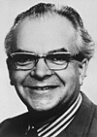
Oxidative Phosphorylation
First, we will learn how electrons are transported from NADH/FADH₂ to oxygen with the concomitant formation of the proton gradient. Then, we will see how ATP is made.
Around 1961, Peter Mitchell published a famous theory that ATP was synthesized by proton gradients formed in the mitochondrion: The “chemiosmotic hypothesis.”
Initially, Mitchell found little support
for his proposal, but when no one
could prove him wrong, more
believers were “converted” and he
eventually received the Nobel Prize
for his work in 1978.
http://nobelprize.org/chemistry/laureates/1978/

Slide 6
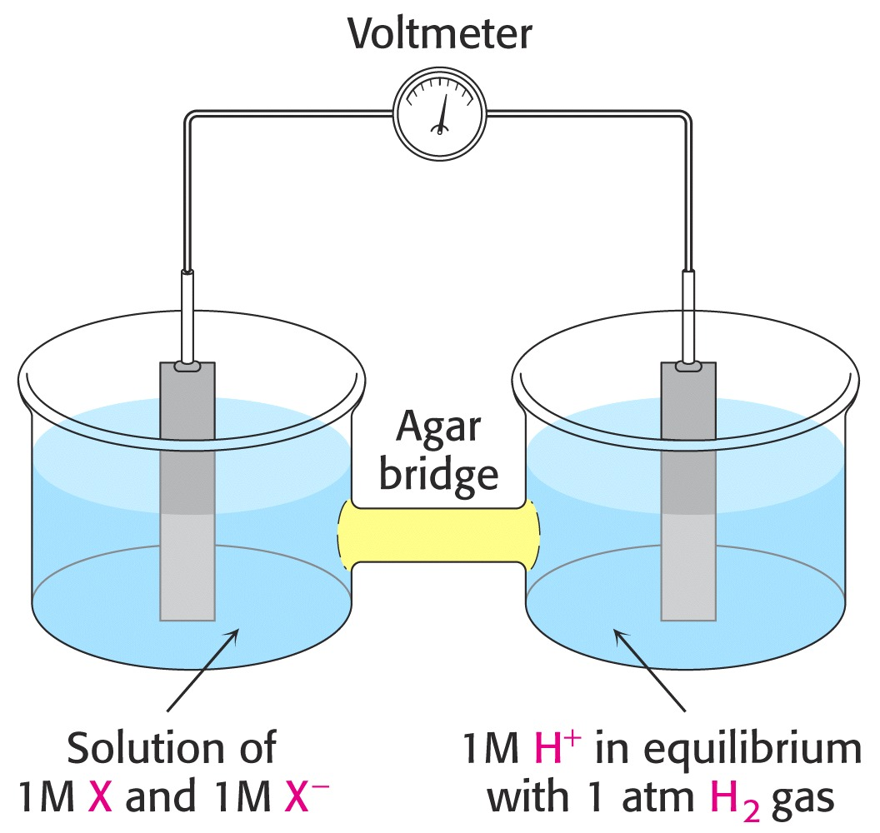
Oxidative Phosphorylation
The driving force for electron transfer from NADH to O₂ is explained by their reduction potentials.
Recall from freshman chemistry that the reduction potential of redox-active substances is easily measured with a volt meter and two separate chambers.
Published reduction potentials for NADH and O₂ show that electrons flow spontaneously from NADH to O₂, with a combined redox potential of +1.14 Volts:
½ O₂ + 2 H⁺ + 2e⁻ → H₂O E’₀ = +0.82 V
NAD⁺ + H⁺ + 2e⁻ → NADH E’₀ = - 0.32 V
½ O₂ + NADH → H₂O + NAD⁺ E’₀ = +1.14 V

Slide 7
Oxidative Phosphorylation
Rather than occurring in a single step, electrons from NADH pass through groups of carriers, mostly within the mitochondrial inner membrane, eventually reaching oxygen.
The most interesting of these carriers are three groups of protein complexes often identified as “Sites I, II, III, & IV.”
I
II
III
IV

Slide 8
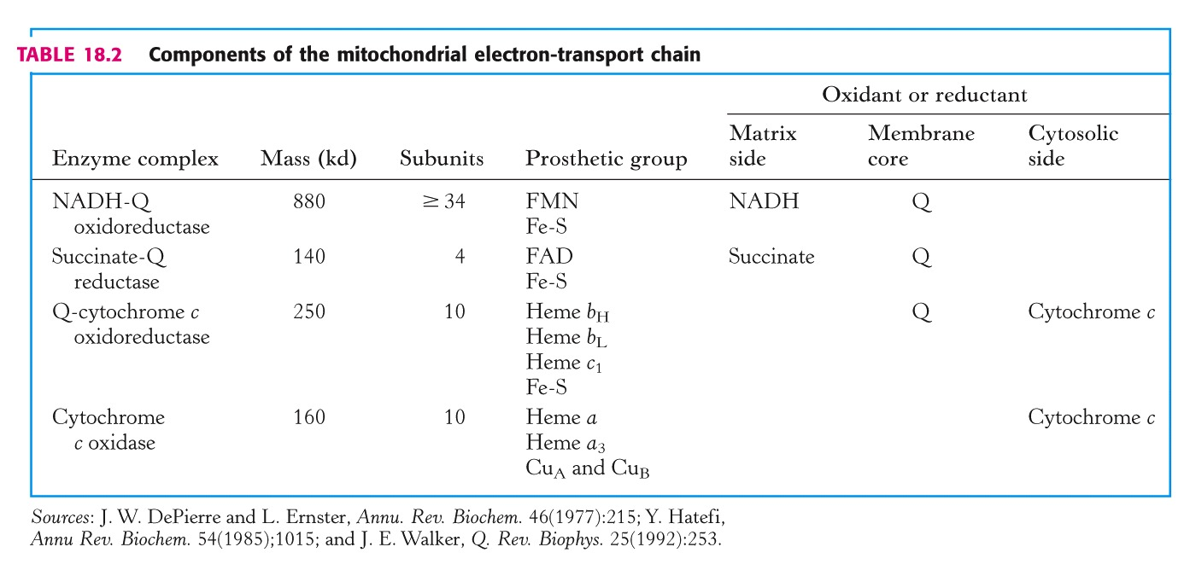
Oxidative Phosphorylation
Sites I, II, III, and IV each contain numerous protein subunits:
I
II
III
IV

Slide 9
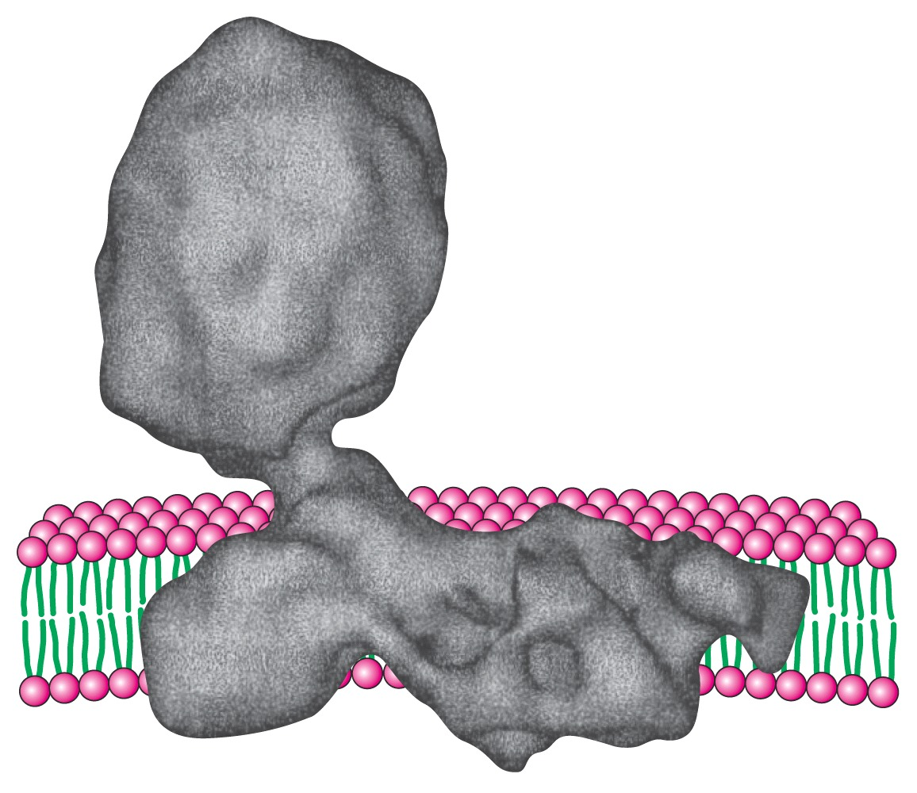
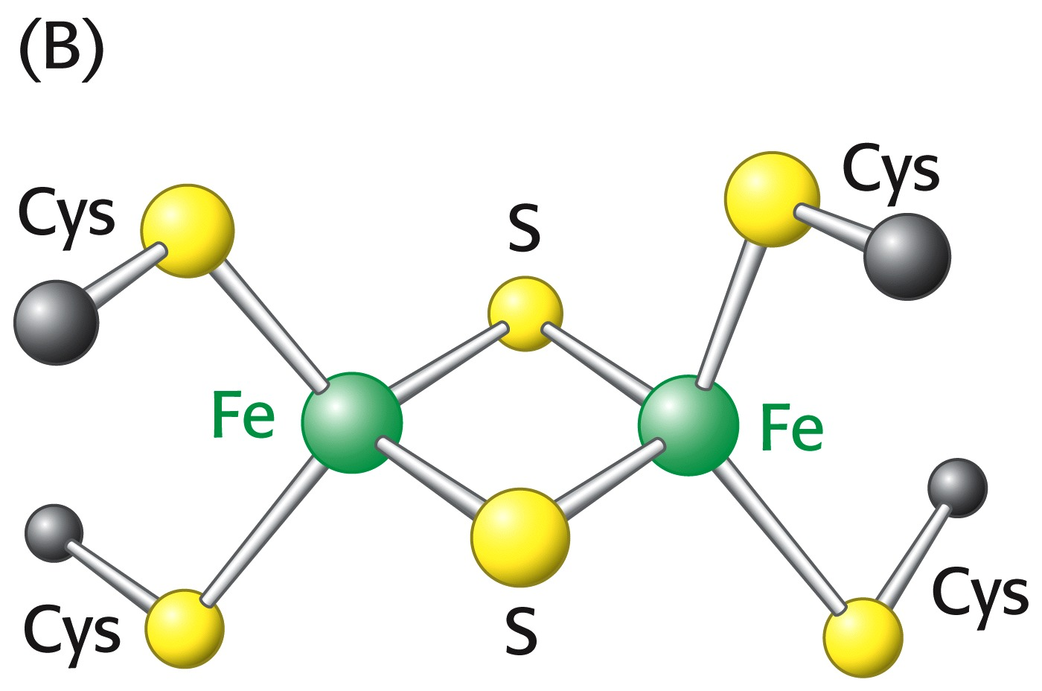
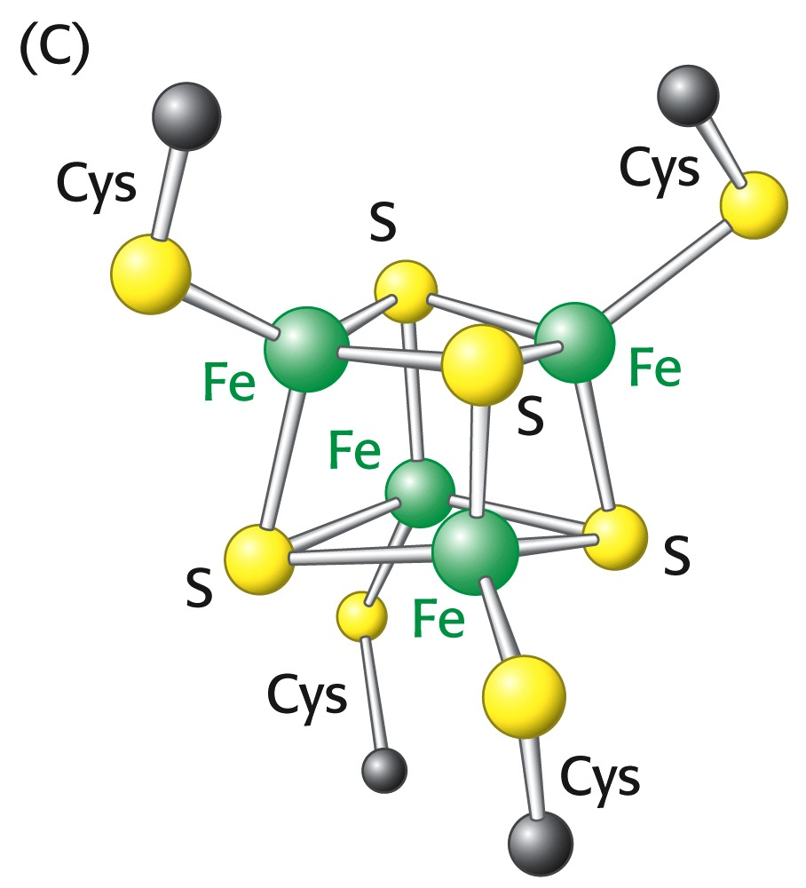
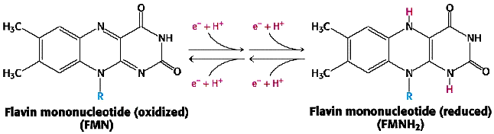
Oxidative Phosphorylation
Electrons from NADH pass through Site I:
During their transit, electrons pass through a flavin [isoalloxazine] ring and iron-sulfur clusters.
The reduction and subsequent oxidation of the isoalloxazine requires two hydrogen atoms. Due to the unique structure of the NADH-Q oxidoreductase complex, hydrogens are drawn from the matrix during reduction and then ejected into the intermembrance space during oxidation.
Matrix: H⁺ H⁺
Intermembrane Space: H⁺ H⁺

Slide 10
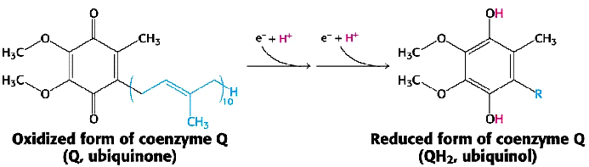
Oxidative Phosphorylation
Electrons are transported through the membrane from Site 1 to Site 3 by ubiquinol (ubiquinone).
This fat-soluble carrier picks up electrons from Site 1 (Q→QH₂), then diffuses laterally through the membrane delivering electrons to Site 3 (QH₂→Q), then returns to Site 1 for more.

Slide 11
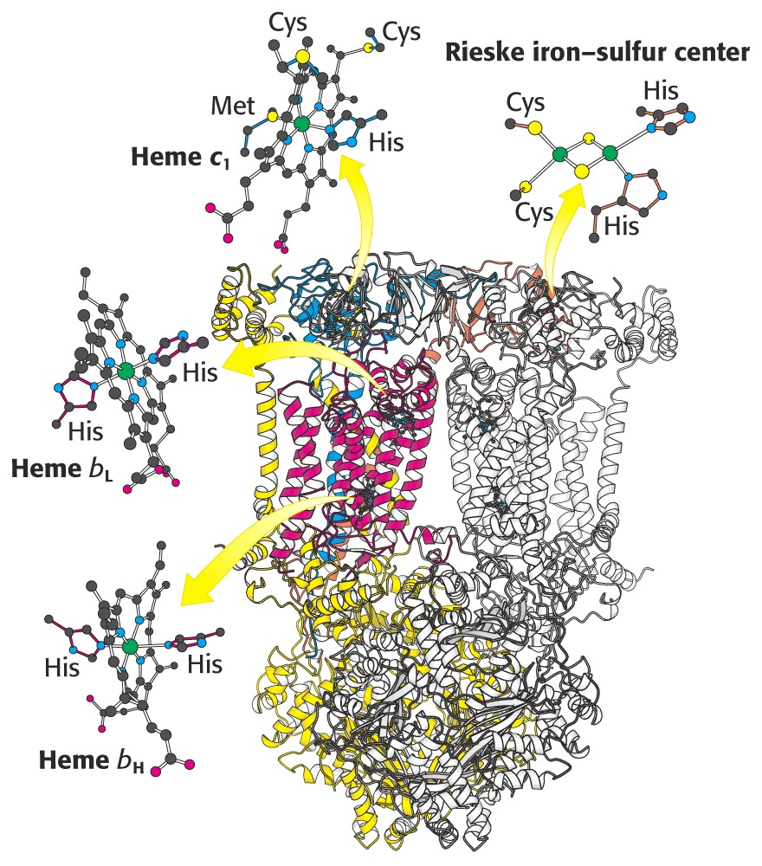
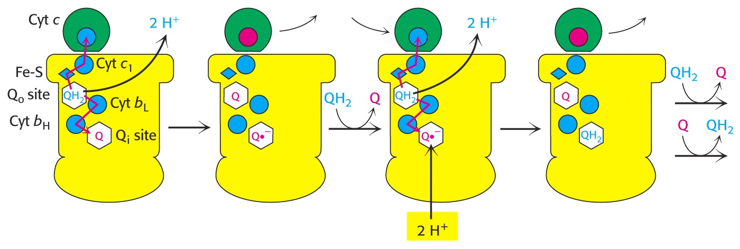
Oxidative Phosphorylation
QH₂ delivers protons to Site III:
“Q-Cytochrome c Oxidoreductase:”
This complex moves electrons through a variety of carriers, including 3 hemes and another 2Fe-2S cluster.
As in Site 1, protons are taken from the matrix and deposited into the intermembrane space during passage of electrons through this site and reduction of the next carrier, cytochrome c:

Slide 12
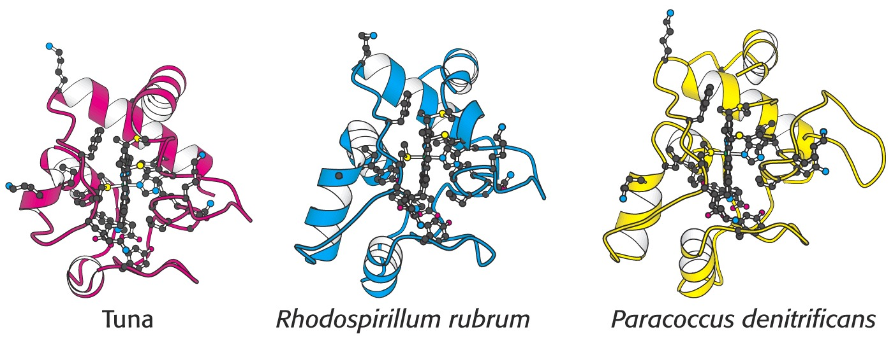
Oxidative Phosphorylation
Cytochrome c (“cyt c”) is a water-soluble protein with a single heme prosthetic group.
Each cyt c transports a single electron from Site III to Site IV through the aqueous intermembrane space. (Cyt c is the only electron carrier that is not located in the mitochondrial membrane!)
Cyt c is structurally similar in many organisms, so much so, that cyt c from one organism can sometimes be used in vitro to transport electrons from Site III→IV in electron transport pathways of other organisms!

Slide 13
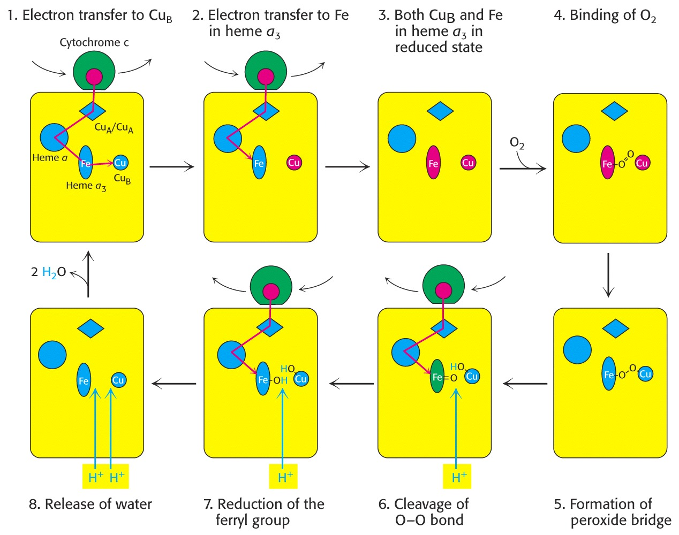
Site IV (“Cytochrome oxidase”) takes electrons from cytochrome c and uses them to reduce oxygen to water. As in previous sites, obligatory hydrogen withdrawal from the matrix accompanies this final electron transport process:

Slide 14
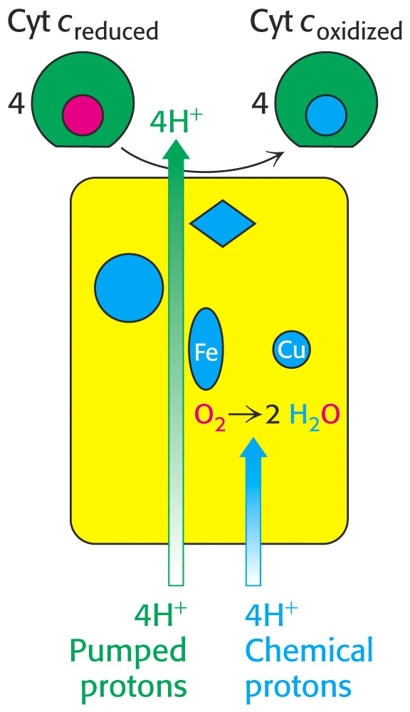
Oxidative Phosphorylation
Additionally, extra protons are “pumped” from the matrix into the innermembrane space during the oxidation of cytochrome c.

Slide 15
Oxidative Phosphorylation
This pathway of electron transport from NADH to H₂O through a variety of electron carriers allows the transformation of redox energy into a proton gradient.
How do scientists know the order of the electron carriers in this pathway?
The reduction potential (E’₀) of each carrier has been determined over the years. Once a reduction potential for a carrier is known, it is relatively easy to place it in its correct position relative to the others since electrons move spontaneously from carriers with lower reduction potentials to carriers with higher reduction potentials.

Slide 16
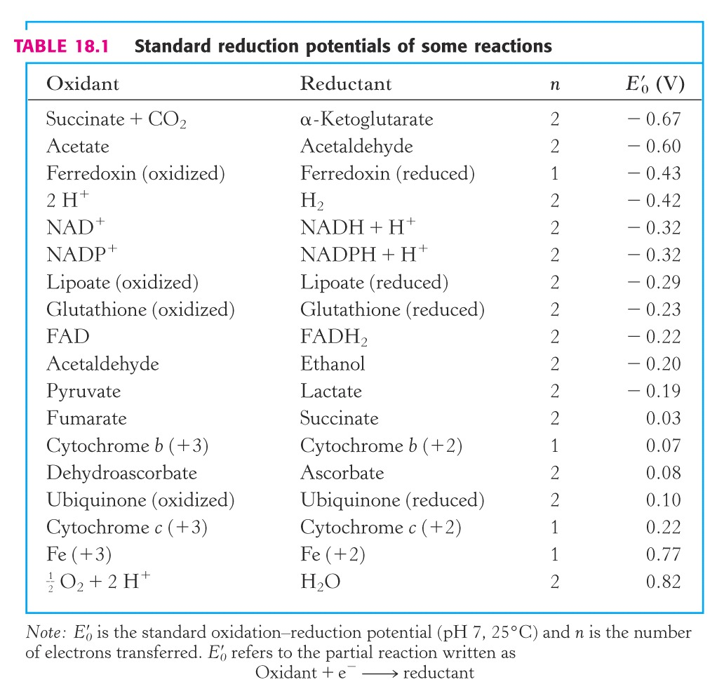
Oxidative Phosphorylation
Note the different E’₀ for NAD⁺ and FAD:
FAD is not a strong enough reductant to reduce electron carriers at Site 1.
However, it can reduce ubiqinone.

Slide 17
Oxidative Phosphorylation
FADH₂ delivers electrons to the electron transport pathway by reducing ubiquinol (Q) to ubiquinone (QH₂).
Recall that FADH₂ is formed in the TCA cycle when succinate is oxidized to malate. Electrons from FADH₂ reduce Q to QH₂ and flow through electron transport, ending up on oxygen.
Consequently, less ATP is formed from the oxidation of FADH₂ than from NADH.
FADH₂

Slide 18
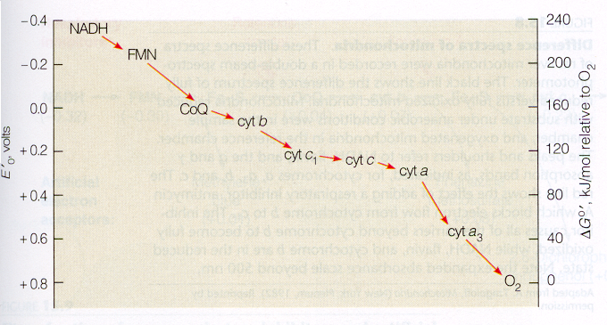
Oxidative Phosphorylation – Electron Carrier Postioning in Chain
The pathway of electron transport is easily determined by comparing reduction potentials (E’₀):

Slide 19
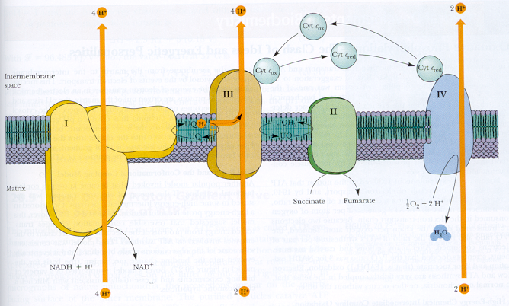
Oxidative Phosphorylation – Electron Carrier Postioning in Chain
Diagram of electron transport chain and electron flow.
(Garrett & Grisham, Biochemistry, 3rd ed., Brooks/Cole)
FADH₂
FAD

Slide 20
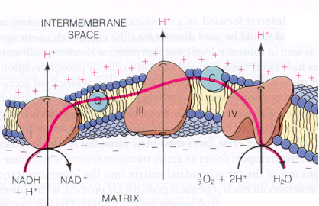
Another View of Electron Transport
(Mathews, et.al, Biochemistry, 3rd ed., Addison Wesley)

Slide 21
Oxidative Phosphorylation
How is the proton-motive force created by obligatory proton transport during passage of electrons converted into high-energy phosphate bonds in ATP?
The historical aspects of the discovery of this fascinating process deserves our attention.

Slide 22
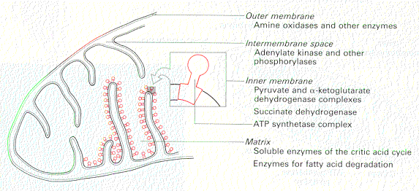
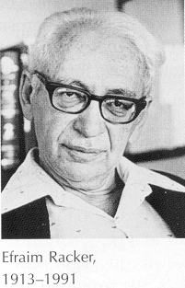
Oxidative Phosphorylation
Ephriam Racker (Cornell) discovered unique knob-like structures on the matrix side of the inner membrane.
He removed these knobs with mild detergents and mixed them with ATP. The ATP was immediately hydrolyzed to ADP, so he named the knobs “ATPase.”

Slide 23
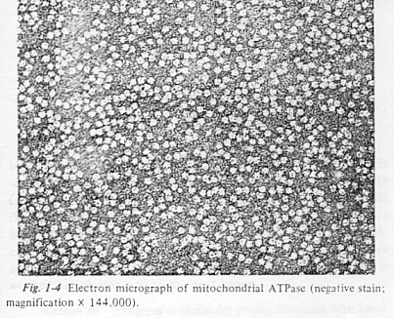
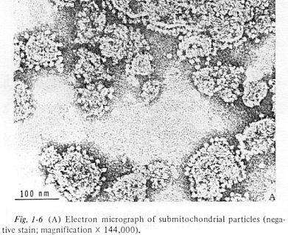
Oxidative Phosphorylation

Slide 24
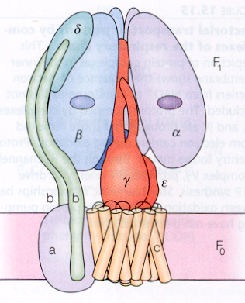
Oxidative Phosphorylation
Protons flow through the channel (F₀) to the large knob (F₁)where ATP is synthesized.
The “ATPase” knobs described by Racker destroy ATP by converting it into ADP + P_{i} if they are not attached to the F₀ subunit.
When attached, they catalyzed the opposite reaction, namely ATP synthesis.

Slide 25
Oxidative Phosphorylation
In Ephriam Racker’s personal account of his discovery, he recites that once removed, the ATPase knobs were difficult to reconsititute, because they were working in the cold room at ~ 4°C. The ATP knobs are labile at this temperature.
A new student tried a serendipitous experiment at room temperature and was able to reattach the knobs, restoring normal ATP synthesis.

Slide 26
Oxidative Phosphorylation
Racker always sought to encourage young students and offered some encouraging advice (“lessons” he’d learned). Examples from a lecture series at Pomona College in 1973:
Chemistry is good, nature is better.
A clean experiment is worth more than a few hundred dirty calculations.
It doesn’t matter if you fall down as long as you pick up something from the floor while you get up.
Not everything that shines is gold. Not everything that floats after high-speed centrifugation is soluble.
Progress is made by young scientists who carry out experiments old scientists said wouldn’t work.
If you accept the statement that only uninhibited investigators use inhibitors, you will soon find out what kind of people work in the field of oxidative phosphorylation.
“I have yet to see a problem however complicated that, when you look at it the right way, does not become more complicated.” (Paul Aldeston)

Slide 27
Oxidative Phosphorylation
Racker was sure ATP was synthesized by proton flow through a membrane channel that was linked to the “ATPase knobs.”
Other scientists were skeptical.
Racker joined with Walt Stoeckenius (UCSF) to conduct a brilliant experiment.
Walt was having a difficult time convincing people that that “red-tide” bacteria Halobacterium halobium was using light to drive a proton pump via a membrane protein (bacteriorhodopsin).

Slide 28
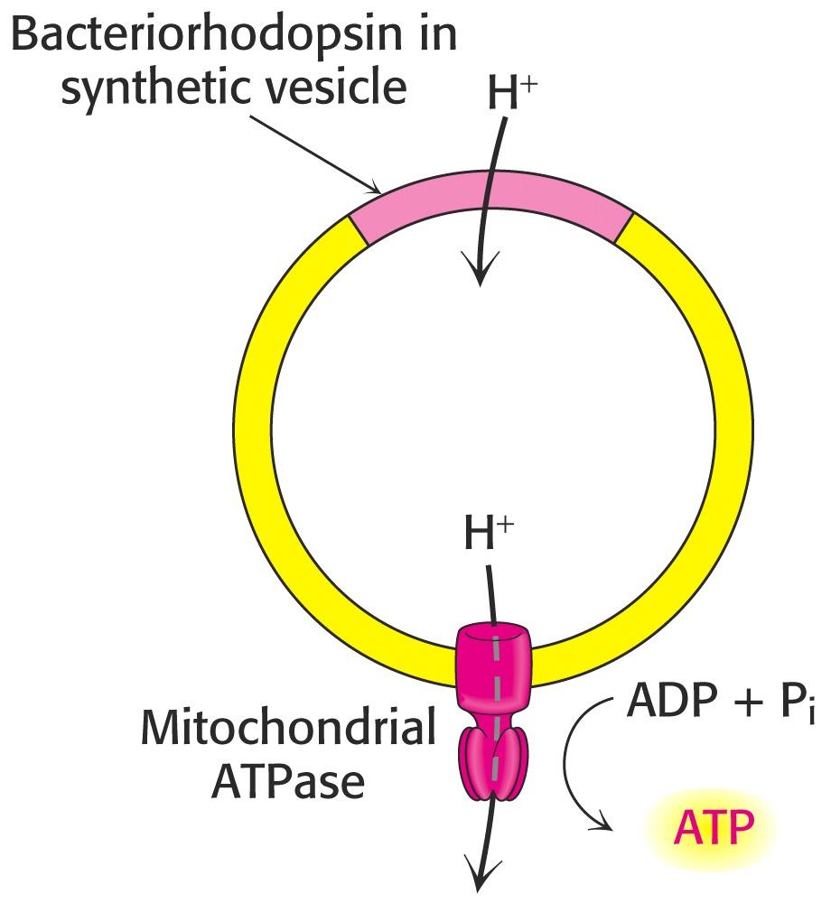
Proton Motive Force & ATP Synthesis
They formed artifical bilayer lipid membrane vesicles and inserted both bacteriorhodopsin and the F₀ & F₁ coupling factors from mitochondria.
When they turned on the light, ADP was converted into ATP!
Both scientists proved their hypotheses in this elegant experiment.

Slide 29
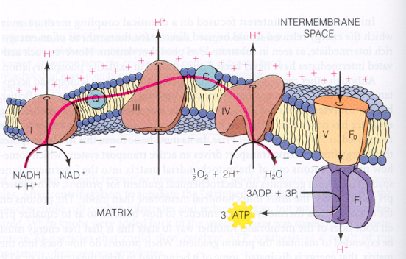
Oxidative Phosphorylation – Proton Flow
In mitochondria, protons flow from the intermembrane space back into the matrix via a specialized channel and the ATPase “knobs,” where ATP is synthesized.

Slide 30
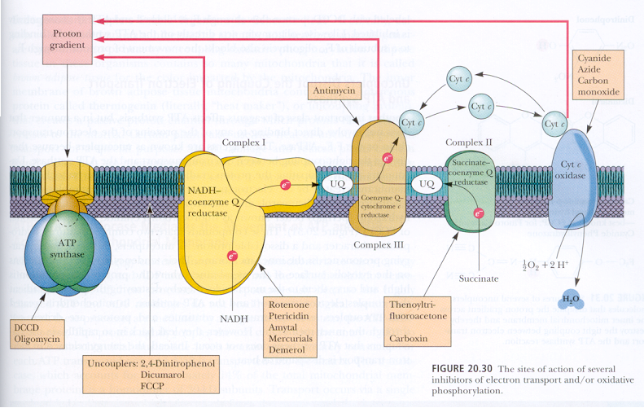
Oxidative Phosphorylation – Proton Flow
(Garrett & Grisham, Biochemistry, 3rd ed., Brooks/Cole)

Slide 31
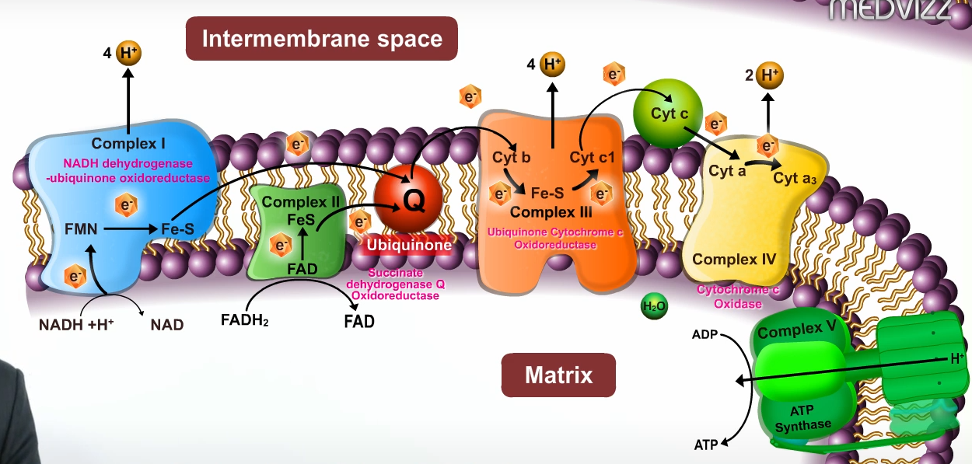
Source: https://www.youtube.com/watch?v=Kxg9BSmkArc

Slide 32
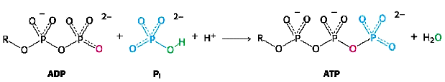
ATP synthesis
The addition of phosphate to ADP seems simple:
Yet, the mechanism and the protein actions are quite complex.
Parts of the ATP synthase complex actually rotate, forming ATP as they turn.

Slide 33
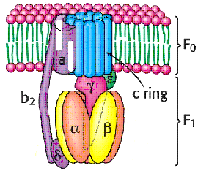
Structure of the ATP Synthase Complex
F₁F₀-ATP Synthase Subunits (E.coli)
Complex | Subunit | Number | Mass (kD)
F₀ | a | 1 | 30
 | b | 2 | 17
 | c | 9-12 | 8
F₁ | α | 3 | 55
 | β | 3 | 52
 | γ | 1 | 30
 | δ | 1 | 15
 | ε | 1 | 5.6

Slide 34
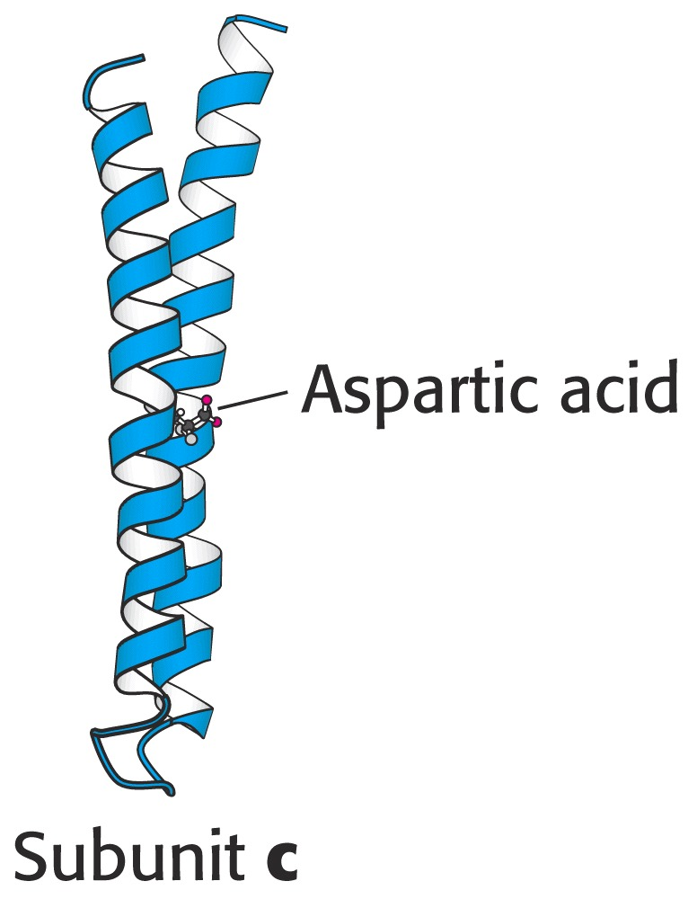
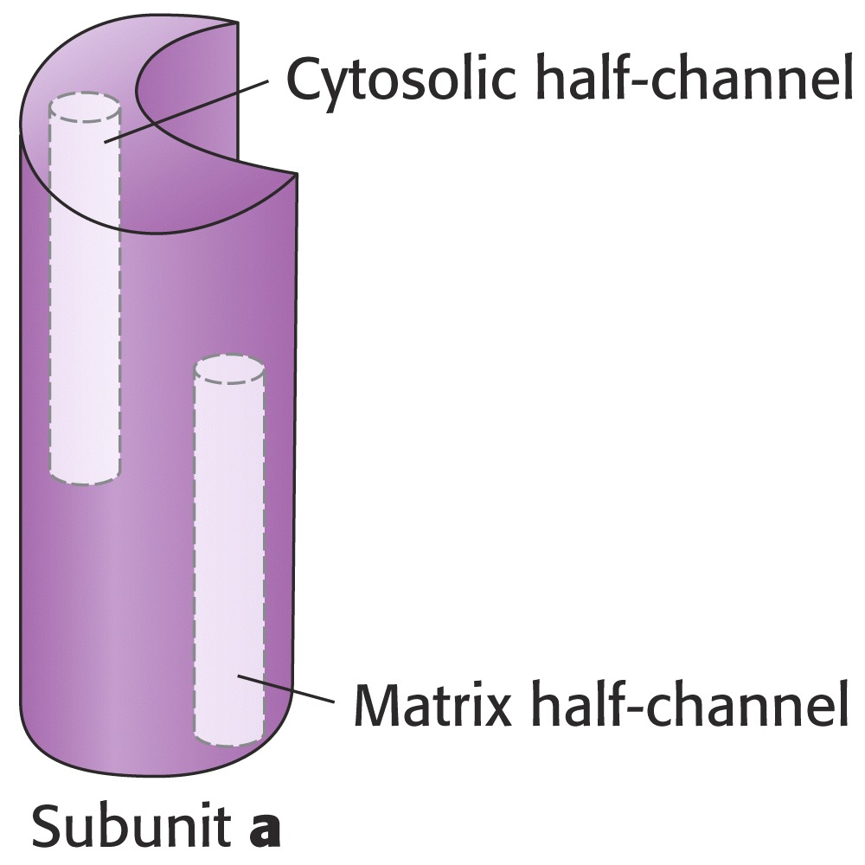
ATP Synthase Structure & Function
The 9-12 cylinder-shaped proteins forming the c-ring are imbedded deep in the membrane. Each of these protein subunits has a critically important amino acid residue [asp 61] about half way across the membrane that is required for the system to function.
Subunit a is where protons pass through the complex from the intermembrane space into the matrix. Protons can not pass through unless they go through both channels.

Slide 35
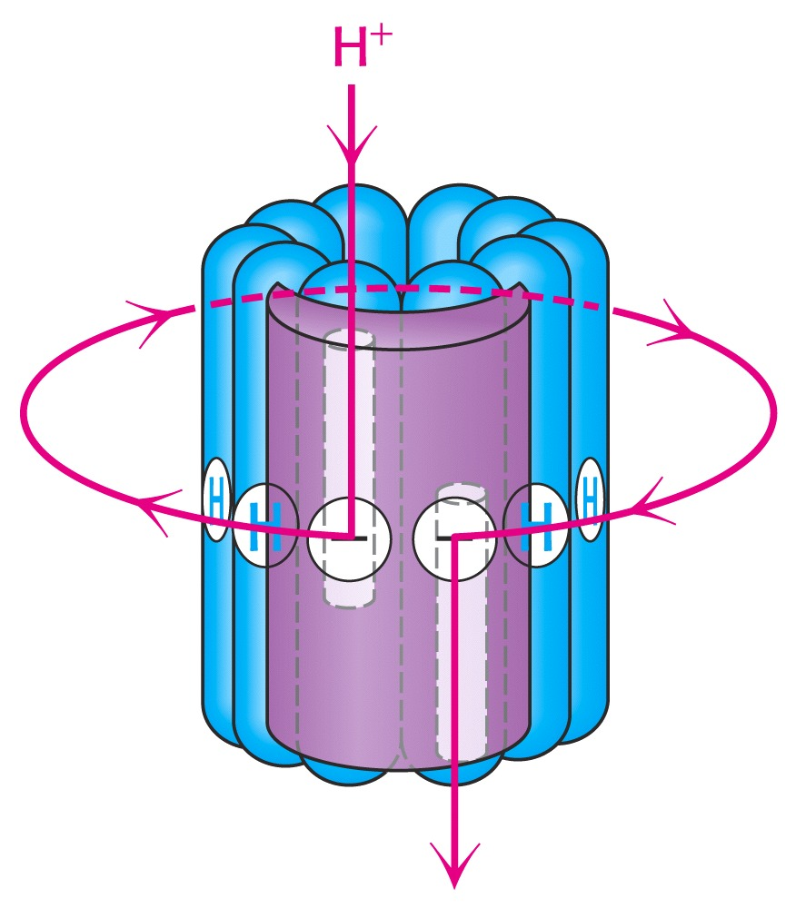
ATP Synthase Structure & Function
Aspartic acid accommodates this proton transfer from one channel to the other.
An asp-61 in one c-ring subunt binds to the proton and then rotates around (the long way) where it is delivered to the other channel:

Slide 36
ATP Synthase Structure & Function
The γ-subunit is tightly attached to the c-ring proteins. As such, it rotates with the c-ring during proton translocation.
However, the three αβ pairs are held in place by the b₂ arm.
Therefore, the γ-subunit rotates inside the core of the F₁ complex.
As the γ-subunit rotates, it changes the conformation of the β subunits. This is an important facet of ATP synthesis.

Slide 37
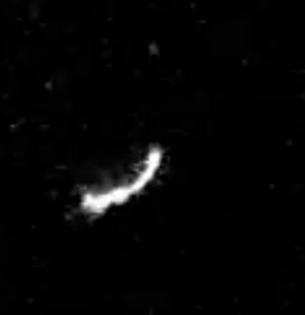
Source: https://www.youtube.com/shorts/QeHCAFKaWM8
ATP synthase live.mpg

Slide 38
ATP Synthase Structure & Function
A team of researchers led by John Walker crystallized the F₁ (knob) structures, in the presence of ADP and App(NH)p (a non-hydrolyzable form of ATP.)
X-ray crystallography showed that the three β subunits were each bound to different substrates:
One to App(NH)p (the ATP analog)
One to ADP
One to nothing at all (empty site)

Slide 39
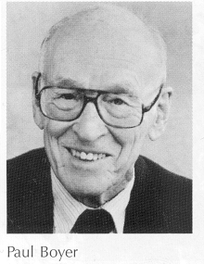
ATP synthesis
Paul Boyer finally put the puzzle together by proposing that there must be three sites with different binding affinities for the substrate (ADP + Pi) and product (ATP).
In fact, the three β-subunits interact in such a way that when one assumes the β-empty form, its neighbor to one side must assume the β-ADP form, and the other neighbor the β-ATP form.
Thus, one complete rotation of the γ-subunit causes each β-subunit to cycle through all three of its possible confomations, and for each rotation, three ATPs are synthesized and release from the enzyme surface.
Boyer received the Nobel Prize for this work in 1997 (born and raised in Provo, Utah)
http://nobelprize.org/chemistry/laureates/1997/boyer-autobio.html

Slide 40
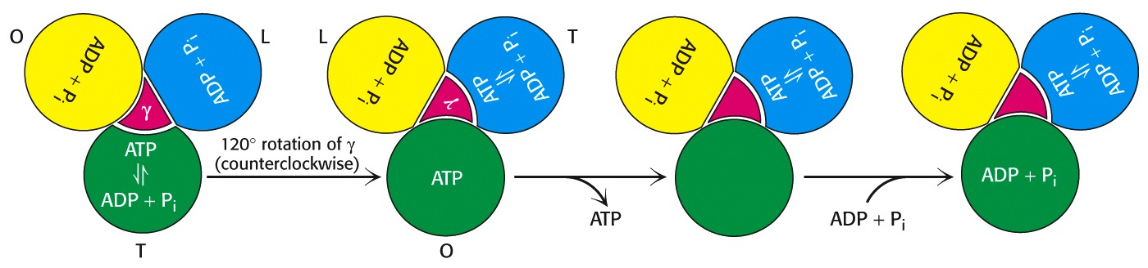
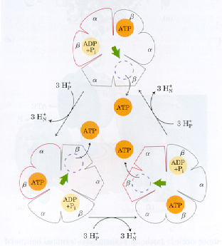
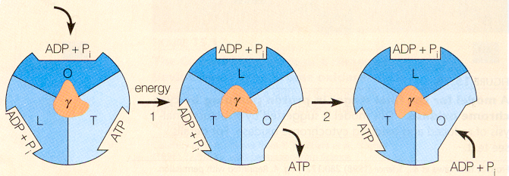
ATP synthesis – byer’s “Binding-change Model”
Stryer, et.al, Biochemistry, 5th ed.
(Mathews, et.al, Biochemistry, 3rd ed., Addison Wesley)
(Garrett & Grisham, Biochemistry, 3rd ed., Brooks/Cole)

Slide 41
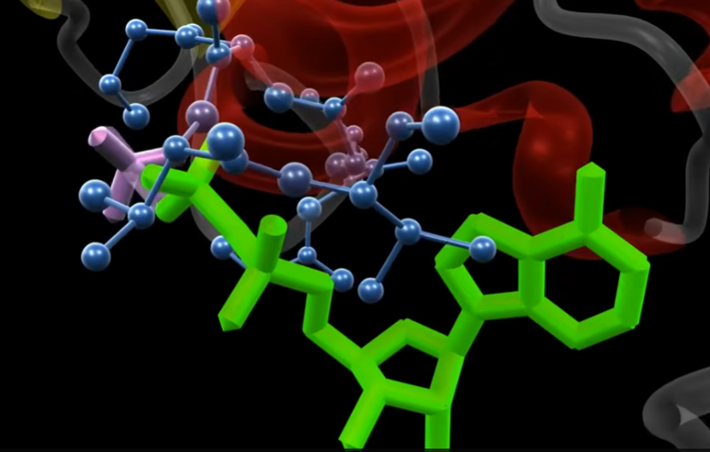
4:58 ATP Synthetase in Action Video: https://www.youtube.com/watch?v=kXpzp4RDGJI

Slide 42
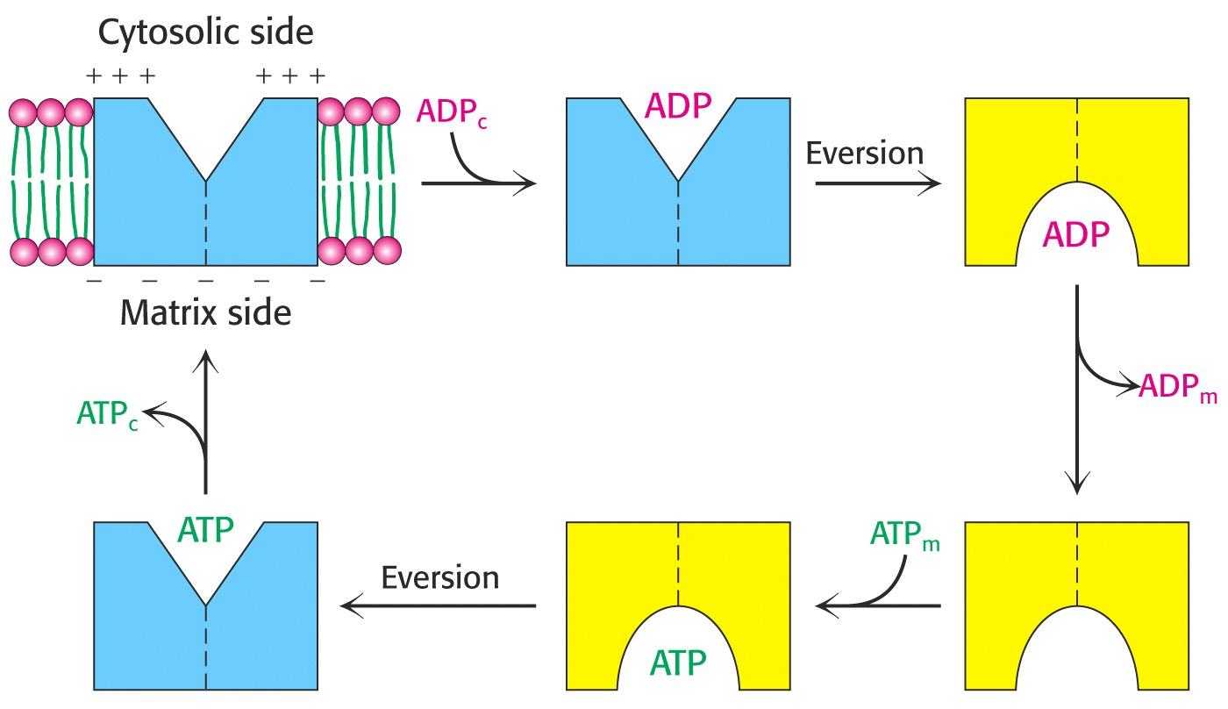
ATP synthesis
ATP moves from the mitochondrial matrix to the cytosol via a specialized membrane transport protein, “ATP-ADP translocase.”
Translocase is tightly coupled to the exchange of ADP for ATP as ATP exits.

Slide 43
ATP synthesis
Some NADH molecules are reduced in the cytosol and must be transported into the mitochonria for electrons to enter the electron transport pathway.
Two different “shuttles” are commonly encountered:
Glycerol 3-phosphate shuttle (transfers electrons to FADH_{2 .}
Malate-aspartate shuttle (transfers electrons to NADH)

Slide 44
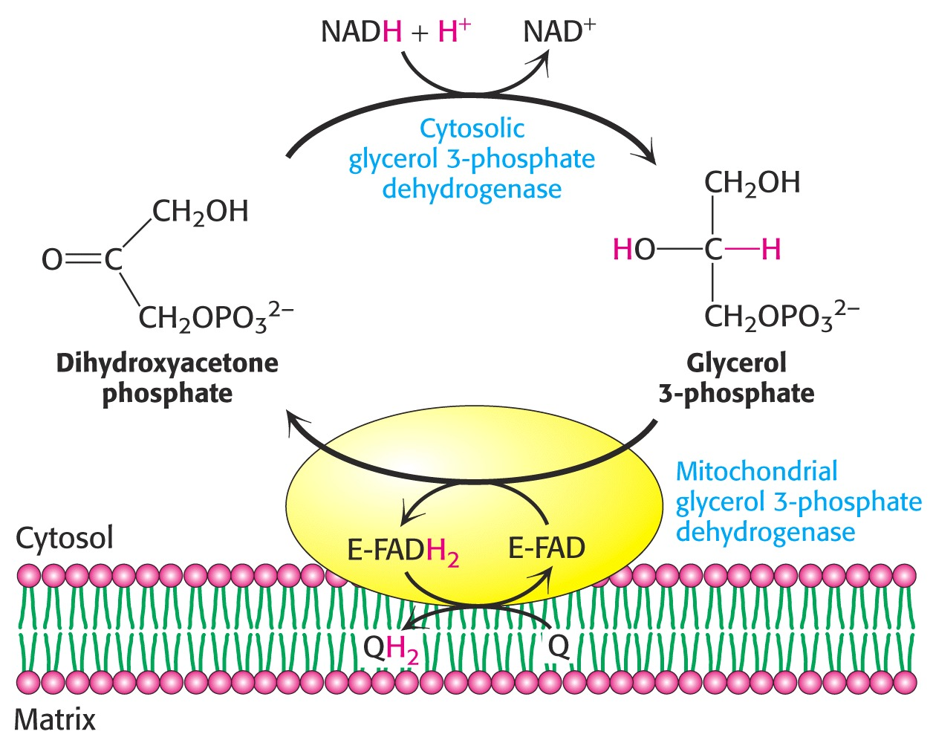
ATP synthesis
Glycerol 3-phosphate shuttle: (NADH ^{2e-} FADH₂)

Slide 45
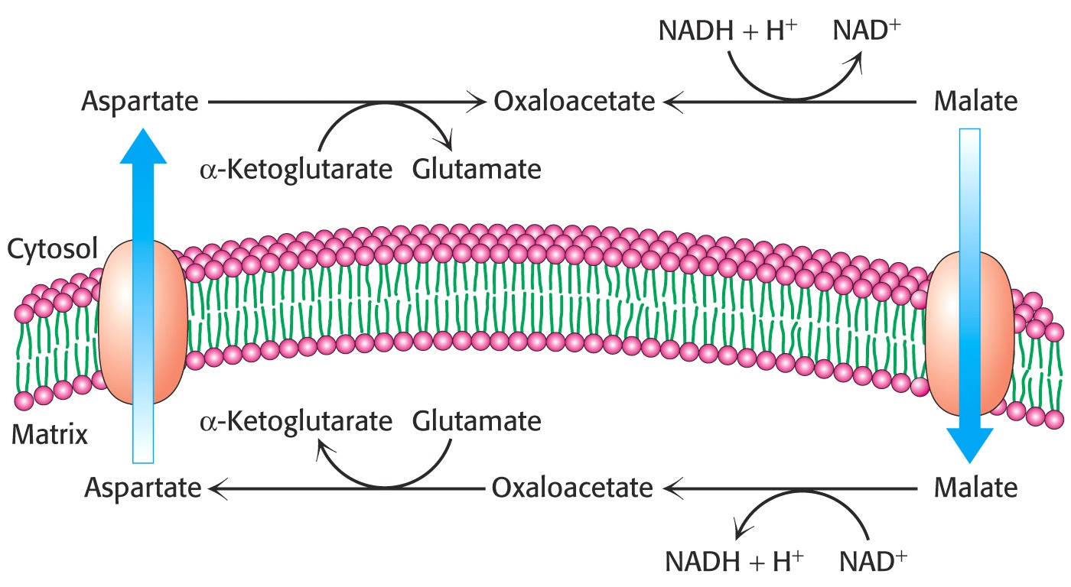
ATP synthesis
Malate-aspartate shuttle: (NADH ^{2e-} NADH)

Slide 46
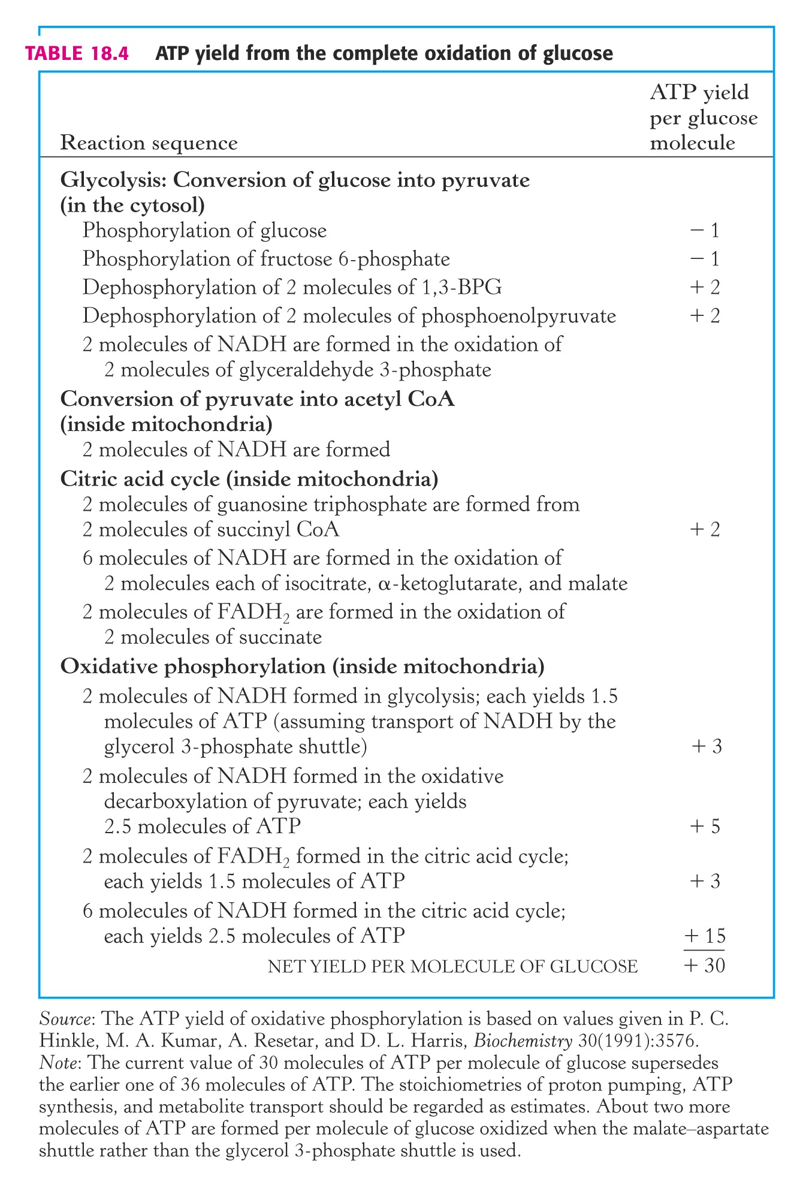
ATP Accounting
Assumptions for Mitochondrial Oxidation (with G-3-P Shuttle):
- - - - - - - - - - - - - - - - - - - -
ATP Yields (2 Sig.Figs):
NADH……… 2.5 ATP
Succinate… 1.5 ATP
Total: 30 ATP
- - - - - - - - - - - - - - - - - - - -
ATP Yields (1 Sig.Fig.):
NADH………… 3 ATP
Succinate….… 2 ATP
Total: 36 ATP
- - - - - - - - - - - - - - - - - - - -

Slide 47
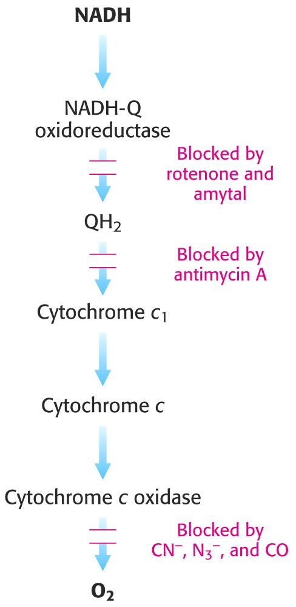
ATP Uncoupling
ATP synthesis can be “uncoupled,” if the proton gradient is prematurely dissipated or impeded.
Certain inhibitors of electron transport act at specific sites to stop electron flow.
Site I: amytal & rotenone
Site III: antimycin A
Site IV: CN⁻, N₃⁻, CO

Slide 48
ATP Uncoupling
Two other inhibitors stop the flow of protons back through ATP synthase:
Oligomycin &
dicyclohexylcarbodiimide (DCCD)
Questions:
What would happen to the rates of electron transport and ATP synthesis if oligomycin were added to tightly-coupled, functioning mitochondria?
In a similar but separate experiment, what would happen to both these rates if the F₁ portion (knobs) of the ATP synthase were removed?

Slide 49
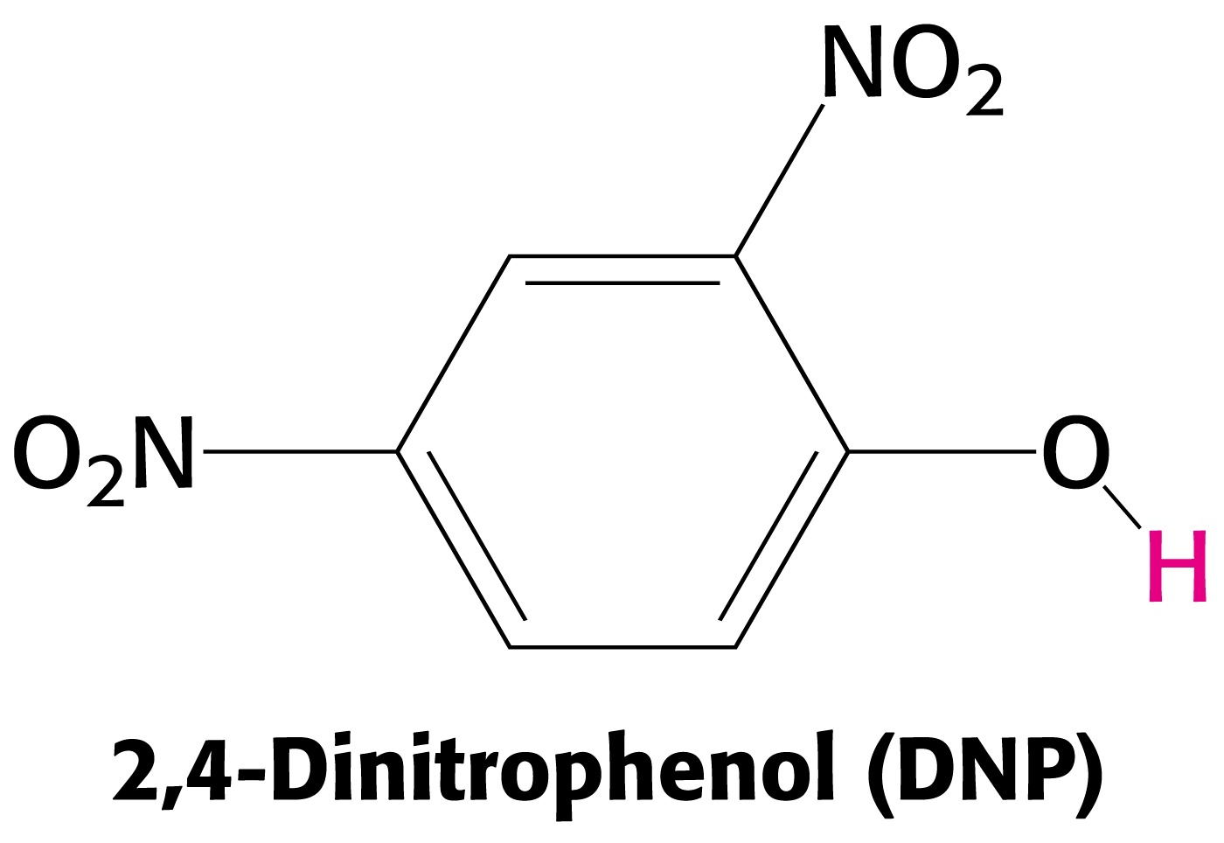
ATP Uncoupling
Other substances allow protons to diffuse back across the membrane without going through the ATP synthase complex.
The toxic agent 2,4-DNP dissipates the proton gradient, slowing or even stopping ATP synthesis.
This phenol can carry protons across the inner mitochondiral membrane.

Slide 50
ATP Uncoupling
Hibernating animals also uncouple ATP synthesis to generate heat (nonshivering thermogenesis).
In brown adipose tissue (which is very rich in mitochondria), uncoupling protein (UCP) or “thermogenin,” forms a pathway for the flow of protons back into the matrix.
This short circuits the proton gradient, generating heat.
Some flowers also generate heat this way to voltalize fragrances that attract insects to fertilize their flowers.

Slide 51
End of Lecture Slides
for
Oxidative Phosphorylation
Credits: Many of the diagrams used in these slides were taken from Stryer, et.al, Biochemistry, 5th & 10th Ed., Freeman Press (in our course textbook).

