Slide 1

Nucleic Acids
Biochemistry 3070

Slide 2
Historical Summary of the Discovery of DNA
The complexity of living processes require large amounts of information.
In the 19th century, scientists began systematic observations of “inheritance,” that has become the modern science of “genetics.”
Chromosomes within the nucleus were identified as the repositories of genetic information.
Deoxyrobionucleic acid [DNA] was eventually identified in the 1940s-1950s as the carrier of genetic information.

Slide 3
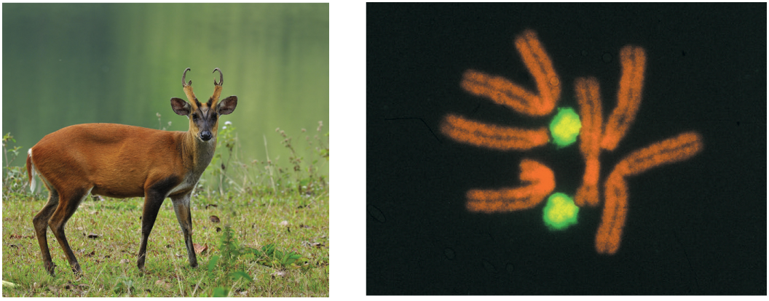
Indian muntjak (red) and human (green) chromosomes:
A single copy of the human genome contains about 3 billion nucleotides (or base pairs) divided among 24 chromosomes (22 autosomal and 2 sex chromosomes (X and Y))
Note: Our textbook counts the 2 sex chromosomes separately… usually, the 2 sex chromosomes are counted as a pair, yielding just 23 chromosome pairs in the human genome.
The Indian muntjac has a similar sized genome distributed on just 3 chromosomes.

Slide 4
Interesting Fact: Length of DNA in a Single Human Cell
The total length of DNA in a single human cell is about 2 meters (6.5 feet), but when unraveled and stretched from all cells in the body, it totals an astounding 100 billion kilometers (62 billion miles)—enough to reach the Sun and back over 300 times!
This incredible length comes from compacting roughly 3 billion base pairs from each of your approximately 30-40 trillion cells.

Slide 5
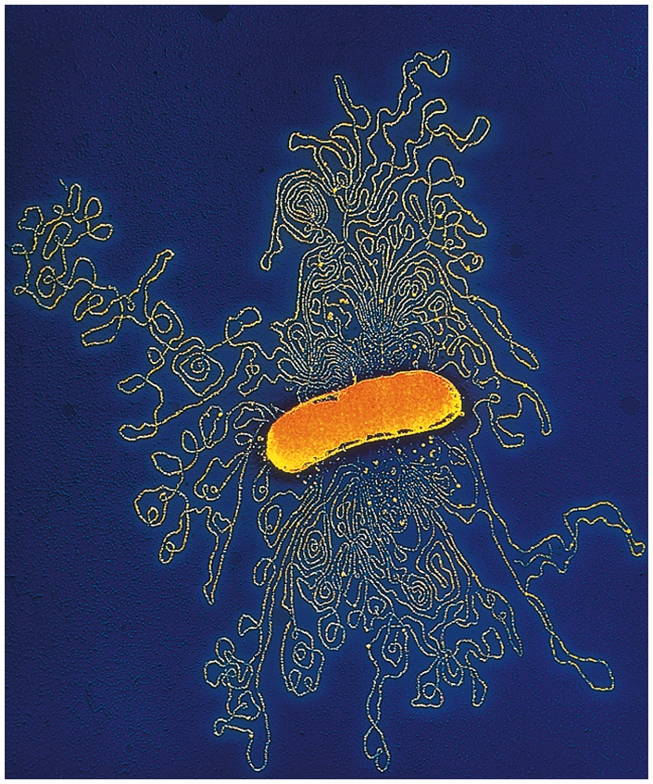
E. coli genome:
The E.coli genome is a single DNA molecule consisting of
4.6 million nucleotides.
Each base can be one of four bases [A,G,C,T], corresponding to two bits of information (2²=4). If one byte is eight bits, then this corresponds to
1.15 megabytes of information.
Human Genome:
1.15 Mbytes x 3,000,000,000 ≈
4,600,000
750 Megabytes of information!

Slide 6
Historical Summary of the Discovery of DNA
Elucidation of DNA’s structure and function depended upon several scientific disciplines:
Descriptive & experimental biology
Biology
Genetics
Organic Chemistry
Physics
The study of nucleic acids was eventually named, “Molecular Biology.”

Slide 7
Historical Summary of the Discovery of DNA
Gregor Mendel: (1865) Basic rules of inheritance from the cultivation of pea plants.
Friedrich Meischer (1865): Extracted “nuclein” from the nuclei of pus cells; it behaved as an acid and contained large amounts of phosphate.
(Hospitals were a rich source of pus during this time, prior to antiseptic use.)
Albrecht Kossel (1882-1896) and P.A. Levene (1920): tetranucleotide hypothesis

Slide 8
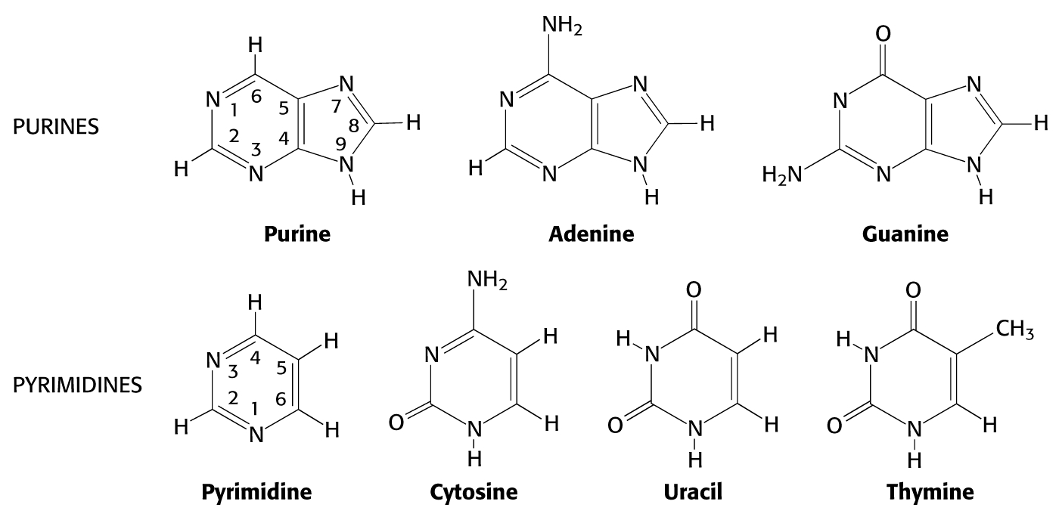
Organic “bases” in DNA (& RNA):

Slide 9
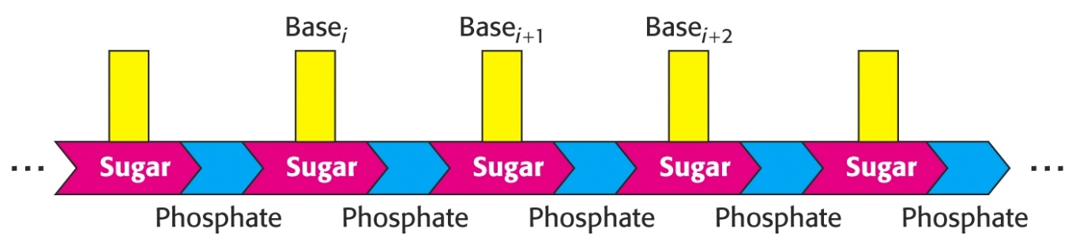
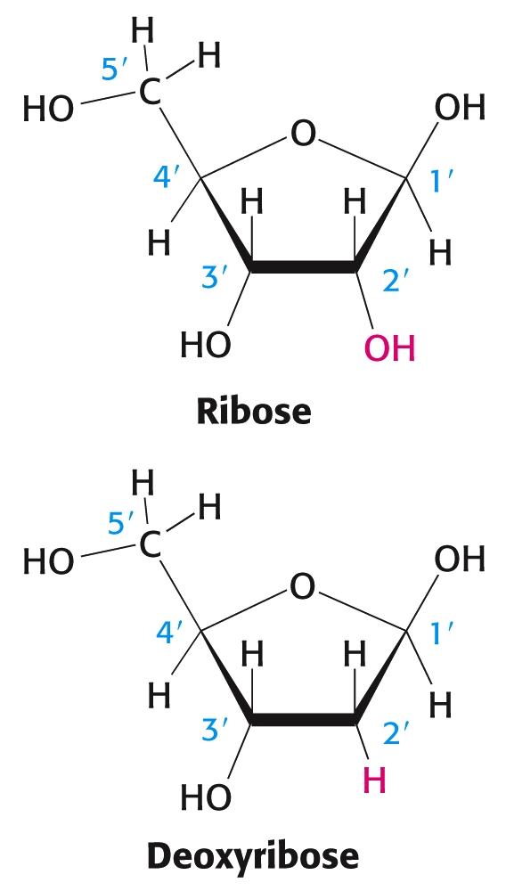
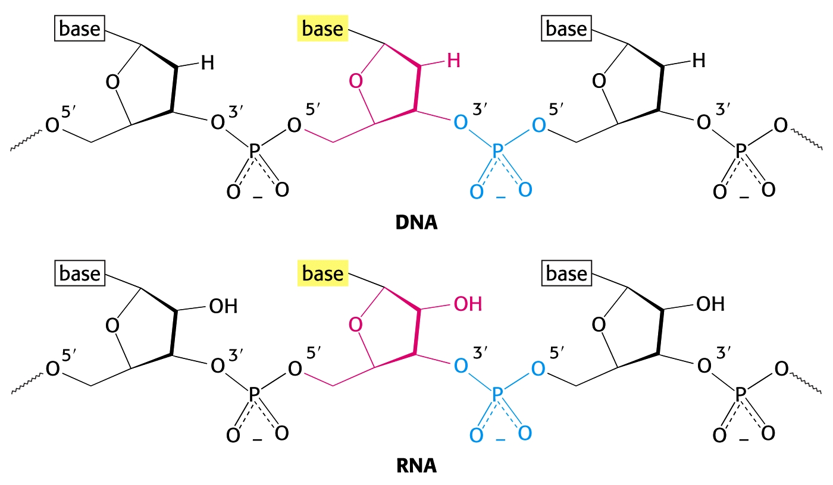
Sugar-phosphate backbone in DNA & RNA:

Slide 10
Scientists who contributed to the discovery of DNA’s structure

Slide 11
Historical Summary of the Discovery of DNA
James Watson published his historical account of this discovery in 1968 entitled, “The Double Helix.”
“My interest in DNA had grown out of a desire, first picked up while a senior in college, to learn what the gene was. Later, in graduate school at Indiana University, it was my hope that the gene might be solved without my learning any chemistry. This wish partially arose from laziness since, as an undergraduate at the University of Chicago, I was principally interested in birds and managed to avoid taking any chemistry or physics courses which looked of even medium difficulty. Briefly the Indiana biochemists encouraged me to learn organic chemistry, but after I used a bunsen burner to warm up some benzene, I was relieved from further true chemistry. It was safer to turn out an uneducated Ph.D. than to risk another explosion.” [Chapter 3]

Slide 12
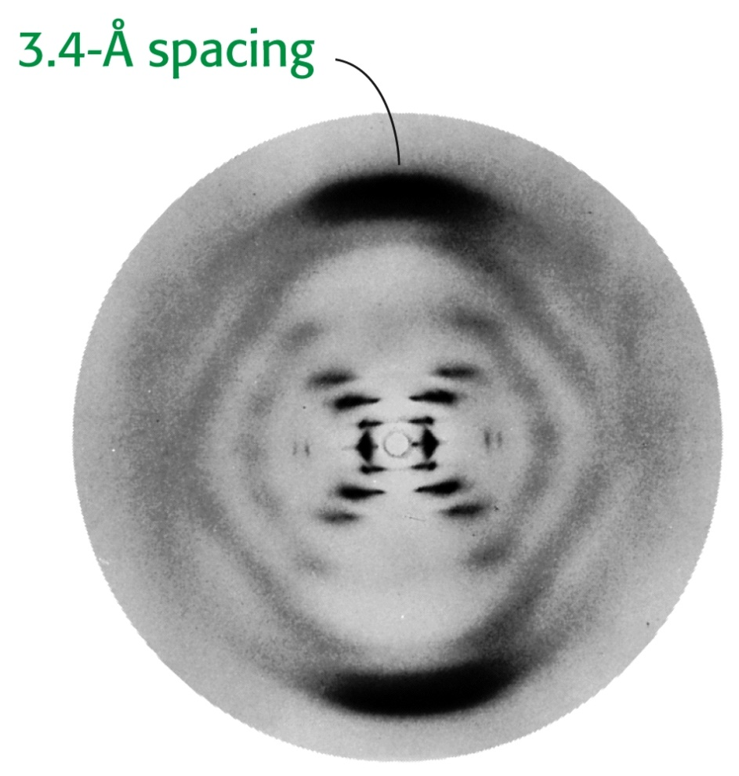
Franklin (& Wilkins) measured x-ray diffraction of DNA fibers that showed:
-DNA was formed of two chains
-Wound in regular helical structure
-Bases were stacked

Slide 13
http://www.nature.com/genomics/human/watson-crick/

Slide 14
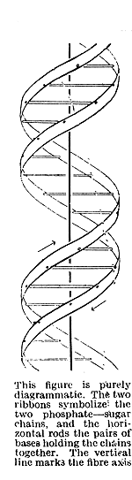
Watson & Crick: Nature Magazine VOL 171, page737; 2 April 1953 (cont.):

Slide 15
Watson & Crick: Nature Magazine VOL 171, page737; 2 April 1953 (cont.):

Slide 16
Watson & Crick: Nature Magazine VOL 171, page737; 2 April 1953 (cont.):

Slide 17
Watson & Crick: Nature Magazine VOL 171, page737; 2 April 1953 (cont.):

Slide 18
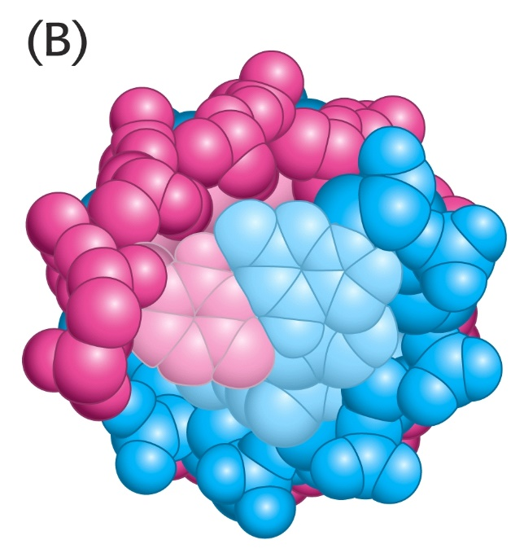
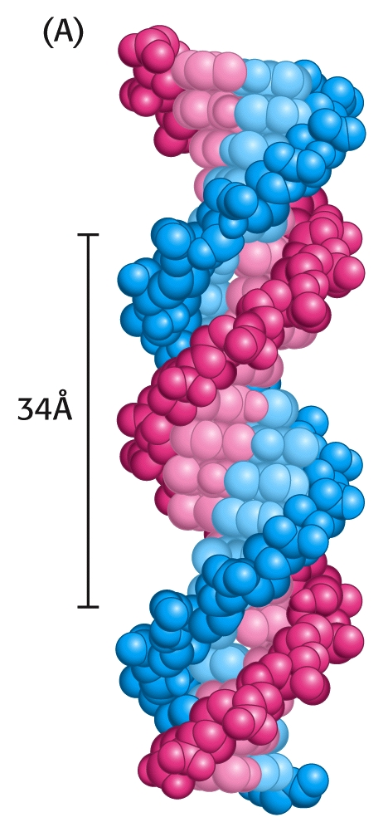
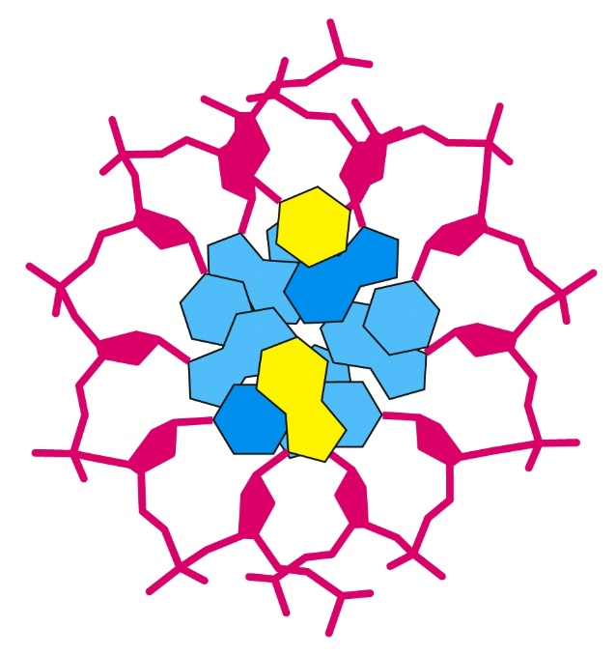
DNA Double Helix:

Slide 19
DNA Can Assume a Variety of Structural Forms
B-form = right-handed double helix made up of anti-parallel strands held together by Watson–Crick base pairs
most DNA under physiological conditions
A-form = similar to B-form, but wider and shorter with tilted base pairs relative to the helix axis
seen in RNA double helices and RNA–DNA hybrid helices
Z-form = left-handed double helix with zigzagged phosphoryl groups
unknown biological role, but Z-DNA-binding proteins have been isolated

Slide 20
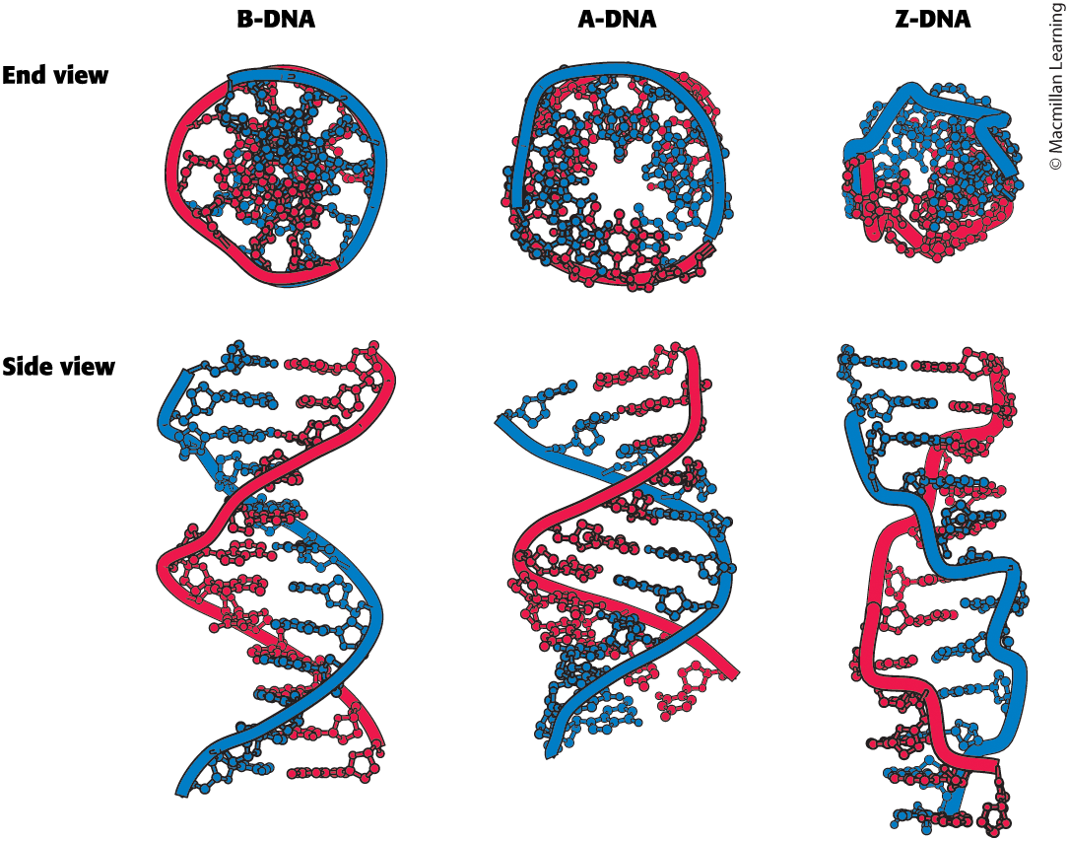
Models of B-form and A-form DNA depict their right-handed helical structures. The B-form helix is longer and narrower than the A-form helix. Z-DNA is a left- handed helix in which the phosphoryl groups zigzag along the backbone.

Slide 21
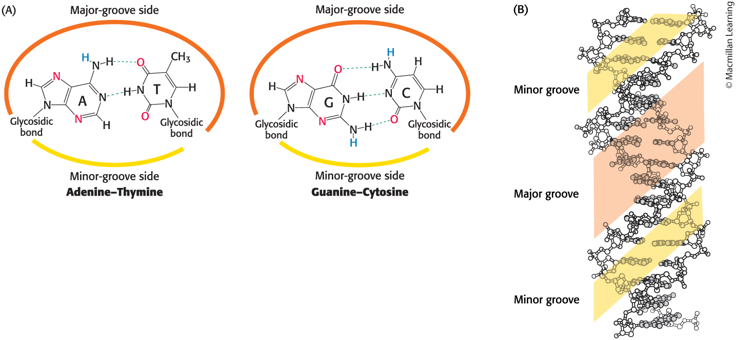
The Major and Minor Groove
The Major and Minor Groove
The DNA double-helix features a major and a minor groove. Because the two glycosidic bonds are not directly opposite each other, each base pair has a larger side that defines the major groove and a smaller side that defines the minor groove.

Slide 22
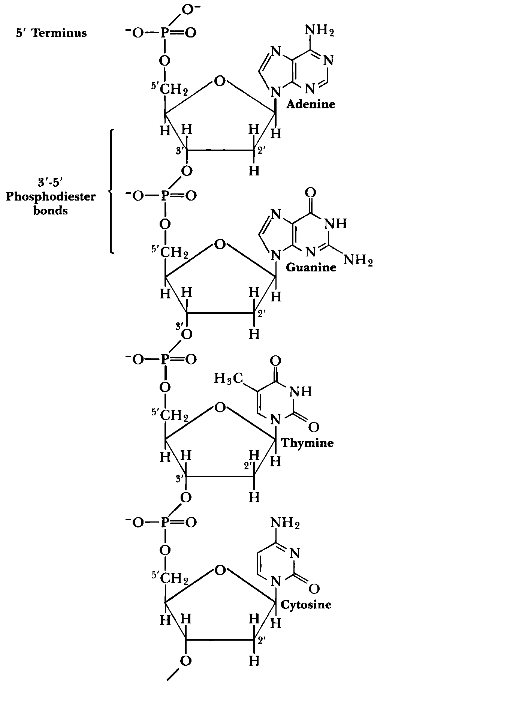
Chemical Structure of DNA

Slide 23
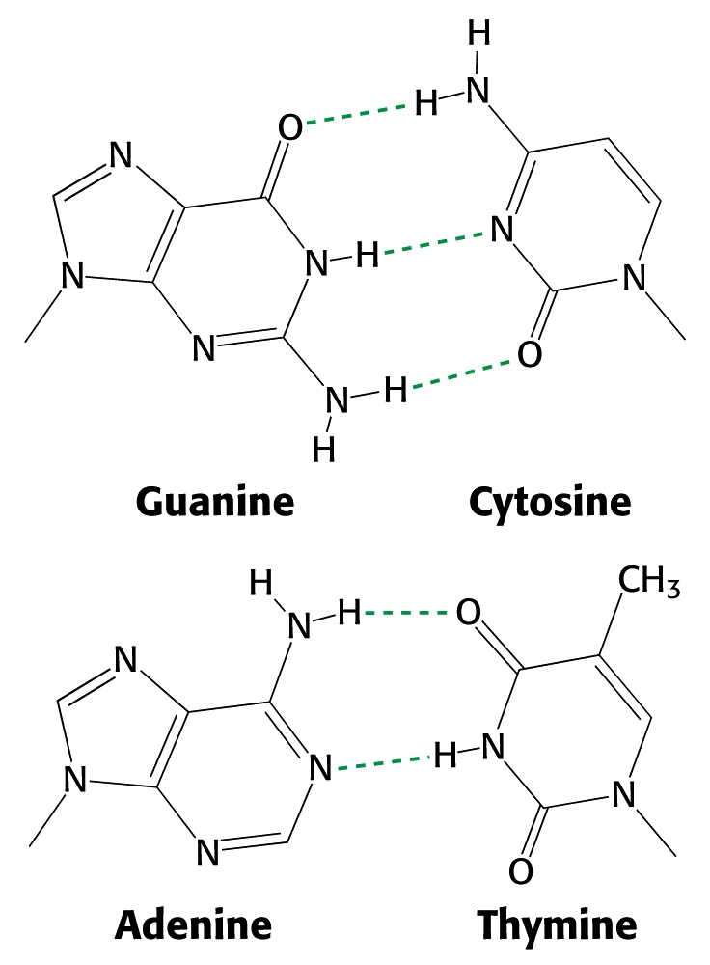
DNA’s double helix stabilized by H-bonds:

Slide 24
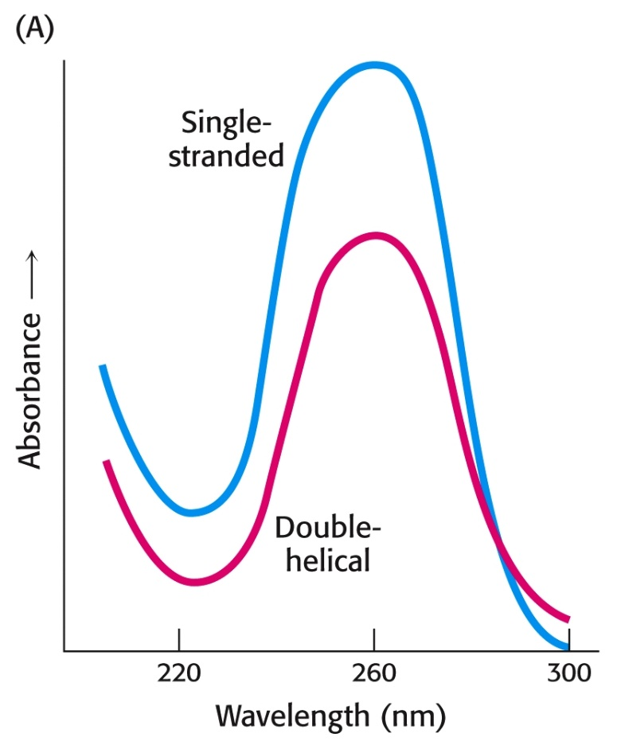
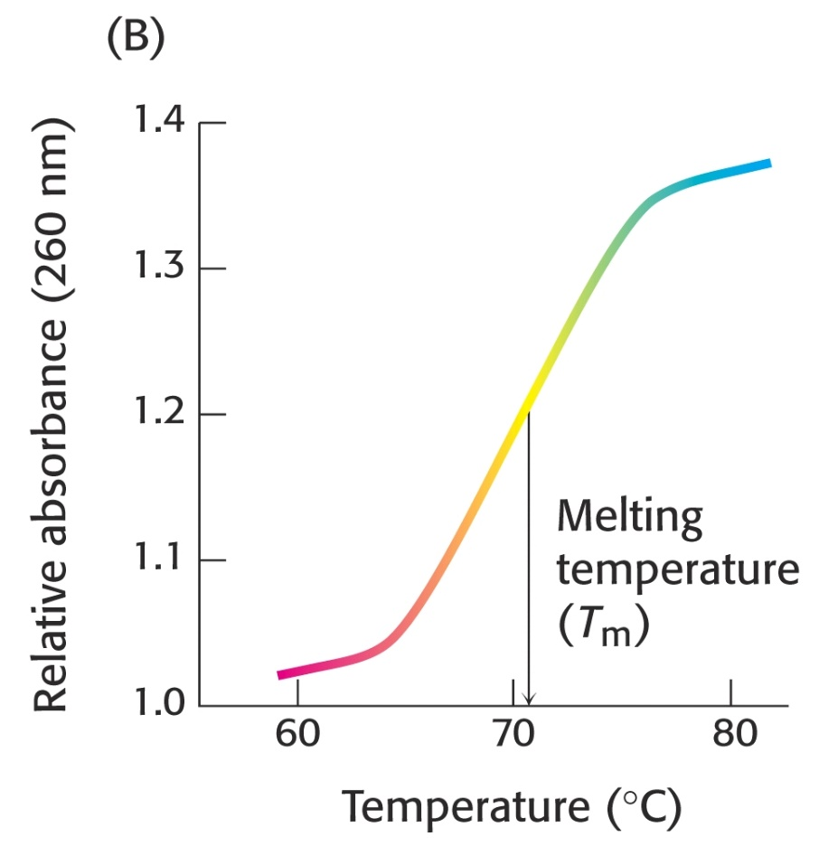

Slide 25
Generally, the type of bases contained in DNA affects the T_{m}.
Question:
Higher contents of which base pairs (A/T) or (G/C) in a segment of DNA would INCREASE T_{m}?

Slide 26
Generally, the type of bases contained in DNA affects the T_{m}.
Question:
Higher contents of which base pairs (A/T) or (G/C) in a segment of DNA would INCREASE T_{m}?
Answer:
Increased numbers of G/C pairs increase T_{m}, due to increased hydrogen-bonding.

Slide 27
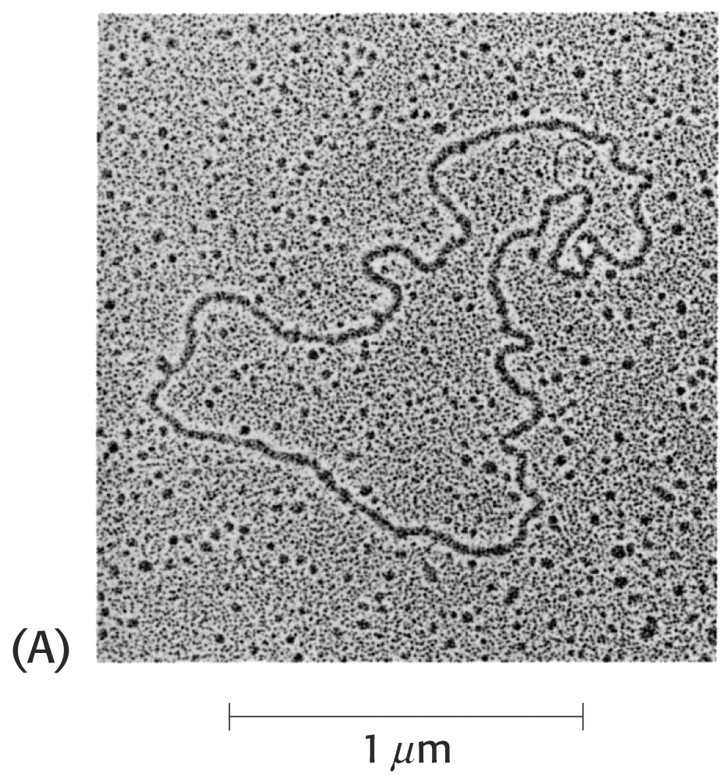
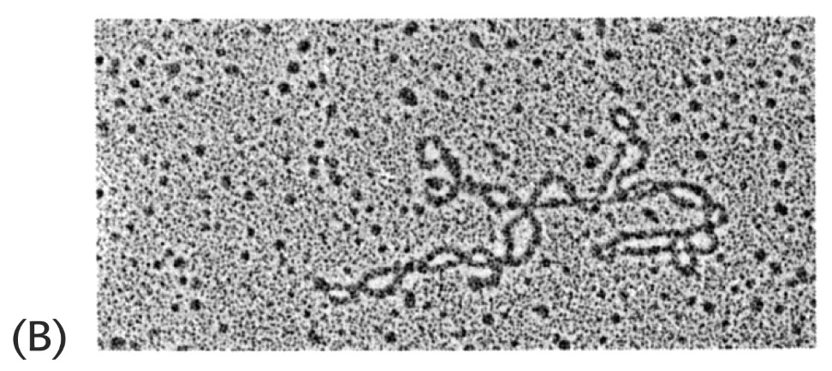
DNA Shapes
Some DNA Molecules are Circular (no “end” to the double helix.)
For example, many bacterial plasmids are composed of circular DNA.
Circular DNA can be “relaxed” or “supercoiled.”
Supercoiled DNA has a much more compact shape.

Slide 28
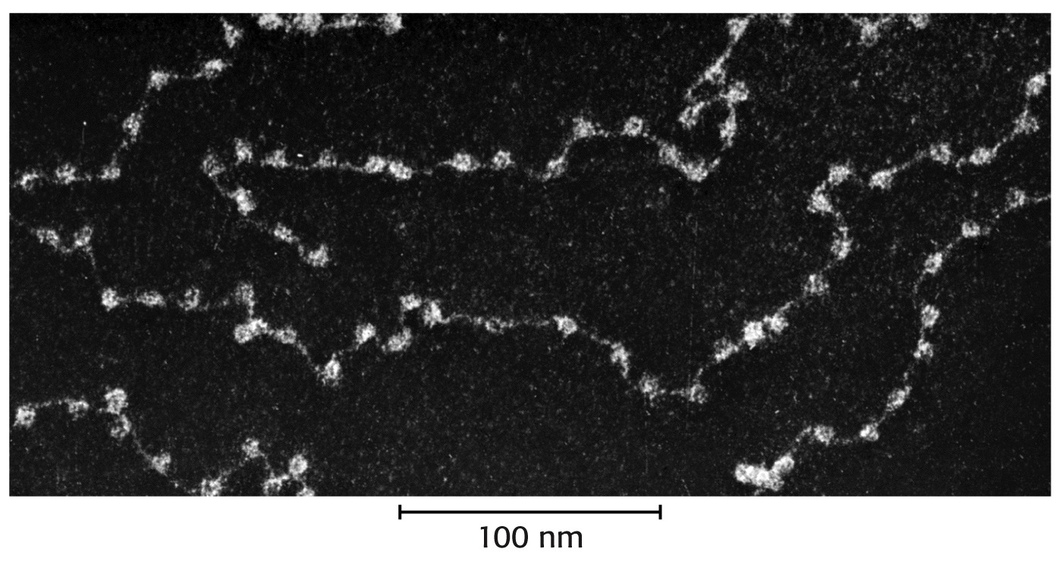
Chromatin Structure: DNA, Histones & Nucleosomes
DNA in chromosomes is tightly bound to proteins called “histones.”
Histone octamers surrounded by 145 base pairs of DNA form units called “nucleosomes.”

Slide 29
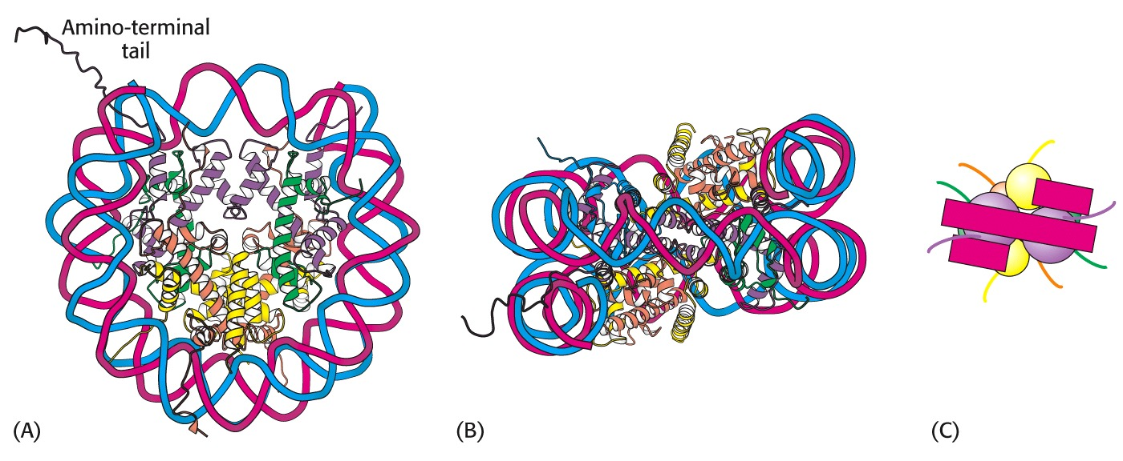
DNA, Histones, & Nucleosomes
Over the past decade, histones have been shown to play important roles in protein expression in addition to organizing and stabilizing DNA.

Slide 30
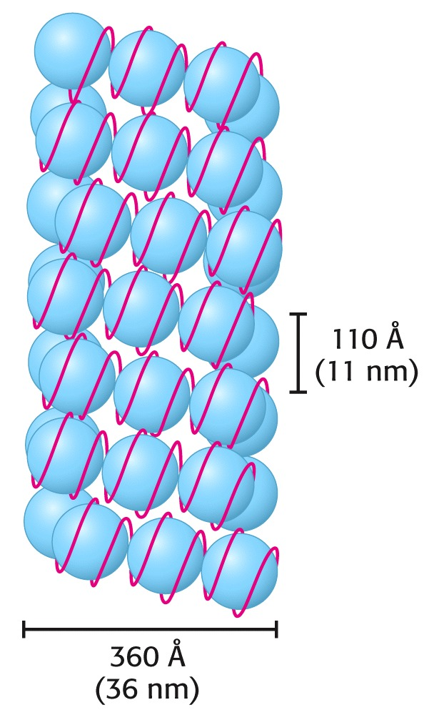
Chromatin Structure: DNA, Histones & Nucleosomes
Chromatin is a tightly-packaged, highly-ordered structure of repeating nucleosomes.
The resulting structure is a helical array, containing about six nucleosomes per turn of the helix.
Stryer, Chapter 31

Slide 31
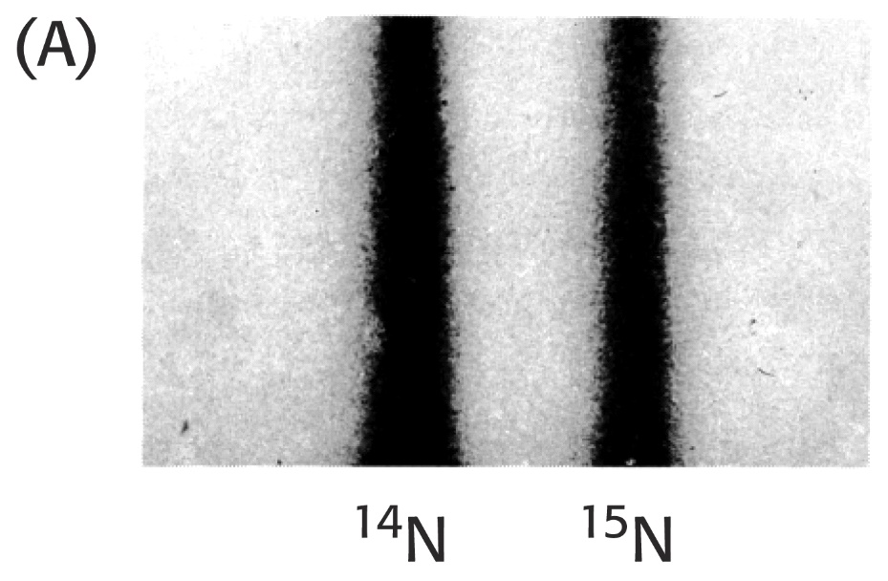
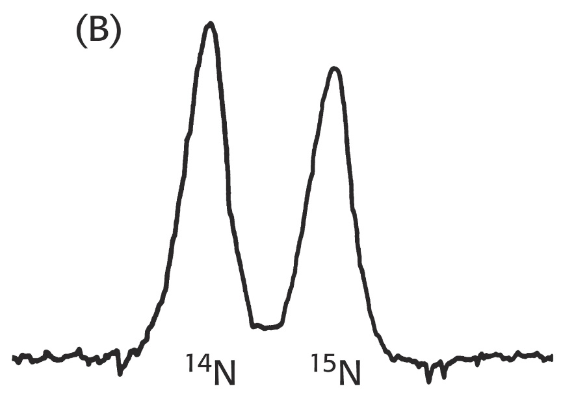
Semi-conservative replication of DNA:
Matthew Messelson & Franklin Stahl utilized “heavy,” ¹⁵N-labeled DNA to demonstrate semi-conservative replication.
Density-gradient centrifugation separates the “heavy” and “light” DNA strands:

Slide 32
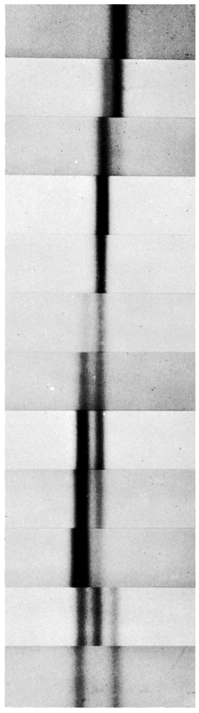
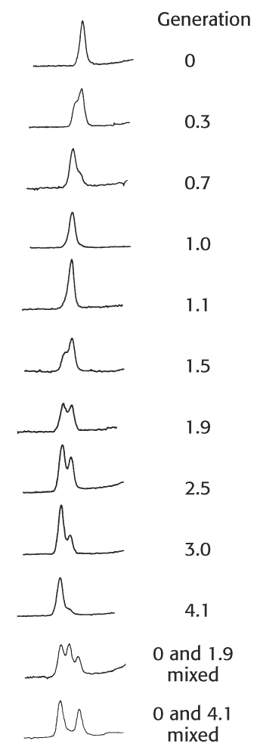
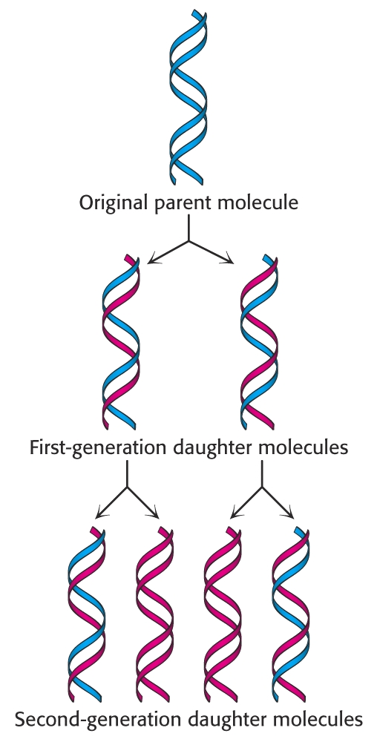
Meselson & Stahl’s Experiment

Slide 33
DNA Replication Mechanism
Semi-conservative replication uses one strand from the parental duplex as a template to direct the synthesis of a new complementary strand in the daughter DNA.
Free deoxynucleoside-5’-triphosphates (dATP, dGTP, dTTP, and dCTP) form complementary base pairs to the template.
Polymerization of the new chain is catalyzed by a special enzyme, “DNA Polymerase,” which forms new phosphodiester linkages.

Slide 34
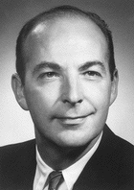
DNA Replication Mechanism
DNA Polymerase was discovered by Arthur Kornberg in 1955, just a few years after Watson & Crick’s landmark publication.
Kornberg was the first person to demonstrate DNA synthesis outside of a living cell.
He received the Nobel Prize in 1959.
1959

Slide 35
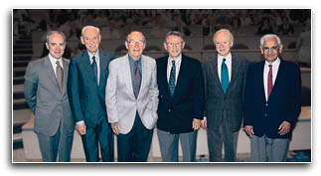
Hugh A D'Andrade
Alejandro Zaffaroni, Ph.D.
Arthur Kornberg, M.D. 1959 Nobel Prize
Paul Berg, Ph.D., 1980 Nobel Prize
Joseph L. Goldstein, M.D., 1985 Nobel Prize
Har Gobind Khorana, Ph.D., 1968 Nobel Prize
University of Rochester Medical Center – Dedication of the Arthur Kornberg Medical Research Building (~1999)

Slide 36
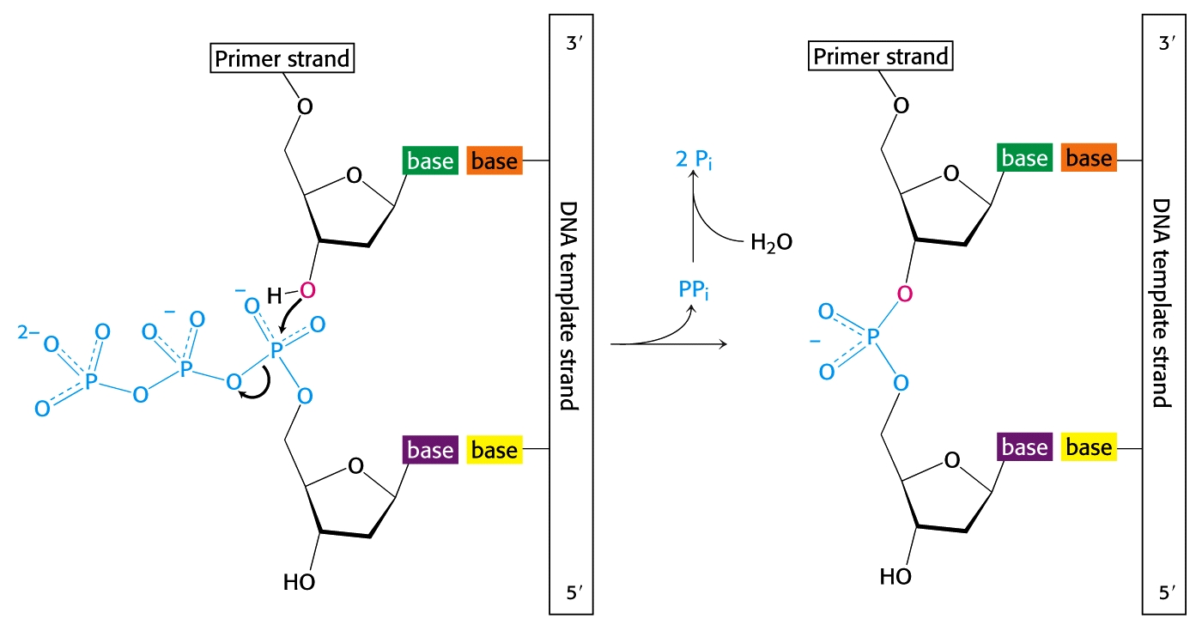
DNA Replication Mechanism
DNA-directed DNA polymerase catalyzes the elongation of a new DNA chain, using a complementary strand of DNA as its guide.
The reaction is a nucleophilic attack by the 3’- hydroxyl group of the primer on the innermost phosphorus atom of the deoxynucleoside triphosphate:

Slide 37
DNA Replication Mechanism
Unique traits of Kornberg’s DNA Polymerase:
Polymerization occurs only in the 5’->3’ direction.
The enzyme is very specific and accurate: Only correct complementary base pairs are added to the growing chain. The preceding base pair must be correct for the enzyme to continue its formation of the next phosphodiester bond.
Mg²⁺ is required.
The enzyme is very fast: The E.coli genome contains 4.6 million base pairs and is copied in less than 40 minutes, at a rate of 2,000 nucleotides/second.
DNA Polymerase requires a primer strand where polymerization is to begin. This means that DNA polymerase must bind to a segment of double-stranded DNA and add new nucleotides to the end of the primer.

Slide 38
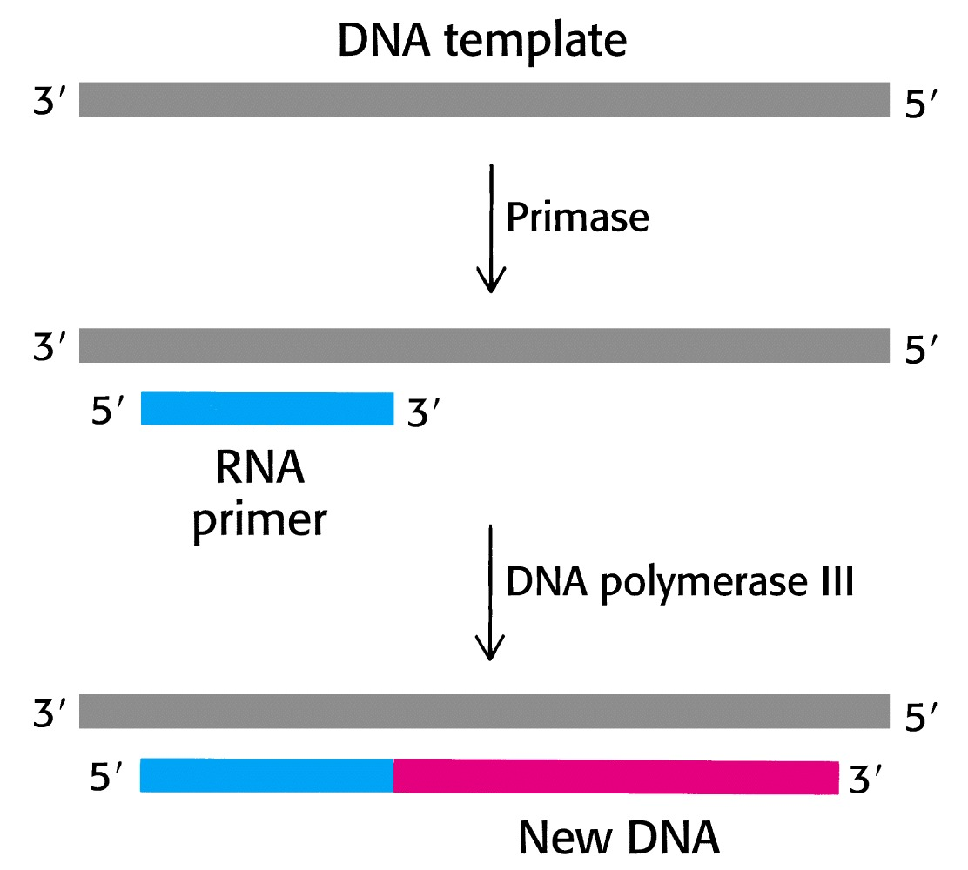
DNA Replication Mechanism
Primers for DNA synthesis are actually short, single-stranded RNA segments.
A specialized RNA polymerase called “primase” synthesizes a short stretch of RNA (~ 5 nucleotides) that is complementary to the DNA template strand.
Later, the RNA primer is removed by the enzyme, “exonuclease.”
Primers are powerful tools in modern biotechnology & genetic engineering.
Stryer, Chap 27

Slide 39
DNA Replication Mechanism
Both strands of DNA act as templates for synthesis of new DNA.
DNA synthesis occurs at the site where DNA unwinds, often called the “replication fork.”
Since DNA is polymerized only in the 5’→3’ direction, and the two chains in DNA run in opposite directions, the new DNA is synthesized in two ways.
The “leading” strand is synthesized continuously.
The “lagging” strand is synthesized in small fragments called “Okazaki” fragments (named for Tsuneko and Reiju Okazaki).

Slide 40
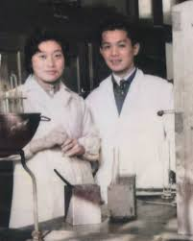
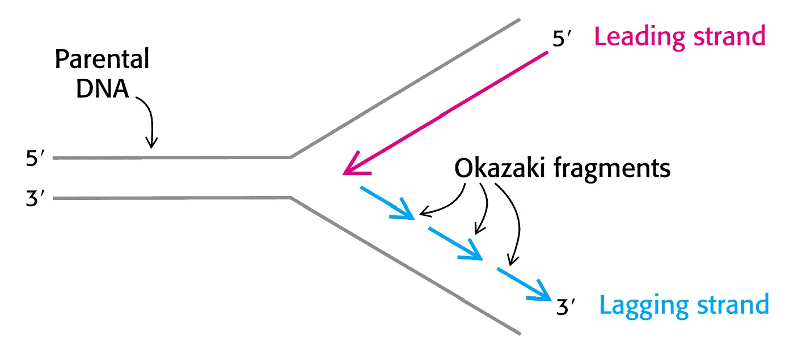
DNA Replication Mechanism
Okazaki fragments are joined by the enzyme, “DNA ligase.” (From “ligate” meaning “to join.”) The DNA Ligase enzyme is another powerful tool in genetic engineering.

Slide 41
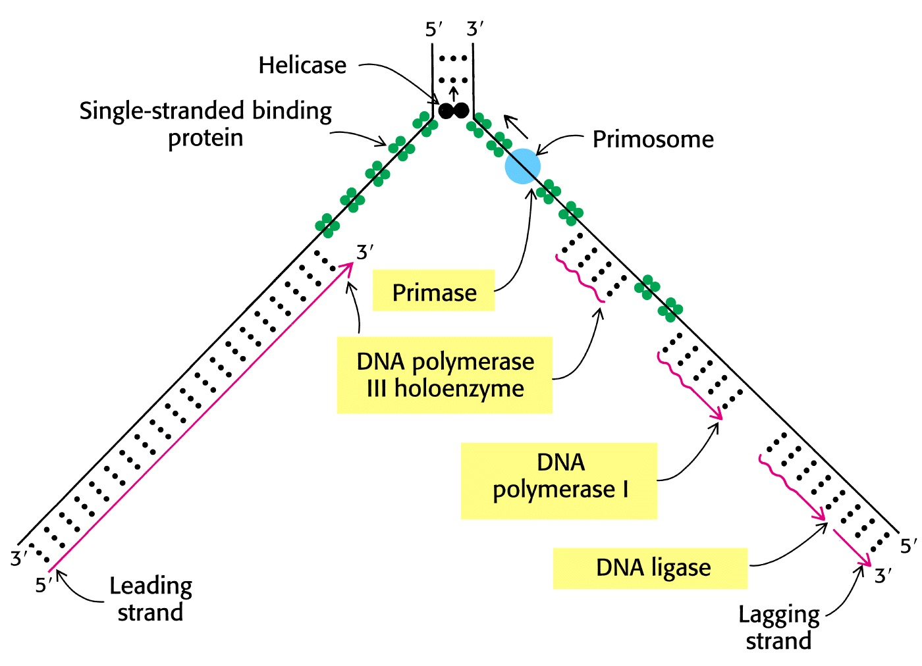
DNA Replication Mechanism
Many enzymes are involved in the replication of DNA:

Slide 42
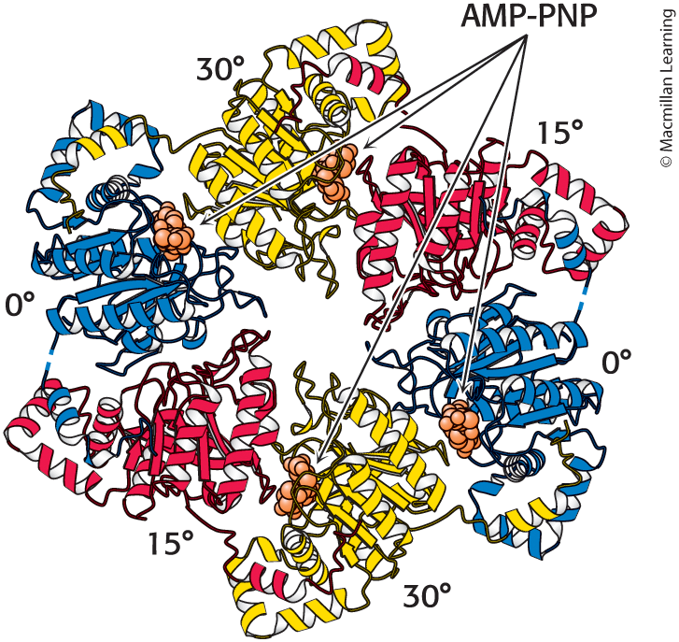
Helicases Are Hexamers with Intrinsic Asymmetry
Each subunit:
has two loops that extend toward the center of the ring structure and interact with DNA
interacts closely with its two neighbors within the ring structure

Slide 43
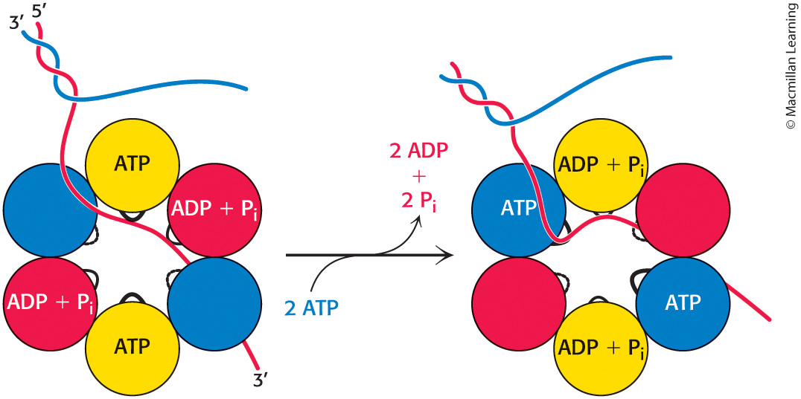
Helicases Unwind DNA
FIGURE 28.11 Helicases unwind DNA. One of the strands of the double helix passes through the hole in the center of the helicase, bound to the loops of two adjacent subunits. Two of the subunits do not contain bound nucleotides. On the binding of ATP to these two subunits and the release of ADP + Pi from two other subunits, the helicase hexamer undergoes a conformational change, pulling the DNA through the helicase. The helicase acts as a wedge to force separation of the two strands of DNA.

Slide 44
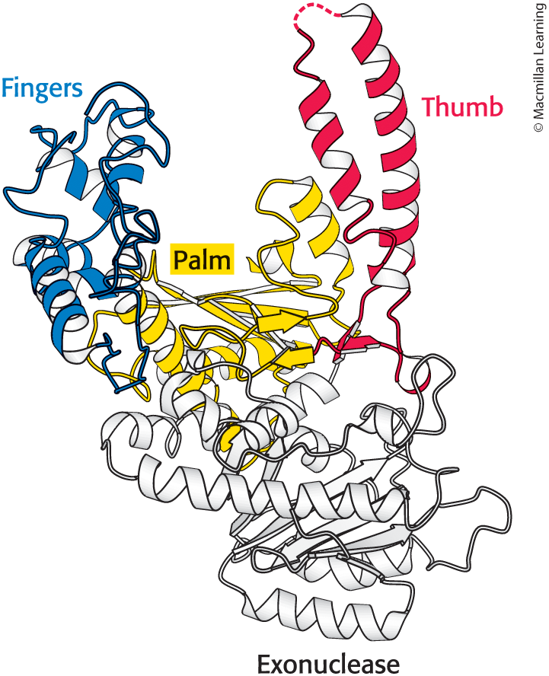
The Functional part of the E. coli DNA Polymerase Resembles a Hand

Slide 45
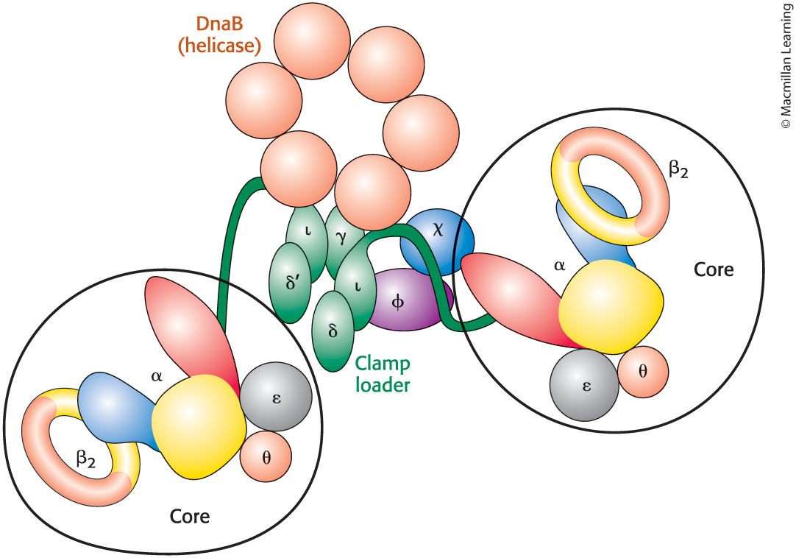
The DNA Polymerase Holoenzyme Complex Consists of Multiple Subunits
Each holoenzyme consists of two copies of the polymerase core enzyme, which comprises the α, ε, and θ subunits and two copies of the β subunit, linked to a central structure. The central structure includes the clamp-loader complex and the hexameric helicase DnaB.
Note the “Sliding Clamp Subunit” on each of the two polymerase cores.

Slide 46
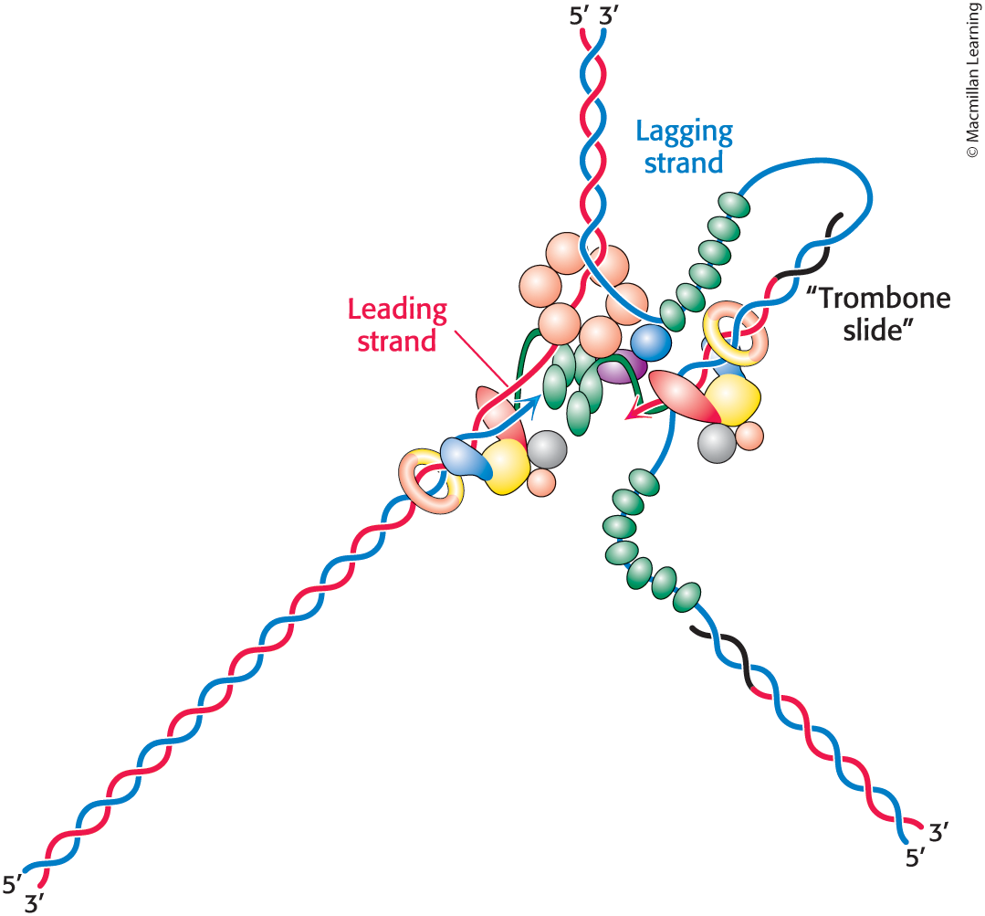
The Trombone Model & DNA Synthesis at the Replication Fork
The replication of the leading and lagging strands is coordinated by the looping out of the lagging strand to form a structure that acts somewhat as a trombone slide, growing as the replication fork moves forward. When the polymerase on the lagging strand reaches a region that has been replicated, the sliding clamp is released and a new loop is formed.

Slide 47
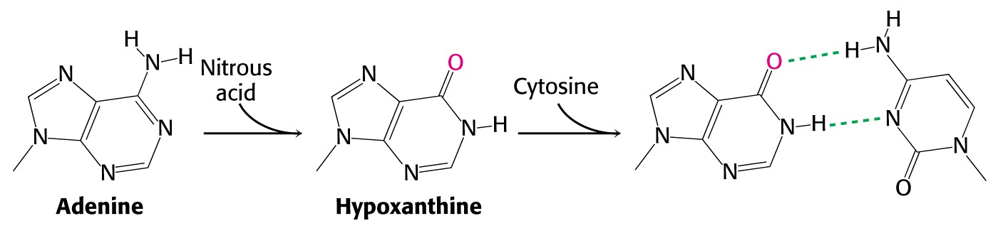
DNA Mutations
Chemical Mutagens can cause changes in a single base pair:
Nitrous acid (HNO₂) can oxidatively deaminate adenine, changing it to hypoxanthine. During the next round of replication, hypoxanthine pairs with cytosine rather than with thymine. The daughter DNA will have a G-C base pair instead of an A-T base pair: [a “substitution” mutation.]

Slide 48
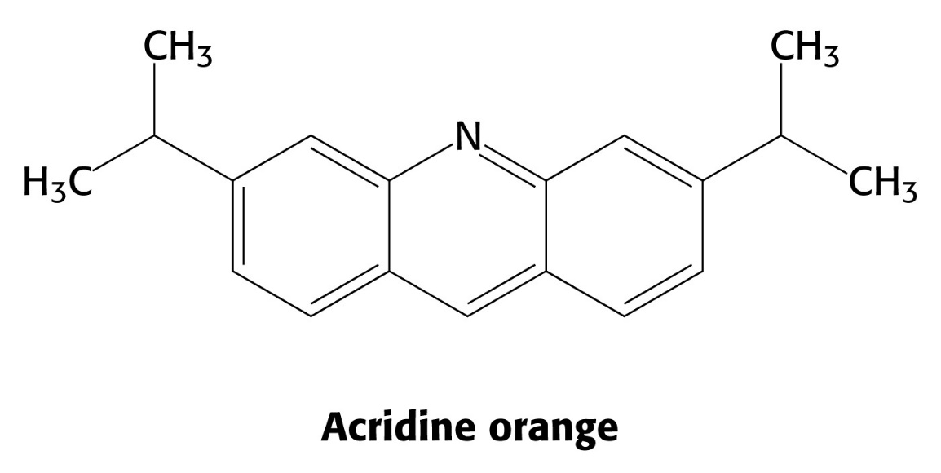
DNA Mutations
A different type of mutation results in an “insertion” mutation.
The dye, acridine orange, “intercalates” into DNA, inserting itself between adjacent base pairs in the DNA structure. This can lead to an insertion or deletion of base pairs in the daughter strands during DNA replication.
This type of mutation is also called a “frame-shift” mutation.

Slide 49
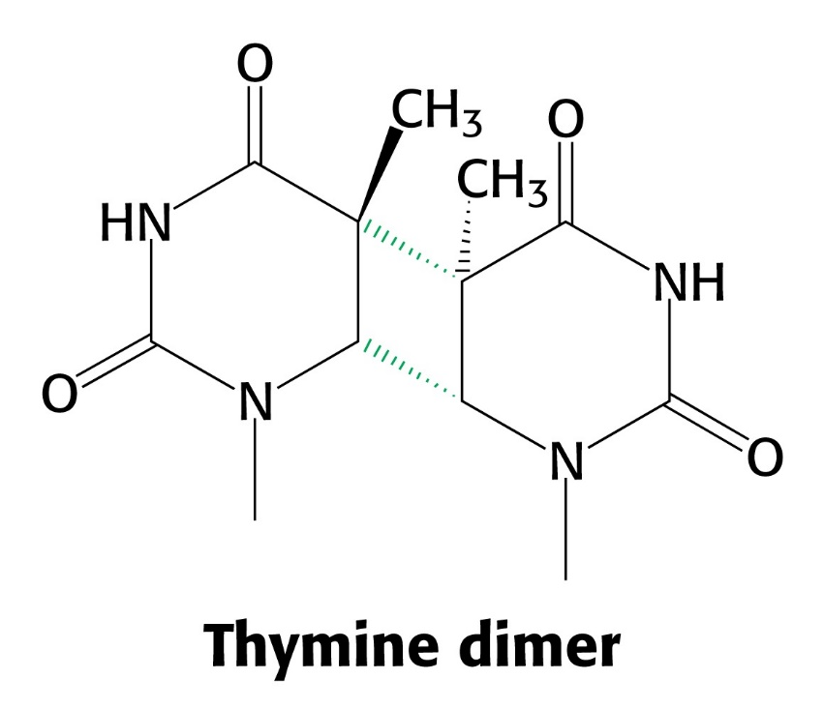
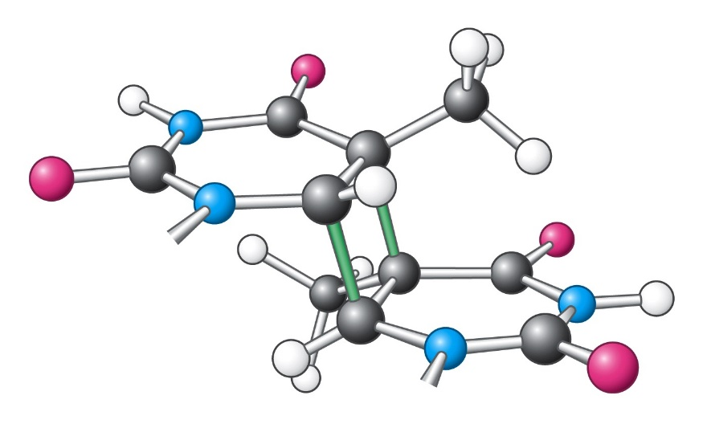
DNA Mutations
Ultraviolet light can also damage DNA, forming thymine-thymine dimers.
Due to disruption of the DNA helix, both replication and gene expression are blocked until the dimer is removed or repaired.

Slide 50
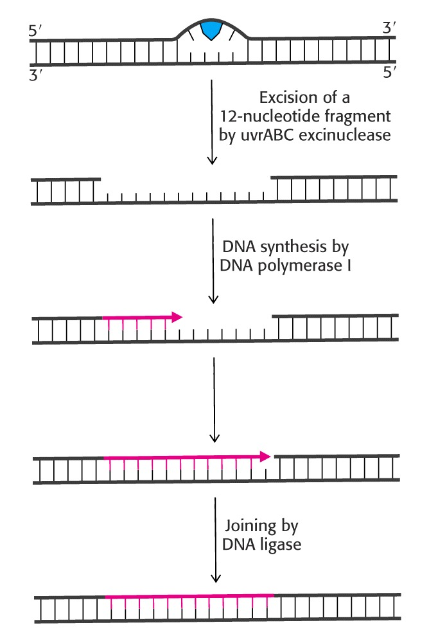
DNA Repair
Various repair mechanisms fix errors in DNA.
Consider the repair of a thymine-thymine dimer initiated by an “excinuclease.”
(Latin “exci” meansto “cut out.”)
Following excision of the damaged section, DNA polymerase replaces the segment and DNA ligase joins in the replacement.

Slide 51
DNA Replication Mechanism
Many cancers are caused by defective repair of DNA.
Xeroderma pigmentosum, a rare skin disease, can be caused by a defect in the exinuclease that hydrolyzes the DNA backbone near a pyrimidine dimer. Skin cancer often occurs at several sites. Many patients die before age 30 from metastases of these malignant skin tumors.
Nonpolyposis colorectal cancer (HNPCC, or Lynch syndrome) is caused by defective DNA mismatch repair. As many as 1 in 200 people will develop this form of cancer.

Slide 52
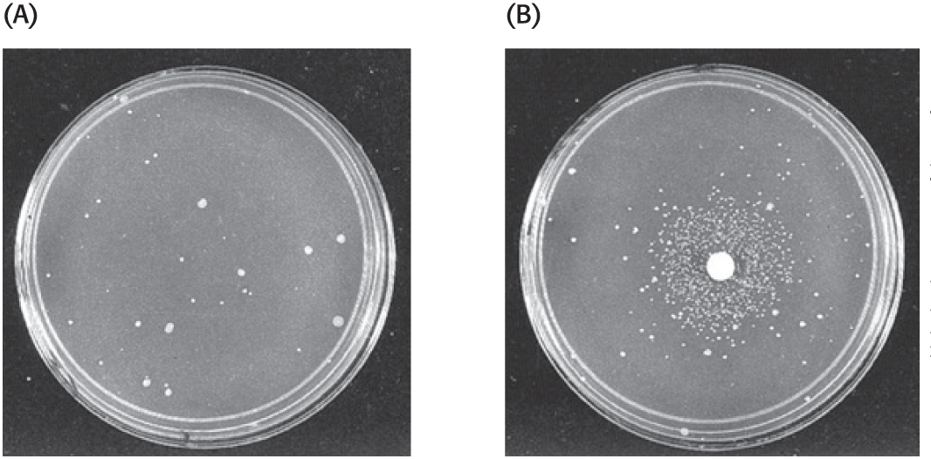
Potential carcinogens can be detected utilizing Bacteria.
The Ames Test (devised by Bruce Ames) utilizes special “tester strains” of Salmonella. These bacteria normally can not grow in the absence of histidine, due to a mutation in one its genes for the biosynthesis of this amino acid. When added to the growth medium (usually agar), carcinogenic chemicals cause many mutations. A small portion of these mutations reverse the original mutation and histidine can be synthesized.
Increased growth of these “revertant” colonies are an excellent indicator of mutagenic potential.
Stryer,Chap 28

Slide 53
RNA Structure and Function
Stryer, Chapter 29

Slide 54
For DNA information to be useful, it must be “expressed” in the form of functional proteins in the cell.
These process is complex and the subject of much research. In fact, most biochemistry and biology textbooks dedicate significant portions of their pages describing this process.
We will only introduce this topic, saving an in-depth look for a later course, namely Biochem 3080.

Slide 55
Gene Expression
Consider the analogy of building a building from directions supplied as “master specifications.”
Master specifications with their associated drawings never leave the safety of the architect’s office.
Instead, relatively short-lived “blue print” copies are “transcribed” and sent to the construction site.
At the building site, the blue prints are “translated” into a new structure.

Slide 56
Gene Expression
Gene expression is the transformation of DNA information into functional molecules.

Slide 57
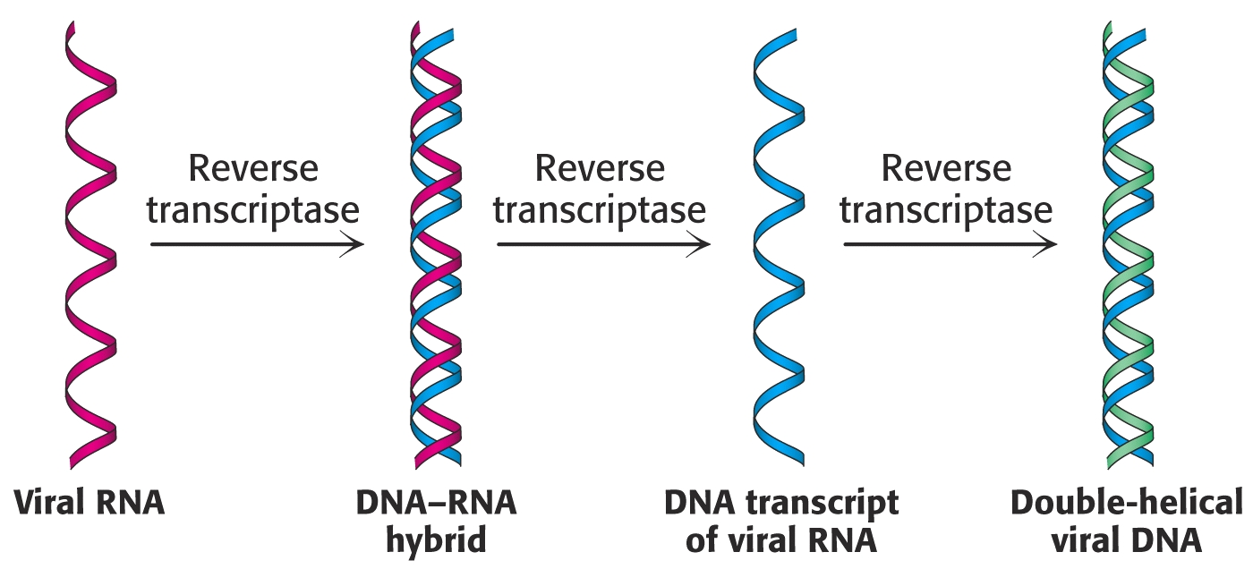
Gene Expression
While this concept is generally true, exceptions have been discovered over the years.
The genes of some viruses are made of RNA.
These genes are copied over to DNA by means of an RNA-directed DNA synthetase called “reverse transcriptase.”

Slide 58
Gene Expression
RNA is “ribonucleic acid.” It differs from DNA in the type of sugars it contains and its base composition.
The ribose sugars in RNA contain a hydroxyl group at the #2 ring position. (DNA does not.)
Uracil is present in RNA instead of Thiamine found in DNA.
Most often RNA is single-stranded.
RNA is found throughout the cell, while DNA is normally confined to the nucleus and some other organelles in eukaryotes.
RNA molecules of various lengths and composition perform different duties in the cell.

Slide 59
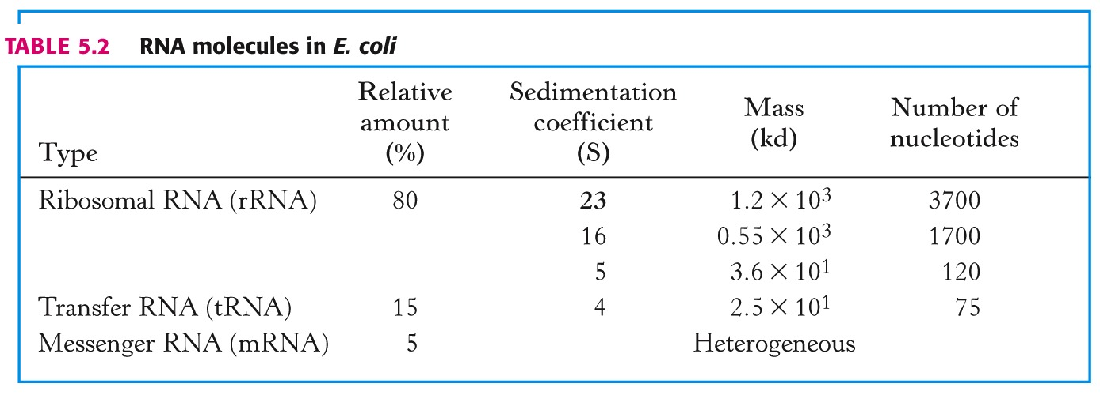
Gene Expression

Slide 60
Gene Expression
Types of RNA:
Messenger RNA (mRNA) – template for protein synthesis (“translation”)
Transfer RNA (mRNA) – transports amino acids in activated form to the ribosome for protein synthesis.
Ribosomal RNA (rRNA) – Major component of ribosomes, playing a catalytic and structural role in protein synthesis.
Small Nuclear RNAs – Play a role in guiding the splicing of messenger RNAs.

Slide 61
RNA Transcription
All RNA synthesis is catalyzed by a DNA-directed RNA synthetase enzyme named “RNA polymerase.”
RNA polymerase requires:
A template (a double or single strand of DNA)
Activated precursors (ATP, UTP, CTP, GTP)
A divalent metal ion (Mg²⁺ or Mn²⁺)
RNA polymerase binds to double stranded DNA and causes an unwinding and separation of the double helix.
When a “promotor site” is encountered on the DNA, it begins transcribing RNA by catalyzing the formation of phosphodiester bonds between the ribonucleoside triphosphates in a similar fashion to DNA synthesis.
RNA polymerization stops at “termination sites” located on the DNA that are recognized by RNA polymerase.

Slide 62
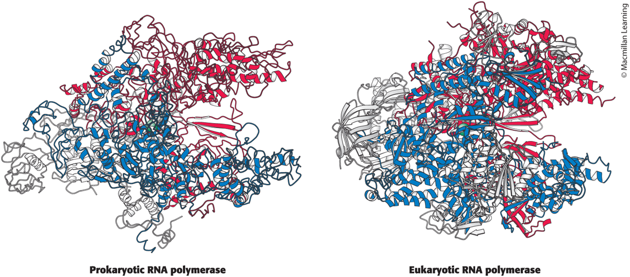
RNA Polymerase Structures in Prokaryotes and Eukaryotes
RNA Polymerase Structures in Prokaryotes and Eukaryotes Resemble Each Other

Slide 63
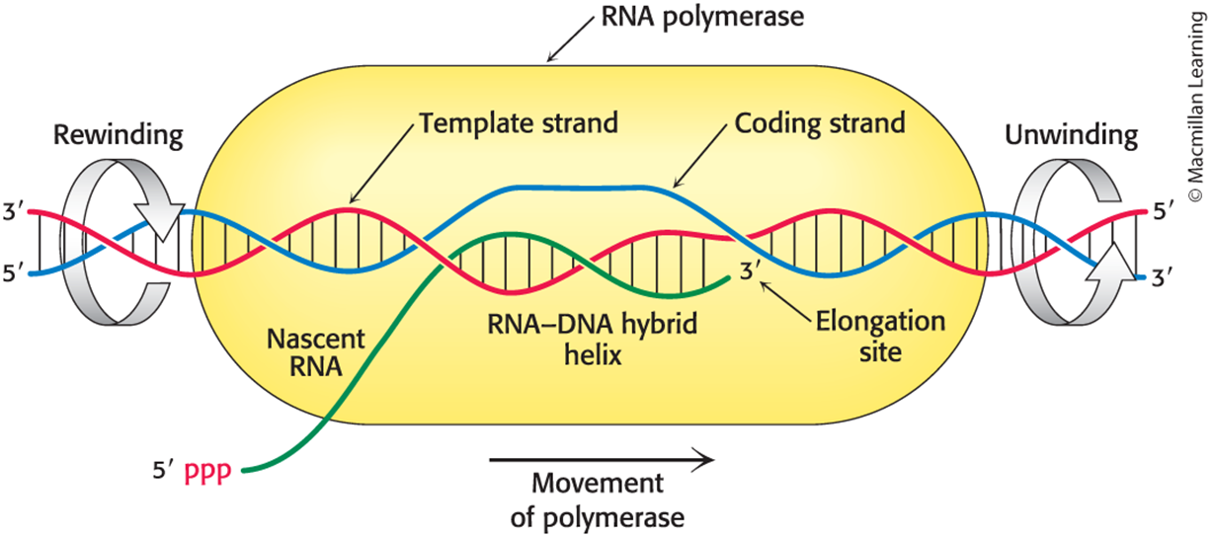
Transcription Bubble Moves With the RNA Polymerase
In this schematic representation of a transcription bubble in the elongation of an RNA transcript, duplex DNA is unwound at the forward end of RNA polymerase and rewound at its rear end. The RNA–DNA hybrid rotates during elongation.
Elongation occurs at a rate of ~50 nucleotides per second.

Slide 64
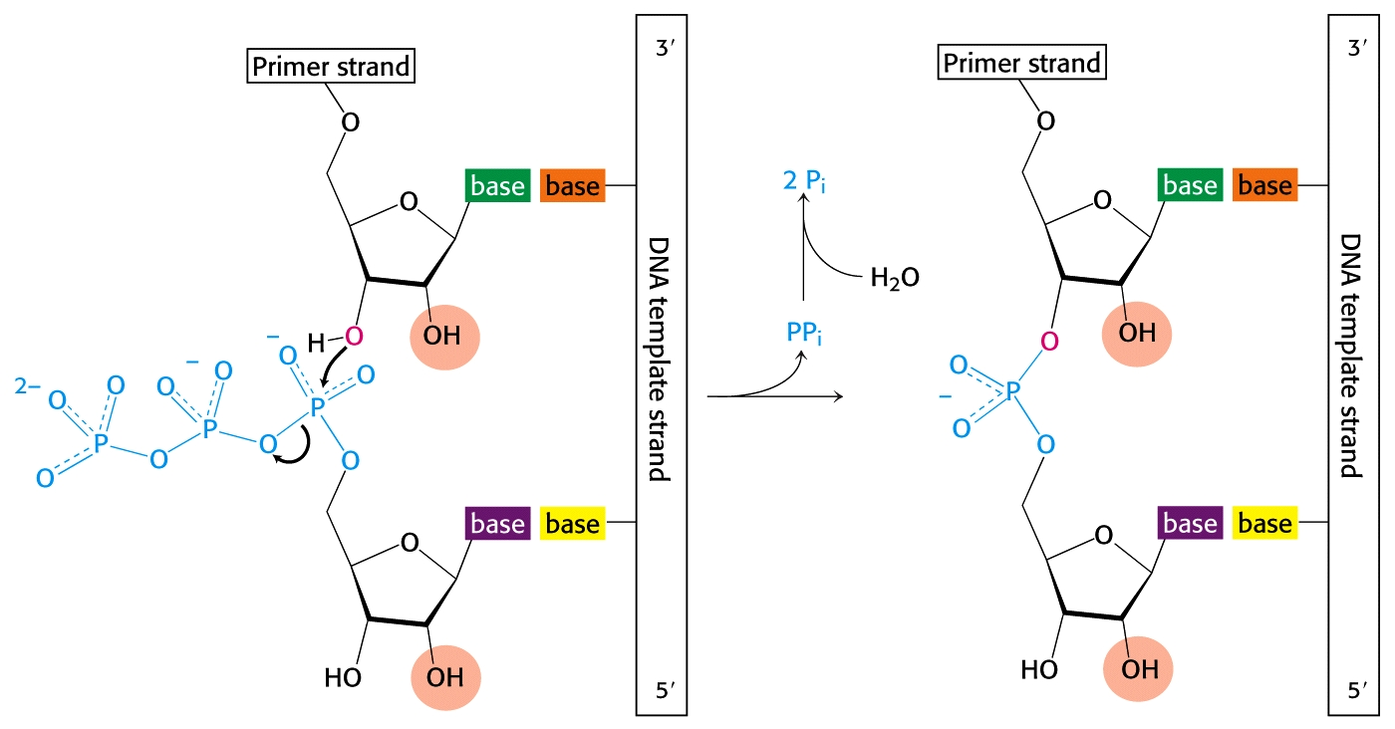
RNA Polymerization

Slide 65

Gene Expression
Promotor Sites on DNA identify initiation sites for transcription of RNA by RNA polymerase in both prokaryotes and eukaryotes.
Terminator Sites are also present on DNA that signal the end of transcription for RNA.
The sequence of DNA between these sites is a “gene” that codes for the production mRNA and eventually at least one protein.

Slide 66

Eukaryotic Promoters Differ Depending on the Type of RNA Polymerase

Slide 67

Gene Expression
In eukaryotes, the mRNA “primary transcript” is processed, resulting in structural changes on the way from the nucleus to the ribosomes in the cytosol:
A “cap” is added the 5’ end
A “poly(A) tail” is added to the 3’ end:

Slide 68
Gene Expression
Other modifications to eukaryotic RNA also occur as a result of processing as they traverse the nuclear membrane:
Internal “intervening” sequences named “introns” are removed and hence are not expressed in the protein structure.
The remaining segments are “spliced” back together to form the “mature” transcript.
Sequences that survive processing and are expressed in the mature transcript are called “exons.”

Slide 69

Gene Expression – Processing of RNA

Slide 70


Gene Expression
Introns were discovered through “hybridization” experiments:
Mature, processed RNA transcripts were mixed with the DNA that encoded their formation. Unbound loops in the DNA structure indicated the sites of the introns:

Slide 71

Processing of Eukaryotic Pre-rRNA Produces Mature rRNAs
The mammalian pre-rRNA transcript contains the RNA sequences destined to become the 18S, 5.8S, and 28S rRNAs of the small and large ribosomal subunits. First, nucleotides are modified: small nucleolar ribonucleoproteins methylate specific nucleoside groups and convert selected uridines into pseudouridines (indicated by red lines). Next, the pre-rRNA is cleaved and packaged to form mature ribosomes, in a highly regulated process in which more than 200 proteins take part.

Slide 72
RNA Molecules are Short Lived
RNA transcripts are relatively short-lived.
mRNAs diffuse to the ribosomes where they direct the synthesis of proteins.
RNAse enzymes in the cell eventually hydrolyze RNA molecules back into individual ribonucleoside monophosphates that are recycled. (Recall Anfinson’s enzyme, ribonuclease.)
Therefore, DNA ultimately controls what proteins are synthesized and their working concentrations in the cell.

Slide 73
tRNA “Adaptor” Molecules
If mRNA is directs protein synthesis, how is the information in the sequence of only four bases in nucleic acids “translated” into a sequence of 20 amino acids in proteins?
In 1958 Francis Crick postulated that complementary base pairing between RNA bases was the key to translation. Twenty different “adaptor” molecules would be needed to specify arrangement of 20 different amino acids.
Eventually, tRNA molecules with complementary binding sites were identified as these “adaptors.”

Slide 74


tRNA Structures
Secondary Structure
Tertiary Structure
Alexander Rich at MIT solved the tertiary structure of mRNA in 1974. He also discovered z-DNA, polysomes, and RNA-DNA hybridization, which is the fundamental principle of modern lab techniques such as PCR, DNA sequencing, and Northern blots.

Slide 75
tRNA Primary & Secondary Structures
All tRNAs share some common traits:
Each is a single chain containing 73-93 ribonucleotides (~25kD)
tRNAs contain many unusual bases (not just A,U,C,G) For example, some are methylated derivatives.
The 5’-end is phosphorylated (usually pG).
The 3’-end terminates with –CCA-OH.
An activated amino acid is attached to the 3’-end via an ester linkage.
tRNAs form regions of double-stranded helicies. This results in “hairpin” loops.

Slide 76

tRNA Tertiary Structure
tRNA Molecules are “L-shaped.”
Two regions of the molecule contain double-helix segments.
The CCA terminus extends from one end of the “L,” where the appropriate amino acid is attached.
Activated amino acids are attached to the CCA terminus by highly specifc “aminoacyl-tRNA synthetases” that sense the anticodon [and other bases throughout the molecule].
The “anticodon” loop is at the other end of the “L.”
Stryer, Chapter 29

Slide 77
mRNA Translation: The Genetic Code
Why are three bases needed in the codons of mRNA to specify amino acid sequences?
Consider the possible combinations of the four bases possible in a hypothetical codon:
One base: 4¹=4 combinations
Two bases: 4²=16 combinations
Three bases: 4³=64 combinations
Only three base sequences have sufficient combinations to code for 20 amino acids.

Slide 78

mRNA Translation: The Genetic Code
Features of the “Genetic Code:”
Three nucleotides encode one amino acid.
The code in non-overlapping:
The code has no punctuation.
The code is degenerate.
The code is nearly universal.

Slide 79


Slide 80
Genetic Code Degeneracy
64 codons obviously exhibit redundancy. For example, all the following codons code for serine (ser): UCU
UCC
UCA
UCG
Such redundancy can help avoid errors in protein expression (especially if the mutation occurs in the third base position).

Slide 81
The Genetic Code
The Genetic Code also contains “start” and “stop” signals:
Start: AUG (fMet)
Stop: UAA, UAG, UGA.
Once translation has begun, the “reading frame” is established, and no spaces or punctuation is needed. The sequence is read like a long sentence of three-letter words without spaces:
e.g, “Theredfoxatethehenandtheegg.”

Slide 82
The Genetic Code
The Genetic Code also contains “start” and “stop” signals:
Start: AUG (fMet)
Stop: UAA, UAG, UGA.
Once translation has begun, the “reading frame” is established, and no spaces or punctuation is needed. The sequence is read like a long sentence of three-letter words without spaces:
e.g, “Theredfoxatethehenandtheegg.”
The red fox ate the hen and the egg.”

Slide 83

The Genetic Code is Universal
The Genetic Code seems to be universal, with the exception of mitochondrial RNA sequences:

Slide 84


Translation: Proteins are synthesized at the Ribosome
Ribosomes are composed of about two parts (2/3) rRNA to one part (1/3) protein.
rRNA provides much of the catalytic role.
Two large parts, 30S and 50S, come together to form the large, active 70S complex for protein synthesis.
30S
50S
70S

Slide 85

Translation: Protein Synthesis at the Ribosome
Prokaryotic protein synthesis begins with the formation of the ribosome complex:
mRNA and fMet tRNA (along with other initiation factors) bind to the 30S subunit.
The larger 50S subunit then joins into the complex.
Stryer, Chapter 29

Slide 86

Translation: Protein Synthesis at the Ribosome
Ribosomes have three important sites:
Site “A” – Aminoacyl site
Site “P” – Peptidyl site
Site “E” – Exit site

Slide 87

Translation: Protein Synthesis at the Ribosome
Peptide Bond Formation:

Slide 88

Translation: Protein Synthesis at the Ribosome
Stryer, Figure 30.24, 10th ed

Slide 89

Translation: Protein Synthesis at the Ribosome
The growing peptide extends through the “tunnel” in the 50S subunit:

Slide 90

Transcription & Translation in Bacteria
Since prokaryotes have no nucleus and do not process primary mRNA transcripts, translation can begin even before transcription is complete!
Consider the photomicrograph of transcription and translation in E. coli bacteria:

Slide 91

Eukaryotic protein synthesis is similar to prokaryotic protein synthesis, except in translation initiation:
Eukaryotics utilize many more initiation factors.
Eukaryotics ribosomes are larger: 40S + 60S = 80S.
The initiating amino acid is methionine, rather than N-formylmethionine.

Slide 92

The differences between eukaryotic and prokaryotic ribosomes can be exploited for the development of antibiotics.

Slide 93


2023 Nobel Prize in Physiology or Medicine: Katalin Karikó & Drew Weissman
Historically, vaccines have used portions of molecules such as proteins or glycans from the surface of viruses or bacteria to train the immune system.
What about injecting RNA and letting cells make the antigenic proteins?
Our immune systems detect and degrade laboratory-produced RNA, which leads to an inflammatory response.
Karikó and Weissman collaborated to try to use RNA to produce vaccines that could be adapted more quickly. They combined Karikó’s expertise in RNA biochemistry with Weissman’s in immunology.
in 2005 in Immunity, the pair proved that it was the lack of base modifications in synthetic RNA that made it immunogenic. They showed that converting the RNA base uridine to pseudouridine in mRNA produced in vitro could reduce the inflammatory response (DOI: 10.1016/j.immuni.2005.06.008).
Overall, N1-methyl-Ψ is more like uridine in translation coding but at the same time, behaves like Ψ that prevents the mRNA from triggering the immune response which is of critical importance to RNA vaccines and therapies.

Slide 94



C)VID-19 mRNA Vaccine
COVID-19 mRNA vaccine tozinameran (BNT162b2) from Pfizer/ BioNTech®, where
Ψ indicates N1-methyl-30 -pseudouridine.
This sequence has 4250 nucleotides: Adenine A, Cytosine C, Guanine G and Pseudo-uridine Ψ.
An amino-acid modification of the Spike protein mRNA is indicated in red.

Slide 95
Basic Research is Sometimes Not Recognized for its Value
A lot of people do great science, but they may or may not be fundable based on today’s criteria.
“We couldn’t get funding; we couldn’t get publications; we couldn’t get people to recognize RNA as something interesting,” Weissman said at a press conference sponsored by the University of Pennsylvania on the day the prize was announced.
Karikó had such difficulty funding her research that she had to leave the University of Pennsylvania; she found work at German company BioNTech. (Something that U Penn regretted later…)
This is a wonderful example of people sticking to their guns, and continuing to work in areas that they believed were important.
Vaccines can be designed, modified and produced in weeks instead of years.
Randy Schekman, who received the 2013 Nobel Prize in physiology or medicine, said: “This morning’s [Nobel] announcement is a welcome antidote to the toxic nonsense spread by vaccine skeptics who use misinformation to sow confusion and doubt.”

Slide 96
End of Lecture Slides
for
Nucleic Acids
Credits: Most of the diagrams used in these slides were taken from Stryer, et.al, Biochemistry, 5th Ed., Freeman Press, Chapters 5, 28, & 29 (in our course textbook).

