Slide 1
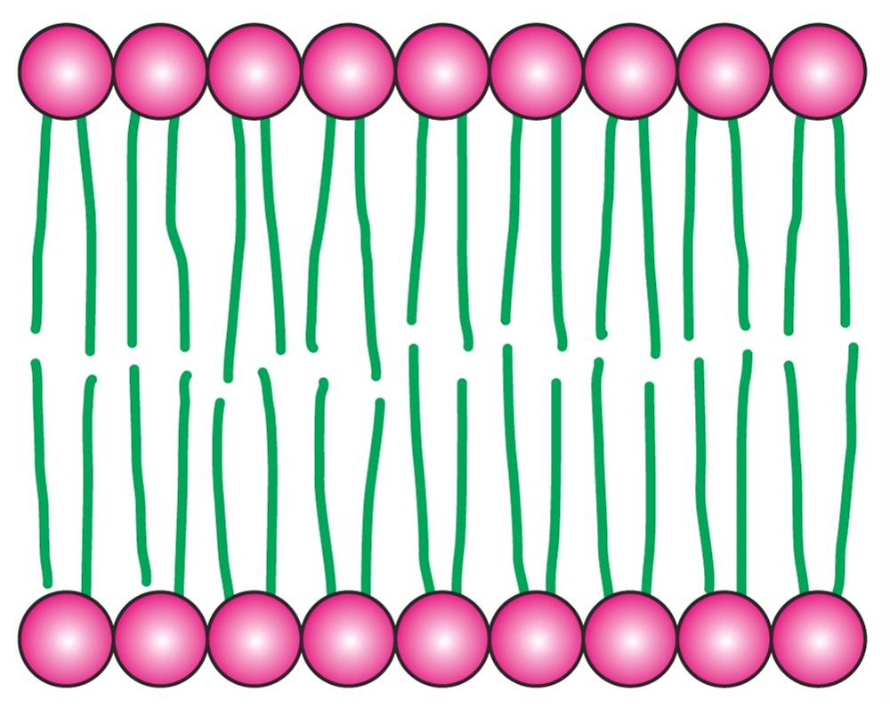
Biochemistry 3070
Lipids & Biological Membranes

Slide 2
Lipids – Their Roles in Living Systems
Lipids are oil-soluble [hydrophobic] organic substances (soluble in CHCl₃, CCl₄, hexane, ether, etc.)
Lipids form membrane barriers between cellular compartments.
Lipids are an excellent, high-Calorie energy storage medium.
Lipids act as lubricants.
Lipids surround many organs, providing thermal insulation and protecting from mechanical shock.
Certain lipids are hormones (chemical messengers)

Slide 3
Lipids
Some lipids are “fats.” Fat [fatty tissue] is composed of lipids and is generally a solid at room temperature.
Oils are composed of lipids that have lower melting points. As such, oils tend to be liquids at room temperature.
Unsaturation (double bonds) contributes to lower melting points, hence oils are often said to contain “polyunsaturates.”

Slide 4
Lipids – Quantitative Testing in Foods
The “fat” content of foods is determined by simple extraction.
A “serving size” sample of food is extracted in hexane for a an extended period of time. The hexane solution is separated from the food and the hexane is then evaporated. The mass of residual materials is collectively called the fat content. (grams of fat / serving size)
Question: How could someone process a food (e.g., a beef steak) so as to make it “low fat?”

Slide 5
Lipids - Classification
LIPIDS
SAPONIFIABLE
NON-SAPONIFIABLE
GLYCEROL ESTERS
NON-GLYCEROL ESTERS
FATS & OILS
WAXES
STEROIDS
PHOSPHOGLYCERIDES
SPHINGOLIPIDS
PROSTAGLANDINS

Slide 6
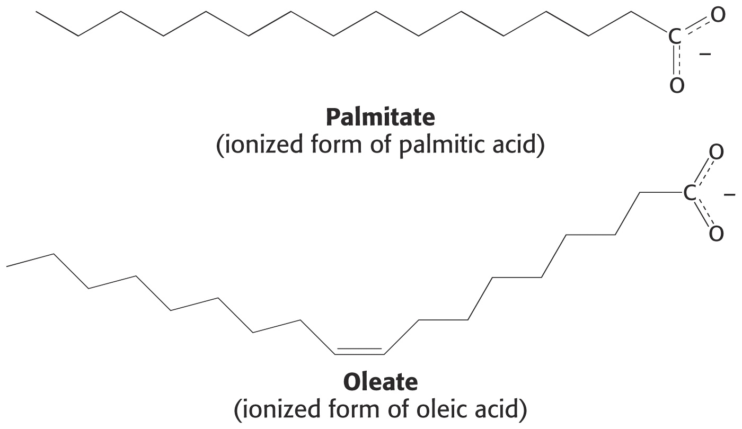
Lipids- Fatty acids
Fatty acids are the primary component of lipids.
They are long-chain carboxylic acids with different degrees of saturation.
Almost all double bonds in naturally-occurring fatty acids are in the “cis” configuration.

Slide 7
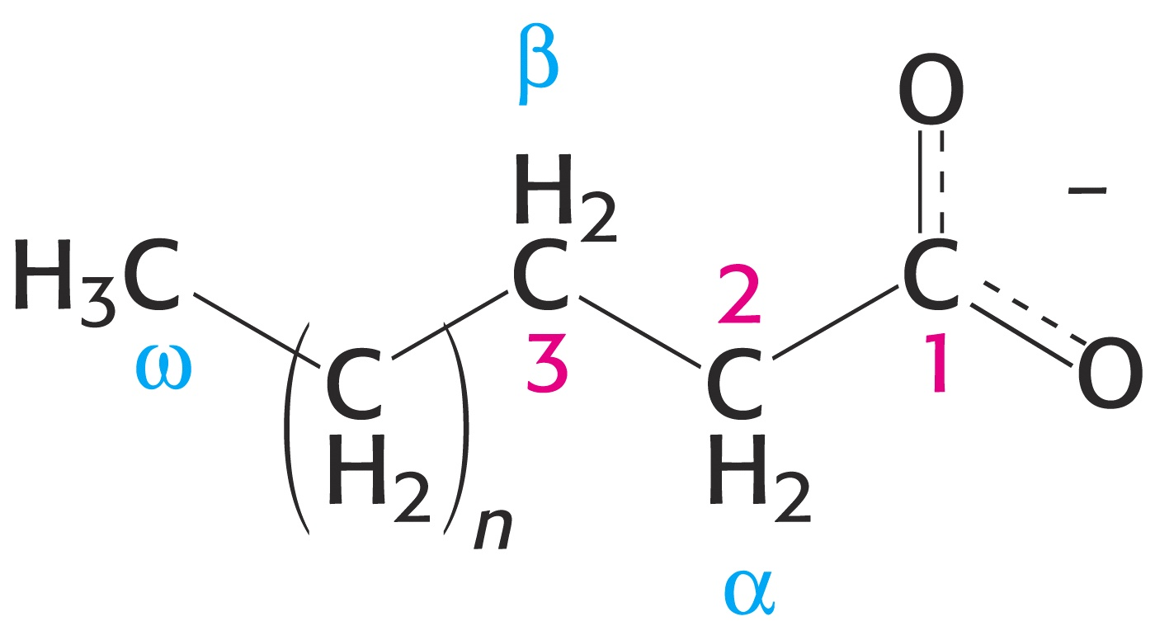
Lipids – Fatty Acid Nomenclature
The IUPAC numbering system assigns #1 to the carbonyl carbon. However, biochemists use the Greek alphabet to label carbons, starting with the #2 or “alpha” carbon:

Slide 8
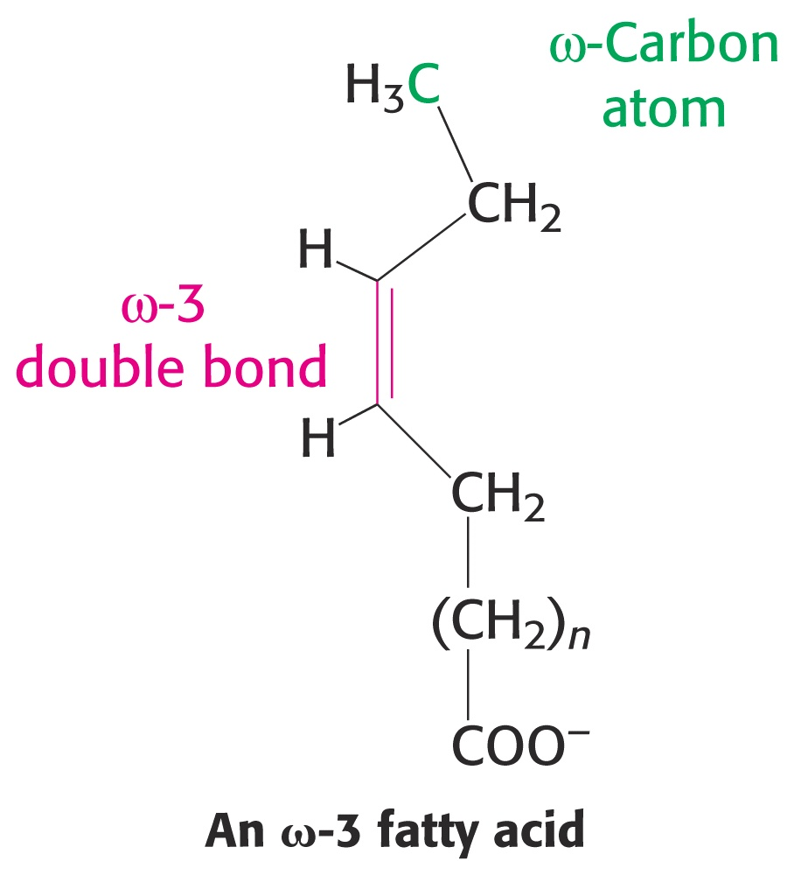
Lipids – Fatty Acid Nomenclature
The terminal carbon is always named the “omega” (ω) carbon (the last letter in the Greek alphabet).
Double bonds are often identified by their distance from the ω-carbon.
e.g.,“ω-3 double bond.”

Slide 9
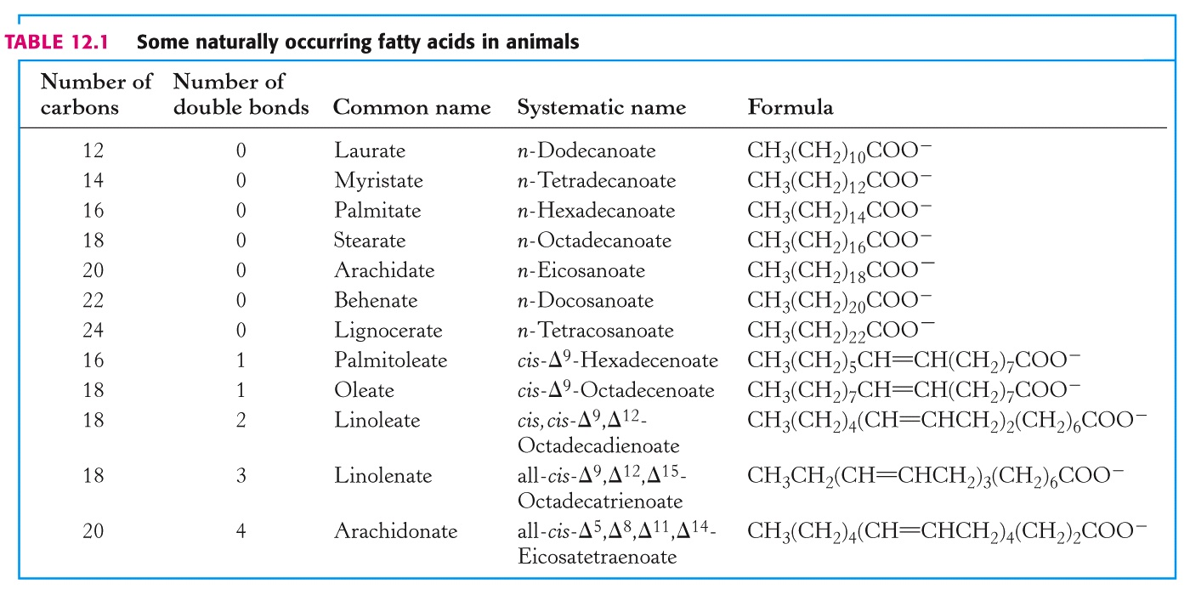
Lipids – Fatty Acids

Slide 10
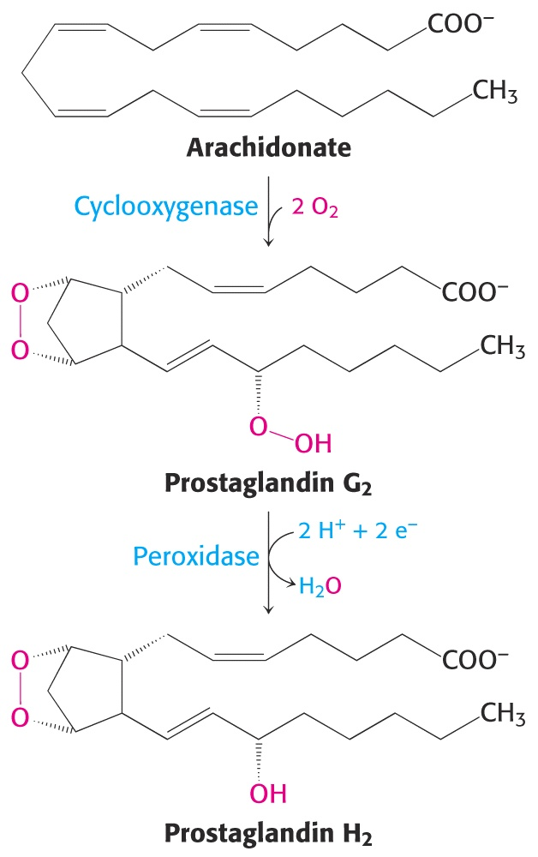
Lipids – Synthesis of Prostoglandin H₂ from Arachidonic acid
The unsaturated C₂₀ arachidonic acid is the precursor for Prostaglandin H₂, which promotes inflammation and modulates gastric acid secretion.
Aspirin and ibuprofen inhibit the first enzyme is this pathway, prostaglandin H2 synthetase.
“Arachidonic” is derived from the Latin name of arachis (peanut.)

Slide 11
Lipids – Physical Characteristics
The “fluidity” [melting points] of lipids depends upon their chain length and degree of unsaturation.
Consider the melting points of two C-18 fatty acids:
Stearic acid (saturated): 69.6°C
Oleic acid (one double bond): 13.4°C
Shorter chains also decrease melting points:
Stearic acid (C-18): 69.6°C
Palmitic acid (C-16): 63.1°C

Slide 12
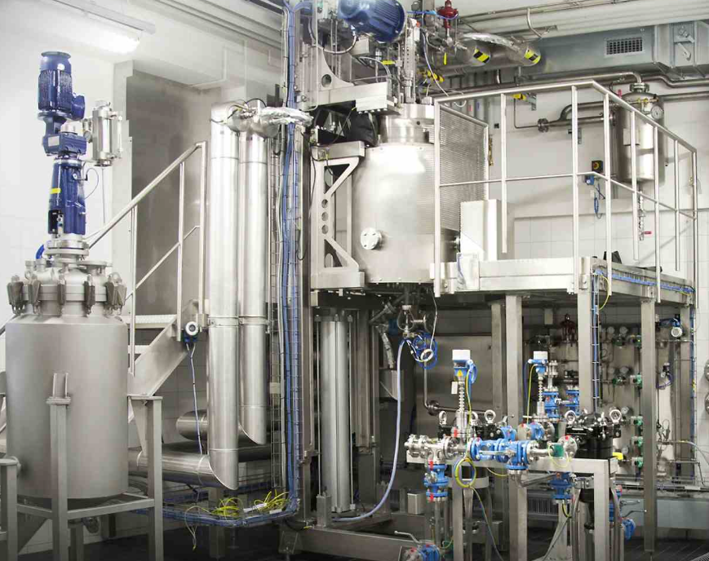
Lipids – Processing of Oils
Margarine is an emulsion of oil and water.
Water content of margarine also affects its texture and “melting” point. A wide variety of margarine products with different water contents are available in today’s market place.
Corn oil is a highly unsaturated liquid at room temperature and is the main source of oil for margarine.
In order to give margarine
a more palatable texture,
the oil is hydrogenated to
“reduce” the number of
double bonds.
Fewer double bonds
increase the “stiffness”
of the margarine.
“Soft spreads” have more
double bonds than
margarine “sticks.”

Slide 13
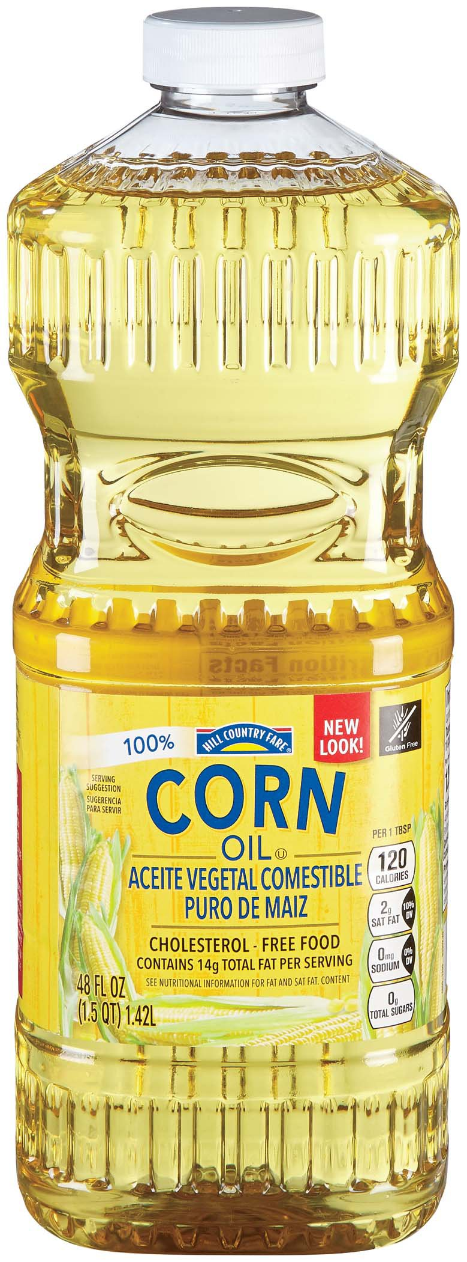
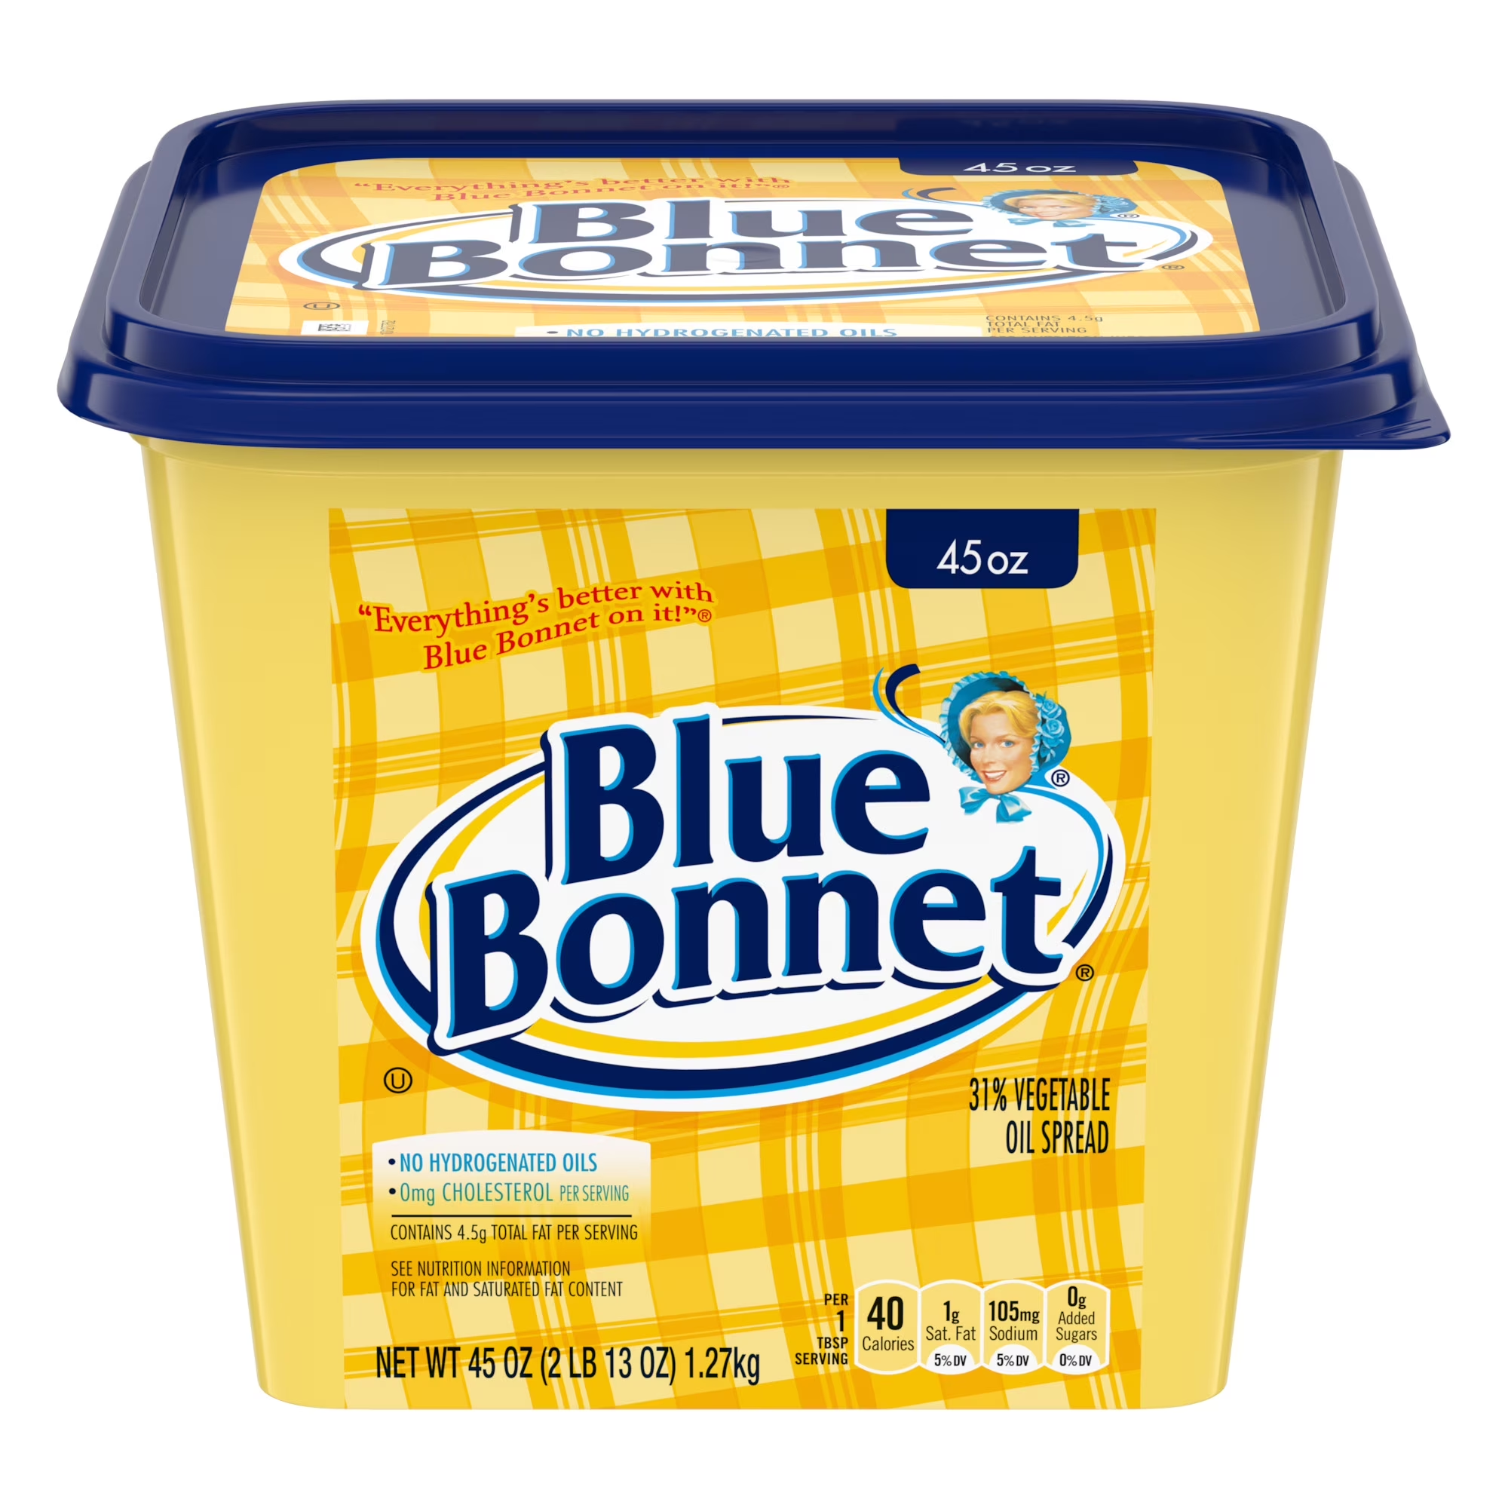
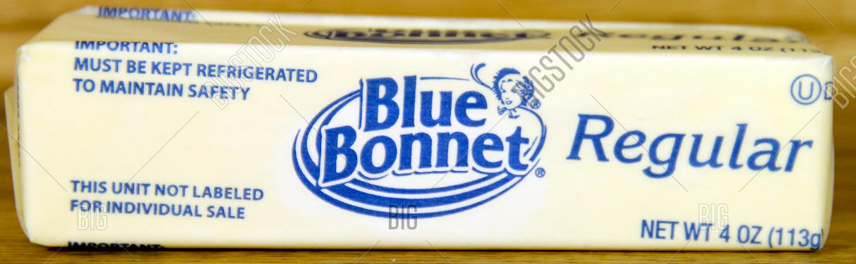
Lipids – Hydrogenation of Corn Oil to Make Margarine Soft Spread and Sticks
H₂
Fewer double bonds increase the “stiffness” of the margarine.
“Soft spreads” have more double bonds than margarine “sticks.”

Slide 14
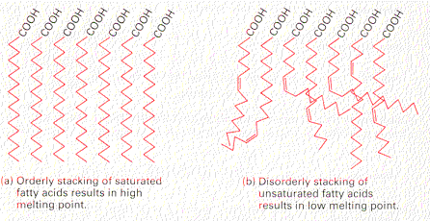
Lipids – Physical Properties
Cis-configured double bonds in fatty acids disrupt orderly stacking and associated induced dipole interactions that are responsible for the higher melting points of lipids:

Slide 15
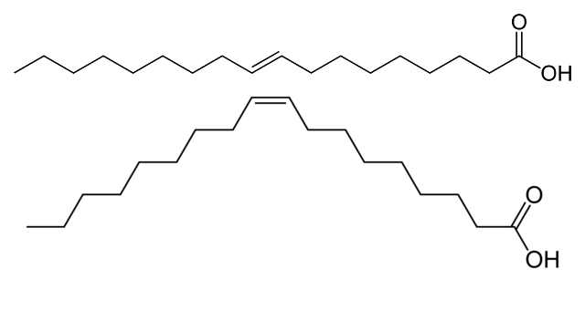
Lipids – Processing of Oils
Catalytic hydrogenation of oils converts double bonds into single bonds. Some reactions are unsuccessful, forming an sp³ (singly-bonded) intermediate that rotates to a trans- configuration before returning to a double bond.
Recall that all naturally occurring double bonds are in the energetically less-favorable “cis-” configuration. Double bonds that reform during catalytic hydrogenation take on the more energetically favorable “trans-” configuration. It has been recently suggested that trans-double bonds are indicators of “processed” foods and are not truly “natural.”

Slide 16
Lipids – Iodine Numbers
Iodine reacts with the double bonds in lipids. The degree of unsaturation is often measured in the lab by titrating the double bonds with I₂.
An “iodine number” is often assigned to fats and oils to indicate the degree of unsaturation. The “iodine number” is the number of grams of iodine that reacts with 100 grams of the fat or oil.
-CH=CH- + I₂ → -CHI-CHI-

Slide 17
Lipids – Iodine Numbers
Iodine Numbers of selected Fats and Oils:
Fat or Oil | Iodine Number
Butterfat | 32-35
Beef Tallow | 40-42
Lard | 55-65
Chicken Fat | 65-75
Olive Oil | 80-88
Corn Oil | 100-125
Cottonseed Oil | 100-110
Soybean Oil | 120-140
Safflower Oil | 142-146

Slide 18
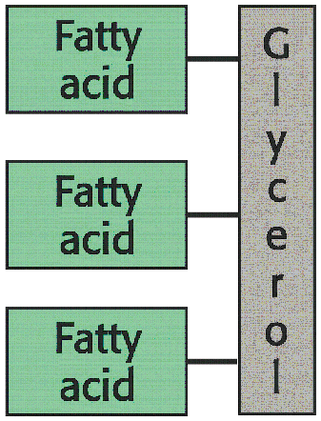
Lipids - Triglycerides
The most common storage form of fats are “triglycerides.”
Triglycerides are tri-esters of glycerol. Three fatty acids are esterified to glycerol, one to each alcoholic group:

Slide 19
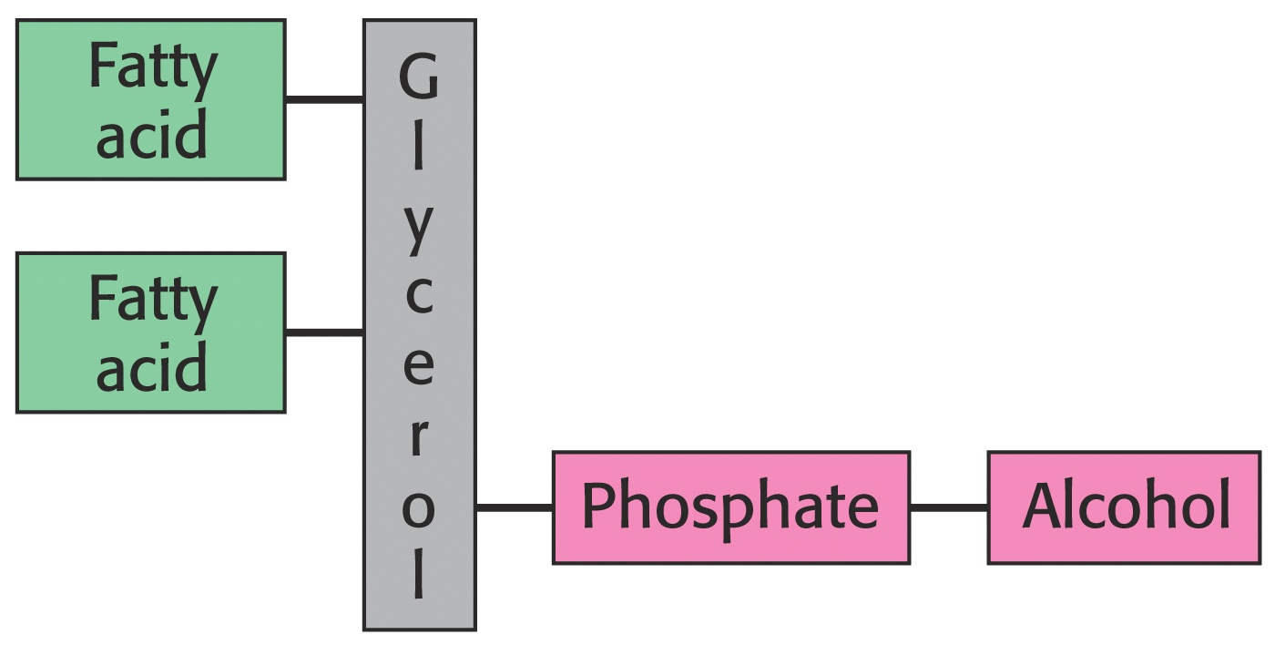
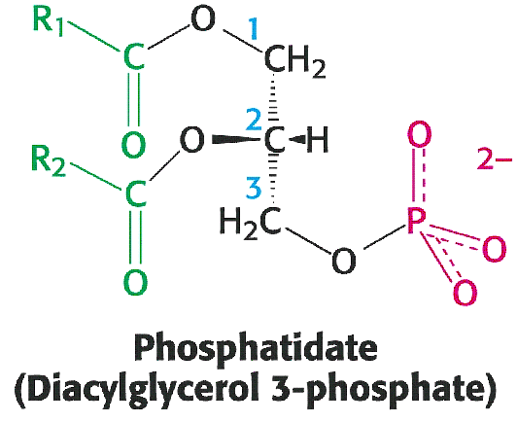
Lipids - Phosphoglycerides
Many lipids, such as most of those found in membranes are diacylphosphoglycerides.
Two acyl groups (fatty acids) are esterified to carbon atoms #1 and #2.
The third position of glycerol is esterified to phosphoric acid.
Most often, an alcohol is esterified to the other side of phosphoric acid.

Slide 20
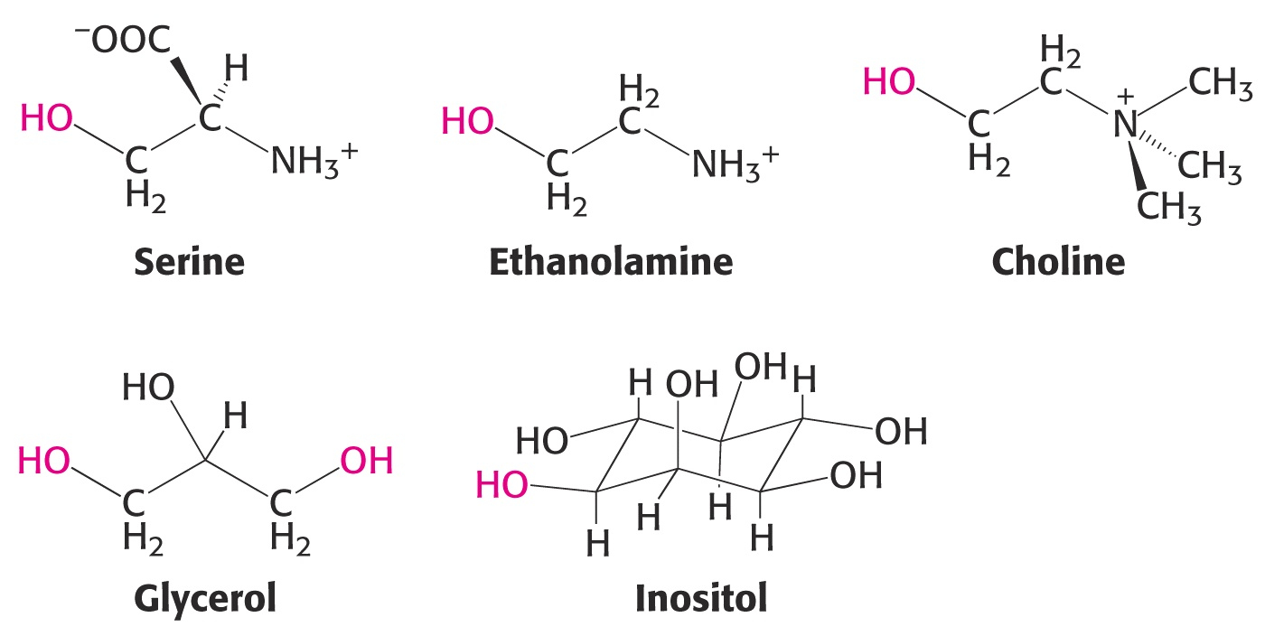
Lipids - Phosphoglycerides
A variety of different alcohols may be part of the phophoglyceride structure:

Slide 21
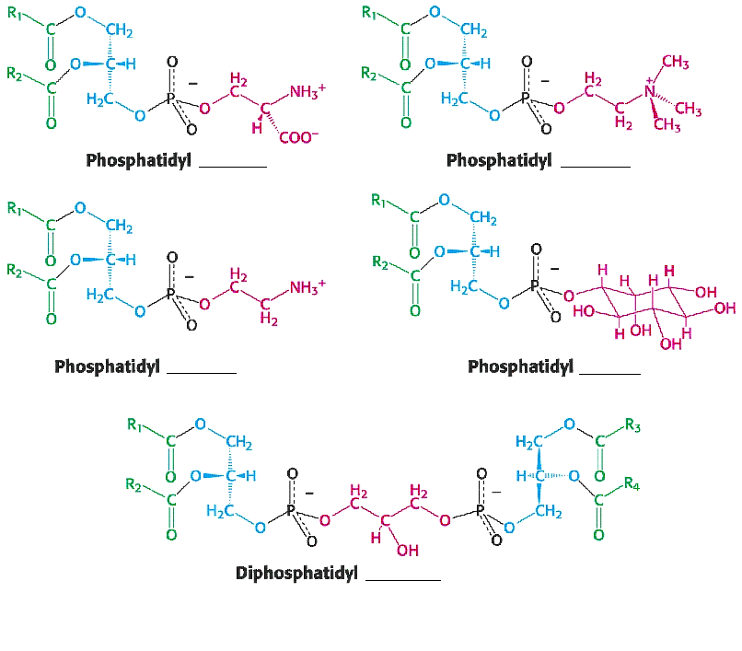
Phospholipid Nomenclature – Complete the names of these phospholipids:

Slide 22
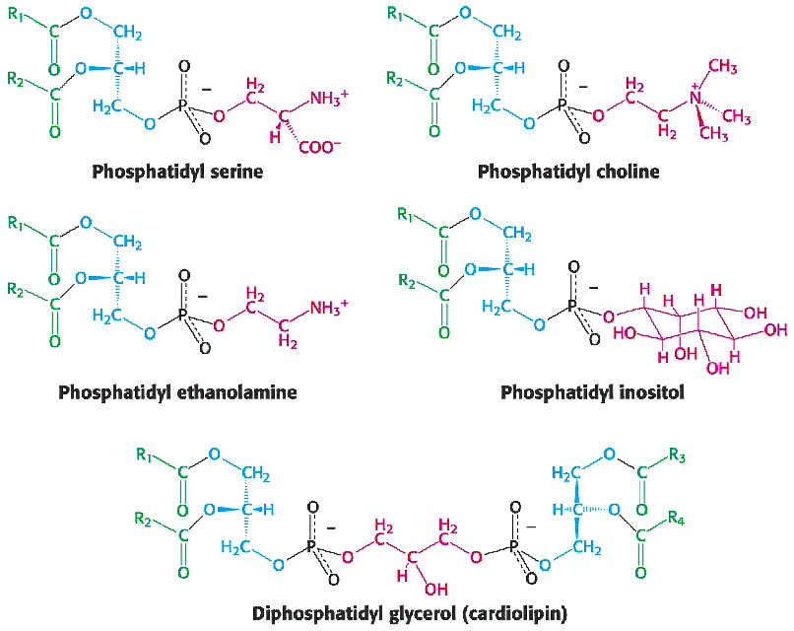
Phospholipid Nomenclature

Slide 23
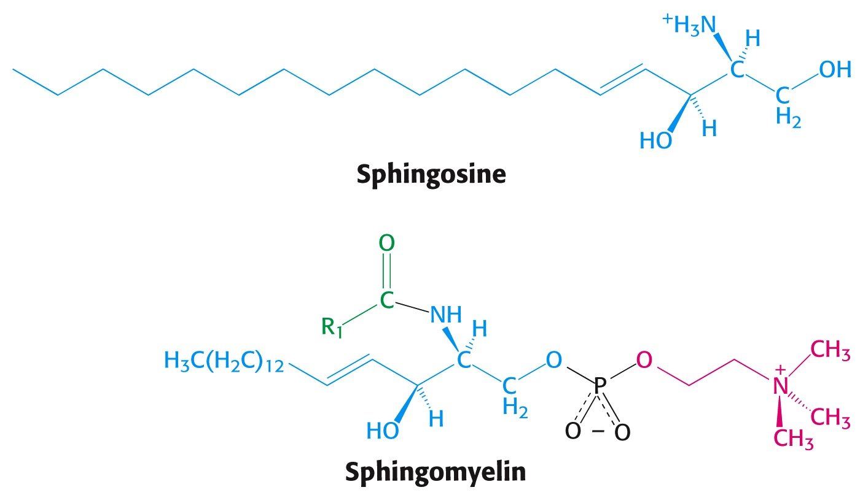
Lipids - Sphingosine
Another class of saponifiable lipids are build around sphingosine, rather than glycerol.
Sphingomyelin contains a phosphocholine ester and a second fatty acid linked by an amide bond.
Amide Bond

Slide 24
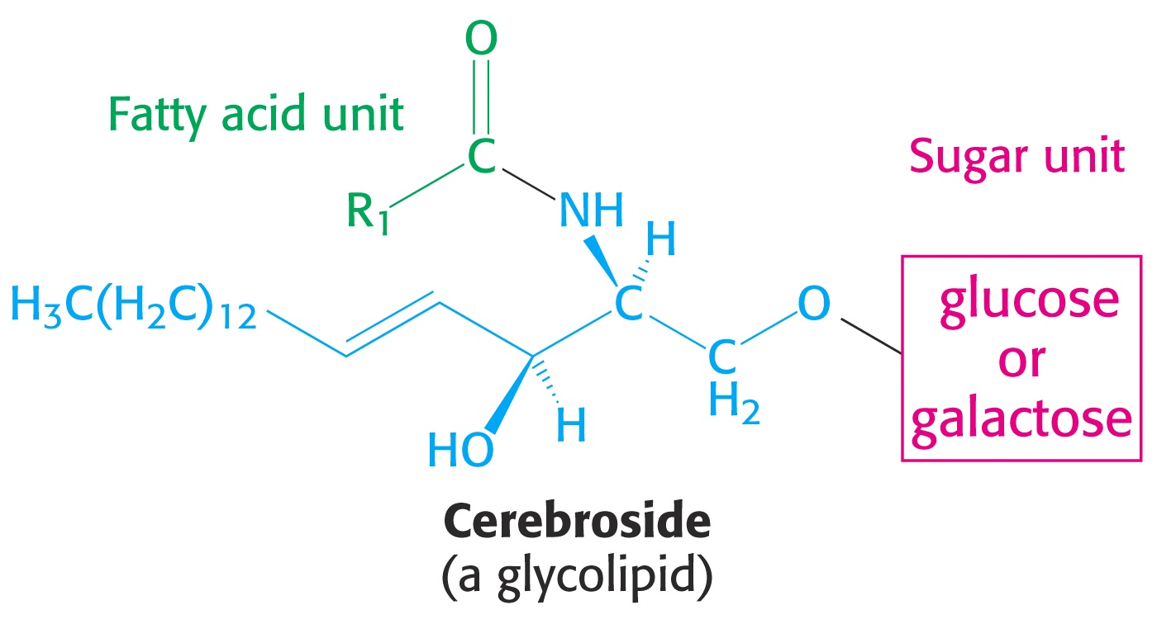
Lipids - Cerebroside
Cerebrosides are glycolipids constructed from sphingosine, a fatty acid, and a carbohydrate:

Slide 25
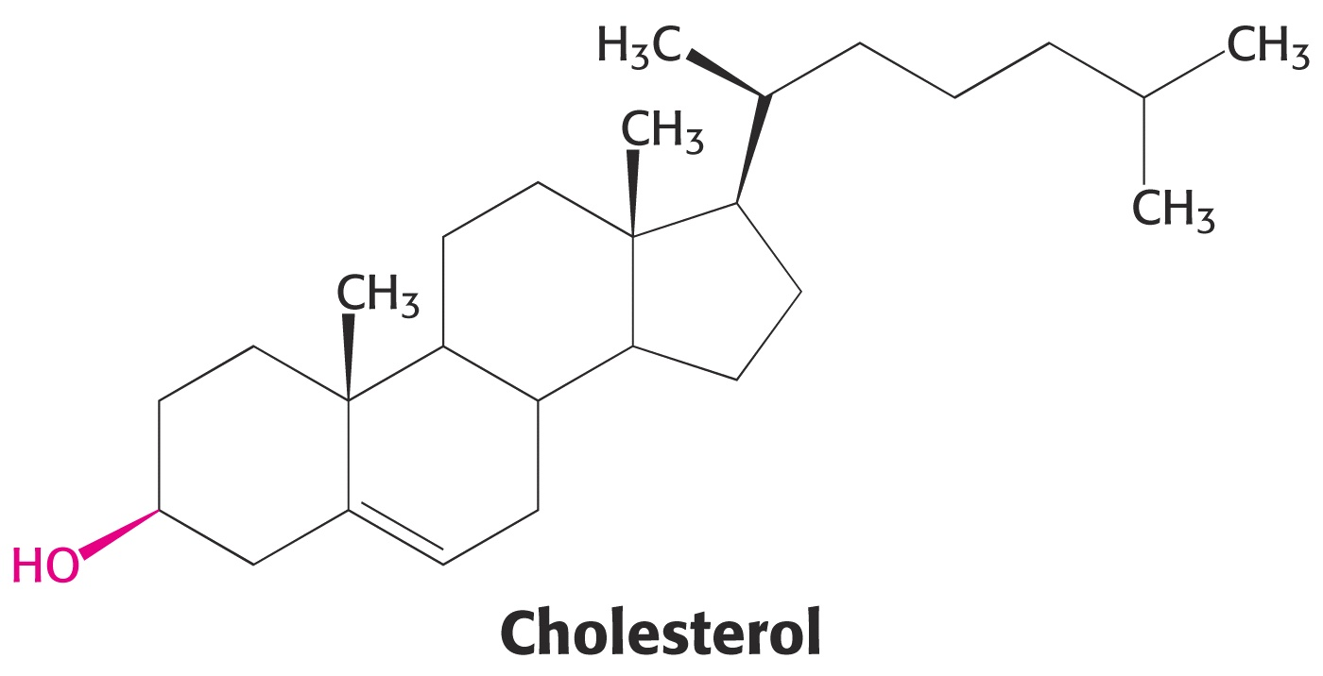
Lipids - Cholesterol
Cholesterol is a lipid with an entirely different structure from the lipids we have discussed so far. It is a steroid, composed of four fused hydrocarbon rings.
Cholesterol is synthesized by animals, but is not present in plants or prokaryotes.
Cholesterol is the starting material for the biosynthesis of steroidal hormones, vitamin D, and bile salts.

Slide 26
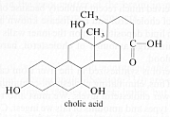
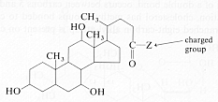
Lipids - Bile Salts
Fresh bile from the liver is yellow, but upon standing turns green and finally brown. The body excretes 0.5-2.0 grams of bile daily and is responsible for the characteristic color of feces.

Slide 27
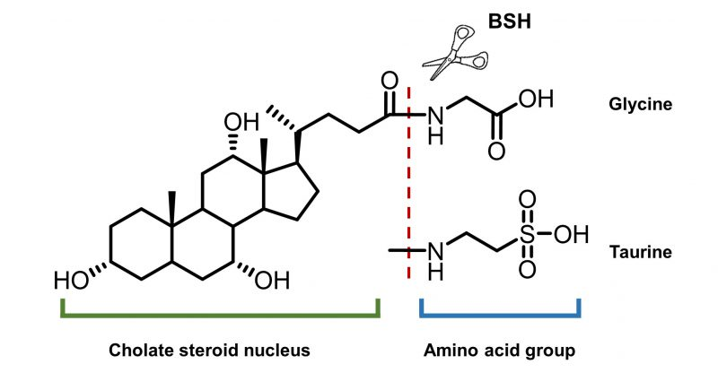
Lipids - Bile Salts
Bile salts are emulsifying agents that help solubilize dietary lipids in the aqueous environment of the digestive tract.

Slide 28
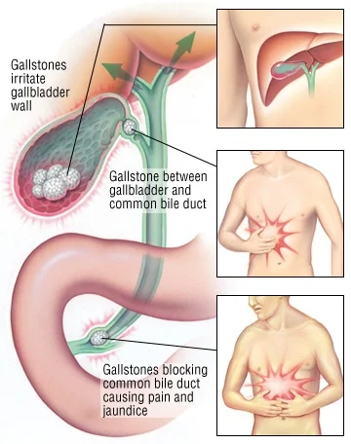
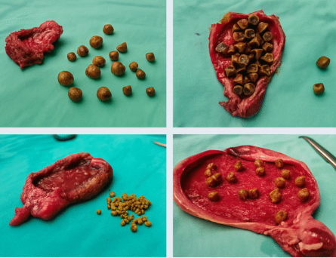
Lipids - Bile Salts
Bile salts are stored in the gall bladder. When needed, they are expelled into the duodenum. If cholesterol “stones” form in the gall bladder, they can block the exit causing significant discomfort (e.g., gall bladder attack)

Slide 29
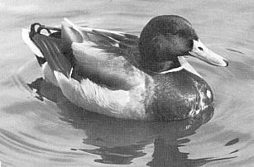
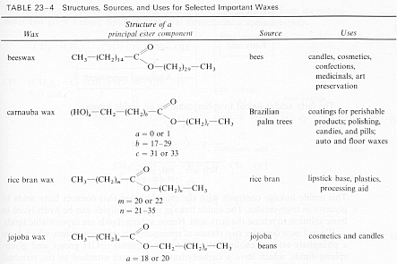
Lipids - Waxes
Waxes are esters of long-chain fatty acids and fatty alcohols. Waxes coat feathers, water-proofing birds and insulating them from cold water.

Slide 30
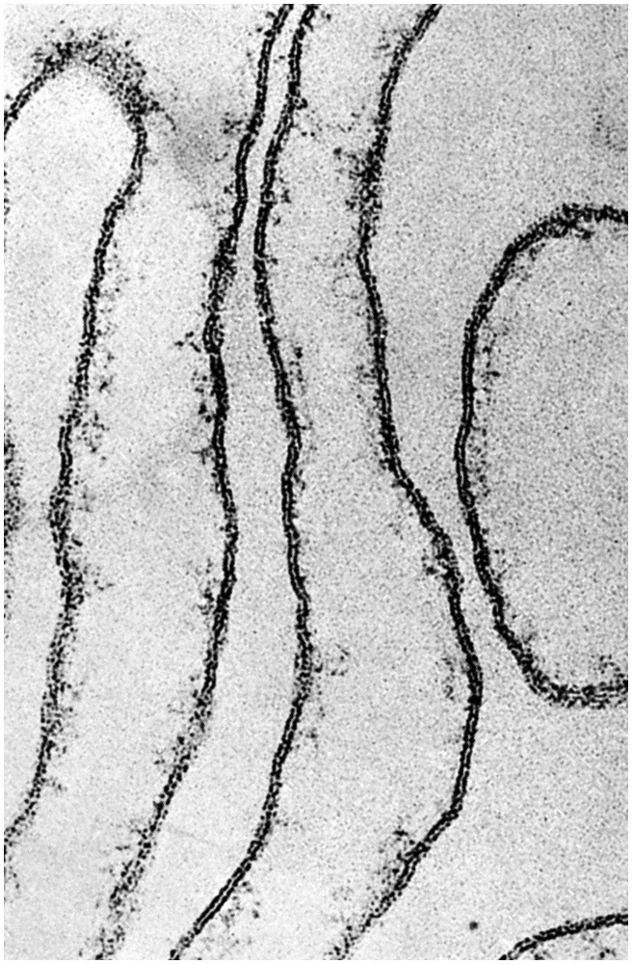
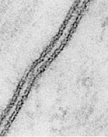
Membranes
Cells are surrounded by a membrane that confines their contents and separates them from the outside world.
Membranes have two layers and are composed of both lipids and proteins.

Slide 31
Membranes - Characteristics
Membranes...
are sheet-like structures, only two molecules thick.
consist mainly of lipids and proteins.
form spontaneously into lipid bilayers.
are non-covalent assemblies.
are asymmetric
are fluid structures.
are electrically polarized.

Slide 32
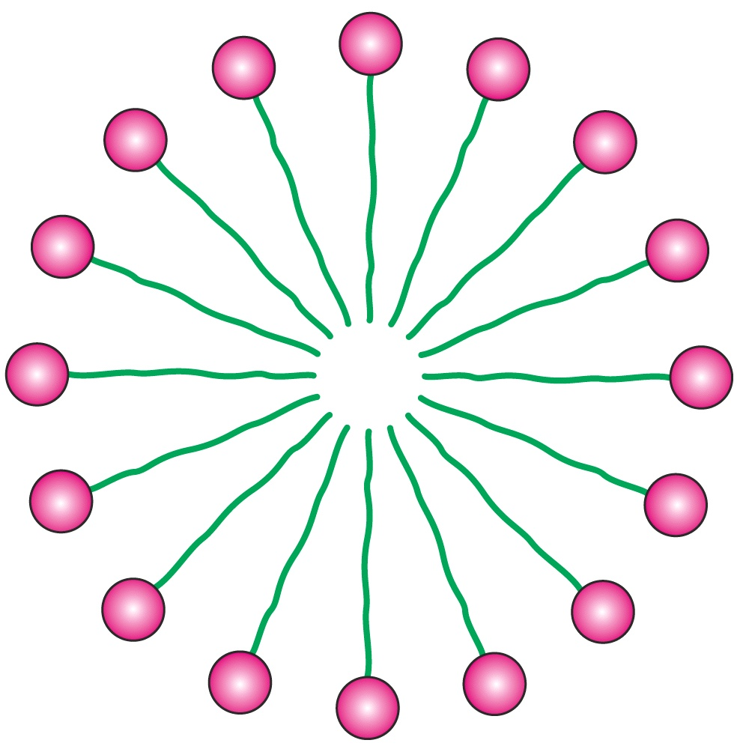
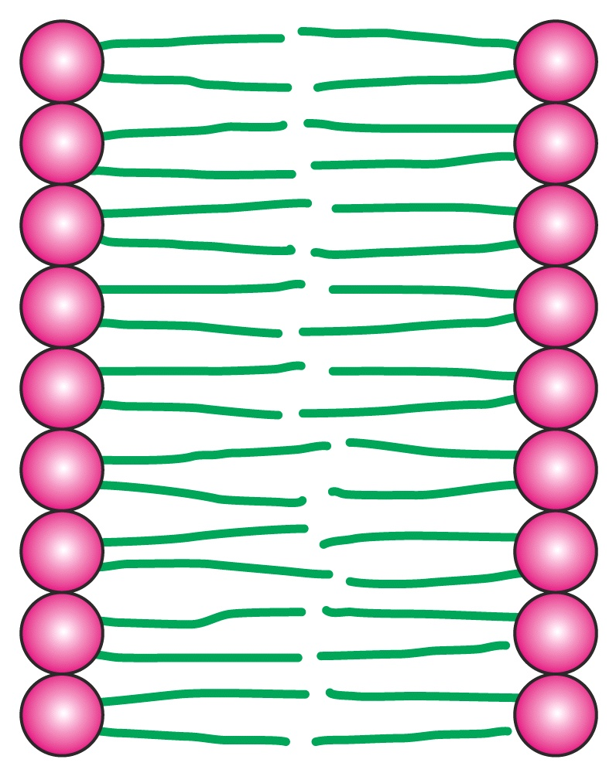
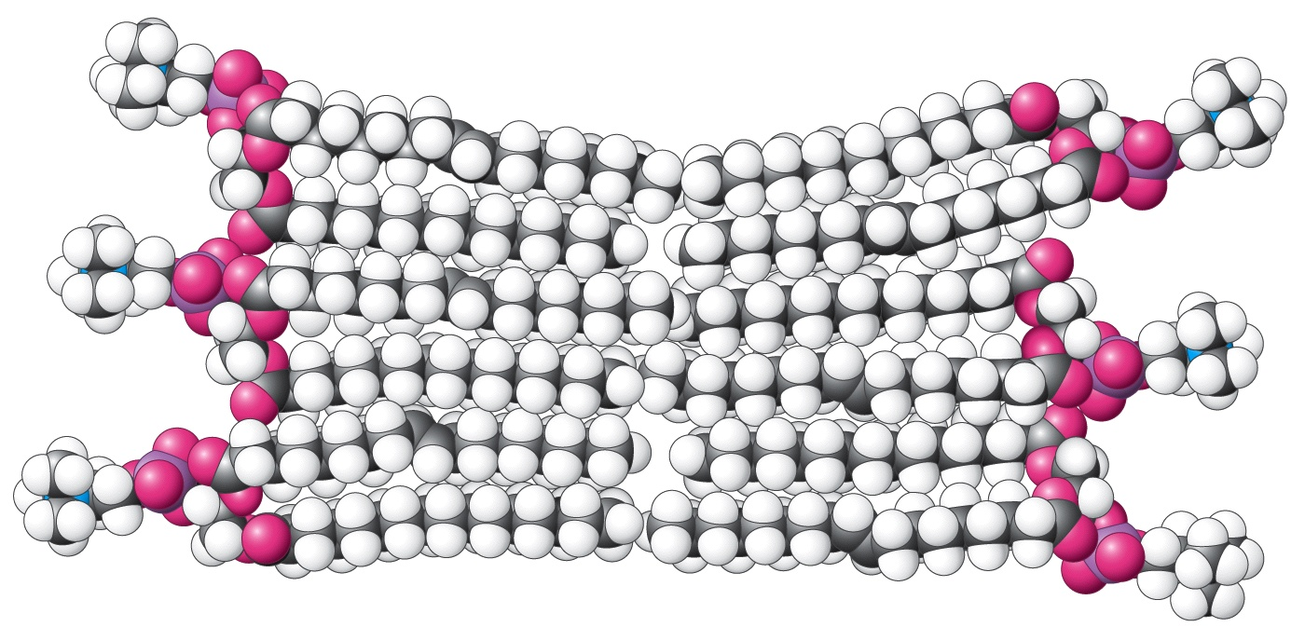
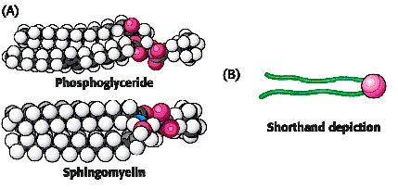
Membranes - Structure
Recall that lipids have both non-polar and polar regions in their structures.
Ionized lipids such as phospholipids spontaneously form micelles.
A similar structure forms in membranes.

Slide 33
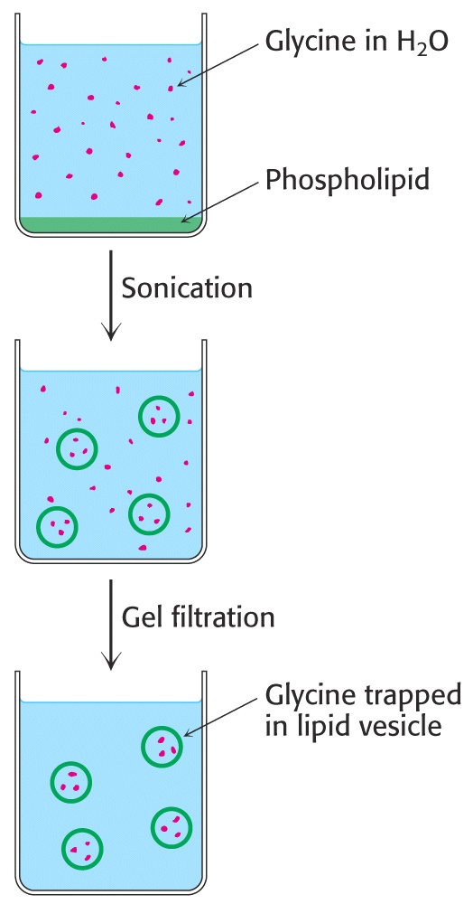
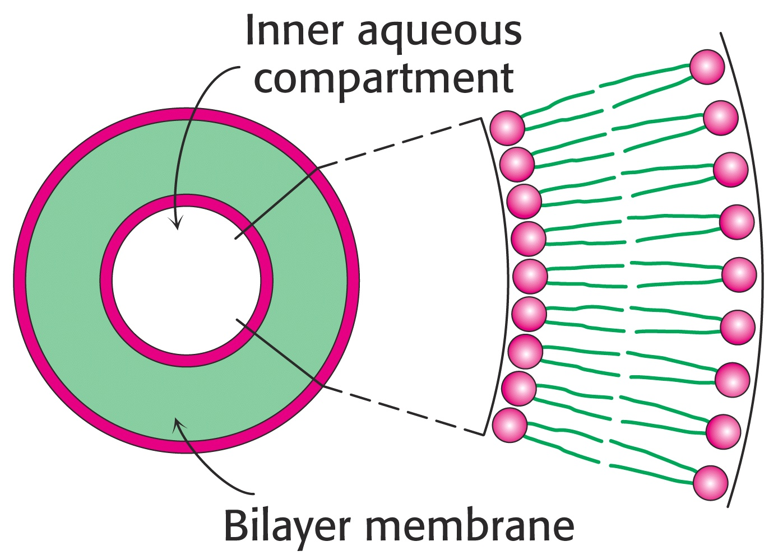
Membranes - Structure
Artificial lipid vesicles can be formed from phospholipids. Sonication of phospholipid suspensions yield “liposomes” that can trap aqueous solutions within their interiors.
Liposomes are useful for laboratory studies as model membranes. They also have promising potential as drug delivery systems.

Slide 34
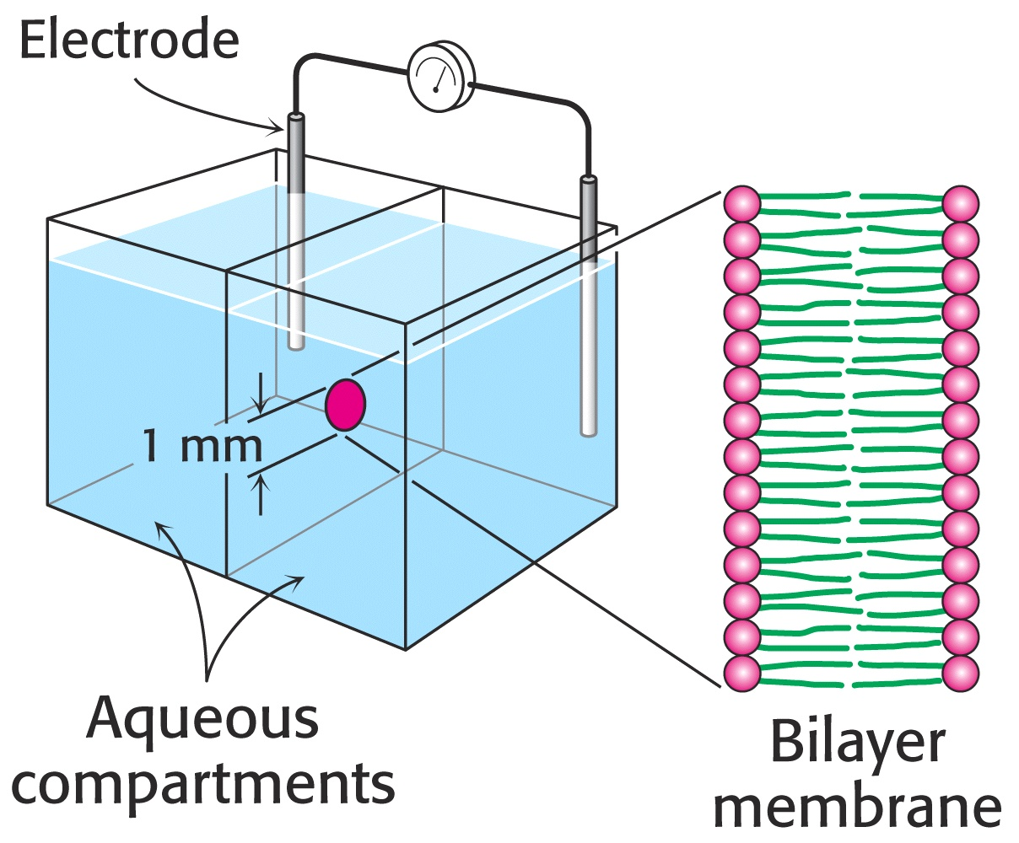
Membranes - Structure
Artificial Bilayer Lipid Membranes (“BLMs”) can be formed across small millimeter- sized holes by “painting” the lipid mixture over the hole and allowing it to spontaneously form an artificial bilayer. When formed, the bilayer looks black due to destructive interference of refracted light.

Slide 35
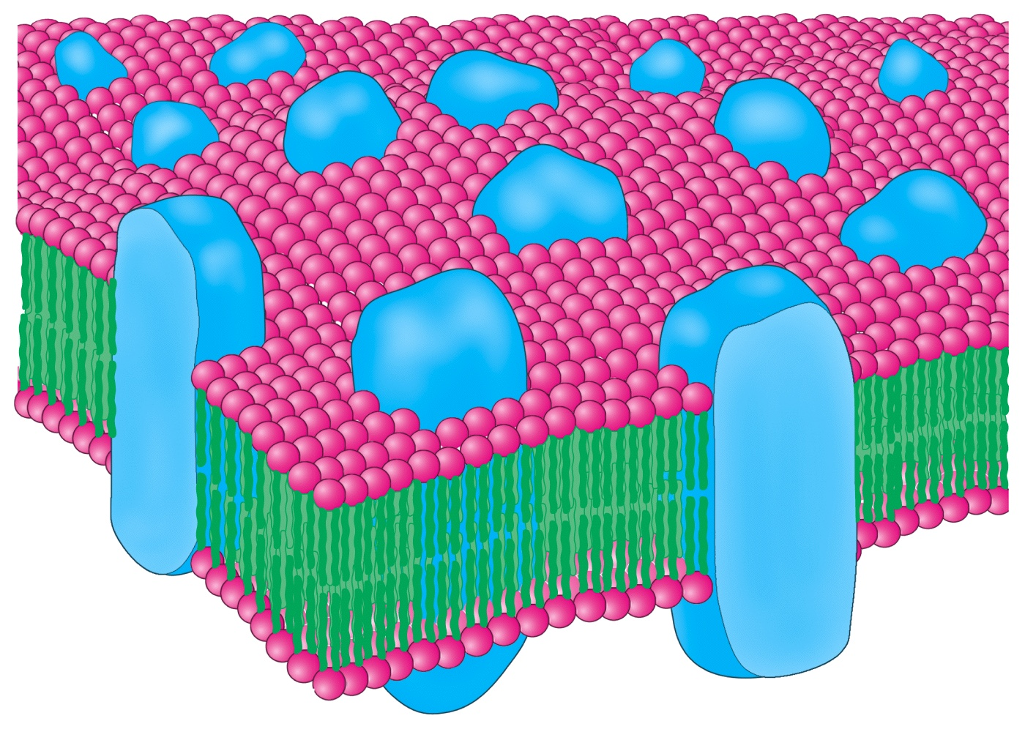
Membranes - Structure
The hydrophobic nature of the interior region of membranes makes them excellent barriers to ionic and polar molecules.
Membranes contain proteins that facilitate transfer of selected ions. Proteins also serve in a wide variety of other roles.
Proteins are held in place by hydrophobic interactions with the membrane. Neither proteins nor lipids are covalently attached to one another.
This type of
proposed structure
is referred to as the
“Fluid Mosaic Model”
of membranes.

Slide 36
Membranes - Structure
Membrane proteins are classified by how strongly they are held by the membrane:
“Peripheral” proteins are held by weak forces and are easily separated from the intact membrane.
“Integral” proteins are held by strong interactions with the hydrophobic interior of the membrane and are difficult to remove, requiring detergents that disrupt the membrane to free the proteins.

Slide 37
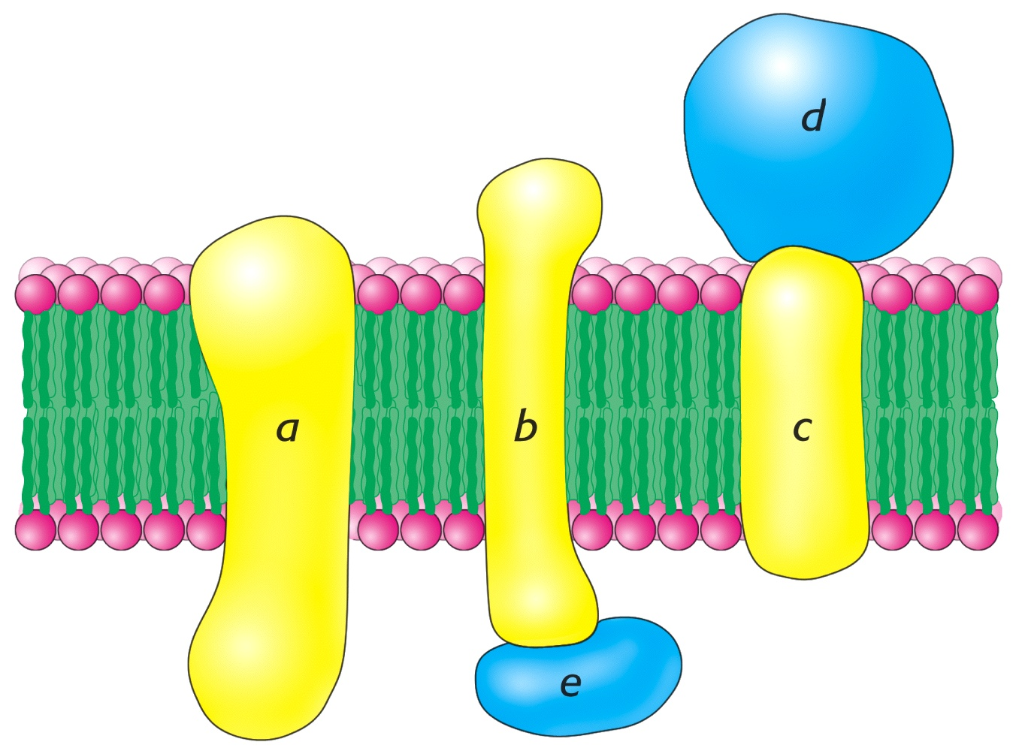
Membranes - Structure
Peripheral proteins are in blue and integral proteins are yellow:

Slide 38
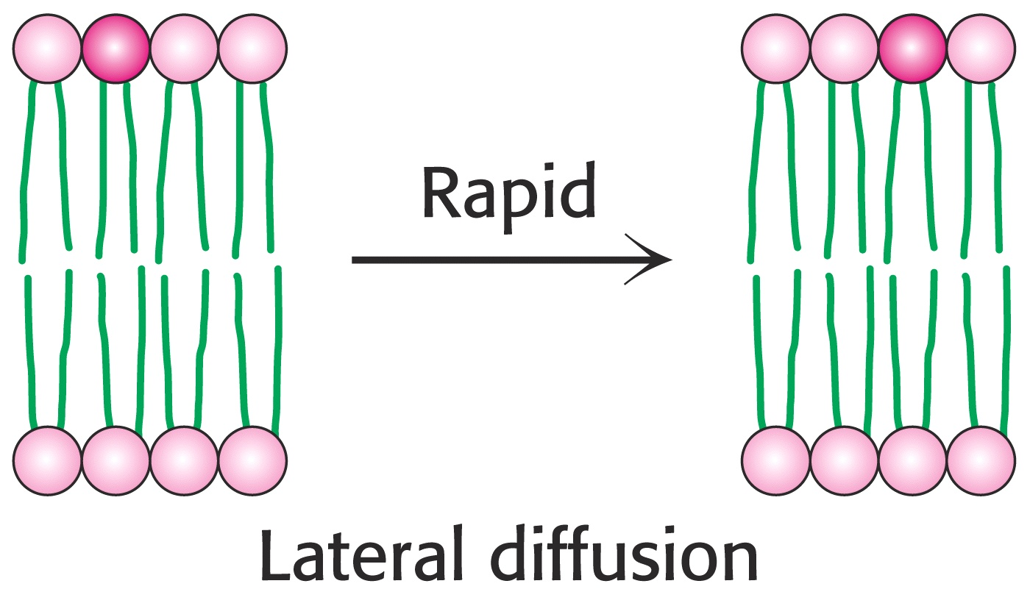
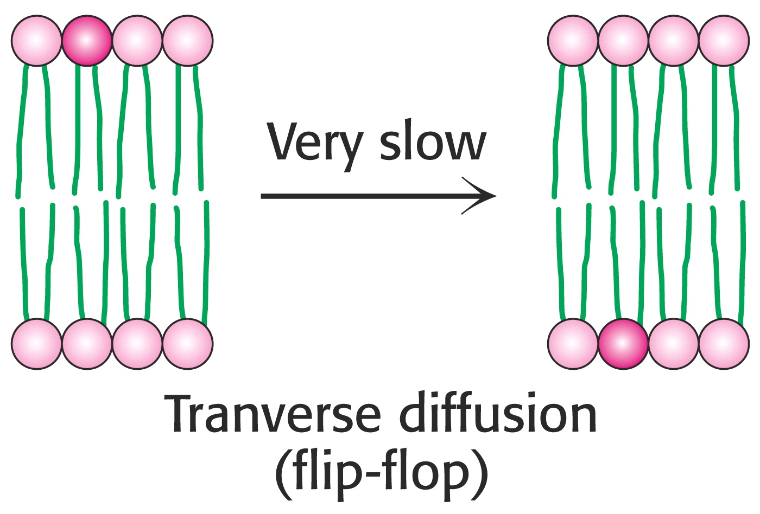
Membranes – Lateral vs. Transverse Diffusion
The Fluid Mosaic Model of membranes explains why individual lipid molecules are free to diffuse laterally across the surface of membranes. On the other hand, “flip-flop” or “transverse” diffusion is very slow.

Slide 39
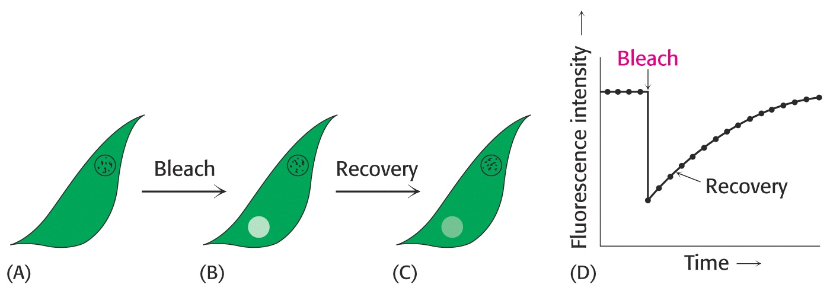
Membranes – Lateral vs. Transverse Diffusion
Photo-bleaching experiments using lipids labeled with dye molecules reveal that lateral diffusion is extremely fast.
A lipid molecule can diffuse from one end of a bacterium to the other is less than a second!

Slide 40
Membranes – Lateral vs. Transverse Diffusion
Diffusion of a molecule is described by the equation
s = (4Dt)^{1/2}
where s = distance traversed
D = diffusion coefficient
t = time
Measurement of lipid diffusion in a variety of membranes indicates that the viscosity is about 100 times that of water, rather like olive oil.

Slide 41
Membranes – Phase Transition Temperatures
Bacteria regulate the fluidity of their membranes by varying the degree of unsaturation and the length of their fatty acids.
For example, the ratio of saturated to unsaturated fatty acyl chains in the E. coli membrane decreases from 1.6 to 1.0 as the growth temperature is lowered from 42°C to 27°C. This decrease prevents the membrane from becoming too rigid at the lower temperature.

Slide 42
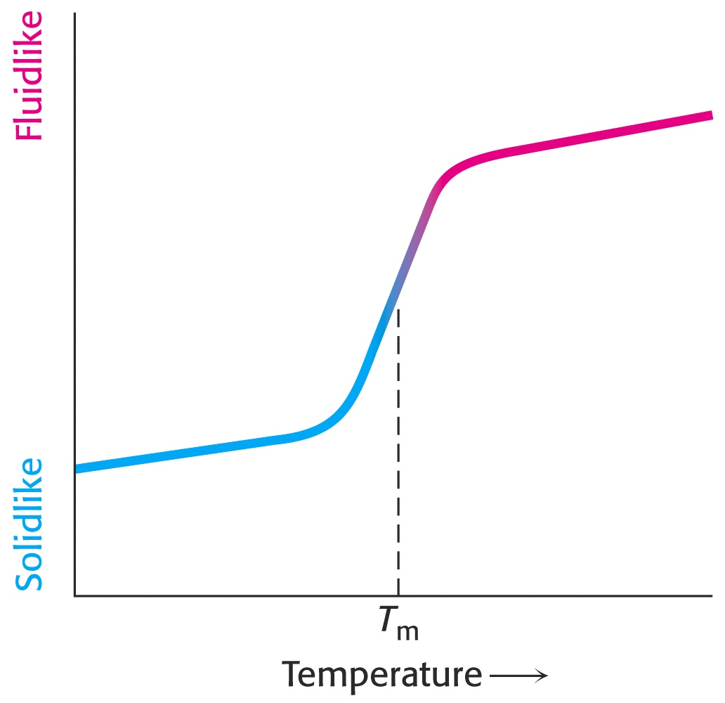
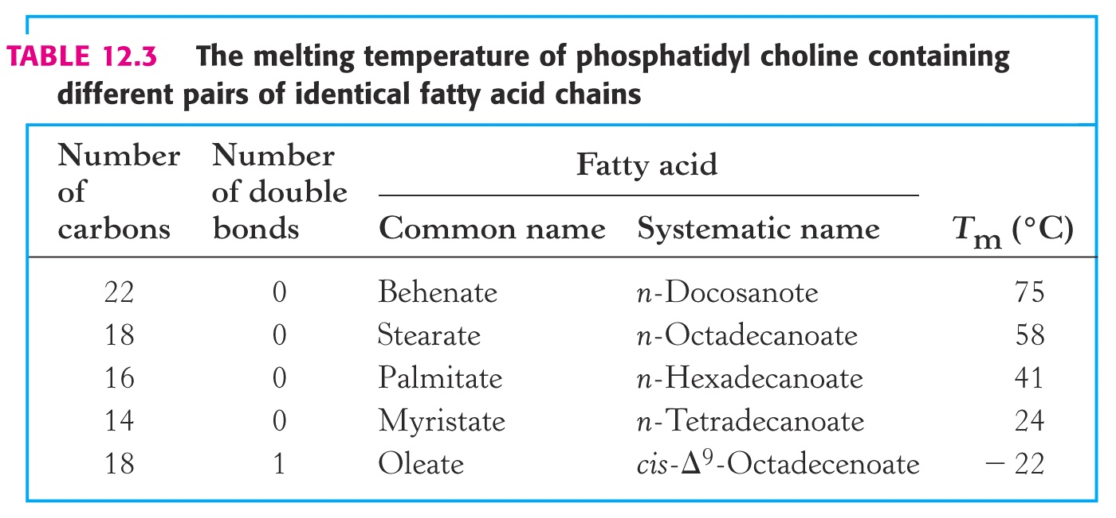
Membranes – Phase Transition Temperatures
The fluidity of membranes is often characterized by their “phase transition temperature” or “T_{m}.”

Slide 43
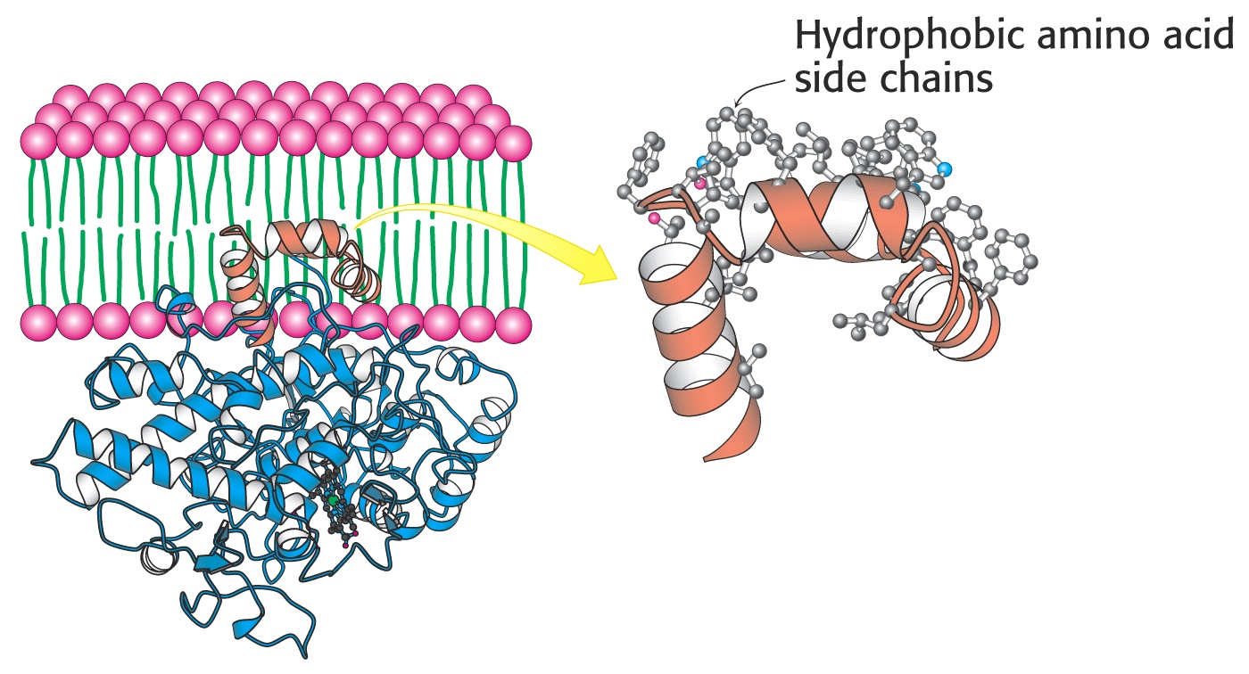
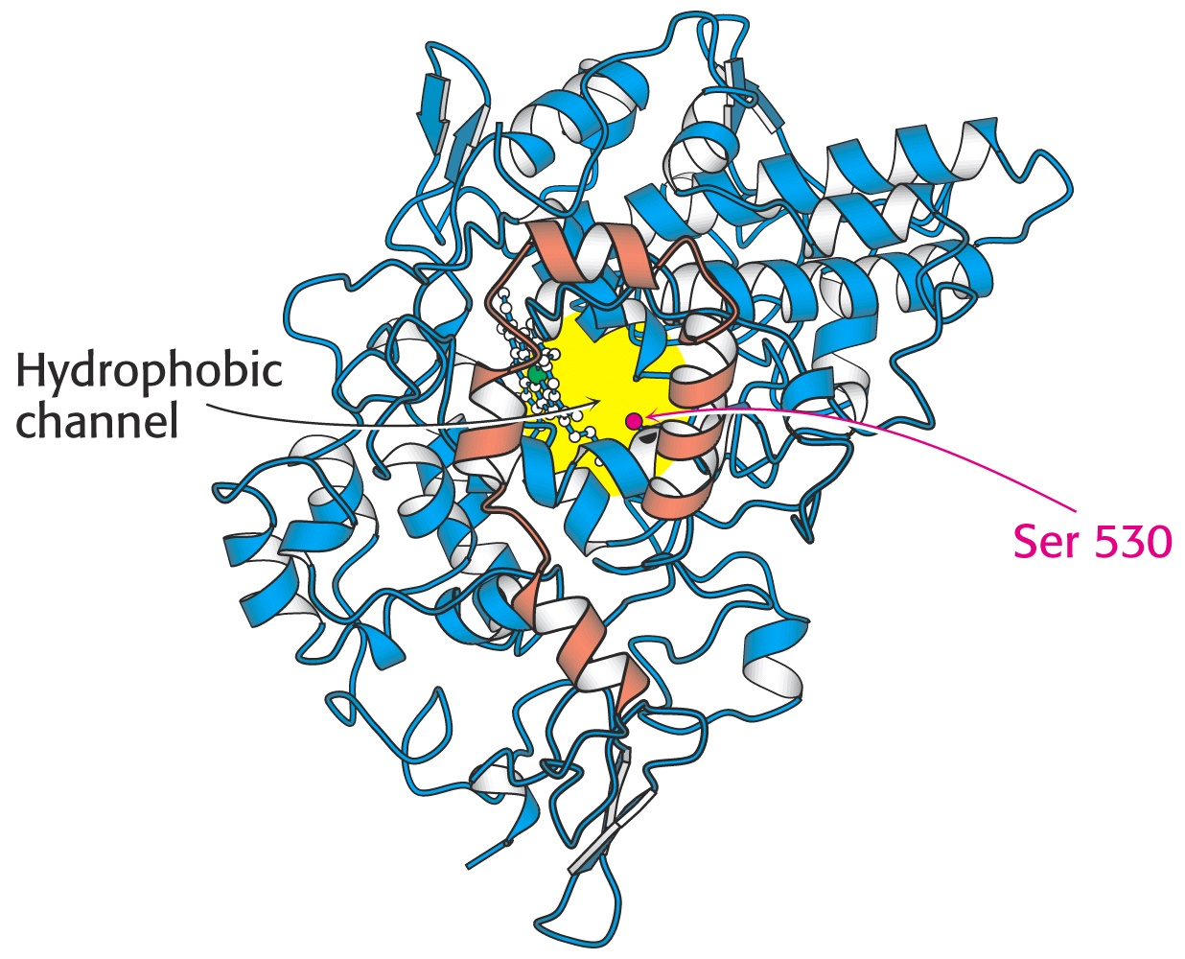
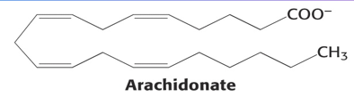
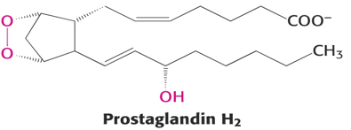
Membranes – Aspirin Function
Prostaglandin H2 synthetase is an integral protein, held in its membrane by a set of alpha helices coated with hydrophobic side chains. A hydrophobic channel shuttles arachidonic acid into position for conversion into prostaglandin H₂ (PH₂). Aspirin blocks this channel, slowing PH₂ production.
X

Slide 44
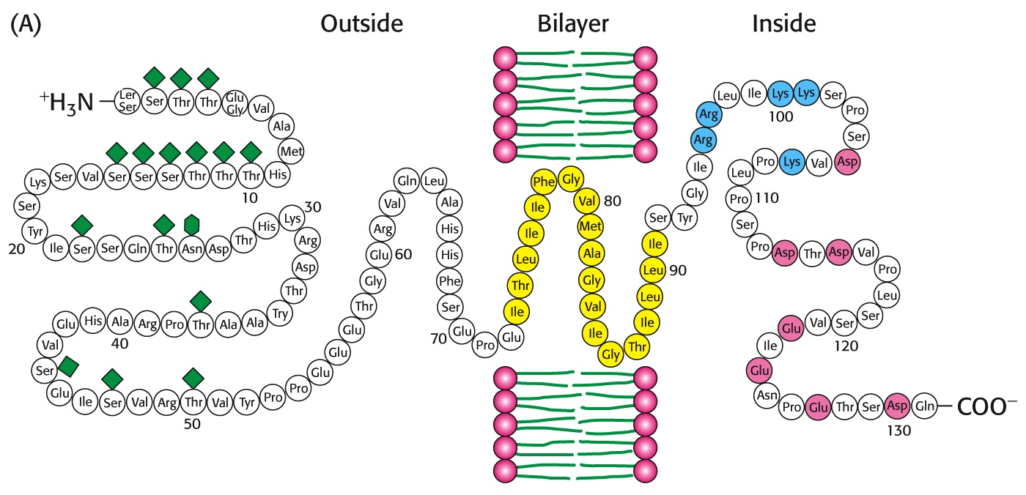
Membranes - Structure
Glycophorin A from erythrocyte membranes contains three distinct domains: 1- an exterior, glycosylated, polar segment, 2- a non-polar segment that is imbedded in the bilayer, and 3- the interior (cytoplasmic) polar segment. The polar regions prevent the protein from slipping out of the membrane and the glycosylated region prevents “flip-flop” diffusion.
Many other membrane proteins contain similar regions. The carbohydrates not only impart polarity to the external membrane surface, but serve in other roles such as cellular recognition, cell aging, and immunological determinants.

Slide 45
End of Lecture Slides
for
Lipids and Membranes
Credits: Many of the diagrams used in these slides were taken from Stryer, et.al, Biochemistry, 10th Ed., Freeman Press (in our course textbook) and from prior editions of this text.

