Slide 1
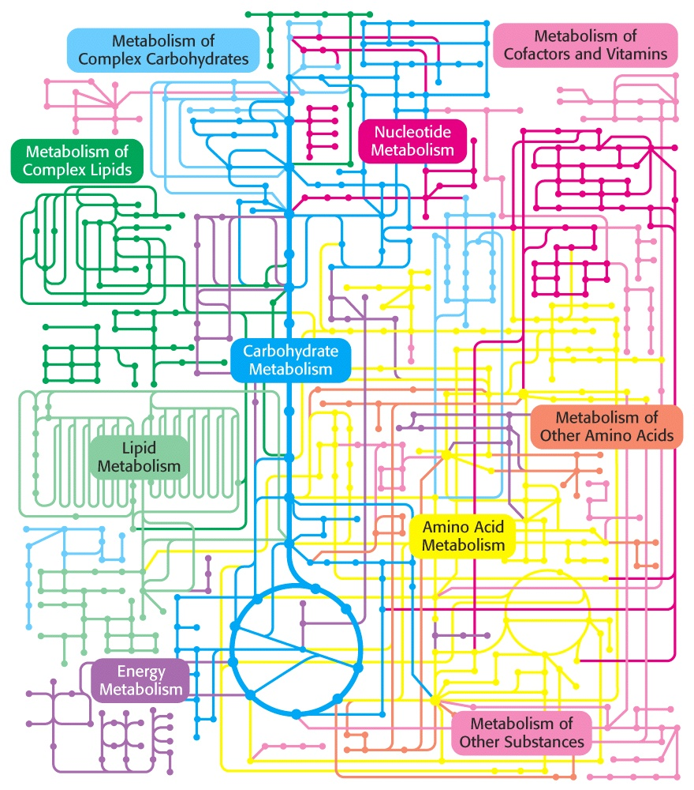
Biochemistry 3070
Introduction
to
Metabolism
www.genome.ad.jp/kregg

Slide 2
Metabolism
After spending so much time studying and learning about the attributes of biochemicals, we are now able to study and answer the fundamental questions of biochemisrty:
How does a cell extract energy and reducing power from its environment?
How does a cell synthesize the building blocks of its macromolecules and then the macromolecules themselves?

Slide 3
Metabolism
Chemical energy is obtained from the oxidation of carbon compounds. This energy may be stored in the form of “high-energy” compounds or as “membrane potentials.”
Metabolism is essentially a linked series of chemical reactions that form “biochemical pathways.”
Exergonic reactions that release usefull energy are called catabolic reactions.
Endergonic reactions that require an input of energy are called anabolic reactions.

Slide 4
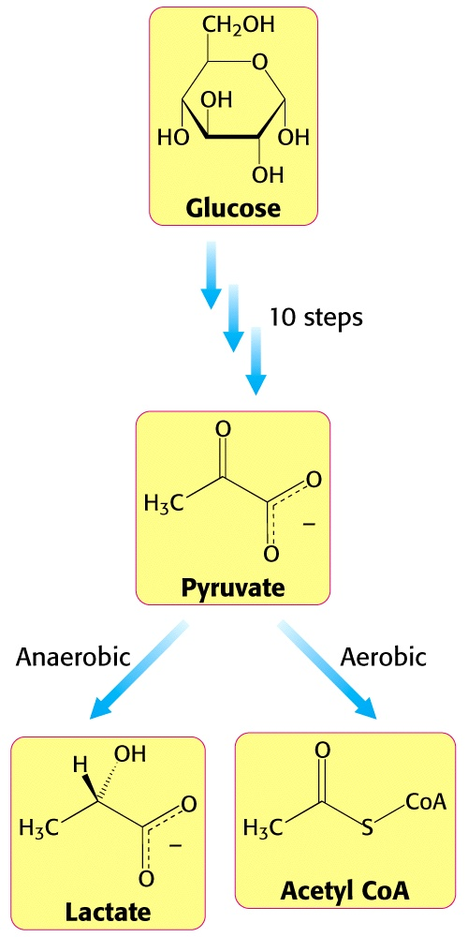
Metabolism
Consider the conversion of glucose into lactate or acetyl CoA.
This is an excellent example of catabolism.

Slide 5
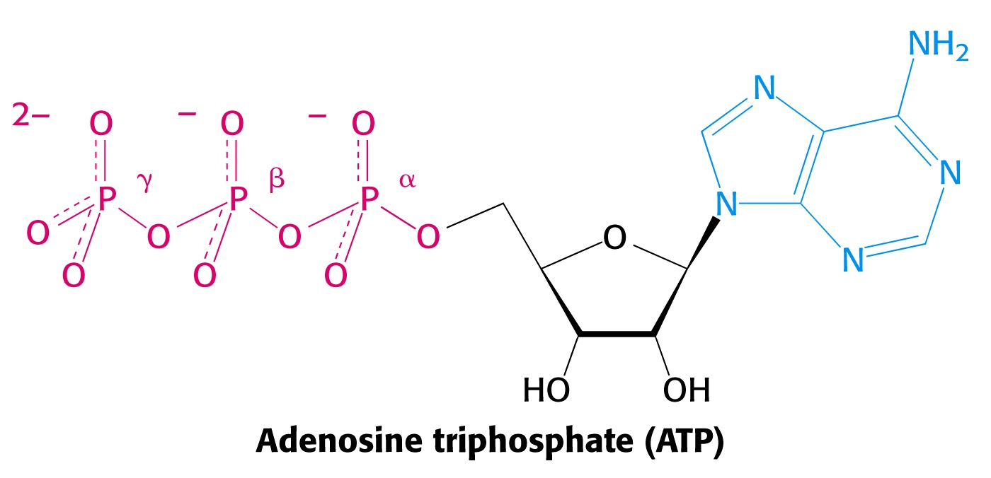
Metabolism
Energy derived from catabolism is often stored in “high-energy” molecules (molecules with high energy bonds). The best example of such a molecule is ATP:

Slide 6
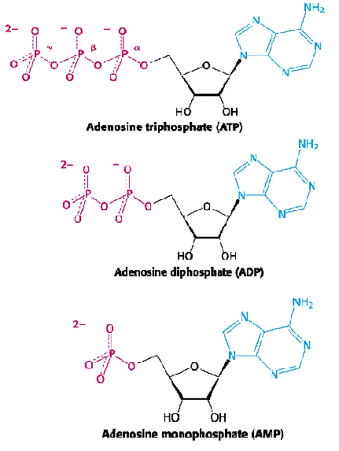
Metabolism
The high-energy component in ATP is its two anhydride linkages between the second and third phosphates.
Recall that anhydrides are very reactive and react with water, hydrolyzing these bonds and releasing free phosphates.
High energy bonds such as these two bonds are sometimes represented as “~.” (Lipman “squiggles”)

Slide 7
Metabolism
These hydrolytic reactions release substantial free energy: (approximate values for ΔG.)
ATP + H₂O → ADP + P_{i} ΔG = -7.3 kcal/mole
ADP + H₂O → AMP + P_{i} ΔG = -7.3 kcal/mole
-14.6 kcal/mole
ATP + 2 H₂O → AMP + PP_{i} ΔG = -10.9 kcal/mole
PP_{i} + H₂O → 2 P_{i} ΔG = - 3.7 kcal/mole
-14.6 kcal/mole
By linking these reactions of ATP to non-spontaneous reactions in the cell, they become spontaneous.

Slide 8
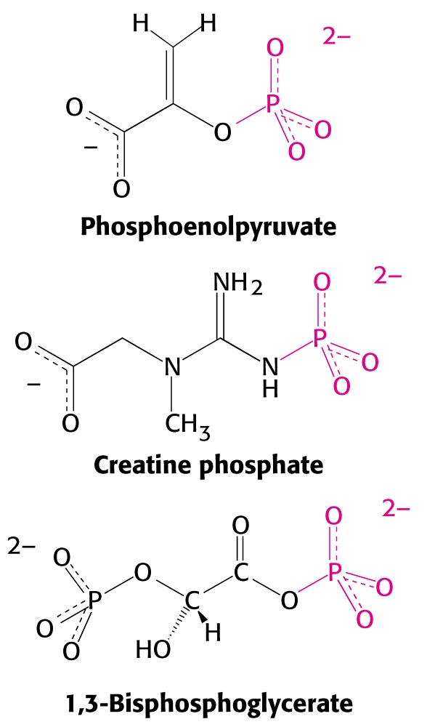
Metabolism
Other energy storage molecules contain high energy phosphate bonds.
In fact, the phosphate bonds in all of these three molecules give off more energy than ATP when hydrolyzed.

Slide 9
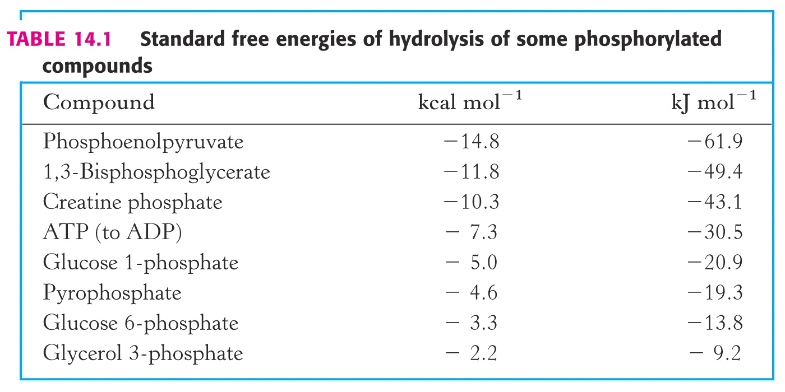
Metabolism

Slide 10
Metabolism – ATP is the Universal Energy Currency
ATP is the “universal energy currency” of the cell.
ATP is similar to the money kept in a wallet (and like money is often spent very quickly.)
When it is gone we have to replenish it. Sometimes we have a savings account or find an ATM nearby from which we can rejuvenate our wallets (e.g., creatine phosphate)
Occasionally, we need to break a CD or bond, which takes longer. This is analogous to waiting for metabolism to regenerate our ATP.

Slide 11
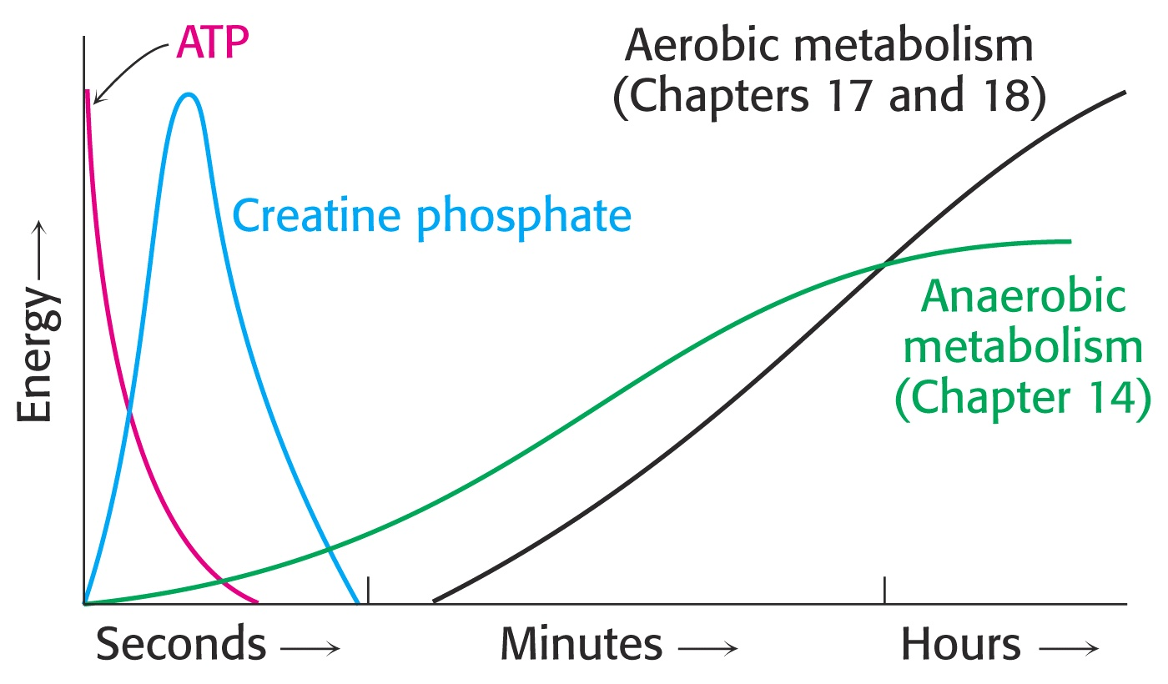
Metabolism
Typical ATP concentrations in the cell are ~4mM.
Creatine phosphate is at a level of ~25mM
During muscle contraction, this ATP is totally consumed in less than second.
Creatine phosphate is all consumed after 4-5 seconds of strenuous muscle activity.

Slide 12
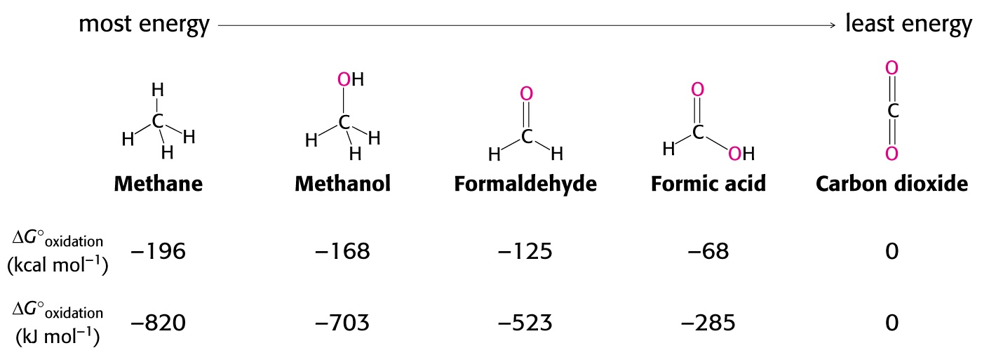
Metabolism – Oxidation of “Fuel Molecules”
When we eat food, we are ingesting reduced carbon atoms.
During metabolism we oxidize these carbons to CO2, releasing potential energy of these foods.
The more reduced a carbon atom, the more potential energy it contains:

Slide 13
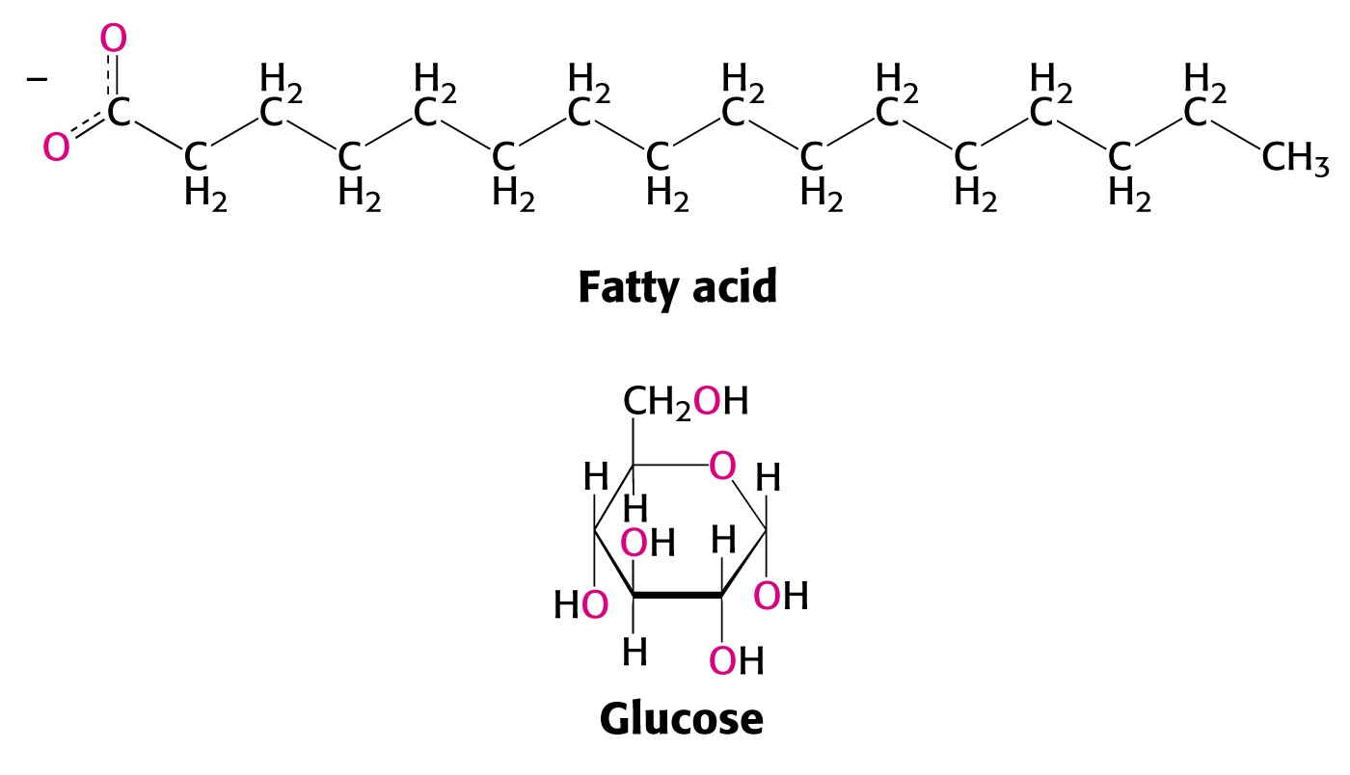
Metabolism
Consider the oxidation states of the carbon atoms in a fatty acid compared to glucose:
Which molecule contains the most potential energy?

Slide 14
Metabolism
Oxidation of carbon atoms occurs rapidly in a flame during combustion:
C₆H₁₂O₆ + 6 O₂ → 6 CO₂ + 6 H₂O + energy
Rapid, one-step reactions such as this are inefficient, losing much of their energy to entropy.
The same overall reactions occur in living systems, but through a variety of metabolic steps that conserve the energy along the way, storing the free energy in chemical intermediates. This makes metabolism much more efficient than simple combustion.

Slide 15
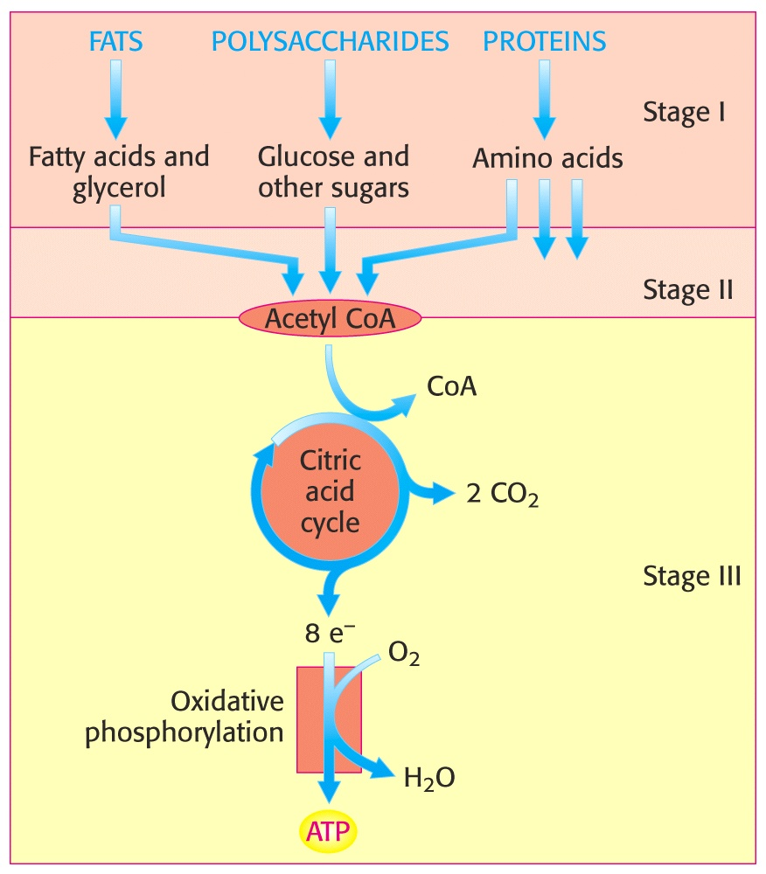
Metabolism – Three General Stages of Catabolism

Slide 16
Metabolism
In addition to energy-carrying molecules, we need other molecules to carry elections.
It is important that these molecules transfer their electrons with relatively strong “reductive” force (electron transfer potential).
The two most commonly encountered electron carriers are pyridine nucleotides and flavin nucleotides.

Slide 17
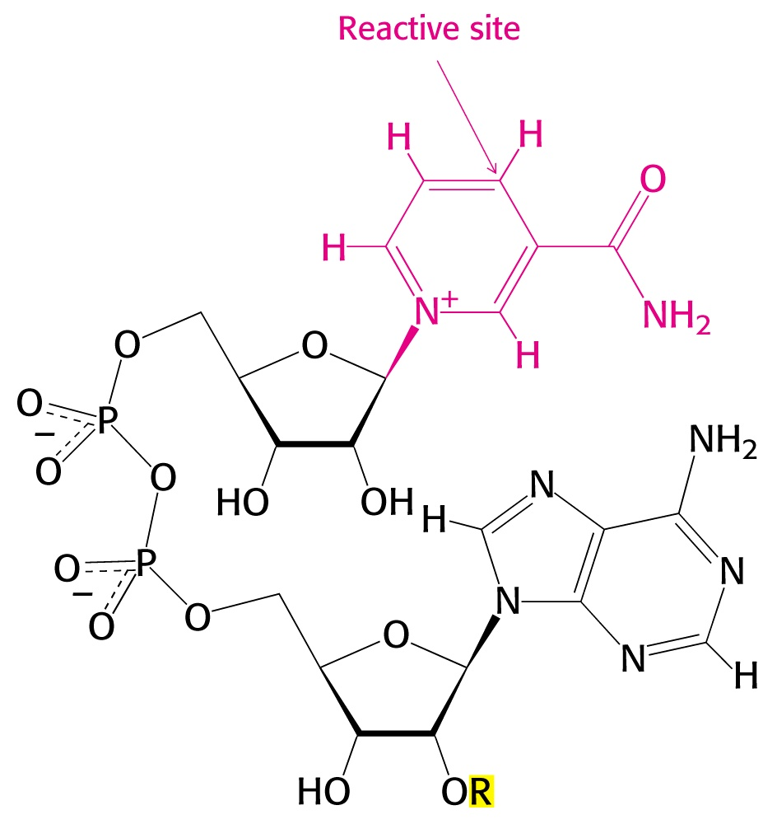
Metabolism - NADH
Nicotinamide adenine dinucleotide (NADH) is a major electron carrier, reduced during oxidation of fuel molecules.
Note that NADH contains an ADP, linked to a second ribose and a nicotinamide base. (hence its name as a “dinucleotide”).
Oxidized form: NAD⁺
Reduced form: NADH

Slide 18
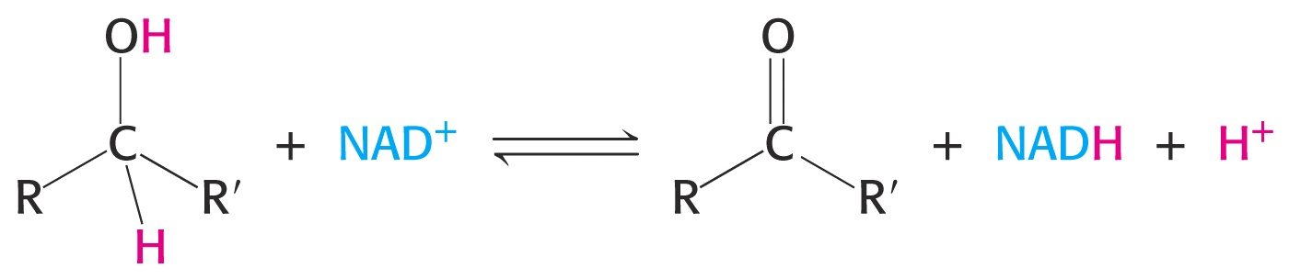
Metabolism
NAD⁺ is most often the species reduced when alcohols are oxidized to ketones or aldehyes:

Slide 19
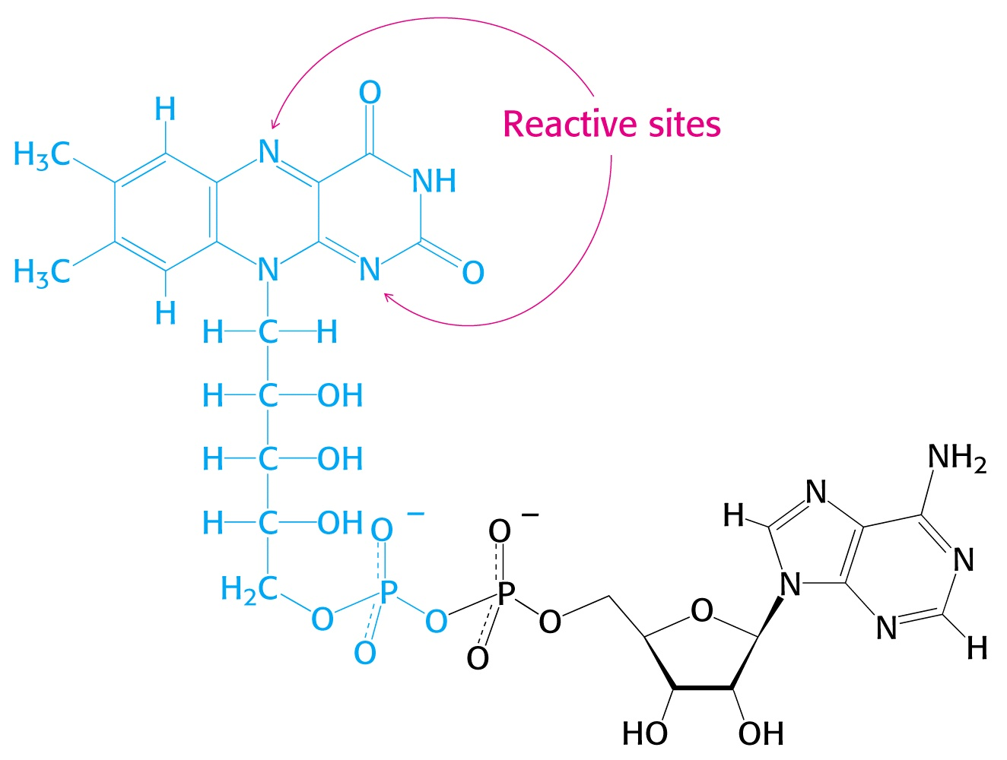
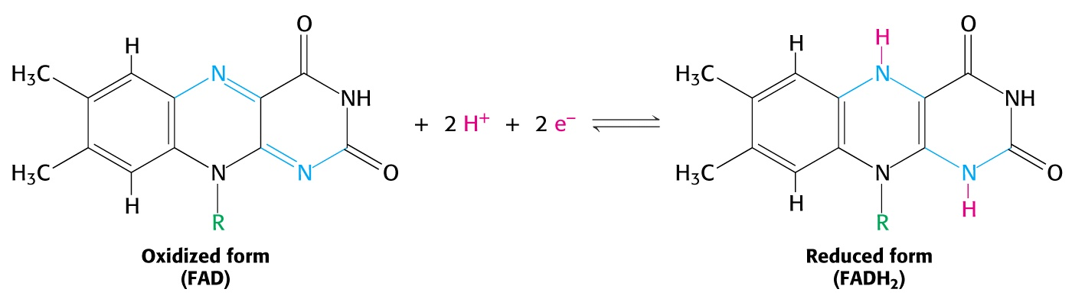
Metabolism – FADH₂
Flavin adenine dinucleotide (FAD) is another key electron carrier.
FAD is reduced during oxidation of single bonds to double bonds, taking both hydrogens and electrons away.
Oxidized form: FAD
Reduced form: FADH₂

Slide 20
Metabolism
Note that FAD contains the equivalent of an ADP molecule attached to another ribose (open chain form) and a flavin (isoalloxazine) base.
Hence FAD is also a “dinucleotide.”
Note: The ribose and flavin are derived from the vitamin, “riboflavin.”

Slide 21
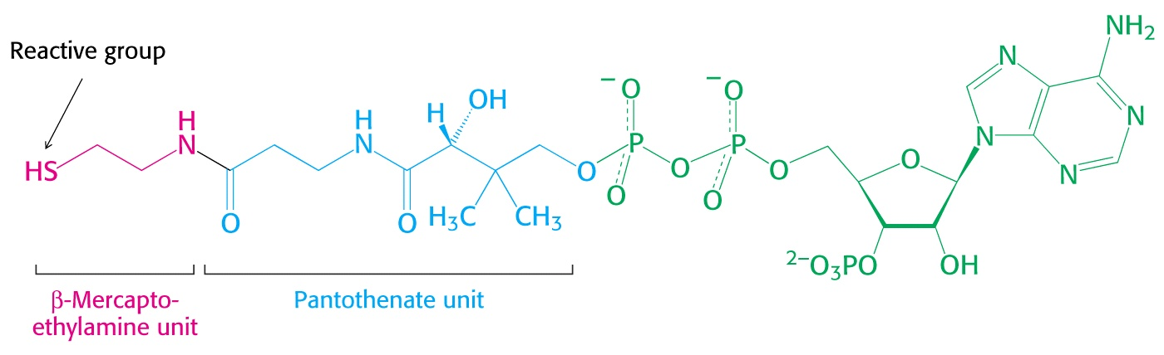
Metabolism
Coenzyme A plays a critical role in metabolism as a carrier of 2-carbon acetyl groups.
These acetyl groups are attached via a thio-ester bond, which is easily formed or broken during transfer of acetyl groups.
Due to its enormous size, CoA is an excellent “leaving group.”
CoA contains an ADP moiety, pantothenate, and a β-mercaptoethylamine unit:

Slide 22
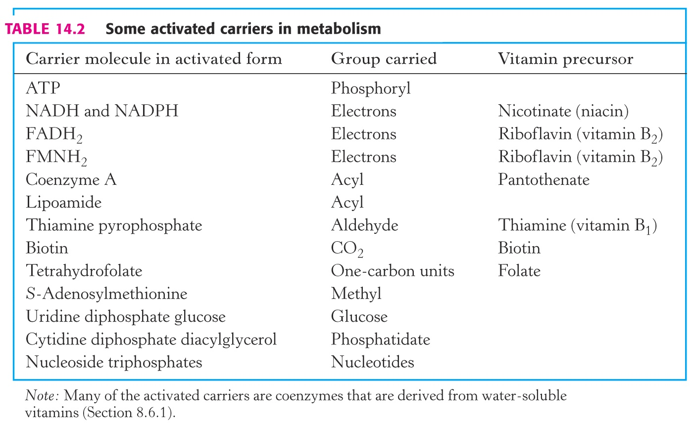
Metabolism – Other Activated Carriers

Slide 23
End of Lecture Slides
for
Introduction to Metabolism
Credits: Many of the diagrams used in these slides were taken from Stryer, et.al, Biochemistry, 5th Ed., Freeman Press (in our course textbook) and from prior editions of this text.

