Slide 1
Industrial Applications of Enzymes
Chem 3070

Slide 2
Industrial Applications of Enzymes:
The industrial enzymes market:
$ 8.8 billion in 2025.
The market is projected to grow at a
CAGR of 6.3% to 7.9%
Expected to reach
$ 12.0 billion in 2030

Slide 3
Enzyme Applications in the Food Industry
Baking
Chocolate syrups
Candy
Infant foods
Cheese and dairy products
Egg products
Fruit juices
Alcoholic beverages
Sweeteners
Meat tenderizing
Flavor development

Slide 4
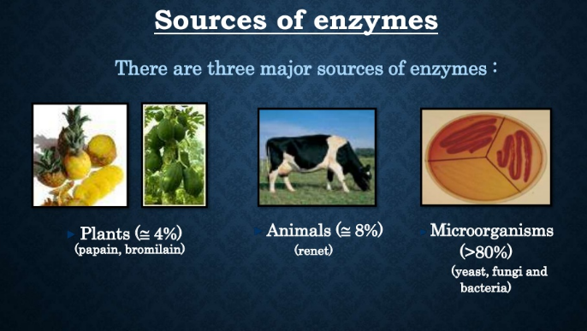

Slide 5
Sources of food enzymes:
Source | Enzymes
Plants | Amylases, glucanase, bromelain, papain, chymopapain, lipoxgenase
Animals | Trypsin, chymotrypsin, pepsin, rennin, catalase, amylase, pancreatic lipase
Microorganisms | Amylase, glucose isomerase, pullunalase, cullase, invertase, microbial lipase, catalase, lactase.

Slide 6

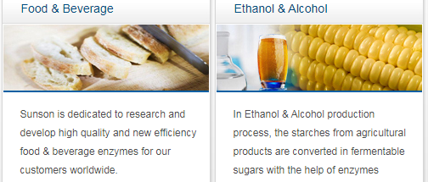
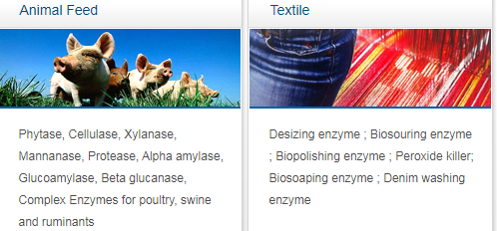
http://www.chinaenzymes.com/index.html
Sources of Industrial Enzymes

Slide 7
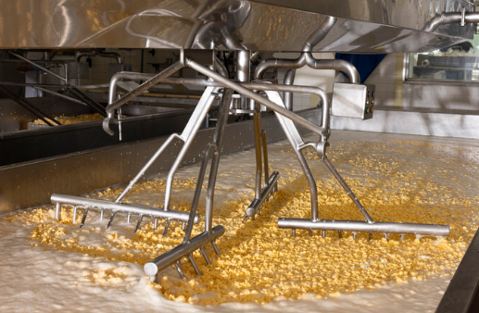
The Dairy Industry
Milk is converted into yogurt,
buttermilk, cheese, butter-
cream, soured cream by
fermentation using enzymes.
Proteases, lipases, and lactases are used to develop flavor compounds.
Rennin is used as a coagulant of milk to produce cheese.
Lactase hydrolyzes lactose for specialized products.

Slide 8
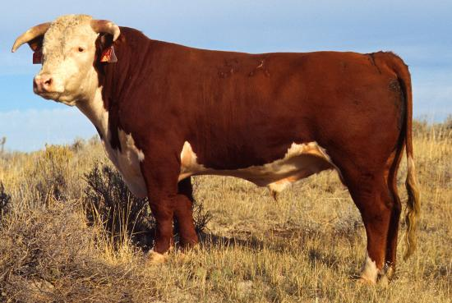
The Meat Industry
Protease enzymes such as papain and bromelain are used to tenderize meat by tenderizing muscle.
Package Warning:
“Use in low amounts to prevent liquefaction of muscle.”

Slide 9
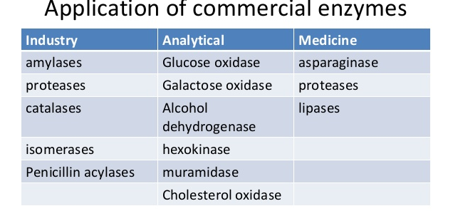
Industrial Applications of Enzymes:

Slide 10
Industrial Applications of Enzymes (cont):

Slide 11
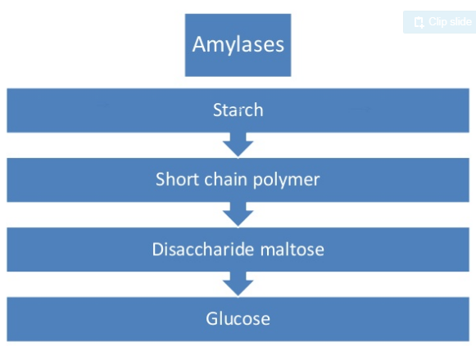
Industrial Applications of Enzymes:
Uses of Amylases:
Production of sweeteners for the food and beverage industry.
Maltose syrup (low viscosity, slight sweet taste and heat stable).
Fructose production glucose →fructose
by glucose isomerase.

Slide 12
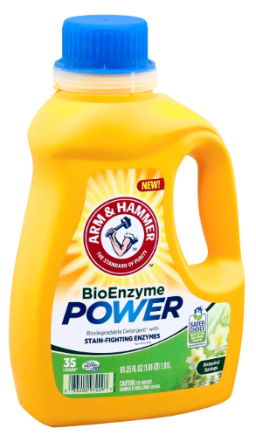
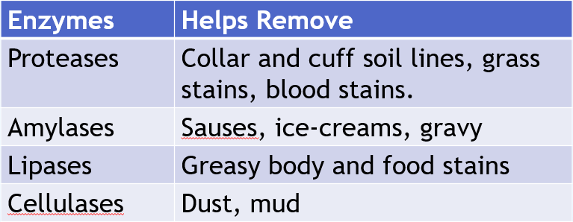
Industrial Applications of Enzymes:
Detergents
Proteases: protein-based stains such as
blood, grass, sweat, eggs, and dairy.
Amylases: starch-based stains from pasta, rice, and potatoes,
Lipases: fats and oils, grease, butter, salad dressings, and body oils.
Cellulases: cellulose
Notes:
https://www.youtube.com/watch?v=GQ1R-mFu2jw

Slide 13
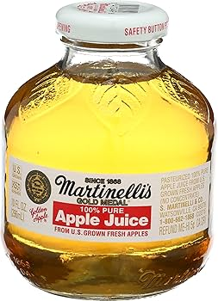
Beverage Industry
Enzymes (like pectinase)
are used to reduce viscosity in fruit juices, increase production yields, volume and color.
Pectinase is used to prevent haze formation in wine (clarification).

Slide 14
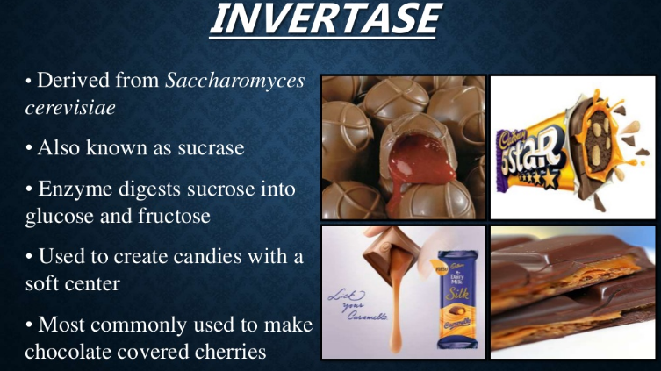

Slide 15
Medical applications of enzymes

Slide 16
Challenges of Using Enzymes in Medical Treatments
Enzymes are too large to be enter many of the body’s cells.
Antigenic proteins elicit immune responses.
Effective half-life in the circulatory system may be only a few minutes.
Must be very pure and administered in very small concentrations.
Must exhibit low Km and high Vmax to be maximally efficient at low concentrations.

Slide 17
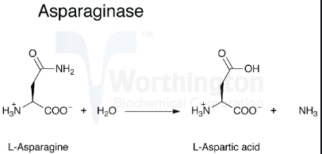
Cancer Treatment
Asparaginase has proved to be
particularly promising for the
treatment of acute lymphocytic
leukemia.
Its action depends upon the fact that tumor cells are deficient in aspartate-ammonia ligase activity, which restricts their ability to synthesize the normally non-essential amino acid L-asparagine. Therefore, they are forced to extract it from body fluids.
The action of the asparaginase does not affect the functioning of normal cells which are able to synthesize enough for their own requirements, but reduce the free exogenous concentration and so induces a state of fatal starvation in the susceptible tumor cells. A 60% incidence of complete remission has been reported in a study of almost 6000 cases of acute lymphocytic leukemia.

Slide 18
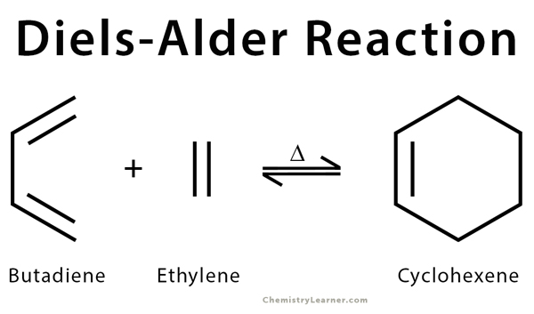
Fluorinase & Diels-Alder Enzymes
David O’Hagen (Univ. St Andrews, UK) is using an enzyme from Streptomyces to add fluorine to organic molecules. He can add F-18 isotopes to tracers used in Positron Emission Tomography (PET) in water at neutral pH and room temperature.
“By scouring public databases, David’s team has now found their enzyme in six different bacteria. ‘We can look at the genomes and order a synthetic gene. We don’t need the organism anymore; we just order in a synthetic gene and over-express it.”
Other researchers are chasing enzymes for some of the best-known organic reactions. For example, some are hunting enzymes to catalyze the Diels–Alder reaction, one of the most powerful in synthetic chemistry.
https://edu.rsc.org/feature/exceptional-enzymes/3007872.article

Slide 19
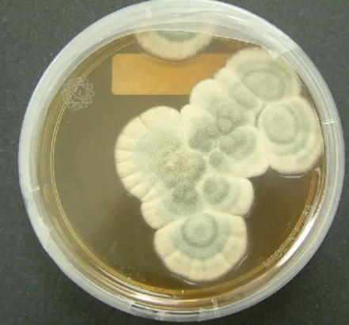
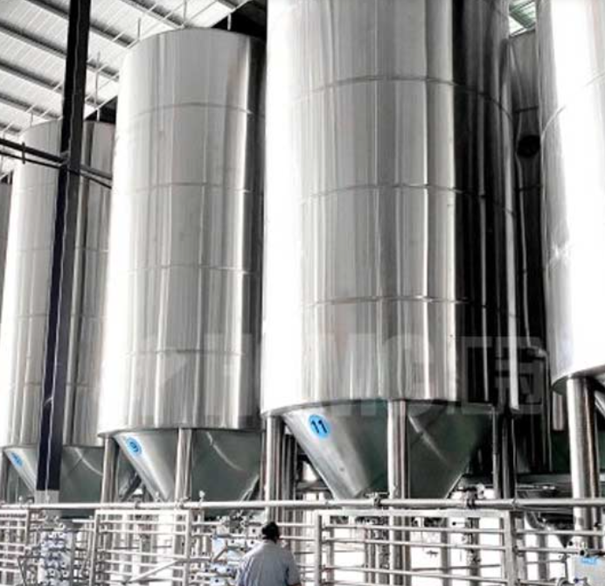
Fermentation Production of Penicillin:
Penicillin is produced today using commercial producing strains of Penicillium chrysogenum that are grown using submerged cultures in constantly agitating and aerated 50,000-gallon stainless steel tanks. These industrial strains can now produce 40-50 grams of penicillin per liter of culture with a 90% recovery yield.
Worldwide sales of penicillin and other beta-lactam antibiotics is now greater than $15 billion (U.S. dollars) per year. These sales numbers exist despite the fact that penicillin’s s cost is now at an all-time low:
$ 300/kg in 1953.
$ 10/kg in 2026.
https://www.news-medical.net/health/Penicillin-Production.aspx

Slide 20
Ethanol Production
DuPont's innovative enzyme technology enables the production of more than 68 billion liters of bioethanol each year.
“For example, the SPEZYME® line of alpha amylase enzymes offers many advantages in the production of fuel ethanol from starch, including robust liquefaction and viscosity reduction at various temperatures and pH levels. Combined with products such as DuPont™ FermaSure® XL, a fermentation additive that rapidly attacks and decreases harmful bacteria, ethanol producers are increasing their ethanol fermentation rates and efficiency.”

Slide 21
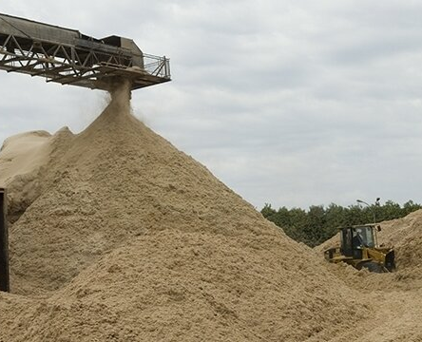
Industrial Applications of Enzymes:
https://phys.org/news/2019-06-enzyme-second-generation-ethanol-production.html
JUNE 17, 2019
Modified enzyme can
increase ethanol production
Trichoderma harzianum, a fungus
found in the Amazon, produces
β-glucosidase that produces free
glucose for fermentation of alcohol.
In the laboratory, however, the researchers observed that high levels of glucose inhibited the activity of β-glucosidase and it is not stable at higher temperatures required for alcohol fermentation.

Slide 22
Industrial Applications of Enzymes:
Based on an analysis of the enzyme's structure combined with genomics and molecular biology techniques, researchers were able to modify the structure to solve these problems.
To arrive at the modified protein, the researchers initially compared the crystal structure of the original molecule with structures of other wild-type β-glucosidases in the GH1 and GH3 glycoside hydrolase families. The results of the analysis showed that glucose-tolerant GH1 glucosidases had a deeper and narrower substrate channel than other β-glucosidases and that this channel restricted glucose access to the enzyme's active site.

Slide 23

Novozymes Publication on Uses of Enzymes:
Enzymes at Work (pdf)
https://www.novozymes.com/en

