Slide 1
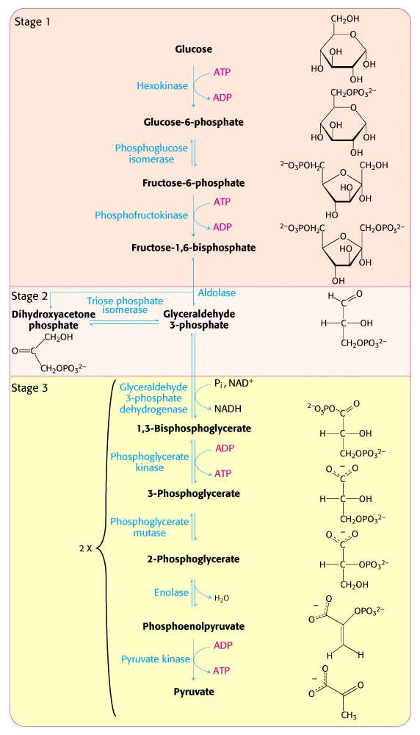
Biochemistry 3070
Glycolysis

Slide 2
Glycolysis
Our study of metabolism begins with glycolysis. (Greek: glyk-”sweet” + lysis “dissolution.”)
Glycolysis is a series of linked chemical reactions that convert glucose into pyruvic acid (pyruvate).
A series of such reactions is called a biochemical “pathway.”
It is fitting that we begin our study of biochemical pathways with glycolysis, since it was the first to be discovered.

Slide 3
Glycolysis
In 1860, the brilliant scientist, Louis Pasteur, asserted an incorrect axiom that biochemistry could only happen inside living cells.
In 1897, a serendipitous discovery by Hans and Eduard Buchner proved Pasteur wrong.
Hoping to use sucrose as a preservative, the Buchners (inventors of the “Buchner Funnel”) mixed cell-free extracts of yeast with sucrose and were surprised to find that it was quickly fermented into alcohol.
Their demonstration of fermentation outside of living cells ushered in the era of modern biochemistry. Metabolism became chemistry! (just over 100 years ago).

Slide 4
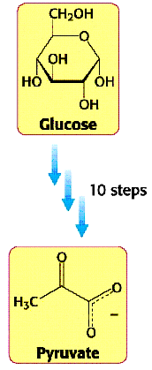
Glycolysis
A number of brilliant scientists contributed to the discovery of the reactions of glycolysis: Gustav Embden, Otto Meyerhof, Carl Neuberg, Jacob Parnas, Otto Warburg, Gerty Cori, and Carl Cori.
In 1940 the complete pathway was elucidated and is often called the “Embden-Meyerhof pathway.”

Slide 5
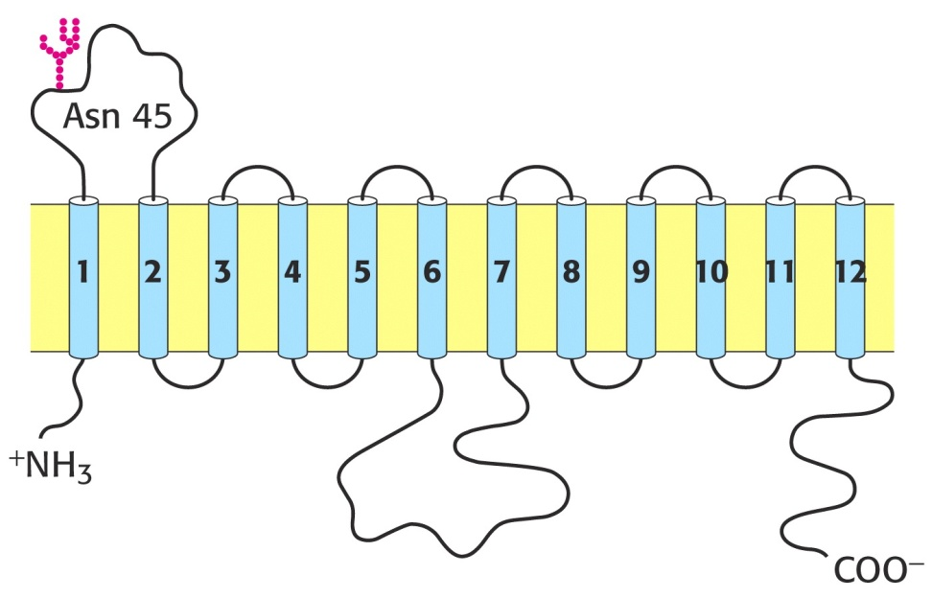
Glycolysis
The site for glycolysis is inside cells in the cytosol (cytoplasm).
Glucose and other sugars are transported into cells by a family of several transport proteins (GLUT1, GLUT2,…, GLUT5.)
GLUT4 transports glucose into muscle and fat cells. The presence of insulin, lead to a rapid increase in the number of GLUT4 transporters in membranes, facilitating more rapid uptake of glucose.
Interesting note: The amount GLUT4 present in muscle membranes increases in response to endurance exercise training.
Twelve hydrophobic α-helices in the GLUT transport protein structure make it an excellent example of an integral membrane protein:

Slide 6
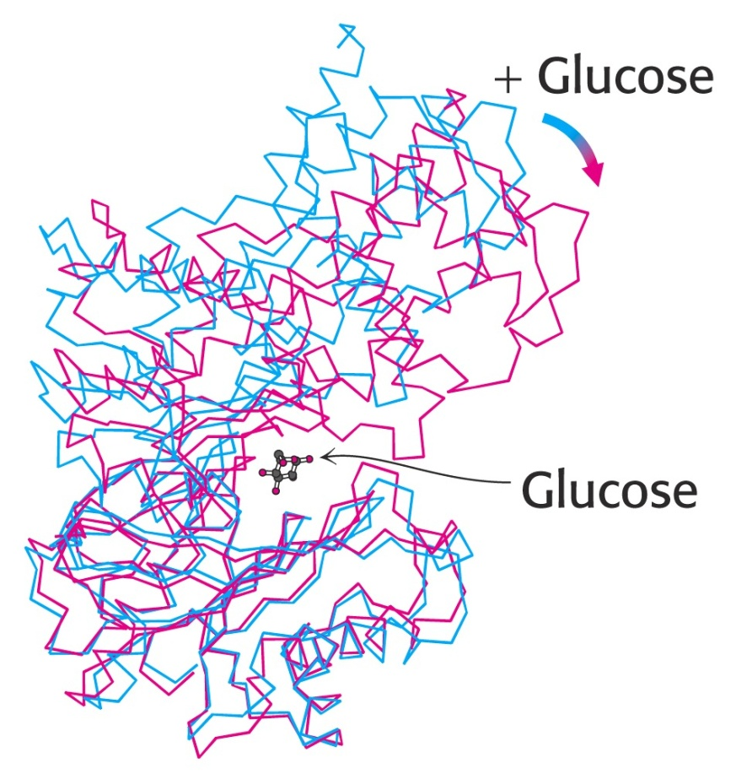
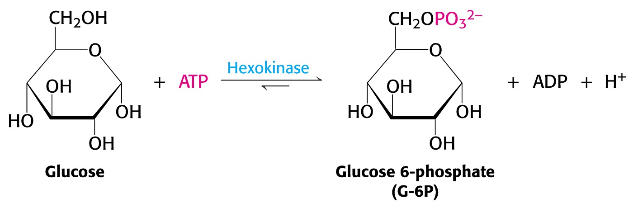
Glycolysis
Following absorption, glucose is rapidly phosphorylated by the transfer of phosphate from ATP to glucose.
The enzyme catalyzing this transfer is hexokinase.
“Kinase” is the name given to the class of enzymes that catalyze the transfer of phosphoryl groups from ATP to the acceptor.
The dramatic change in hexokinase 3-D structure upon binding to glucose is a prime example of “induced fit.”

Slide 7
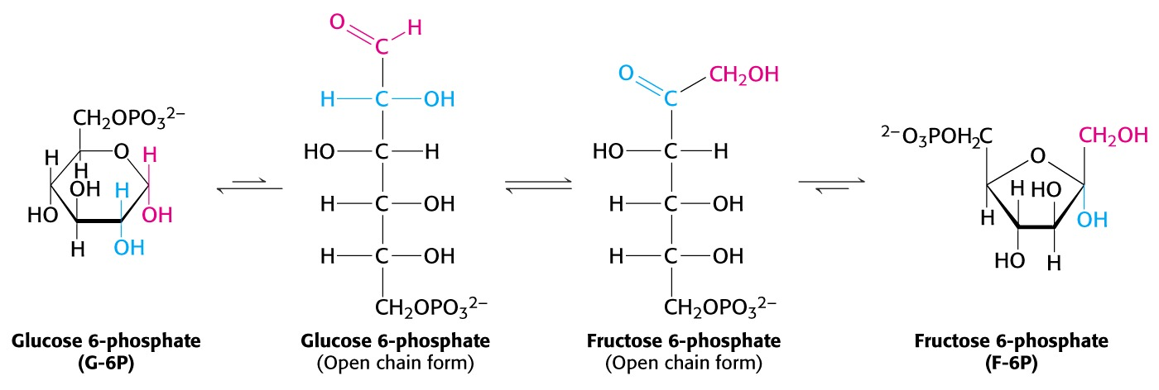
Glycolysis
The next step in this pathway is the isomerization of glucose-6-phosphate to fructose-6-phosphate:
Note : Fructose can also phosphorylated by hexokinase to form fructose-6-phosphate.

Slide 8
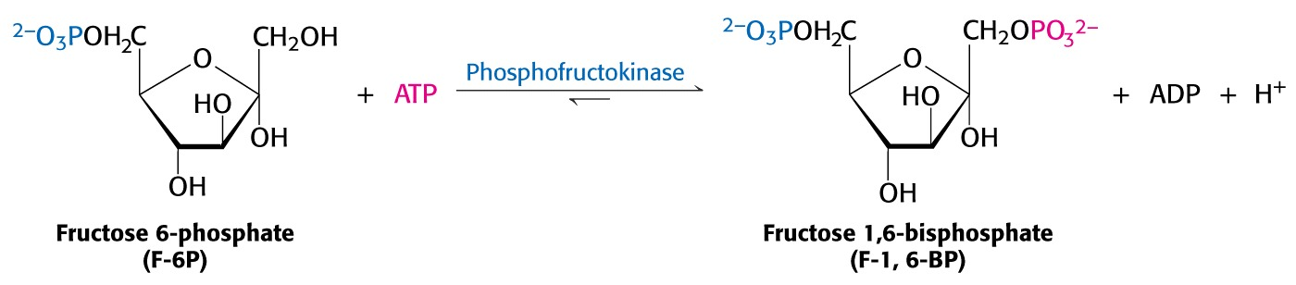
Glycolysis
Fructose-6-phosphate is phosphorylated again to form fructose-1,6-diphosphate.
The enzyme for this reaction is “phosphofructokinase (PFK),” the main control enzyme in regulating the glycolytic pathway.

Slide 9
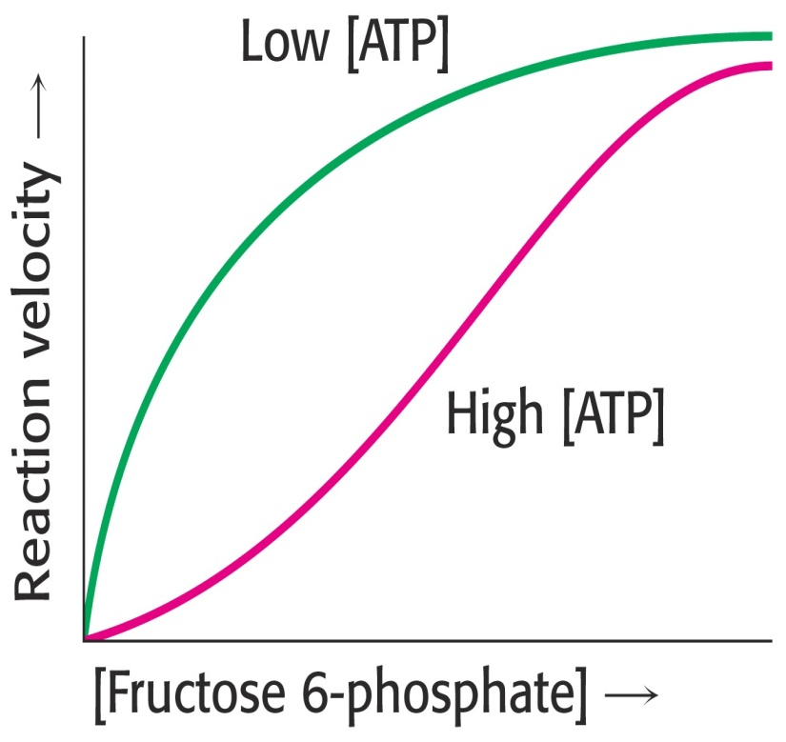
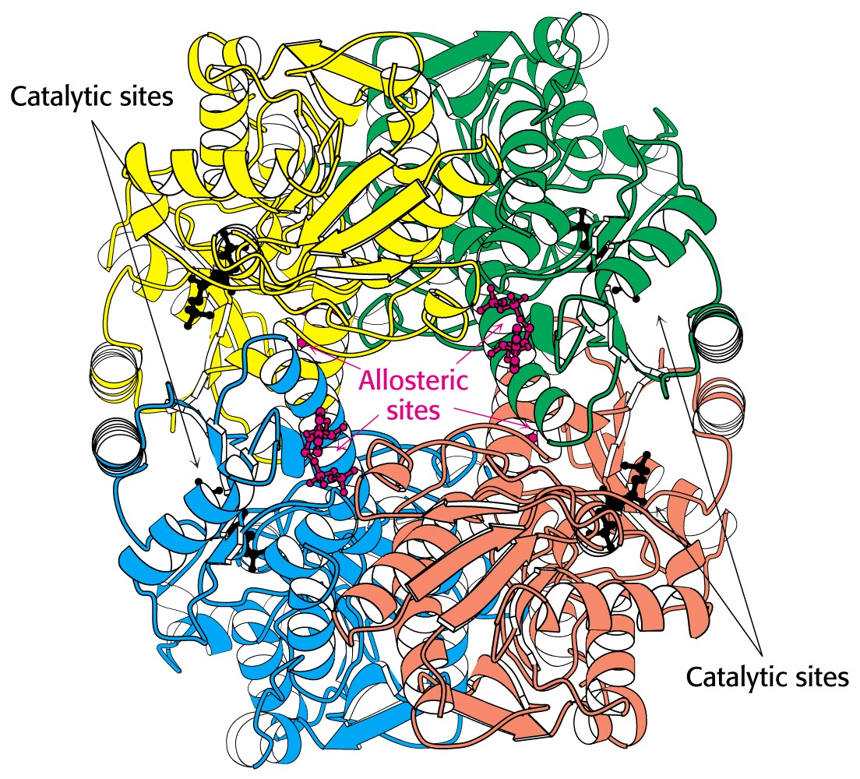
Glycolysis – PFK Regulation
The activity of PFK is affected by a large number of cellular metabolites. High levels of ATP inhibit PFK while high levels of AMP activate the enzyme.

Slide 10
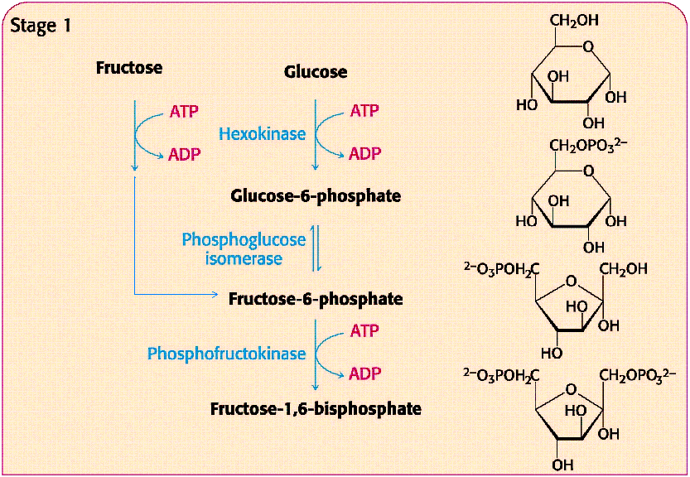
Glycolysis – the six-carbon sugars

Slide 11
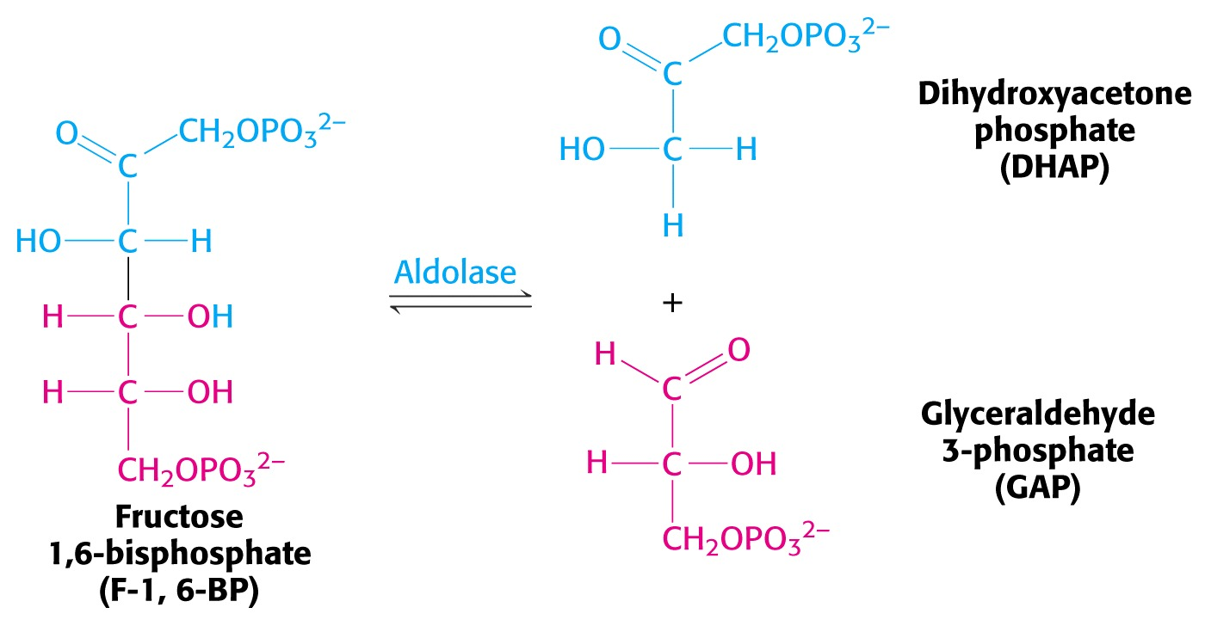
Glycolysis
Fructose-1,6-diphosphate is split into two 3-carbon sugars via a reverse aldol condensation reaction catalyzed by aldolase.

Slide 12
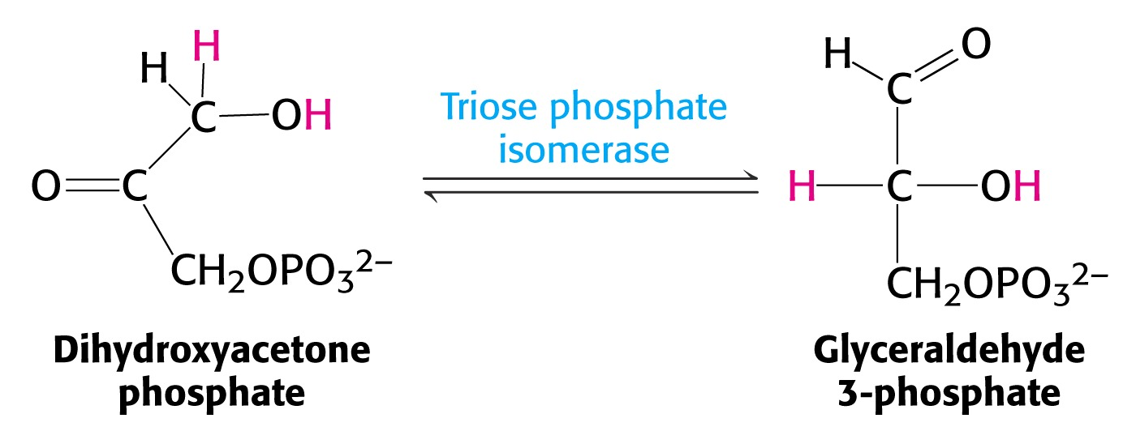
Glycolysis
Dihydroxyacetone phosphate is then isomerized to glyceraldehyde-3-phosphate:
From this point forward, we have TWO identical 3-carbon molecules continuing on through the glycolytic pathway.

Slide 13
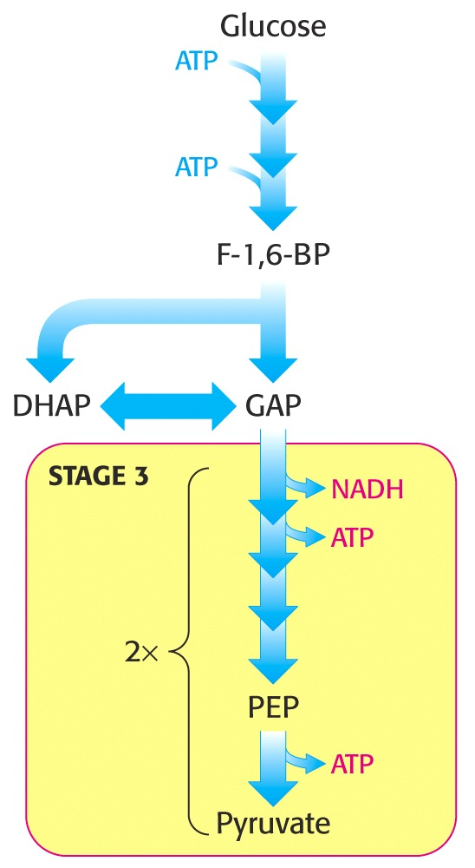
Glycolysis
Until this point in the pathway, no gain in energy or reductive power has been achieved. In fact, we have consumed two ATP molecules to get to this point.
The remaining reactions in this pathway now reciprocate by yielding beneficial gains.

Slide 14
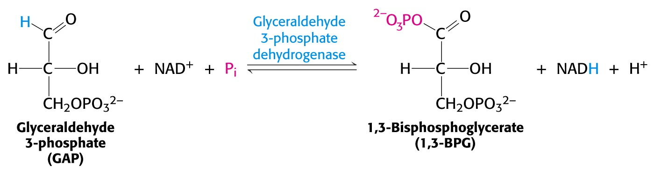
Glycolysis
Glyceraldehyde-3-phosphate is oxidized to 1,3-biphosphoglycerate (1,3-BPG), catalyzed by a dehydrogenase enzyme.
Electrons lost during this oxidation are transferred to NAD⁺, forming NADH, preserving the reducing power (reductive potential) of the electrons for other metabolic reactions.
In 1,3-BPG the #1 carbon has been oxidized from an aldehyde to an acid, but phosphate has been linked via a relatively high energy anhydride (acyl-phosphate) linkage:

Slide 15
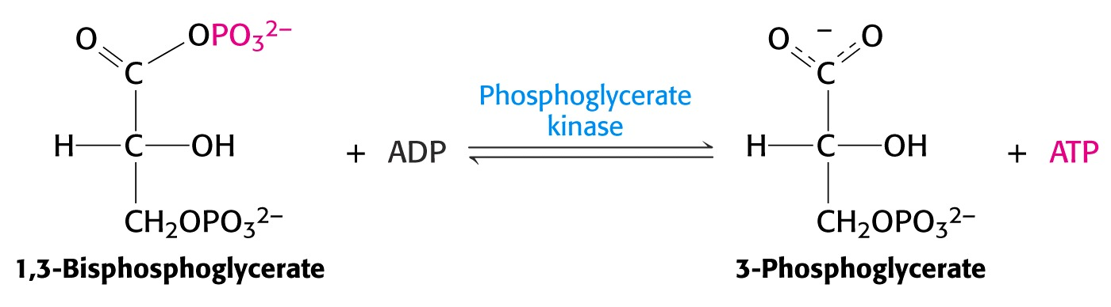
Glycolysis
The high-energy phosphate is now utilized to synthesize ATP. A “kinase” enzyme catalyzes the transfer of phosphate from 1,3-BPG to ADP:

Slide 16
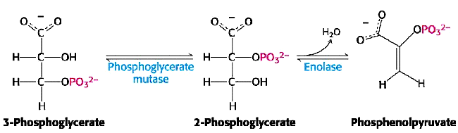
Glycolysis
The next two reactions of glycolysis isomerize G3P to G2P and dehydrate G2P to form phosphoenolpyruvate (PEP).
PEP contains an extremely high-energy phosphate, with a phosphate group transfer potential much higher than ATP!

Slide 17
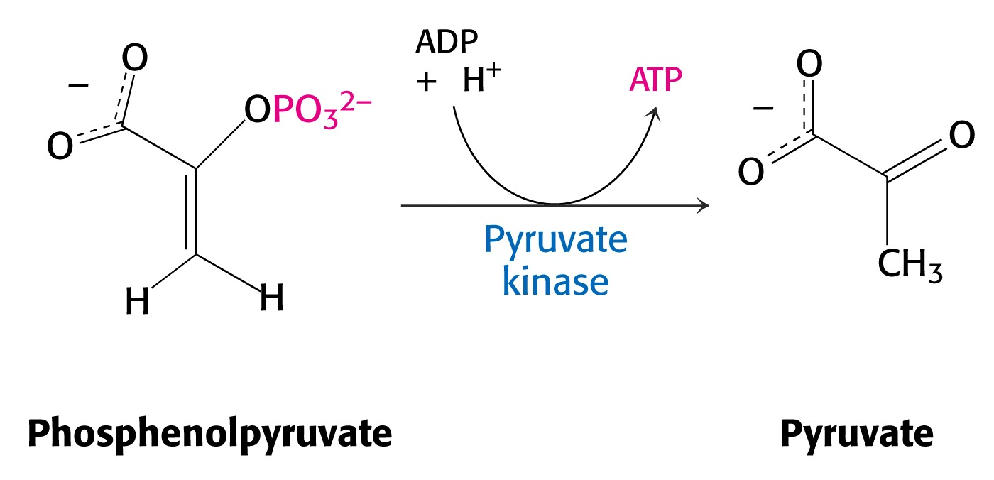
Glycolysis
Utilizing this high transfer potential, the enzyme pyruvate kinase transfers phosphate to ADP (forming ATP), leaving pyruvic acid (pyruvate) as the final product of glycolysis.

Slide 18
Glycolysis
The entire glycolysis pathway converts one molecule of glucose into two molecules of pyruvate.
During this series of reactions, two molecules of ATP are consumed and for ATP’s are synthesized, yielding a Net Gain of 2 ATP’s.
In addition, the oxidation of two molecules of 1,3-BPG yield two molecules of NADH, saving the reductive power of these electrons for future use.

Slide 19
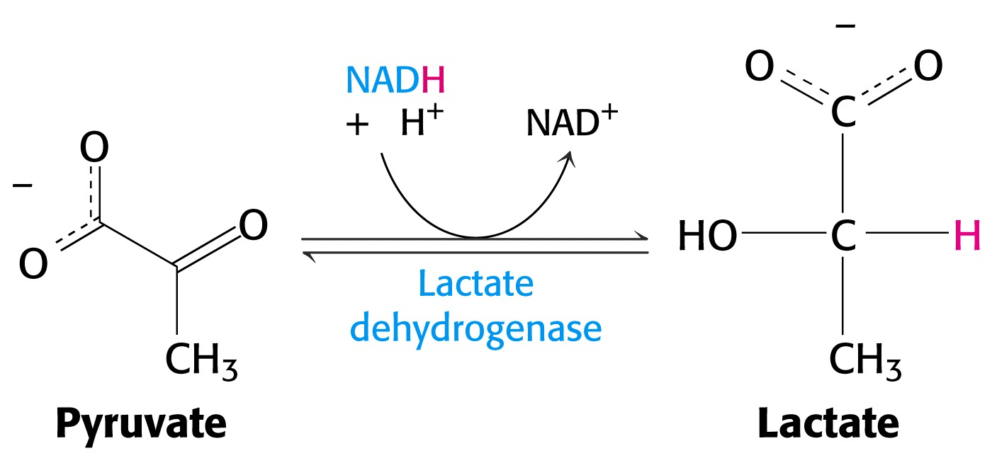
Glycolysis
Pyruvate is a flexible intermediate. For energy production, it normally diffuses into the mitochondrion where it will be oxidized further.
However, mitochondrial oxidation requires oxygen. If oxygen is lacking in the tissue cells of animals (hypoxic condition), then pyruvate is converted into lactic acid.

Slide 20
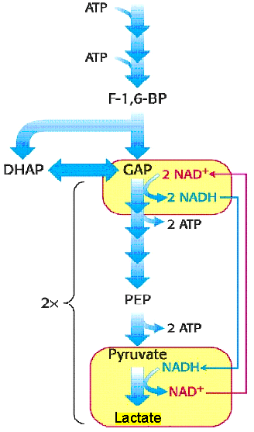
Glycolysis
The reduction of pyruvate’s ketone functional group into an alcohol requires a reducing agent. NADH provides the electrons and enough reduction potential to do the job.
In fact, consuming NADH is the main goal of this reaction. Cellular levels of NAD⁺/NADH are limited, and oxidation of NADH back to NAD⁺, provides an ongoing supply of this reactant for continued oxidation of GAP and continued production of ATP.
Lactate is a “dead end” in this provisional shunt, accumulating in muscle cells during strenuous activity. Eventually, it must be oxidized back to pyruvate (a task normally performed by the liver).

Slide 21
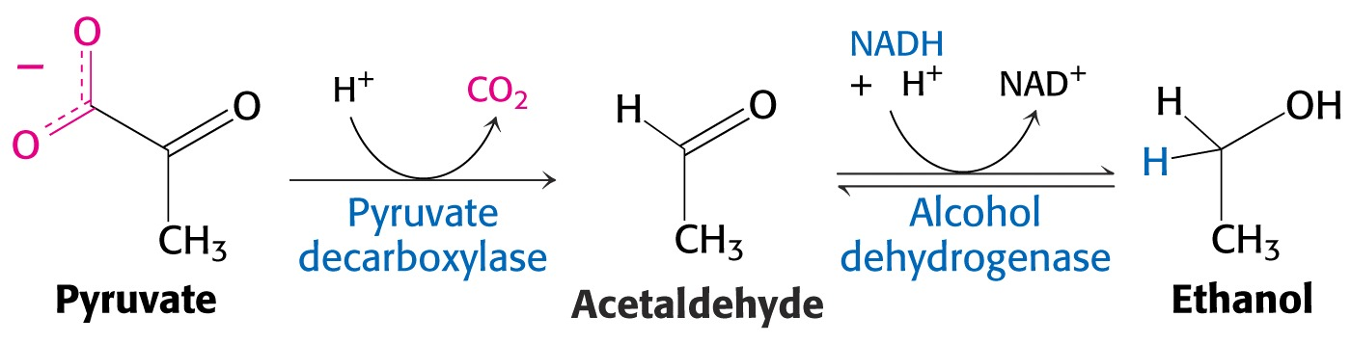
Glycolysis
In yeast and other microorganisms, hypoxic conditions result in a different product to maintain redox equivalence (NAD⁺ supply).
These organisms first decarboxylate pyruvate, forming acetaldeyde and then reduce it to ethanol.
Anaerobic conversion of glucose into ethanol is called fermentation, one of the most studied and applied biochemical pathways of all time.

Slide 22
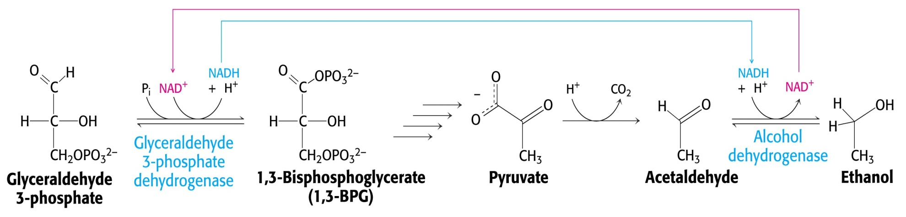
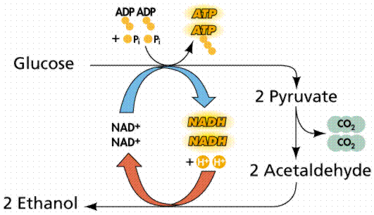
Glycolysis
http://chemcases.com/alcohol/alc-03.htm

Slide 23
Glycolysis
Ethanol is the pharmaceutically active component of alcoholic beverages.
As such, it is heavily regulated and taxed by government agencies.
Prior to organized, governmental regulation, or even gas chromatography, methods were developed to test the alcohol content of beverages.

Slide 24
Glycolysis
Pirates, sailors, and merchants who would purchase rum (either for resale or consumption) would often test the alcohol content by pouring some of it over gunpowder and igniting it. If it burned rapidly the alcohol content was acceptable (usually > 50%). However, if the combustion was slow or didn’t work at all, it was considered inferior.
This “Proof” of 50% alcohol content has survived even today, with “100-proof ” alcohol containing 50% alcohol. (200-proof is equivalent to 100%).

Slide 25
Glycolysis – Toxicity of Alcohols
Like most other alcohols, ethyl alcohol is toxic.
The LD₅₀ is approximately 1 pint. (When consumed in a single dose, 1 pint will kill 50% of most humans.)
By comparison, the LD₅₀ for methanol is about one fluid ounce (30mL).
Ethylene glycol (antifreeze) is also very toxic. The vicinal alcohol groups impart a “sweet” taste to ethylene glycol, making it appealing to children and pets. All containers of EG should be kept in a locked cabinet away from children or pets to prevent accidental poisoning.

Slide 26
Glycolysis
The reason for these alcohols’ toxicity is their enzymatic oxidation to aldehydes or acids by alcohol dehydrogenase:

Slide 27
Glycolysis
Fermentation produces alcohol, but only to certain concentrations. As the alcohol content reaches approximately 8-14%, the microorganisms (yeast) die and their enzymes are denatured.
To obtain higher concentrations of alcohol, the mixture is distilled. The alcohol distills as an azeotrope, or a mixture of 95% alcohol and 5% water.
Common commercial forms of “distilled spirits” include “Everclear” (white lightening), a common name for 95% alcohol (190-proof), and “hard-drinks” such as whisky and vodka with approximate concentrations in the 70-140 proof ranges.
Question: Beer contains less than 8% alcohol. Is it a ‘distilled spirit?”

Slide 28
Glycolysis
During prohibition in the 1920’s, ethanol was produced and distributed on the “black market.” Extensive “back-woods” research in “open-air” clandestine laboratories was conducted… often yielding unique and highly confidential “recipes” for its production.
How is alcohol produced in a small-scale operation?

Slide 29
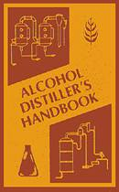
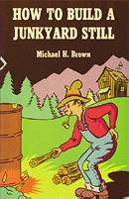
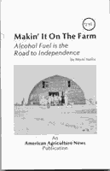
Glycolysis
Homemade alcohol appears to maintain its popularity, not just for consumption, but as an alternative fuel source.
Examples of currently available “textbooks” from the internet.

Slide 30
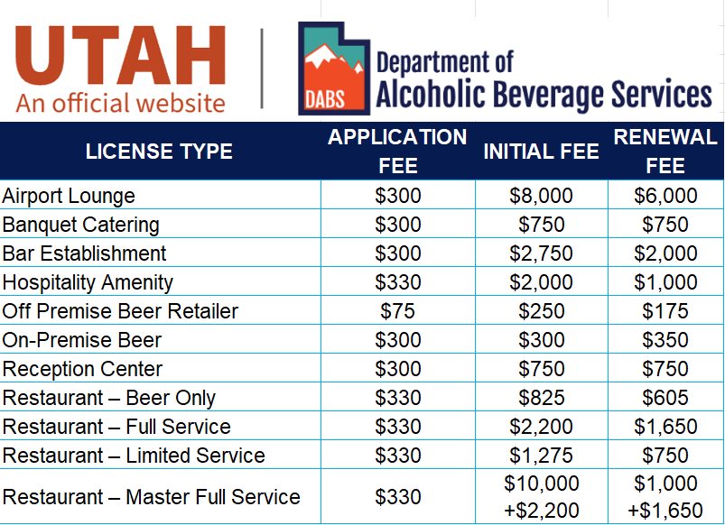
Glycolysis – Alcohol Licensing in Utah as of March 3, 2026
Source: https://abs.utah.gov/fee-schedule/

Slide 31
Glycolysis – Denatured alcohol
Since large quantities of ethyl alcohol are needed for industry and manufacturing, alcohol for this use is denatured.
Denatured alcohol is not regulated nor taxed by government agencies because it is unfit for human consumption.
Alcohol denaturation is accomplished by adding undesirable or toxic chemicals to the alcohol at ~ 5-10% by volume. (e.g., methanol, isopropanol, etc.)

Slide 32
Glycolysis
To summarize, anaerobic fermentation of glucose to ethanol by microorganisms or to lactate by animals is a temporary way to replenish NAD⁺ supplies to continue ATP production.
Aerobic oxidation of pyruvate by mitochondria is the more productive and most commonly encountered pathway to obtain the optimum energy benefit from carbohydrate metabolism.

Slide 33
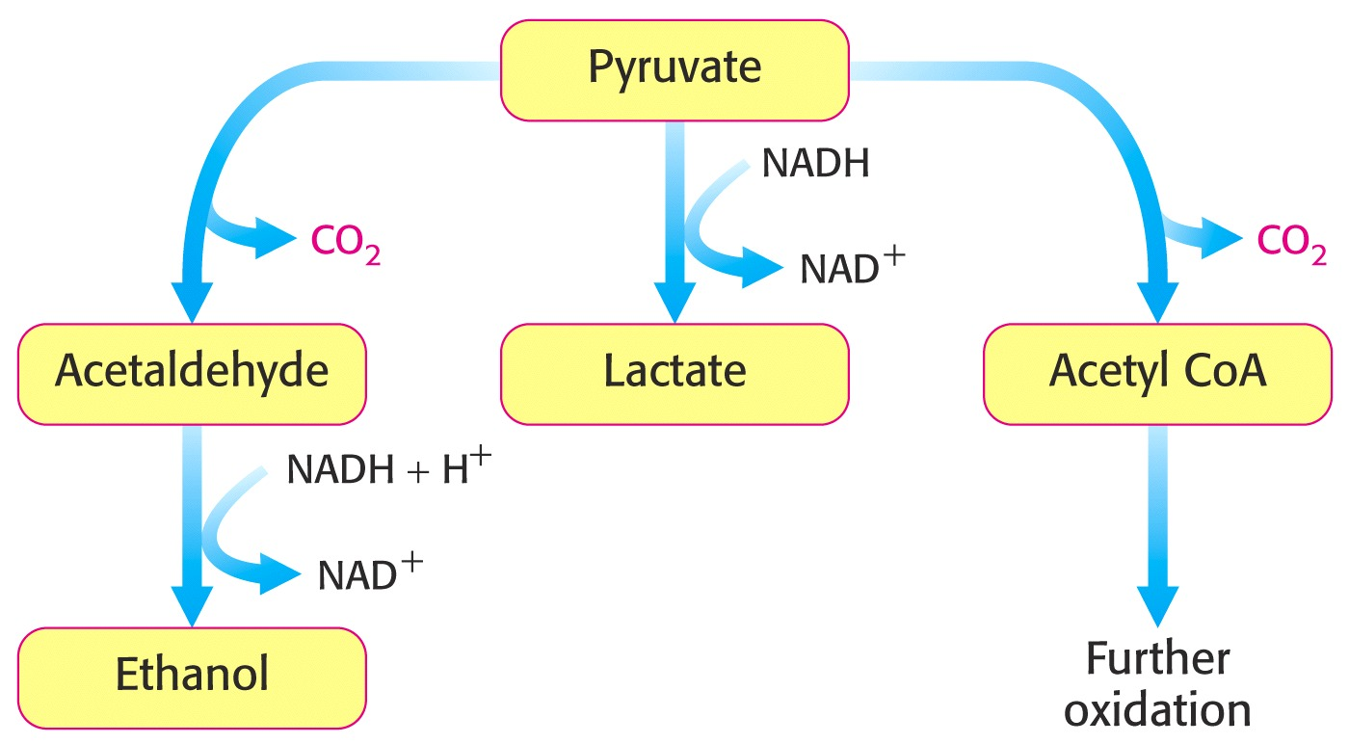
Glycolysis
Mitochondiral Oxidation

Slide 34
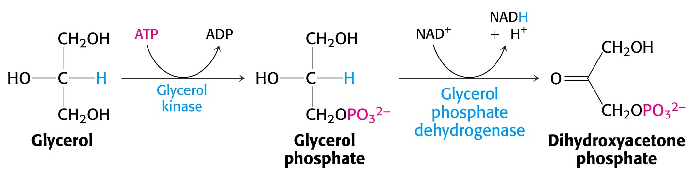
Glycolysis
Other chemicals can enter the glycolysis pathway by converting them into glycolytic intermediates.
For example, glycerin can be converted to dihydroxyacetone phosphate (DAP):

Slide 35
Gluconeogenesis
When levels of pyruvate are high and energy demands are low, pyruvate can be converted back into glucose by a series of reactions called “gluconeogenesis.”
Gluconeogenesis shares some of the same (reversible) reactions as the glycolysis pathway, however three of the reactions are very different due to their irreversible nature.

Slide 36
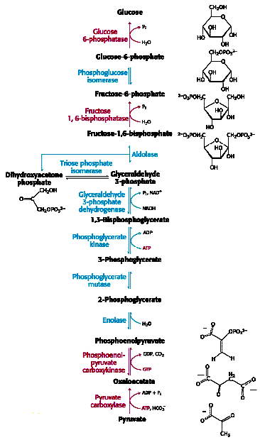
Gluconeogenesis
Gluconeogenesis reactions that differ from glycolysis.
1 & 2: Simple phosphatase enzyme hydrolyze the phosphates, releasing them from F-1,6-DP and F-6-P without synthesizing ATP.
3. Pyruvate carboxylase adds an activated CO₂ to pyruvate, forming oxaloacetate. Then the CO₂ is removed, yielding PEP.
(Biotin is an important enzyme cofactor, functioning as the carrier for activated CO₂ in the synthesis of oxaloacetate.)

Slide 37
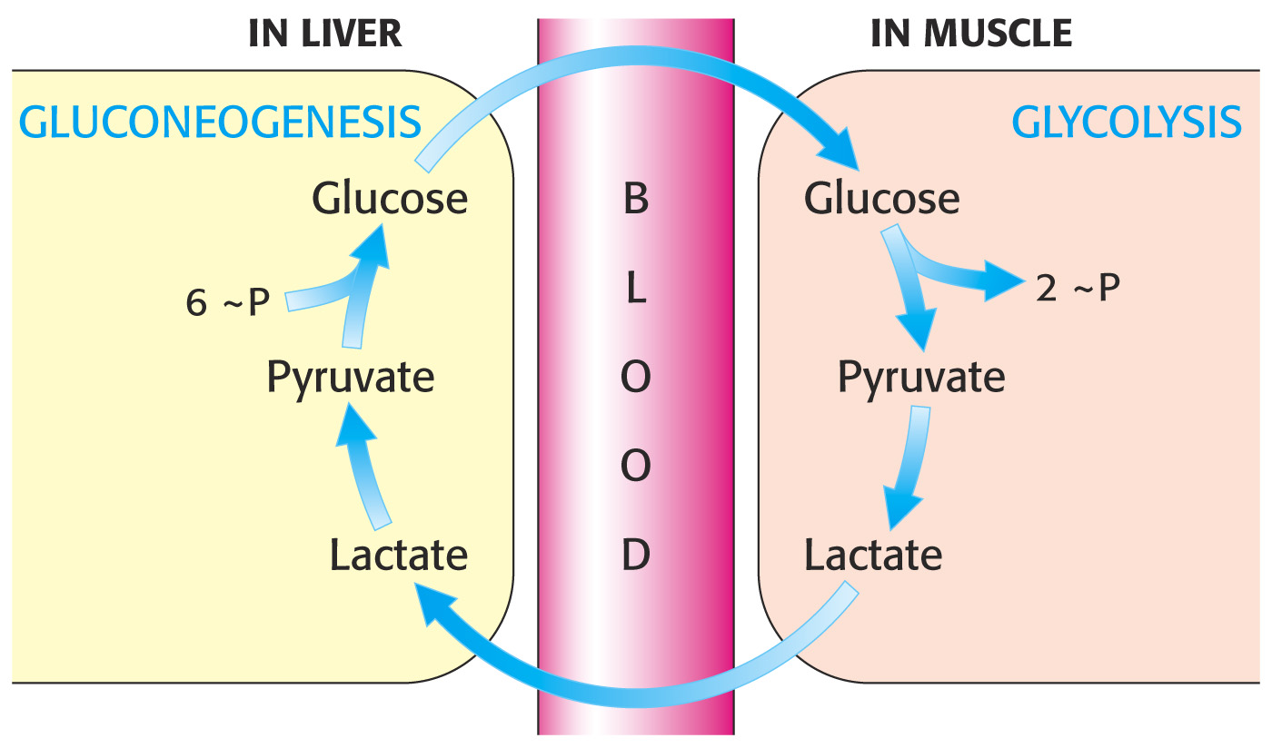
Glycolysis occurs primarily in the muscles, while gluconeogenesis occurs in the liver.
Lactate formed during anaerobic glycolysis is usually transported to the liver where it is converted all the way back to glucose via gluconeogenesis.
This process is often called the “Cori” cycle, named for the husband and wife team who first described it.

Slide 38
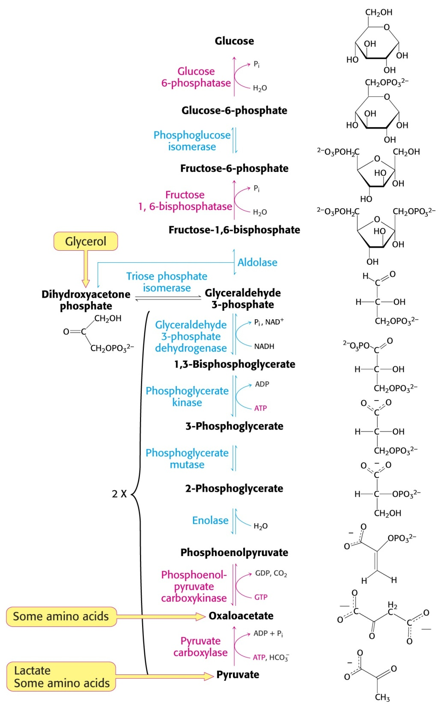
Gluconeogenesis
As a result of the gluconeogenic pathway, glucose can be synthesized from pyruvate and many other biomolecules such as amino acids:

Slide 39
End of Lecture Slides
for
Glycolysis
Credits: Many of the diagrams used in these slides were taken from Stryer, et.al, Biochemistry, 5th Ed., Freeman Press (in our course textbook) and from prior editions of this text.

