Slide 1
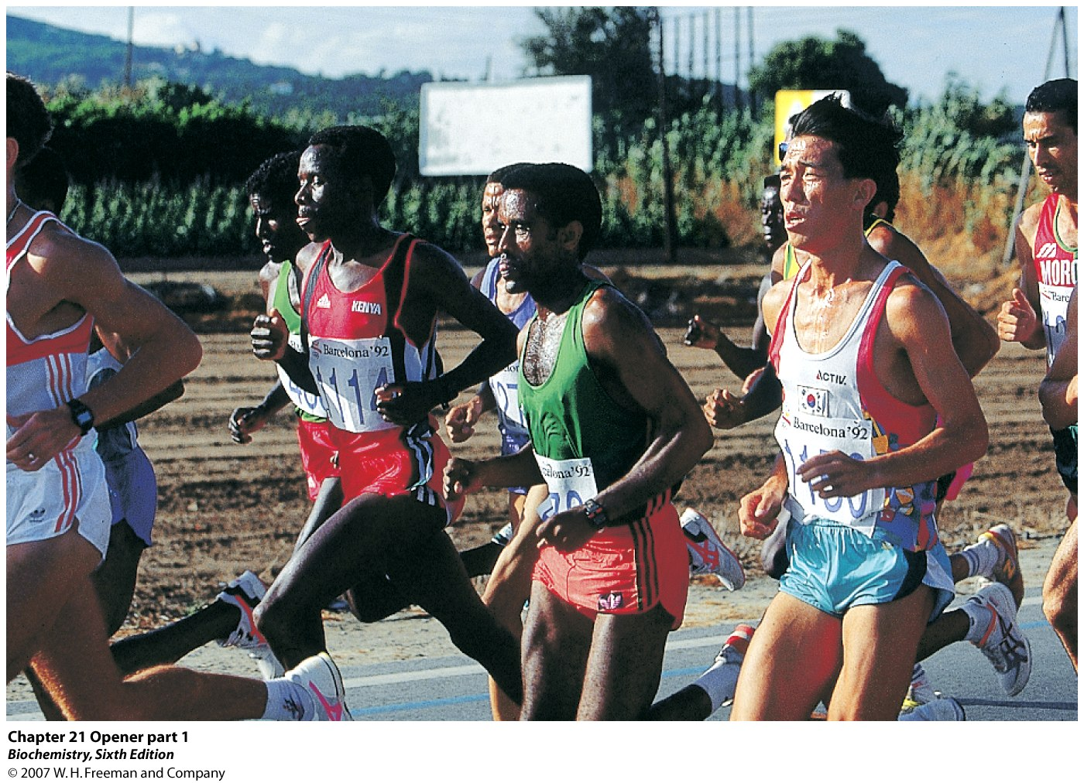
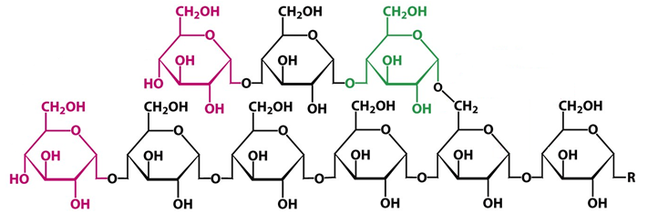
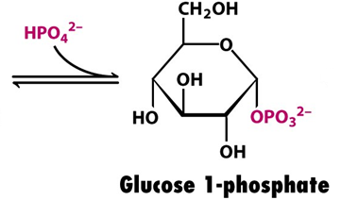
Glycogen Metabolism

Slide 2
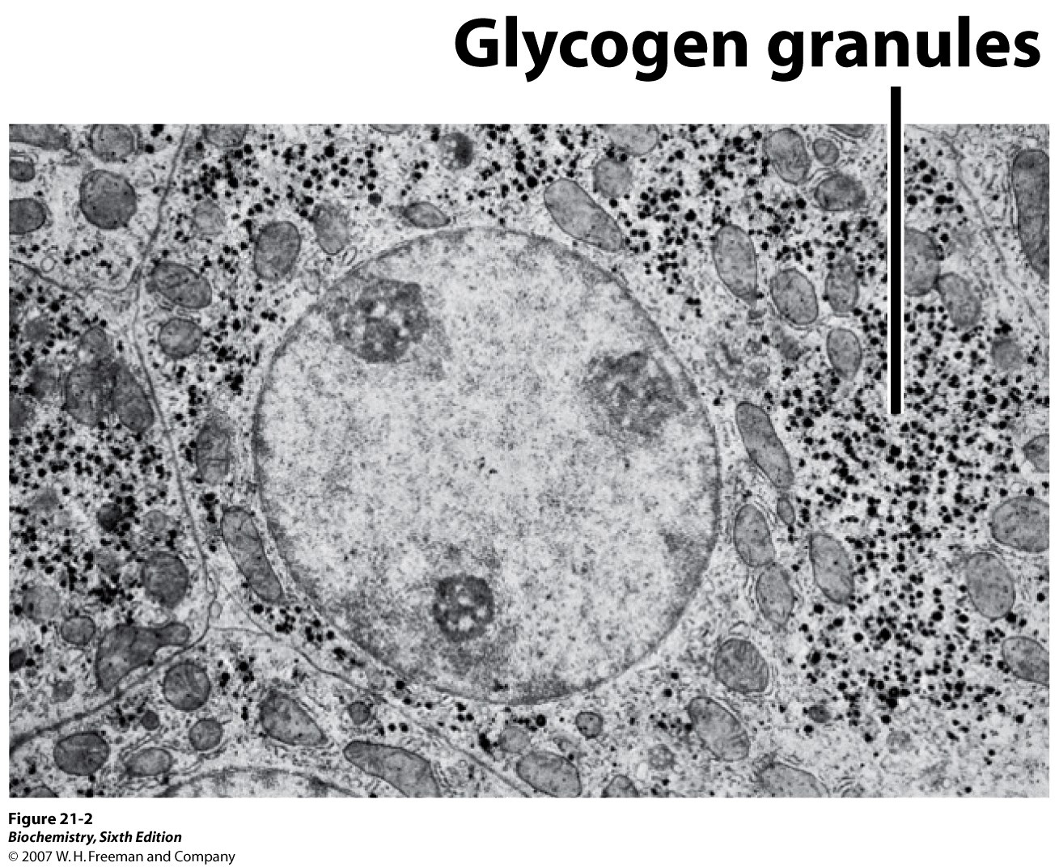

Slide 3
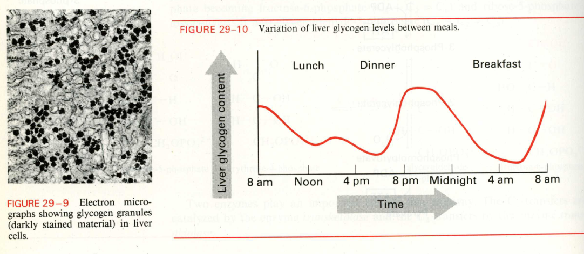

Slide 4
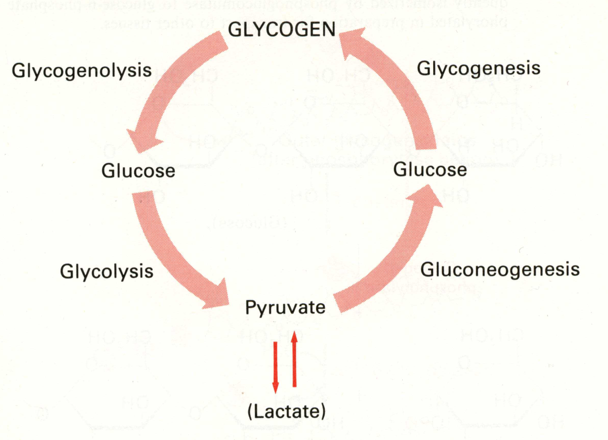
The important pathways of glucose metabolism. Note that the glycogen degradations pathways end in -lysis, while the glycogen synthesis pathways end with -genesis.

Slide 5
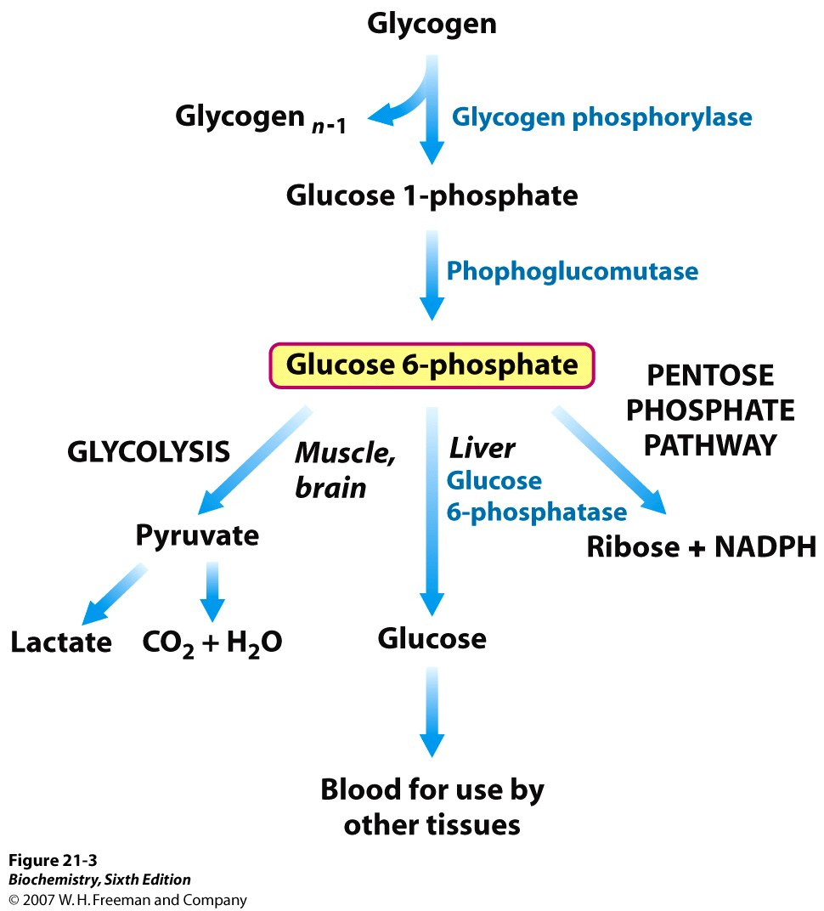

Slide 6
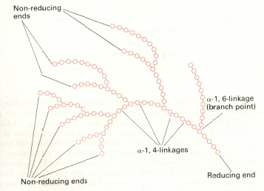
Glycogen nomenclature

Slide 7
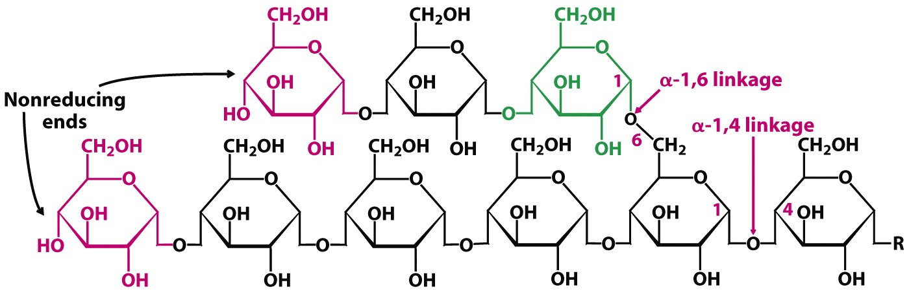

Slide 8
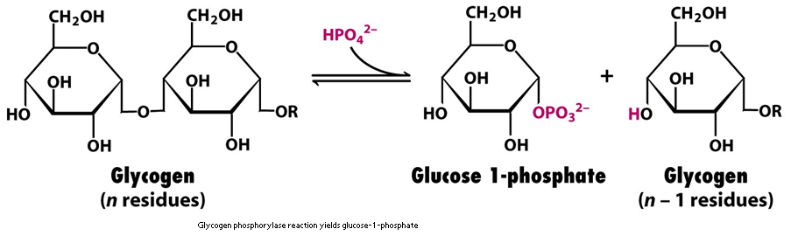

Slide 9
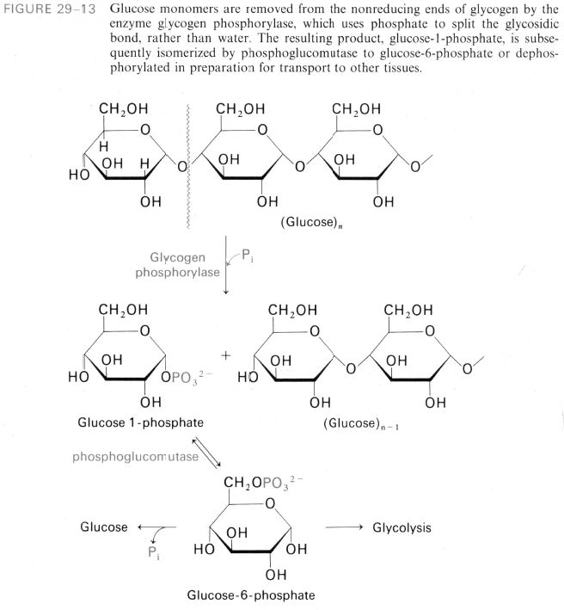

Slide 10
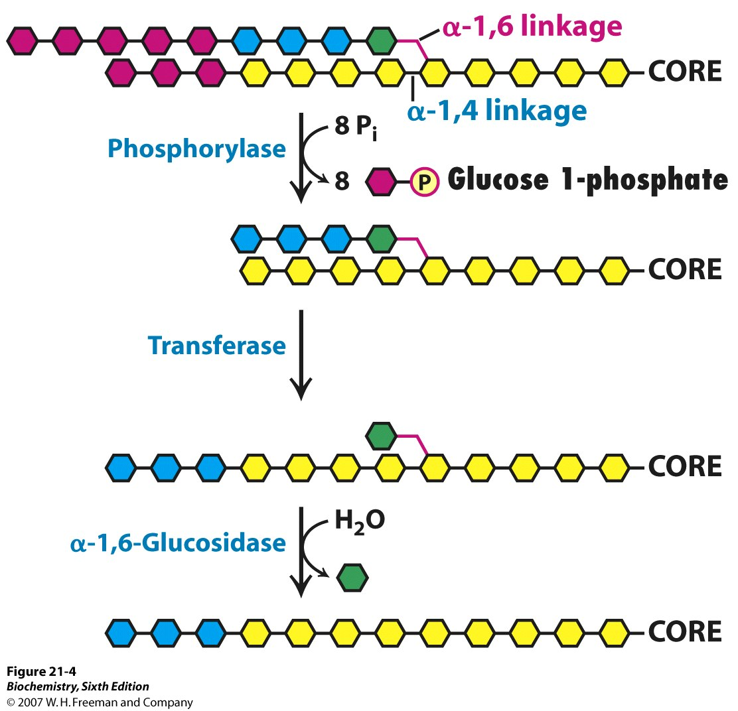

Slide 11
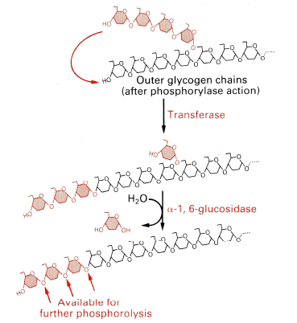
Glycogen De-branching Process

Slide 12
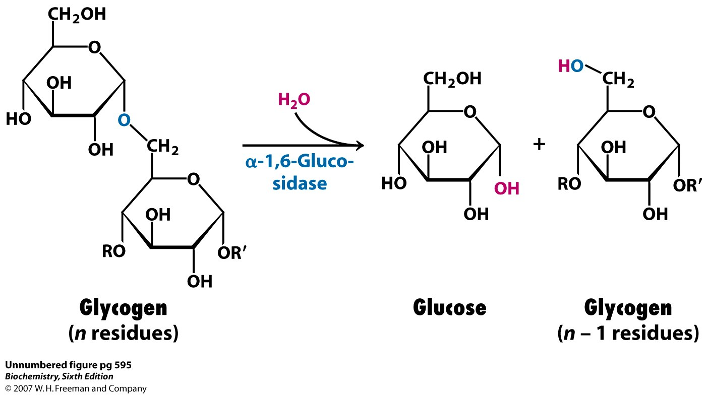

Slide 13
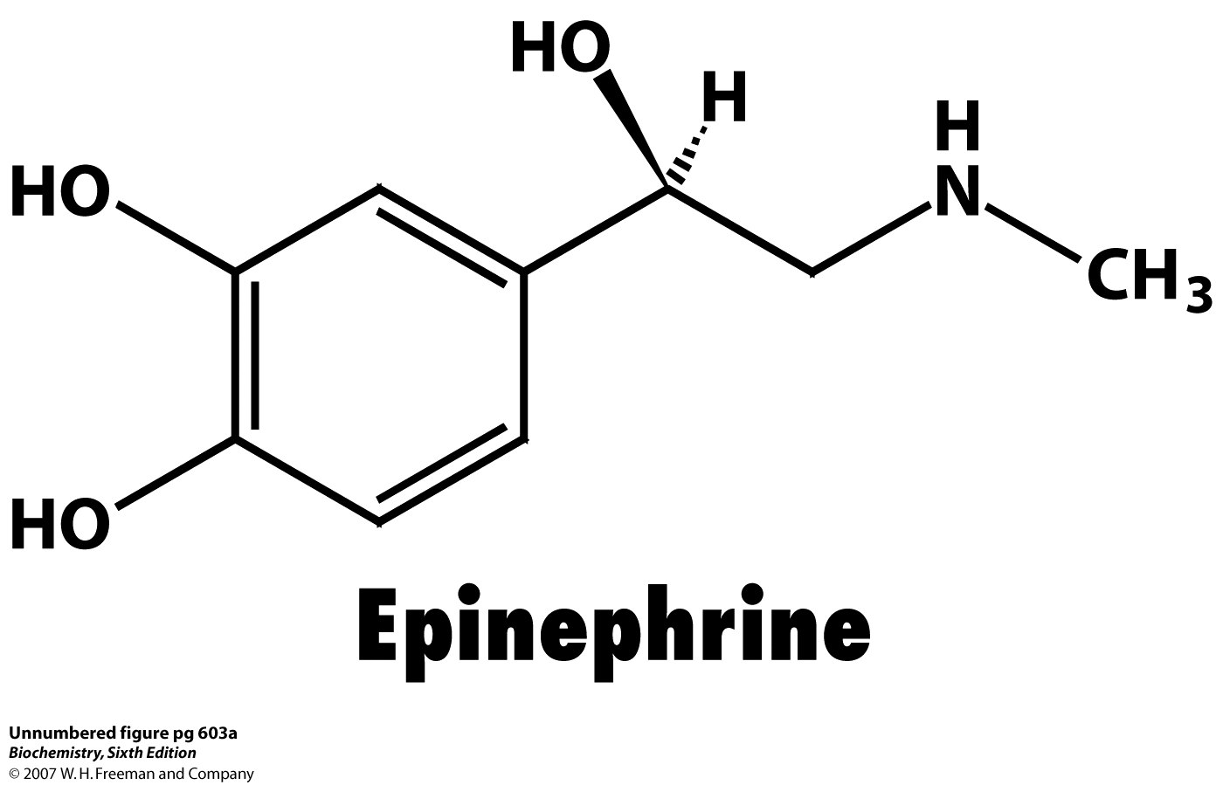
(β-phenylethylamine)

Slide 14
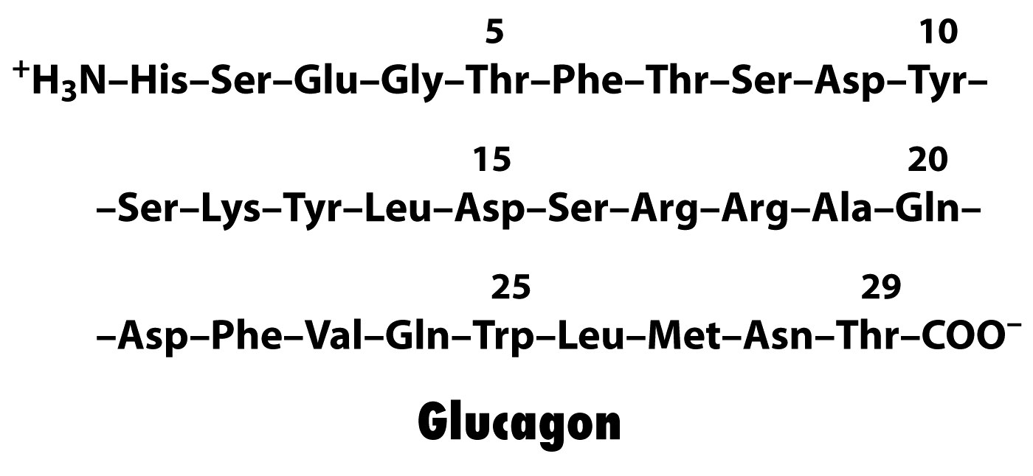

Slide 15
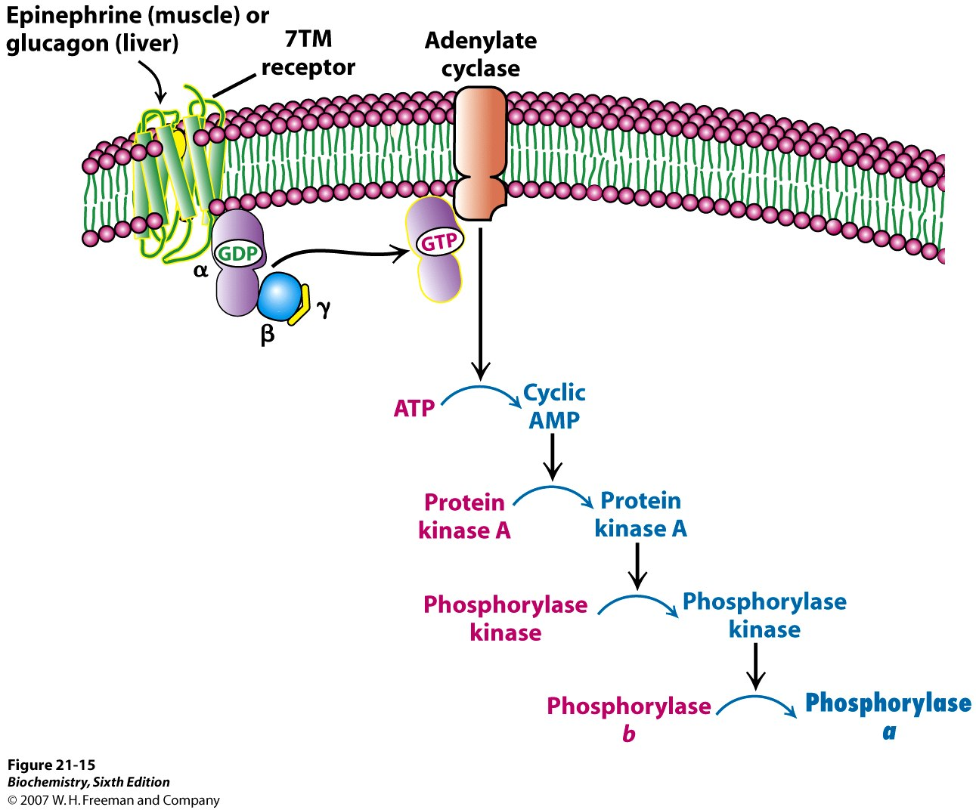

Slide 16
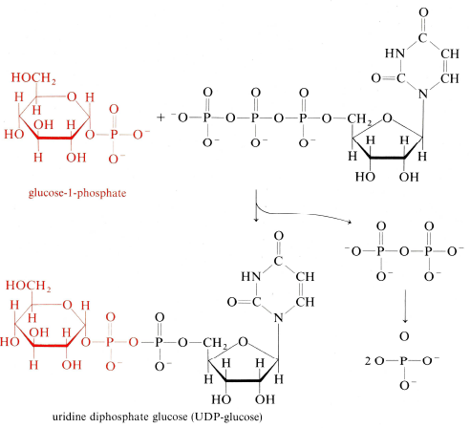
Glycogen Synthesis starts with the activation of glucose-1-P to UDP-glucose:

Slide 17
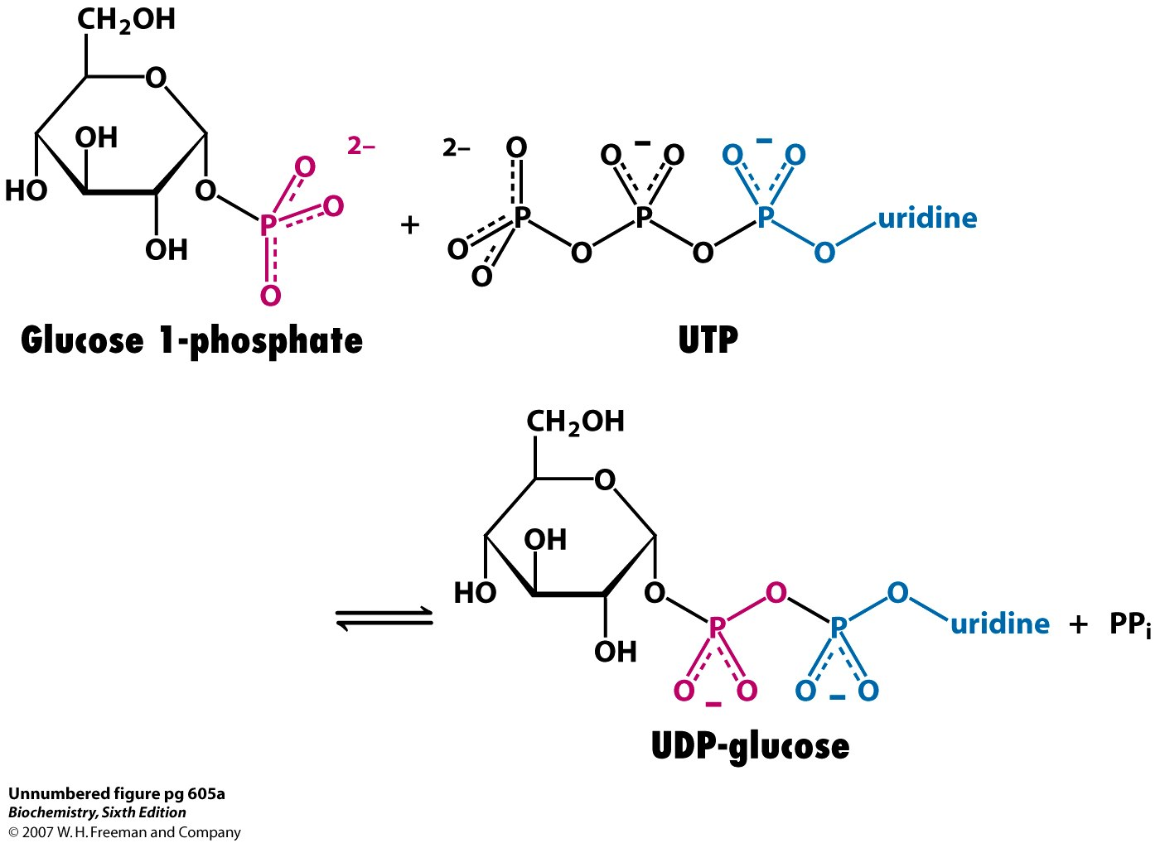

Slide 18
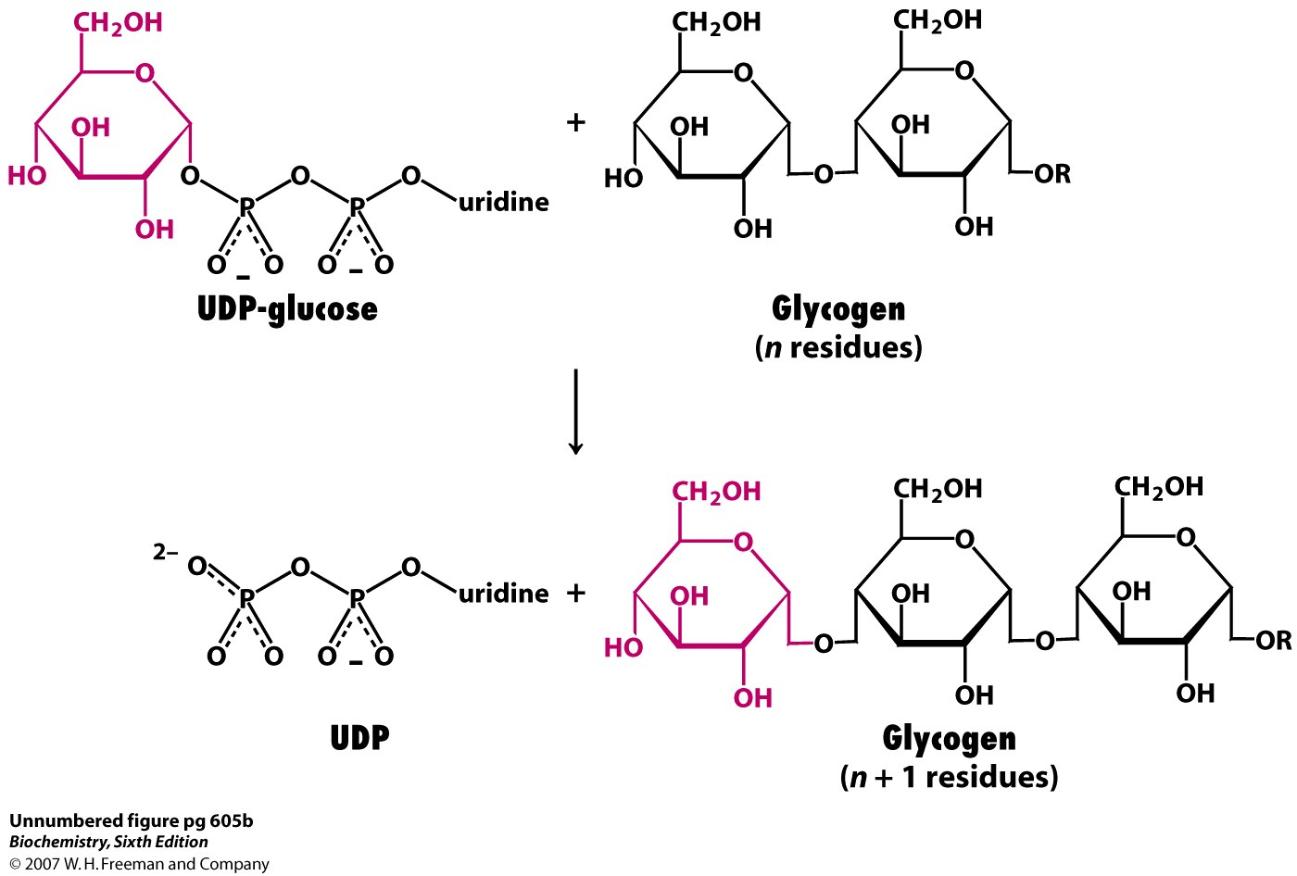

Slide 19
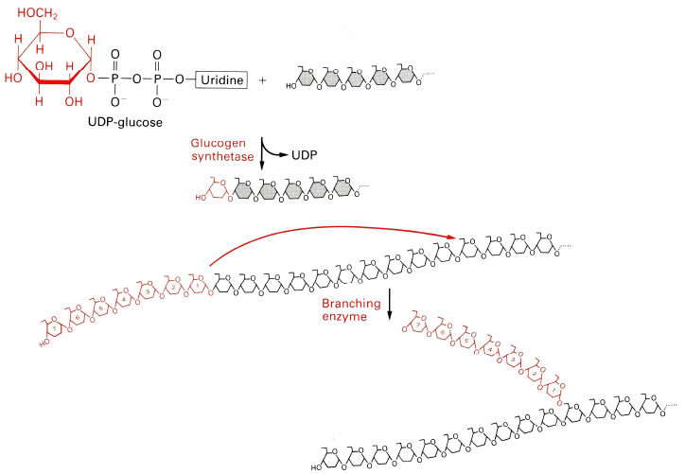
Glycogen Synthesis: Elongation & Branching

Slide 20
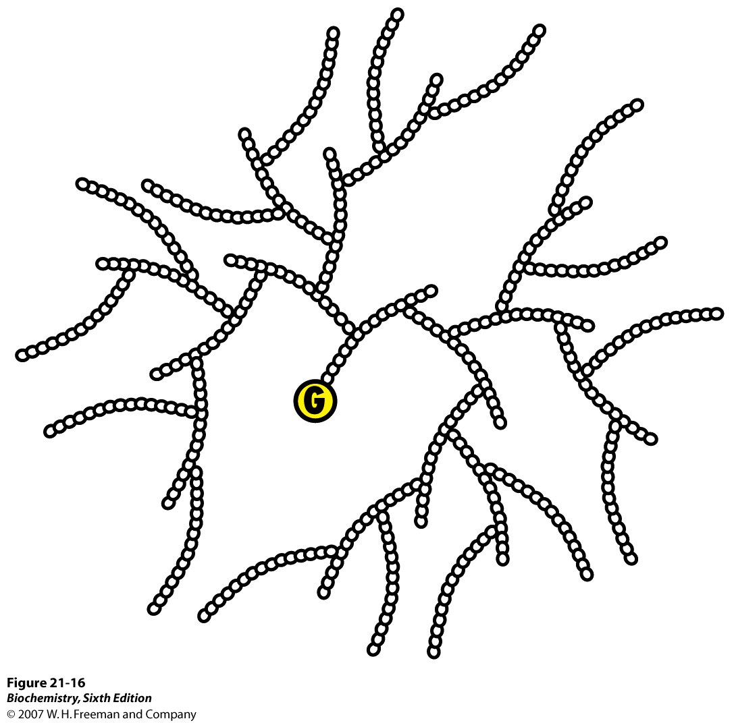

Slide 21
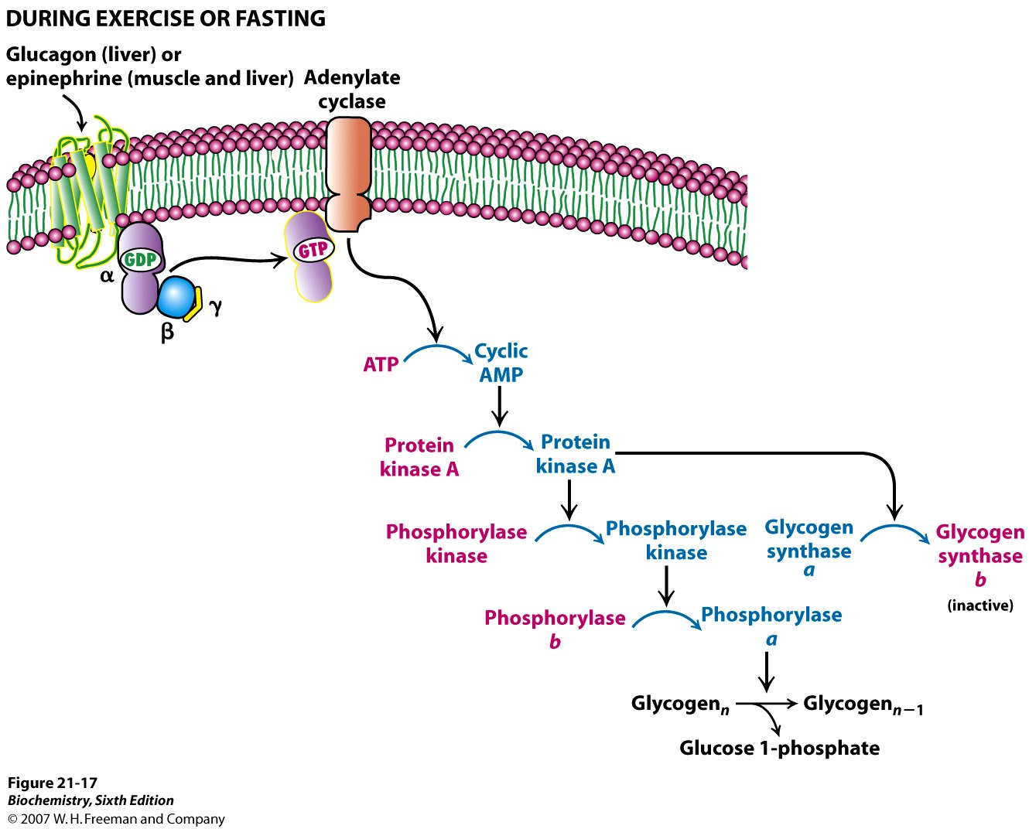

Slide 22
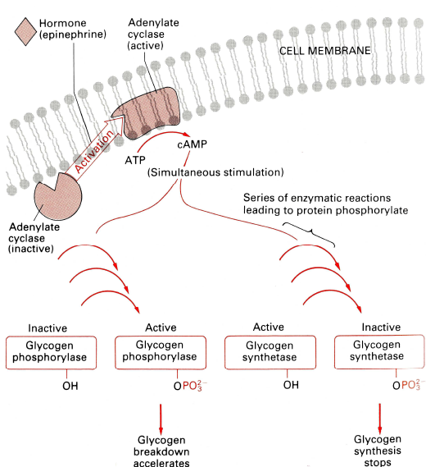
Hormonal regulation of Glycogen Metabolism

Slide 23
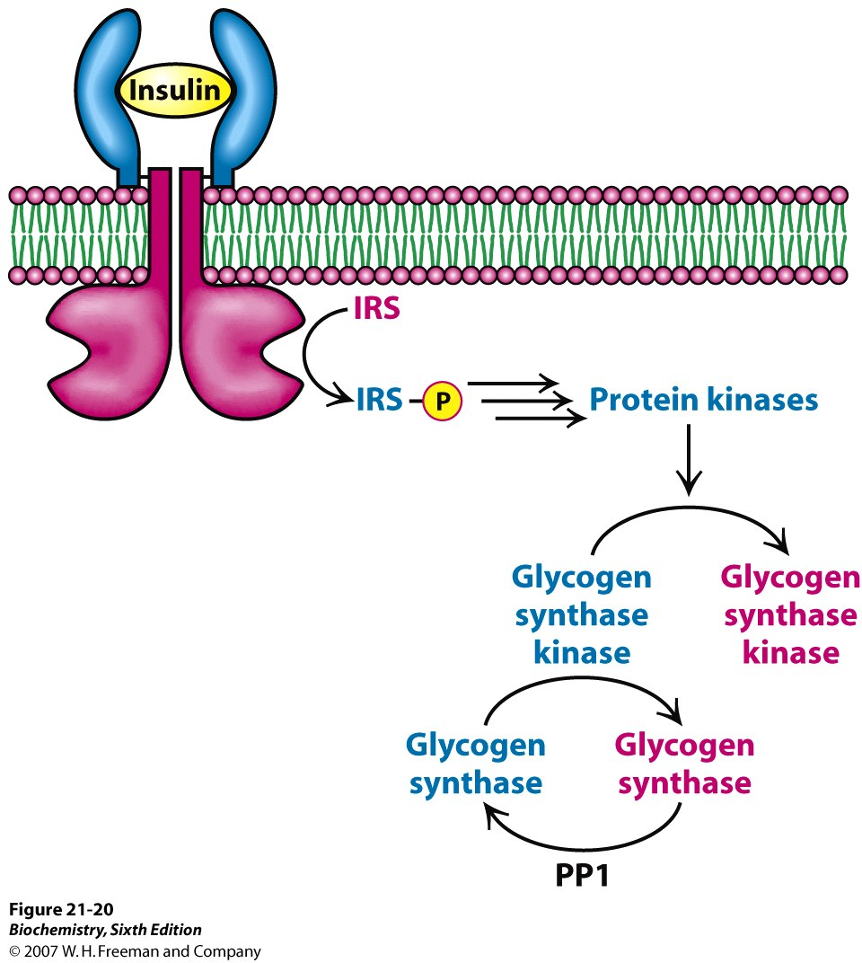

Slide 24
Hormonal regulation of Glycogen Metabolism
Insulin
Insulin Receptor Substrates [IRS-P]
Active protein kinases phosphorylate & inactivate glycogen synthetase kinase
Protein phosphatase -1 dephosphorylates glycogen synthetase, activating the enzyme and restoring glycogen reserves.
Glycogen Synthesis Accelerates

Slide 25
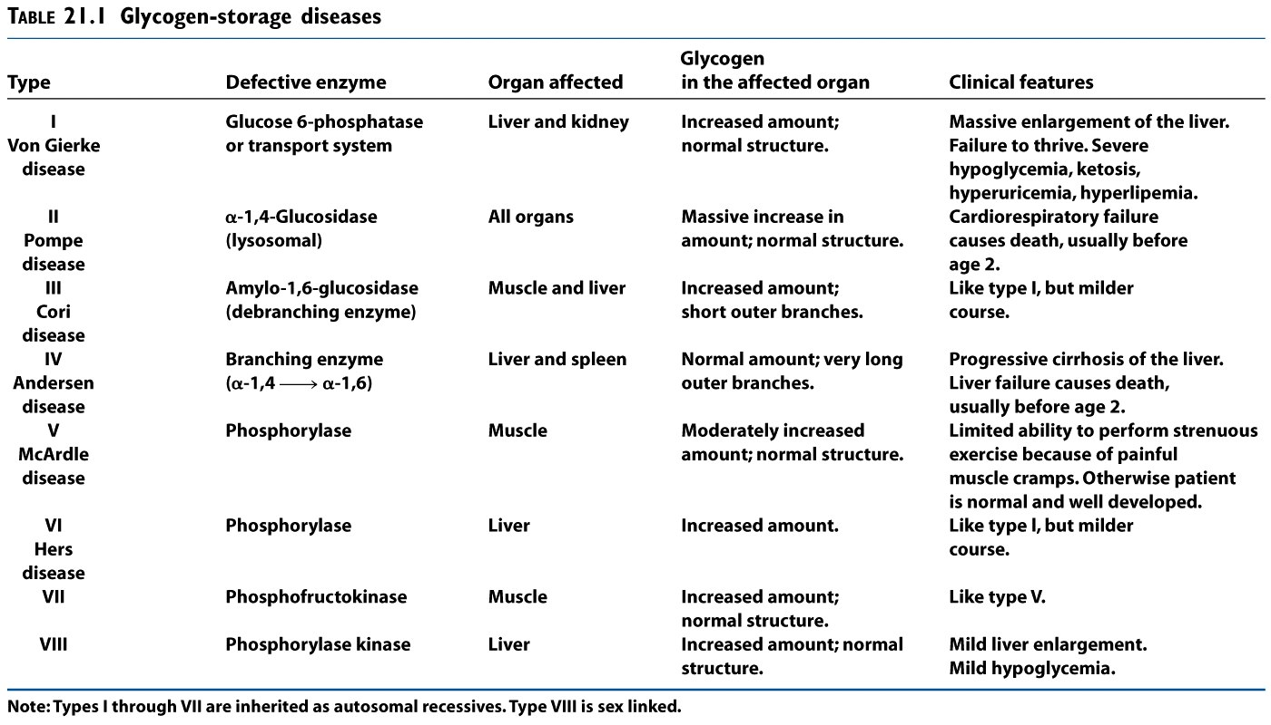

Slide 26
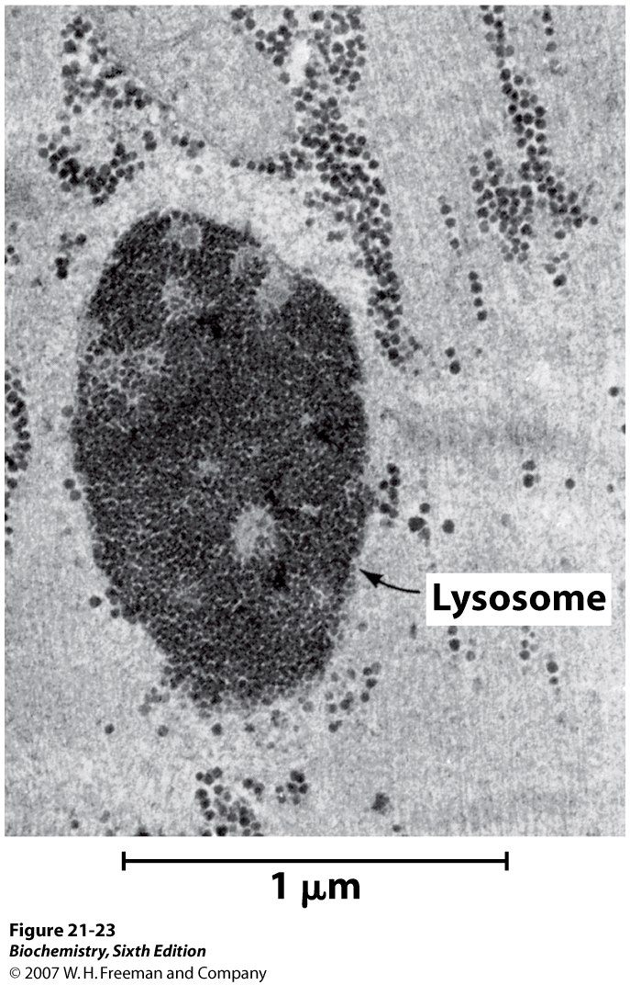
Glycogen-engorged lysosome:
Pompe’s disease is caused by a deficiency in α-1,4-glycosidase in lysosomes.
Although cytoplasmic glycogen levels are normal, polymers of glycogen can not escape from the lysosome.

Slide 27
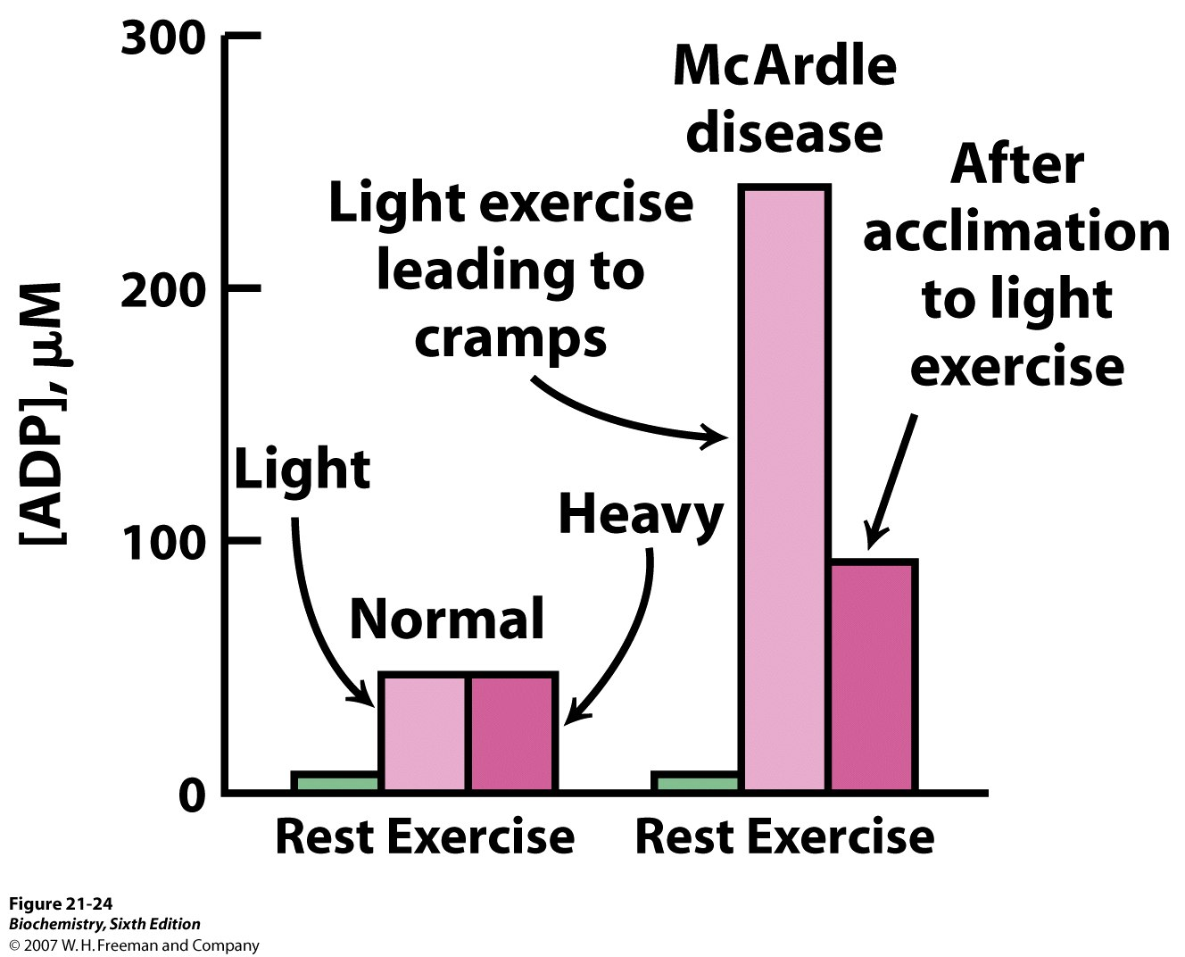
MRI (³¹P-NMR) studies show high levels of ADP in muscle cells of patients with McArdle’s disease.

Slide 28
McArdles’ disease is caused by an absence of muscle glycogen phosphorylase enzyme activity.
Subsequently, glycolytic activity slows and ADP accumulates. Creatine phosphate is hydrolyzed during strenuous exercise, yielding a more alkaline environment in muscle cells.

Slide 29
End of Glycogen Metabolism Lecture

