Slide 1
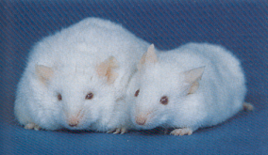
Biochemistry 3070
Fatty Acid Metabolism

Slide 2
Fatty Acid Metabolism
In a typical mammal, 10%-20% of the body weight is lipid, the bulk of which exist as triglycerides.
Recall from our earlier discussions, triglycerides are triacyl-esters of glycerol in which each of its three alcohol groups is esterified to a fatty acid.
Almost all fatty acids contain an even number of carbon atoms. We will see in this discussion that this is a result of the way they are synthesized, namely from acetyl-CoA (two carbon building blocks).
Triglycerides are excellent energy storage vehicles, offering the highest caloric density and potential energy compared to carbohydrates or proteins.

Slide 3
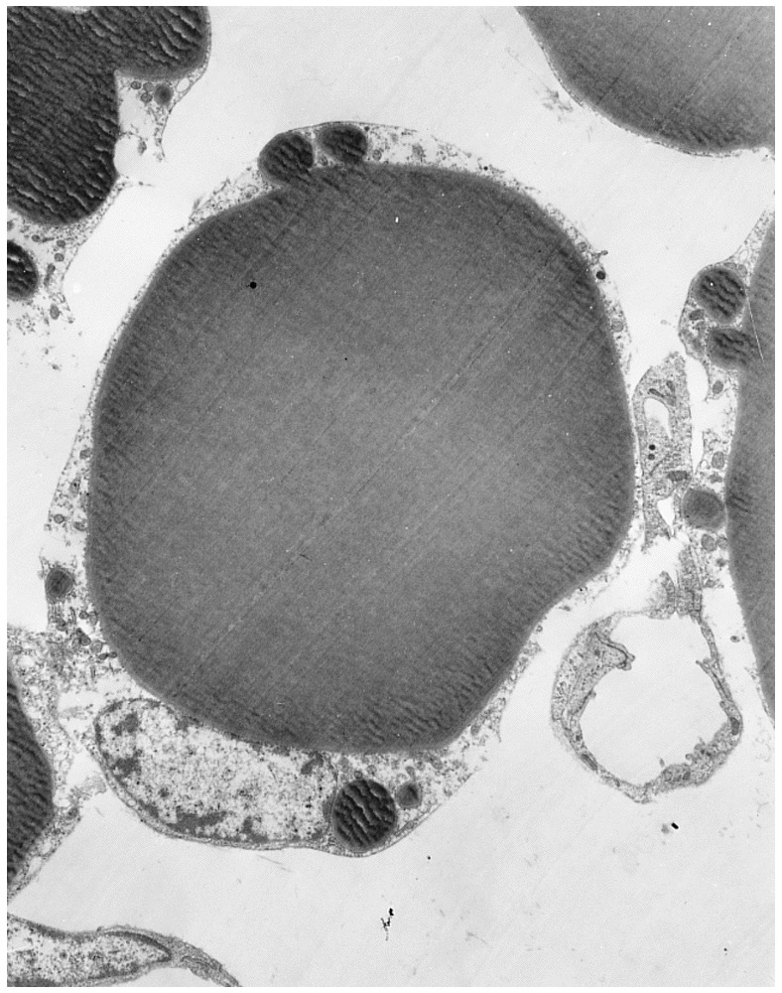
Fatty Acid Metabolism
Triglycerides are distributed in all organs, particularly in adipose tissue, where droplets of this lipid represent more than 90% of the cytoplasm of some cells.
About 100 times more energy is stored as mobilizable lipid than as mobilizable carbohydrate in the normal human being.
A normal 70kg man has roughly 15kg of triglycerides scattered throughout his tissues and organs.
This means that ~ 20% (15/70) of a man’s body weight contains 99% (100:1) of the energy (calories) in his body!

Slide 4
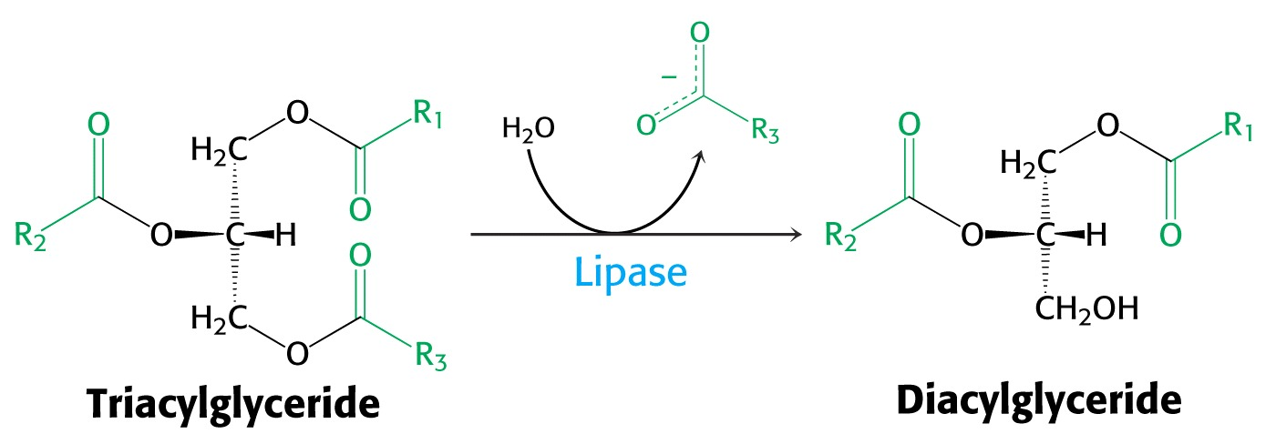
Fatty Acid Metabolism
Dietary lipids are emulsified in the small intestine with the help of bile salts secreted by the liver.
Prior to their absorption, they are hydrolyzed into individual fatty acids with the aid of enzymes such as pancratic lipase.

Slide 5
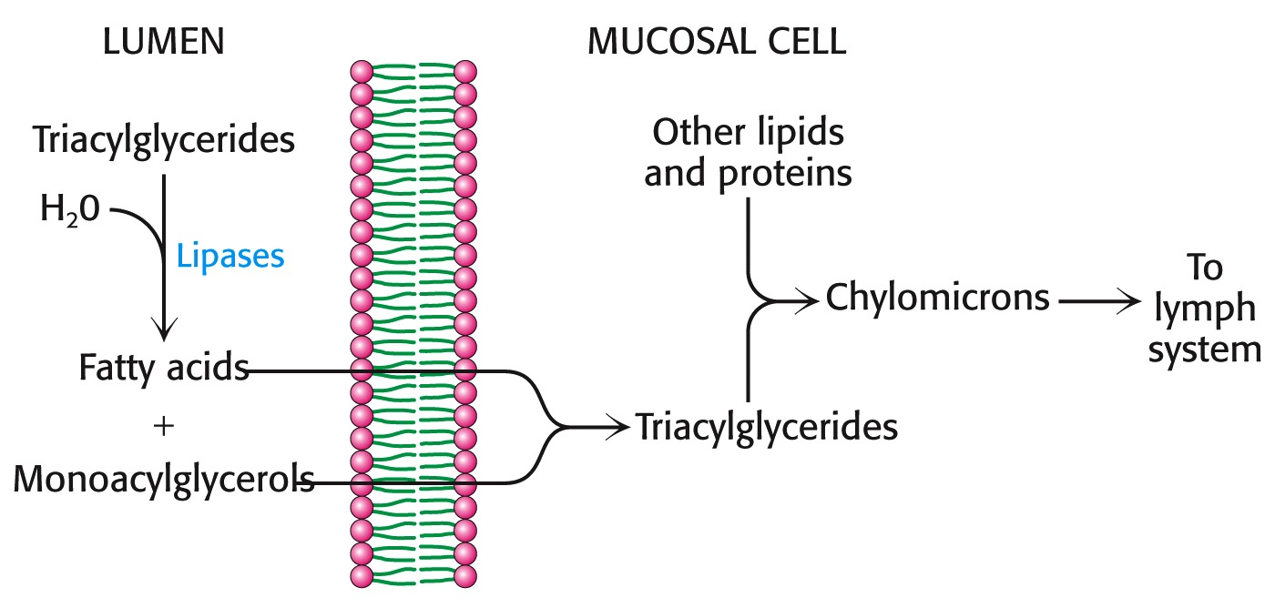
Fatty Acid Metabolism
The resulting free fatty acids are then absorbed from the lumen and are combined with other lipids and proteins in the mucosal cells.
Lipids transport packages of these lipids and protein called “cylomicrons” are then transported by the lymph system and eventually the blood stream to the tissues. Triglycerides are then resynthesized inside storage cells.

Slide 6
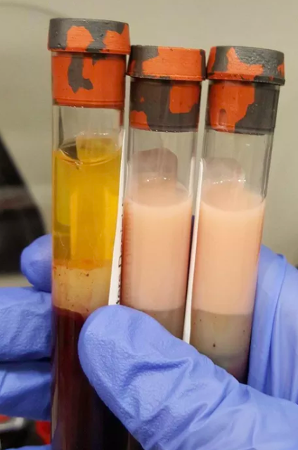
Fatty Acid Metabolism
If enough fatty acids are absorbed, the blood may appear slightly turbid and take on a yellow tint, due the presence of chylomicrons.
Upon centrifugation of chylomicron-laden blood, a lipid layer may form.
Usually within four hours after a meal, few if any chylomicrons remain in the blood, owing to their movement into adipose tissue cells or into the liver.

Slide 7





Good Bad Ugly

Slide 8
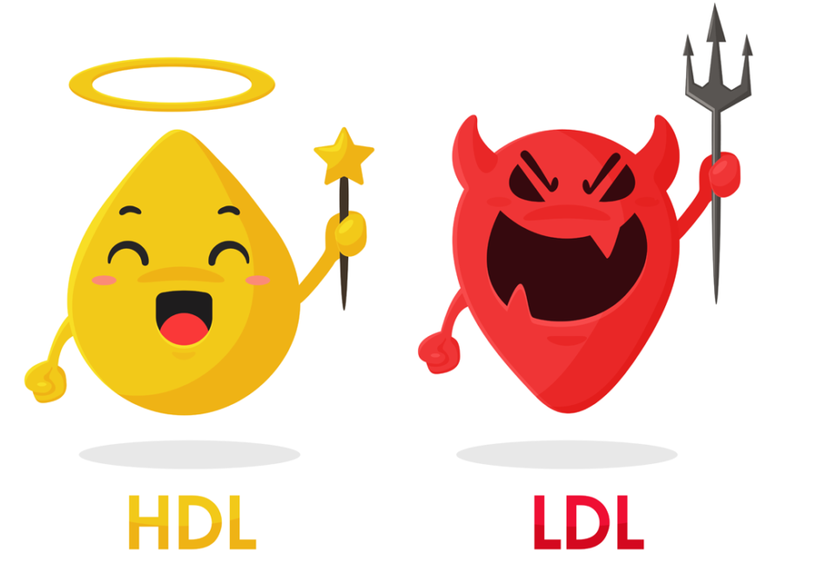
Fatty Acid Metabolism
In the postabsorptive state, when chylomicrons are virtually absent from the blood, some 95% of lipids (including cholesterol) in the blood are bound to lipoproteins (lipid transport proteins).
Two of these lipoproteins are classified according to their densities (as determined by centrifugation in salt solutions or D₂O):
  Low density lipoprotein (LDL) ← “Bad Cholesterol”
  High density lipoproteins (HDL) ← “Good Cholesterol”
These lipoproteins have received
considerable attention as indicators
of a tendency toward heart disease
and atherosclerosis.

Slide 9
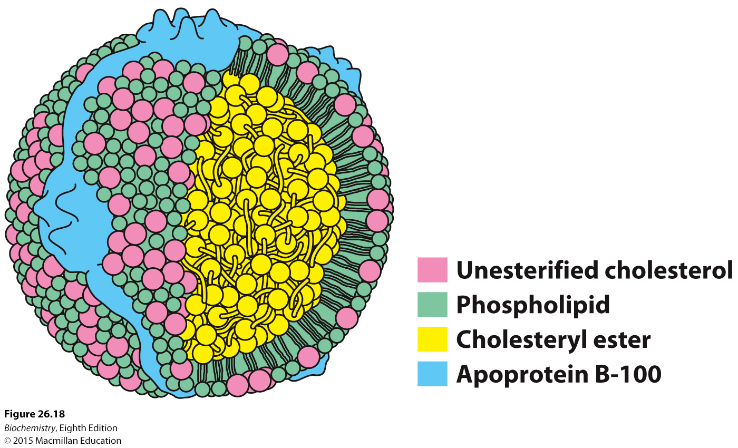
Lipoprotein Structure
High lipid content to protein ratio decreases density, yielding LDLs.
As lipid content decreases, density increases, yielding HDLs.

Slide 10
Fatty Acid Metabolism – HDL & LDL
Diets high in saturated fats and cholesterol tend to increase LDL levels in the blood.
LDL contains a relatively high percentage of cholesterol and appears to play a role in deposition of cholesterol in arteries (cholesterol is a major component of arterial plaque).
On the other hand, HDL is beneficial to human health, by apparently interfering with LDL chloesterol deposition.
Some evidence indicates that exercise tends to elevate HDL.
In general, a high ratio of HDL/LDL is an indicator of overall condition and health of the circulatory system.

Slide 11
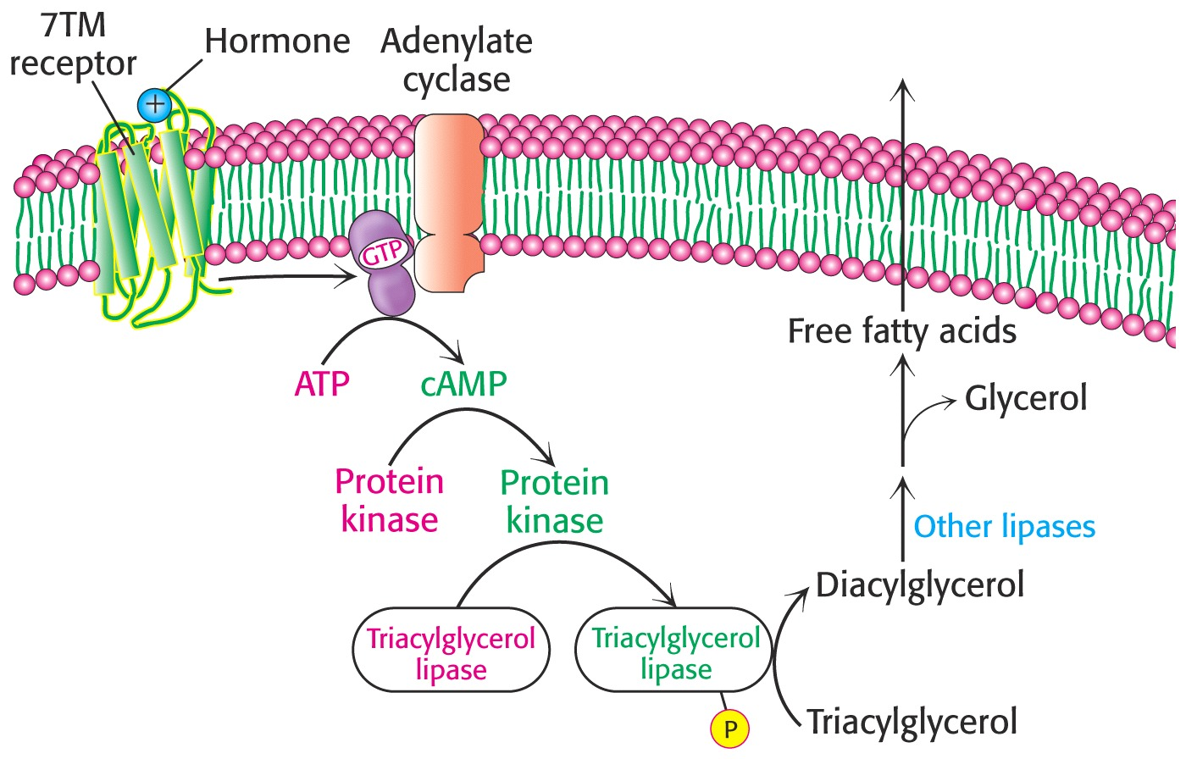
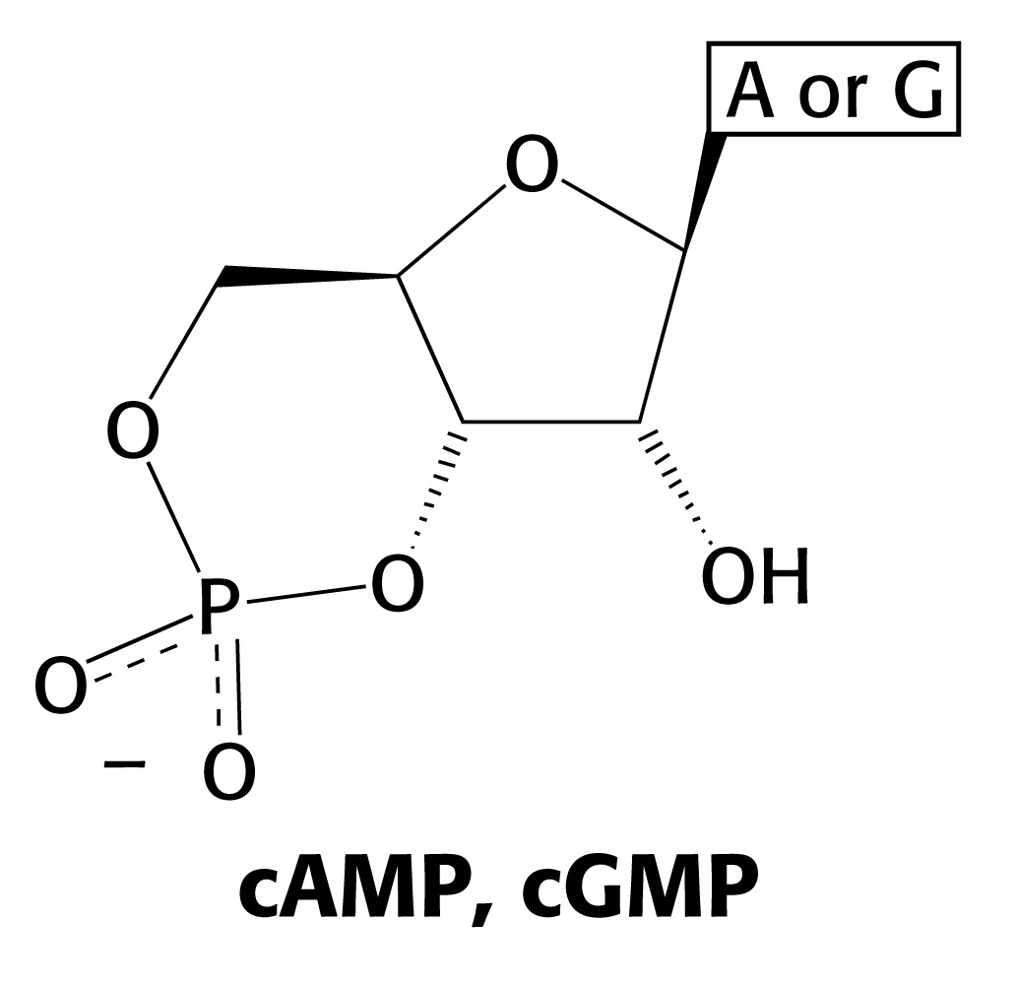
Mobilization of triglyceride energy reserves is regulated by cyclic AMP (cAMP)-mediated hormones that initiate an enzymatic cascade of reactions leading to the activation of triacylclycerol lipase, which hydrolyzes triglycerides back to free fatty acids.
cytosol

Slide 12
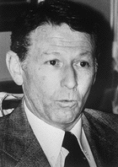
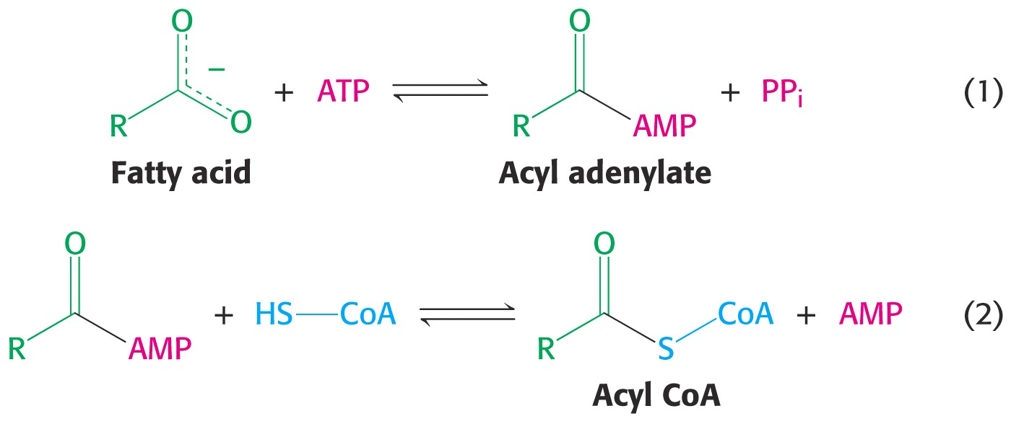
Fatty Acid Metabolism
Following absorption by energy-demanding cells, fatty acids are first “activated” prior to oxidation.
Paul Berg discovered that this occurs in two steps and that the process uses up two high-energy bonds of ATP a results in a “fatty acyl CoA”:
http://nobelprize.org/chemistry/laureates/1980/berg-autobio.html

Slide 13
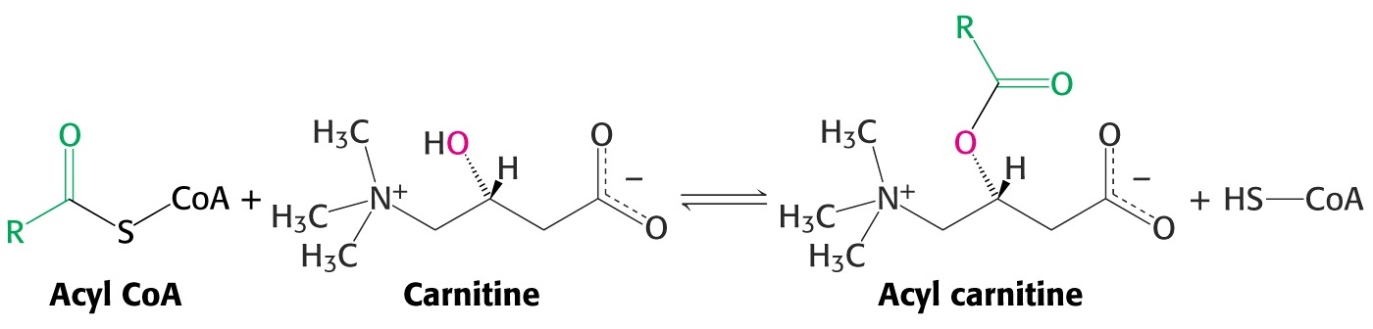
Fatty Acid Metabolism
Activation of fatty acids to fatty acyl CoAs occurs on the cytoplasmic surface of the mitochondrion.
However, actual oxidation of these acyl CoAs occurs in the mitochondrial matrix, necessitating their transport into the matrix.
This transport is medicated by a special mechanism that utilizes carnitine, an unusual quaternary δ-amino acid, to carry the fatty acid across the membrane(s).
The enzyme, acyltransferase, couples fatty acids to carnitine.

Slide 14
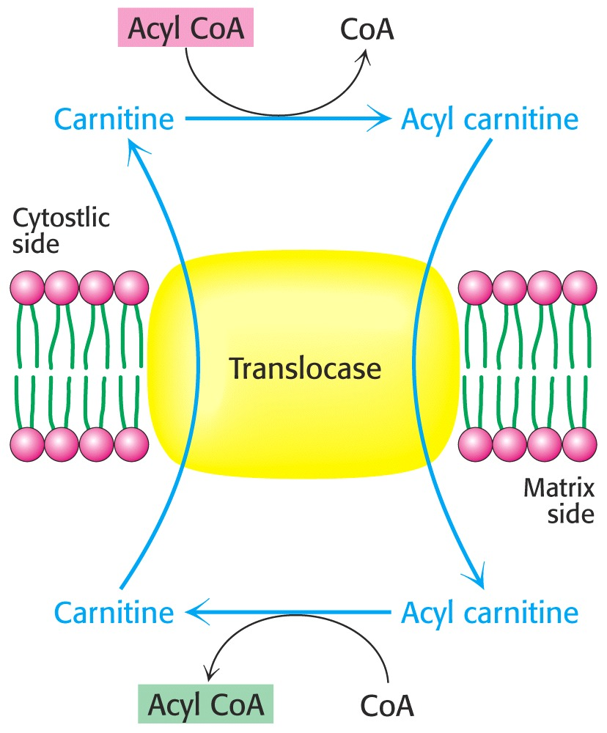
Fatty Acid Metabolism
Transport into the matrix is mediated by tranlocase:
Once in side the matrix, the fatty acyl CoA is ready for oxidation.

Slide 15
Fatty Acid Oxidation
In 1904, Franz Knoop conduced the first “labeling” experiment to determine how fatty acids are metabolized.
He fed dogs different length synthetic fatty acids, each terminating with an ω-phenyl group.
Urine extracts yielded to types of products:
Odd-numbered fatty acids → benzoic acid
Even-numbered fatty acids → phenyl acetate.
His conclusion:
Oxidation of fatty acids occurs at the β-carbon.
Why did he come to this conclusion?

Slide 16
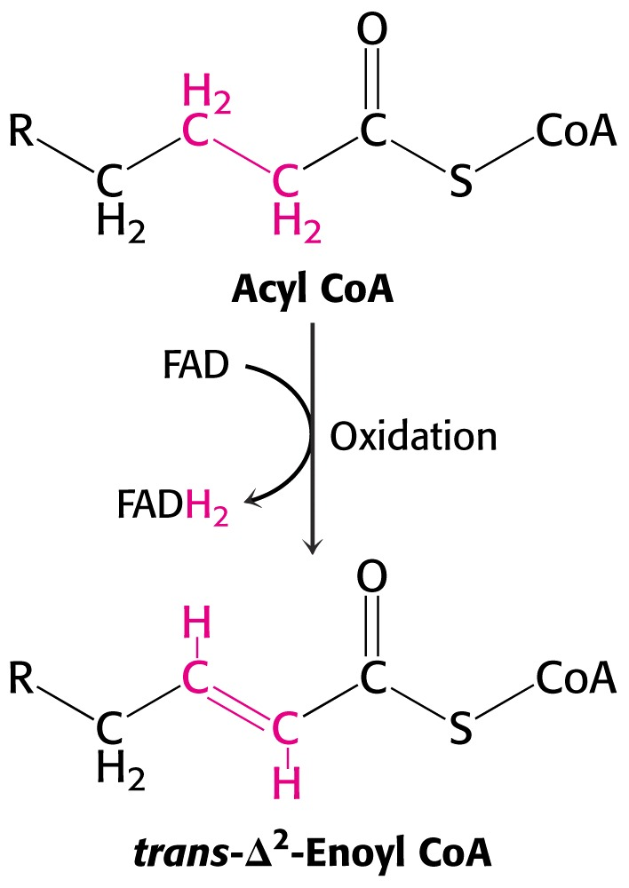
Fatty Acid Metabolism
The first step in fatty acid oxidation is the formation of a double bond between the α and β carbons.
This oxidation is coupled to the reduction of FAD to FADH₂.

Slide 17
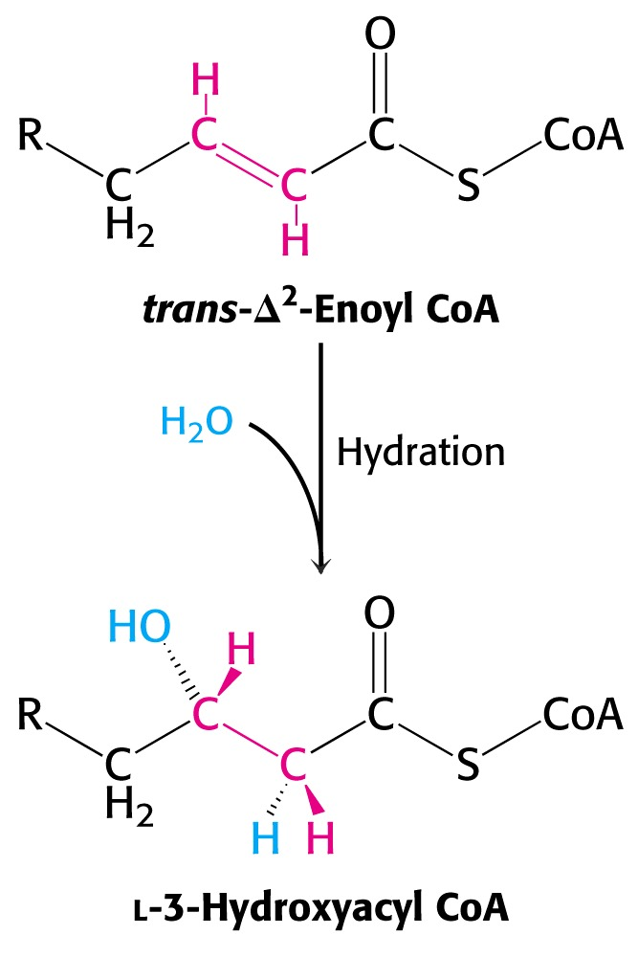
Fatty Acid Metabolism
The second step is the hydration of the double bond to form the corresponding β-hydroxy acyl CoA.

Slide 18
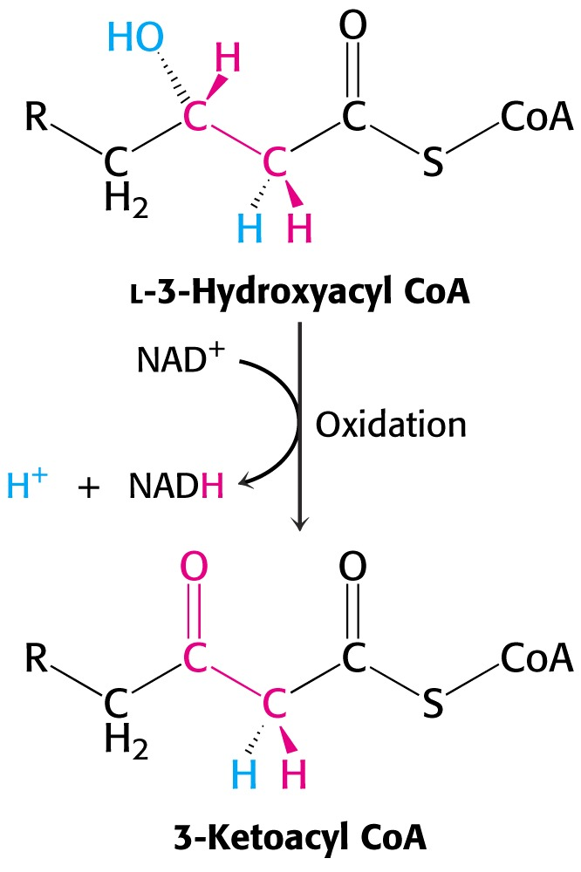
Fatty Acid Metabolism
The third step:
The β-hydroxyl group is oxidized to a ketone.
This is linked to the reduction of NAD⁺ to NADH.

Slide 19
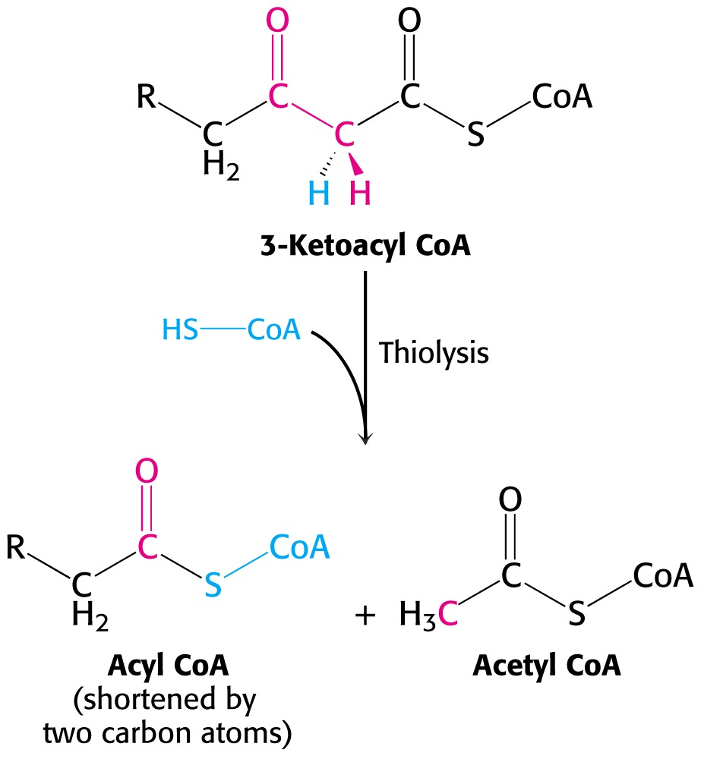
Fatty Acid Metabolism
The fourth step:
Two carbons are removed from the acyl CoA by “thiolysis.” That is, another CoA attacks the carbonyl carbon, lysing the α,β-bond and releasing acetyl CoA.
The other product is another fatty acyl CoA, ready for another round of this oxidation “cycle.”

Slide 20
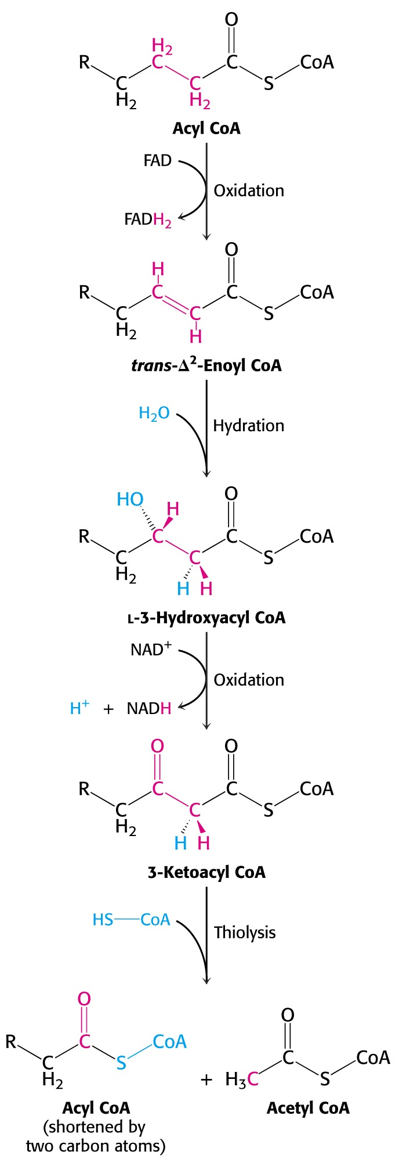
Fatty Acid Metabolism
By repeating this cycle and removing two carbons as actyl CoA in each round, the entire fatty acid is oxidized.
Quesiton:
This cycle is often referred to as “beta-oxidation” of fatty acids.
Why is this?

Slide 21
Fatty Acid Metabolism
(Repeated cycles)
Questions:
1. How many rounds of this fatty acid oxidation cycle are needed to completely convert palmitate (C₁₆) into actyl CoA?
2. How many acetyl CoAs are formed?
3. How many NADH’s are formed?
4. How many FADH’s are formed?
(Consider these same questions for C₁₂-C₁₈ fatty acids.)

Slide 22
Fatty Acid Metabolism
Fatty Acid Oxidation - ATP Yields
Fatty Acid: | Palmitic acid
# of Carbons: | 16
Rounds of Cycle: | 7
Yields: | # |  | ATP/each | Totals:
Acetyl CoA | 8 |  | 10 | 80
FADH2 | 7 |  | 1.5 | 10.5
NADH | 7 |  | 2.5 | 17.5
Gross Total ATP: |  |  |  | 108
Less 2 High E Bonds for Activation: |  |  |  | -2
Net ATP Yield: |  |  |  | 106

Slide 23
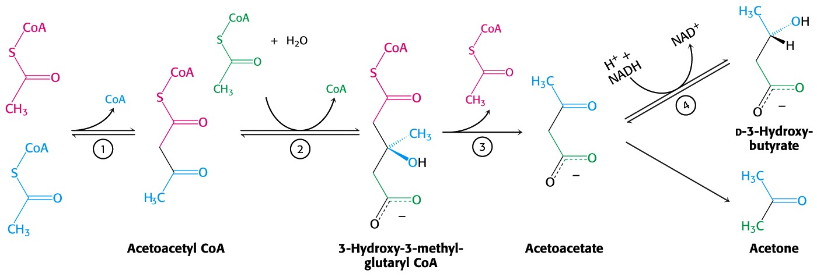
Fatty Acid Metabolism
During fasting, significant quantities of acetyl CoA are produced from fatty acid oxidation. However, insufficient quantities of TCA intermediates (e.g. oxaloacetate) limit entry of acetyl CoA into the cycle.
Hence, acetyl CoA is diverted to form “ketone bodies.”

Slide 24
Fatty Acid Metabolism
If the concentrations of these ketone bodies build up in the blood, they spill over into the urine. Ketone bodies in the urine are a clear indication of fasting or a dietary disorder.
Acetoacetate (β-ketoacid) undergoes a slow, sponataneous decarboxylation to acetone. The odor of acetone may be detected on the breath of a person who has a high level of acetoacetate in the blood.

Slide 25
Fatty Acid Metabolism
The presence of both glucose and ketone bodies in the urine are a strong indication of diabetes.
Lack of sufficient insulin results in high blood sugar levels that spill glucose into the urine.
Since cells are not stimulated to absorb glucose so they must resort to fatty acid oxidation. Low levels of carbohydrate-derived carbon skeletons prevent acetyl CoA from being metabolized via the TCA cycle, resulting in elevated ketone body concentrations in the blood (and urine.)
Finally, ketone bodies are mostly acids, high levels of which result in acidosis, impairing tissue function (particularly noticeable in the central nervous system.)

Slide 26
Fatty Acid Synthesis
Fatty acids are synthesized by a cyclic pathway whose reactions appear very similar to a reversal of fatty acid oxidation reactions.
However, although the reactions appear to be similar, the pathways are very different, using different enzymes, different cofactors, and different regulatory controls.
Fatty acids are built from acetyl CoA molecules (two carbons at a time.) First, acetyl CoA is activated by adding CO₂ to form malonyl CoA:
Acetyl CoA Malonyl CoA
+ ATP + HCO₃⁻ (& biotin cofactor)

Slide 27
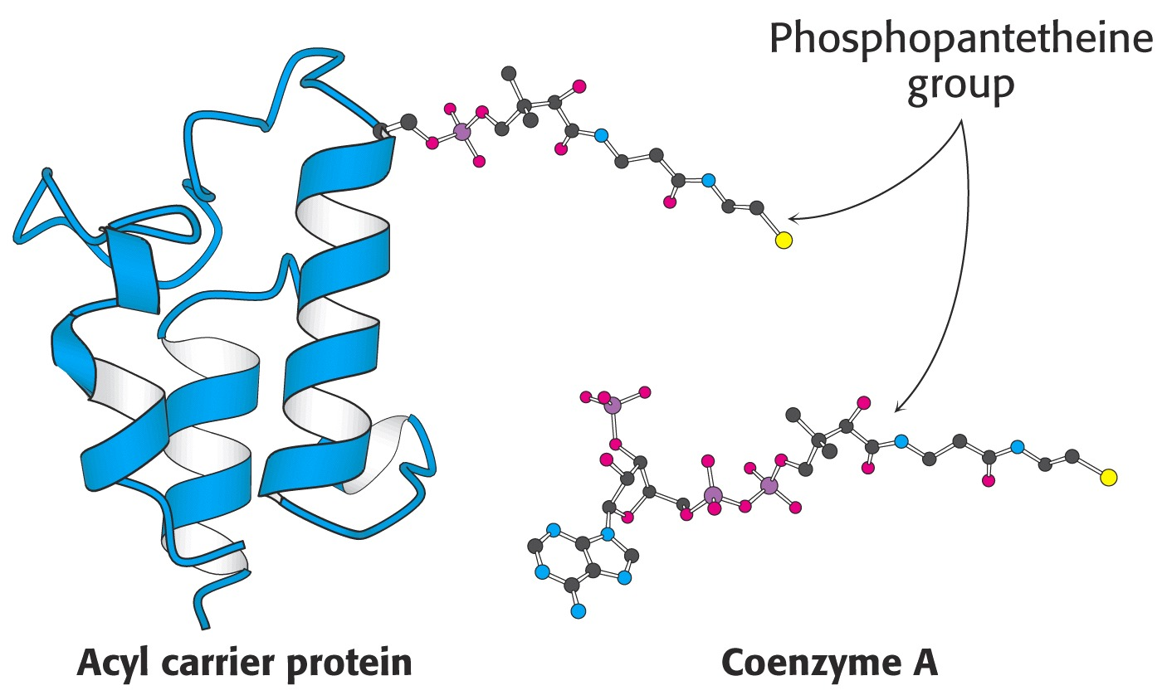
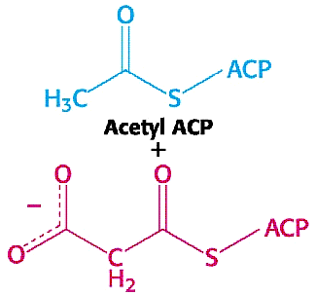
Fatty Acid Synthesis
In the next step, malonyl CoA and another acetyl CoA are each separately reacted with a 77-amino acid protein that replaces the CoA, forming acetyl-ACP and malonyl-ACP:

Slide 28
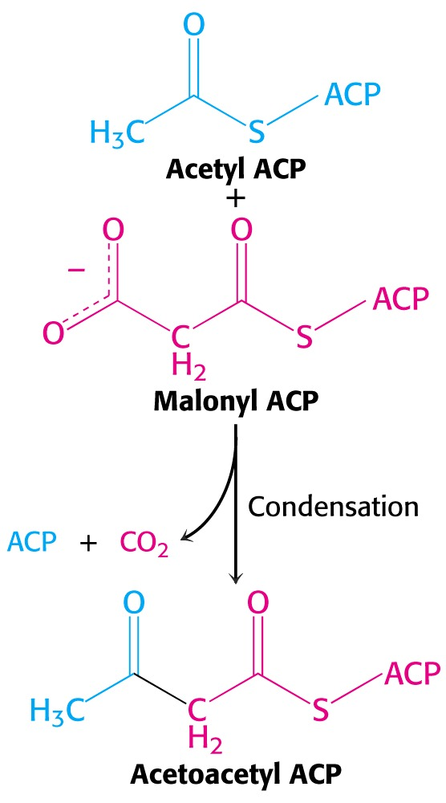
Fatty Acid Synthesis
As the first step in fatty acid synthesis, malonyl ACP reacts with acetyl ACP to form the four-carbon product, acetoacetyl-ACP.
(CO₂ is lost from malonyl ACP as it combines with acetyl ACP.)

Slide 29
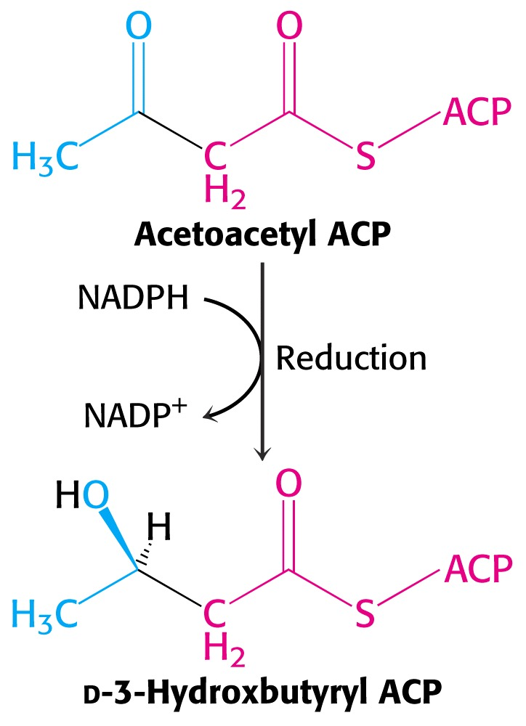
Fatty Acid Synthesis
Step Two:
The β-ketone group on the newly lengthened chain is reduced to an alcohol, utilizing reductive potential supplied by NADPH.
This is one of the first times we have encountered NADPH as a reducing agent. (It differs from NADH only in the attachment of a phosphate to a ribose sugar ring.) NADPH is often used as a reducing agent for biosynthesis.

Slide 30
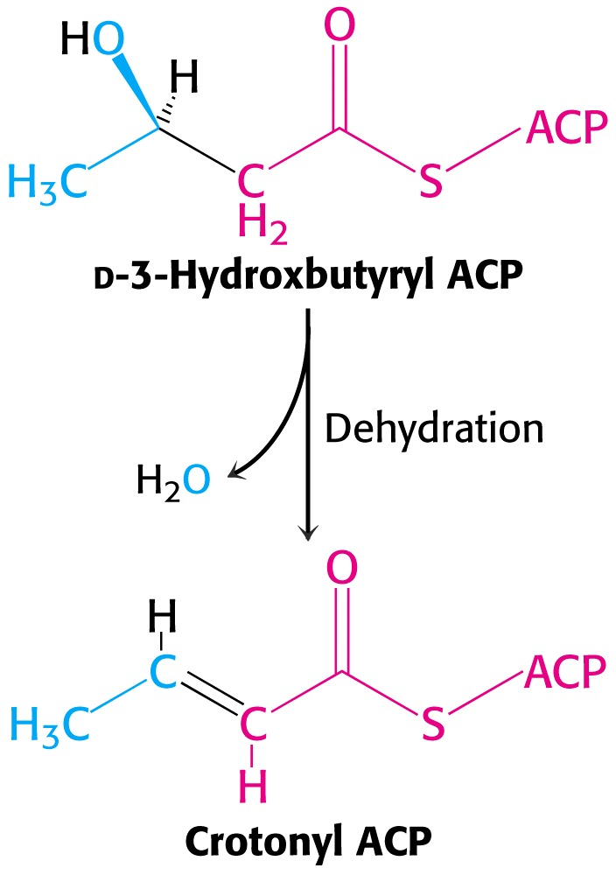
Fatty Acid Synthesis
Step Three:
The β-hydroxyl group is removed via dehydration, leaving a double bond between the α and β carbons.

Slide 31
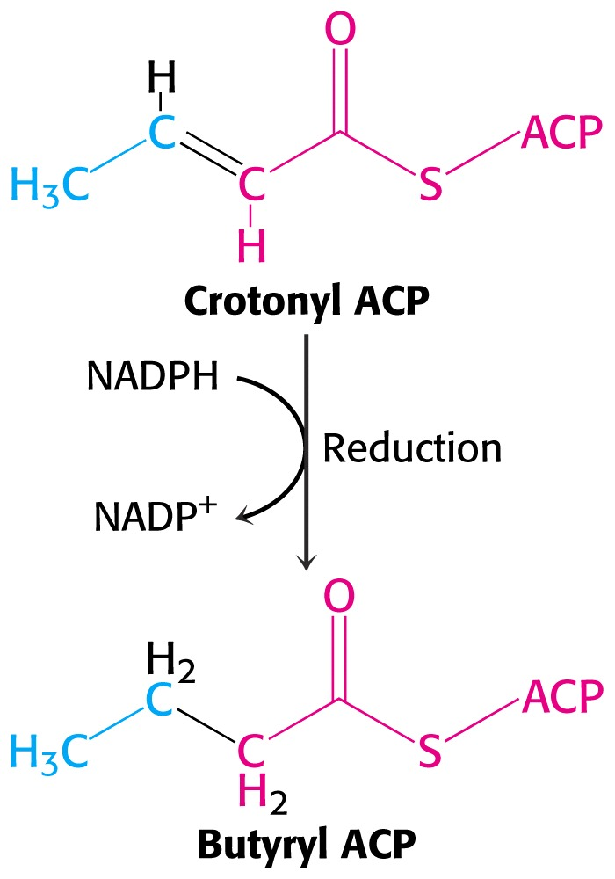
Fatty Acid Synthesis
Step Four:
The double bond is reduced to a single bond with the assistance of another NADPH.

Slide 32
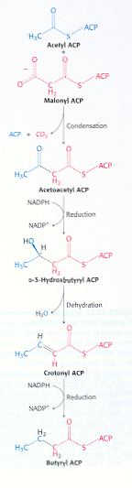
Fatty Acid Synthesis
(Repeated cycles)
Repeated turns of this series of reactions occurs to lengthen the growing fatty acid chain.
Butyryl ACP returns to condense with malonyl ACP during the second turn of this cycle. Longer products also return to condense with malonyl CoA until the chain has grown to its appropriate length (most often C₁₆).

Slide 33
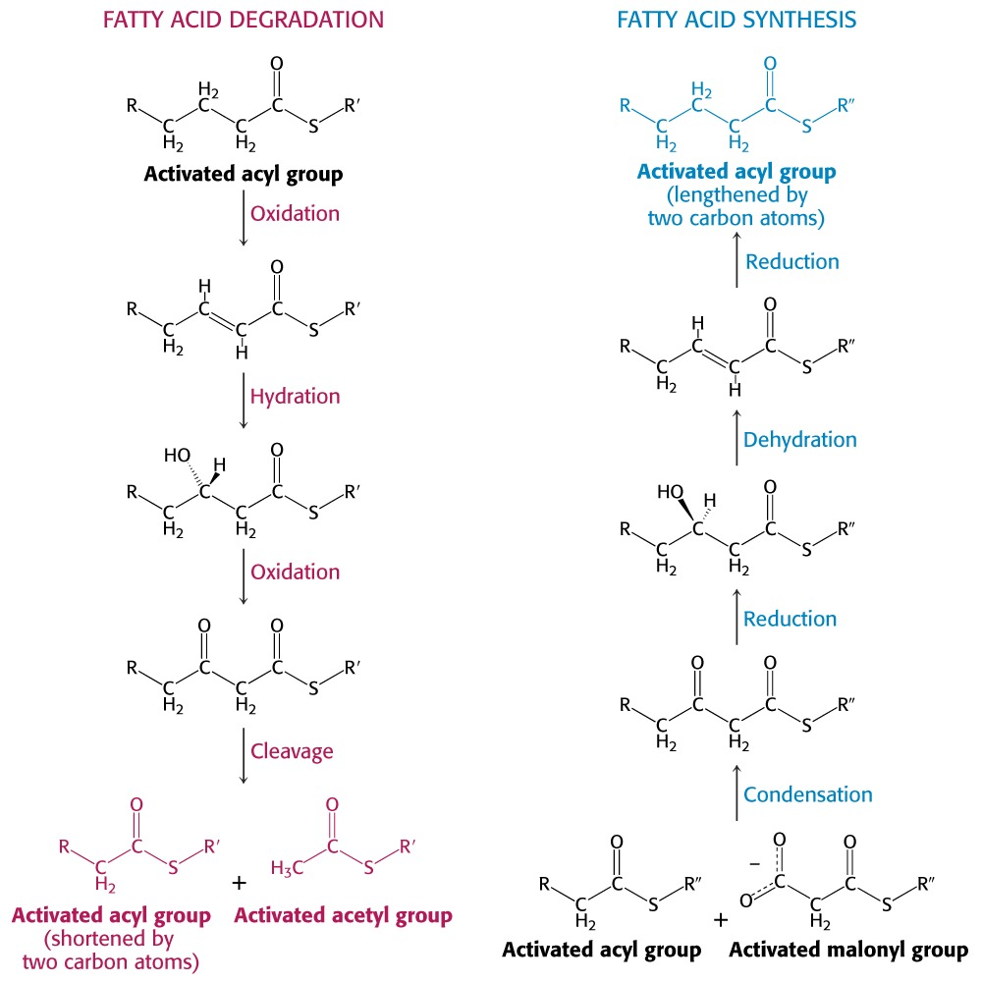

Slide 34
Fatty Acid Metabolism
Fatty acid synthesis and oxidation are both carefully regulated. When one is functioning, the other is inactive.
For example, “lipolytic” hormones such as epinephrine, glucagon, and others simultaneously activate oxidation and inhibit biosynthesis.
In addition, the two pathways are located in different regions of the cell, further facilitating differential control.

Slide 35
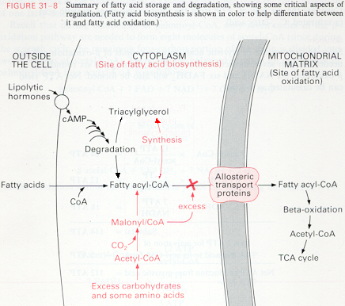

Slide 36
End of Lecture Slides
for
Fatty Acid Oxidation
Credits: Many of the diagrams used in these slides were taken from Stryer, et.al, Biochemistry, Freeman Press (in our course textbook) and from prior editions of this text.

