Slide 1
Exploring Proteins
Biochemistry 3070

Slide 2
Proteome
Every living cell contains thousands of different proteins.
The human geneome is huge:
3 billion DNA bases coding ~ 40,000 genes.
Most of these genes code for different proteins.
The term, “proteome,” was coined from [proteins] expresed by the [geneome].
“Proteomics” is the science of both protein expression and function.

Slide 3
Proteome
Proteins differ from one another in respect to:
Amino acid composition
Molecular shape and size
Function
To study proteins in detail, each protein must be identified & purified. Then detailed studies can be performed on the purified protein.
How are proteins isolated and purified?

Slide 4
Protein Purification
First, the biochemist must find a specific attribute associated with the protein that can be used to identify the protein of interest:
Enzyme activity
Color
A metal cofactor (e.g., zinc, iron, copper, etc)
It’s binding affinity to a certain substance
As proteins are fractionated into groups during purification, this attribute is used to follow the protein through its purification.

Slide 5
Homogenization
First, cells are broken, usually by homogenization.
Often the next step is centrifugation at various g-forces (rotor speeds), often called “differential centrifugation.” The resulting pellets and supernatants help to separate the proteins into different fractions.
e.g., nuclei are easily separated from mitochrondia, since nuclei spin down at relatively low g-forces. Soluble proteins must be centrifuged at very high forces to spin them out of solution.

Slide 6
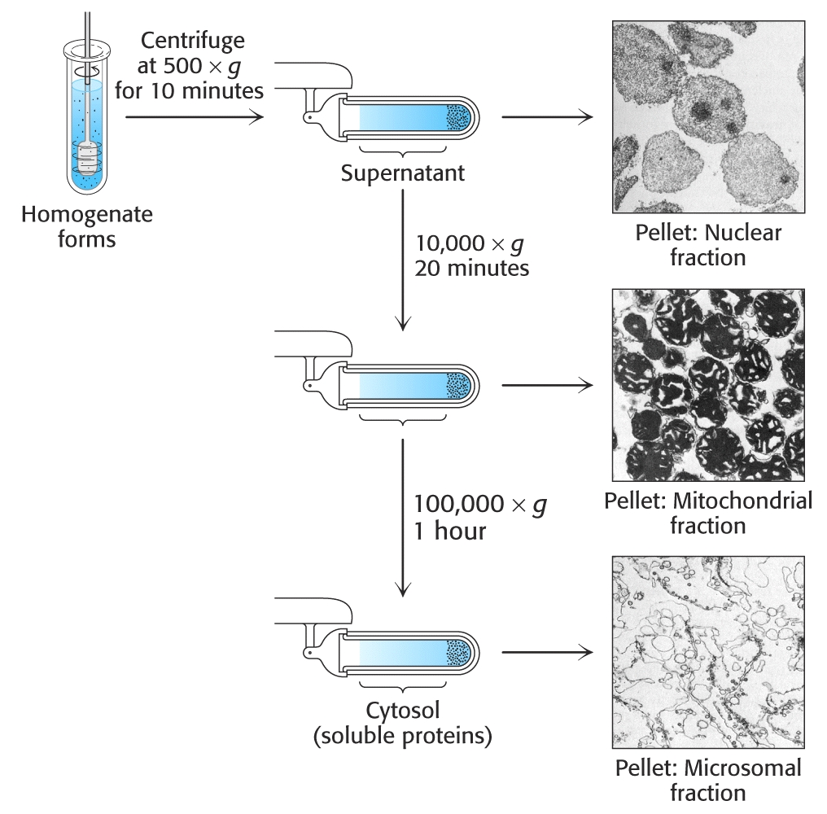
Differential Centrifugation:

Slide 7
Salting Out Proteins
Protein purification techniques:
“Salting out” proteins:
Increasing ionic strength by adding salts such as ammonium sulfate can cause proteins to precipitate. Centrifugation separates the precipitated proteins from the proteins that are still soluble at a given ionic strength.
Separating Proteins from Blood:
0.8M (NH₄)₂SO₄ precipitates fibrinogen… leaving serum albumin in solution. However, 2.4M (NH₄)₂SO₄ precipitates serum albumin.

Slide 8
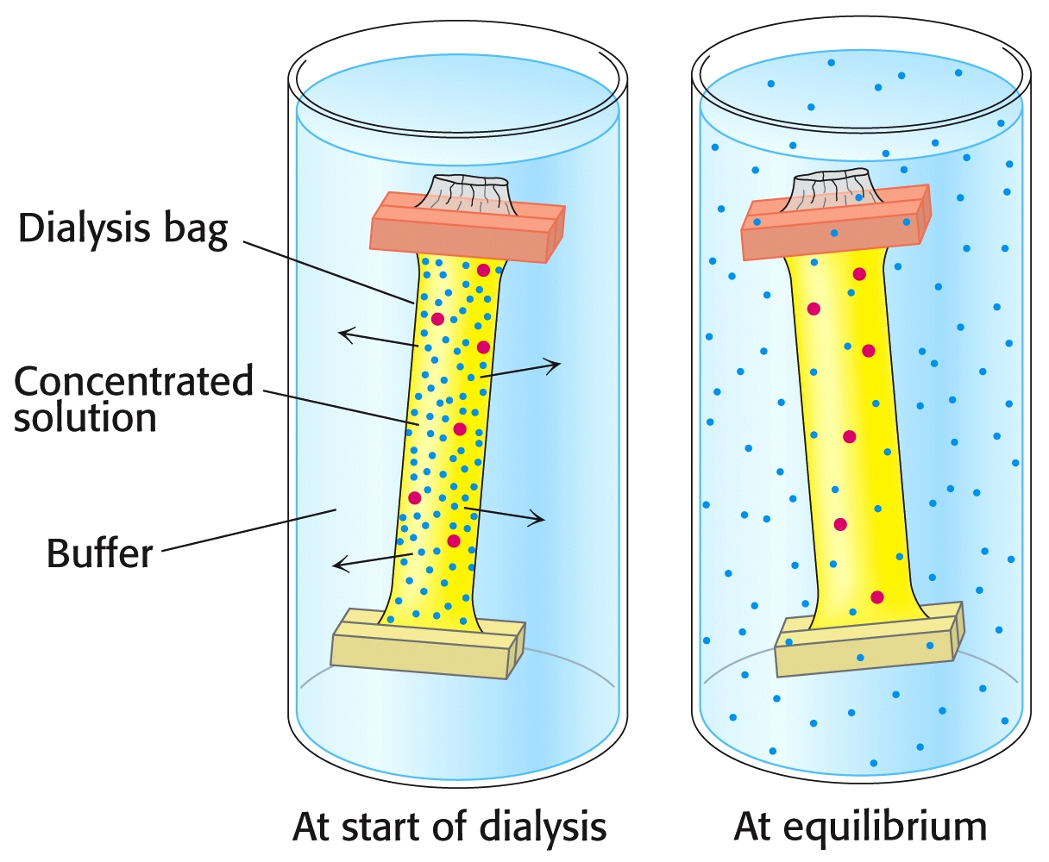
Dialysis
Protein purification techniques:
“Dialysis” of proteins:
Proteins are easily separated on the basis of their size. Large proteins can be separated from smaller ones via dialysis. Dialysis tubing with different pore sizes allow smaller molecular weight molecules to diffuse through, retaining the larger ones.

Slide 9
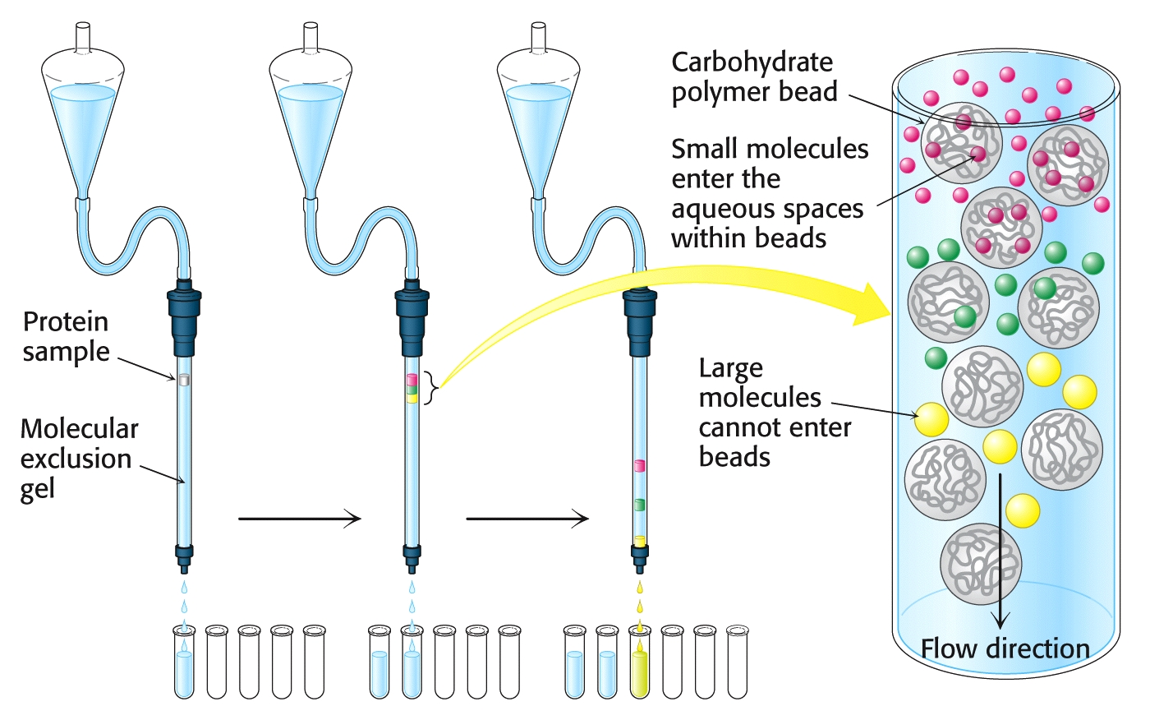
Gel Filtration
Protein purification techniques:
“Gel-Filtration” of proteins:
Gel filtration separates proteins on the basis of their molecular weights. Small pores in the gel allow smaller molecules to become trapped in the matrix, slowing their flow through the column. Larger molecular weight proteins move more rapidly. Hence, large MW proteins elute from the column before the smaller ones.

Slide 10
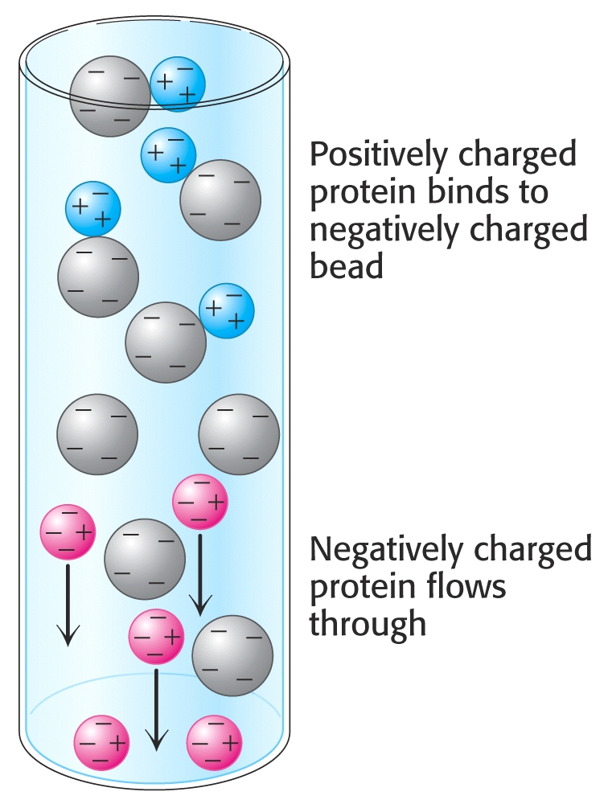
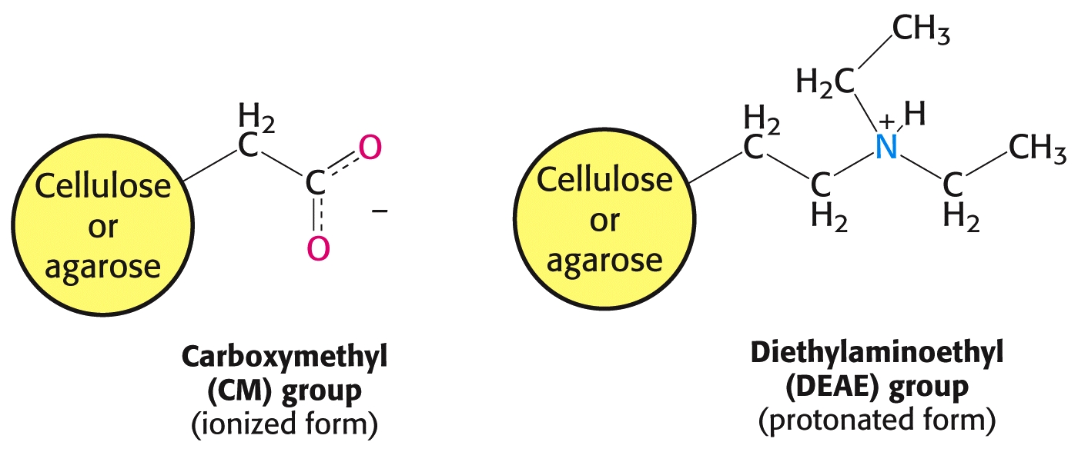
Protein purification techniques:
“Ion Exchange” of proteins:
Proteins can be separated on the basis of their net charge. Charged proteins bind to ion exchange resins that have opposite charges. Changes in pH or salt concentration disrupt this binding, allowing the proteins to elute from the column.

Slide 11
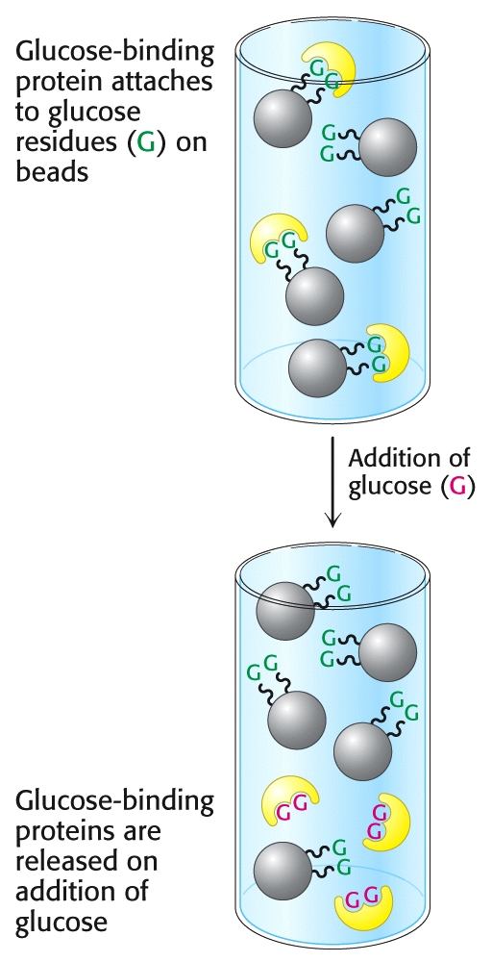
Affinity Chromatography
Protein purification techniques:
“Affinity Chromatography” of proteins:
Some proteins have high affinity for certain chemicals or functional groups. If a special column packing material is prepared that contains these high-affinity chemicals, the protein of interest will selectively bind to the column. Often, antibodies against the protein of interest will also be immobilized on the gel to bind to their target proteins. Affinity chromatography is a very powerful separation technique.

Slide 12
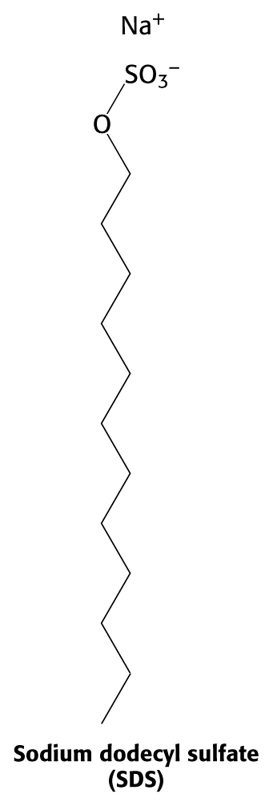
Protein purification techniques:
“Electrophoresis” of proteins:
Proteins contain numerous ionic charges (+/-), depending on pH. When placed in an electrical field, the proteins move at different rates, depending on the charge/mass ratio. If a polymeric gel is present in the matrix, larger MW proteins move slower that smaller proteins, due to steric hindrance.
To add negative charge to the surface of proteins, “SDS” [sodium dodecylsulfate] detergent is added. In an “SDS gel” proteins are separated on the basis of their molecular weight (size); those with larger MW move slowly & those with small MW move rapidly. (The opposite of gel permeation.)
After separation, the gel is often stained, allowing the proteins to be visualized.

Slide 13
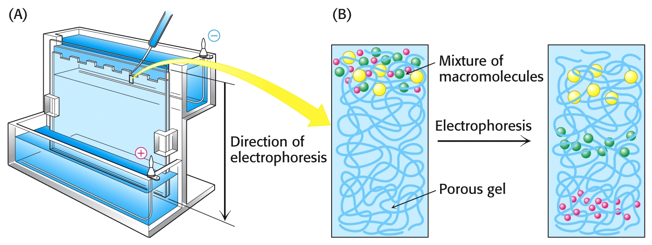
Protein purification techniques:
“Electrophoresis” of proteins:

Slide 14
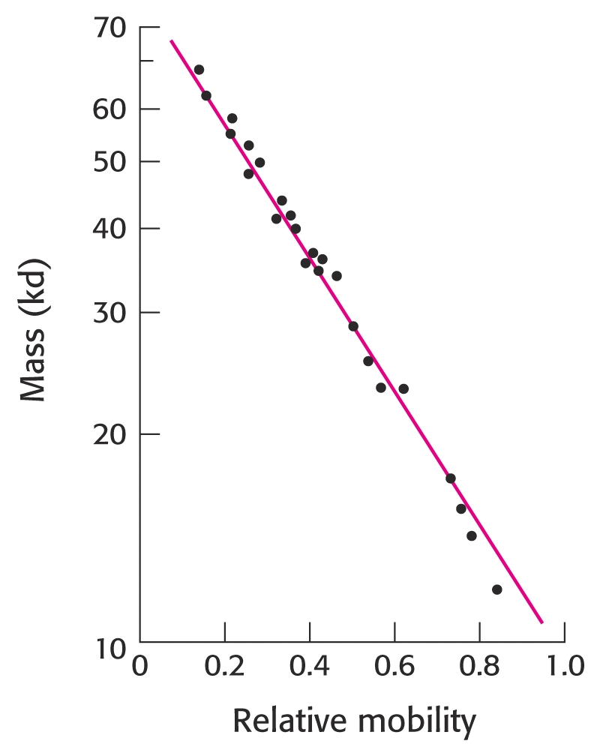
Protein purification techniques:
“Electrophoresis” of proteins:
In SDS PAGE, proteins are separated by Mol.Wt., such that if their relative mobility (R_{f}) is plotted against the log of their molecular mass, a linear relationship is obtained. Molecular weights of unknown proteins can be estimated in this way.

Slide 15
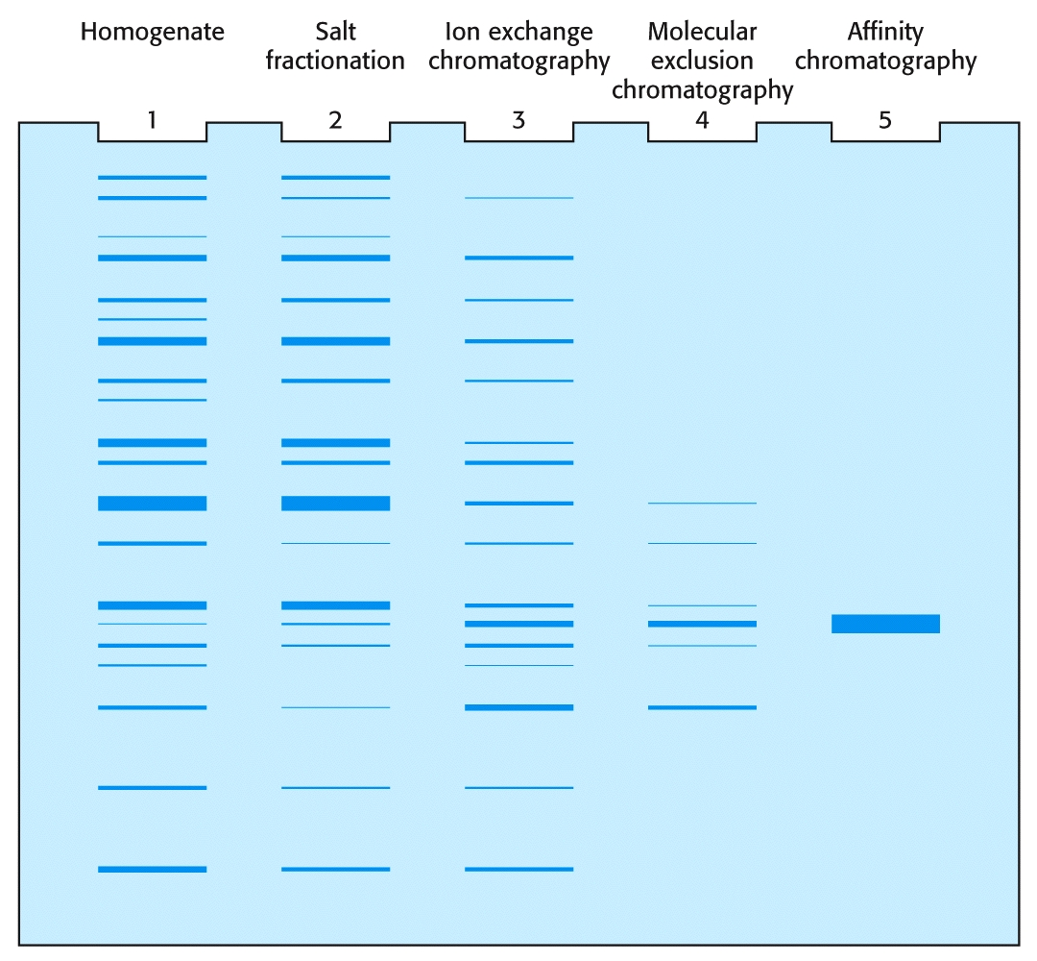
Protein purification techniques:
“Electrophoresis” can be used to follow the purification process for proteins:

Slide 16
Protein purification techniques:
“Ultra-Centifugation” of proteins:
By spinning proteins at ultra-high g-forces in an “ultra-centrifuge,” properties such as their partial specific (molecular) volume, their shape, density may be studied.
All these parameters are involved in the “Svedberg” equation:
s = m(1-vp)/f
where
s = sedimentation coefficient (“Svedbergs”)
m = mass of the protein,
v = partial specific volume
p = density of the surrounding medium
(1-vp) is the “boyant density” of the surrounding medium.

Slide 17
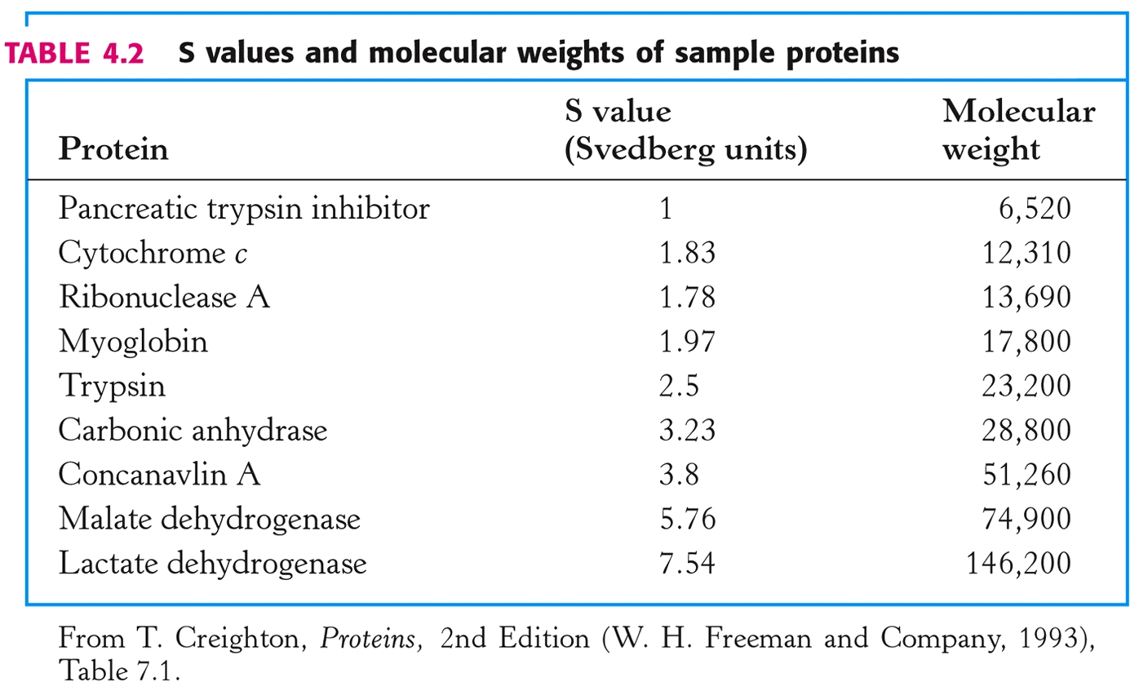
Protein purification techniques:
“Ultra-Centifugation” of proteins:
The smaller the “Svedberg”value (“S”), the slower a molecule moves in a centrifugal field. The S value depends on a protein’s MW, shape, density, and the density of the surrounding solution.

Slide 18
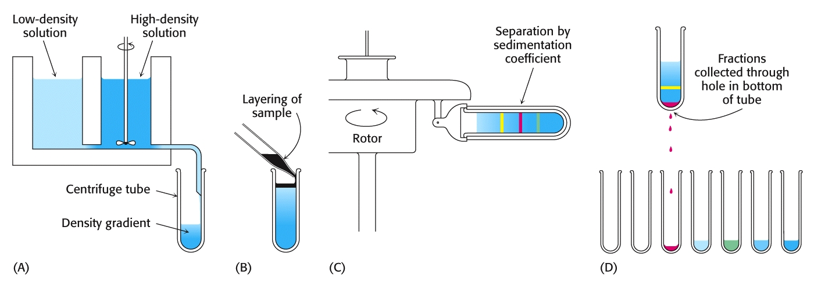
Protein purification techniques:
“Zonal-Centrifugation” of proteins:
By spinning large biomolecules such as proteins at ultra-high g-forces in an “ultra-centrifuge,” they may be separated from one another. The use of “solution gradients” help by allowing the protein to move to its “sedimentation equilibrium.” (e.g., 5% - 20% sucrose solutions)

Slide 19
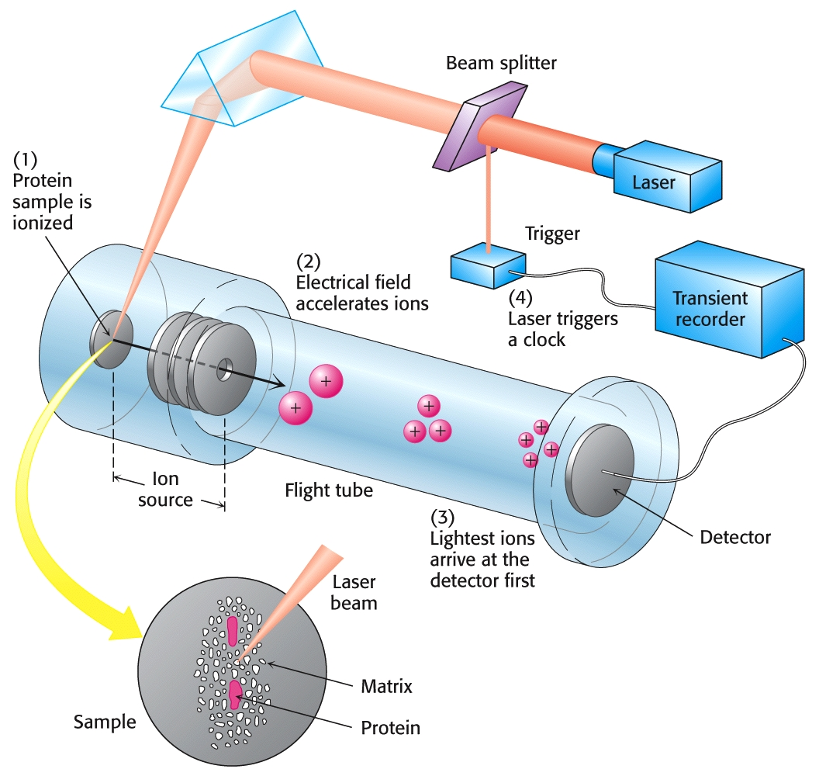
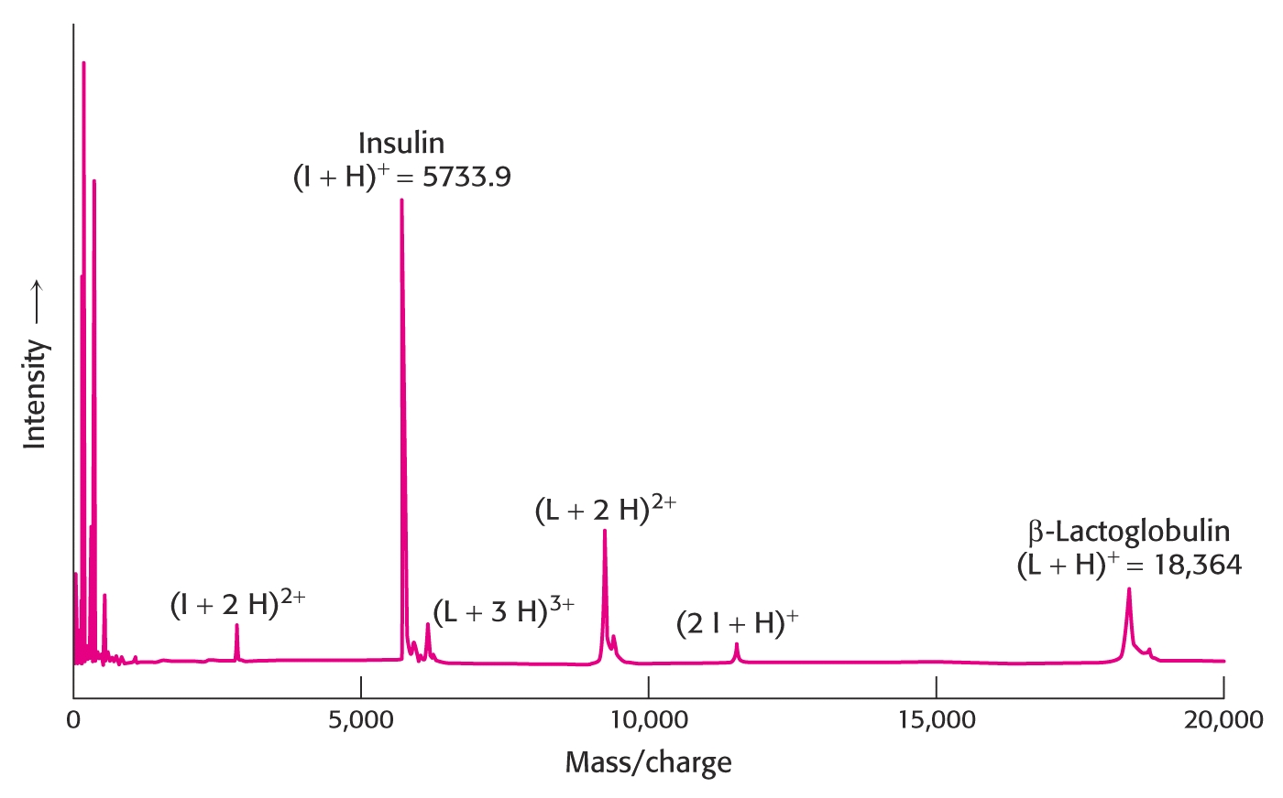
Protein purification techniques:
“Mass Spec” of proteins:
“Matrix-assisted Laser Desorption-ionization – Time of Flight (MALDI-TOF)” and “Electrospray” Mass Spectrometry allow very precise determination of the molecular weights of proteins.

Slide 20
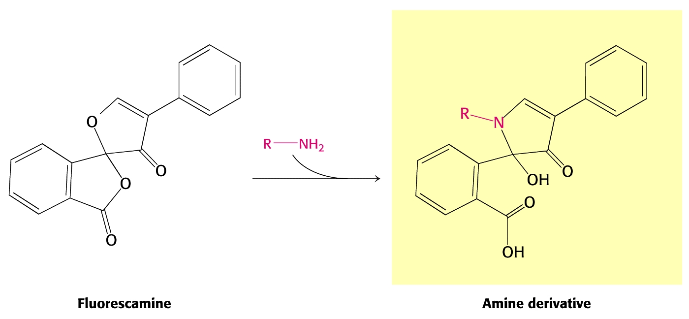
Protein & Amino Acid Detection Techniques:
Ninhydrin:
Allows the detection of only micrograms of amino acids (~10nmole), about as much as in a single fingerprint.
Fluorescamine:
Detects as little as one nanogram (~10pmole)!
(Both these methods are used by crime labs to lift latent finger prints.)

Slide 21
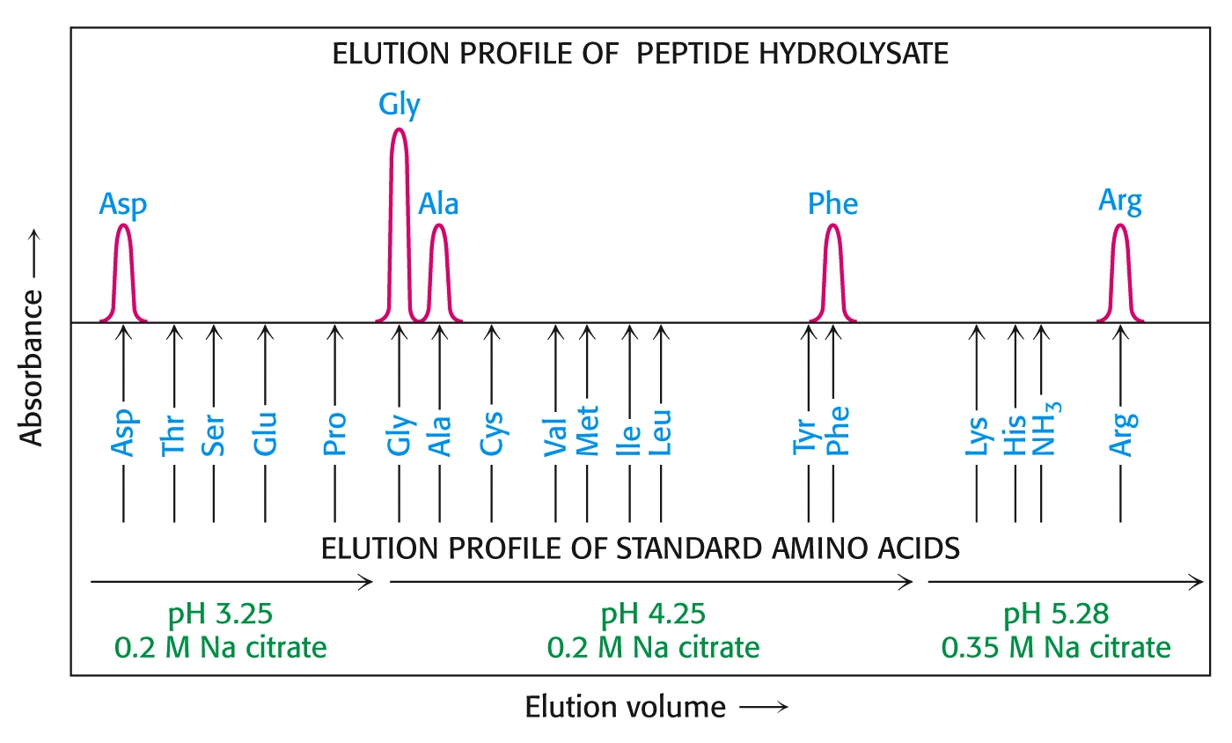
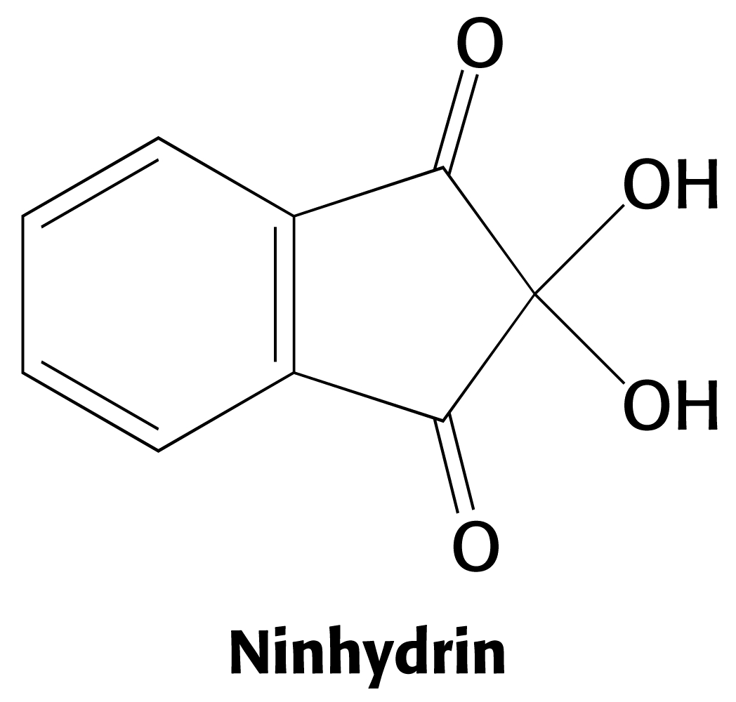
Protein Analysis:
“Amino Acid Composition” of proteins:
Following purification of a protein, it is often desirable to ascertain its amino acid composition. The protein is totally hydrolyzed (e.g., 6N HCl at 110°C for 24 hours). Quantitation of each amino acid is determined by ion-exchange chromatography. Normally, the hydrolyzed amino acids are visualized by reacting with Ninhydrin, turning them an intense blue color (except proline, which turns yellow).

Slide 22
Protein Sequencing Techniques:
“Automated Edman Degradation” of proteins:
After determining its amino acid composition, the amino acid sequence in the protein is often determined. The Edman Method revolutionized biochemistry in this arena. He utilized “phenyl isothiocyanate” in his method, which sequentially reacts with amino-terminal residues, releasing “PTH-amino acids.” Over time, this reagent works its way along the polypeptide backbone, breaking peptide bonds and releasing PTH amino acids that are identified. Hence the name, “Automated Edman Degradation.”
Automated instruments can sequence numerous residues in a single chain.

Slide 23
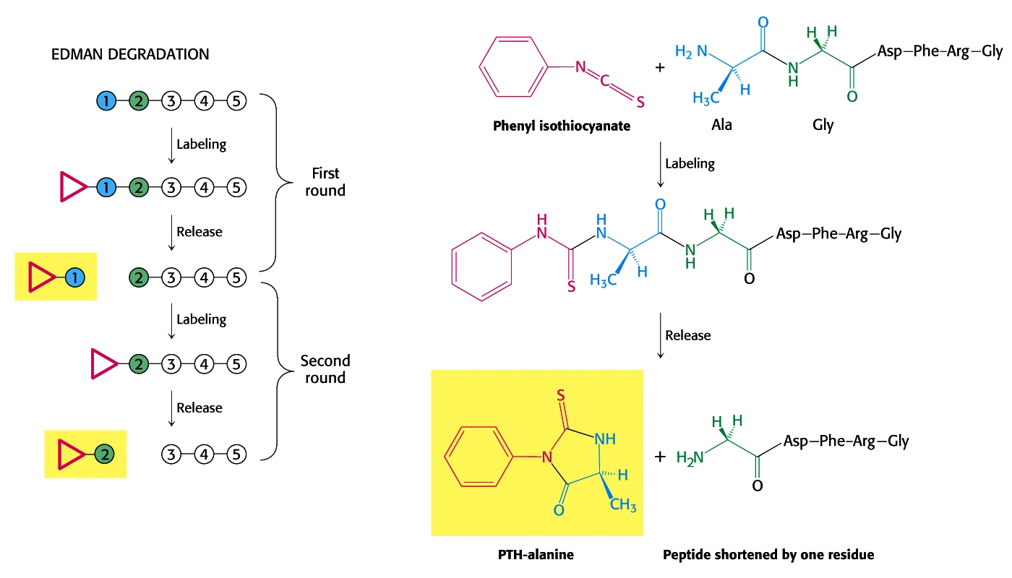
Protein Sequencing Techniques:
“Automated Edman Degradation” of proteins:

Slide 24
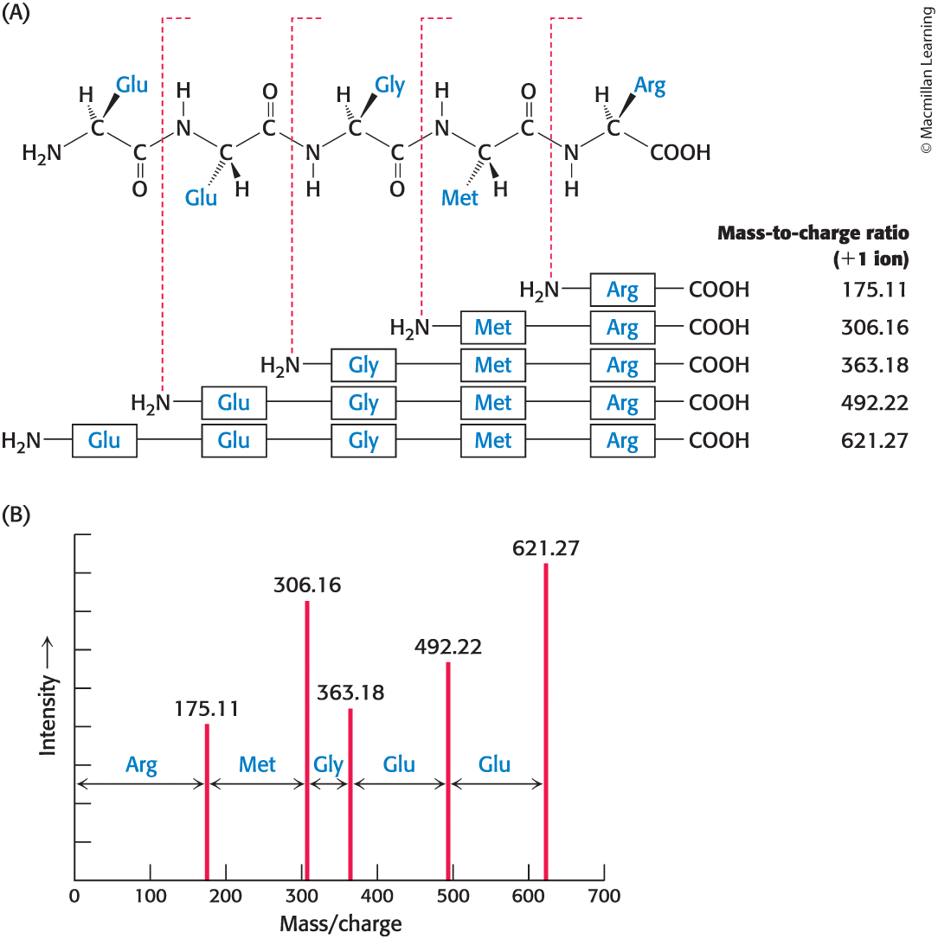
Peptide Sequencing Is Now More Commonly Performed by Tandem Mass Spectrometry

Slide 25
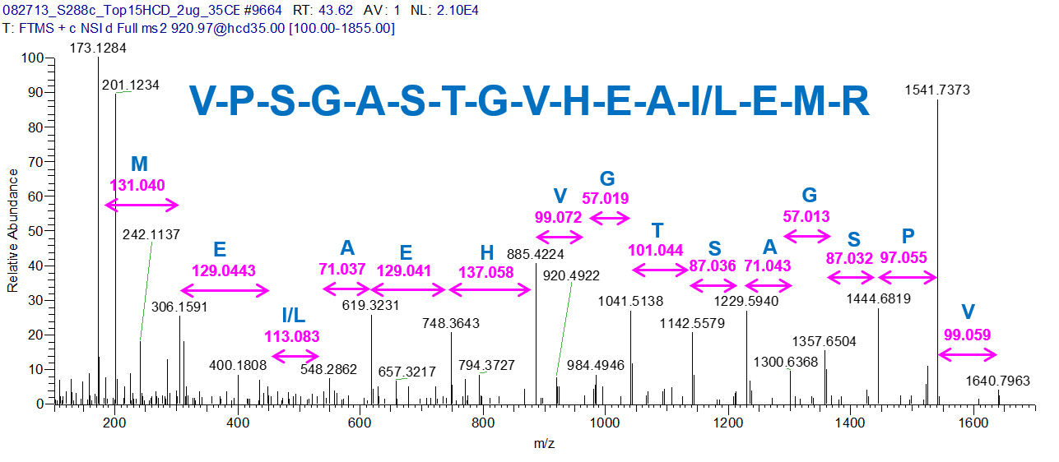
Mass Spec Sequencing

Slide 26
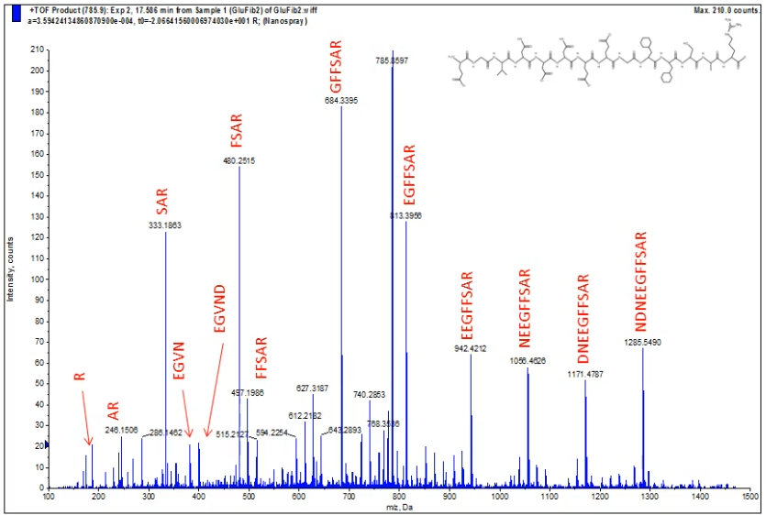
Mass Spec Sequencing

Slide 27
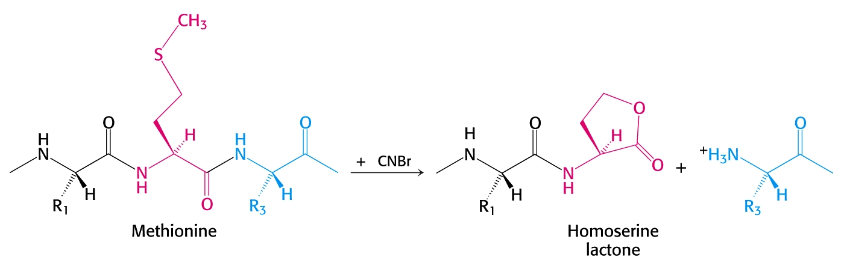
Protein Sequencing Techniques:
Both the Edman Method and tandem MS/MS sequencing methods benefit from breaking down large proteins into shorter segments. Different chemical reagents and enzymes are used, to obtain overlapping segments. These overlapping segments help to align the various strands and solve the puzzle of the entire sequence of the original protein sequence.
For example, CNBr cleaves peptide bonds on the carbonyl side of methionine residues:

Slide 28
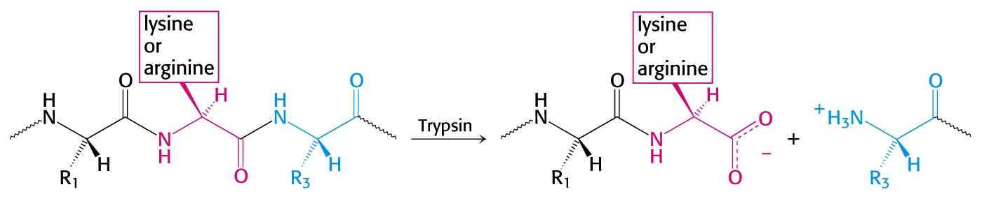
Protein Sequencing Techniques:
In another example, the enzyme trypsin catalyzes the hydrolysis of peptide bonds on the crboxyl side of either lysine or arginine:

Slide 29
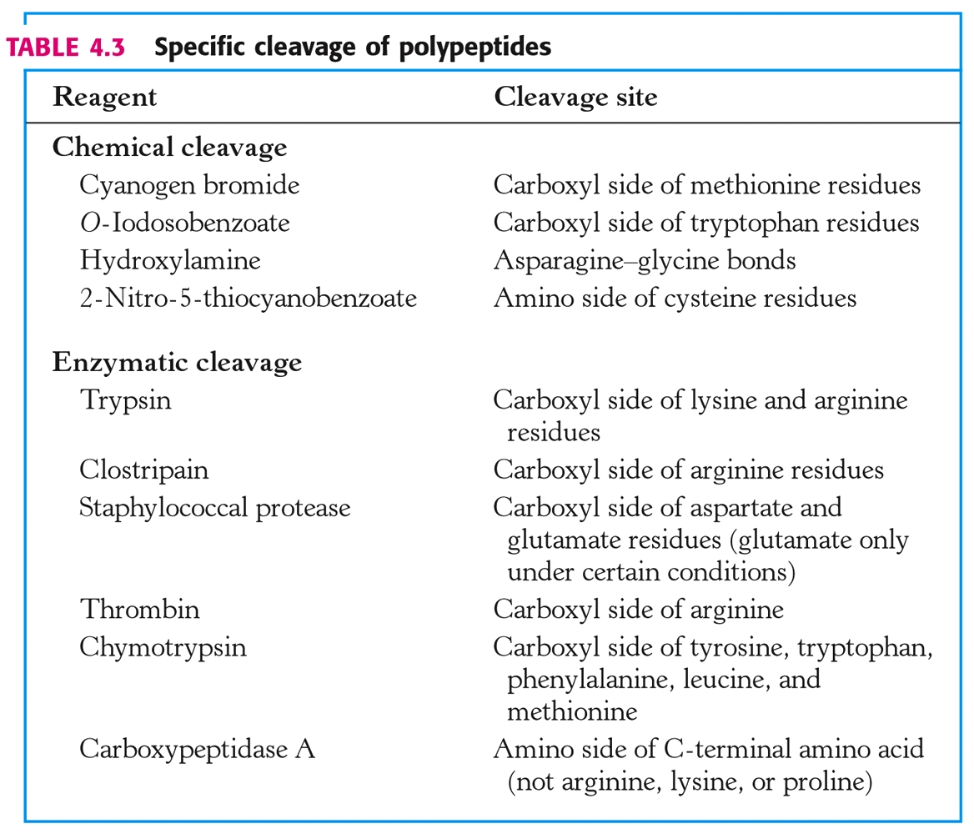
Protein Sequencing Techniques: “Cutting Tools”

Slide 30
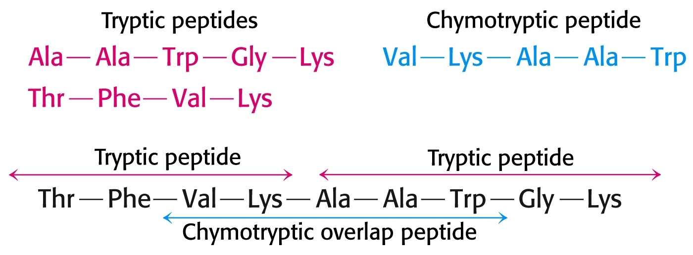
Protein Sequencing Techniques:
Consider the nonapeptide below that is subjected to two different treatments. The chymotryptic overlapping peptide specifies the arrangement of the two tryptic peptides:

Slide 31
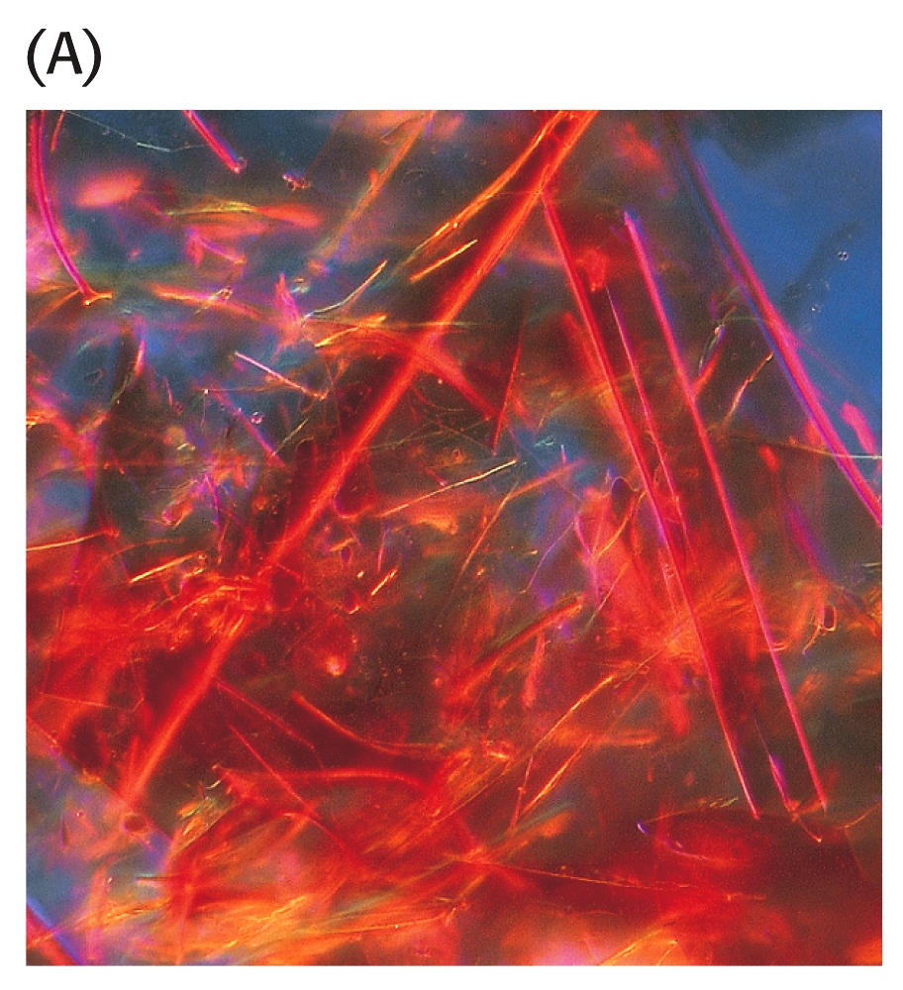
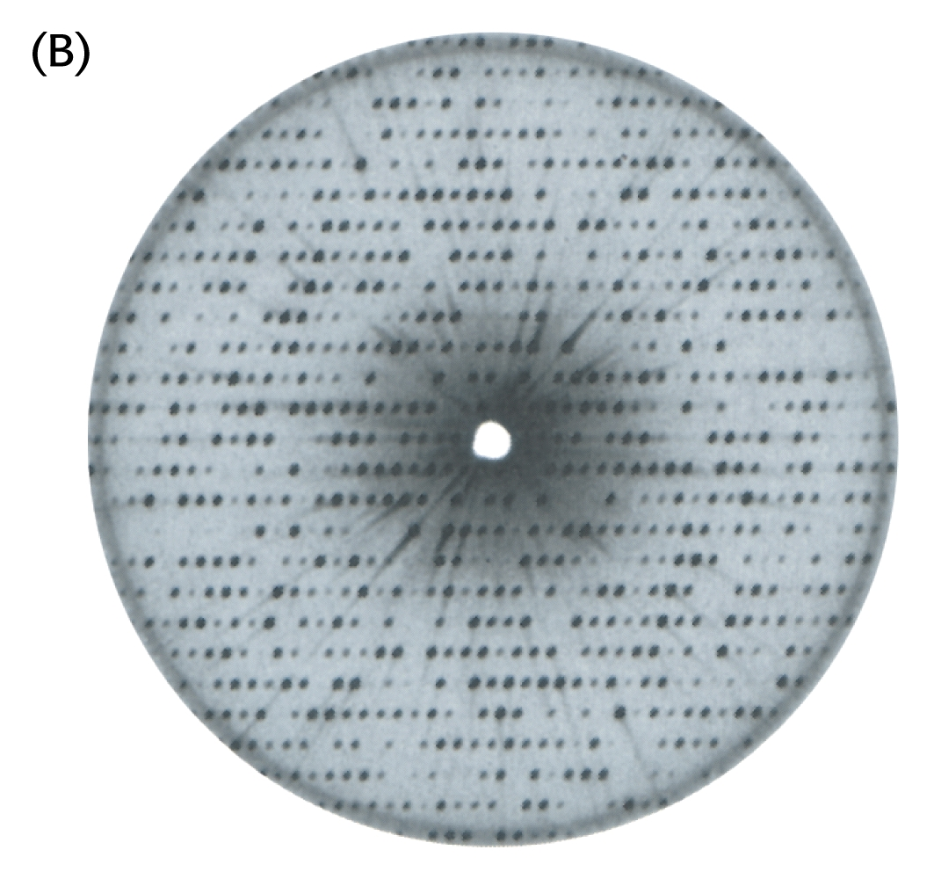
Determining Tertiary Protein Structure:
X-Ray Crystallography reveals 3-D structure in great detail by measuring distances between atoms in a protein crystal. Consider Myoglobin:

Slide 32
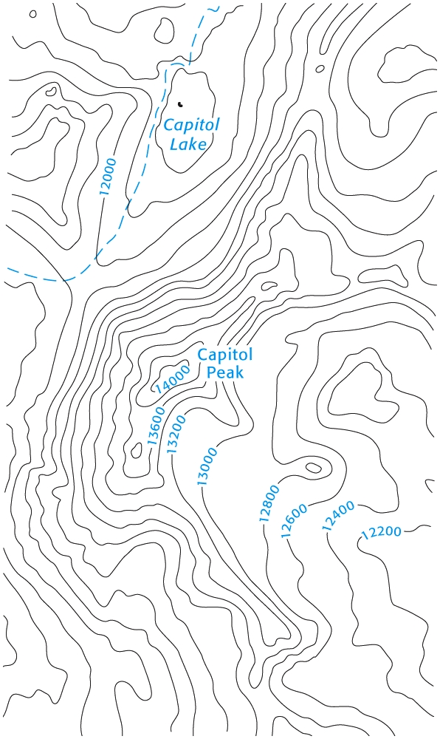
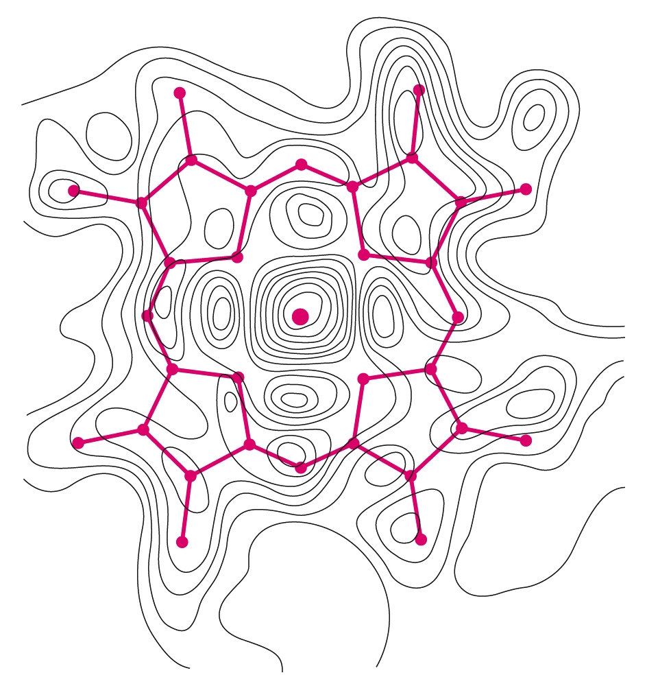
Determining Tertiary Protein Structure:
X-Ray Crystallography yields electron-density maps that can be used to determine the spatial arrangement of the atoms in the molecule.

Slide 33
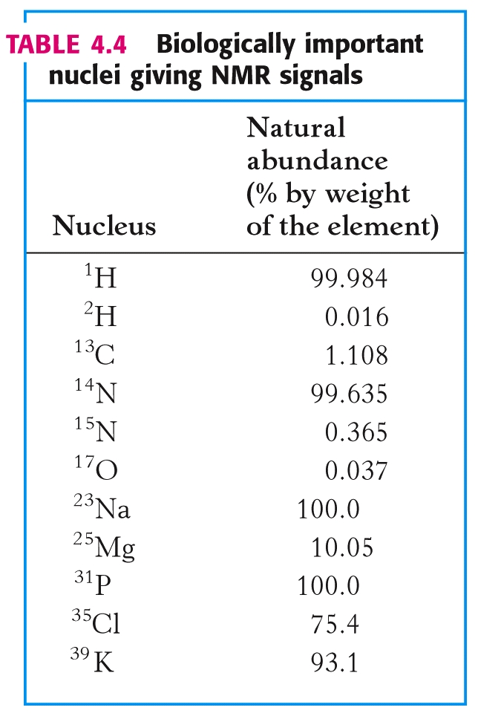
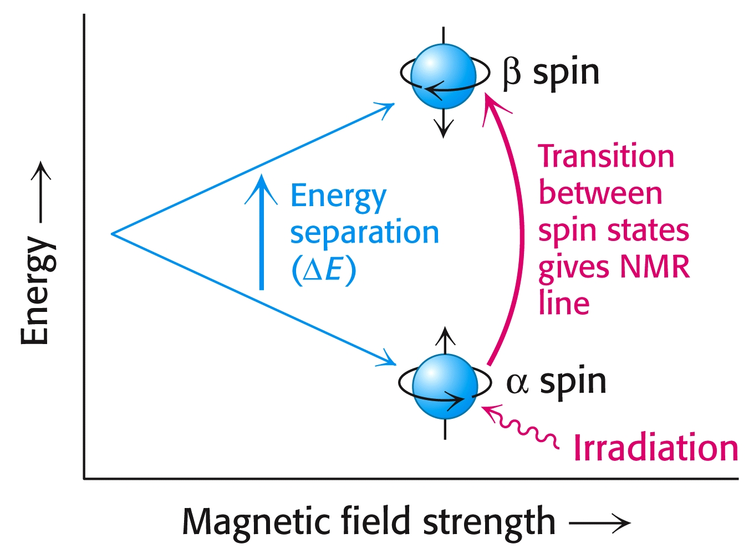
Determining Tertiary Protein Structure:
NMR can reveal atomic structure by measuring the absorption shifts of various nuclei.
A strong magnetic field separates nuclear spin states:

Slide 34
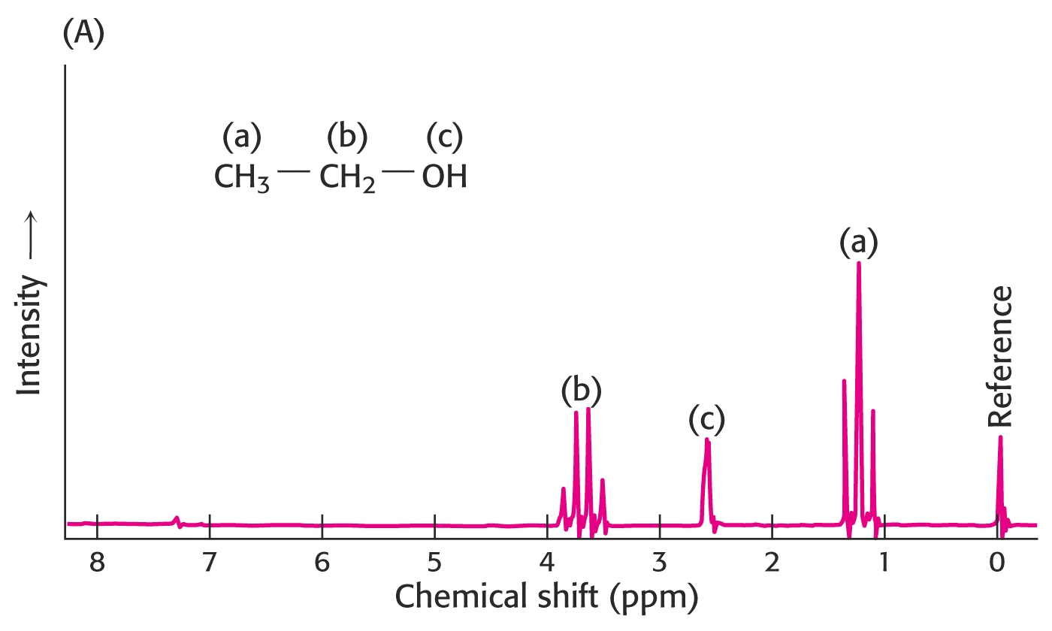
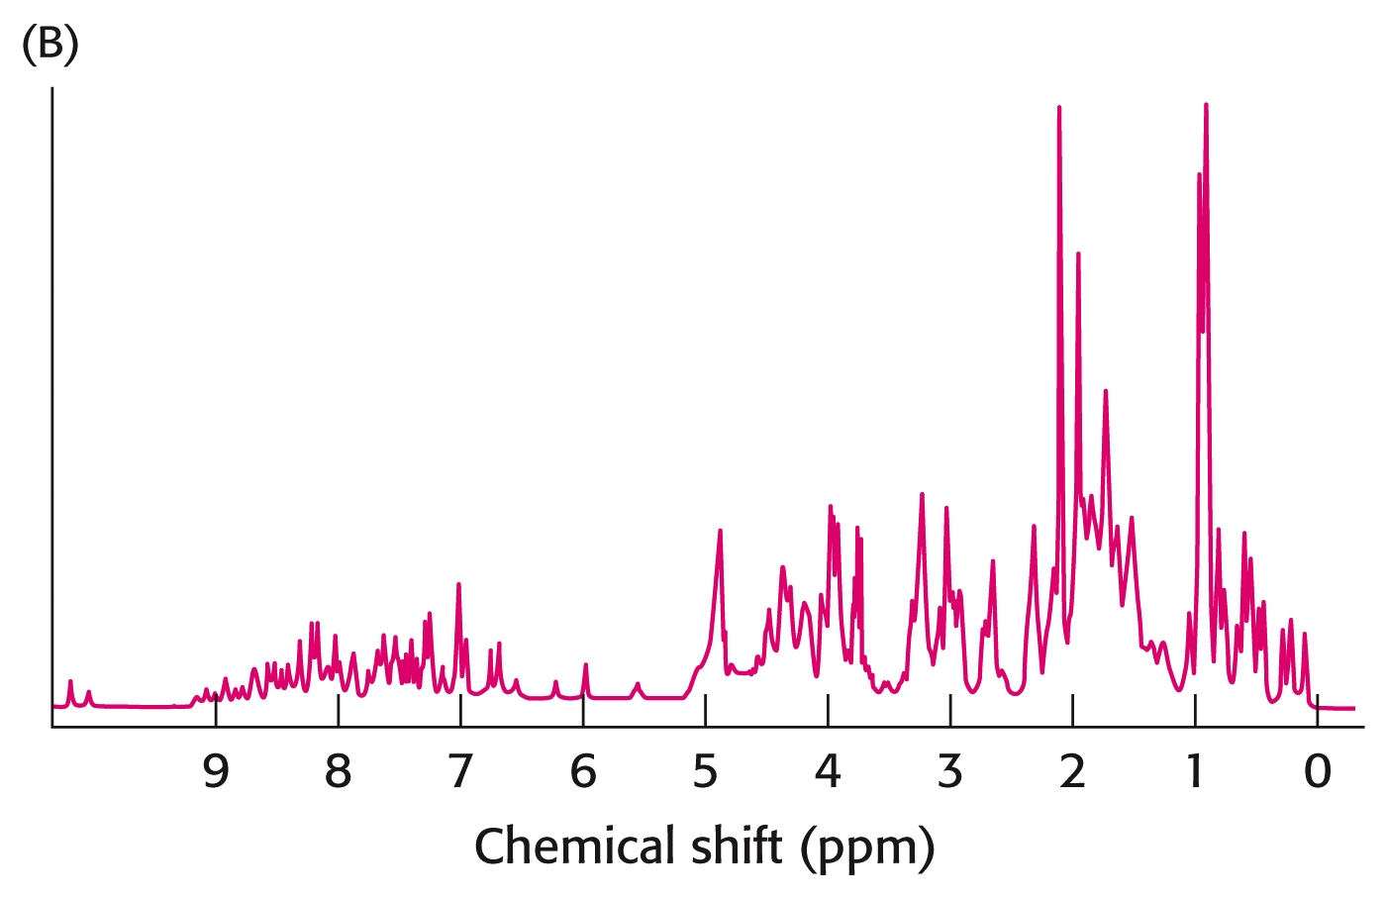
Simple vs. Complex NMR Spectra:
Ethanol: Protein:

Slide 35
Determining Tertiary Protein Structure:
NMR can measure interactions between atoms that are relatively close to one another in the tertiary structure.
NOE: (Nuclear Overhauser Effect): Energy transfer from an excited nucleus to an unexcited nucleus is easily observed in NMR. However the atoms must be close to each other, as this energy transfer decreases with the radius to the SIXTH power!
Signal proportional to 1 / R⁶
NOESY:
“Nuclear Overhauser Enhancement Spectroscopy”

Slide 36
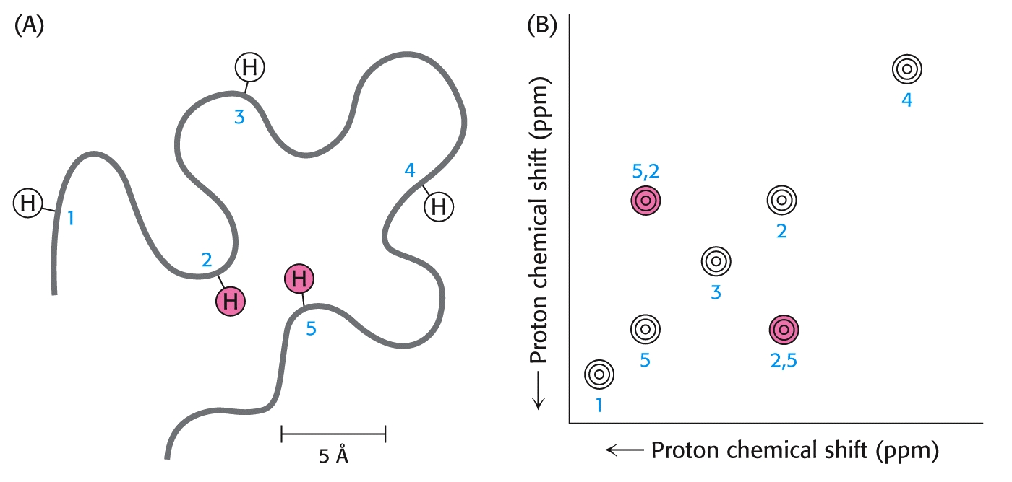
“NOESY”

Slide 38
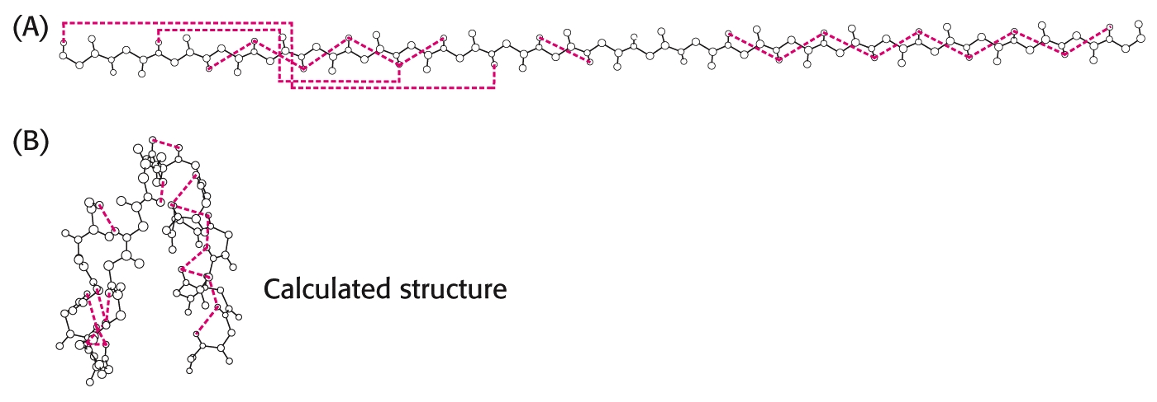
Interactions between amino acids that are observed in NOSEY NMR:

Slide 39
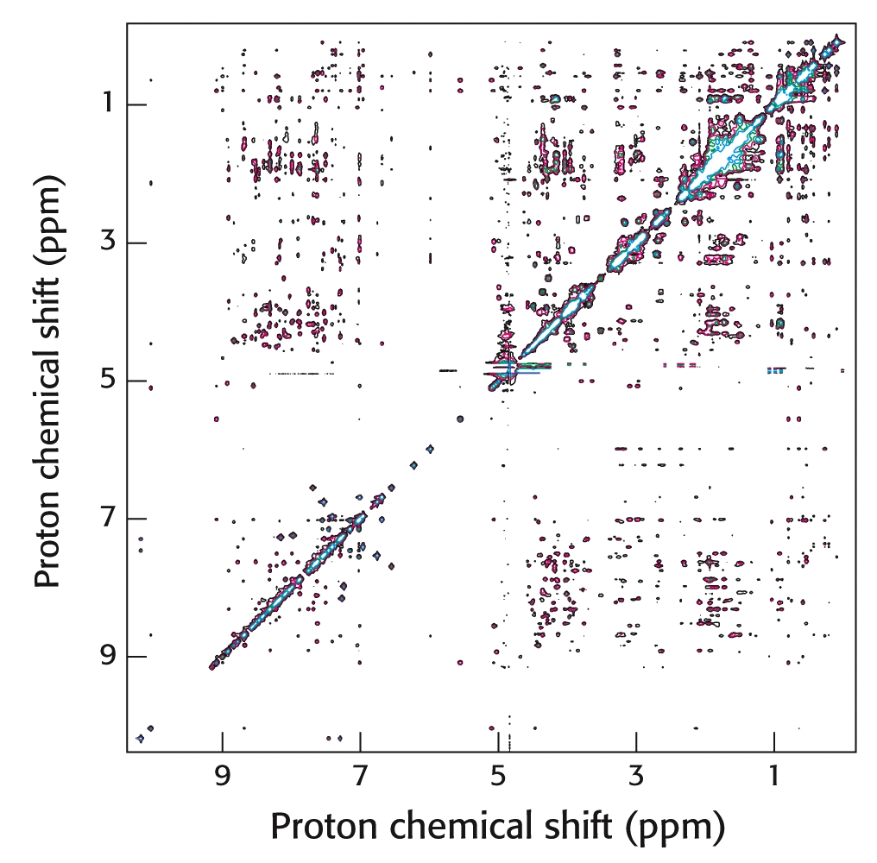
“NOESY”
55-amino acid protein fragrament

Slide 40
Immunoglobulins (antibodies) can be utilized as powerful analytical tools in biochemistry
An antibody (Immunoglobulin, Ig) is a complex protein formed by an animal in response to the presence of a foreign substance (most often foreign proteins).
An antibody usually exhibits specific and high affinity for their “antigens” that stimulated their synthesis. The antibody recognizes certain groups of amino acids called “antigenic determinants” or “epitopes.”
Each anitbody is synthesized by a unique cell.
“Monoclonal” antibodies are identical antibodies that have been synthesized by identical, cloned cells.

Slide 41
Immunoglobulins:
Antibody-producing cells can also be “tricked” into making antibodies against small molecules such as hormones or even pesticides.
These small molecules are called “haptans.”
Normally, haptans are attached to larger proteins and injected into animals to produce antibodies, since small molecules normally do not elicit antibody production.
Antibodies can be prepared against almost any haptan. This allows broad utilization in analytical chemistry and in diverse applications from early pregnancy tests to pesticide detection.
These types of analyses are called “Immunoassays.”

Slide 42
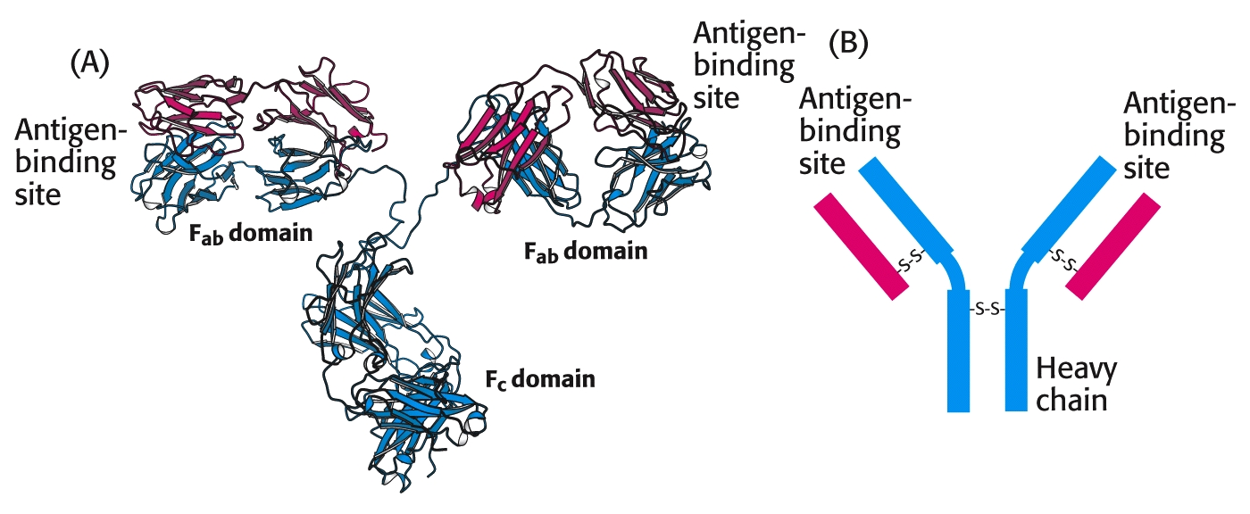
Antibody structure:

Slide 43
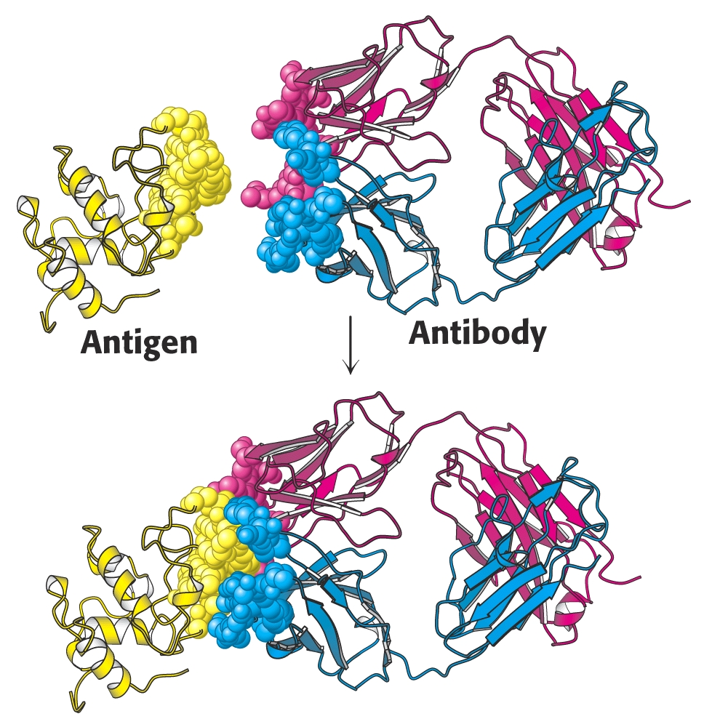
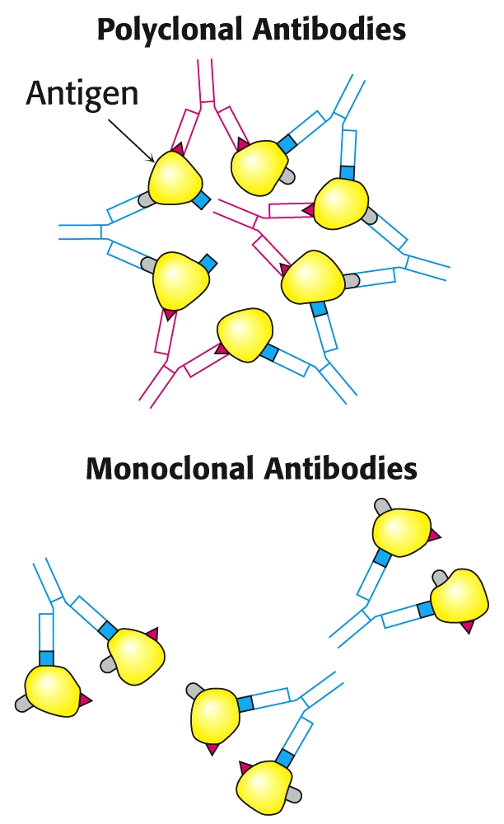
Antigen – Antibody Binding:

Slide 44
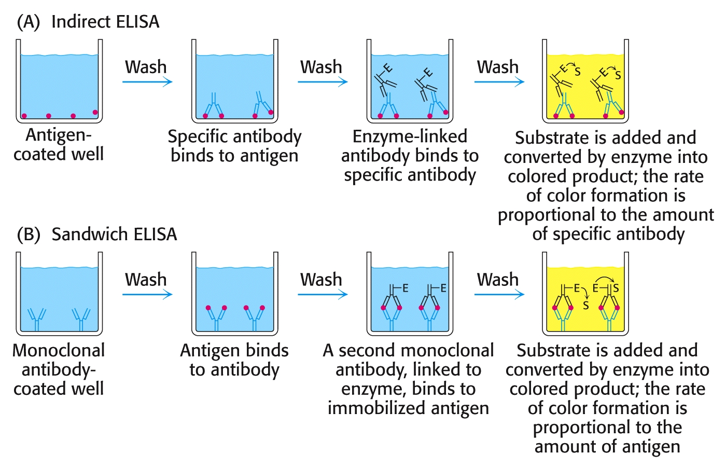
Enzyme Linked Immunosorbent Assay (ELISA):
Indirect ELISA: Detects the presence of an antibody
Sandwich ELISA: Detection and Quantitation of Antigen

Slide 45
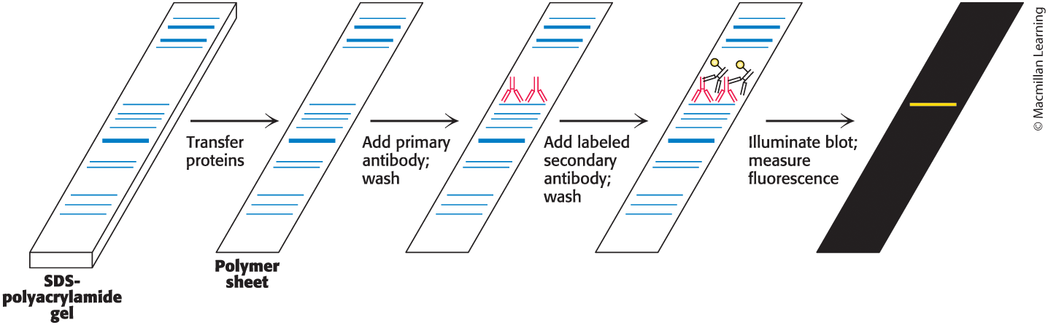
“Western” Blots: Detect Proteins in Gels
Separated proteins in an SDS PAGE gel are transferred to a polymer sheet. Then antibodies identify the location of the desired protein:

Slide 46
End of Lecture Slides
for
Exploring Proteins
Credits: Most of the diagrams used in these slides were taken from Stryer, et.al, Biochemistry, 5th Ed., Freeman Press, Chapter 4 (in our course textbook).

