Slide 1

Exploring Genes
Biochemistry 3070

Slide 2
Recombinant DNA Technology
Recombinant DNA technology has revolutionized biochemistry since its inception in the early 1970’s.
Utilizing enzymes that cut, join, and replicate DNA and/or RNA is a key concept in modern chemical and biological laboratories.
Synthesizing new and unique strands of nucleic acids offers a powerful tool in understanding cellular functions.

Slide 3
Nucleic Acid Hybridization
Another powerful concept in studying genes is the complementary binding of the bases in either DNA or RNA.
Hybridization between complementary strands of nucleic acids allows researchers to identify specific locations, identify specific strands of DNA or RNA, and observe changes in the structure of nucleic acids.

Slide 4
Basic Tools of Gene Exploration
Basic Techniques of Biotechnology:
Restriction enzymes – cut DNA at specific sites
Blotting techniques – separate and identify regions of DNA and RNA
DNA Sequencing – Automated methods allow rapid and accurate sequencing of bases in nucleic acid polymers.
Solid-phase synthesis of nucleic acids – de novo synthesis of precise sequences
Polymerase Chain Reaction (PCR) – amplifies segments of DNA, permitting charaterization and manipulation.
Computers – storage and manipulation of large quantities of information

Slide 5
Restriction Enzymes
Restriction enzymes (“restriction endonucleases”) recognize specific sequences of duplex DNA and cleave both strands at this location.
Restriction enzymes are found in wide variety of prokaryotes, where they protect the cell by cleaving foreign DNA molecules.
The cell’s own DNA is not cleaved because the sites recognized by its own restriction enzymes are methylated.

Slide 6
Restriction Enzymes
Many restriction enzymes recognized specific sequences containing four to eight base pairs and hydrolyze a phosphodiester bond in each strand near this sequence.
These sites possess a unique characteristic: They possess a twofold rotational symmetry (C_{2v}).
Such symmetry is often called a “palindrome.” (derived from the Greek “palindromos,” to run back again.)

Slide 7
Palindromes
Examples of palindromes in the English language:
MOM
DAD
RADAR
MADAM, I’M ADAM
A MAN, A PLAN, A CANAL, PANAMA
What other palindromes can you think of?

Slide 8
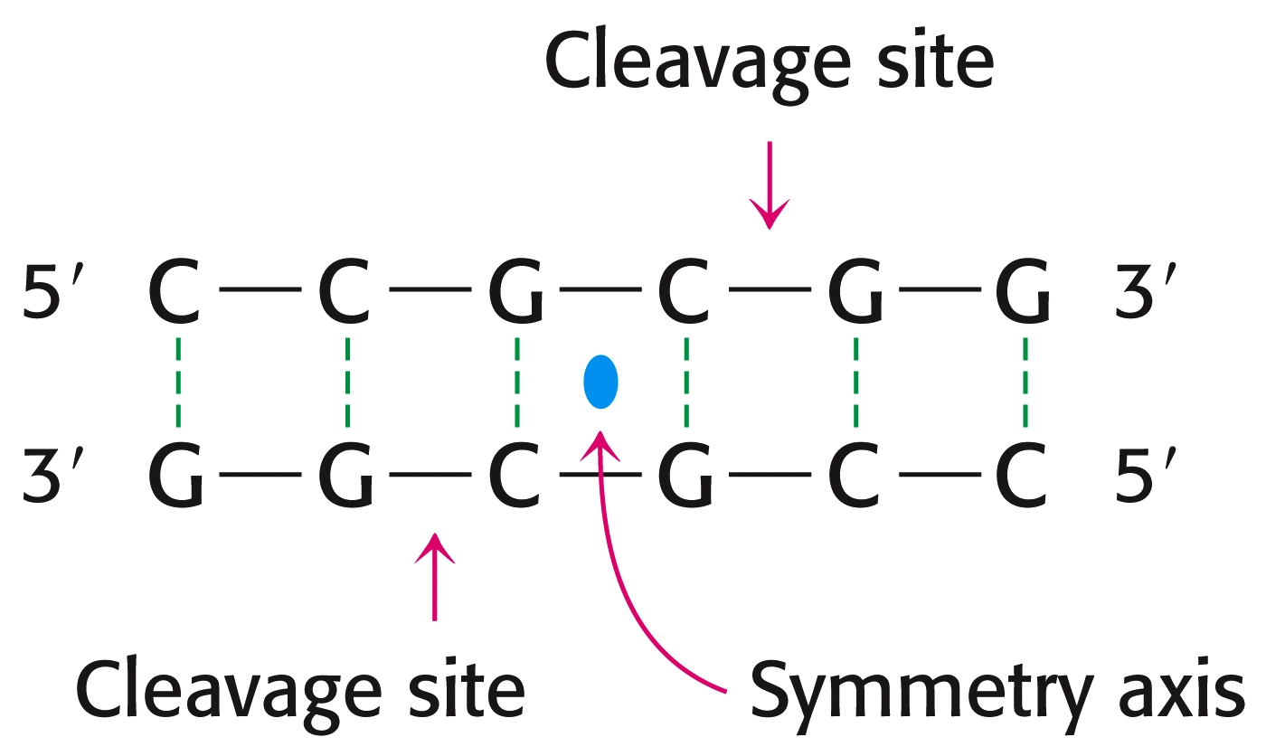
Restriction Enzymes – Palindromic Sites

Slide 9
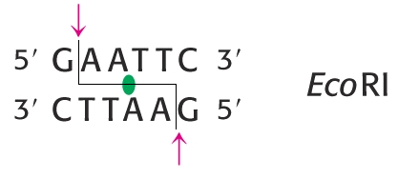
Restriction Enzymes
More than 100 restriction enzymes have been isolated and characterized.
They are named according to the organism that synthesizes them:
EcoRI:
Synthesized by E. coli, strain “R,” restriction enzyme #1
EcoRI’s cleavage site:

Slide 10
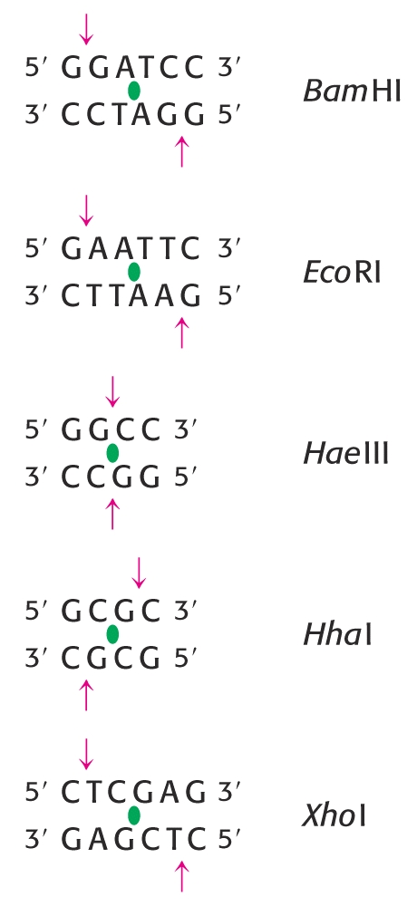
Restriction Enzymes
Specificities of commonly used restriction enzymes.
Note the twofold axis of symmetry at each site.

Slide 11
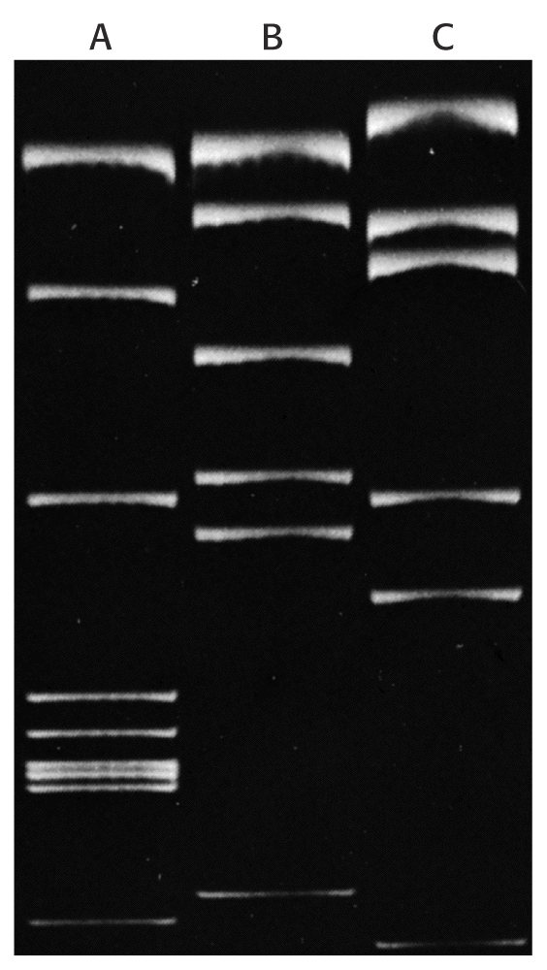
Restriction Enzymes
Treating identical strands of DNA with different restriction enzymes yields different fragments.
These fragments may be separated in electrophoretic gels.
Staining with ethidium bromide allows detection of 50ng of DNA.
SV40 (Viral) DNA cleaved with 3 different restriction enzymes.

Slide 12
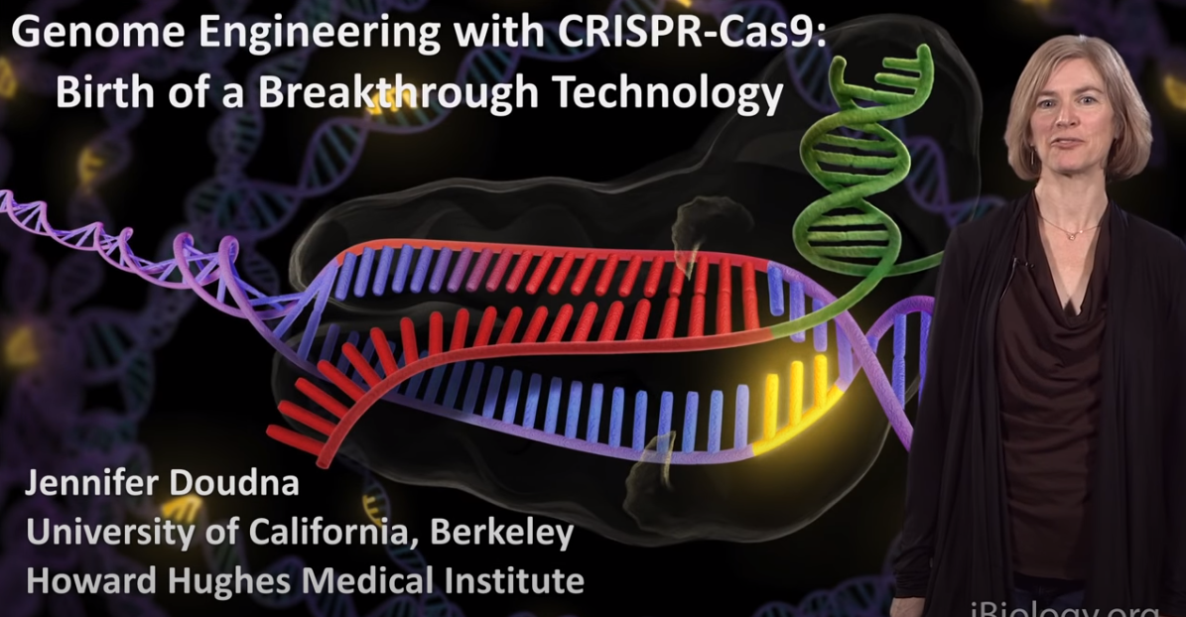
Nobel Prize in 2020 for CRISPR/Cas9 “Genetic Scissors”
https://www.youtube.com/watch?v=SuAxDVBt7kQ
https://www.youtube.com/watch?v=SuAxDVBt7kQ\ 10 minute video

Slide 13
Knockouts
Researchers frequently want to “knockout” to keep it from producing its functional protein to study its function, as well as disease modeling and drug targeting, etc.
CRISPR-Cas9 is the most modern and efficient method to do this, using a “guide RNA” to direct the CRISPR to cut the DNA is a specific location. When the cell tries to repair this cut, it often makes mistakes (insertions or deletions), which scramble the genetic code and disable the gene.
Other techniques such as Homologous Recombination and Gene Trapping can also be used to knockout a gene, but are often not as specific as CRISPR.
Knockout experiments are the "gold standard" for determining gene function.

Slide 14
Southern Blotting of DNA Gels
“Southern blotting” may be used to identify specific fragments of DNA. (Edwin Southern)
Following transfer of separated strands of DNA from the gel to a nitrocellulose sheet, a ³²P-labeled “probe” with a complementary base sequence is hybridized to the target fragment.
After rinsing away the unbound probe, autoradiography reveals the location of the desired fragment on the sheet.

Slide 15
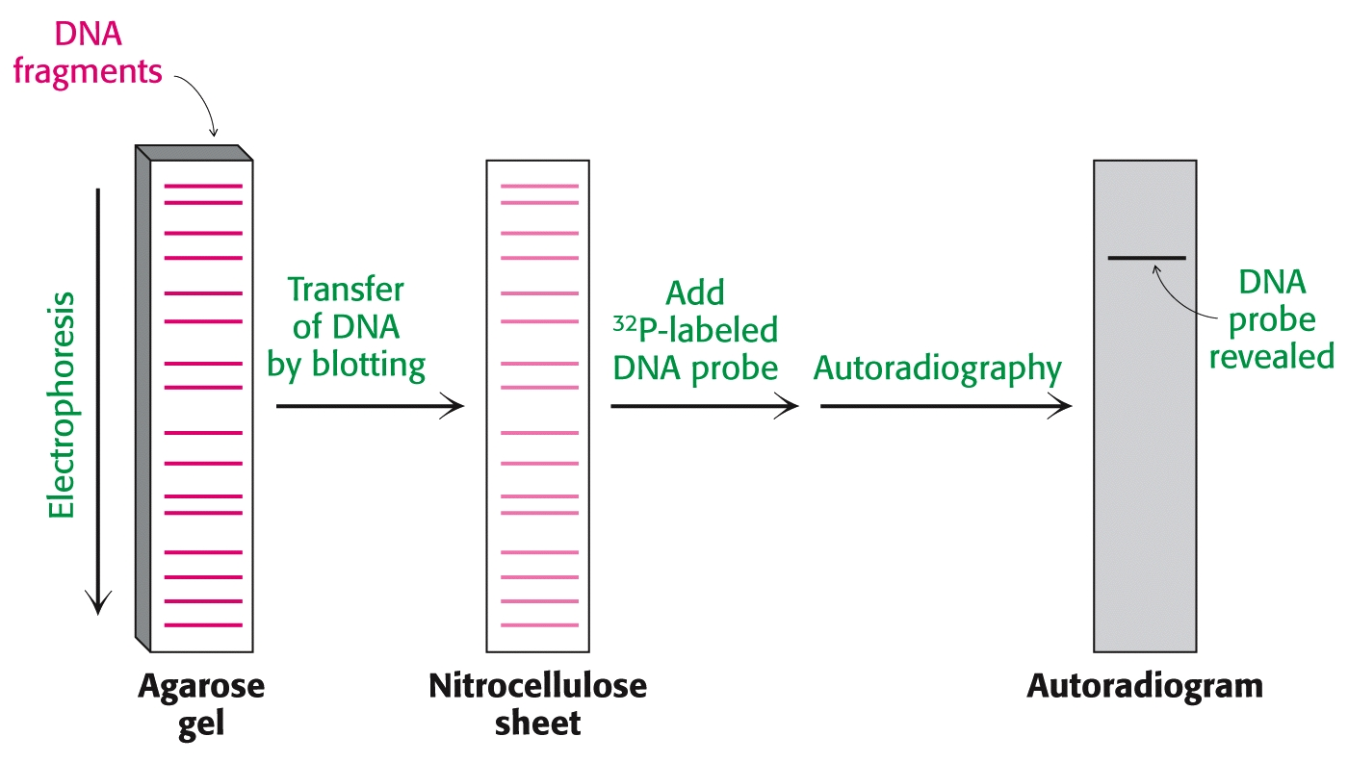
Southern Blotting of DNA Gels

Slide 16
Northern Blotting of RNA Gels
RNA can also be analyzed via similar blotting techniques.
RNA molecules are separated in electrophoretic gels, then blotted onto polymeric sheets. 32P-labeled RNA probes form hybrids and are located via autoradiography.
Such RNA blots have been [whimsically] termed “Northern Blots.”

Slide 17
Blotting Techniques
Review of Blotting Techniques:
Blot Type | Separates | Probe | Visualizaton
Southern | DNA | Complementary ³²P-DNA strand | Autoradiography
Northern | RNA | Complementary ³²P-RNA strand | Autoradiography
Western | Proteins | Antibody attached to radioactive label or enzyme (ELIZA) | Autoradiography or color change

Slide 18
Sequencing DNA
Nucleic acid fragments can be recovered and studied further.
For example, DNA fragments resulting from treatment with EcoRI can be recovered and then subjected to further treatments with other restriction enzymes to create smaller fragments.
Eventually, such smaller fragments can be sequenced in detail, revealing the exact base sequence.
Overlapping sequences are utilized to “map” the entire DNA sequence. (Similar to protein sequencing, but on a much larger scale.)

Slide 19
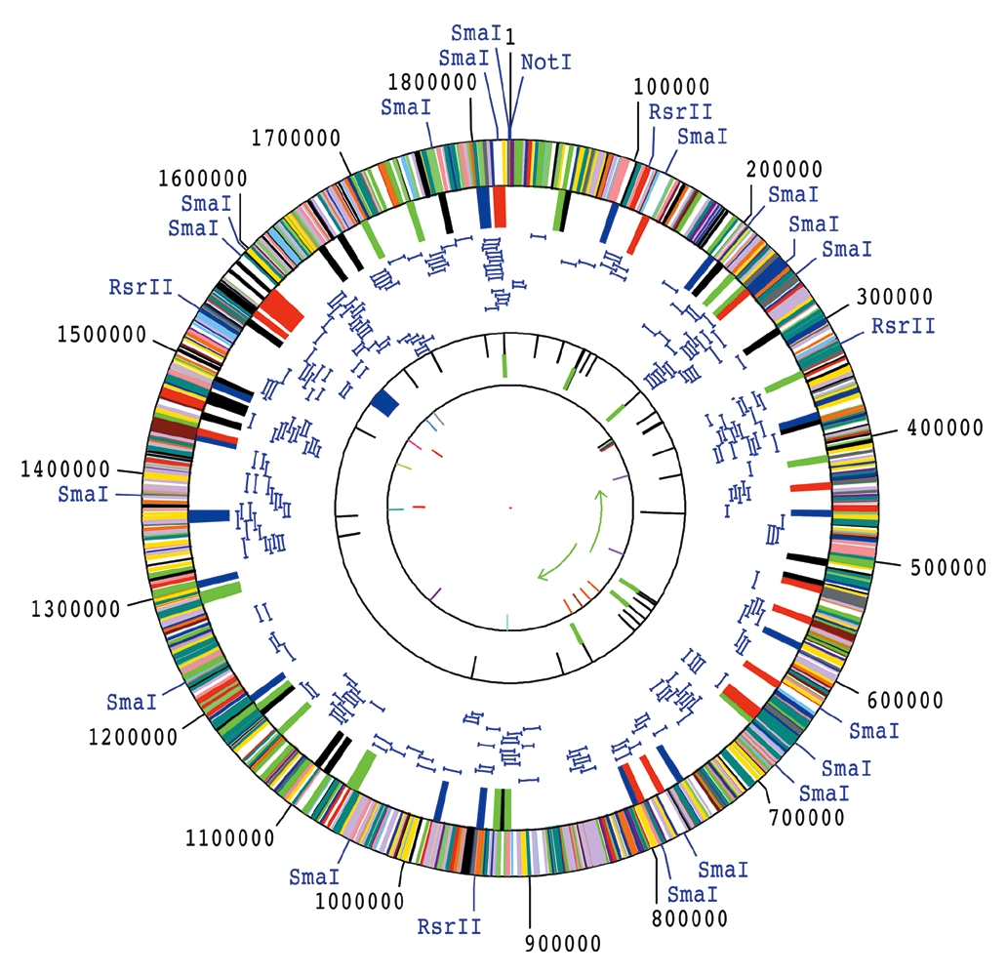
Sequencing DNA
The complete genome of the Haemophilus influenzae bacterium:
1,830,137 base pairs; 1,740 proteins

Slide 20
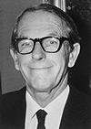
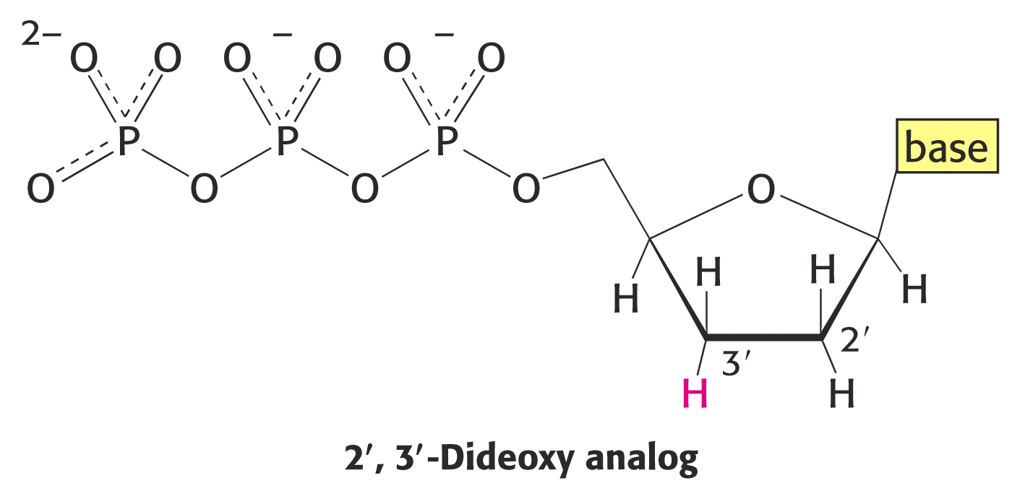
Sequencing DNA
How do researchers sequence DNA?
The Sanger Dideoxy Method:
Fredrick Sanger & coworkers devised an ingenious method. They interupted DNA replication by including small amounts of dideoxy analogs of nucleotide triphosphates:
For example, when ddATP in added to a growing strand, replication stops immediately. Various length strands are produced, all ending in adenine.
Fredrick Sanger, Nobel Prize, 1980

Slide 21
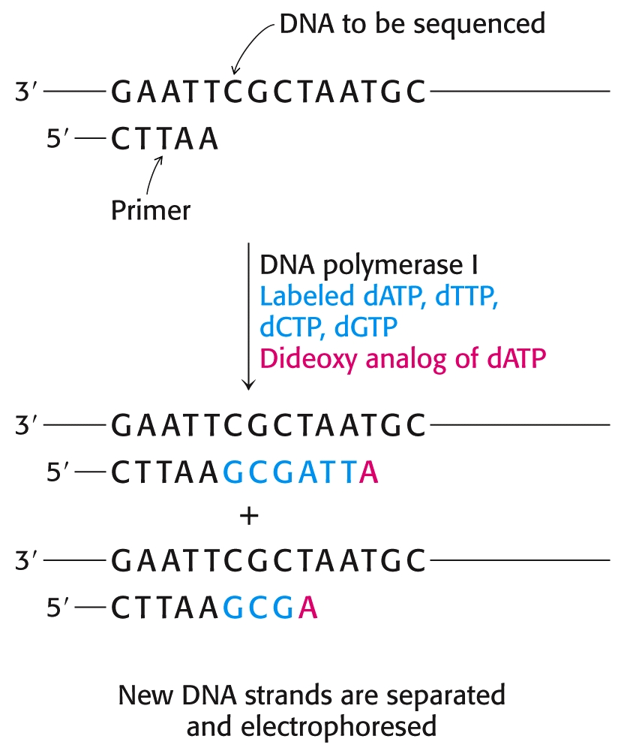
Sequencing DNA
The Sanger Dideoxy Method:
For example, when ddATP in added to a growing strand, replication stops immediately. Various length strands are produced, all ending in adenine.
Separate treatments using ddTTP, ddCTP, and ddGTP all yield strands with different molecular weights, terminating with these respective bases.

Slide 22
Sequencing DNA
The Sanger Dideoxy Method(cont.):
By splitting the solution of a DNA fragment into four test tubes, and treating each with a different dideoxy analog, a complete collection of new, single stranded DNA strands are formed. Each new strand has a different molecular weight and each ends with a dideoxy analog.
The four separate solutions are subjected to electrophoresis in individual lanes, separating them according to molecular weight (with larger strands moving slower than smaller ones). After separation, the sequence may be read directly from the gel.
Question: Which end of the gel corresponds to the 5’ end… the top or bottom of the gel?
(Hint: The shortest fragment is at the bottom of the gel.)
Answer: The 5’end is at the bottom, since DNA replication occurs in the 5’ to 3’ direction.

Slide 23
Sequencing DNA
The need for more rapid sequencing methods let to a relatively simple modification to this Sanger method.
A fluorescent tag is added to the primer. Identical primers with four different colored tags are prepared. Then, a different colored primer is added to each of the four tubes.
After termination, each fragment is color coded, depending on its terminating base.
The contents of all four tubes are recombined and separated by capillary electrophoresis. A laser-assisted fluorescence detector automatically reads the color to determine the sequence.

Slide 24
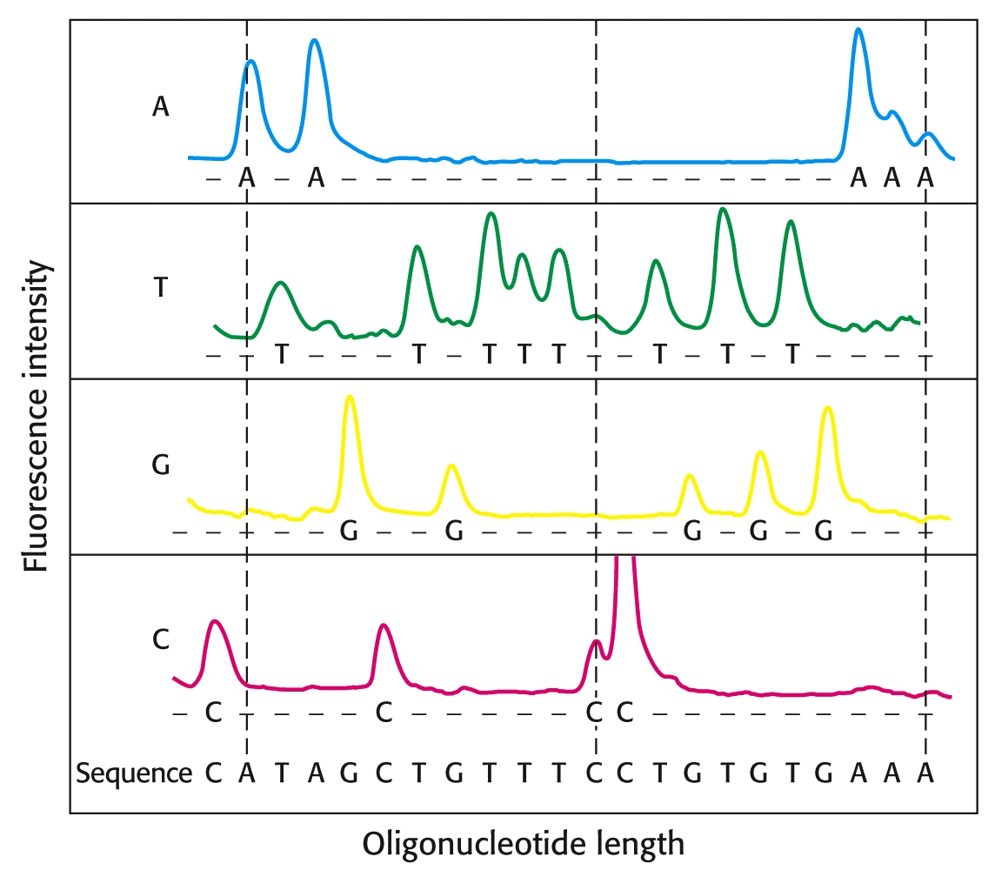
Sequencing DNA

Slide 25
Nanopore Sequencing
As of 2025, the most modern and rapid biochemical method for DNA sequencing is Nanopore Sequencing sometimes referred to as the "Third-Generation" method. It sequences single molecules of DNA in real-time without the need for traditional chemical labels or massive amplification… at a rate of
~ 600 base pairs / second!
Unlike previous methods that used light or pH changes, Nanopore sequencing uses ionic current.
Nanopore: A tiny protein pore (often an engineered version of alpha-hemolysin) is embedded in an electrically resistant synthetic membrane.
Current: A constant voltage is applied across the membrane, creating a steady flow of ions (current) through the pore.
Unzipping: the enzyme, helicase, binds to the double-stranded DNA, unzips it, and feeds a single strand through the nanopore at a controlled speed.
Signal: As each nucleotide (A, T, C, or G) passes through the constriction of the pore, it physically blocks the ion flow to a different degree.
Each base creates a unique "squiggle" in the electrical signal.

Slide 26
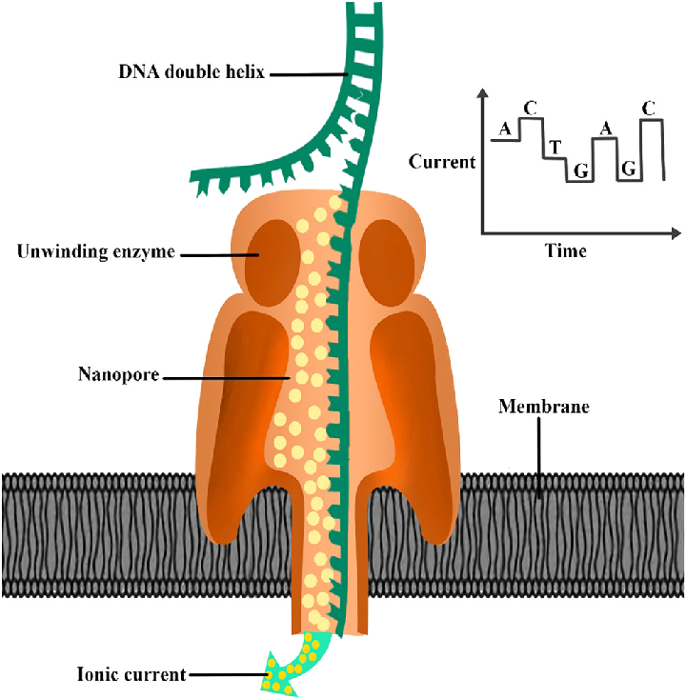
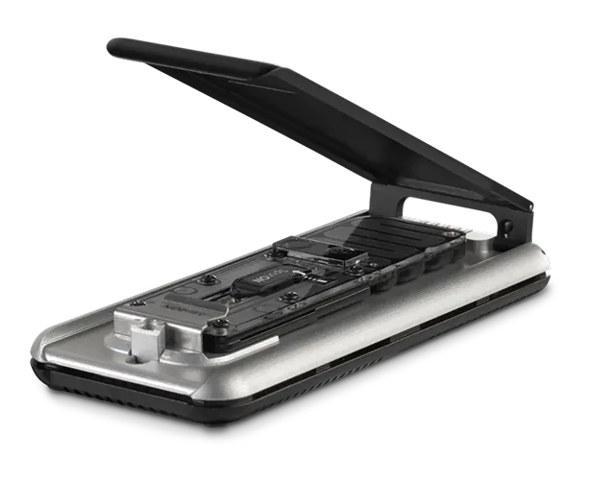
Nanopore Sequencing
Feature | Modern Nanopore (ONT)
Read Length | Ultra-long (up to 4 million bases)
Speed | Real-time (results stream as it's read)
Preparation | Minimal (no PCR required)
Portability | Devices as small as a USB drive
Modifications | Can detect methylation directly
Oxford Nanopore Technologies
MinIon: $2,999
Fits in the palm of your hand
Weighs only 130 g
Bacterial whole genome
Full length 16s rRNA
Whole transcriptome (cDNA)
Transcriptomes (direct RNA)
DNA or RNA (longest >4Mb
https://nanoporetech.com/ja/products/sequence/minion

Slide 27
Nanopore Multiplexing
Multiplexing:
Sequencing multiple samples simultaneously on a single flow cell.
In nanopore sequencing, this is achieved by "tagging" each sample with a unique DNA signature before they are pooled together. The process relies on a biochemical step called barcoding.
Barcode Attachment: Each individual sample is prepared separately in its own tube. A unique synthetic DNA sequence—the "barcode"—is attached to the ends of the DNA fragments using ligase.
Pooling: Once every sample has its own specific barcode, all the samples are mixed together into a single tube.
Loading: The combined pool of barcoded DNA is loaded onto a single Flow Cell. Because the nanopore reads individual DNA strands one by one, it doesn't care that the strands came from different sources.It simply processes the "soup" of DNA, reading the barcode first and then the rest of the genetic sequence.
Massive Scaling:
Modern kits allow for the multiplexing of up to 96 samples on a small MinION flow cell,
or
As many as 2,304 samples on high-throughput systems.

Slide 28
Synthetic DNA
DNA can be readily synthesized by automated techniques.
Some well-funded laboratories have their own bench-top automated synthesizers.
Other laboratories order specific DNA sequences from companies that offer inexpensive, custom syntheses (often for less than $1/base pair) and can deliver within 1-3 days.

Slide 29
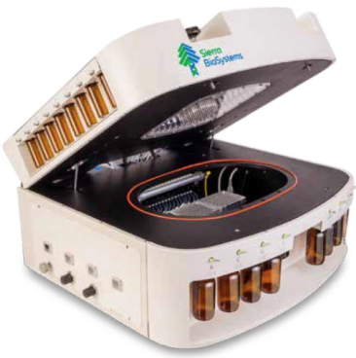
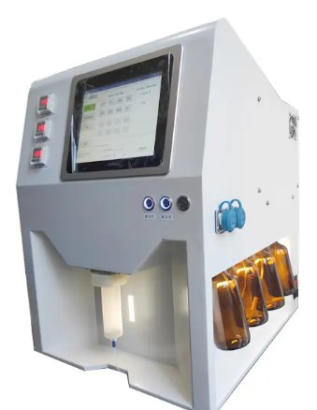
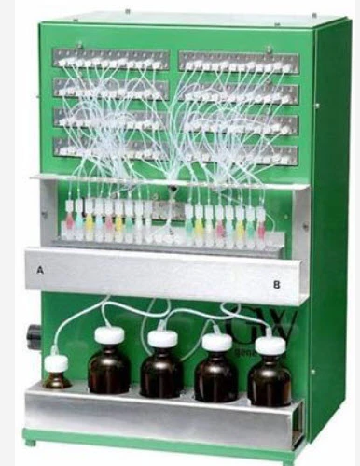
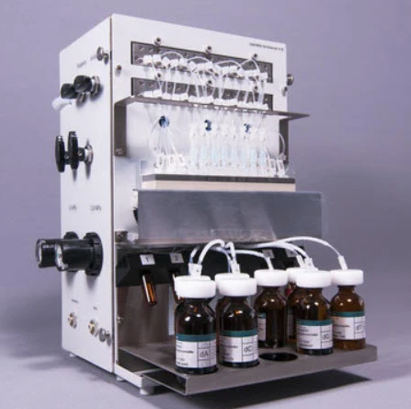
DNA Synthesizers for Laboratories

Slide 30
Purchasing Custom DNA Sequences
What Can Be Ordered:
Oligonucleotides (Oligos): Short, single-stranded DNA sequences (typically up to 200 bases) used for PCR primers and probes.
Gene Fragments: Double-stranded DNA (dsDNA) that you can clone yourself (e.g., IDT's gBlocks or Twist's Gene Fragments).
Cloned Genes: The DNA sequence is pre-inserted into a vector (plasmid) of your choice and sequence-verified by the provider.
Cost:
As of January, 2026, the cost for custom DNA sequences prices range from $0.07 to $0.40 per base pair (bp) for standard sequences.
Large bulk orders (pools) can be as low as $0.02/base for very large libraries.
Turnaround Time:
Twist Bioscience: Express Genes ship in 2-4 business days
GenScript: FLASH Gene ships in 4 business days
Azenta (GENEWIZ): Next-day delivery of unmodified oligos.

Slide 31
Polymerase Chain Reaction (PCR)
The biggest challenge in early studies of DNA was the small quantities available to researchers (usually one copy per cell).
The only option was to harvest DNA from large quantities of tissues or cells.
A single technique revolutionized DNA studies.
In 1984 Kary Mullis devised the method now called the “polymerase chain reaction” or “PCR.”

Slide 32
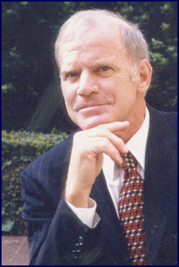
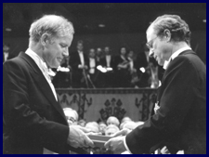
Polymerase Chain Reaction (PCR)
Kary Banks Mullis:
1944-
Chemist / Surfer
(B.S. degree in chemistry )
1993 Nobel Prize in Chemistry for his invention of the polymerase chain reaction (PCR) method.
His work "hastened the rapid development of genetic engineering" and "greatly stimulated biochemical research and opened the way for new applications in medicine and biology."

Slide 33
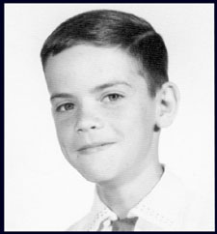
Polymerase Chain Reaction (PCR)
Kerry Mullis – (In his younger years:)
Source: http://www.karymullis.com/
"Every November when I was young, my mother would give my brothers and me a pile of catalogues and let us pick what we wanted for Christmas. It was in one of those catalogues that I found a Gilbert Chemistry Set. Something about tubes filled with things with exotic names intrigued me. My objective with that set was to figure out what things I might put together to cause an explosion.
"I discovered that whatever chemicals might be missing from the set could be bought at the local drugstore. In the 1950s in Columbia, South Carolina, it was considered okay for kids to play with weird things. We could go down to the hardware store and buy 100 feet of dynamite fuse, and the clerk would just smile and say, 'What are you kids going to do? Blow up the bank?'

Slide 34
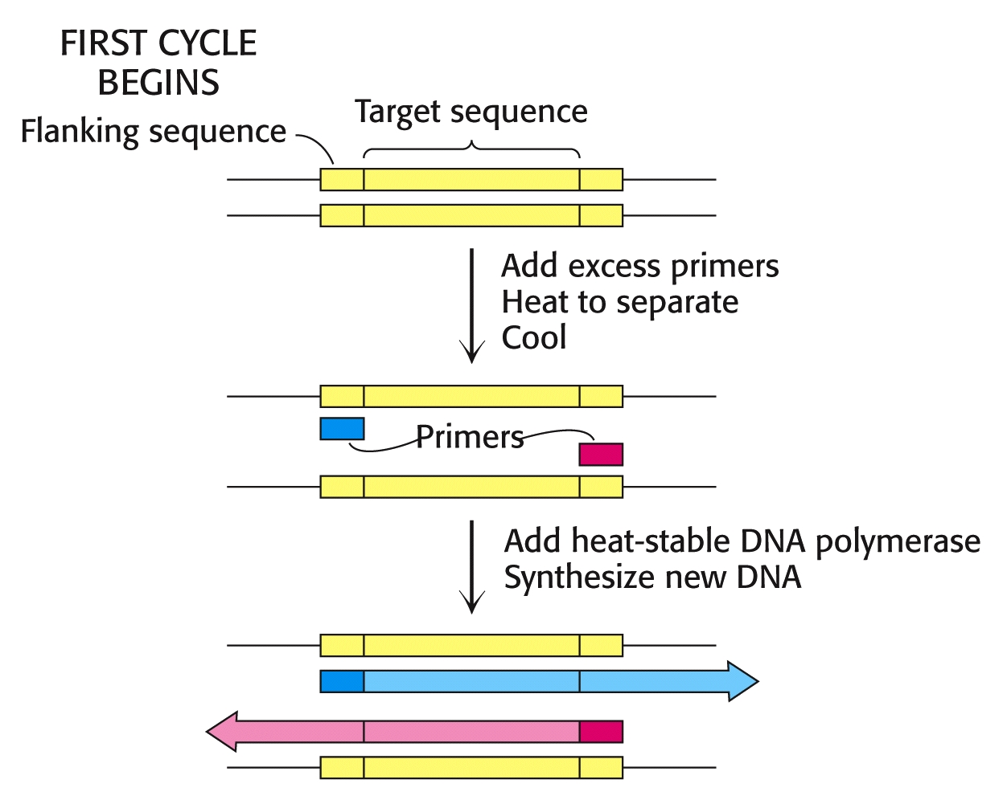
Polymerase Chain Reaction (PCR)

Slide 35
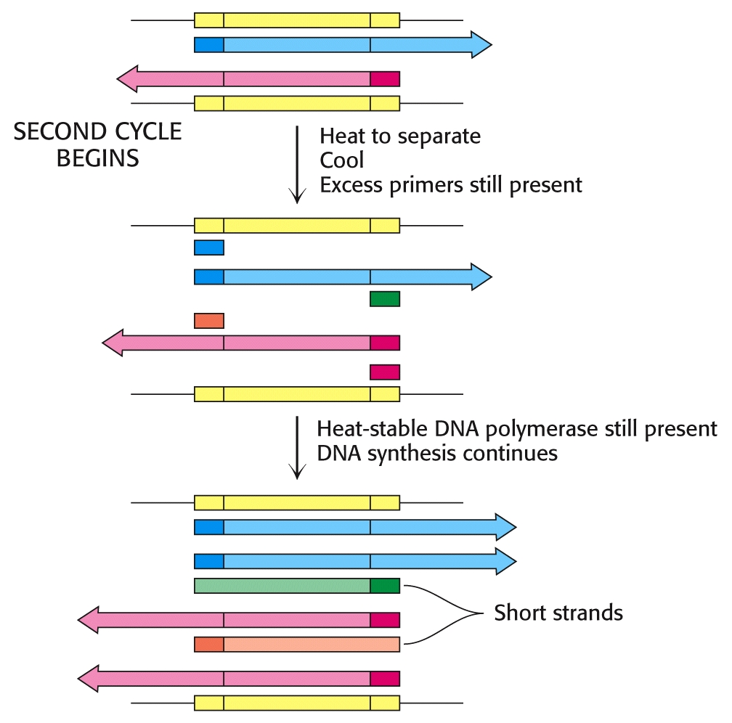
Polymerase Chain Reaction (PCR)

Slide 36
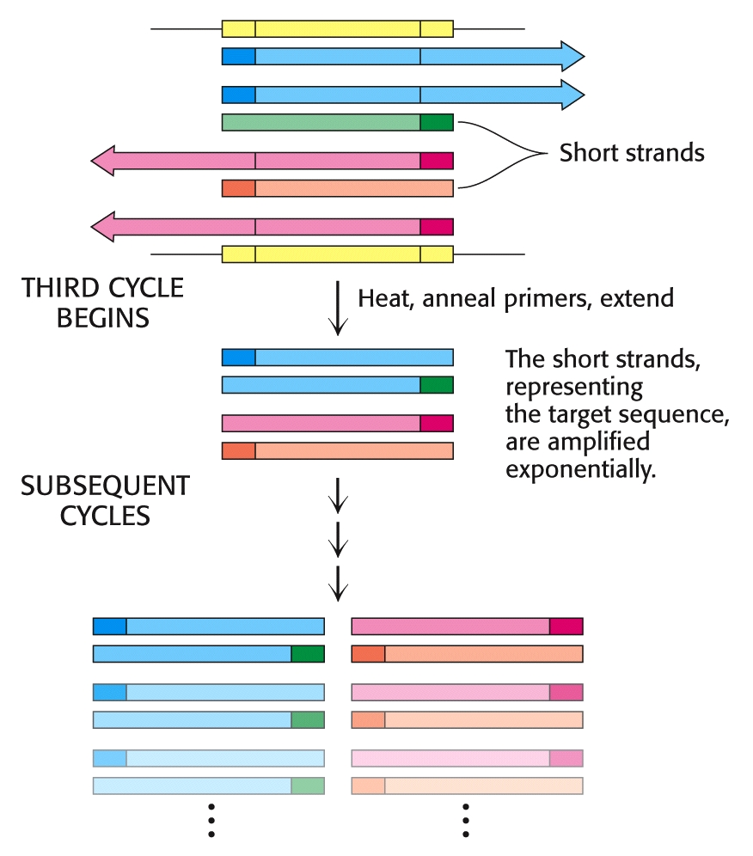
Polymerase Chain Reaction (PCR)

Slide 37
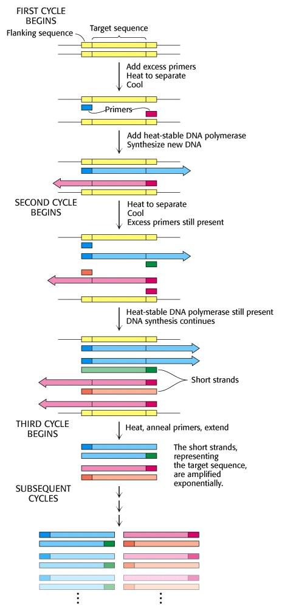
PCR
Each round of the PCR amplification takes only a few minutes and can be automated in a simple, desktop PCR “cycler.”

Slide 38
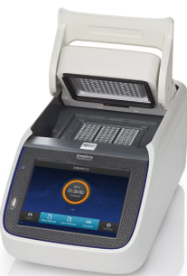
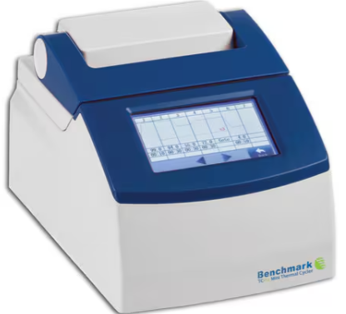
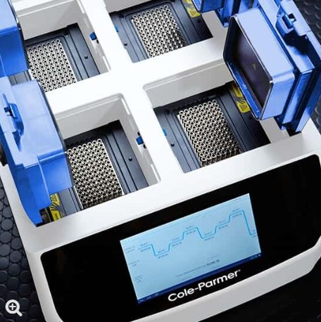
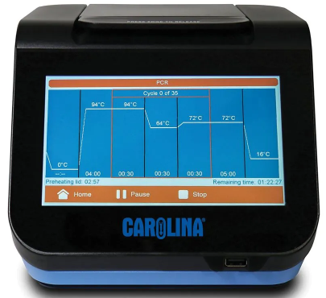
Examples of PCR Desk-top thermo cyclers:

Slide 39
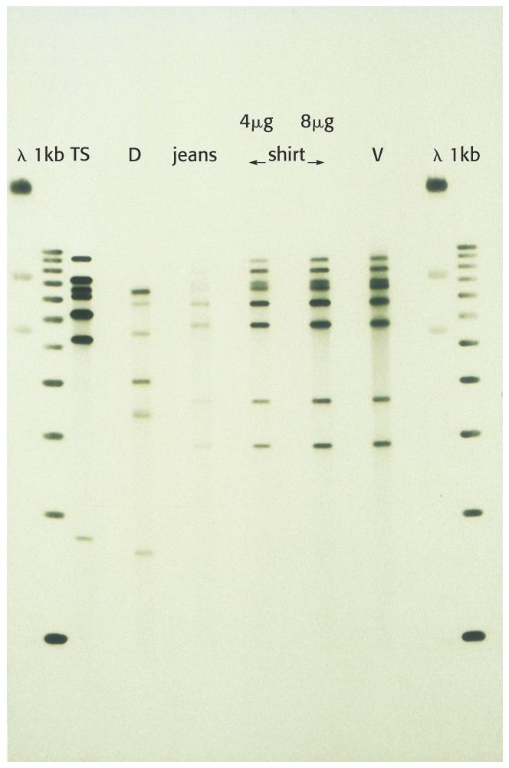
Polymerase Chain Reaction (PCR)
Example of “CSI” DNA matching in forensics applications:
PCR-amplified fragments of DNA from blood stains used in evidence for a murder investigation:
Outside Lanes: Controls
D = defendant’s blood
Jeans = blood stains from defendant’s pants
Shirt = blood stains from defendant’s shirt
V = victim’s blood

Slide 40
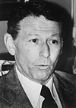
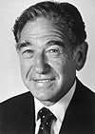
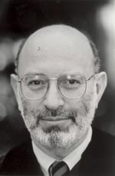
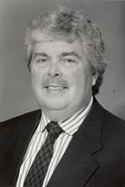
Recombinant DNA Technology
Recombinant DNA technology was born in the early 1970’s, led by Paul Berg, Herbert Boyer, and Stanley Cohen.
Paul Berg: Nobel Prize (1980) for his fundamental studies of the biochemistry of nucleic acids, with particular regard to recombinant-DNA http://nobelprize.org/chemistry
Stanley Cohen: Nobel Prize (1986) “for his discovery of growth factors.” http://nobelprize.org/chemistry
http://web.mit.edu/
Herbert Boyer: $500,000 Albany Medical Center Prize in Medicine and Biomedical Research (shared with Stanley Cohen).
http://web.mit.edu/

Slide 41
Recombinant DNA Technology
Recombinant DNA is essentially composed of DNA strands that have been cut and then “recombined” with new inserts of foreign DNA.
Recombinant DNA experiments usually involve the use of a “vector.” A vector is a segment of DNA that can replicate autonomously in a host cell.
Bacterial plasmids are excellent vectors. Plasmids are relatively short, circular DNA molecules that act as accessory chromosomes in bacteria.

Slide 42
Recombinant DNA Technology
One elegant way of splicing new DNA into a plasmid vector, is to treat the vector with a restriction enzyme that splits the double helix and leaves short segments of single stranded DNA (some times called “sticky ends” or “cohesive ends.”)
The segment of DNA to added to the plasmid is also treated with the same restriction enzyme, leaving complementary sticky ends.
When mixed, the two treated strands form complementary base pairing between their ‘sticky” ends. The two strands can then be joined with ligase enzyme, effectively “splicing” the two segments together.

Slide 43
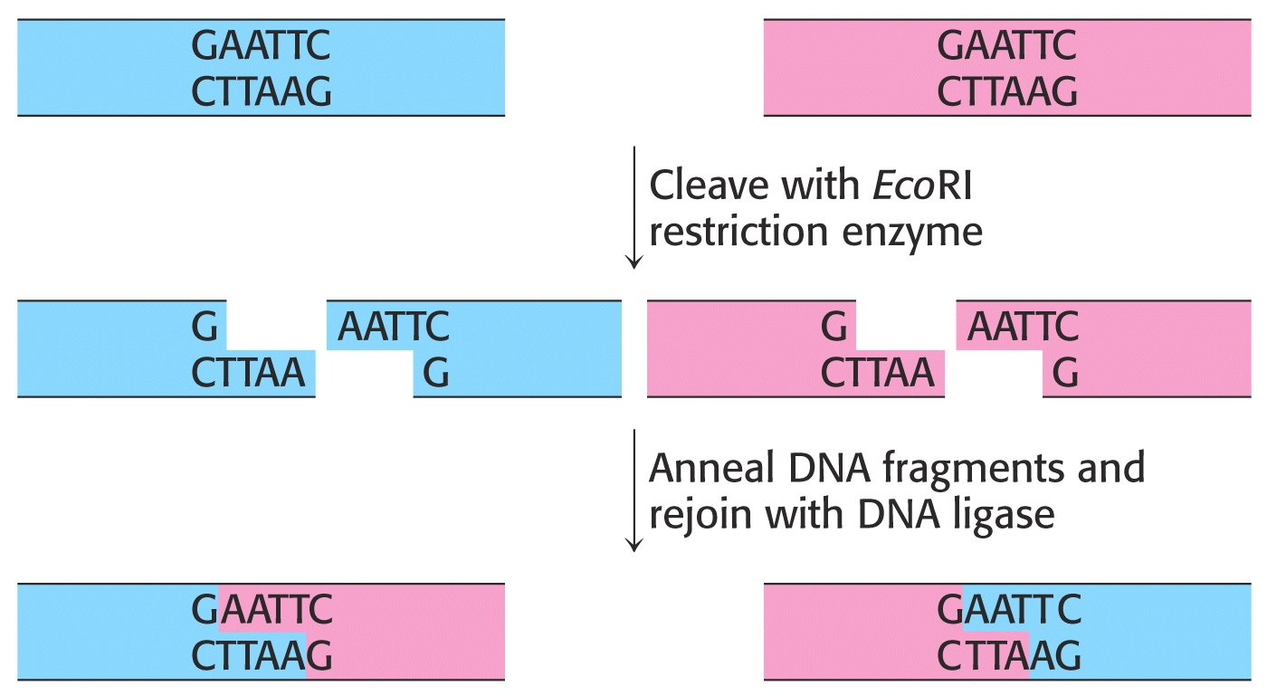
Recombinant DNA Technology

Slide 44
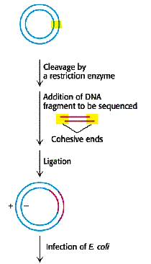
Recombinant DNA Technology

Slide 45
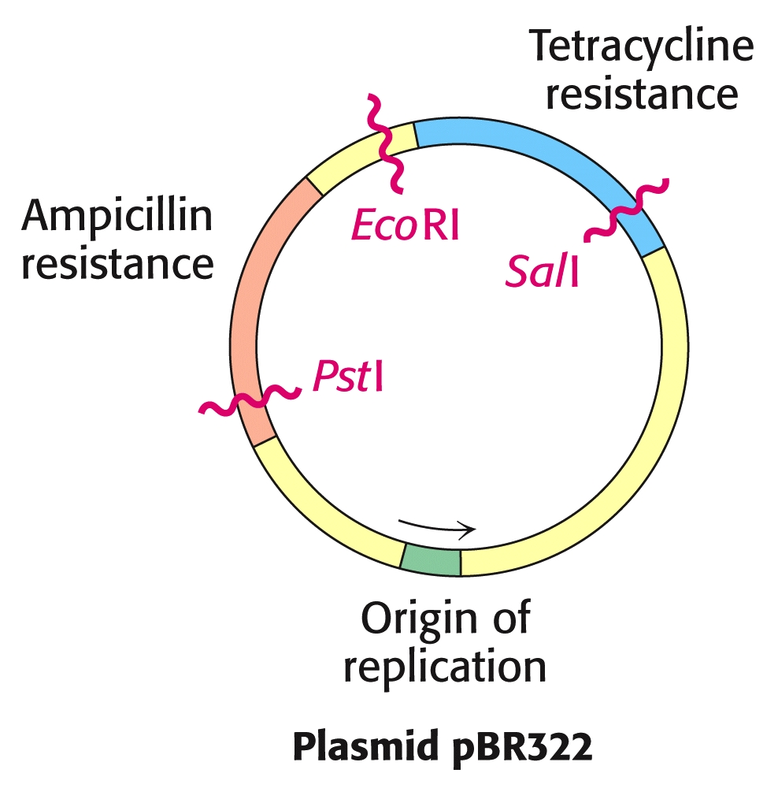
Recombinant DNA Technology

Slide 46
Recombinant DNA Technology
After new recombinant DNA molecules have been produced, they must be introduced into a host organism.
Bacterial plasmid vectors can be introduced through a variety of methods:
Chemical Treatments of host cells can make them “leaky,” allowing the plasmid vectors to sneak into the organism.
Electroporation involves shooting small gold particles coated with DNA plasmids into cells.

Slide 47
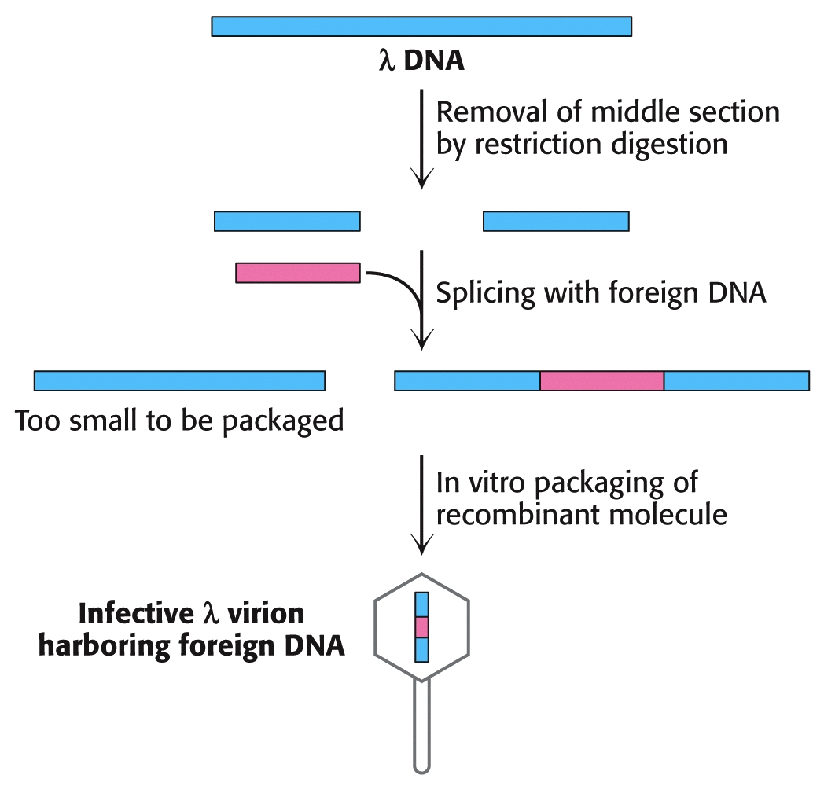
Recombinant DNA Technology
Lambda Phage also carries an excellent DNA vector:
Insertion into host cells is easily accomplished for host cells normally targeted by the virus. The virus binds to the surface and then injects its DNA contents into the host cell.

Slide 48
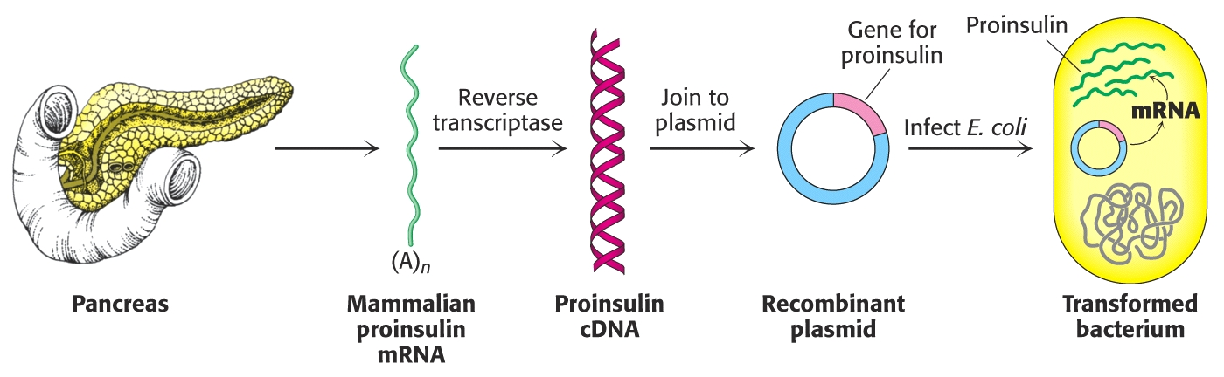
Recombinant DNA Technology
Complementary DNA prepared from mRNA can be expressed in host cells:

Slide 49
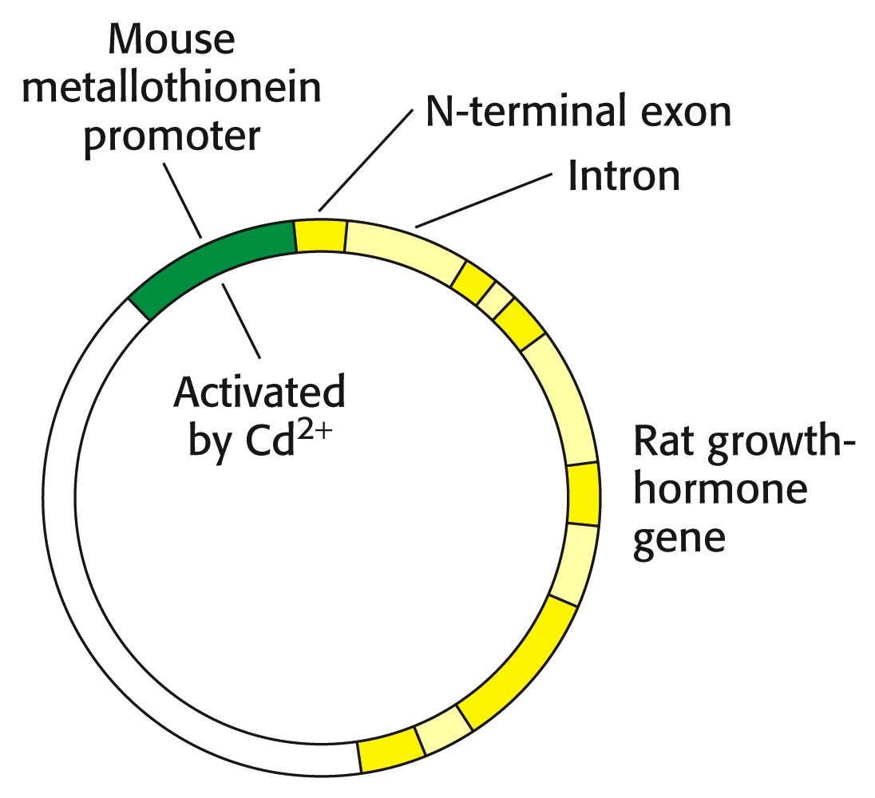
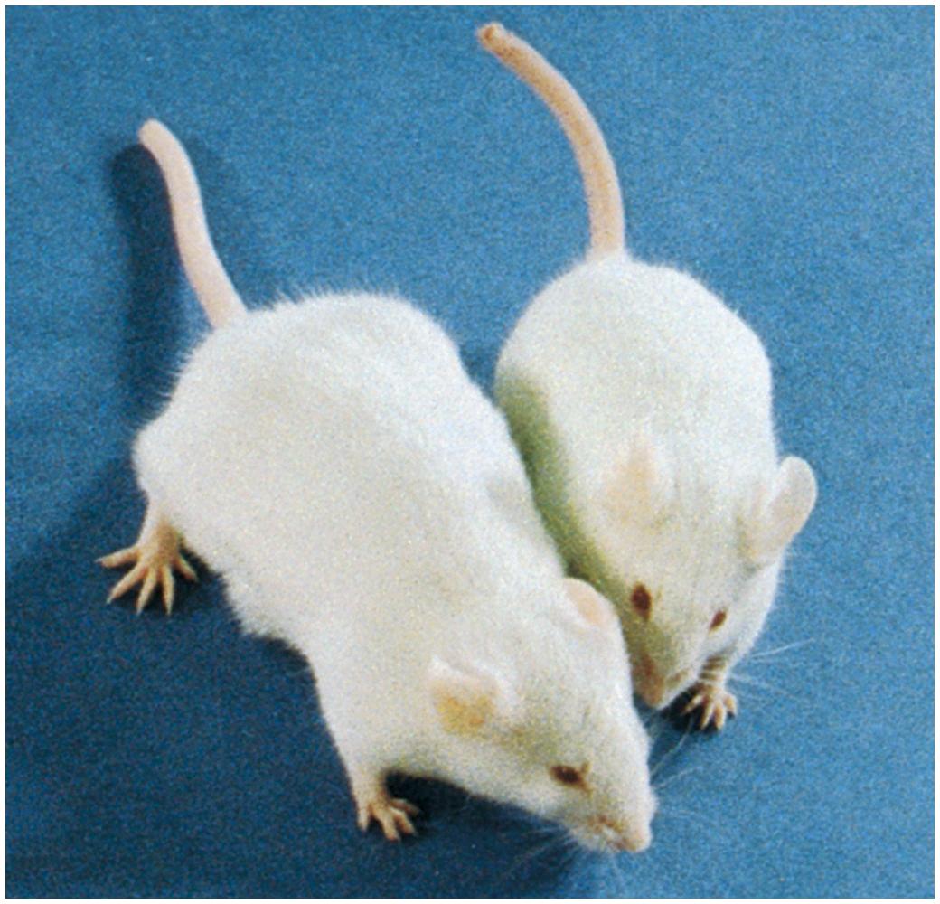
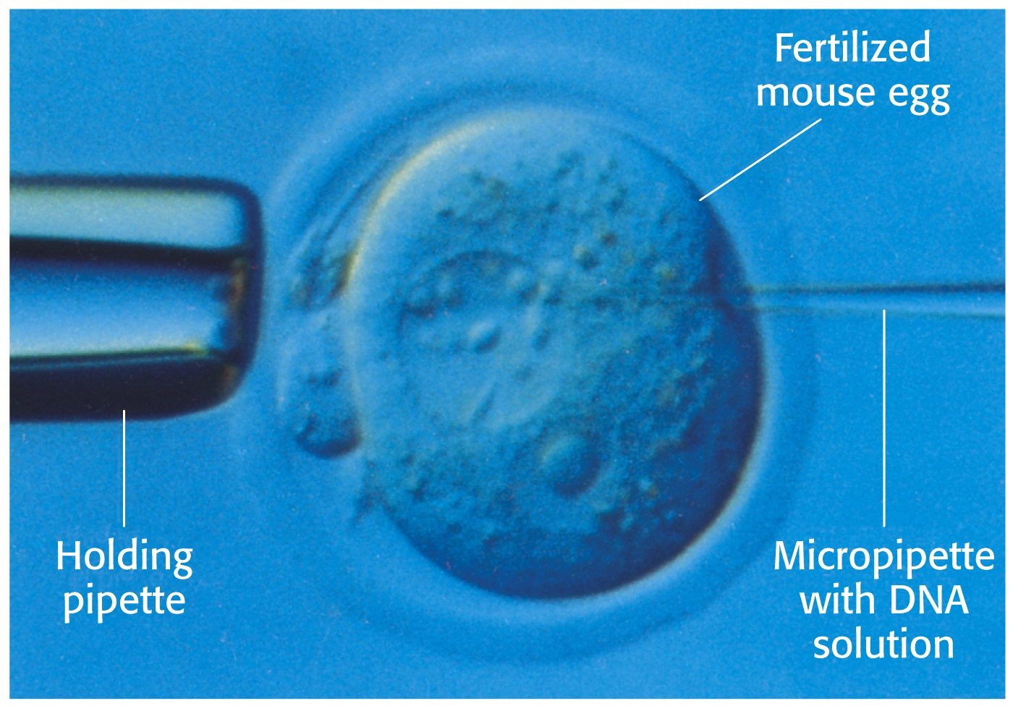
Recombinant DNA Technology
Recombinant DNA can be injected into fertilized eggs, and then be expressed in the organism.

Slide 50
Recombinant DNA Technology
Novel proteins with new functions can be created through directed changes in DNA:
Deletions
Substitutions
Insertions
Designer Genes

Slide 51
End of Lecture Slides
for
Exploring Genes
Credits: Most of the diagrams used in these slides were taken from Stryer, et.al, Biochemistry, 5th Ed., Freeman Press, Chapter 6 (in our course textbook).

