Slide 1
Enzymes
10th ed. Chapters 5, 6, 7
Biochemistry 3070

Slide 2
Enzymes
Enzymes are biological catalysts.
Recall that by definition, catalysts alter the rates of chemical reactions but are neither formed nor consumed during the reactions they catalyze.
Enzymes are the most sophisticated catalysts known.
Most enzymes are proteins. Some nucleic acids exhibit enzymatic activities (e.g., rRNA). We will focus primarily on protein-type catalysts.

Slide 3
Enzyme Characteristics
Enzymes significantly enhance the rates of reactions, by as much as ~ 10⁶!
For example, the enzyme “carbonic anhydrase” accelerates the dissolution of carbon dioxide in water:
CO₂ + H₂O → H₂CO₃
While this occurs without the help of this enzyme, the enzyme increases the rate of reaction by one million times (10⁶).

Slide 4
Enzymes – Turnover Number
How fast can an enzyme produce products?
The “turnover number” is used to rate the effeciency of an enzyme. This number tells how many molecules of reactant a molecule of enzyme can convert to product(s) per second.
In the case of carbonic anhydrase, this means that a single molecule of enzyme converts 10⁵ molecules of CO₂ to H₂CO₃ per second!

Slide 5
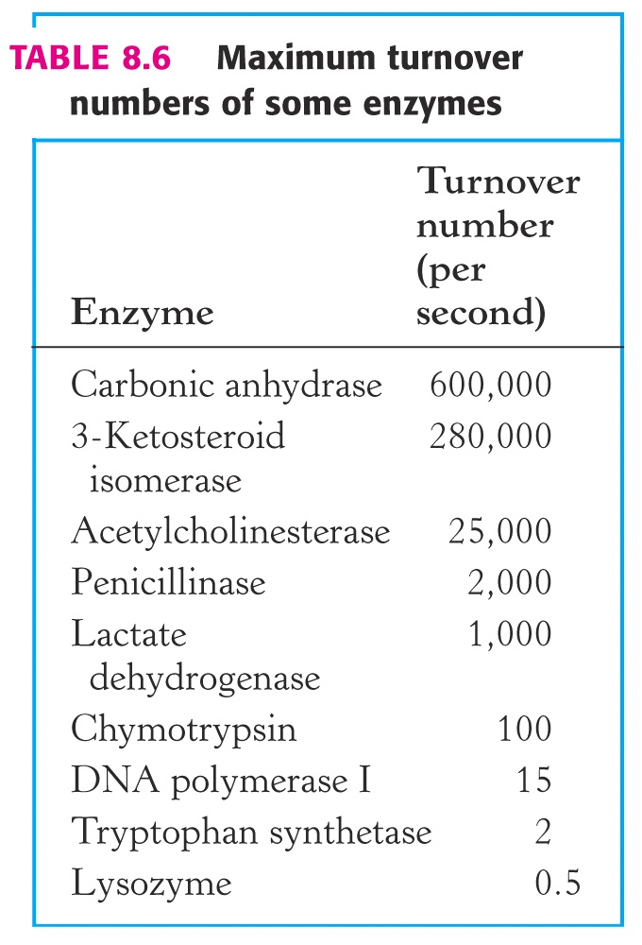
Enzymes – Turnover Numbers

Slide 6
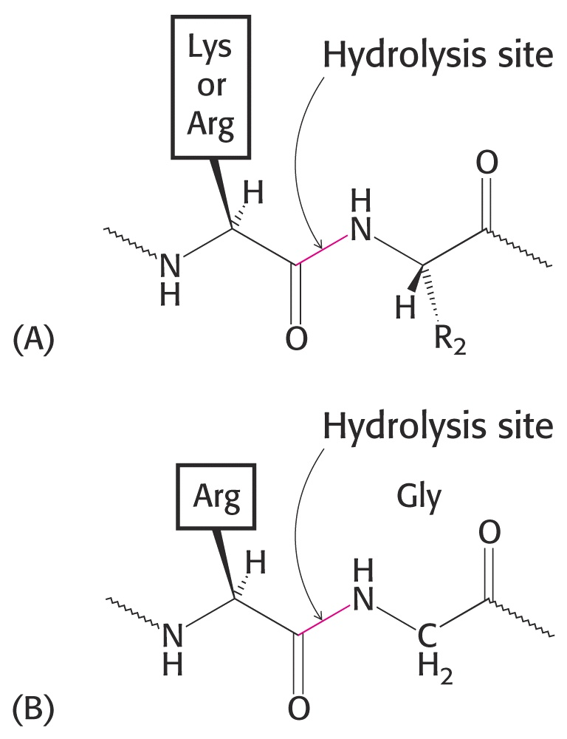
Enzyme Specificity
Enzymes can be very specific.
For example, proteolytic enzymes help hydrolyze peptide bonds in proteins.
  Trypsin is rather specific
  Thrombin is very specific

Slide 7
Enzyme Specificity
DNA Polymerase I is a very specific enzyme.
During replication of DNA, it exhibits an error rate of only one wrong nucleotide base per 10⁸ base pairs! (Note: 3x10⁹ bp / 1x10⁸ ≈ 30 errors/human genome)
Enzymes also recognize stereochemistry.
The enzyme “L-amino acid oxidase” acts only upon L-amino acids, ignoring “D” amino acids.

Slide 8
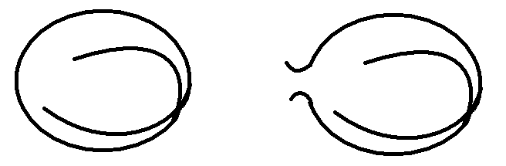
Enzyme Regulation
Enzymes are also regulated in a variety of ways:
Some are synthesized in an inactive form.
Trypsin is synthesized as a long, single polypeptide chain in an inactive form called “trypsinogen.” Another specific enzyme catalyzes the hydrolysis of a peptide bond, splitting it into two parts before it becomes active:
Inactive precursor Active Enzyme

Slide 9
Enzyme Regulation
Enzymes can also be regulated by covalent modification.
Alcoholic side chains of the amino acids serine (1°-OH), threonine(2°-OH), and tyrosine (Ar-OH) are phosphorylated to control some enzymes:
-CH₂-OH + PO₄³⁻ → -CH₂-O-PO₃²⁻
(Some enzymes are more active when phosphorylated while others are more active when dephosphorylated.)

Slide 10
Enzyme Regulation
Certain enzymes are regulated by “feedback inhibition.” In this case, products of the reaction (or downstream products) return at high concentrations, binding to the enzyme and slowing its catalytic activity.

Slide 11
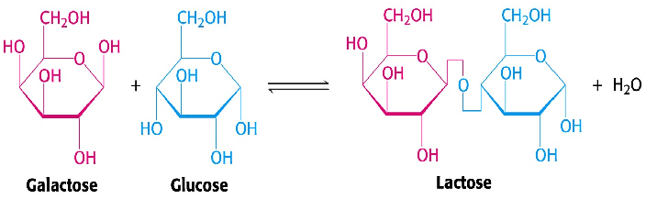
Enzyme Regulation
Subunit Modulation can also affect an enzyme’s velocity, affinity or specificity.
Lactose Synthetase normally adds galactose to amino acid side chains in proteins.
However, at parturition, mammary tissues produce a modulating subunit that binds to this enzyme, causing it to add galactose to glucose, forming lactose (milk sugar).

Slide 12
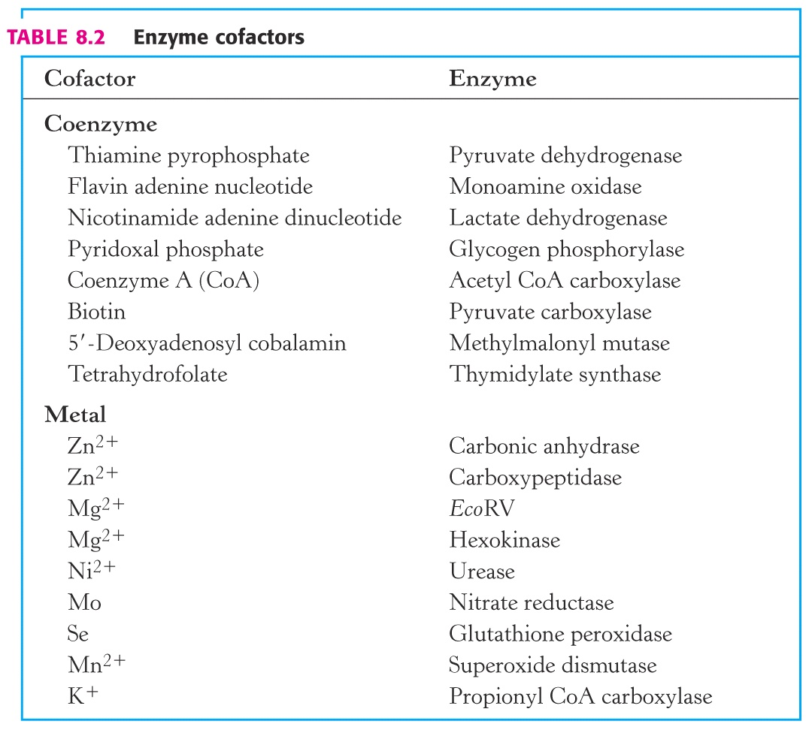
Enzyme Cofactors
Some enzymes require “cofactors.”
Cofactors are split into two groups:
  Metals
  Coenzymes (small organic molecules)
Most vitamins are coenzymes.
“Apoenzyme” + cofactor = “Holoenzyme”

Slide 13
Enzyme Classification
Enzymes are classified and named according to the types of reactions they catalyze:
  Proteolytic enzymes [such as trypsin] lyse protein peptide bonds.
  “ATPase” breaks down ATP
  “ATP synthetase” synthesizes ATP
  “Lactate dehydrogenase” oxidizes lactate, removing two hydrogen atoms.
Such a wide variety of names can be confusing. A better method was needed.

Slide 14
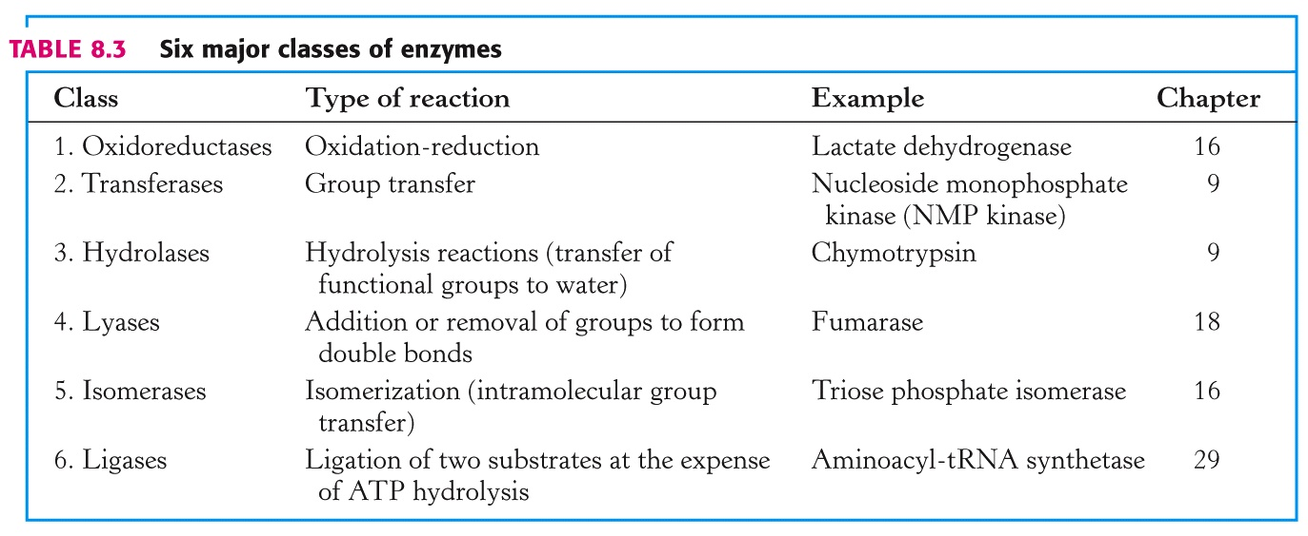
Enzyme Classification
The “Enzyme Commission” invented a systematic numbering system for enzymes based upon these categories, with extensions for various subgroups. e.g., nucleoside monophosphate kinase (transfers phosphates)
EC 2.7.4.4. 2 = Transferase, 7 = phosphate transferred,
4=transferred to another phosphate, 4 = detailes acceptor

Slide 15
Enzymes – Gibbs Free Energy
Thermodynamics governs enzyme reactions, just the same as with other chemical reactions.
Gibb’s “Free Energy,” ΔG, determines the spontaneity of a reaction:
ΔG must be negative for a reaction to occur spontaneously (“exergonic”).
A system is at equilibrium and no net change can occur if ΔG is zero.
A reaction will not occur spontaneously if ΔG is positive (“endergonic”); to proceed, it must receive an input of free energy from another source.

Slide 16
Enzymes – Gibbs Free Energy
For the reaction: A + B → C + D,
ΔG = ΔGº + RT ln [C][D]
[A][B]
ΔG = ΔGº + RT ln K_{eq}
At 25°C, when K_{eq} changes by 10-fold, ΔG changes by only 1.36!
Small changes in ΔG describe HUGE changes in K_{eq}.
Extensive Description with Calculations in Section 5.2 ΔG^{o’} or ΔG’ denotes pH=7

Slide 17
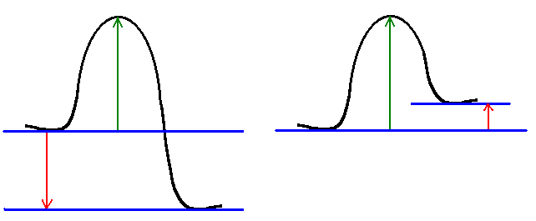
Enzymes – Free Energy of Reacion
Exergonic Reaction:
(Spontaneous)
Endergonic Reaction:
(Non-spontaneous)
ΔG‡
ΔG‡
ΔG
ΔG
ΔG determines SPONTANEITY (“-” for spontaneous)
ΔG‡ determines the RATE of the reaction.

Slide 18
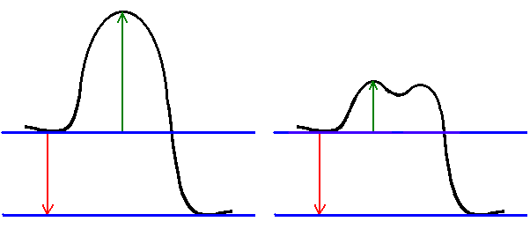
Enzymes – Activation Energy
Uncatalyzed Reaction:
Catalyzed Reaction:
ΔG‡
ΔG‡
ΔG
ΔG
Lower activation energy (ΔG‡) increases the rate of reaction, reaching equilibrium faster.
In this case, ΔG remains unchanged. Thus, the final ratio of products to reactants at equilibrium is the same in both cases.

Slide 19
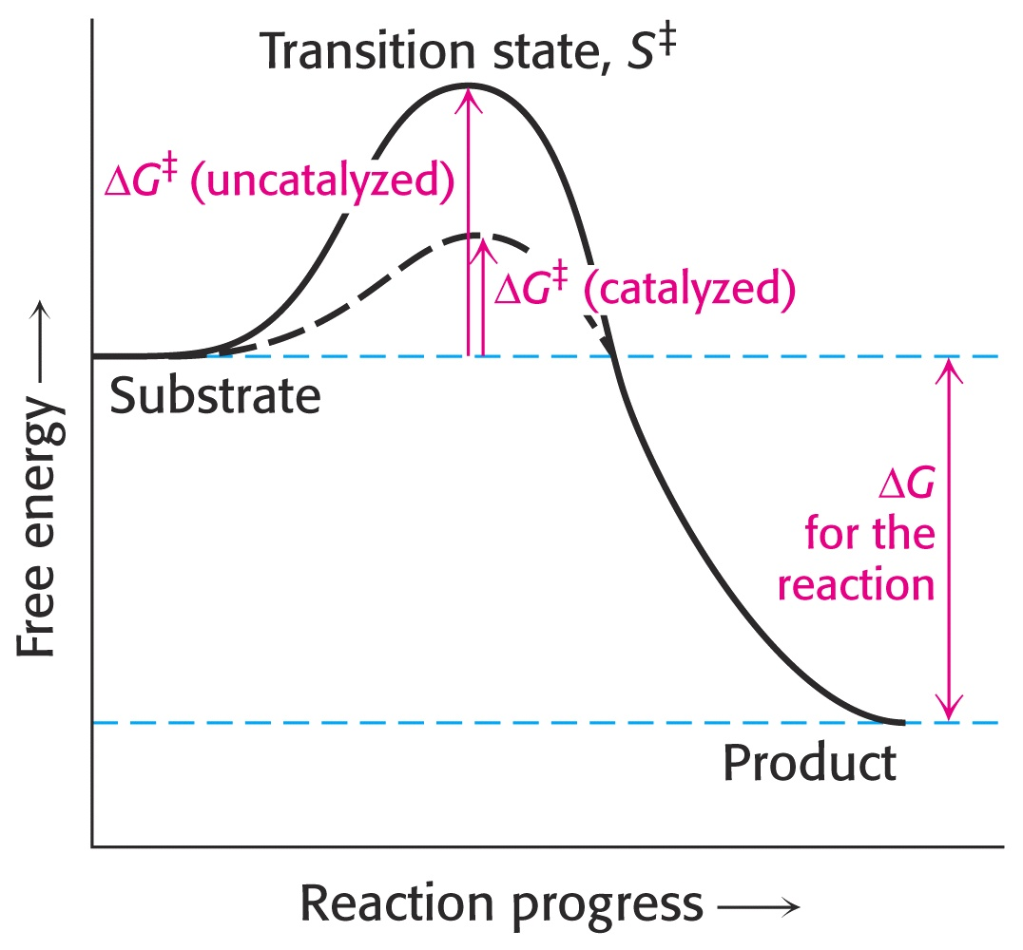
Enzymes – Gibbs Free Energy

Slide 20
Enzyme-Substrate Complex
In biochemistry, we use slightly different terms for the participants in a reaction:
Traditional | Biochemistry
Reactant | Substrate
Catalyst | Enzyme
Product | Product

Slide 21
Enzyme-Substrate Complex
For enzymes to function, they must come in contact with the substrate.
While in contact, they are referred to as the “enzyme-substrate complex.”
The high specificity of many enzymes led to the hypothesis that enzymes were similar to a lock… and the substrate was like a key: (Fischer, 1890)
In 1958, Koshland proposed that the enzyme changes shape to fit the incoming substrate. This is called an “induced fit.”

Slide 22
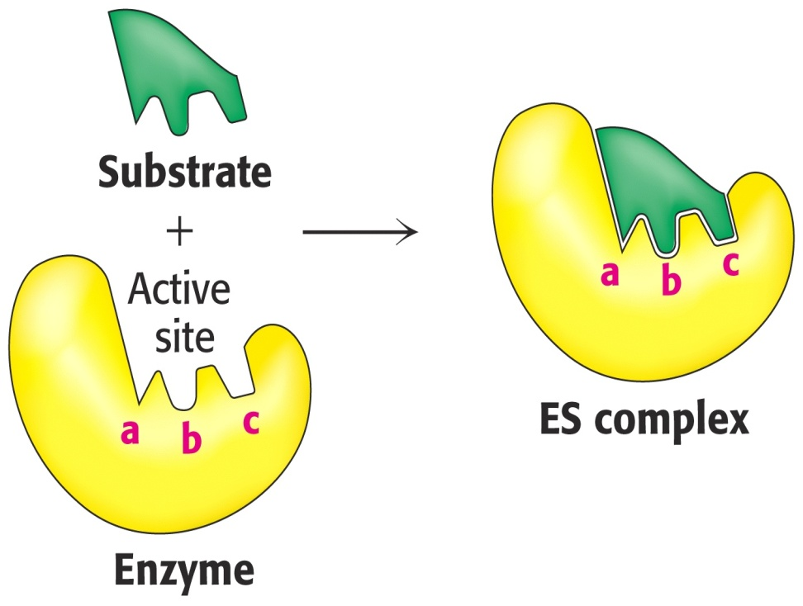
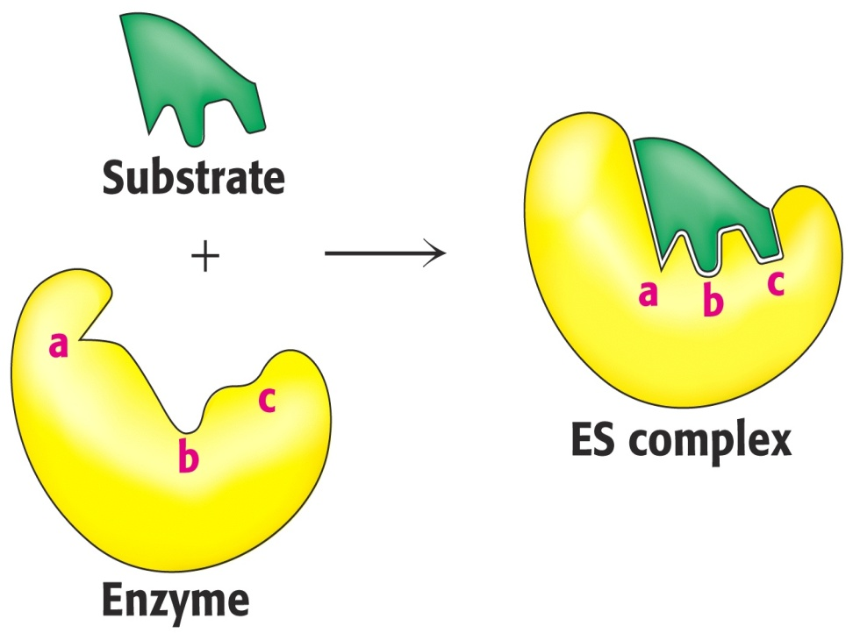
Enzyme-Substrate Complex
“Lock & Key” Theory:
“Induced Fit” Theory:

Slide 23
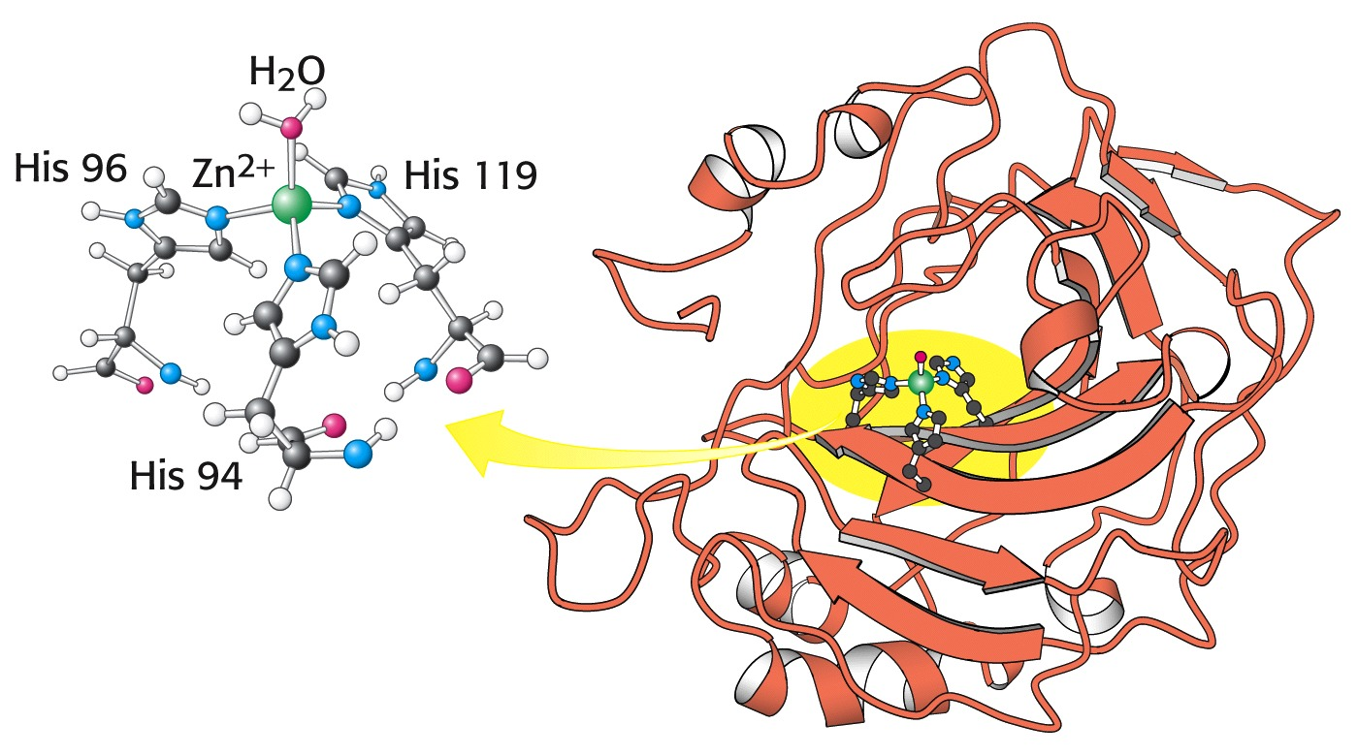
Enzyme – Active Site
Enzymes are often quite large compared to their substrates. The relatively small region where the substrate binds and catalysis takes place is called the “active site.” (e.g., human carbonic anhydrase:)

Slide 24
Enzyme – Active Site
General Characteristics of Active Sites:
  The active site takes up a relatively small part of the total volume of an enzyme
  The active site is a 3-dimensional cleft or crevice.
  Water is usually excluded unless it is a reactant.
  Substrates bind to enzymes by multiple weak attractions (electrostatic interactions, hydrogen bonds, hydrophobic interactions, etc.
  Specificity of binding depends on precise spatial arrangement of atoms in space.

Slide 25
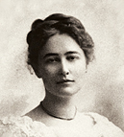
Enzymes – Michaelis-Menton Equation
In 1913, two scientists, Leonor Michaelis and Maud Menten proposed a simple model to account for the kinetic characteristics of enzymes*.
* “The kinetics of invertase activity” Biochemische Zeitschrift 49, 333 (1913)
Leonor Michaelis
Maud Menten

Slide 26
Enzymes – Michaelis-Menton Equation
What was Michaelis’ and Menton’s contribution?
Since the enzyme and substrate must form the ES complex before a reaction can take place, they proposed that the rate of the reaction depended upon the concentration of ES:
They also proposed that at the beginning of the reaction, very little product returned to form ES. Therefore, k₋₂ was extremely small and could be ignored:

Slide 27
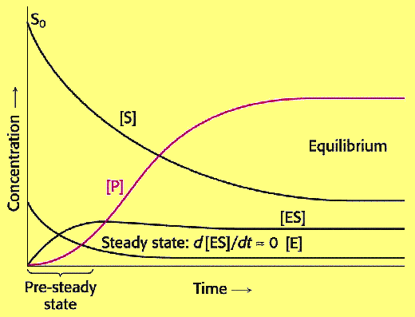
Enzymes – Michaelis-Menton Equation

Slide 28
Enzymes – Michaelis-Menton Equation
The rate (Velocity) of the appearance of product, depends on [ES]:
V = k₃[ES]
ES has two fates:
Go to product
Reverse back enzyme + substrate
When the catalyzed reaction is running smoothly and producing product at a constant rate, the concentration of ES is constant at we say that the reaction has reached a “steady state.” Therefore, we may say that the rates for formation of ES and the breakdown of ES are equal:
Rate of ES Formation d[ES]/dt = k₁[E][S]
Rate of ES Breakdown -d[ES]/dt = k₂[ES] + k₃[ES]
At the “steady state:” d[ES]/dt = 0 = k₁[E][S] – (k₂+k₃)[[ES]
Rearranging: k1[E][S] = (k2+k3)[[ES]

Slide 29
Enzymes – Michaelis-Menton Equation
Steady State: k1[E][S] = (k2+k3)[[ES]
Rearrange, solving for [ES]: [ES] = [E][S] k ₁ .
k₂ + k₃
Define M&M constant: K_{m}: .. Km = k₂ + k₃ .
(“Dissociation”) k₁
Result: [ES] = [E][S] / K_{m}
If: [E] <<<[S], then [S] – [ES] ≈ [S]
Since: [Et] = [E] + [ES], it follows that [E] = [Et] – [ES]
Substituting for [E]: [ES] = ([Et] – [ES]) [S] / K_{m}
Solving for [ES]: [ES] = [Et][S] / Km .
1+ [S] / Km
Simplifying: [Es] = [Et] [S]
[S] + Km

Slide 30
Enzymes – Michaelis-Menton Equation
Steady State: k1[E][S] = (k2+k3)[[ES]
Rearrange, solving for [ES]: [ES] = [E][S] k ₁ .
k₂ + k₃
Define M&M constant: Km:. Km = k₂ + k₃ .
k₁
Result: [ES] = [E][S] / Km
If: [E] <<<[S], then [S] – [ES] ≈ [S]
Since: [Et] = [E] + [ES], it follows that [E] = [Et] – [ES]
Substituting for [E]: [ES] = ([Et] – [ES]) [S] / K_{m}
Solving for [ES]:* [ES] = [Et][S] / Km .
1+ [S] / Km
Simplifying:* [Es] = [Et] [S]
[S] + Km
*Class Assignment: Show this algebreic rearrangement. Submit during next lecture period.

Slide 31
Enzymes – Michaelis-Menton Equation
Now that we have an expression V = k₃ [ES]
for [ES], we substitute into our V = k₃ [Et] [S] .
“velocity” equation: [S] + Km
Consider [S] and Km: V = k₃ [Et] [S] .
[S]+Km
As [S] → ∞, then [S] → 1
[S]+Km
We can define maximal velocity Vmax = k₃ [Et]
as the velocity when [S] = ∞.
(We also assume that under these conditions, all enzymes [Et] are bound to S in the ES complex. )
The rate constant, k₃, is the “turnover number,” or the maximum number of substrates can be converted to products by a single enzyme molecule.
Therefore: V = Vmax [S]
(M&M Equation) [S] + Km

Slide 32
Enzymes – Michaelis-Menton Equation
(M&M Equation) V = Vmax [S]
[S] + Km
What does this equation describe?
It describes the velocity of an enzyme-catalyzed reaction at different concentrations of substrate [S].
It helps determine the maximum velocity of the catalyzed reaction.
It assigns a value for Km, the “Michaelis constant,” that is inversely proportional to the affinity of the enzyme for its substrate.
How is this equation utilized in the laboratory?
A series of test tubes are prepared, all with identical concentrations of enzyme, but increasing concentrations of substrate.
The velocity of each tube increases as the substrate increases.
A plot of the results is hyperboic, reaching an asymptote we define as Vmax.

Slide 33
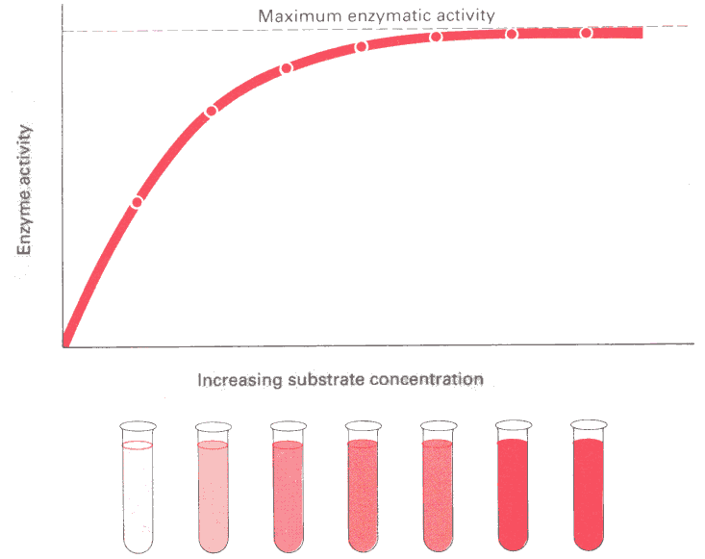
Enzymes – Michaelis-Menton Equation
V = Vmax [S]
[S] + Km
Why does the velocity reach a maximum?

Slide 34

What Happens when the work load exceeds the workers’ rate?
Let’s let Lucy and Ethel show us how excessive work load can exceed worker capacity.
https://www.youtube.com/watch?v=K3axU2b0dDk

Slide 35
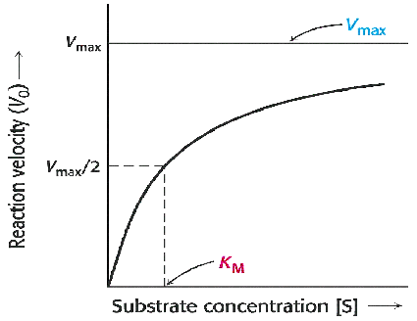
Enzymes – Michaelis-Menton Equation
The Michaelis-Menton equation was a pivotal contribution to understanding how enzymes functioned.
However, during routine use in the laboratory, it was difficult to estimate Vmax. Everyone had different ideas the actual value for Vmax.
Since it is impossible to actually make a solution with infinite concentration of substrate, a different equation was needed.

Slide 36
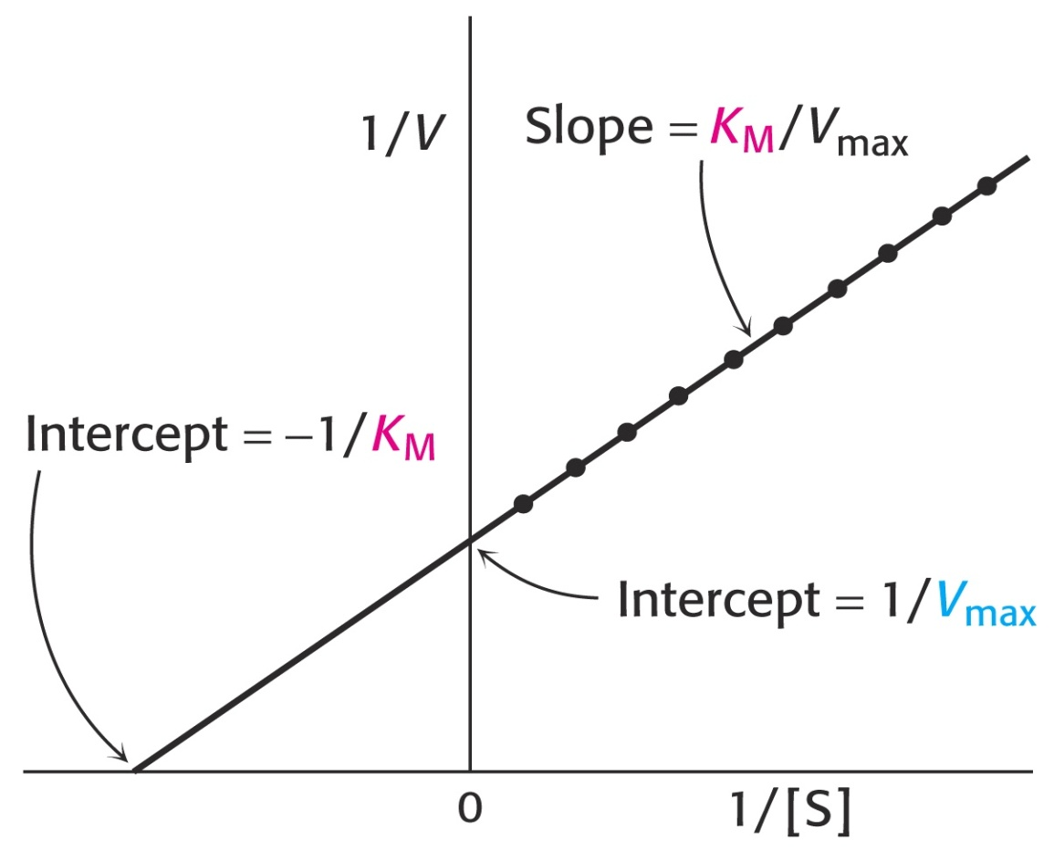
Enzymes – Linewaver-Burke Equation
A relatively simple solution was provided by Lineweaver and Burke, who simply suggested that the M&M equation be inverted. This would yield a “double inverse plot” that is linear:
(M&M Equation) V = Vmax [S]
[S] + Km
Inverting the Equation yields: 1 = Km 1 + 1 .
(Lineweaver-Burke Equation) V Vmax [S] Vmax
By plotting 1/ V as a function of 1/[S],
a linear plot is obtained:
Slope = Km/Vmax
y-intercept = 1/Vmax
Class Assignment:
Show the algebreic steps used to
obtain the Linvweaver-Burke
equation from the
Michaelis-Menton Equation.

Slide 37

Enzymes – Linewaver-Burke Equation
Comparision of these two methods of plotting the same data:
Michaelis-Menton Equation: Linewaver-Burke Equation:

Slide 38
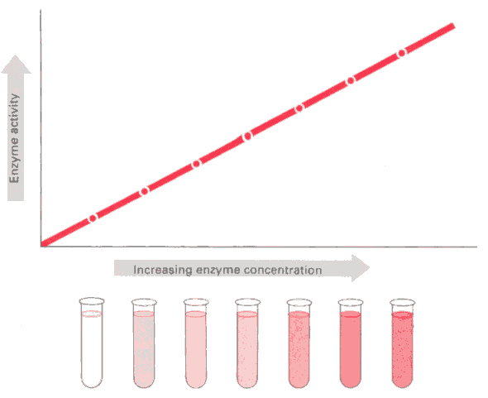
Enzymes – Michaelis-Menton Equation
Consider the case where [S] = ∞. When Vmax is plotted as a function of [Et], a linear plot is obtained, with the slope = k₃.
It is assumed in this case that the only factor limiting velocity is the total amount of enzyme present.
This technique is used in medical laboratories to test for the concentration of enzymes in blood or other fluids.
Vmax = k₃ [Et]

Slide 39
Enzymes – Levels Associated with Disease States

Slide 40
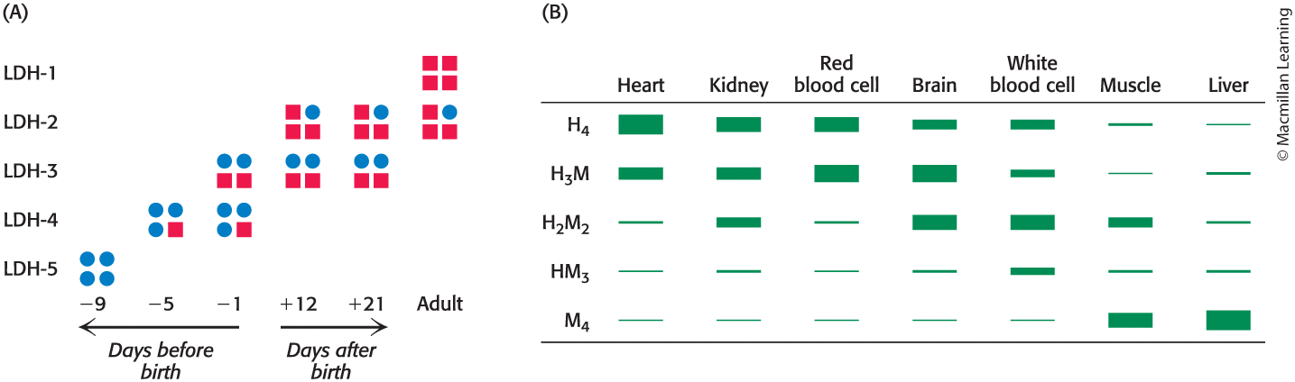
Lactate Dehydrogenase Isozymes
The LDH enzyme is a tetramer, composed of two different subunits. These five “isozyme” forms vary by tissue.
Normally, LDH isozymes are not present in the blood serum, unless they are “leaking” out of damaged tissue. The specific isozyme form can help identify the location of injured organ(s).

Slide 41
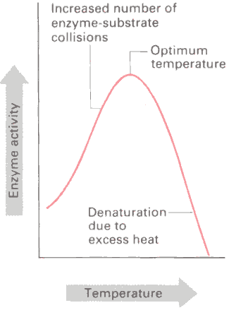
Enzymes – Factors Affecting Activity
Temperature affects enzyme activity. Higher temperatures mean molecules are moving faster and colliding more frequently.
Up to a certain point, increases in temperature increase the rates of enzymatic reactions.
Excess heat can denature the enzyme, causing a permanent loss of activity.
Examples:
Cooking denatures many enzymes, killing bacteria and inactivating viruses, parasites, etc.
Grass grows faster during the hot summer than during the cooler spring or fall.
Insects cannot move as fast in cold weather as they can on a hot day.
Operating rooms are often cooled down to slow a patient’s metabolism during surgery.

Slide 42
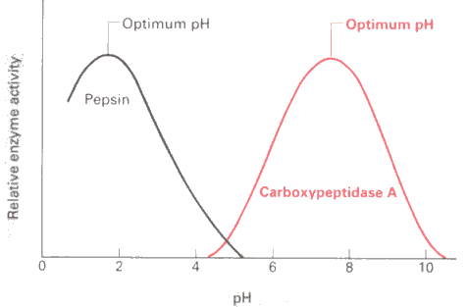
Enzymes – Factors Affecting Activity
pH often affects enzymatic reaction rates. The “optimum pH” refers to the pH at which the enzyme exhibits maximum activity. This pH varies from enzyme to enzyme:

Slide 43
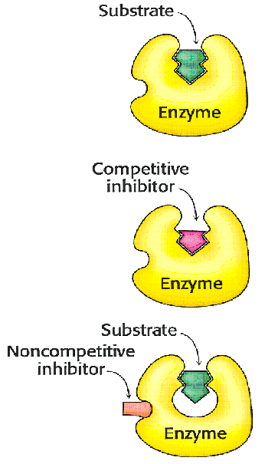
Enzymes - Inhibition
Various substances can inhibit enzymes.
Reversible Inhibition falls into two types:
Competitive Inhibition: A molecule that is structurally-similar to the intended substrate molecule binds to the active site and blocks substrate from binding. It therefore reduces the number of ES complexes that may form, slowing the reaction velocity.
Competitive inhibition can be overcome by increasing substrate concentration.
Noncompetitive Inhibition: An inhibitor molecule binds to a different site other than the active site, decreasing the turnover number. Increasing substrate concentration will not overcome this type of inhibition.

Slide 44
Enzymes – Competitive Inhibition

Slide 45
Enzymes – Competitive Inhibition
The antibiotic sulfanilamide was first discovered in 1932. Sulfanilamides and its derivatives are called “sulfa drugs.”
Sulfanilamide is structurally similar to p-aminobenzoic acid (PABA), that is required by many bacteria to produce an important enzyme cofactor, folic acid. Sulfanilamide acts as a competitive inhibitor to enzymes that convert PAGA into folic acid, resulting in a depletion of this cofactor. This results in retarded growth and eventual death of the bacteria. (Mammals absorb their folic acid from their diets, so sulfanilamide exerts no effects on them.)

Slide 46
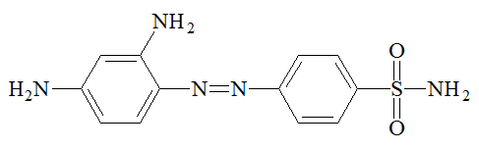
Discovery of Sulfanilamide
During World War I, Gerhard Domagk, cared for wounded soldiers, many of whom died from gas gangrene infections. After the war, he returned to Kiel as a research pathologist, searching for chemical compounds to treat bacterial infections. In late 1932, he discovered the red azo-dye made by I.G. Farben (Bayer), Prontosil, worked well against Streptococcal infections in laboratory mice.
When his 6-year old daughter almost died of a Strep infection, he treated her with Prontosil and she recovered. (Her resulting red colored skin eventually cleared up.) Domagk received a Nobel Prize for his discovery in 1939.
Just a few months later in May of 1933, a progressive physician in Salt Lake City traveled to New York and brought home Prontosil, giving what was no doubt the first dose of Prontosil to a patient in Utah.
In 1935, French researchers discovered that mammals break down Prontosil into a smaller, colorless component: sulfanilamide.
sulfanilamide

Slide 47
Enzymes – Competitive Inhibition
By adding various functional groups to the basic structure, increased effectiveness has been achieved:

Slide 48
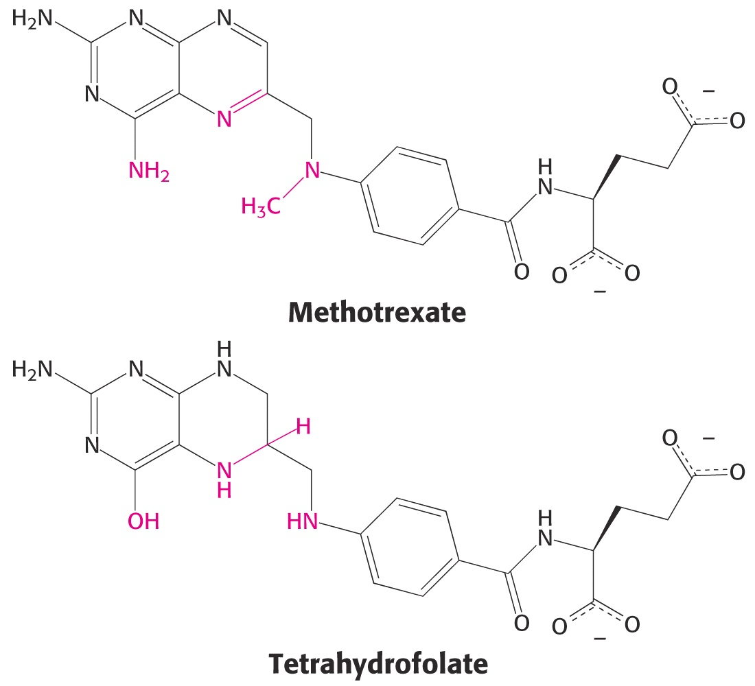
Enzymes – Competitive Inhibition
Methotrexate is a competetive inhibitor for the coenzyme tetrahydrofolate (required for proper activity of the enzyme dihydrofolate reductase). This enzyme assists in the biosynthesis of purines and pyrimidines.
Methotrexate binds 1,000-fold more tightly to this enzyme than tetrahydrofolate, significantly reducing nucleotide base synthesis. It is used to treat cancer.

Slide 49
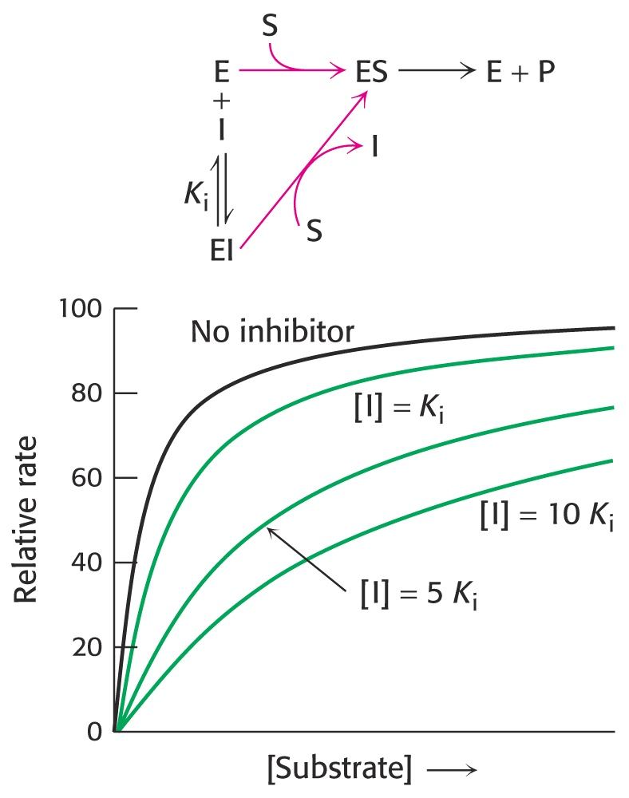
Enzymes - Inhibition
Kinetics of Competitive Inhibition:
(Note that at high [S], Vmax can be regained.)

Slide 50
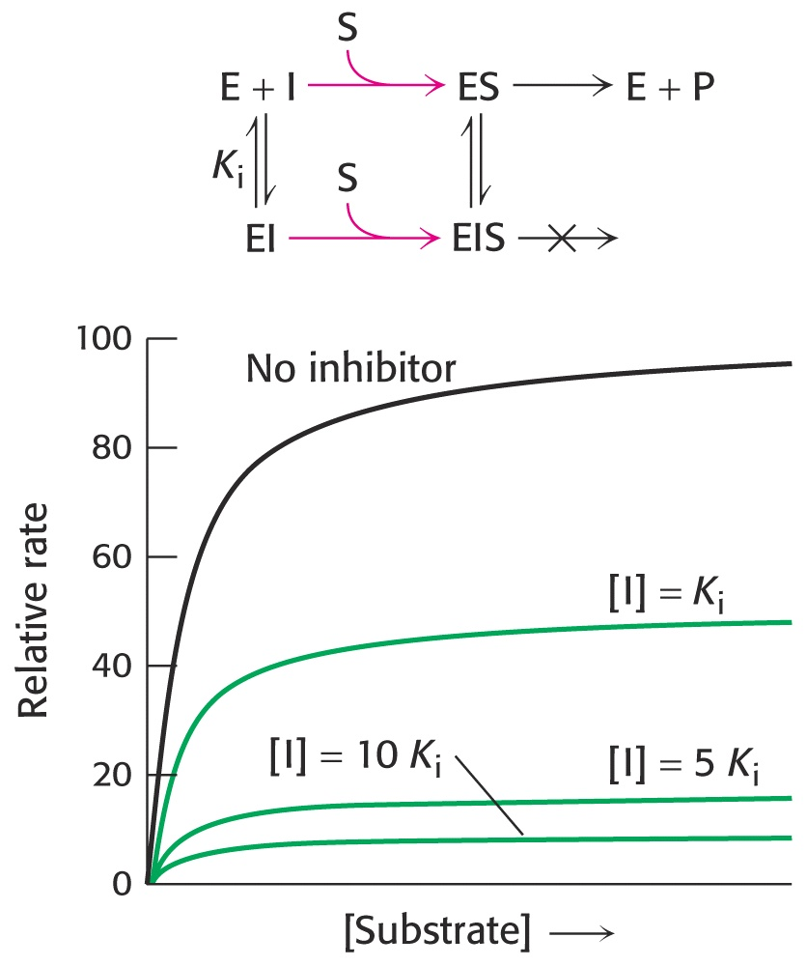
Enzymes - Inhibition
Kinetics of non-competetive inhibition:
(Note that at high [S], Vmax is reduced from the non-inhibited Vmax.)

Slide 51
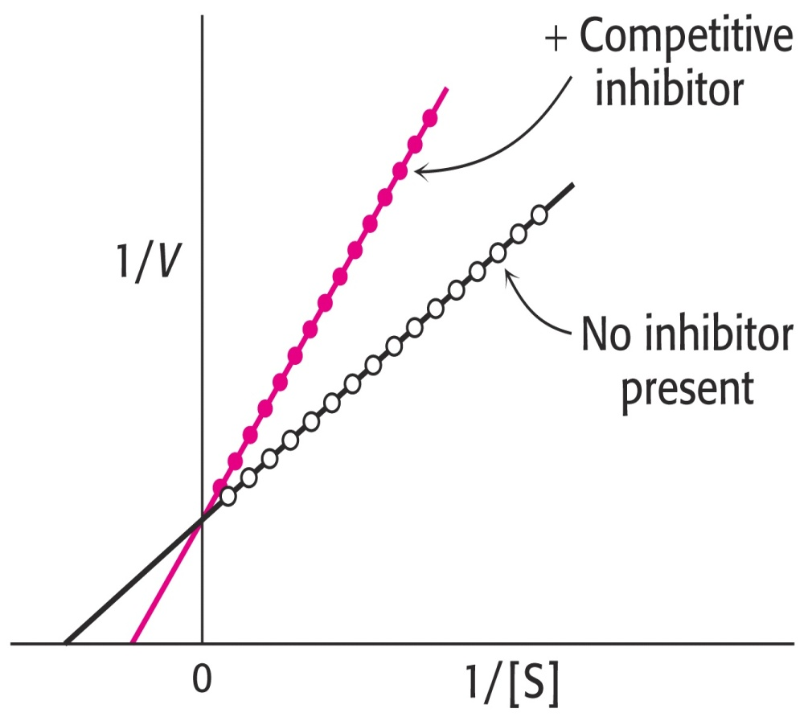
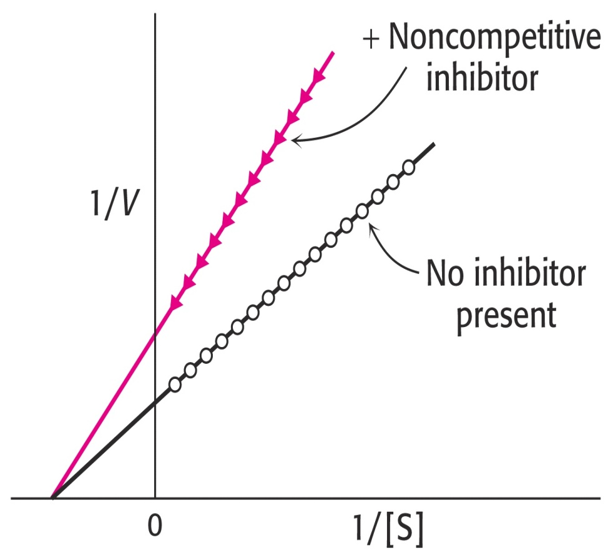
Enzymes - Inhibition
Comparing both types of inhibition on Lineweaver-Burke plots makes the determination of the type of inhibition much clearer:

Slide 52
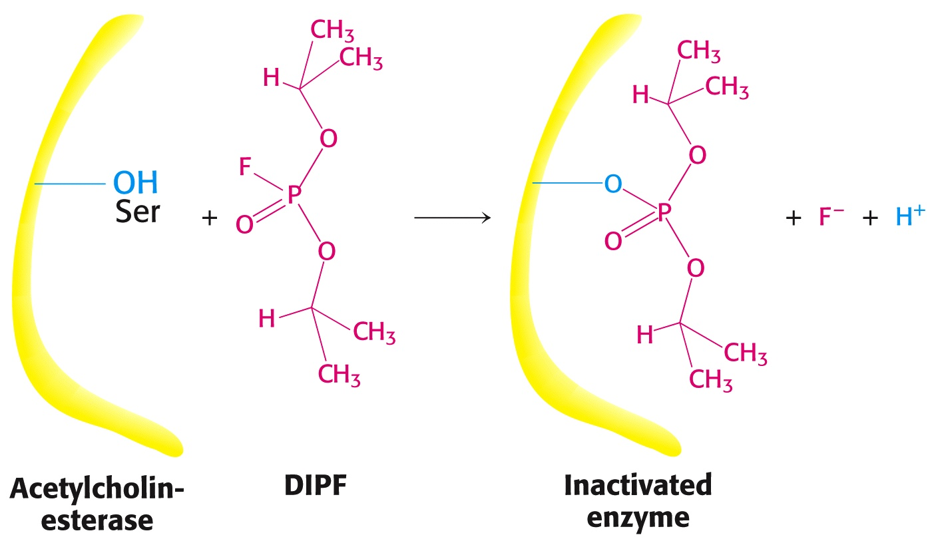
Enzymes – Inhibition
Irreversible Inhibitors are toxic. In the laboratory they can be used to map the active site. These inhibitors often form covalent linkages to amino acids at the active site.
DIPF (diisopropylphosphofluoridate) forms a covalent linkage to serine. If serine plays an important catalytic role for the enzyme, DIPF can permanantly disable the enzyme. Acetycholinesterase is an excellent example of DIPF inactivation (making agents such as DIPF potent nerve agents):

Slide 53
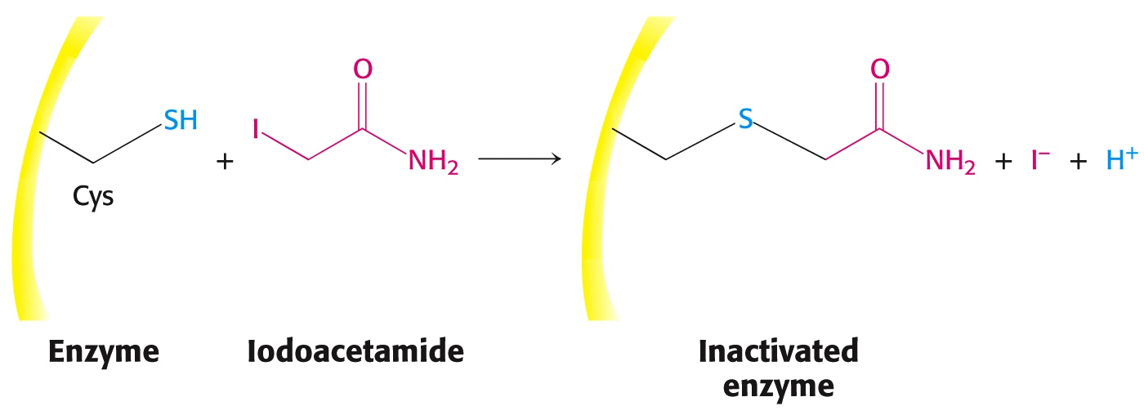
Enzymes – Inhibition
Another example of irreversible inhibition by covalent modification is the reaction between iodoacetamide and a critical cysteine residue:

Slide 54
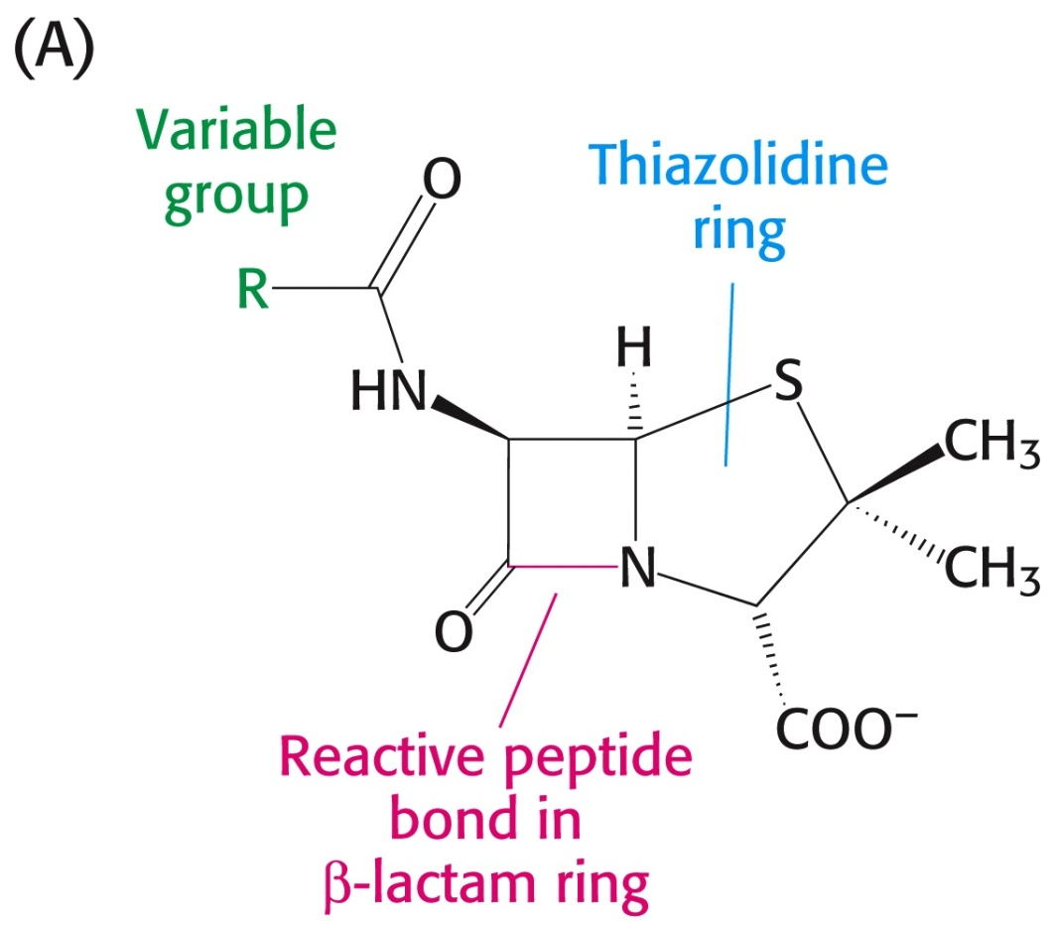
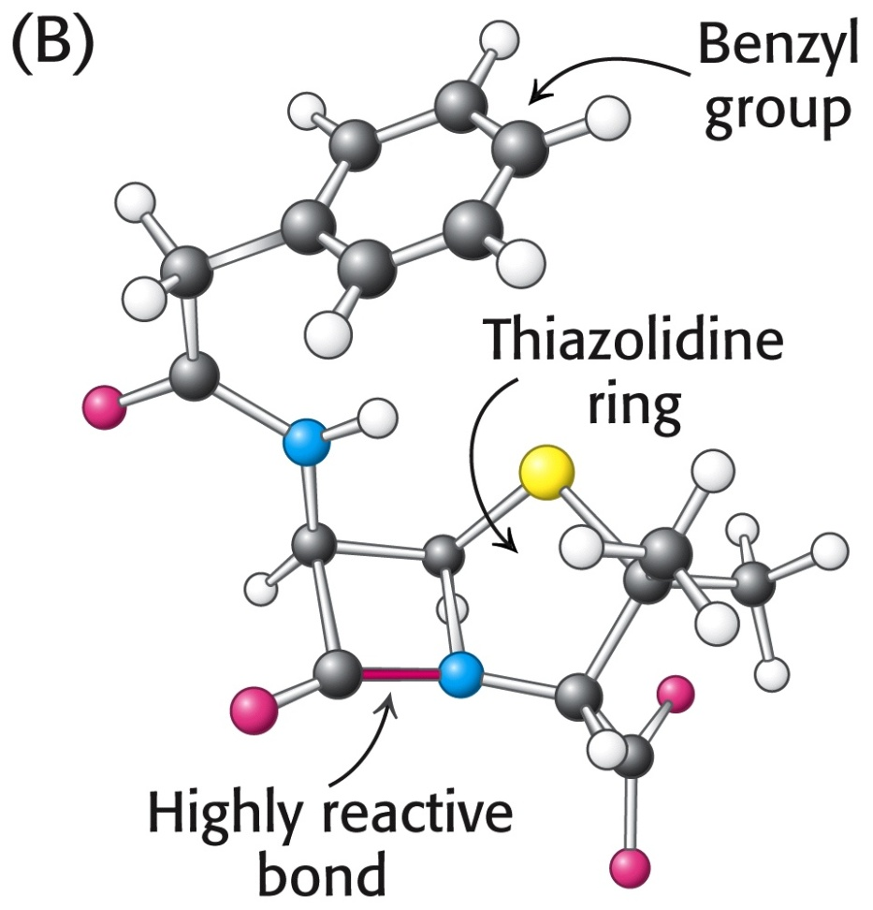
Enzyme Inhibition – Penicillin
Penicillin is a classic irreversible enzyme inhibitor, acting on bacterial “transpeptidase.” This enzyme strengthens bacterial cells walls, by forming peptide bonds between D-amino acids that cross link the peptidoglycan structure in cell walls.
Penicillin contains a beta-lactam ring (cyclic amide) fused to a thiazolidine ring:

Slide 55
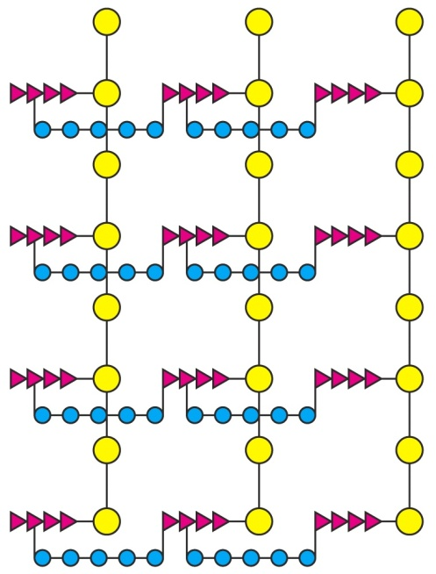
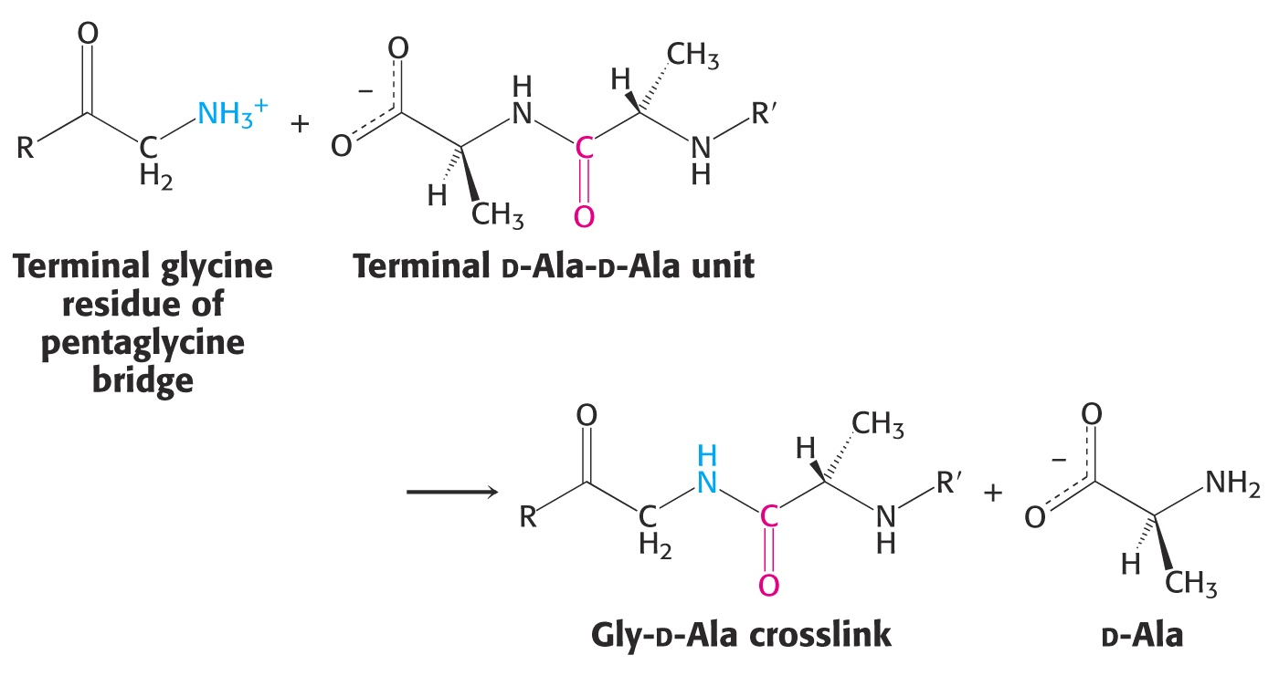
Enzyme Inhibition – Penicillin
Normally, the transpeptidase enzyme forms cross links that stabilize a polysaccharide cell wall structure on the outside of certain bacteria.

Slide 56
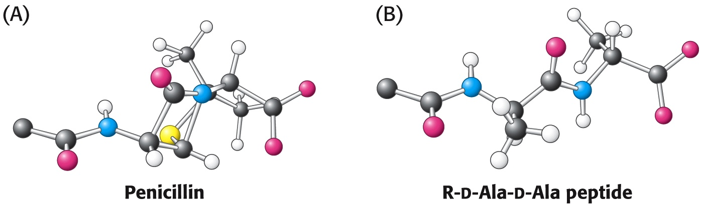
Enzyme Inhibition – Penicillin
Penicillin’s structure is VERY SIMILAR to the normal substrate for this enzyme.
In fact, penicillin is drawn into the active site of the transpeptidase enzyme much like a competetive inhibitor would be, due to its structural similarity:

Slide 57
Enzyme Inhibition – Penicillin
Upon binding to the active site, the beta-lactam ring opens and forms a covalent linkage to a serine at the active site, permanently deactivating the enzyme:

Slide 58
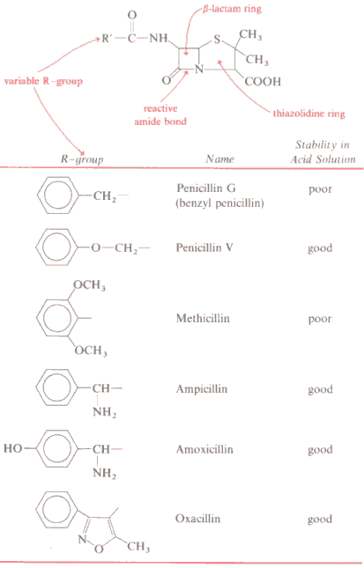
Enzyme Inhibition – Penicillin
Over the years, organic chemists altered the basic penicillin molecule, adding groups for better acid resistance and a broader antibacterial activity spectrum.
“PenVK” is the trade name for
“Penicillin V, potassium salt.”
Due to the structural similarities between these “cillins,” allergies to one type of cillin, extend throughout the entire group of “beta-lactams.”

Slide 59
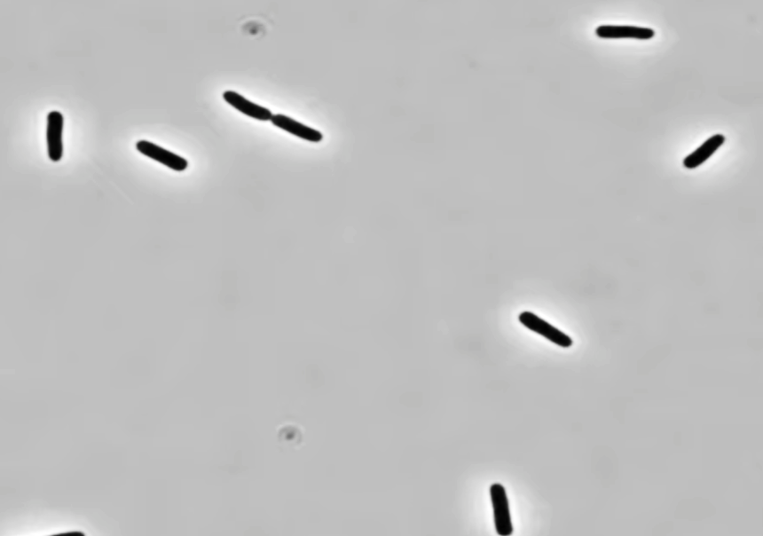
Video of E. coli Treated with Ampicillin
https://www.youtube.com/watch?v=jlyy1gN2UNY

Slide 60
End of Lecture Slides
for
Oxygen Transport Proteins
Credits: Most of the diagrams used in these slides were taken from Stryer, et.al, Biochemistry, 5th Ed., Freeman Press, Chapter 10 (in our course textbook) and from prior editions of this work.

