Slide 1
Enzyme Mechanisms
Biochemistry 3070

Slide 2
Enzyme Mechanisms
Enzymes catalyze reactions by utilizing the same general reactions as studied in organic chemistry:
Acid-base catalysis
Covalent catalysis
Metal ion catalysis
Catalysis by alignment (approximation)
Additional free energy is obtained through the “Binding Energy” (binding of the substrate to the enzyme.)
Binding energy often helps stabilize the transition state, lowering ΔG‡.

Slide 3
Enzyme Mechanisms
Since there does not exist any simple way to visualize the mechanism of an enzyme-catalyzed reaction, how is the mechanism determined?
Careful X-ray and NMR structural studies of enzymes attached to substrates and selective chemical modification of side chains at the active site gives us clues as to what groups participate.
Standard organic chemical reactions are used to hypothesize the mechanism.
Subsequent kinetic studies and genetically- engineered enzymes can often help validate a proposed mechanism.

Slide 4
Enzyme Mechanisms
In this section we will study the reaction mechanisms for some specific enzyme-catalyzed reactions:
Lysozyme (acid-base catalysis)
Carbonic anhydrase (metal ion, Zn²⁺)
Proteases (Zymogens):
Chymotrypsin, trypsin, elastase (nucleophillic attack)
Blood clotting (hemostatic) enzymes (e.g. thrombin) & enzymatic [amplifying] cascades

Slide 5
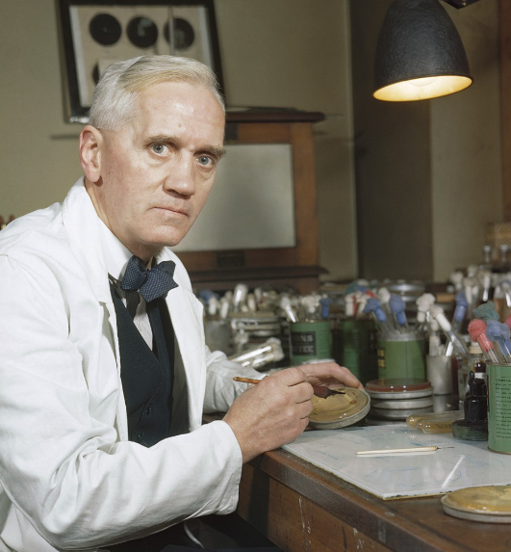
Enzyme Mechanisms - Lysozyme
In 1922, Alexander Fleming had a cold.
He discovered that mucosal secretions
and tears inhibited the growth of bacteria
on agar plates.
(A serendipitous discovery?)
He named the mysterious enzyme
“lysozyme” (bacteria LYSing enZYME).
He believed that this enzyme might be an excellent antibiotic for treating bacterial infections. However, he discovered that proteins are not rugged enough to serve in this role.
Note: The scientific community initially reacted to Alexander Fleming's 1922 discovery of lysozyme with indifference, viewing it as a minor "laboratory curiosity" rather than a significant medical breakthrough.
Applying the same lab techniques, 7 years later he discovered penicillin!

Slide 6
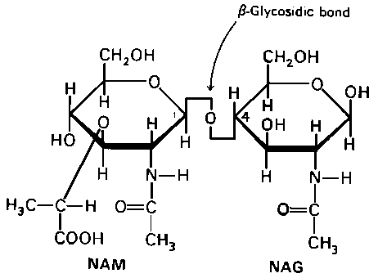
Enzyme Mechanisms - Lysozyme
Lysozyme cleaves polysaccharides that give structural integrity to bacterial cell walls.
Cell wall polysaccharides are composed of two kinds of glucose derivatives connected by β(1→4) linkages:
NAG: N-acetylglucoseamine
NAM: N-acetylmuratic acid
Chitin is also a
Substrate:
poly β(1→4) NAG
(In shells of crustaceans)

Slide 7
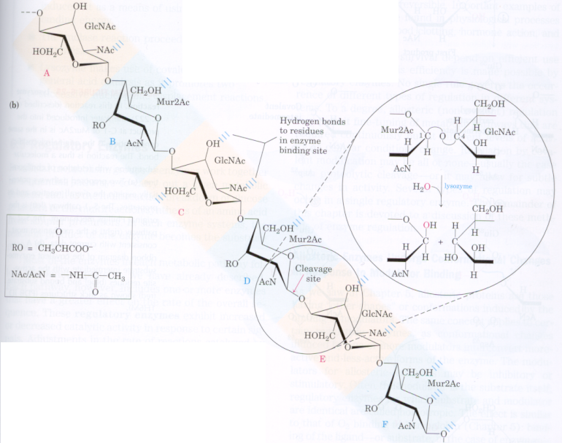

Slide 8
Enzyme Mechanisms - Lysozyme

Slide 9
Enzyme Mechanisms - Lysozyme

Slide 10
Enzyme Mechanisms - Lysozyme

Slide 11
Enzyme Mechanisms - Lysozyme

Slide 12
Enzyme Mechanisms - Lysozyme

Slide 13
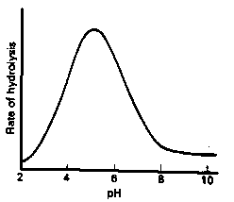
Enzyme Mechanisms - Lysozyme
Mechanistic Valiadation Experiments
Esterifcation of either Glu-35 or Asp-52 stops the reaction. If other acids are modified, no overall change in activity is observed.
Optimum pH for the enzyme is ~5. The reason for this lies in the ionization state of both Glu-35 and Asp-52:
At pH>5: Glu-35 ionizes and can not supply the hydrogen ion required.
At pH<5: Asp-52 is protonated and can not stabilize the carbocation intermediate.

Slide 14
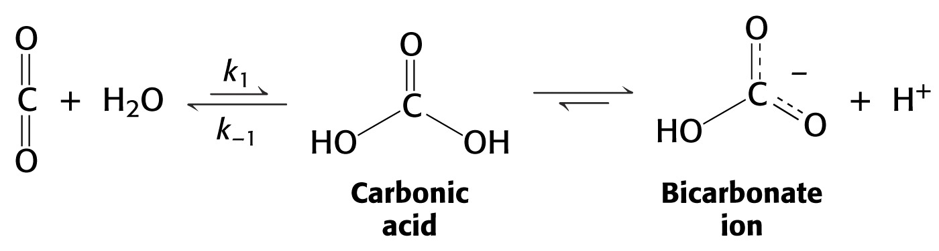
Enzyme Mechanisms – Carbonic Anhydrase
Carbonic anhydrase catalyzes the critically important reaction of hydrating CO₂ to form bicarbonate:
This enzyme enhances the rate of this reaction by more than 10⁶! At these rates, the limiting factor is how fast the molecules can diffuse to the active site!

Slide 15
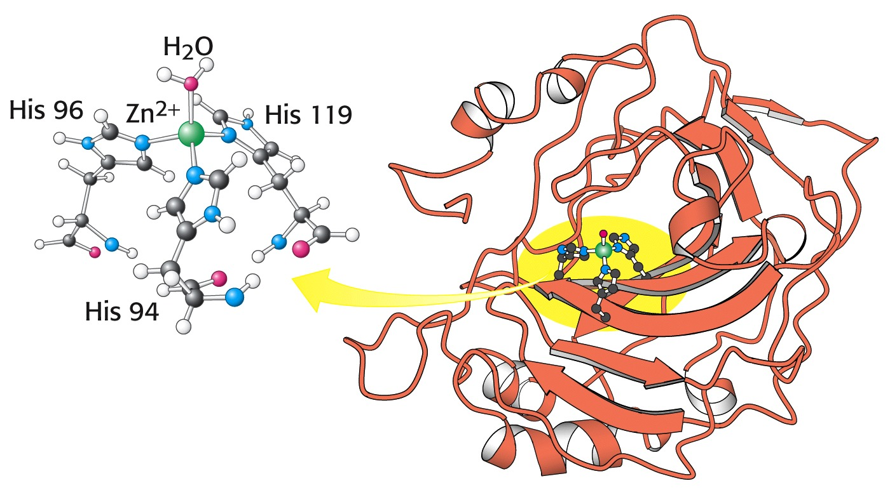
Enzyme Mechanisms – Carbonic Anhydrase
Carbonic Anhydrase contains an important cofactor at the active site, namely a zinc ion, that helps activate water molecules prior to their reaction with CO₂.

Slide 16
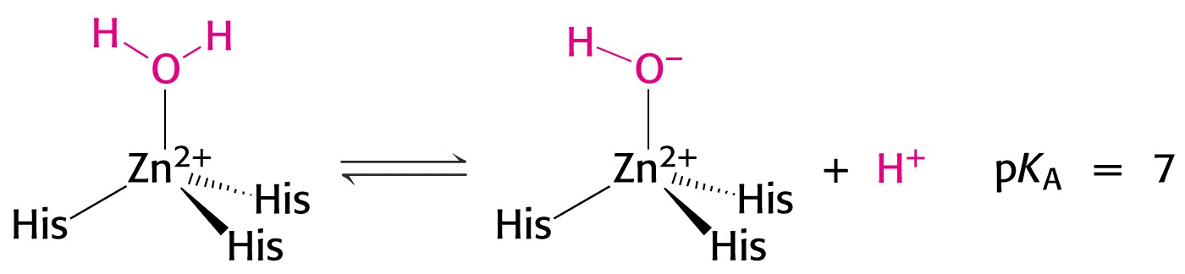
Enzyme Mechanisms – Carbonic Anhydrase
The binding of water to zinc, reduces the pKa for water from its normal 15.7 down to 7. This allows the formation of the strong hydroxide (HO⁻) nucleophile at neutral pH:

Slide 17
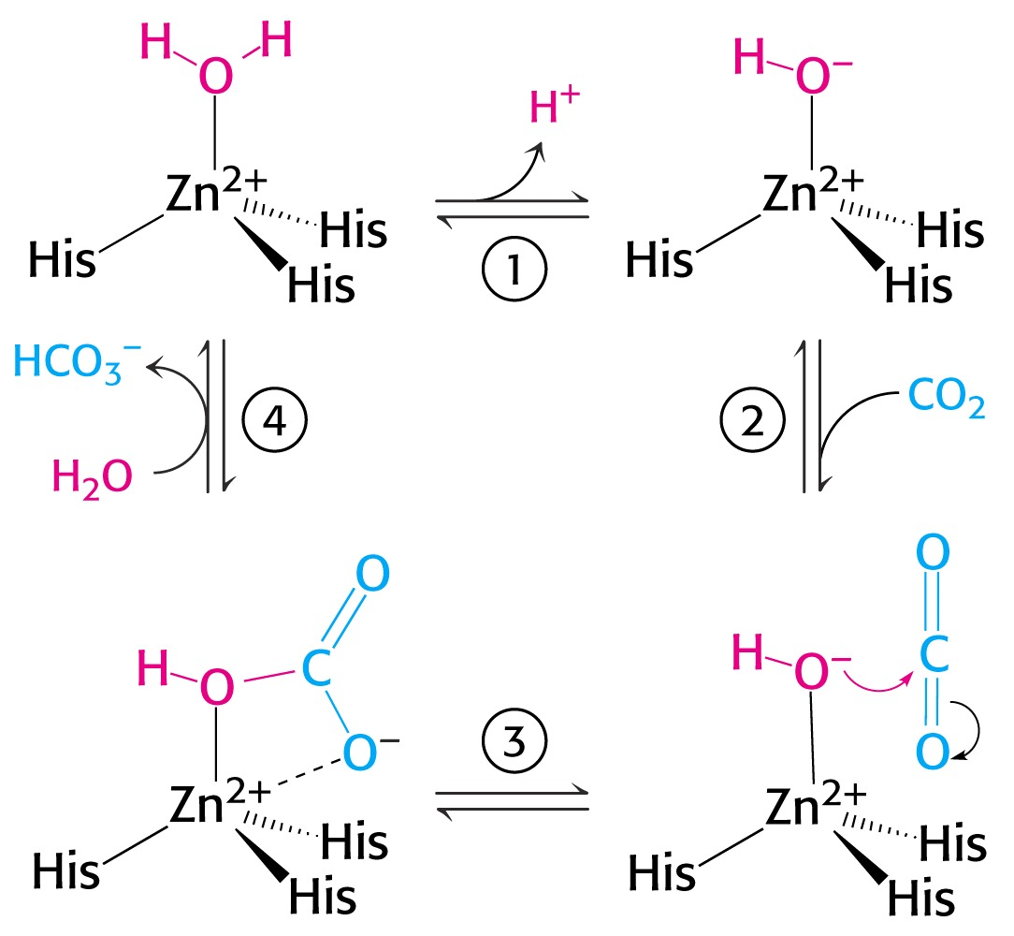
Enzyme Mechanisms – Carbonic Anhydrase
The enzyme then positions CO₂ for nucleophilic attack by the hydroxide, resulting in the formation of bicarbonate.
Water then displaces the product, starting the cycle again.

Slide 18
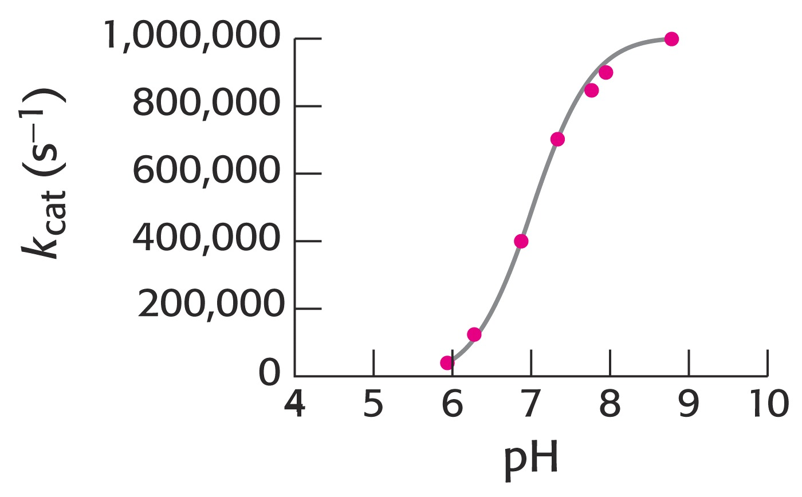
Enzyme Mechanisms – Carbonic Anhydrase
The pH profile for enzyme activity reveals that below pH=7, the deprotonation of the zinc-bound water can not proceed fast enough to keep up the rate observed at higher pH:

Slide 19
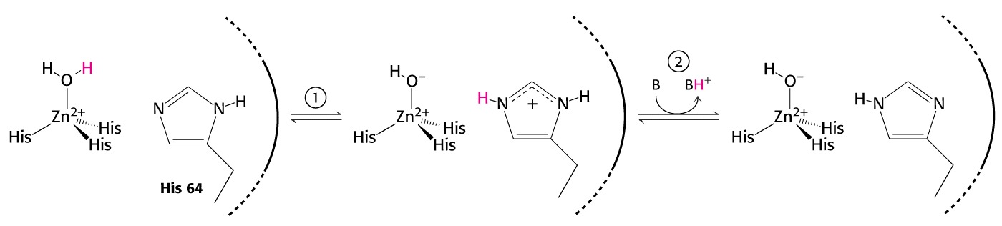
Enzyme Mechanisms – Carbonic Anhydrase
As the hydroxide ion forms, the exiting hydrogen ion can not diffuse away fast enough to keep up with the exceptional speed of the reaction cycle, so His-64 helps by shuttling it away to the surface of the protein:
This shifts equilibrium substantially in favor of the hydroxide formation.

Slide 20
Enzyme Mechanisms – Serine Proteases
Proteolytic enzymes help degrade proteins and recycle amino acids in living systems. Certain proteolytic enzymes also function in blood clotting and processing of proteins.
The serine proteases are an important sub-group of this class of enzymes. The alcoholic functional group of serine at the active sites of these proteases serves as a strong nucleophile, attacking the carbonyl carbon in peptide bonds.

Slide 21
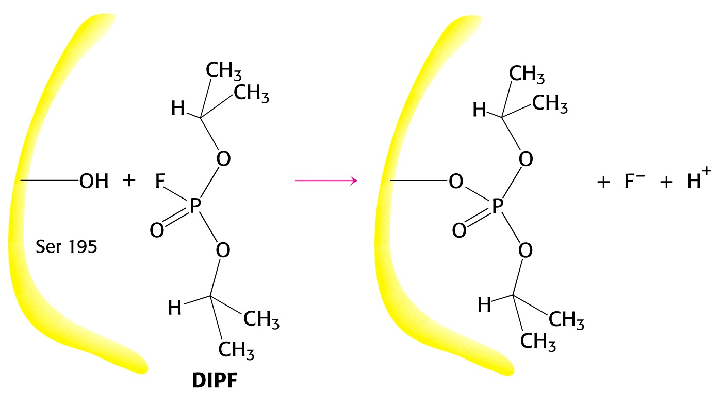
Enzyme Mechanisms – Serine Proteases
Reagents such as diisopropylphosphofluoridate (DIPF) that react with serine can “poison” these enzymes, rendering them inactive:

Slide 22
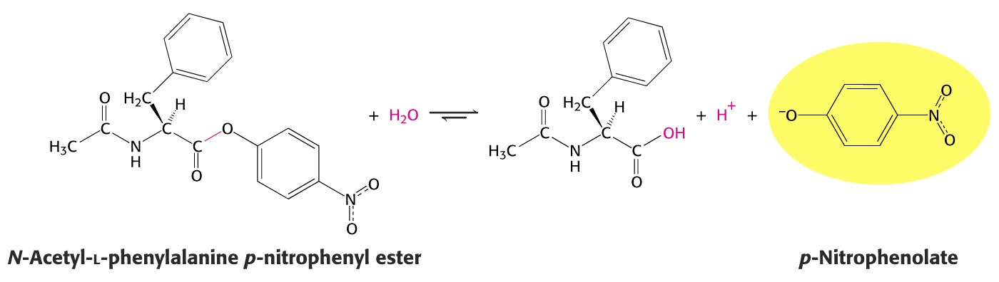
Enzyme Mechanisms – Chymotrypsin
Chymotrypsin is one of the best known serine proteases. It catalyzes the hydrolysis of peptide bonds following amino acids with large, bulky non polar groups (e.g., phenylalanine)
Chymotrypsin can be tricked into hydrolyzing synthetic substrates that release a highly colored substrate such as p-nitrophenol. This facilitates its study in the laboratory.

Slide 23
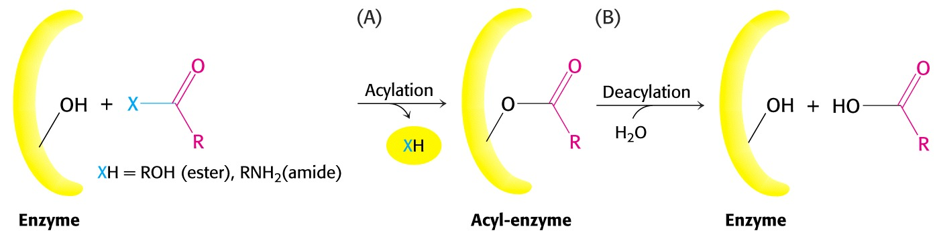
Enzyme Mechanisms – Chymotrypsin
Ser-195 attacks substrates, forming an ester linkage to the substrate as the first step in the reaction mechanism. This leaves part of the substrate covalently bonded to the enzyme.
Water subsequently enters, deacylating the enzyme by hydrolyzing the ester bond.

Slide 24
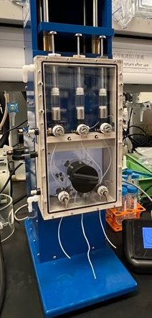
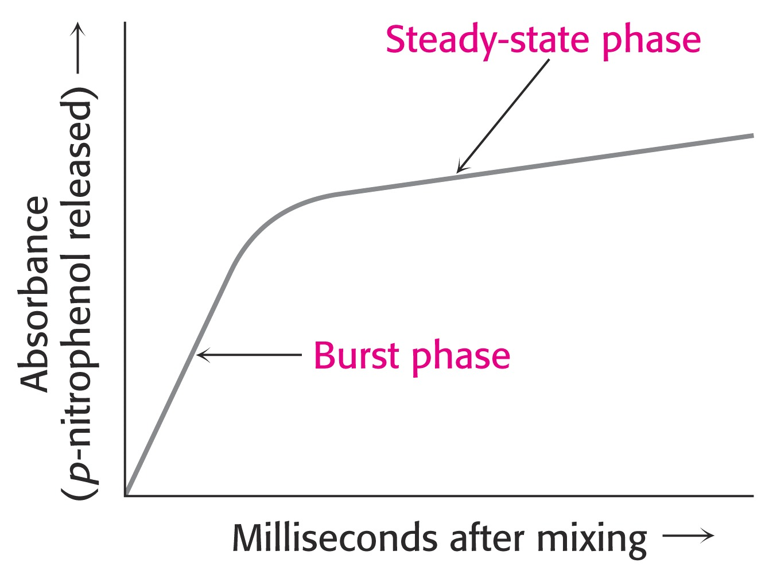
Enzyme Mechanisms – Chymotrypsin
The first step of this reaction is FAST. The rate-limiting step is hydrolysis of the ester bond to free the enzyme for the next cycle.
This is shown by rapid mixing experiments that allow rate determinations at the millisecond time scale. “Burst Phase” kinetics at time zero, change to a slower rate after all enzymes are acetylated, waiting for water to release them in the rate limiting step:

Slide 25
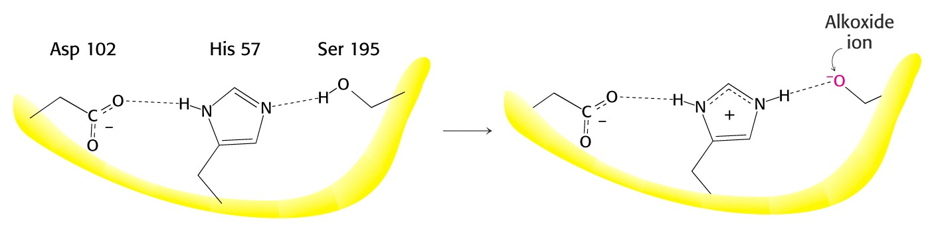
Enzyme Mechanisms – Chymotrypsin
An important amino acid “triad” helps abstract a proton from serine forming an alkoxide, a much stronger nucleophile. This is often called a “charge relay network,” since it distributes and stabilizes ionic charges across all three amino acids:

Slide 26
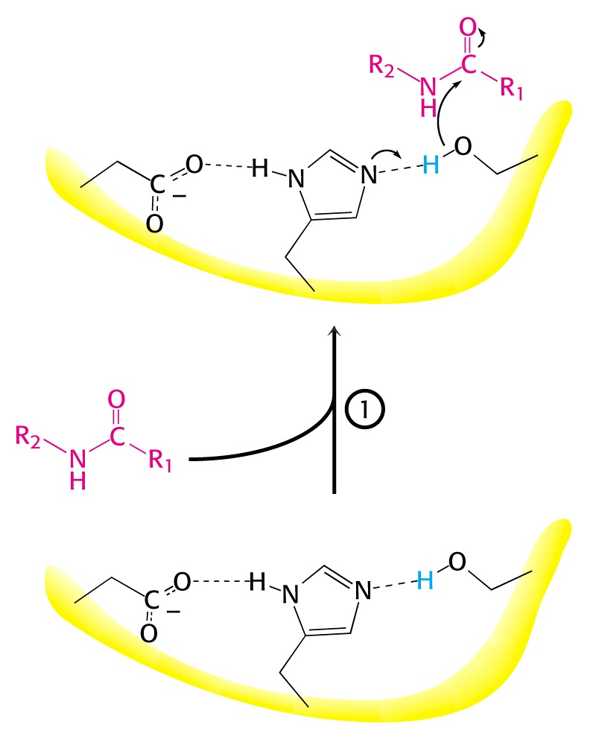
Enzyme Mechanisms – Chymotrypsin
The first step of the reaction mechanism is an attack by the serine alkoxide on the carbonyl carbon of the substrate’s peptide bond.

Slide 27
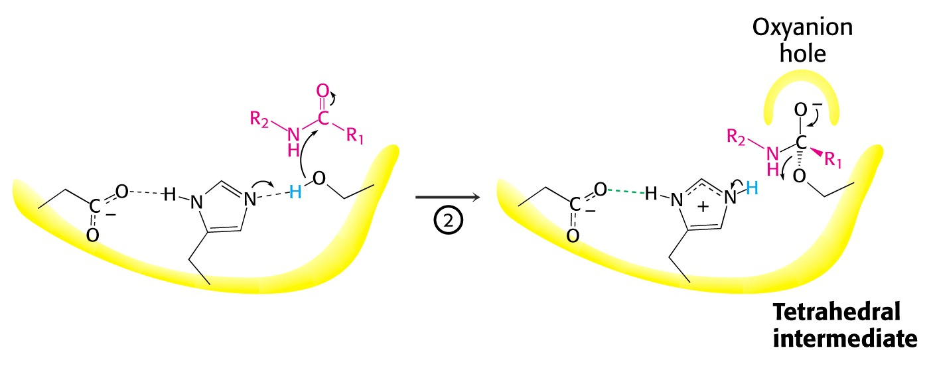
Enzyme Mechanisms – Chymotrypsin
The attack results in the fomation of a new bond and the carbon changes hybridzation state (from sp₂ to sp₃). The charged oxygen atom is stabilized by polar amino acids in a “oxyanion hole.”

Slide 28
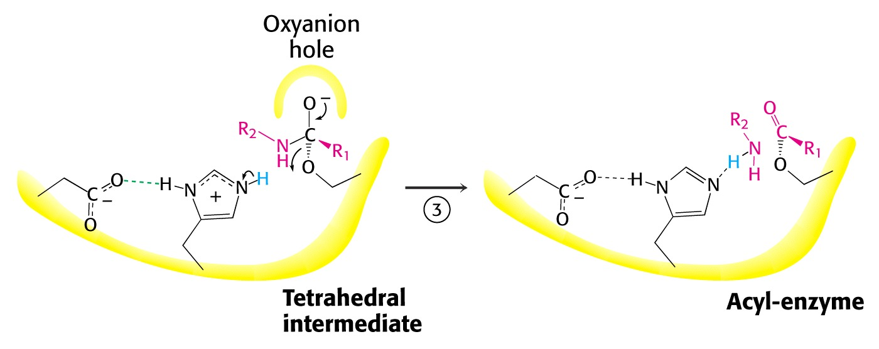
Enzyme Mechanisms – Chymotrypsin
Rearrangement of the electrons breaks the peptide bond…

Slide 29
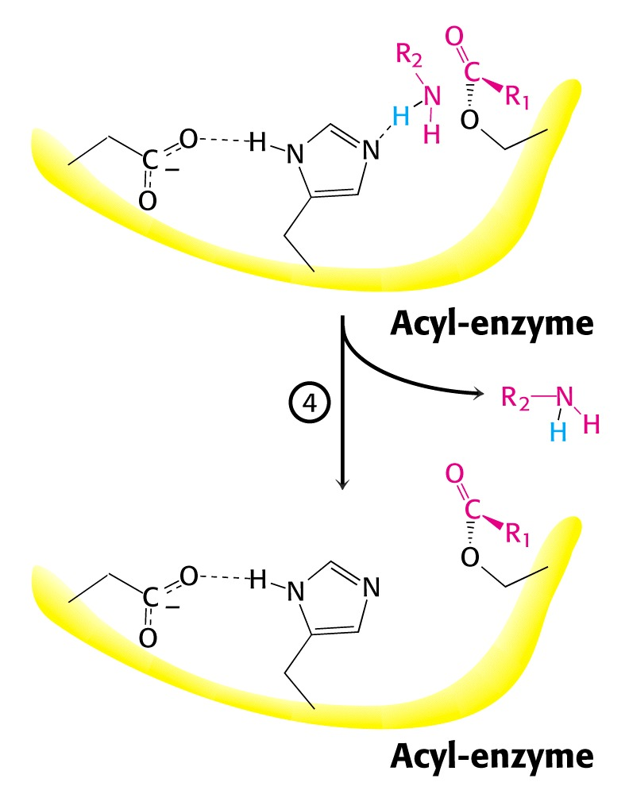
Enzyme Mechanisms – Chymotrypsin
… and the peptide fragment with the amino terminus diffuses away.
This leaves the remaining portion of the substrate covalently linked via an ester linkage.

Slide 30
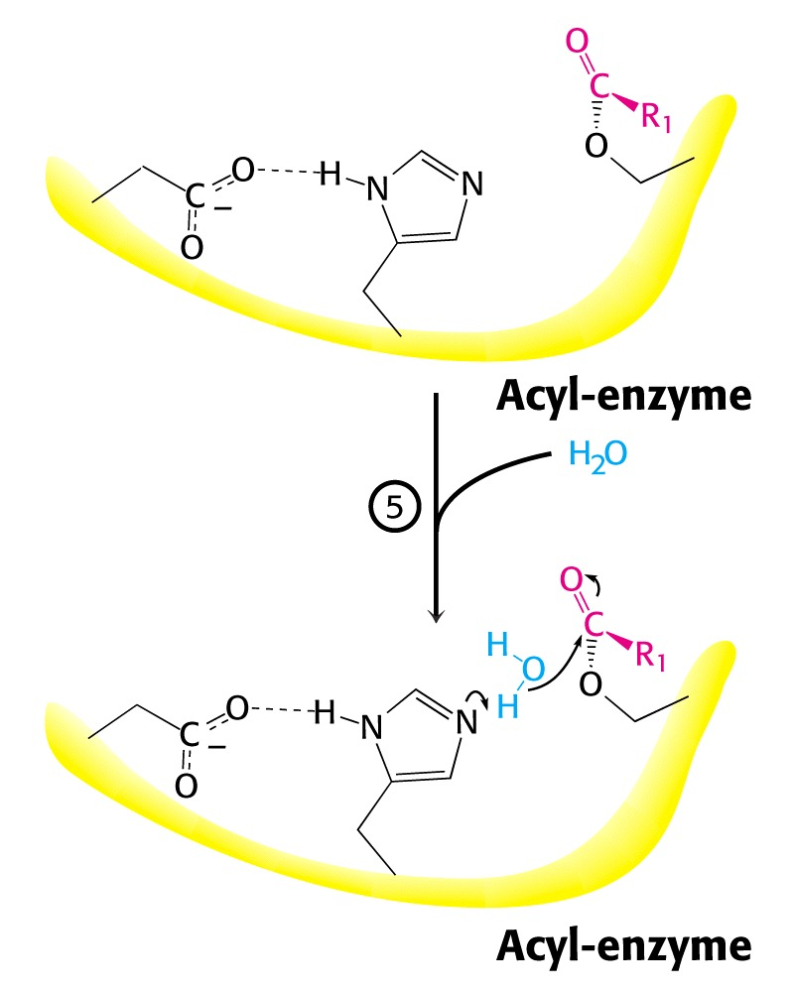
Enzyme Mechanisms – Chymotrypsin
Water now diffuses into the active site and the whole process is repeated, this time with water as the nucleophile, rather than serine.
The charge relay network helps form hydroxide that attacks the carbonyl carbon.

Slide 31
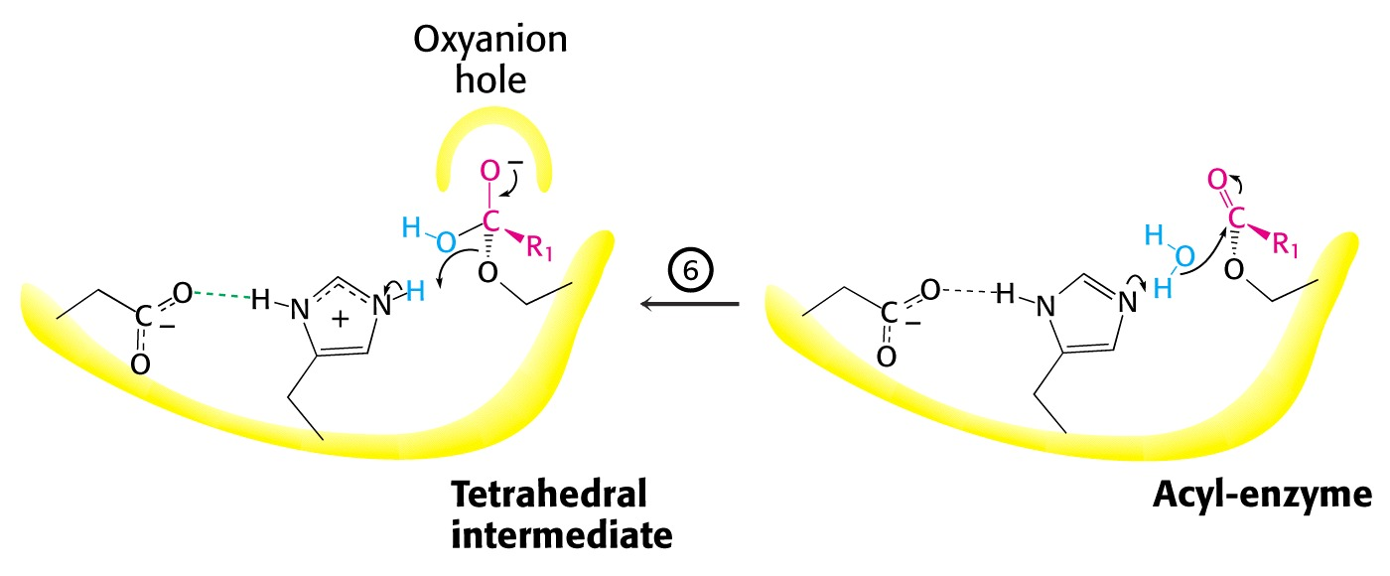
Enzyme Mechanisms – Chymotrypsin
The tetrahedral (sp³) intermediate is again stabilized by the oxyanion hole and the charge relay network:

Slide 32
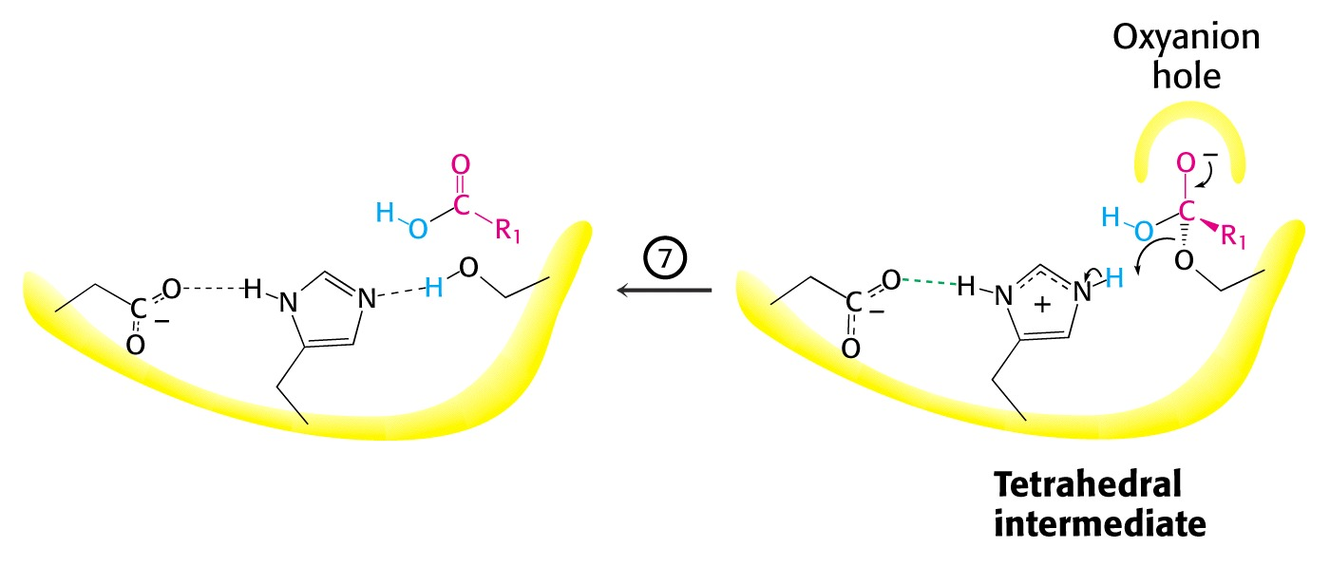
Enzyme Mechanisms – Chymotrypsin
Rearrangement of electrons breaks the ester bond and releases the other peptide fragment.

Slide 33
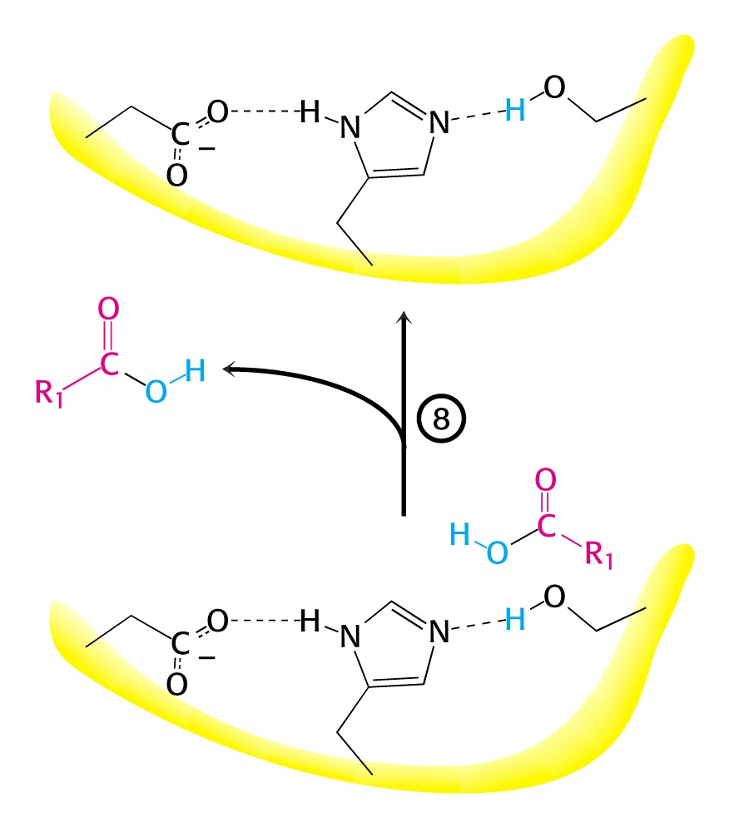
Enzyme Mechanisms – Chymotrypsin
As electrons shift back across the charge relay network, the hydrogen moves back to serine, reinstating the enzyme in initial form for the next round of catalysis:

Slide 34
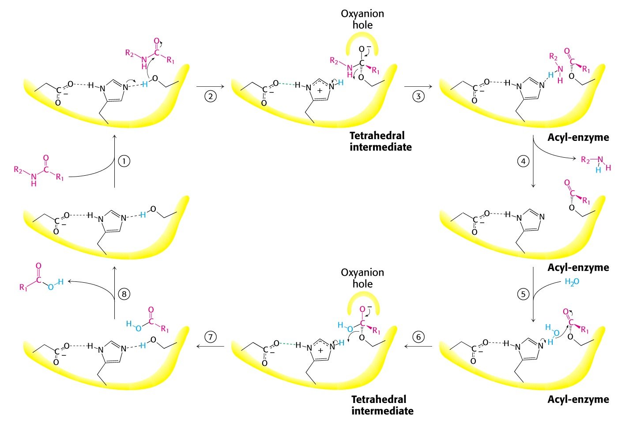
Enzyme Mechanisms – Chymotrypsin

Slide 35
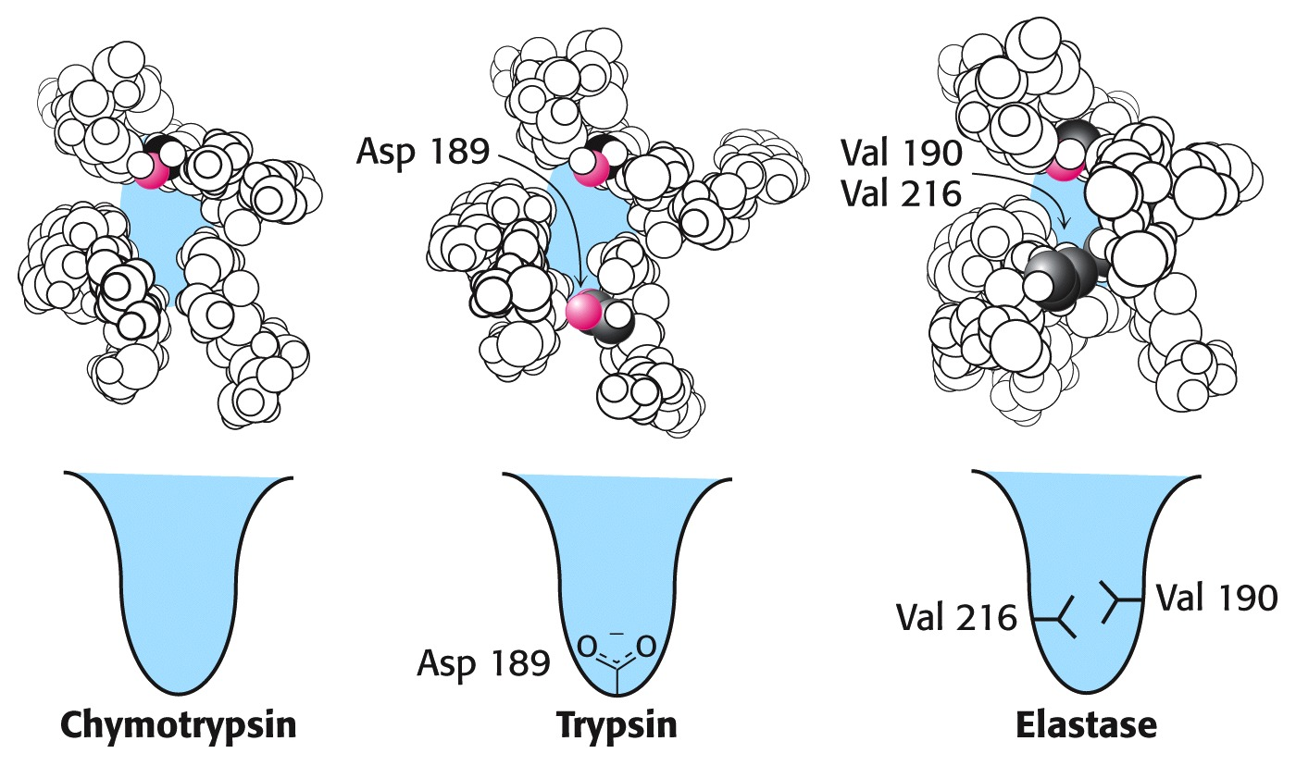
Enzyme Mechanisms – Chymotrypsin, Trypsin, Elastase
Other serine proteases share the same mechanism. However a separate “pocket” explains the different substrate specificities of these enzymes:

Slide 36
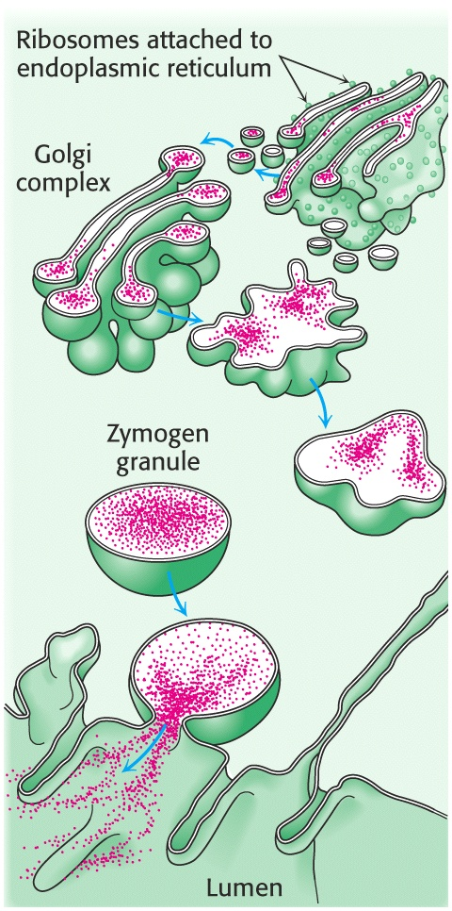
Enzyme Mechanisms – Chymotrypsin
Chymotrypsin and other serine proteases are called zymogens. They are synthesized in the pancreas in an inactive form and stored in granules.
This inactive form is a precursor named “chymotrypsinogen.”

Slide 37
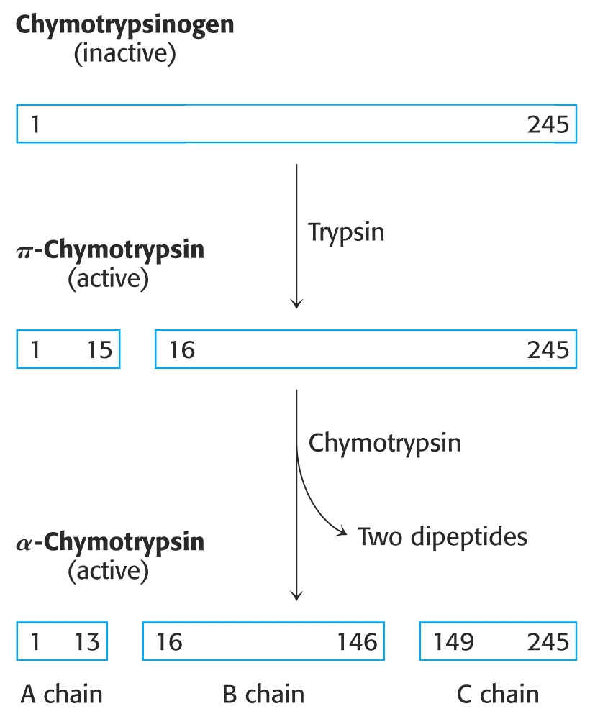
Enzyme Mechanisms – Chymotrypsin
Chymotrypsinogen is activated by proteolytic action of other zymogens in the duodenum.
Such activation of enzymes by proteolytic cleavage is a common theme among a variety of enzymes.

Slide 38
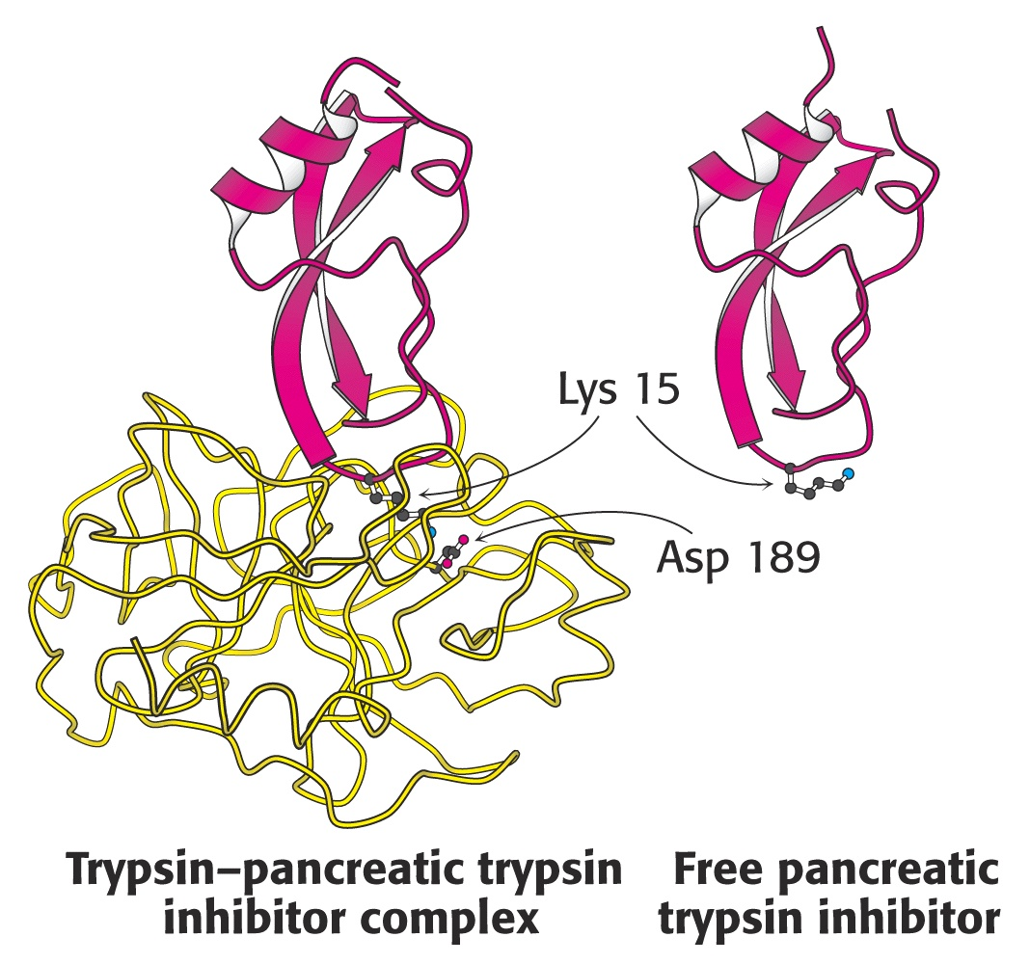
Enzyme Mechanisms – Pancreatic Trypsin Inhibitor
A third way in which the body is protected from undesirable proteolytic action is to synthesize competitive inhibitors, such as the pancreatic trypsin inhibitor (~6kD).
When bound, this inhibitor turns the critically important histidine in the charge relay network out of its normal plane, breaking up the smooth flow of electrons across the amino acid triad. This greatly reduces the ability of serine to form an alkoxide, impeding the initial step in the enzyme mechanism. Upon dilution in the duodenum, the inhibitor dissociates, freeing the enzyme for action.

Slide 39
Enzyme Mechanisms – Elastase Inhibitor
An similar important inhibitor of a different zymogen, elastase, is the 53-kD protein α₁-antitrypsin. (“anti-elastase” would be a better name.)
This inhibitor binds to elastase in the lungs, helping prevent proteolytic damage to the alveolar linings caused by elastase.
A “type Z” mutation substitutes lys for glu-53, resulting in compromised secretion from liver cells where it is synthesized. The resulting decreased level of this inhibitor in the lungs leads to emphysema.

Slide 40
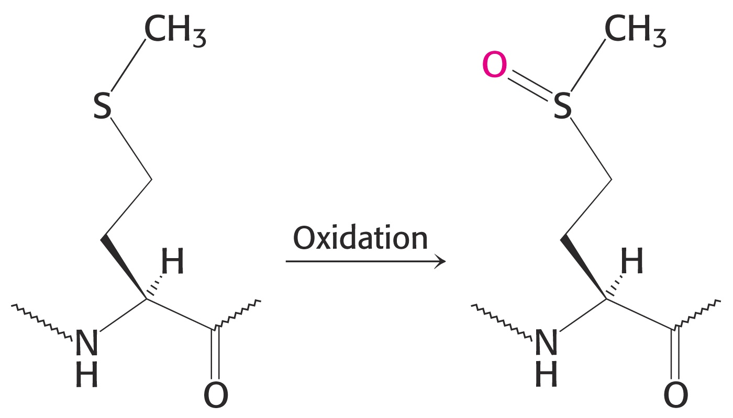
Enzyme Mechanisms – Elastase Inhibitor
Smoking also damages this α₁-antitrypsin inhibitor. Smoke oxidizes methionine-358, a residue essential for binding to elastase. The reduced affinity of elastase for the α₁-antitrypsin inhibitor frees the enzyme to destroy tissues in the lung.

Slide 41
Enzyme Mechanisms – Blood Clotting
The complex process of forming a blood clot is catalyzed by a number of proteolytic enzymes acting one upon another, forming an “enzymatic cascade.”
Such enzymatic cascades rapidly amplify biological “signals” by phenomenal amounts. Each enzyme in the cascade activates the next, according to its turnover number.
Multiple steps multiply the effect, giving rise to incredible amplification.
For example, consider four sequential cascade enzymes, each with a turnover number of 1000: 10³ x 10³ x 10³ x 10³ = 10¹²!
This helps explain why very small signals can cause huge effects in biological systems.

Slide 42
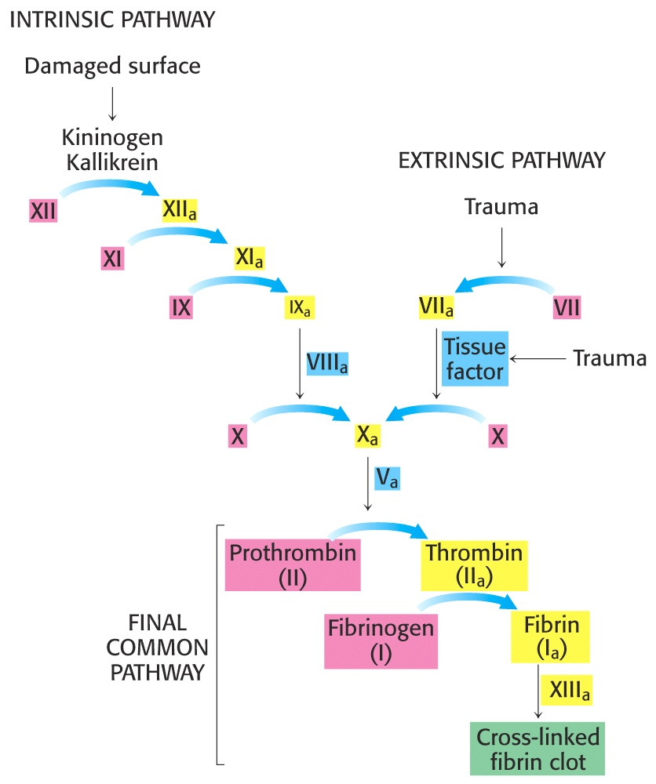
Enzyme Mechanisms Blood Clotting
Two pathways activate blood clotting, both by enzymatic cascades that converge for the last few steps:
(Roman numerals in the names of these enzymes reflect the order they were discovered.)

Slide 43
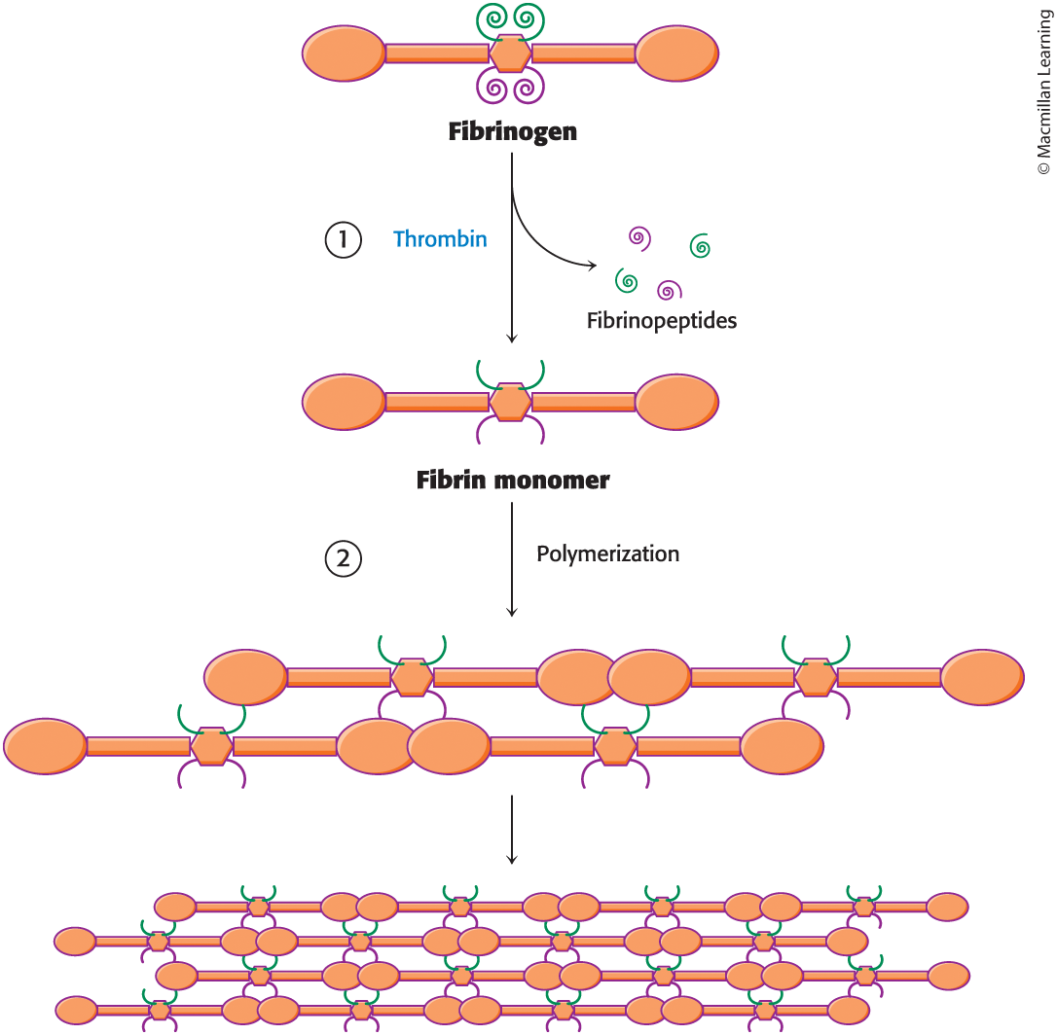
Enzyme Mechanisms – Blood Clotting
The blood clot is actually formed when fibrinogen in converted to fibrin by thrombin. Thrombin removes fibrinopeptides, reducing fibrin’s solubility. Subsequent polymerization forms an insoluble matrix.
Figure 7.26 Textbook

Slide 44
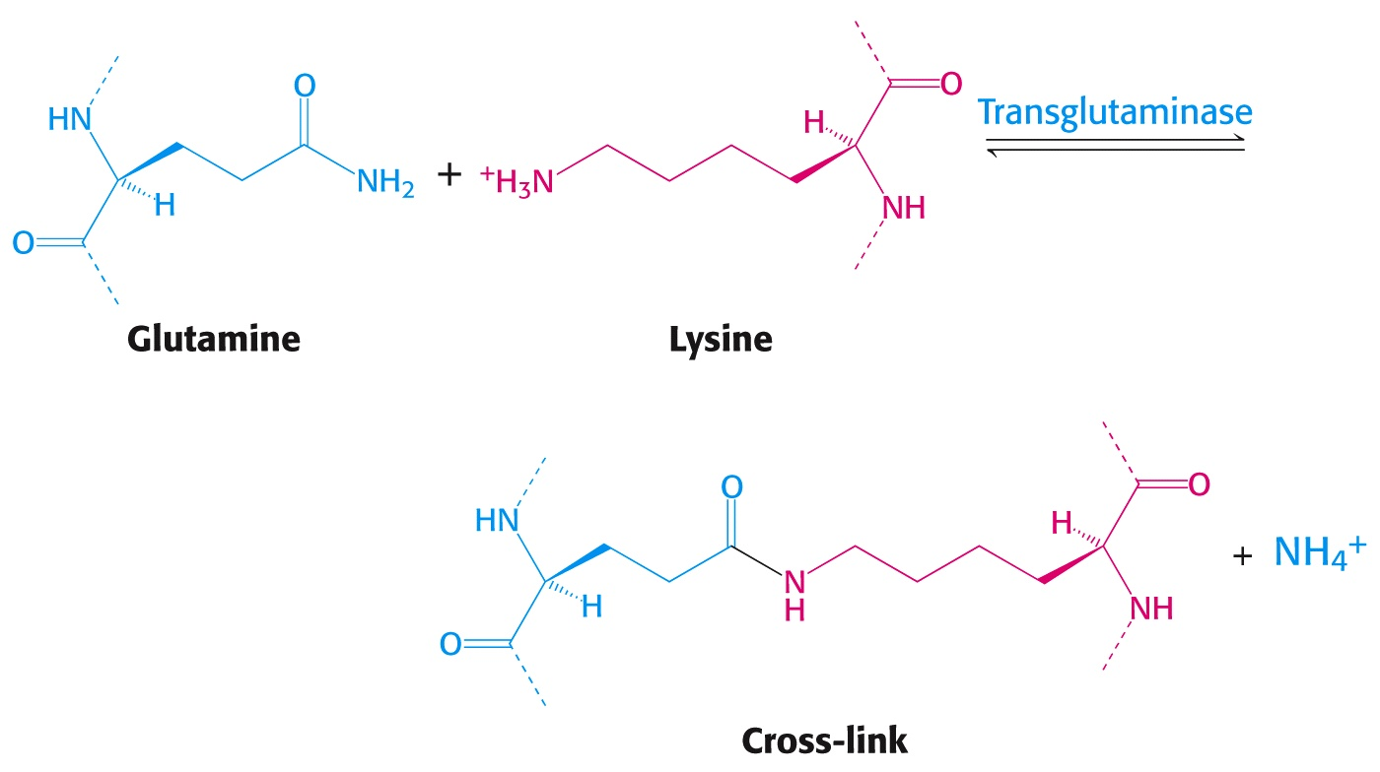
Enzyme Mechanisms – Blood Clotting
The insoluble fibrin matrix is stabilized by the formation of “crosslinks” between lysine and glutamate residues in different monomers:

Slide 45
Enzyme Mechanisms – Blood Clotting
Thrombin is active only when converted from its inactive form, “prothrombin,” to thrombin by Factor X, another serine protease enzyme located in platelet membranes.
Prothrombin contains a number of glutamate residues that have been altered.
Following synthesis at the ribosome, the first 10 glutamates in the amino terminal region of prothrombin must be converted into γ-carboxyglutamate for prothrombin to function properly.

Slide 46
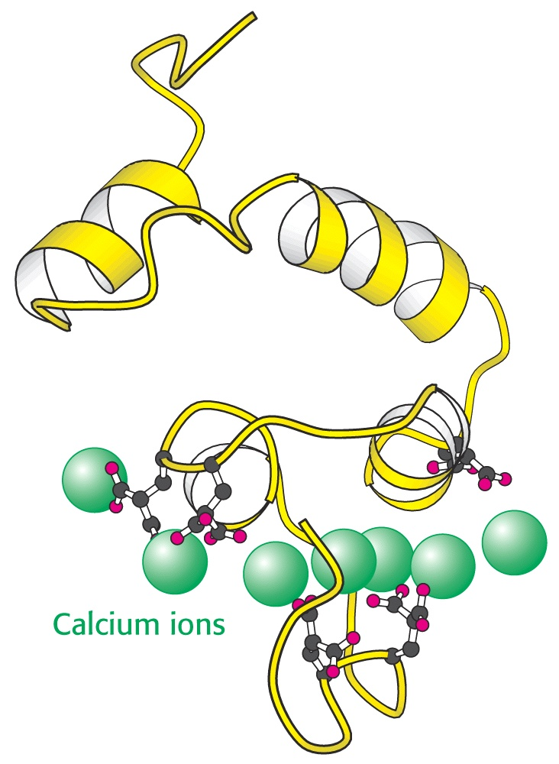
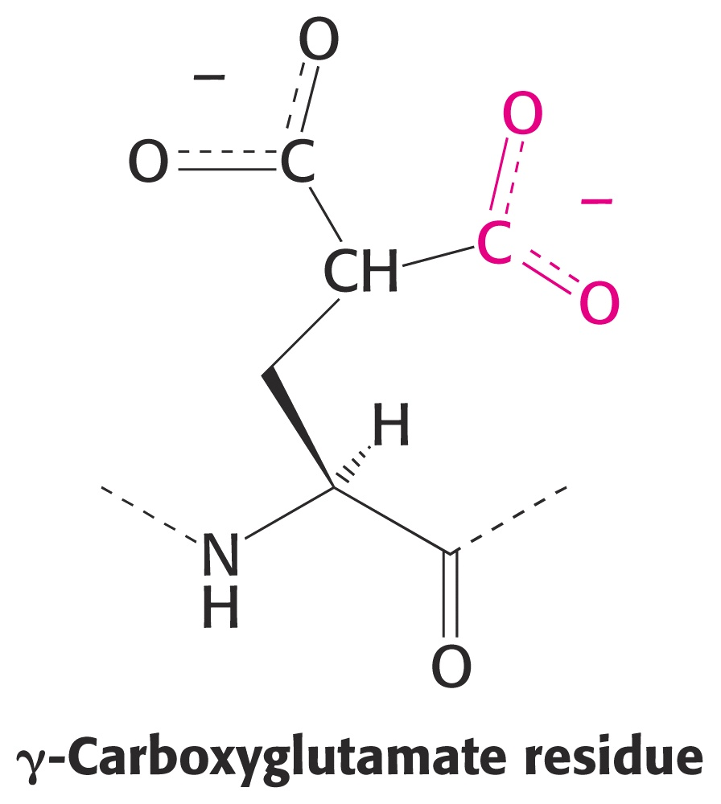
Enzyme Mechanisms – Blood Clotting
The γ-carboxyglutamate side chains are strong chelation agents for calcium ions. These calcium ions facilitate diffusion and binding to platelet membranes where Factor X can convert prothrombin into active thrombin.
Vitamin K is a cofactor for the enzyme (γ-Glutamyl Carboxylase) that carboxylates glutamate to form -carboxyglutamate.

Slide 47
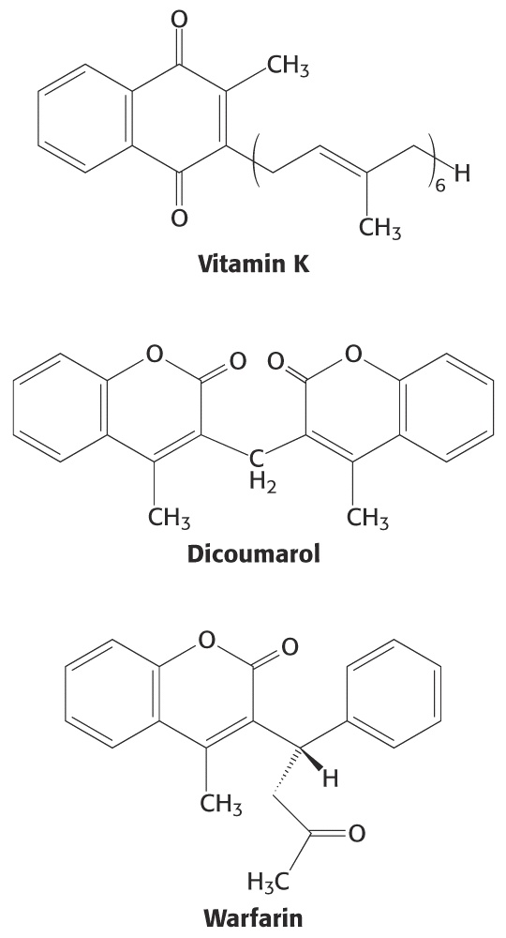
Enzyme Mechanisms – Blood Clotting
Lack of sufficient Vitamin K results in slower clotting times.
Structural analogs of vitamin K act as competitive inhibitors of this important enzyme, resulting in reduced levels of γ-carboxyglutamate in prothrombin. This results in significantly longer clotting times.
These inhibitors are used as “blood thinners” and as rodent [rat] poisons.

Slide 48
End of Lecture Slides
for
Enzyme Mechanisms
Credits: Many of the diagrams used in these slides were taken from Stryer, et.al, Biochemistry, 5th Ed., Freeman Press, Chapter 9 & 10 (in our course textbook) and from prior editions of this work.

