Slide 1
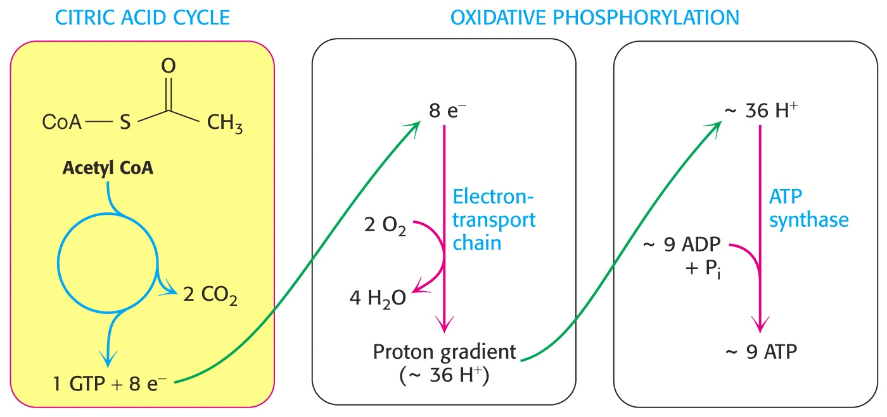
Biochemistry 3070
Mitochondrial Oxidation:
The Citric Acid Cycle

Slide 2
Mitochondrial Oxidation
Further eukaryotic oxidation of pyruvate occurs in mitochondrion.
Pyruvate diffuses into the mitochondrion where it totally oxidized to CO₂ via the citric acid cycle.
Electrons from these oxidation processes are then used to reduce oxygen to water with the concomitant formation of ATP.
The unique structural aspects of mitochondria facilitate its energy-harvesting role.

Slide 3
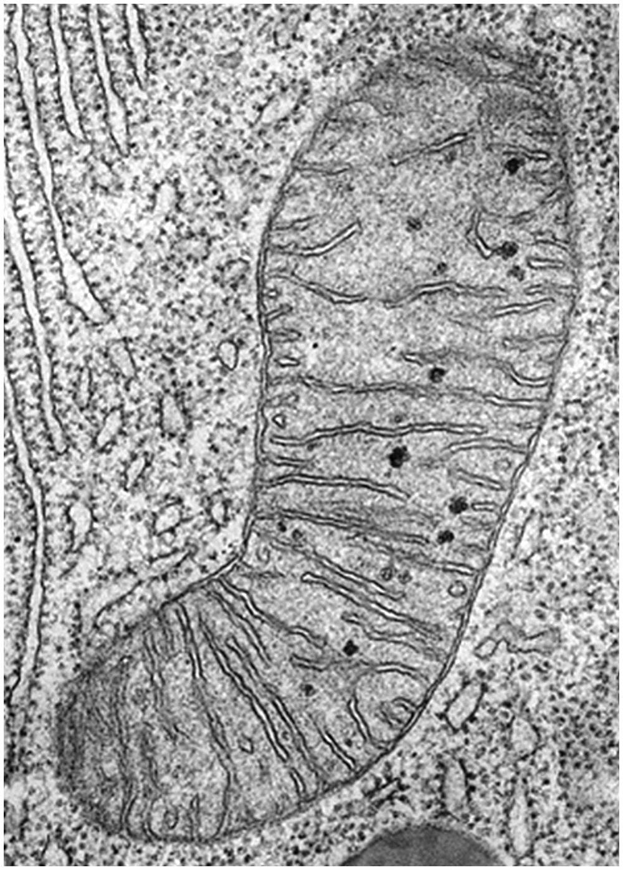
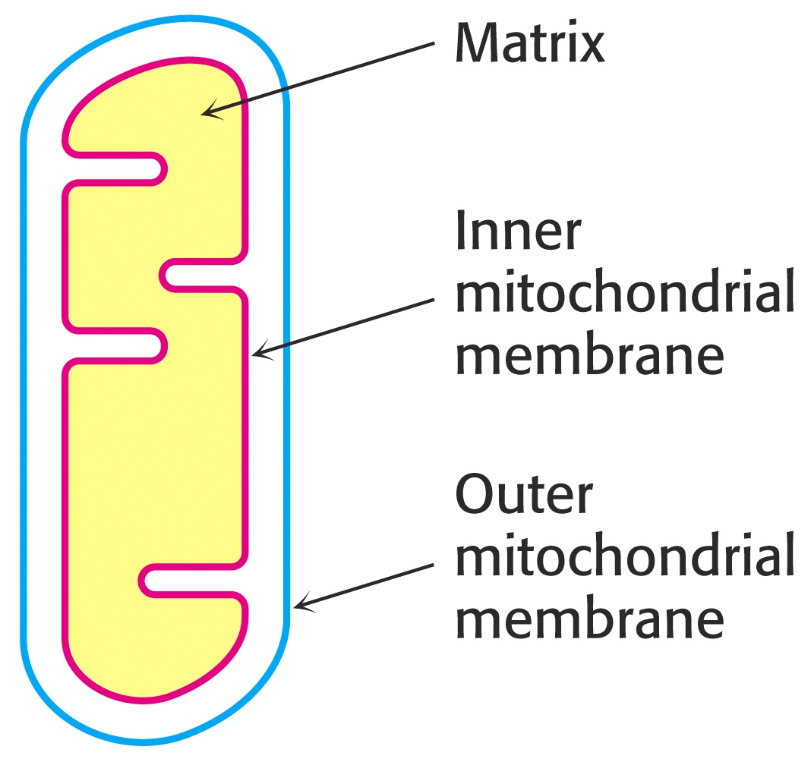
Mitochondrial Structure

Slide 4
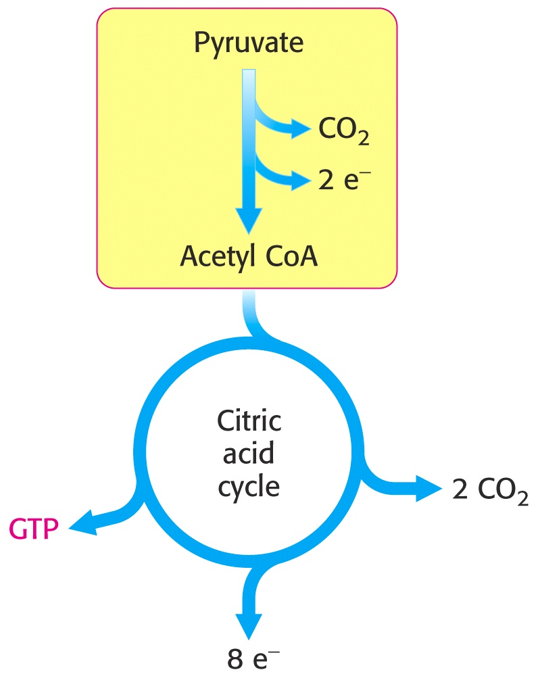
Mitochondrial Structure
Once inside the mitochondrion, pyruvate is oxidatively decarboxylated to form acetyl CoA.
Then, acetyl CoA enters the citric acid cycle, where its two carbons are eventually oxidized to CO₂.

Slide 5
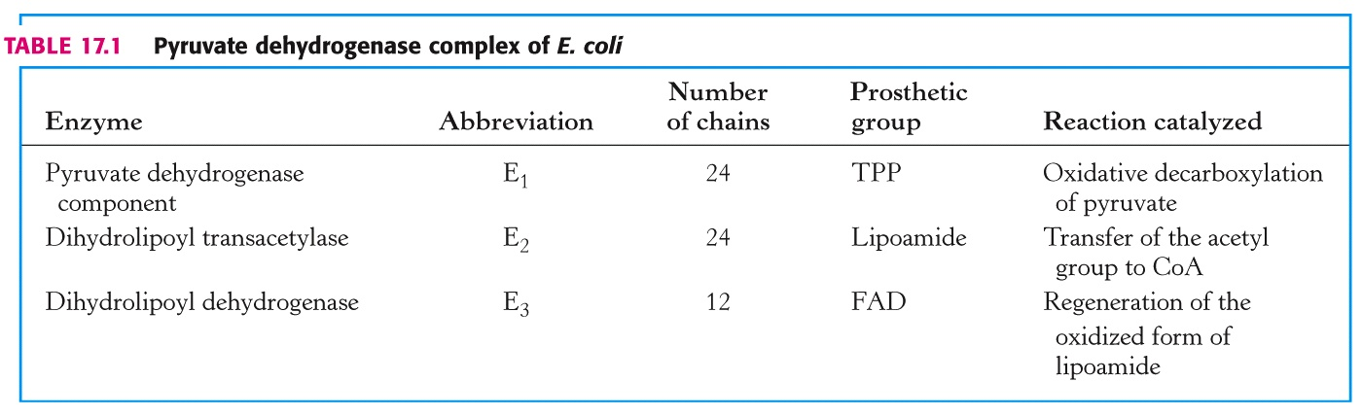
Oxidative Decarboxylation of Pyruvate
The irreversible oxidative decarboxylation of pyruvate is catalyzed by an incredibly complicated enzyme complex named the “pyruvate dehydrogenase complex.”
In E.coli this enzyme complex contains three enzymes (each with several polypeptide chains) and five coenzymes:

Slide 6
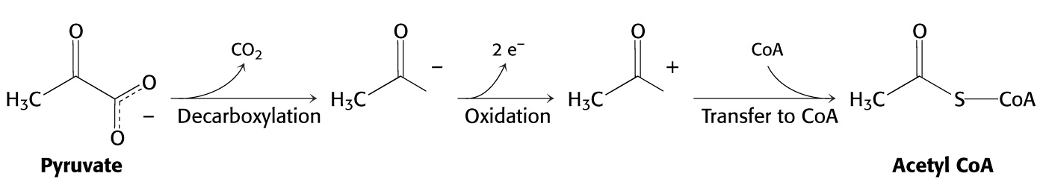
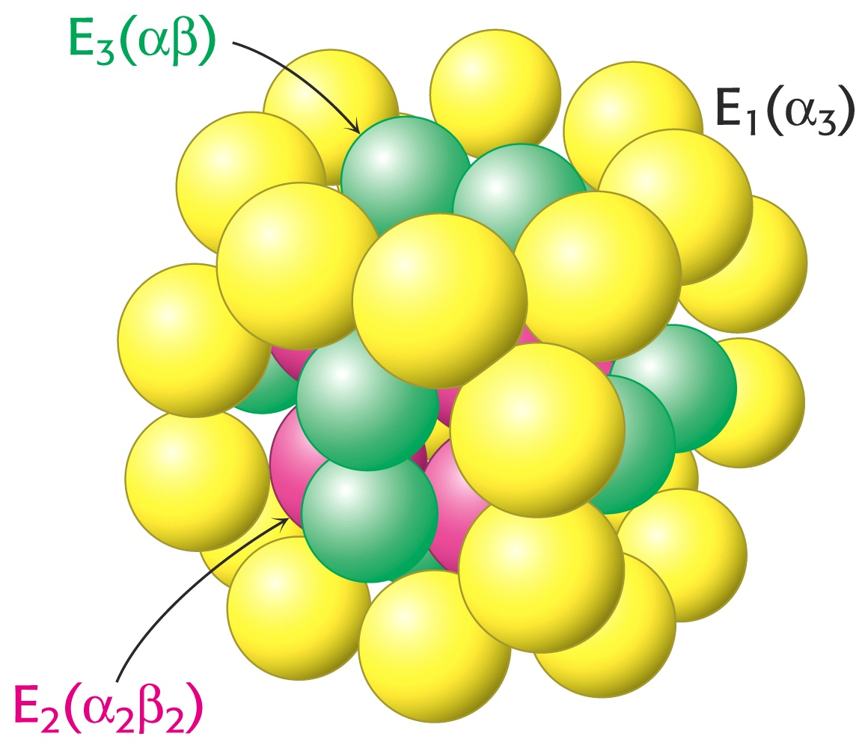
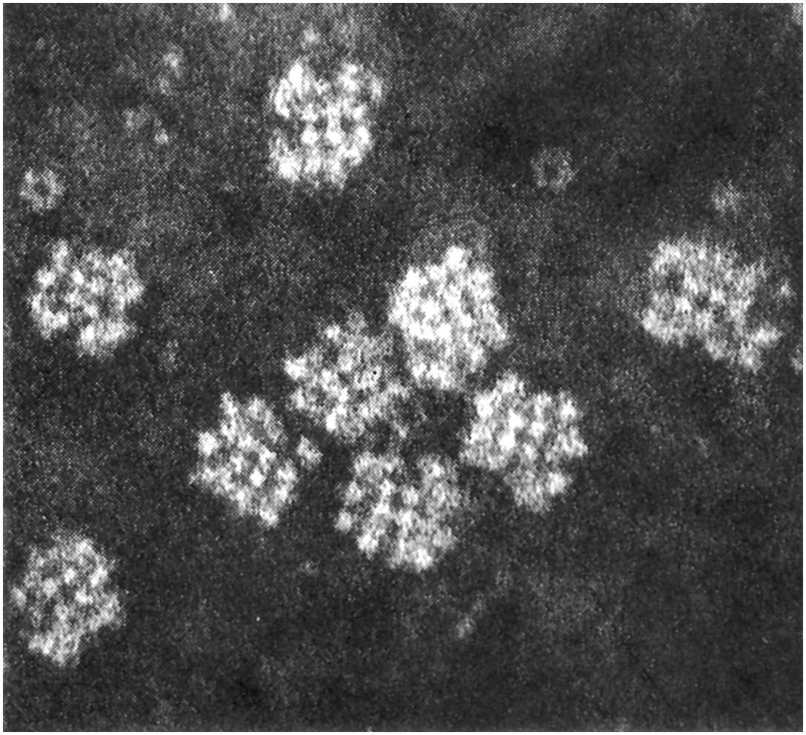
Pyruvate Dehydrogenase Complex

Slide 7
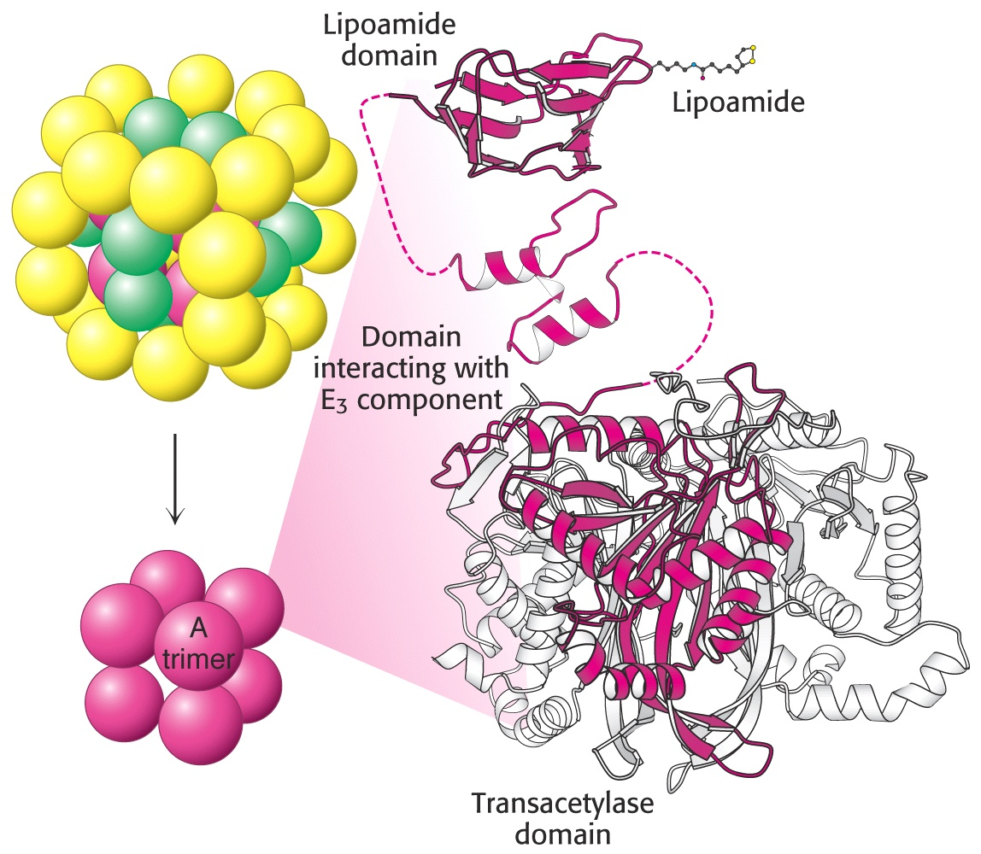
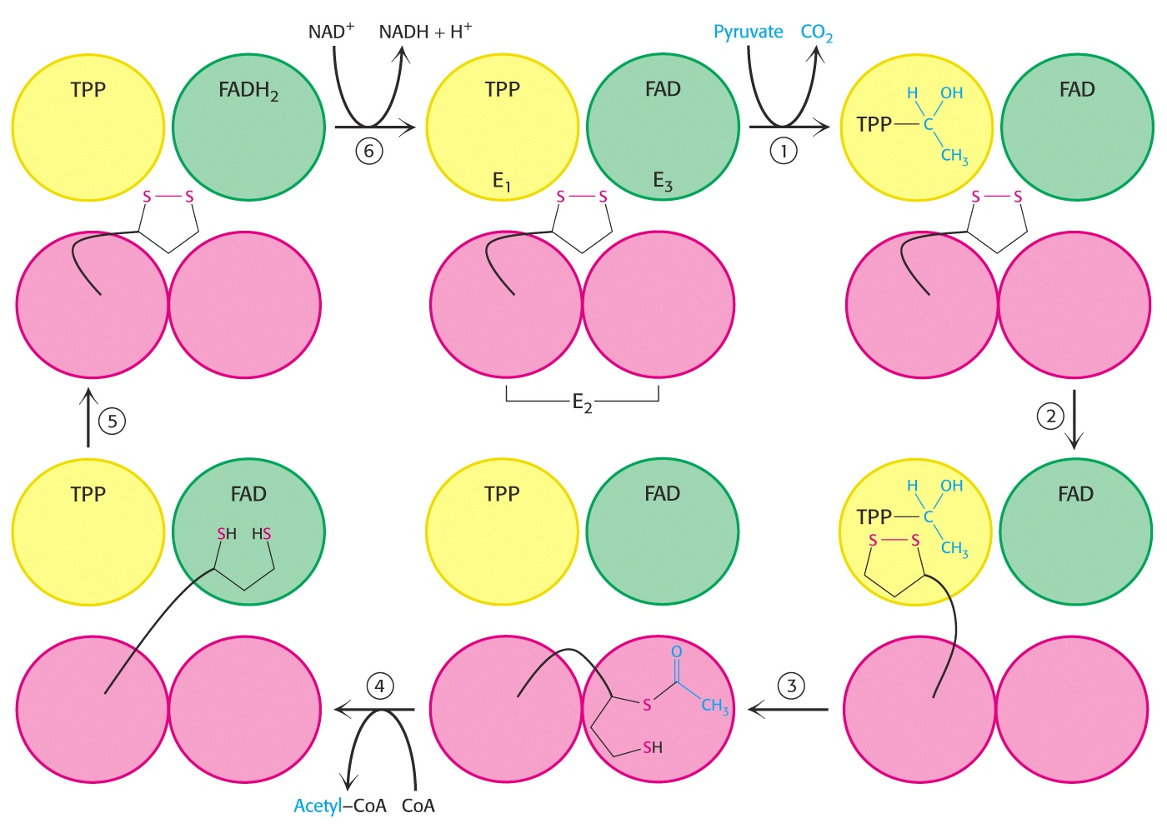
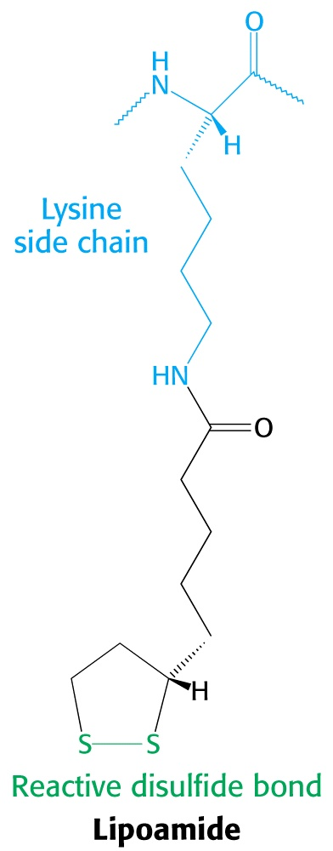
Pyruvate Dehydrogenase Complex
Lipoamide acts as an “arm,” attaching to the two-carbon group from pyruvate and literally moving it around to the next active site. It then swings over to FAD to get reduced and start the cycle again.

Slide 8
Pyruvate Dehydrogenase Complex
Deficiency of thiamine and poisoning by mercury and arsenic all disrupt pyruvate metabolism.
Thiamine is an important structural component of prosthetic groups of three enzymes in the pyruvate dehydrogenase complex. Without sufficient supplies, pyruvate metabolism is curtailed, which is manifested as “Beri-beri” (a neurological and cardiovascular disorder.)

Slide 9
Pyruvate Dehydrogenase Complex
Arsenic and mercury bind to the dihydrolipoyl groups in the lipoamide “arm,” rendering it useless in the complex.
Treatments for these poisons is administration of sulfhydryl reagents that compete for binding to the metal ions, and are excreted.
“Lewisite” is an arsenic-based chemical weapon used in World War I. The British developed BAL (British anti-lewisite), an antidote:

Slide 10
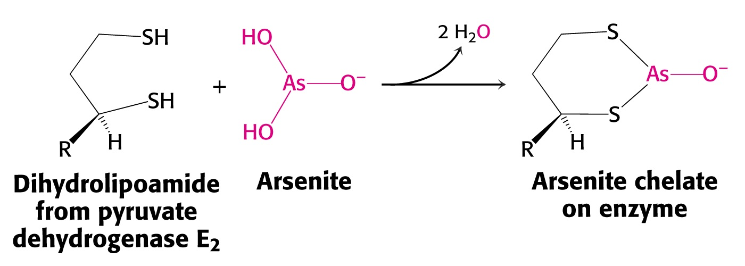
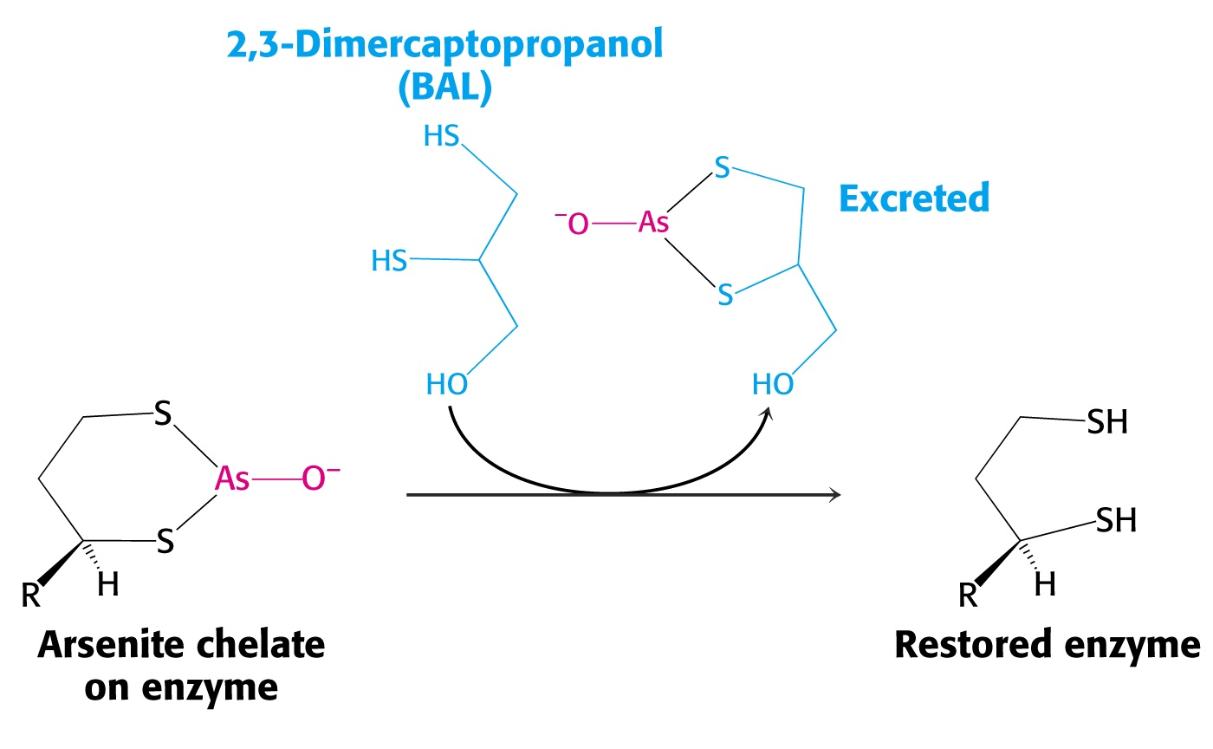
Lewisite Antidote

Slide 11
Pyruvate Dehydrogenase Complex
The overall reaction catalyzed by this amazing enzyme complex seems deceivingly simple:
CO₂ is lost, converting pyruvate from a three-carbon acid into a two-carbon acetyl group carried by CoA.
The two electrons lost during this oxidation end up on NADH.

Slide 12
The Citric Acid Cycle
Acetyl CoA is now ready for entry into the Citric Acid Cycle.
Citric acid contains three carboxylic acid functional groups. The cycle is sometimes call the TCA Cycle. “TCA” actually stands for “Tri-Carboxylic Acid.”
The series of reactions in the TCA cycle were elucidated in part by Hans Krebs, and is therefore often referred to as the “Kreb’s Cycle.”

Slide 13
The Kreb’s Cycle
When Dr. Krebs submitted his manuscript describing the Krebs cycle, it was rejected by the prestigious journal, Nature. (A fact he told many students about during his career, to encourage young scientists!)
His series of reactions that now are studied in every biochemistry and cell biology course was published in the journal, “Enzymologia.”
Let’s examine these reactions.

Slide 14
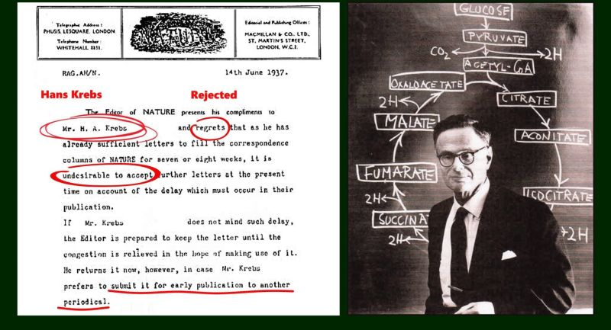
Hans Krebs Rejection Letter from Nature

Slide 15
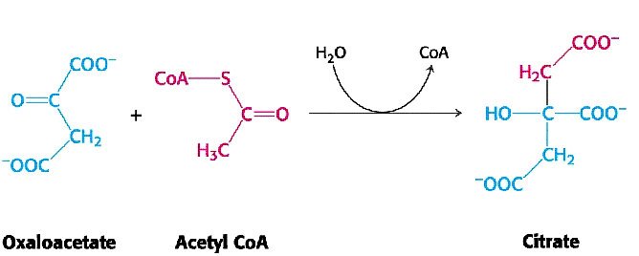
The Citric Acid Cycle
In the first step of the pathway, acetyl CoA combines with oxaloacetate to form citric acid:
4 carbons + 2 carbons → 6 carbons

Slide 16
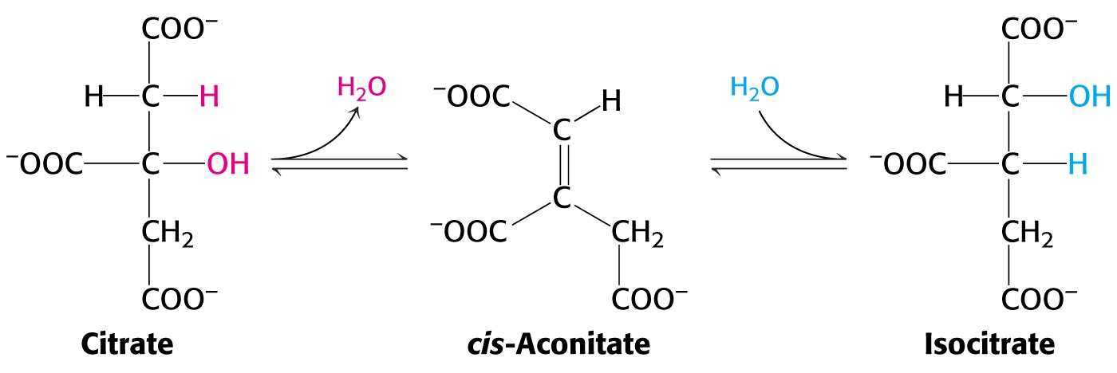
Citric acid is then isomerized in a two-step reaction in which it is first dehydrated (forming cis-aconitate) then rehydrating the double bond to form isocitrate.
(In most diagrams of the citric acid cycle, this step is omitted.)

Slide 17
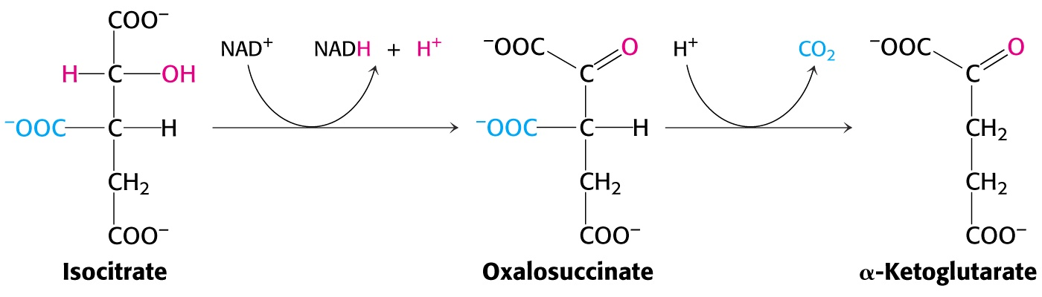
The Citric Acid Cycle
Isocitrate is then oxidatively decarboxylated to form α-ketoglutarate, accompanied by the formation of both NADH and CO₂.
Note that α-ketoglutarate contains only 5 carbons, since CO₂ is lost during the reaction.
(Note: oxalosuccinate is seldom shown in most diagrams of the TCA Cycle.)

Slide 18
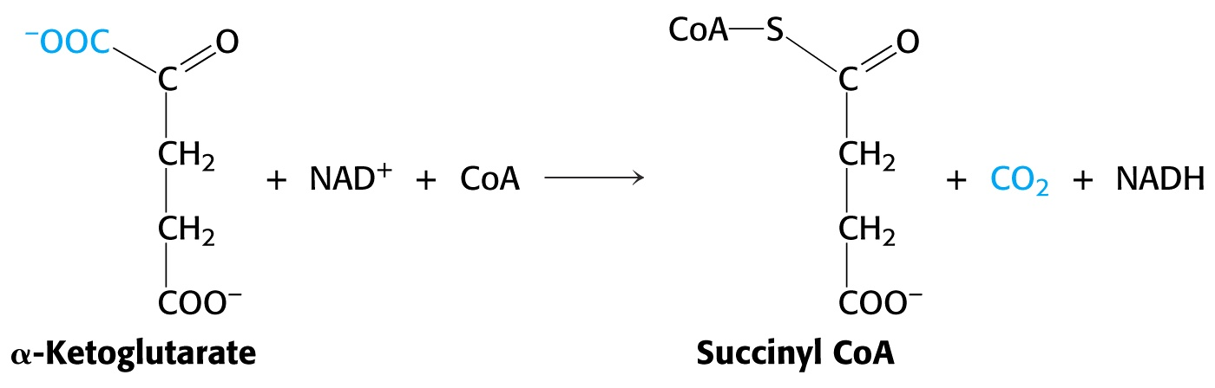
The Citric Acid Cycle
In the very next step, the 5-carbon moiety is again oxidatively decarboxylated with the formation of another NADH and another CO₂.
However, in this reaction, CoA forms a thioester linkage to the new 4-carbon group, yielding succinyl CoA.
Important Note: This reaction and its associated enzyme is very similar to the pyruvate dehydrogenase complex (that converted pyruvate into acetyl CoA.)

Slide 19
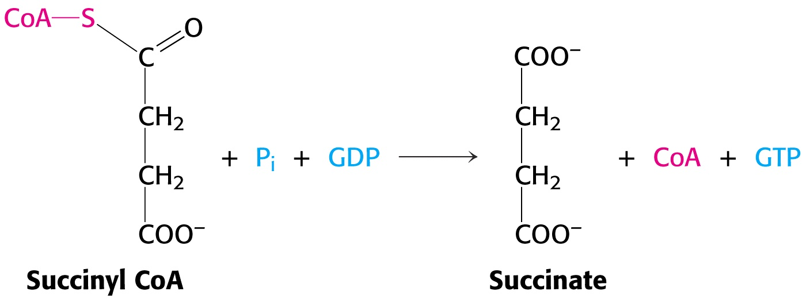
The Citric Acid Cycle
The relatively high energy content of the CoA bond is now released through phosphorylysis. The resulting phosphoric acid – succinic acid anhydride intermediate provides enough transfer potential to convert GDP into GTP.
(For accounting purposes we will count the formation of this high-energy bond in GTP equivalent to the conversion of ADP to ATP.)

Slide 20
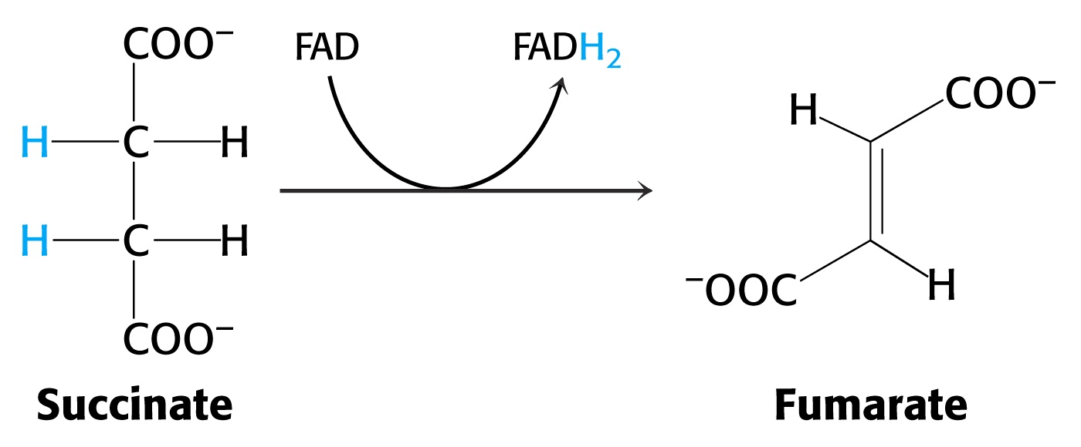
The Citric Acid Cycle
Succinic acid (succinate) is now oxidized by removing two hydrogens and two electrons, resulting in a double bond forming between the α and β carbons.
FAD (not NAD₊) is the reducing agent here, because the oxidation potential of this reaction is not sufficient to reduce NAD₊).

Slide 21
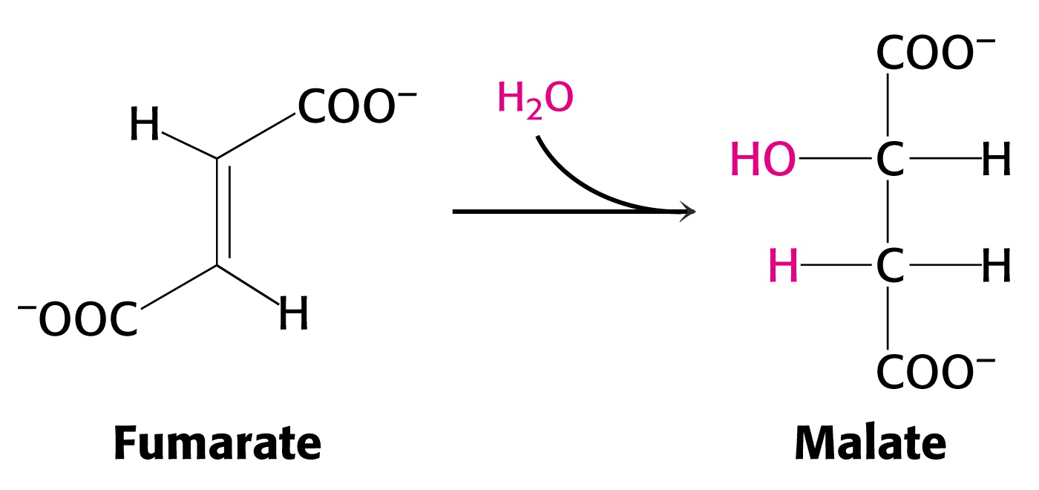
The Citric Acid Cycle
Fumarate is then hydrated, forming an alcohol functional group on the β-carbon (malate).

Slide 22
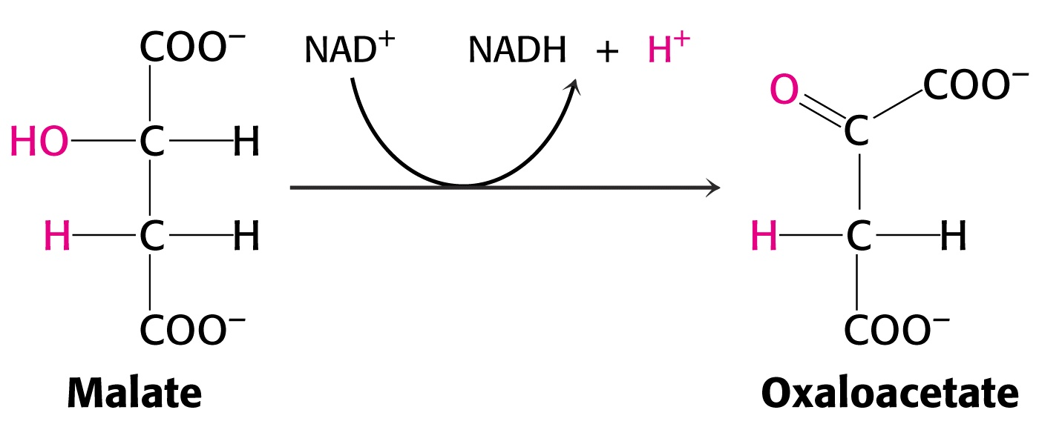
The Citric Acid Cycle
Oxidation of the β-hydroxyl group now forms a ketone functional group on this carbon, resulting the formation of oxaloacetate, the original starting material of the cycle !

Slide 23
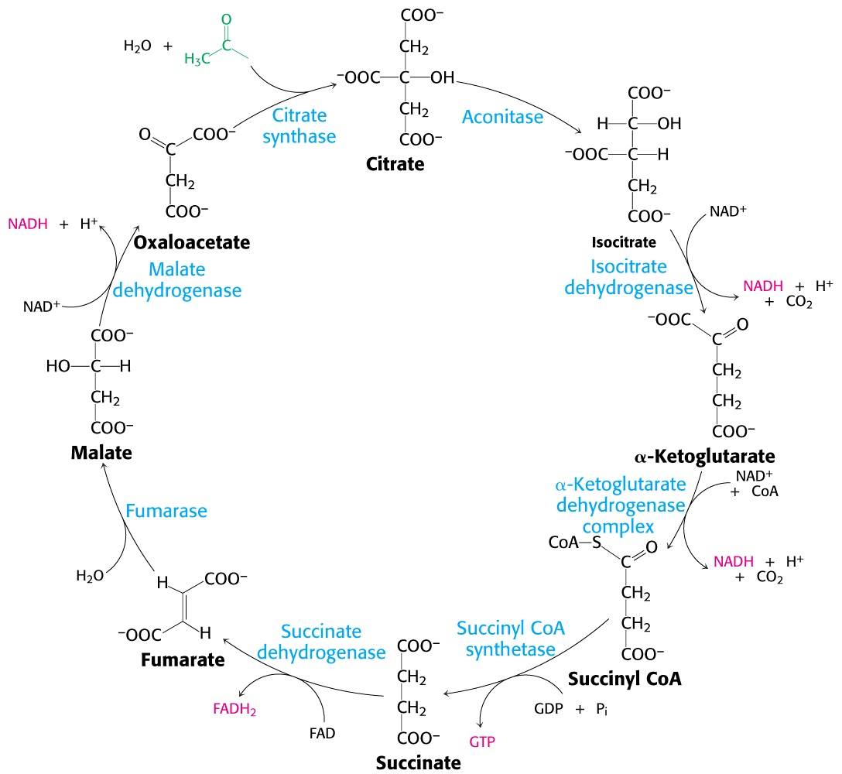
The Citric Acid Cycle

Slide 24
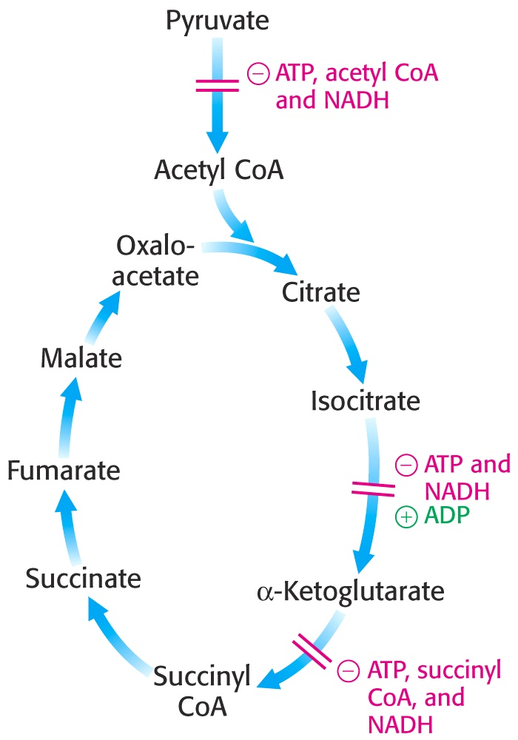
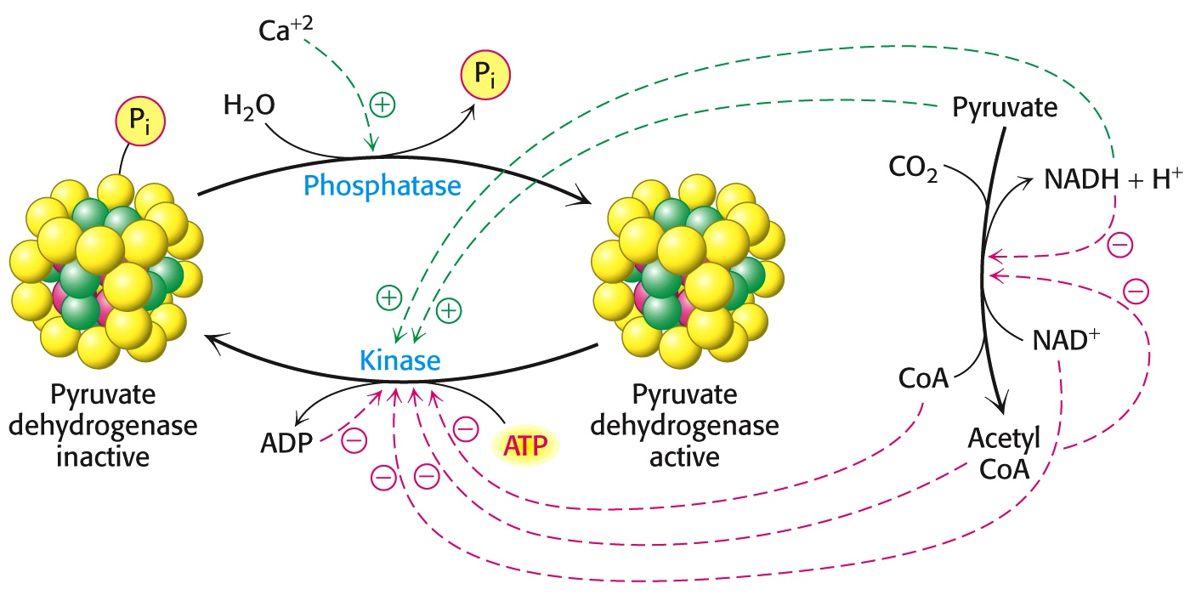
Control Points of the Citric Acid Cycle
The pyruvate dehydrogenase complex is regulated allosterically, affected by a host of different cellular metabolites and by reversible phosphorylation.

Slide 25
The Glyoxylate Pathway
Question:
Knowing that oxaloacetate (one of the TEC cycle compounds) can be converted into glucose (via gluconeogenesis), can we convert acetyl CoA into glucose?

Slide 26
The Glyoxylate Pathway
Recall that two carbons enter the citric acid cycle as acetyl CoA. Two carbons are lost as CO₂.
Therefore, we can not ever get ahead enough to divert oxaloacetate into gluconeogenesis to make glucose.
However, plants and bacteria can…..
How is this accomplished?

Slide 27
The Glyoxylate Pathway
Answer: Plants and bacteria take a short cut across the TCA cycle, avoiding the decarboxylation reactions.
Isocitrate (C₆) is split into succinate (C₄) and glyoxylate (C₂), preserving the two carbon atoms.
Glyoxylate (C₂)then reacts with acetyl CoA (C₂) to form malate (C₄) and subsequently oxaloacetate which can move on to glucose, leaving succinate to provide the carbon skeleton for continuation of the TCA cycle.
(As we shall see later in our discussion of fatty acid metabolism, this is how plant convert energy-rich lipids into carbohydrates. )

Slide 28
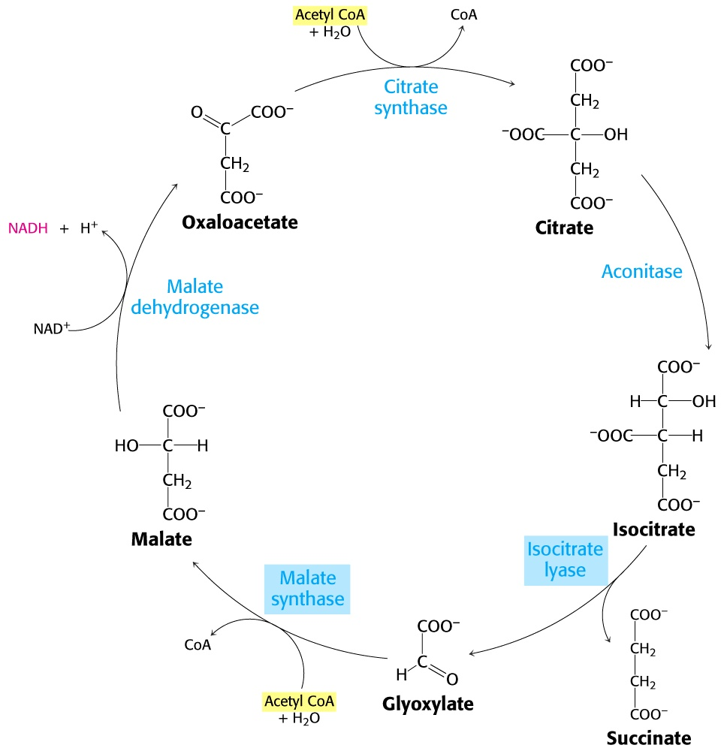
The Glyoxylate Pathway

Slide 29
End of Lecture Slides
for
Mitochondrial Oxidation:
The Citric Acid Cycle
Credits: Many of the diagrams used in these slides were taken from Stryer, et.al, Biochemistry, 10th Ed., Freeman Press (in our course textbook) and from prior editions of this text.

