Slide 1
Biochemistry 3070
Carbohydrates

Slide 2
Carbohydrates
French scientists coined the term “hydrates de carbone” [hydrates of carbon] to describe a unique group of biochemical substances who’s empirical formula is:
CH₂O
Elemental analysis of carbohydrates yields one unit of H₂O for every carbon atom.

Slide 3
Carbohydrates
Almost all carbohydrates are produced by photosynthesis. In this process, plants combine carbon dioxide from the air with water from the soil utilizing energy derived from sunlight to give simple carbohydrates:
6 CO₂ + 6 H₂O → C₆H₁₂O₆ + 6 O₂

Slide 4
Carbohydrates
Carbohydrates serve two major functions in plants:
  In the form of cellulose, they are structural elements. Wood is a good example of the strength of cellulose.
  As starch, they provide nutritional reserves (energy) for the plant.
Often, the simple carbohydrates are called “sugars.”

Slide 5
Carbohydrates
Animals obtain carbohydrates by eating plants.
Carbohydrates constitute ~65% of the typical human diet.
In animals, carbohydrates serve two main roles:
  Provide energy (gained from the biological oxidation of carbohydrates)
  Supply carbon atoms for the synthesis of other biological substances.

Slide 6
Carbohydrates
Carbohydrates are polyhydroxy aldehydes or ketones, or substances that yield these compounds upon hydrolysis.
Carbohydrates vary in structure from those containing a few carbon atoms to gigantic, polymeric molecules having molecular weights in the hundreds of thousands!

Slide 7
Carbohydrates
In the simplest form, carbohydrates may be classified as either aldoses or ketoses:

Slide 8
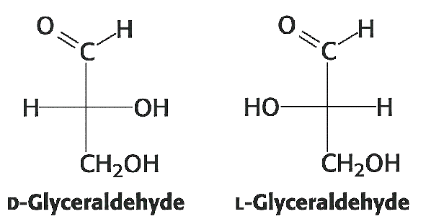
Carbohydrates
The stereochemistry of carbohydrates can be quite complex, due to the number of chiral carbons in their structures. Consider the simplest 3-carbon carbohydrate glyceraldehye, a triose with only one chiral carbon.
The last chiral carbon in the chain (the chiral carbon with the highest IUPAC number) is often called the “pentultimate” carbon atom. It is labeled as a distinguishing structural factor in the name of carbohydrates as “D” or “L.”

Slide 9
Carbohydrates
The names of higher molecular weight sugars indicate the number of carbons they contain:
  tetrose (C₄)
  pentose (C₅)
  hexose (C₆)
  heptose (C₇).
The multiple asymmetric carbons give rise to both enantiomers and diastereoisomers (isomers that are not mirror images of each other).

Slide 10
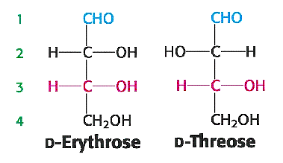
Carbohydrates
Instead of assigning stereochemical configurations to each carbon (IUPAC names), biochemists simply give all these stereochemical configurations different names.
Carbohydrates that differ by only one asymmetric center are called “epimers.”

Slide 11
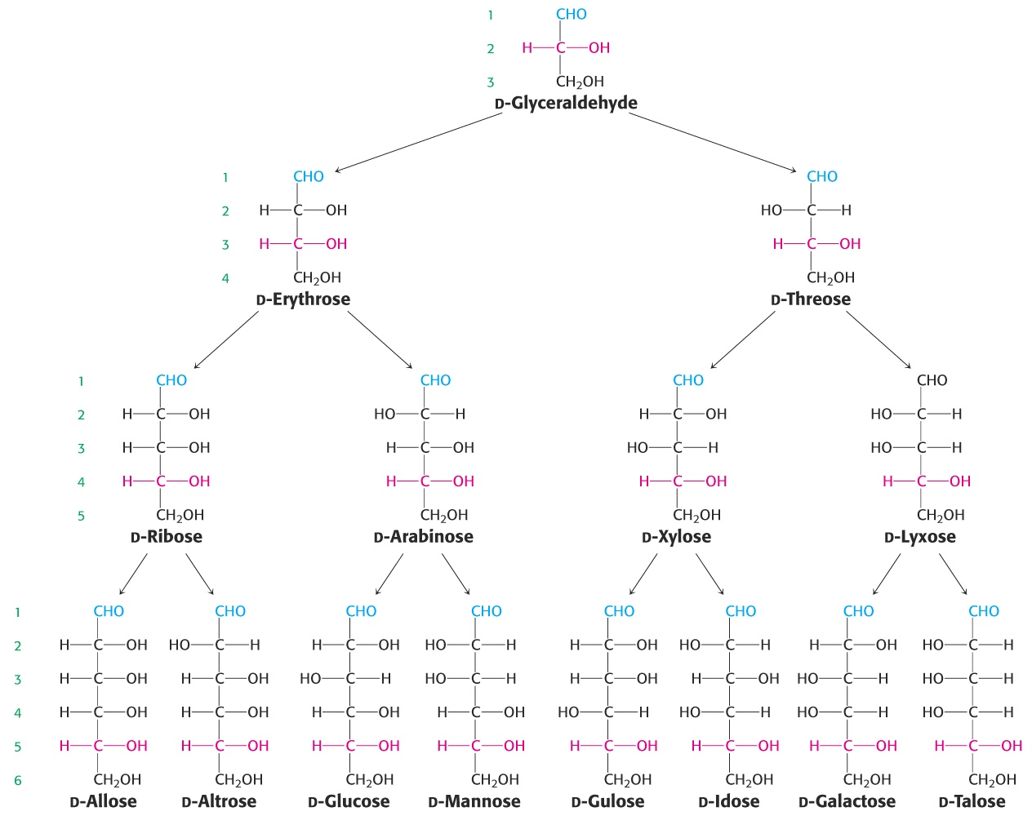
Carbohydrates – Aldose Family

Slide 12
Carbohydrates - Glucose
Glucose is the most important aldose.
Glucose is sometimes referred to as “dextrose,” since when dissolved in water, it rotates plane polarized light to the right.
Glucose is “blood sugar,” and is the most important nutrient in our blood stream, usually present in the amount of 70-100 mg/100mL(deciliter).
A high glucose level is hyperglycemic;
A low glucose level is hypoglycemic.

Slide 13
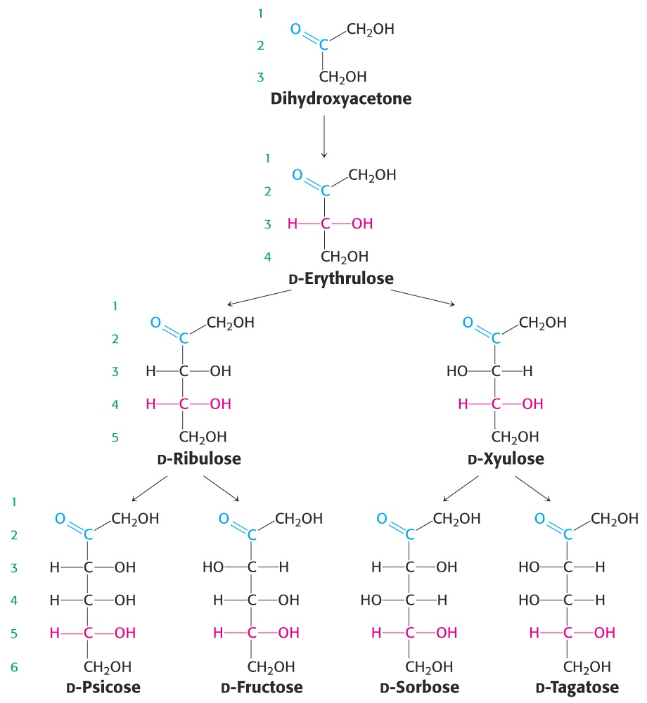
Carbohydrates – Ketose Family

Slide 14
Carbohydrates
Fructose is the most important ketose.
An alternative name for fructose is “levulose,” because it rotates light to the left.
Fructose is the sweetest of all the naturally occurring sugars.
Fructose is found in honey and many other sweet tasting foods.
High-fructose corn syrup is an important sweetener for soda pop and other commercial beverages.

Slide 15
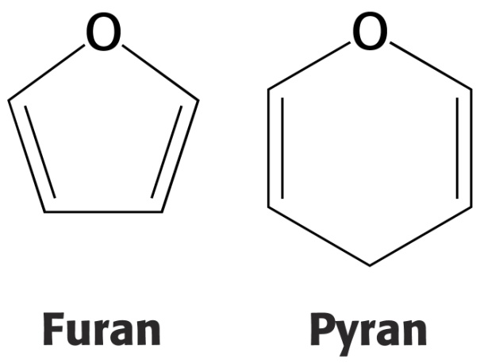
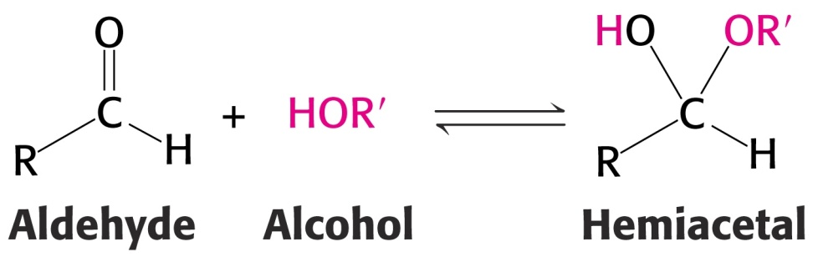
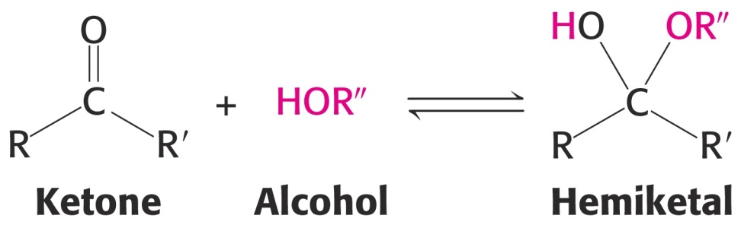
Carbohydrates
Both aldoses and ketoses of appropriate lengths can cyclize, forming “furanose” or “pyranose” rings.
Aldehydes form hemiacetal linkages:
Ketoses form hemiketal linkages:

Slide 16
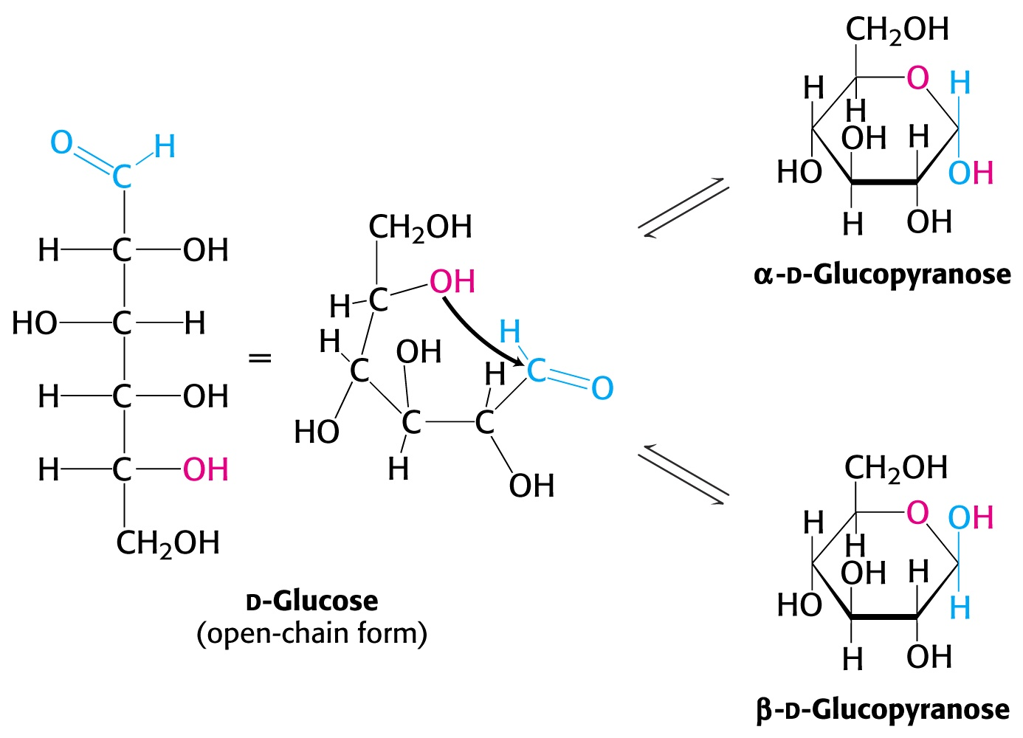
Carbohydrates
Formation of the cyclic structures occurs as a distant hydroxyl group attacks the carbonyl carbon (the “anomeric” carbon atom).
“α”
“anomers”
“β”

Slide 17
Carbohydrates
Ketose sugars are also capable of rearranging their structures into aldoses via tautomerization. These two forms are in equilibrium, with the ketose form being more predominant. For this reason, we sometimes refer to ketoses as “potential aldoses.”

Slide 18
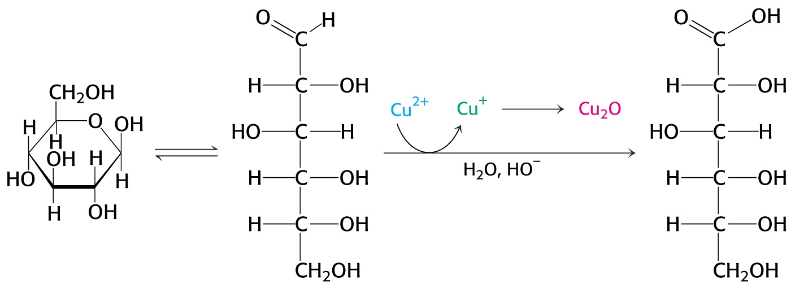
Carbohydrates
Sugars with aldehyde groups (or potential aldehydes) are called “reducing” sugars.
Reducing sugars can reduce Cu²⁺ (blue solution) to Cu¹⁺ (insoluble red precipitate, as Cu₂O). This is the basis for the “Benedicts” test; reducing sugars turn the blue soluble cupric ion (“Fehling’s solution”) into an insoluble brick red precipitate.
Therefore, all sugars capable of forming aldehydic reducing groups are classified as reducing sugars.

Slide 19
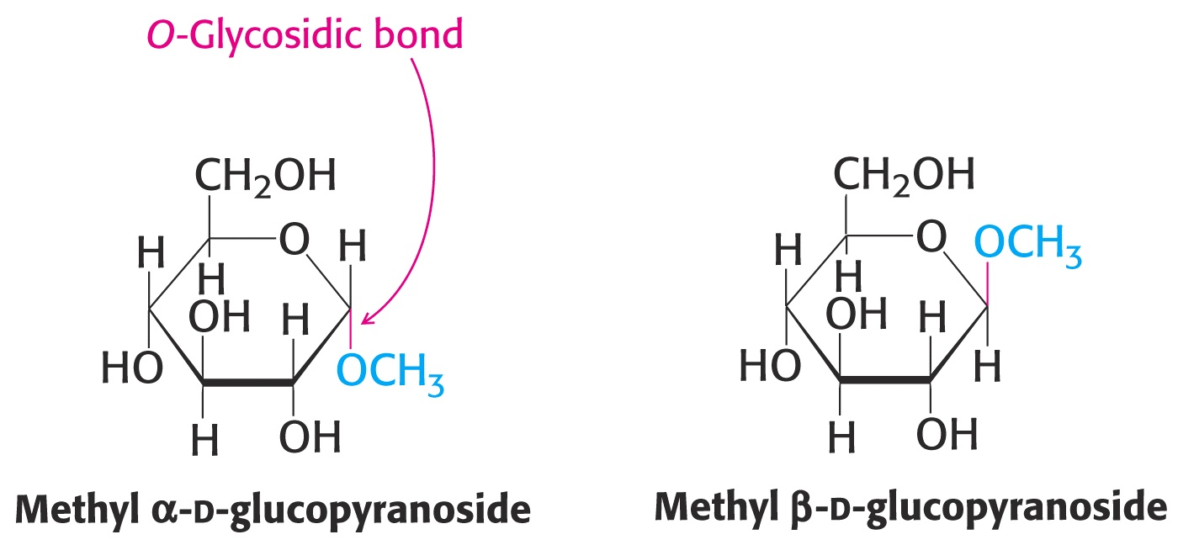
Carbohydrates
If cyclic carbohydrates are locked into their cyclic form, they can not open up to form aldehydic groups, therefore changing their classification to “non-reducing” sugars.
Recall that the hemiacetal linkages (C-O-C-O-H) can open, allowing the ring form to convert into the open chain form. However, full acetal linkages (C-O-C-O-C) are “locked” and can not revert back to their respective aldehydes.

Slide 20
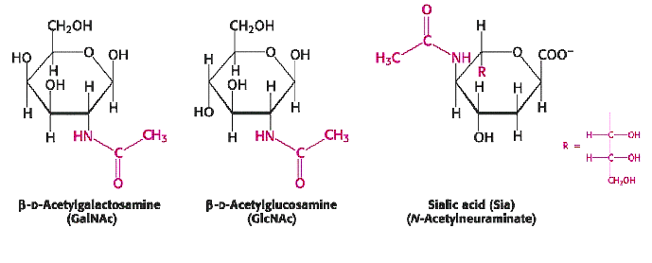
Carbohydrates
As we have seen in the case of the substrate for lysozyme (NAG-NAG), some carbohydrates are modified to contain nitrogen. Other similar derivatives also occur in nature:

Slide 21
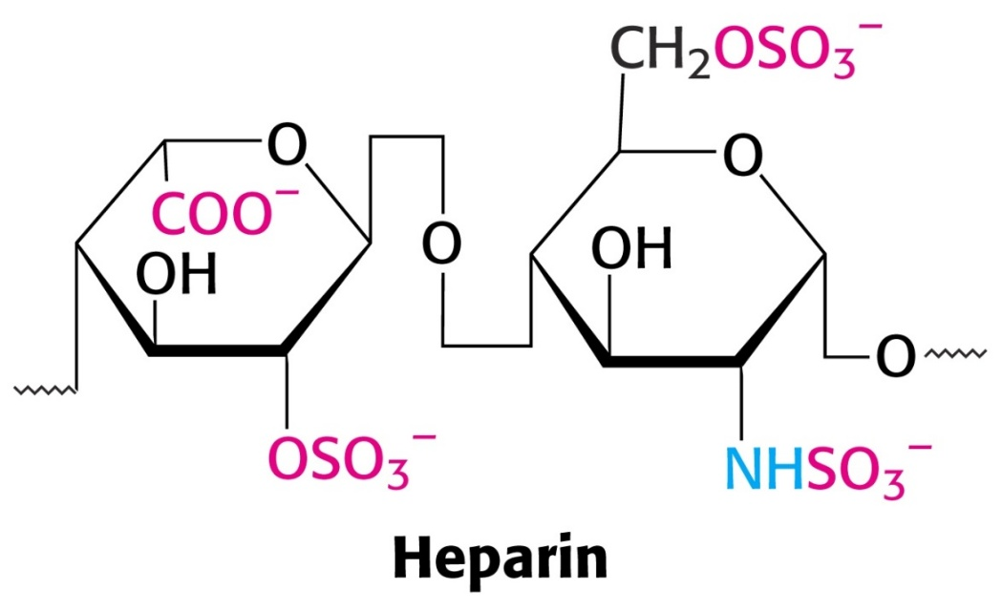
Carbohydrates - Heparin
Heparin is a unique polysaccharide with both nitrogen and sulfate present as part of its structure.
Heparin interferes with thrombin’s conversion of fibrinogen to fibrin, thus acting as a powerful anticoagulant.
Historical Note: In 2008, a major public health crisis occurred when heparin was adulterated with a synthetic contaminant, oversulfated chondroitin sulfate (OSCS), a chemically modified substance that mimics heparin's physical properties. In the United States alone, the FDA reported 81 deaths and hundreds of serious injuries linked to the tainted batches.
The contaminated material was traced back to a manufacturing plant in Changzhou, China after a widespread swine virus in China in 2007 significantly reduced the pig population, which is the primary source of raw heparin.

Slide 22
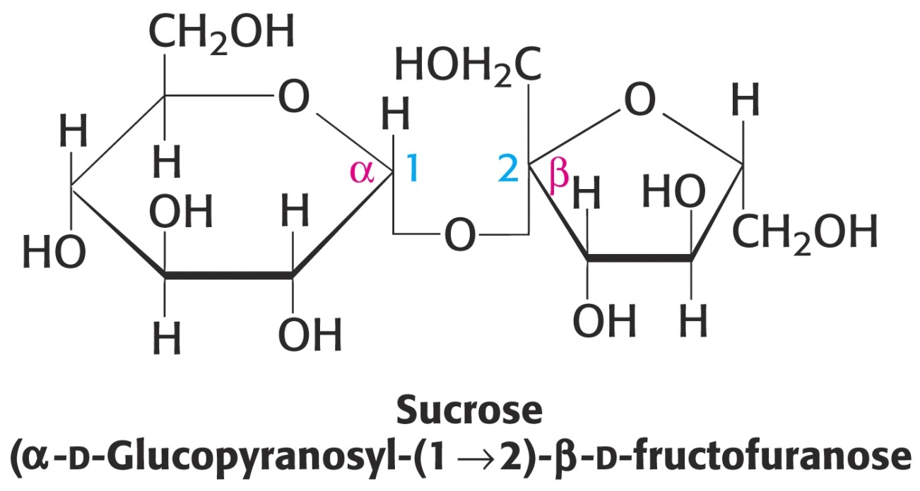
Carbohydrates
By linking simple sugars together, more complex sugars are formed. Consider sucrose (table sugar, in which glucose is linked to fructose in “head-to-head” fashion. This particular glycosidic linkage is an “α(1→2)” linkage:
Question: Is sucrose a “reducing sugar?”

Slide 23
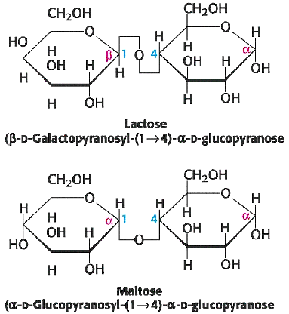
Carbohydrates
Other frequently
encountered dimers
include
  lactose
  (milk sugar):
and
  maltose:
Question: Are either of these disaccharides “reducing sugars?”

Slide 24
Relative Sweet Tastes of Beverage Sweeteners
Relative Sugar Sweetness Scale
(Sucrose = 1)
Lactose | 0.16
Galactose | 0.32
Maltose | 0.33
Glucose | 0.74
Sucrose | 1.00
Invert Sugar | 1.25
Fructose | 1.73
Sodium cyclamate | 30
Aspartame | 180
Saccharin | 450
Sucralose | 600

Slide 25
Carbohydrates
Carbohydrates are classified by the number of monomers contained in their structures:
  Monomeric sugars are called “monosaccharides.”
  Dimers are called “disaccharides.”
  Polymeric carbohydrates are called “polysaccharides.”

Slide 26
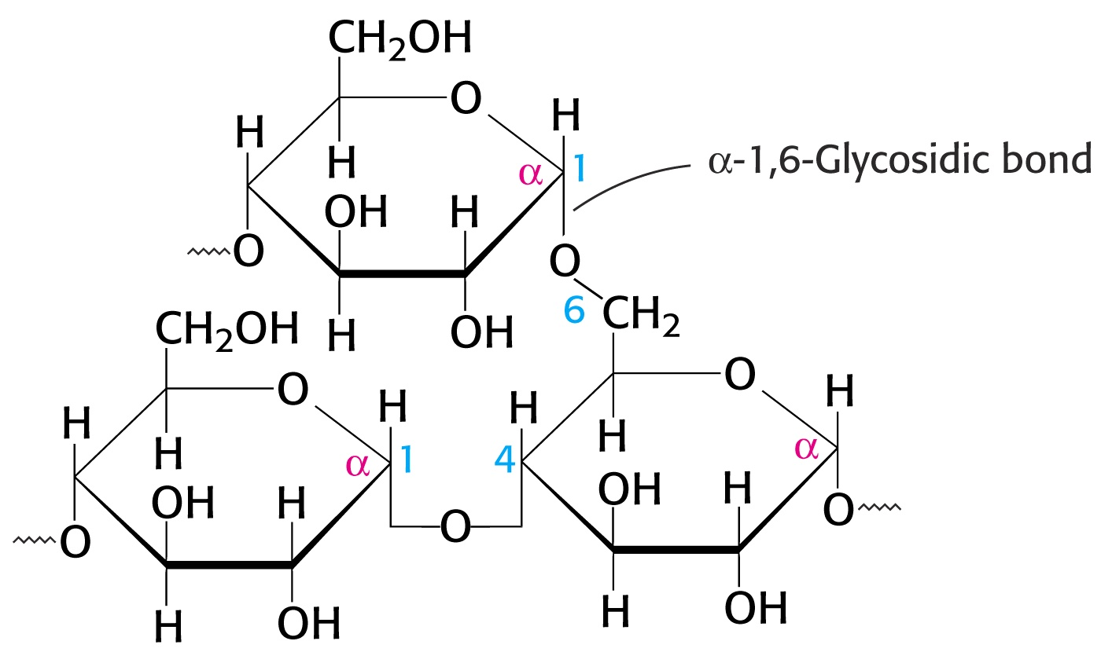
Carbohydrates
The most common polysaccharide in animal cells is glycogen.
Glycogen is a polymer of glucose, containing both α(1→4) and α(1→6) linkages (at “branch points”). Branching occurs about every 10 glucose residues.

Slide 27
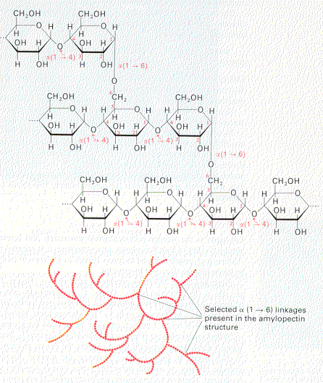
Carbohydrates
Glycogen is a branched polysaccharide.
Due to its polymeric structure formed by acetal linkages, almost all the monomers are “non-reducing.” The one exception is the hemiacetal at the #1 carbon in the first monomer of the polymer.
Hence, glycogen has many “non-reducing ends with only one “reducing end.”

Slide 28
Carbohydrates
Plants also utilize “polyglucose” polysaccharides for energy storage.
Their unbranched, linear polysaccharide is “starch” or “amylose” (contains only α(1→4) linkages).
Their branched polysaccharide is “amylopectin.” While the branch points are formed by α(1→6) linkages, similar to animal glycogen, amylopectin has a lower degree of branching (only about 1 branch per 30 glucose residues.)

Slide 29
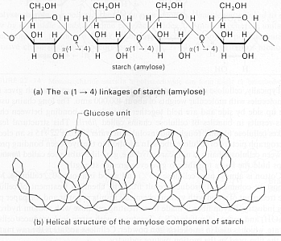
Carbohydrates
Linear starch molecules form helical structures in aqueous solutions.
This helical structure accommodates the molecular iodine molecule (I₂) perfectly into its core, changing its color to dark blue-black.
This color change is often utilized as a “spot test” for the presence of starch, and is the basis for all “starch indicators” used in many common analytical test procedures.

Slide 30
Carbohydrates
When we eat starch, an enzyme in our saliva, amylase, catalyzes the hydrolysis of its α(1→4) bonds.
In the duodenum, a pancreatic amylase also joins in, further catalyzing the hydrolysis of starch’s α(1→4) linkages.
This breaks down the polymer into small chains and eventually into single monomers to facilitate absorption.
Hence, after eating “complex” carbohydrates, release of glucose is a slower, sustained process, resulting in a “time-release” nutritional benefit.

Slide 31
Carbohydrates
The various length polymers formed by the degradation of starch are identified by various names:
starch → dextrins → maltose → glucose
polysaccharide polysaccharide disaccharide monosaccharide
Partially hydrolyzed starches are more soluble than starch and are used in many products:
Mucilage and some pastes contain dextrins (e.g. postage stamps and envelopes)
Mixtures of dextrins and maltose are used in baby foods and infant formulas.

Slide 32
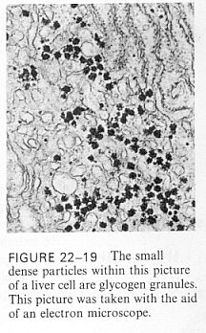
Carbohydrates
Glycogen is an ideal energy storage form for glucose. The large size of these macromolecules prevents them from diffusing out of cells.
Also, storage of glucose in polymeric form reduces osmotic pressure.
Cells would burst if all of
the glucose in glycogen
were present in free form.
Glycogen can become so
concentrated in cells that it
can precipitate or crystallize
into glycogen granules.

Slide 33
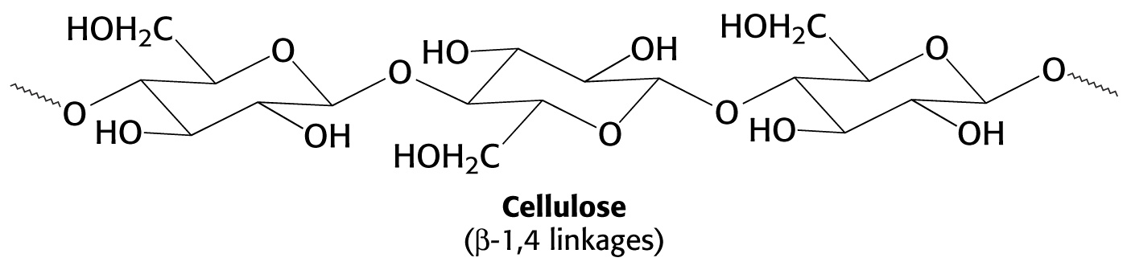
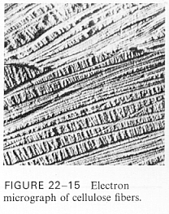
Carbohydrates
Plants also contain cellulose, an unbranched “polyglucose” polysaccharide containing β(1→4) linkages.
While this difference seems trivial, this slight molecular difference makes a huge difference in the physical properties of cellulose. Cellulose exhibits a much higher tensile strength than do starches.

Slide 34
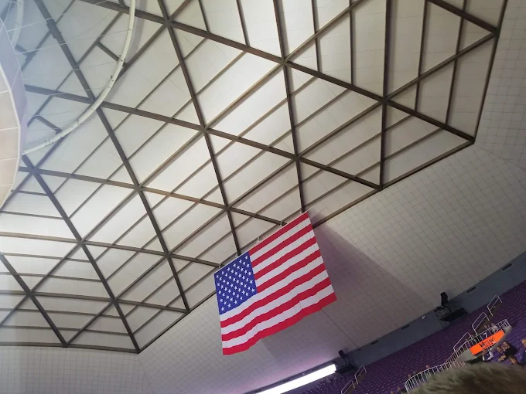
Dee Event Center – Laminated Beams Support Roof

Slide 35
Carbohydrates
Humans can not digest cellulose, since we lack the enzyme to catalyze the hydrolysis of β(1→4) linkages.
What about other animals?
  Can ruminant (grazing) animals digest cellulose?
  Can termites digest cellulose?

Slide 36
Carbohydrates
Animals can not digest cellulose. Ruminant animals and termites both harbor bacteria in their intestines that can digest cellulose, forming a symbiotic relationship: The bacteria secrete enzymes that can hydrolyze β(1→4) linkages. In return, the animal provides them with a warm place to live.
Once the cellulose is hydrolyzed, the animal can absorb the resulting glucose.
Since humans do not digest cellulose, it is often called “fiber” and has no caloric value. However, it contributes to a healthy diet due to its beneficial effects on the gastrointestinal tract.

Slide 37
Carbohydrates
Polymeric carbohydrates are synthesized through the action of glycosyltranferases, special enzymes that form glycosidic bonds.
Many different specialized glycosyltranferases are known, each forming linkages between diverse types of monomeric sugars.

Slide 38
Carbohydrates – Blood Groups
Human blood groups are formed from complex groups of polysaccharides on the surfaces of erythrocytes.
These carbohydrates are attached to glycoproteins and glycolipids on the surfaces of red blood cells where they act as specialized anitgenic determinants.
The three most common blood types (A,B,O) are differentiated by the presence and type of only ONE monosaccharide!

Slide 39
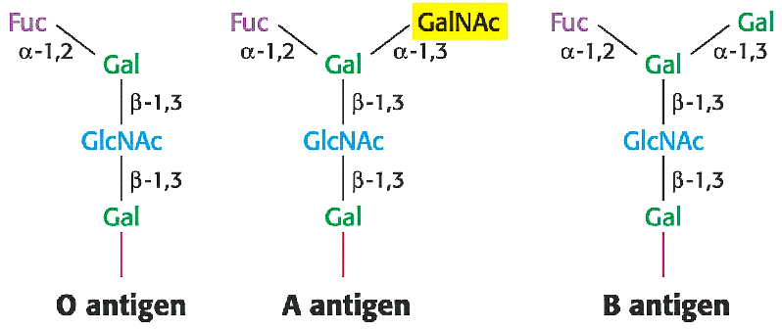
Carbohydrates – ABO Blood Groups
These “ABO” carbohydrate structures have a common oligosaccharide foundation called the “O” antigen.
Type “A” adds N-acetylgalactosamine
Type “B” adds galactose.

Slide 40
Carbohydrates – ABO Blood Groups
Specific glycosyltransferases add the extra monosaccharide to the O antigen.
Each person inherits the gene for one glycosyltransferase of this type from each parent:
A = N-acetylgalactosamine, B = galactose
These two enzymes differ in only 4 of 354 amino acid positions.
The “O” phenotype is the result of a mutation that leads to the premature termination of translation of this enzyme and, hence, to the production of no active glycosyltransferase.

Slide 41
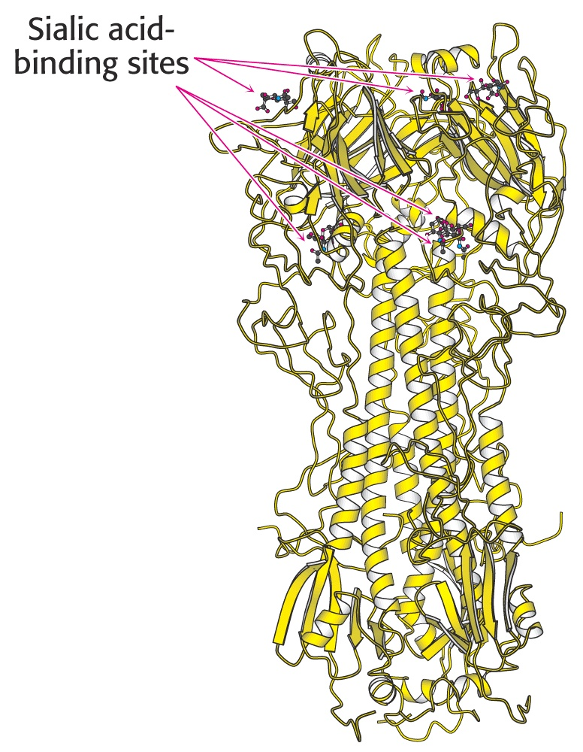
Carbohydrates
Many microorganisms utilize carbohydrate structures on the surface of cells to recognize and subsequently infect host cells.
For example, influenza virus recognizes and binds to sialic acid residues on cell-surface proteins of its host as the initial event leading to infection.

Slide 42
End of Lecture Slides
for
Carbohydrates
Credits: Many of the diagrams used in these slides were taken from Stryer, et.al, Biochemistry, 10th Edition, Freeman Press (in our course textbook) and from prior editions of this text.

