Slide 1
Amino Acids & Proteins
Biochemistry 3070

Slide 2
Proteins are linear copolymers built from monomeric units called amino acids.
Twenty amino acids are commonly found in proteins.
These amino acids contain a variety of different functional groups:
Alcohols (R-OH)
Phenols (Ph-OH)
Carboxylic acids (R-COOH)
Thiols (R-SH)
Amines (R-NH₂)
and others…

Slide 3
Protein function depends on both
amino acid content, and
amino acid sequence.
Protein fold into diverse shapes such as
spherical
elipsoidal
long strands, etc.
All information for 3-D structure is contained in the linear sequence of amino acids.

Slide 4
To understand protein function, we must first understand the nature of amino acids.
Amino acids are essentially α-amino acids:
alpha carbon (IUPAC #2 position)
H₂N – C – COOH
|
R
When R is not H, the alpha carbon
is asymetric, giving rise to isomers.

Slide 5
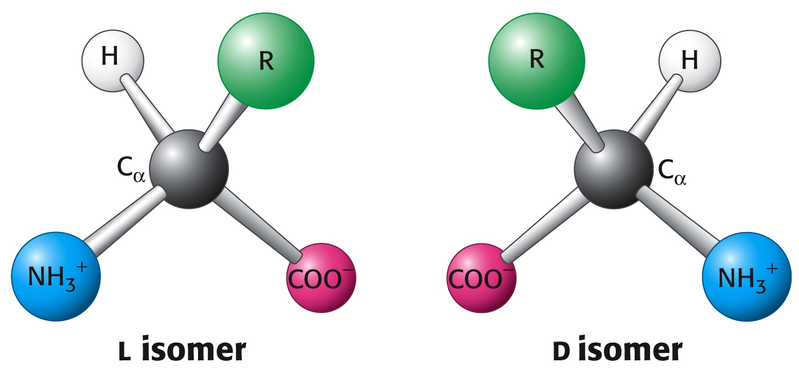
Only L-amino acids are constituents of proteins. “L” and “D” isomeric nomenclature is similar to the “R” and “S” utilized in modern organic chemistry.

Slide 6
Carboxylic acids are traditional Bronsted-Lowery acids, donating a proton in aqueous solution.
The pKa for caroboxylic acids is normally around 2 to 5. That is, the pH at which these acids are 50% ionized:
R-COOH → R-COO⁻ + H⁺
pH= [less than 2] → [above 5]

Slide 7
Amino groups function as bases, accepting a proton.
The pKa for amino groups is usually around 9 – 10. Again, at the pKa these groups are 50% ionized:
R-NH₃⁺ → R-NH₂ + H⁺
pH= [below 8] → [above 9]

Slide 8
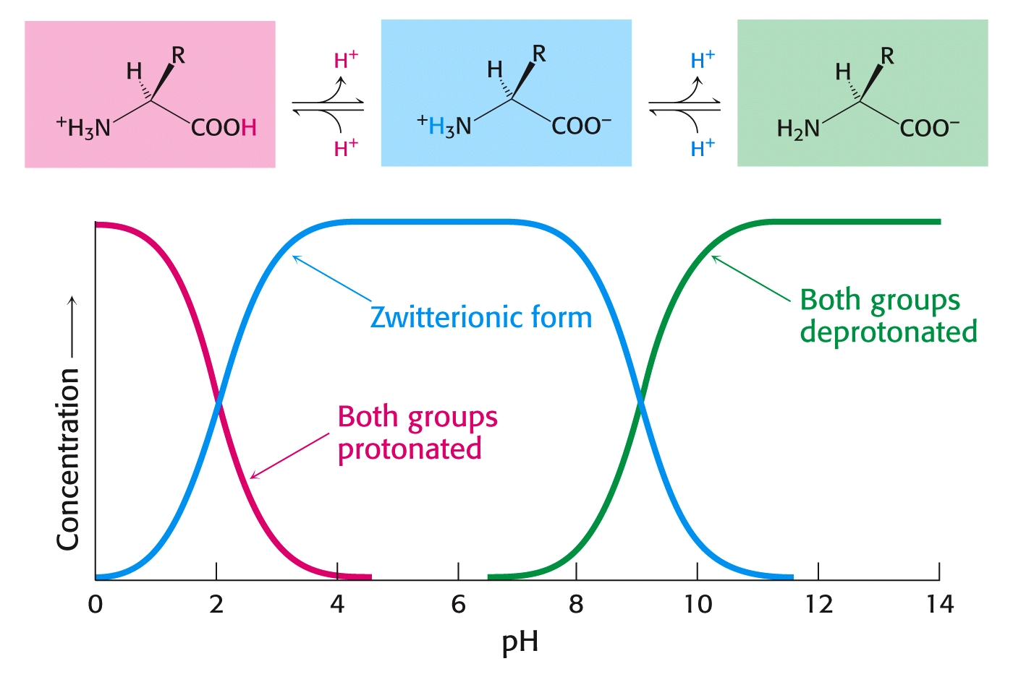
Even though both acids and amines are present in the same molecule, they mostly behave as though they were separate entities:

Slide 9
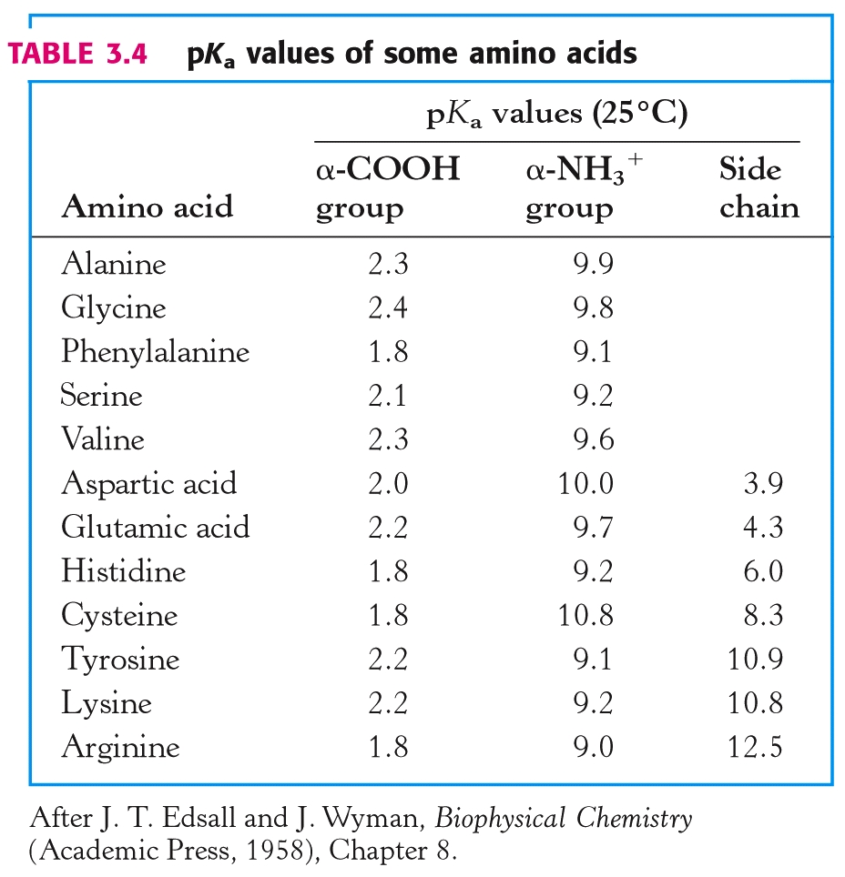

Slide 10
Summary:
At low pH, proton concentration [H+]is high. Therefore, both amines and carboxylic acids are protonated. (-NH₃⁺ & -COOH)
At high pH, proton concentration is low. Therefore, both amines and carboxylic acids are deprotonated. (-NH₂ & -COO⁻)
At neutral pH, amines are protonated(-NH₃⁺) and carboxylates are deprotonated(-COO⁻)

Slide 11
“Zwitter” Ions:
Ions bearing two charges were named zwitter ions by German scientists; the name still applies today, especially for amino acids at neutral pH:
⁺H₃N – CH₂ – COO⁻

Slide 12
Acid-Base Properties of Amino Acids
Draw the following chemical structures for glycine:
(Non-existent form:) H₂N – CH₂ - COOH
pH=1:
pH=7:
pH=12:

Slide 13
Acid-Base Properties of Amino Acids
Draw the following chemical structures for glycine:
(Non-existent form:) H₂N – CH₂ - COOH
pH=1: ⁺H₃N – CH₂ - COOH
pH=7:
pH=12:

Slide 14
Acid-Base Properties of Amino Acids
Draw the following chemical structures for glycine:
(Non-existent form:) H₂N – CH₂ - COOH
pH=1: ⁺H₃N – CH₂ - COOH
pH=7: ⁺H₃N – CH₂ – COO⁻
pH=12:

Slide 15
Acid-Base Properties of Amino Acids
Draw the following chemical structures for glycine:
(Non-existent form:) H₂N – CH₂ - COOH
pH=1: ⁺H₃N – CH₂ - COOH
pH=7: ⁺H₃N – CH₂ – COO⁻
pH=12: H₂N – CH₂ – COO⁻

Slide 16
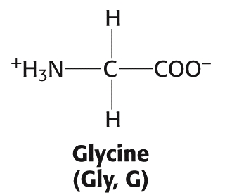
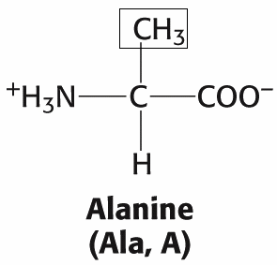
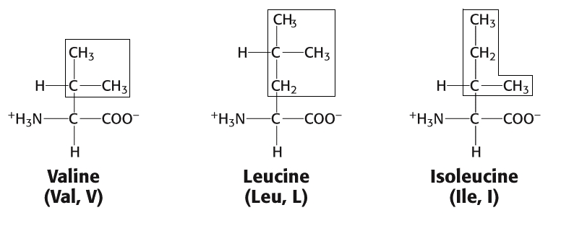
Amino acids: (Aliphatic)

Slide 17
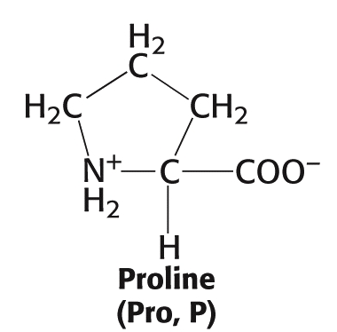
Amino acid Proline
(The only secondary (2°) amino acid or (“imino” acid.)

Slide 18
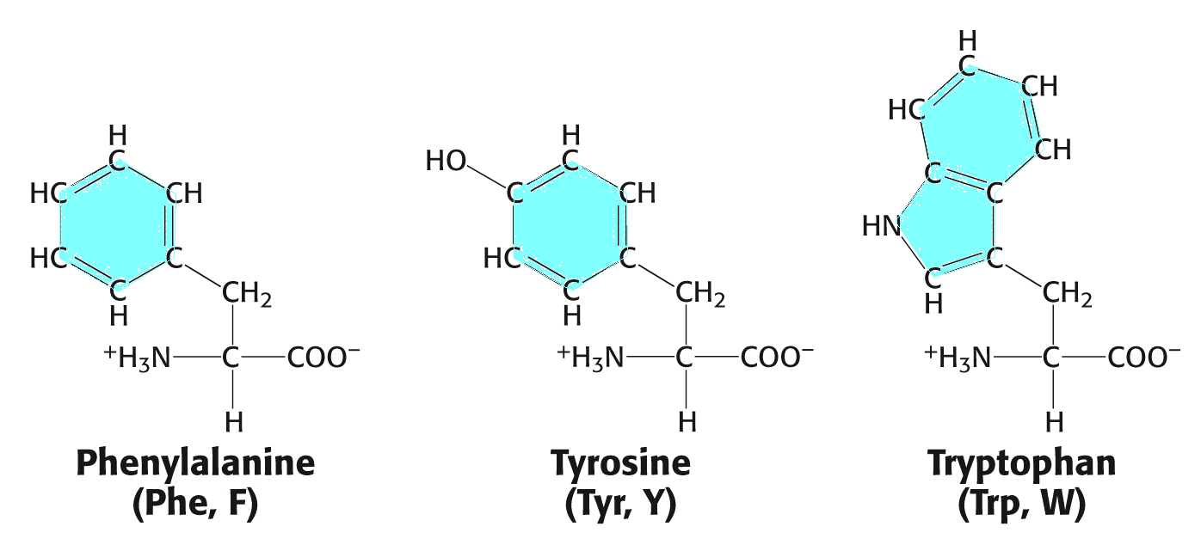
Amino acids (Aromatic)

Slide 19
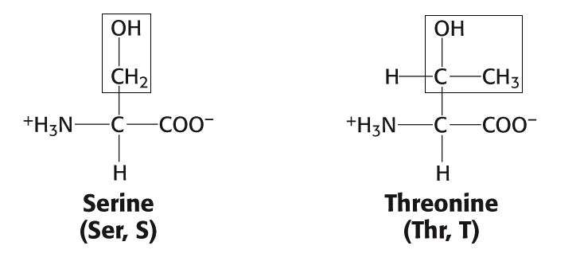
Amino acids (Alcohols)

Slide 20
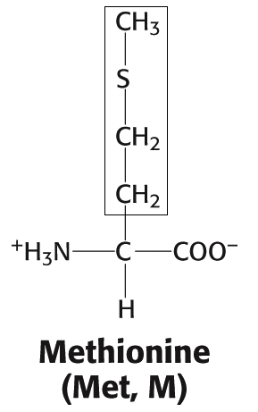
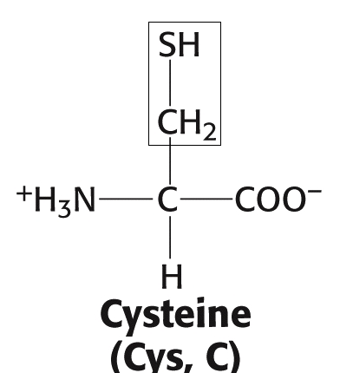
Amino acids (Sulfur)

Slide 21
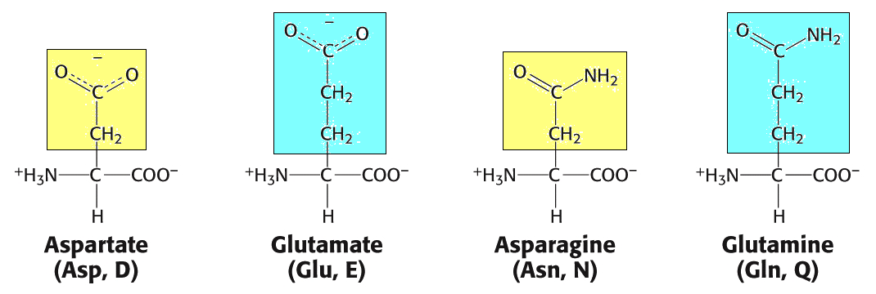
Amino acids (Acids and related amides)

Slide 22
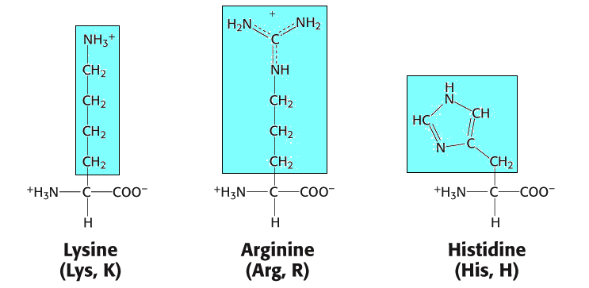
Amino acids (Basic)

Slide 23
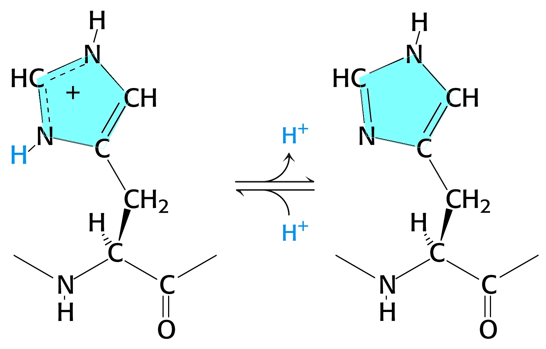
Histidine (Acid/Base Activity)

Slide 24
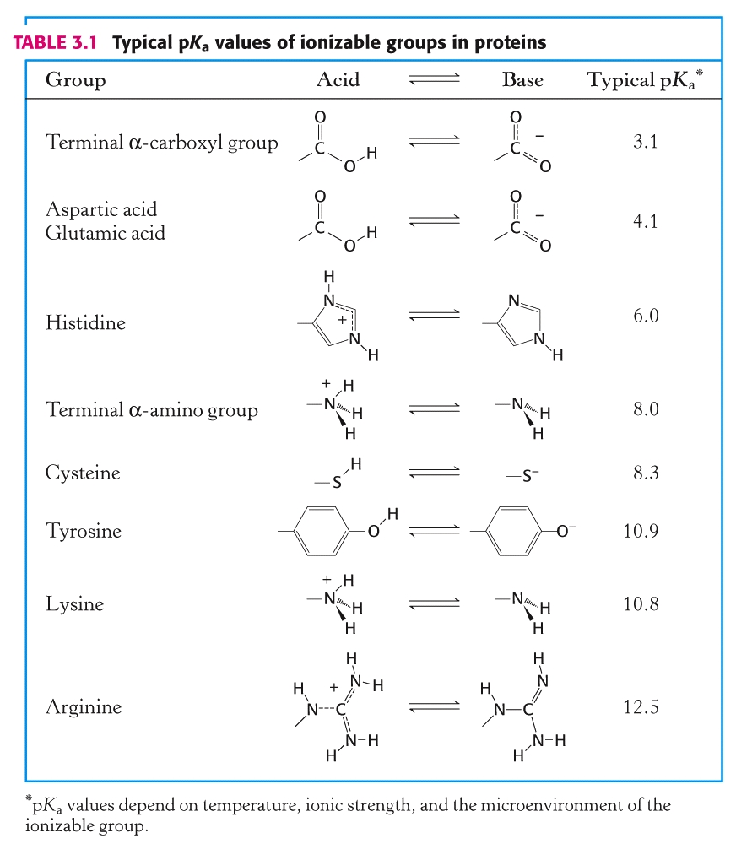

Slide 25
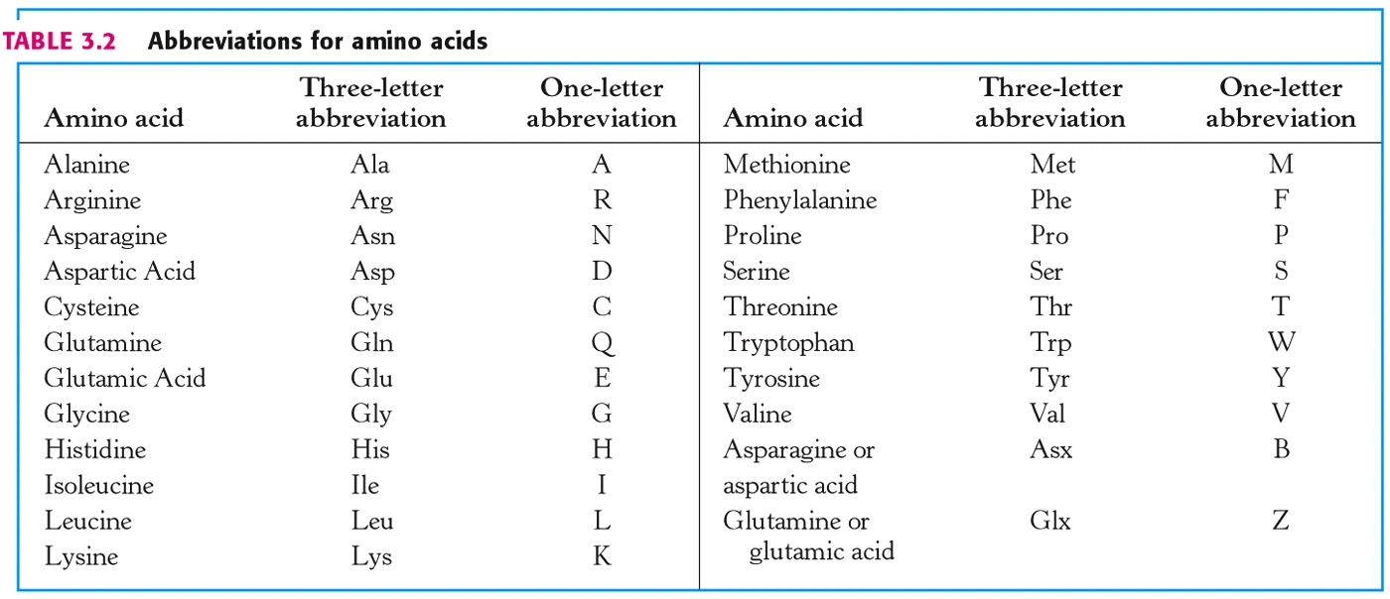

Slide 26
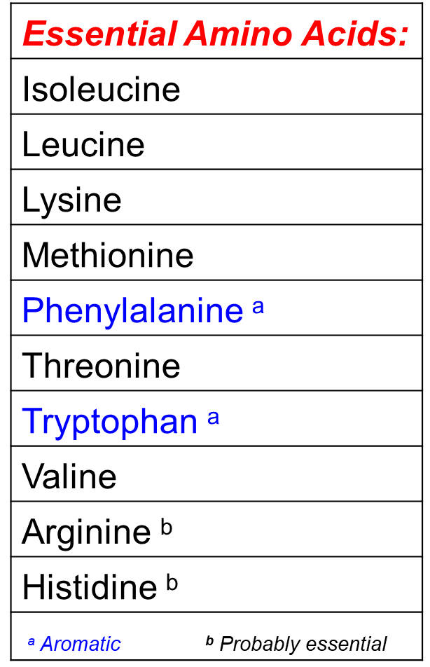

Slide 27
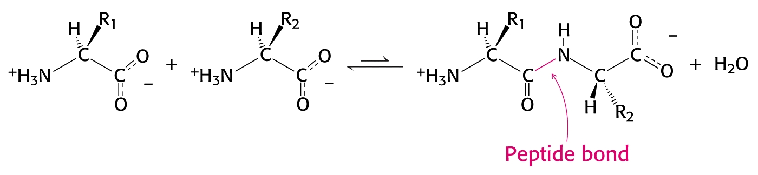
Amino acids are polymerized via amide or “peptide” bonds:

Slide 28
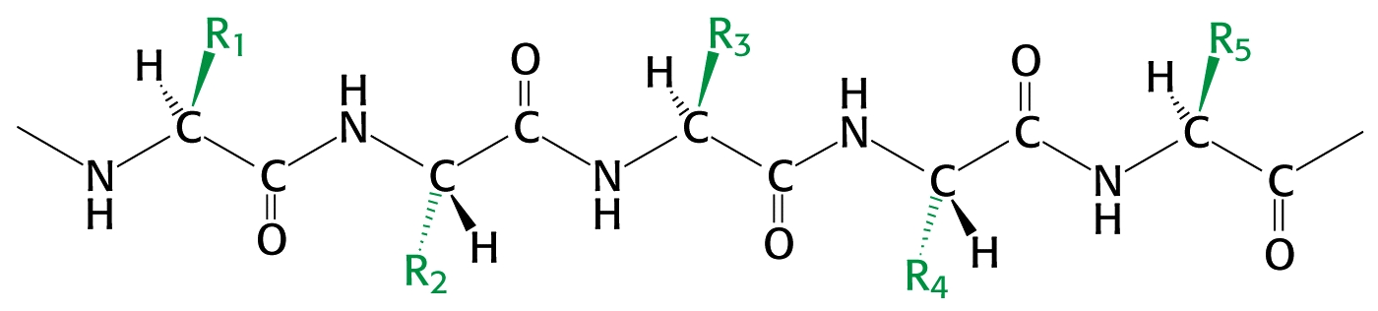
Copolymer of amino acids:
– a “polypeptide”
Definition:
Amino acid polymers of ≤50 amino acids are called
“polypeptides, peptides, oligopeptides, etc.”
Amino acids polymer of >50 amino acids are called “proteins.”

Slide 29
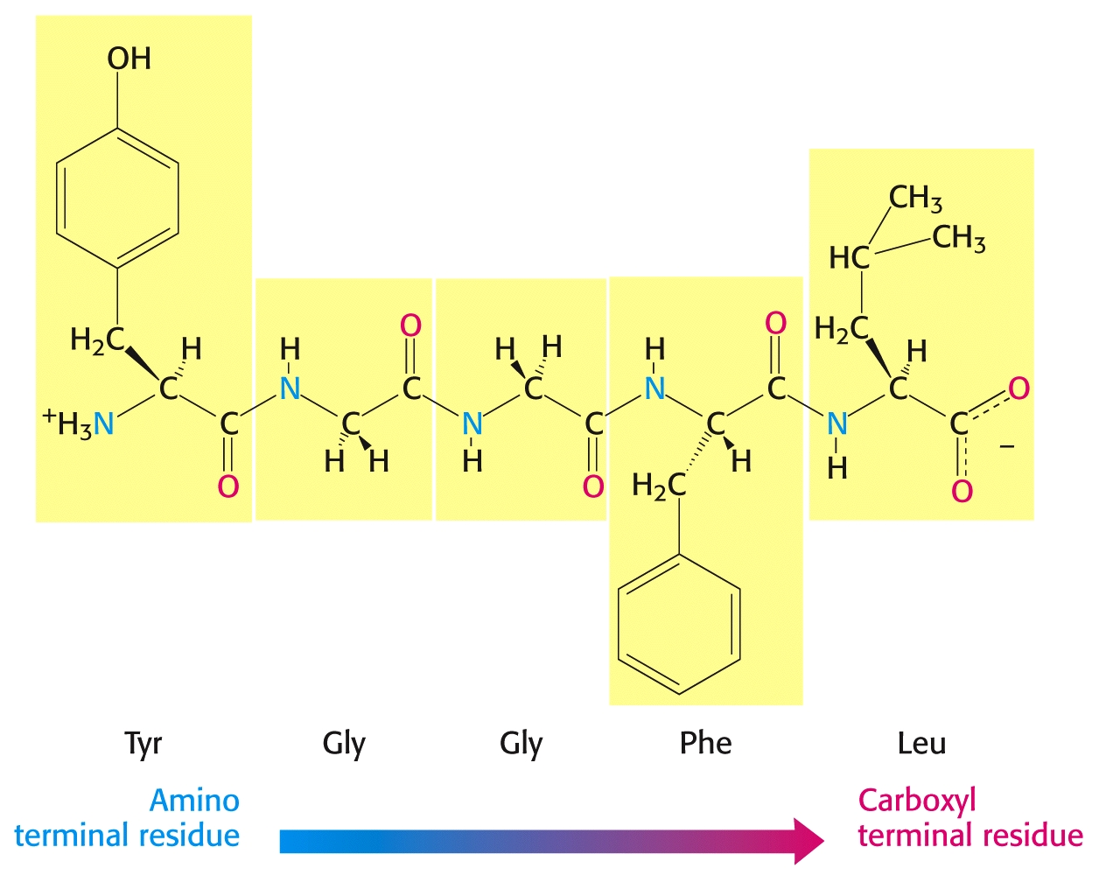

Slide 30
An example of a “dipeptide” is the sweetener Aspartame.
Other names include:
NutraSweet
Equal
Tri-Sweet
Sanecta
IUPAC Name:
“N-L- α – Aspartyl-L-phenylalanine 1-methyl ester”
Abbreviated Structure:
Asp – Phe - OCH₃

Slide 31
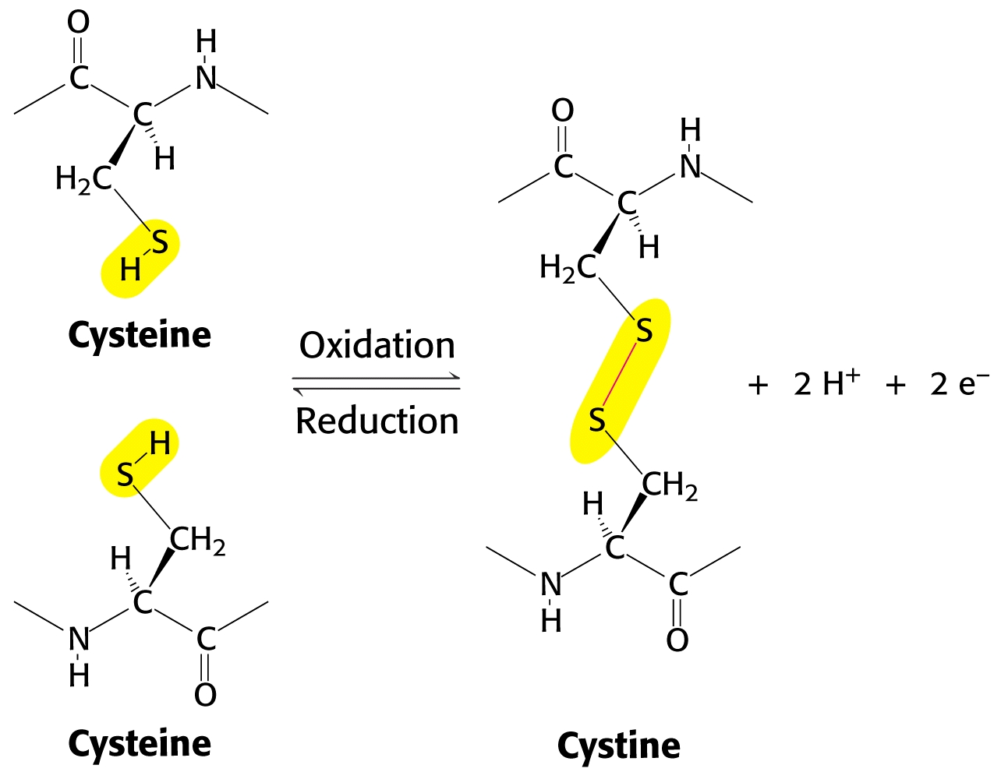
Cross links between peptide chains:
Disulfide linkages between individual “cysteines” are called “cystines:”

Slide 32
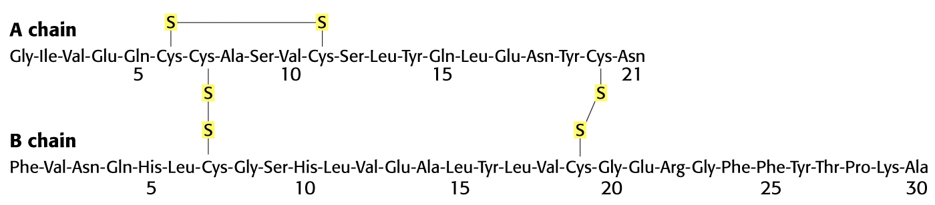
Insulin is the smallest protein, with 51 amino acids in two chains linked by cystine (disulfide) cross links:

Slide 33
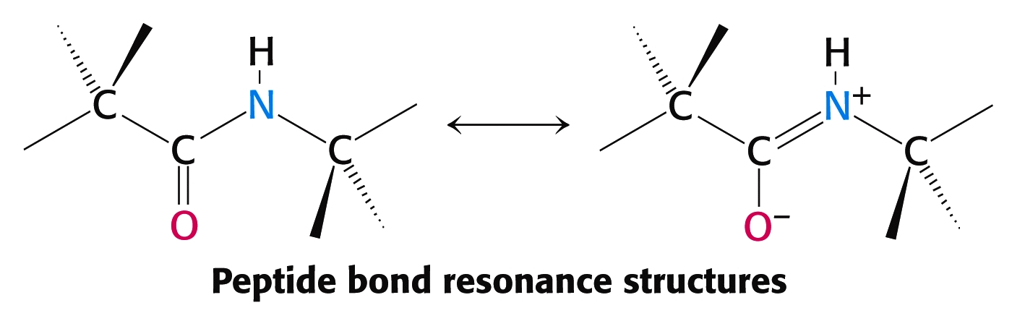
Peptide bonds have partial double bond character due to resonance that limits rotation about this bond:

Slide 34
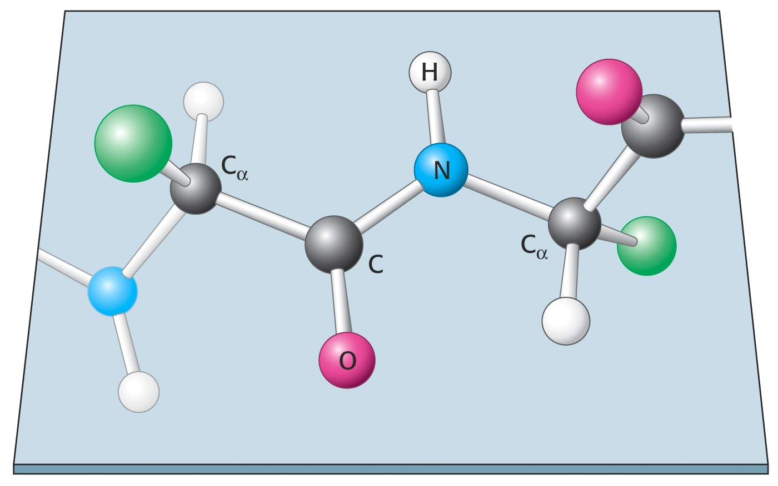

Slide 35
Levels of Protein Structure
Primary (1°) Protein Structure
linear sequence of amino acids.
Secondary (2°) Protein Structure
localized regional structures
Teritary (3°) Protein Structure
overal shape of proteins
Quaternary (4°) Protein Structure
interactions between proteins

Slide 36
Protein Structure:
Twisting about various bonds in the polypeptide backbone gives proteins a variety of shapes.
Bond angles give rise to secondary structures. Then, localized secondary structures help drive the peptide folding that gives rise to tertiary structure.

Slide 37
Secondary Structure in Proteins:
Pauling and Corey proposed two secondary structures in proteins many years before they were actually proven:
alpha – helix beta - sheet
Both of these secondary protein structures are stabilized by hydrogen bonding between the carbonyl oxygen atoms and the nitrogen atoms of amino acids in the protein chain.

Slide 38
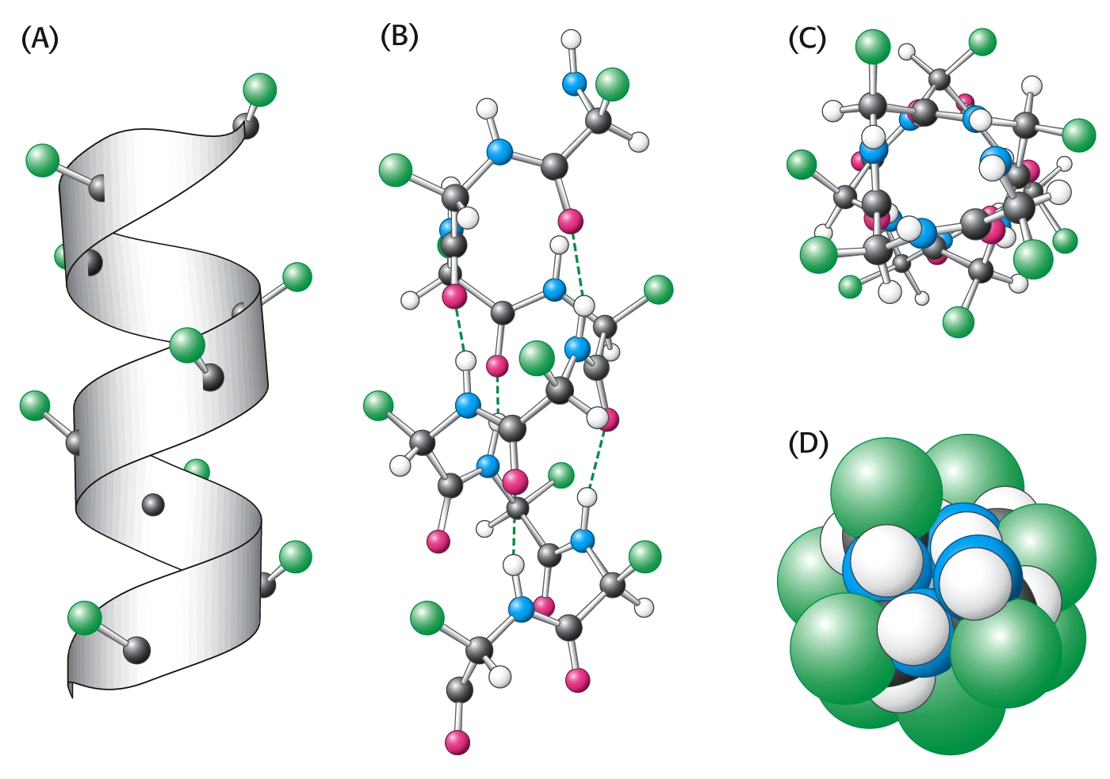
The alpha (α) – helix:

Slide 39
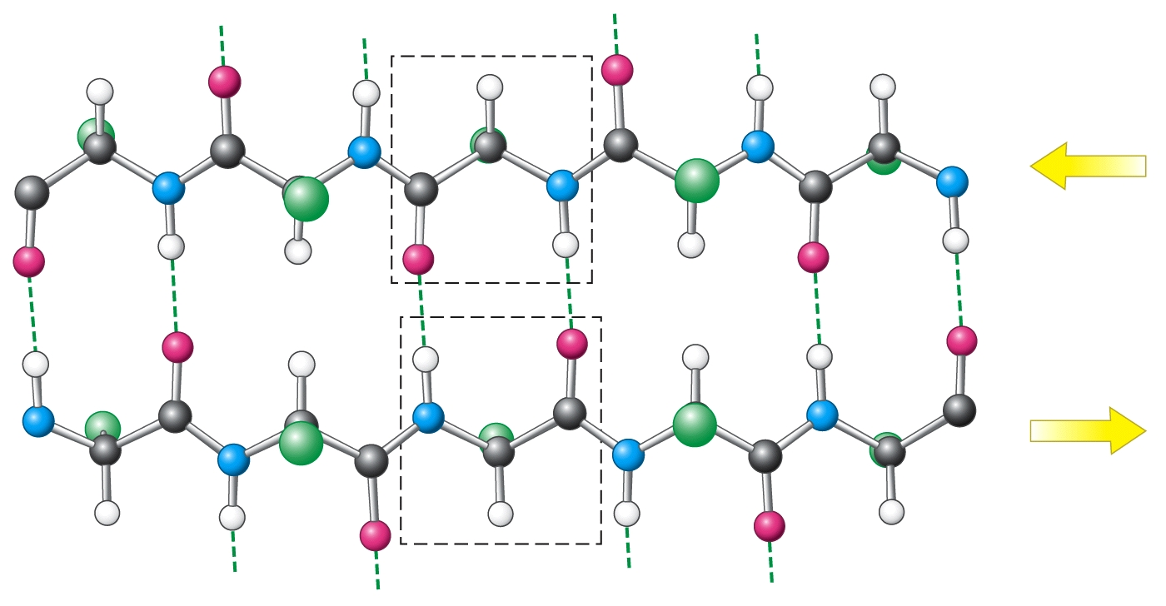
beta – sheet (antiparallel):

Slide 40
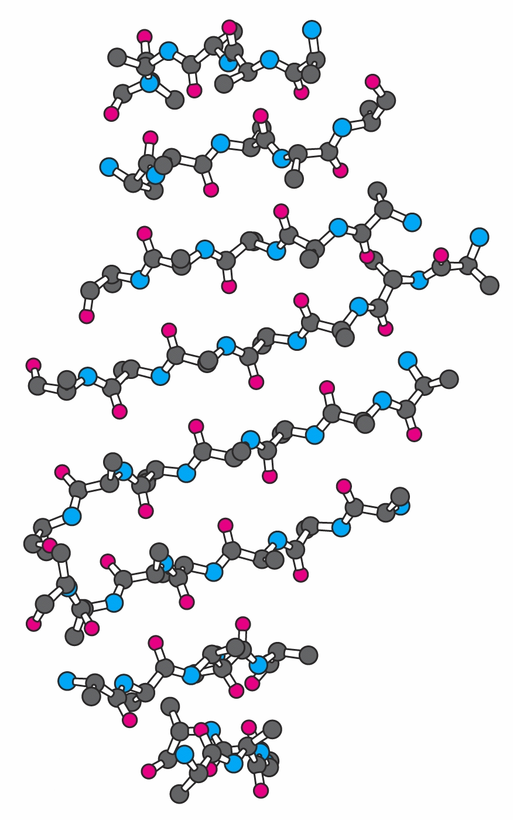
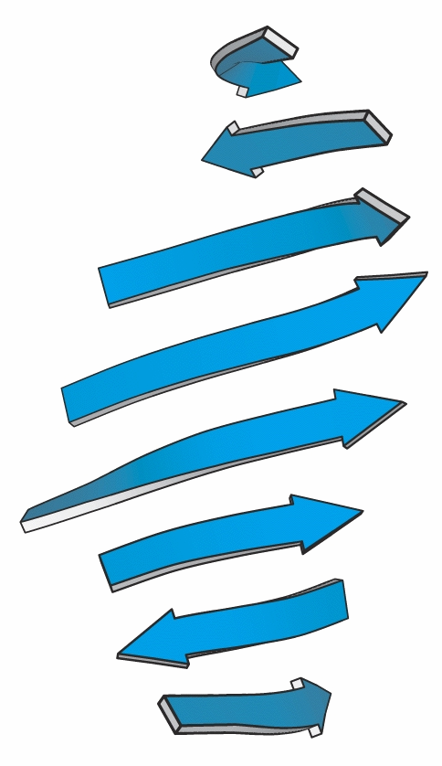
beta – sheet (artistic representations):

Slide 41
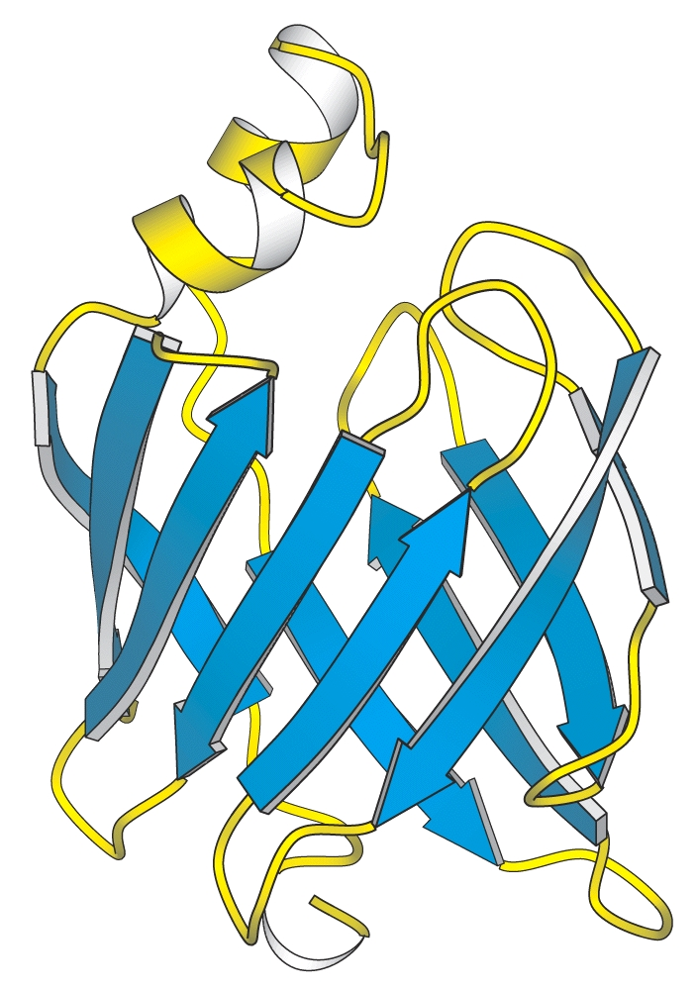
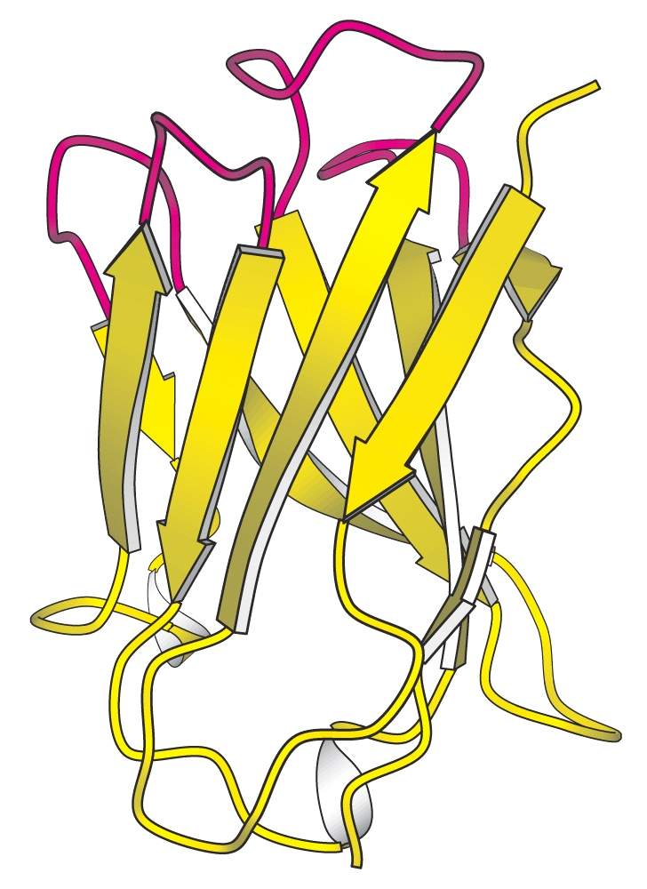
Examples of beta-sheet domains in proteins:

Slide 42
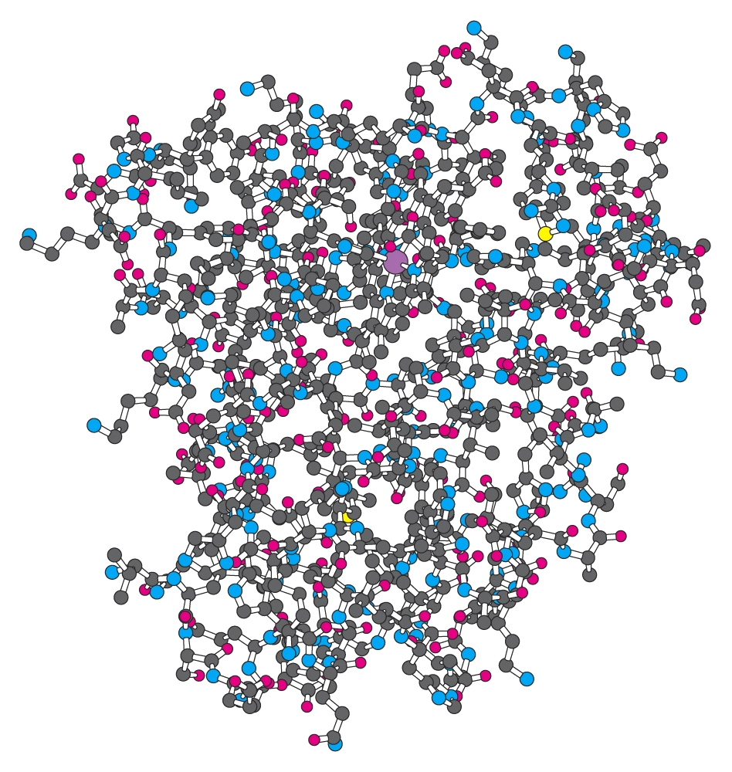
Tertiary (3°) Structure of Protein
Water-soluble proteins fold into compact structures with nonpolar cores.

Slide 43
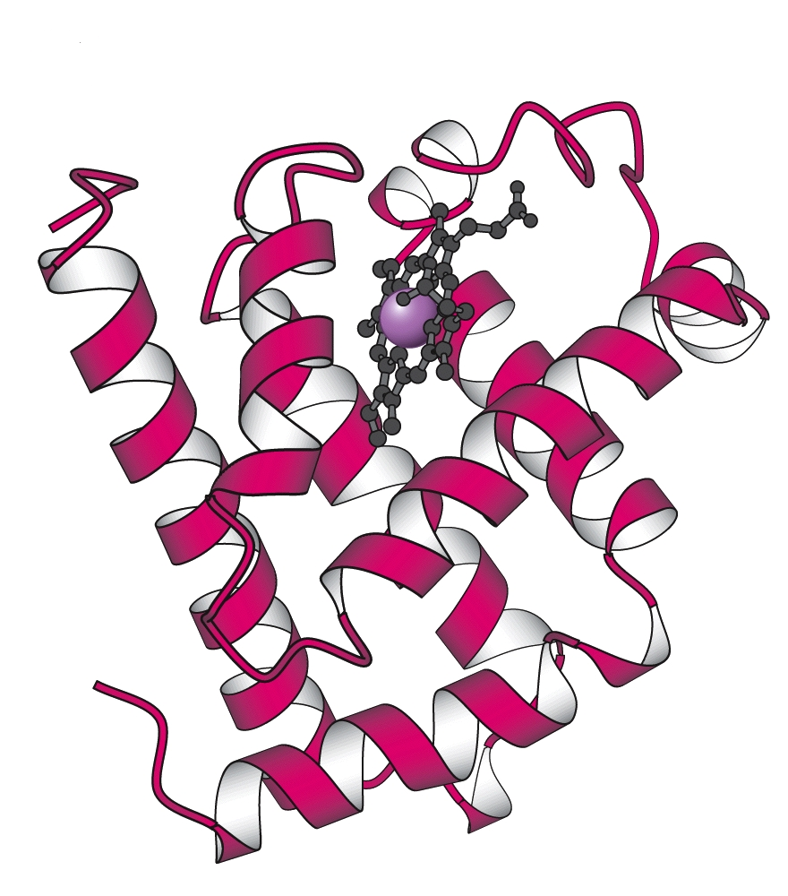
Tertiary (3°) Structure the Protein Myoglobin
Water-soluble proteins fold into compact structures with non-polar cores.

Slide 44
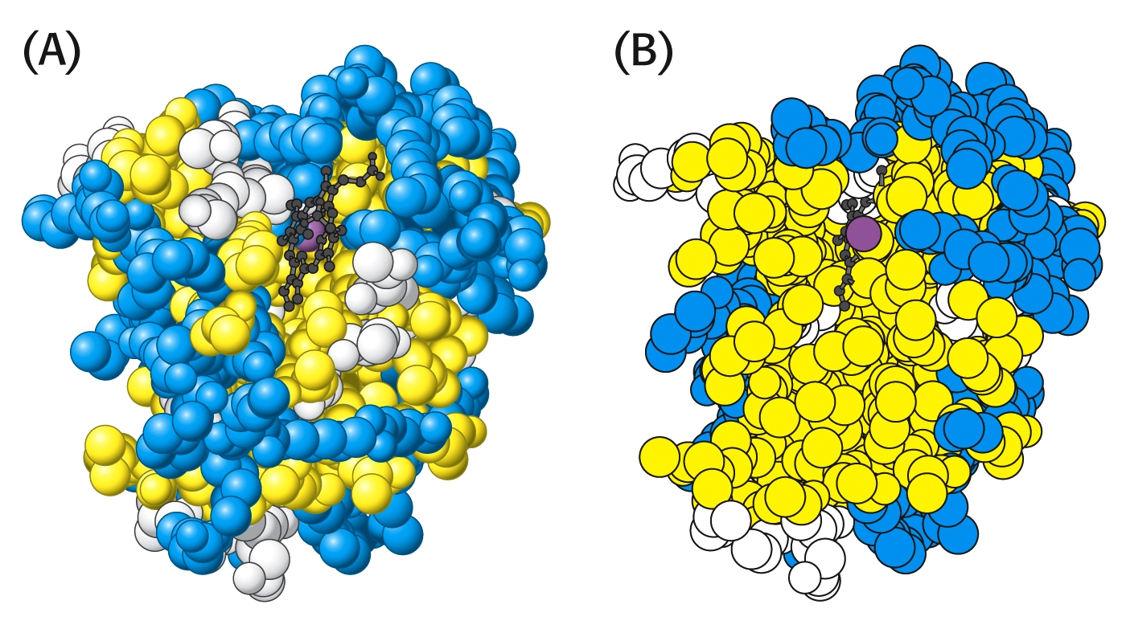
In the case of myoglobin and many other proteins, the majority of hydrophobic amino acids (yellow) are found inside in structure:

Slide 45
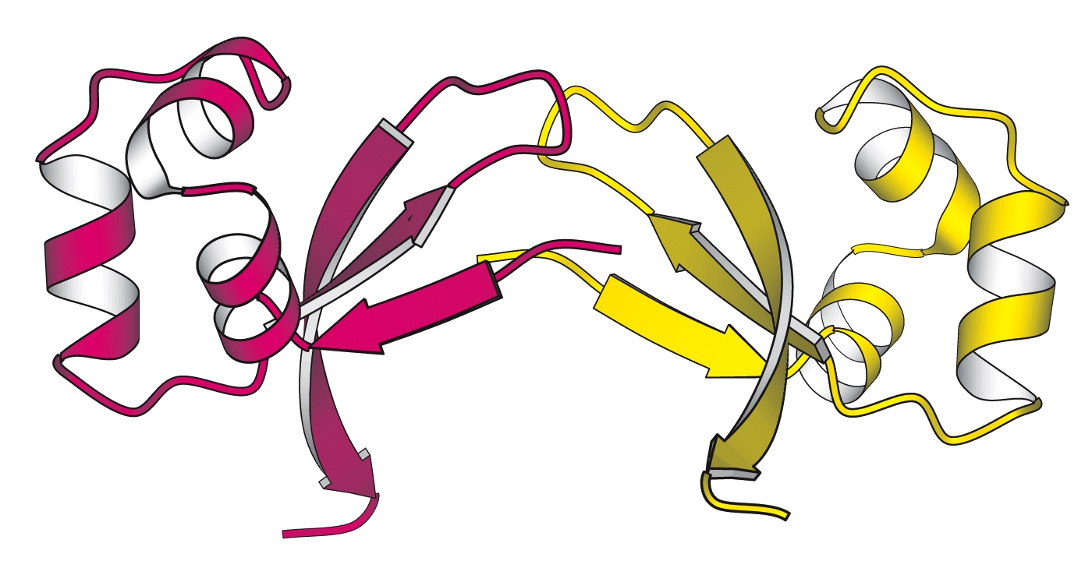
The Cro protein of Lambda bacteriophage is a dimer of identical subunits:

Slide 46
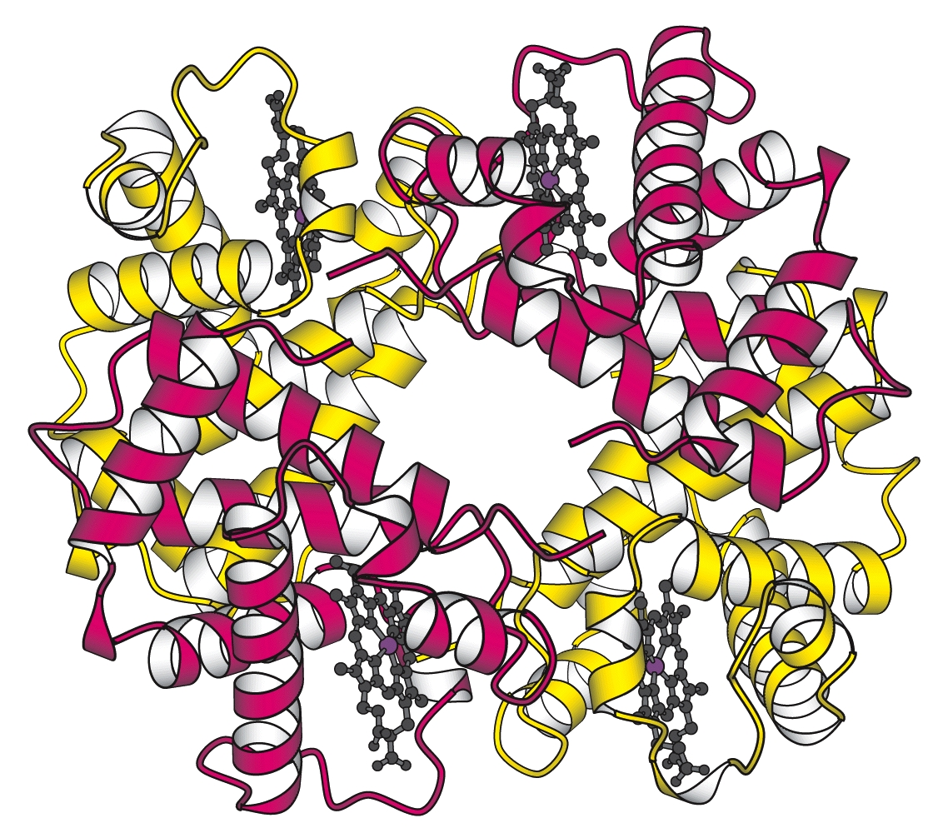
Hemoglobin is a protein tetramer, containing two identical pairs of subunits:

Slide 47
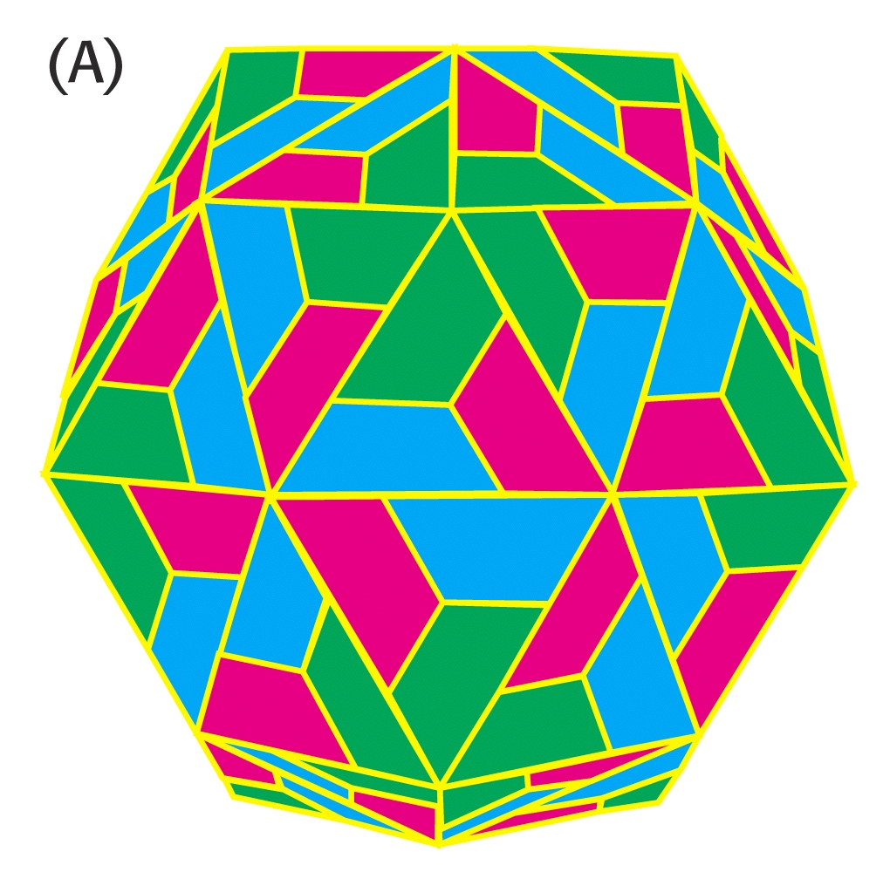
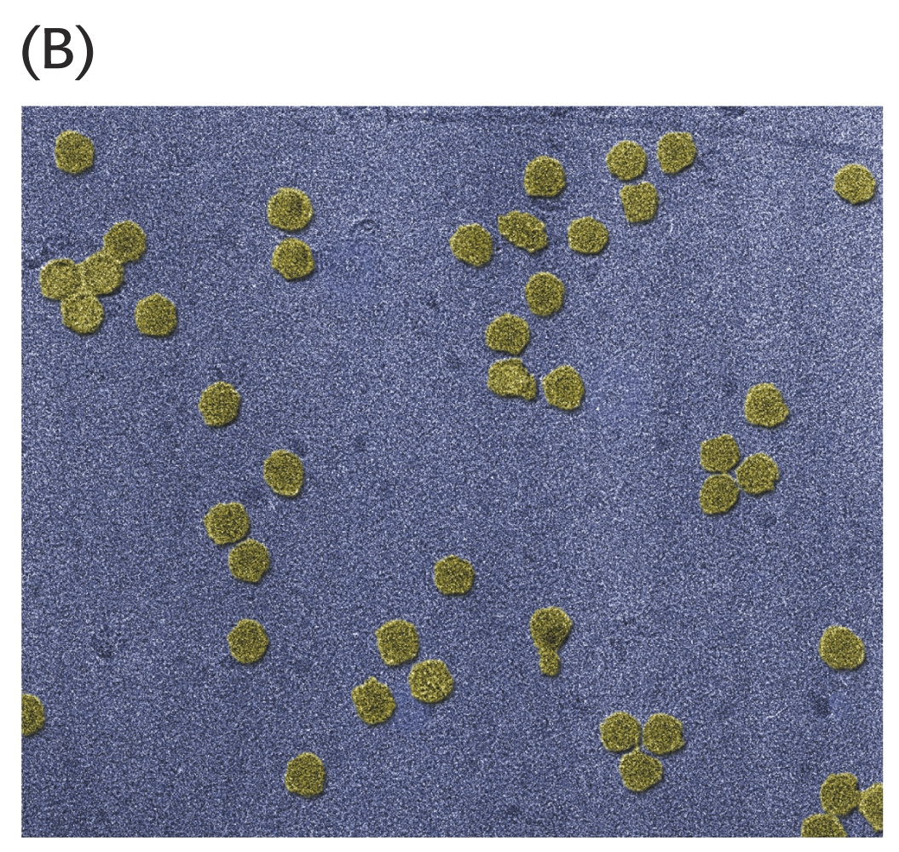
The coat of rhinovirus contains 60 copies of each of four subunits (240 total)!

Slide 48
How Do Proteins Form 3° Structure?
In 1961 Christian Anfinsen published a classic landmark work that clearly showed tertiary structure was determined by primary structure!
His experiment was a classic example of well-designed experiments that did not require expensive equipment or years of work.
Received the Nobel for Chemistry in1972
It deserves our attention.

Slide 49
Anfinson chose the enzyme, ribonuclease, for his experiments. This enzyme hydrolyzes RNA and is composed of a single polypeptide chain with 124 amino acids.
Four disulfide (cystine) linkages are observed in the active enzyme that stabilize the 3-D (3°) shape of the enzyme.
The enzyme functions only when its 3° structure is properly aligned.

Slide 50
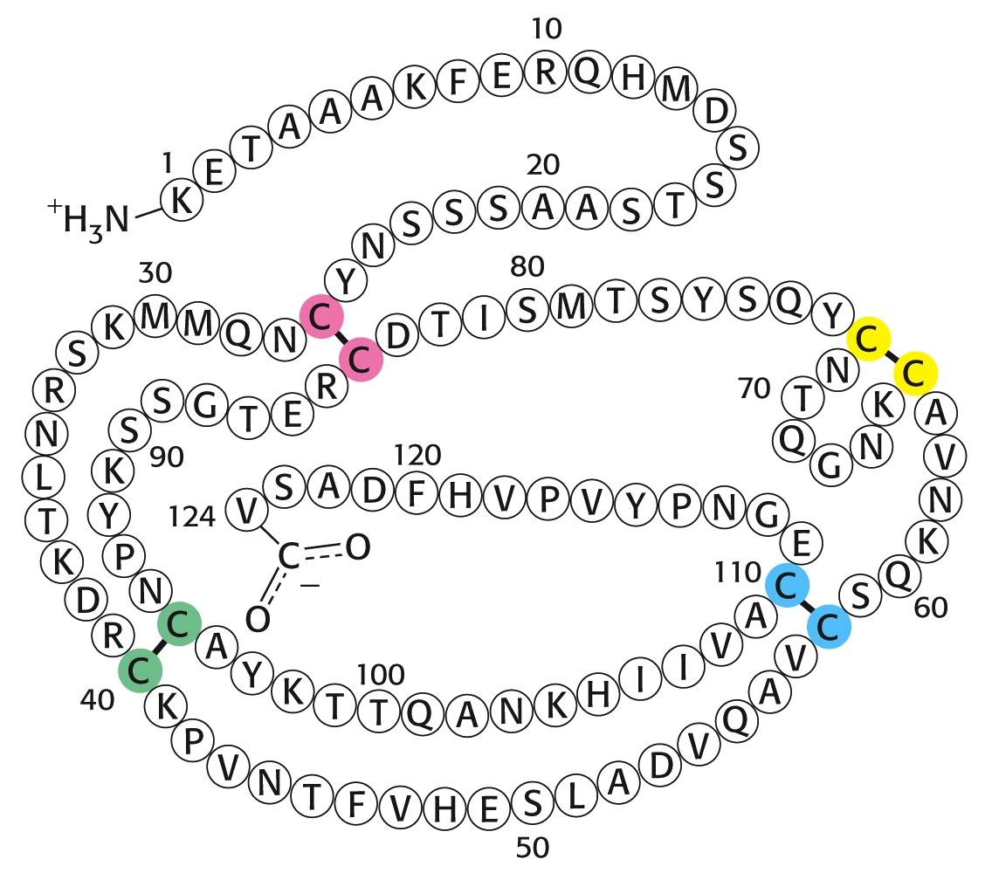
Amino acid sequence of ribonuclease:

Slide 51
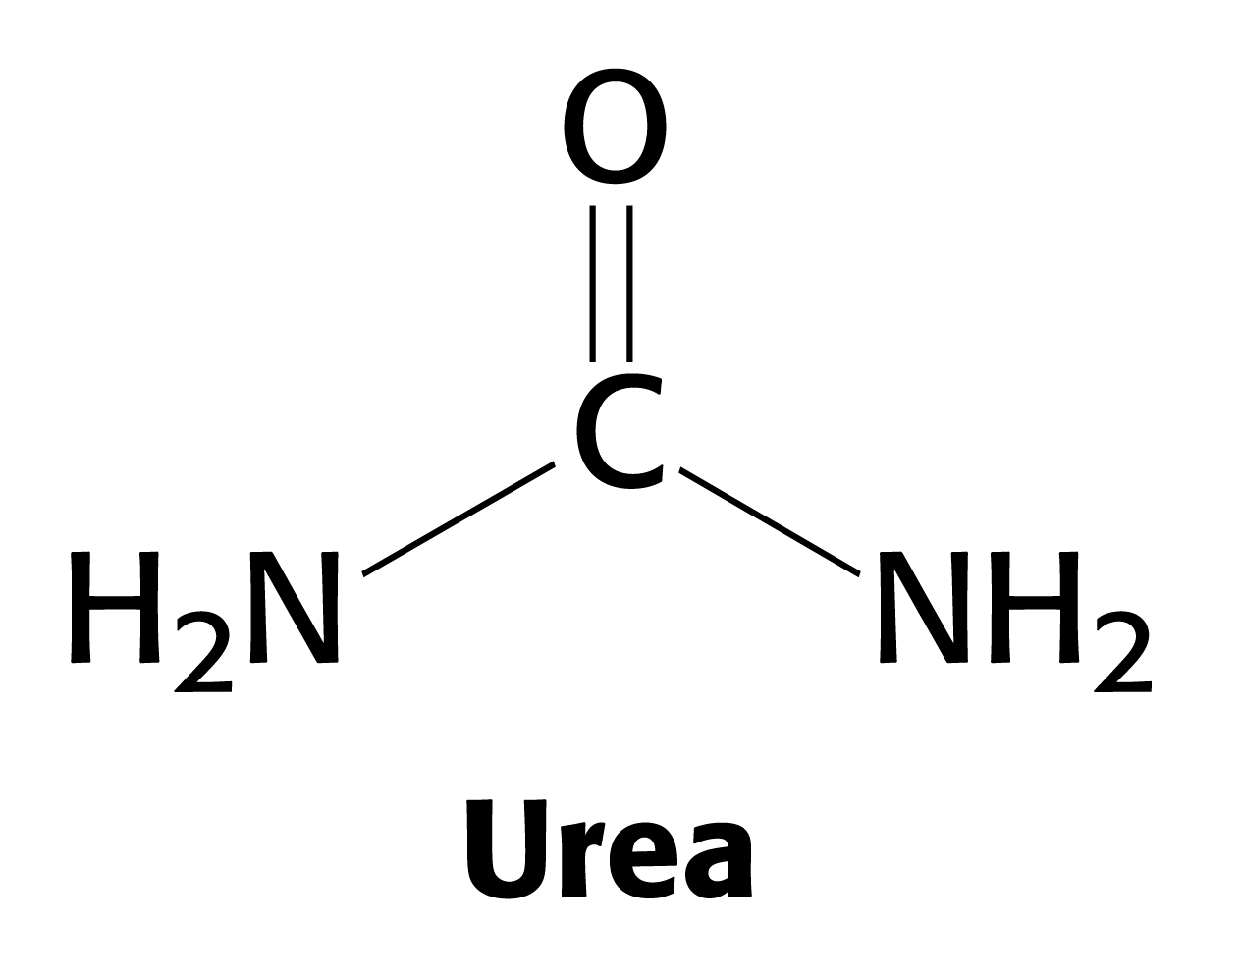
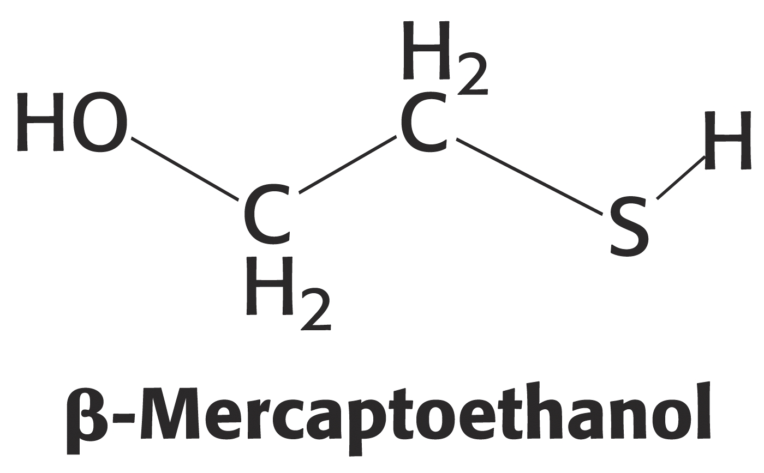
Anfinson used two chemicals to disrupt the enzyme’s 3° structure [DENATURATION ]
urea - disrupts hydrogen bonds
β-mercaptoethanol – reduces disulfide bonds

Slide 52
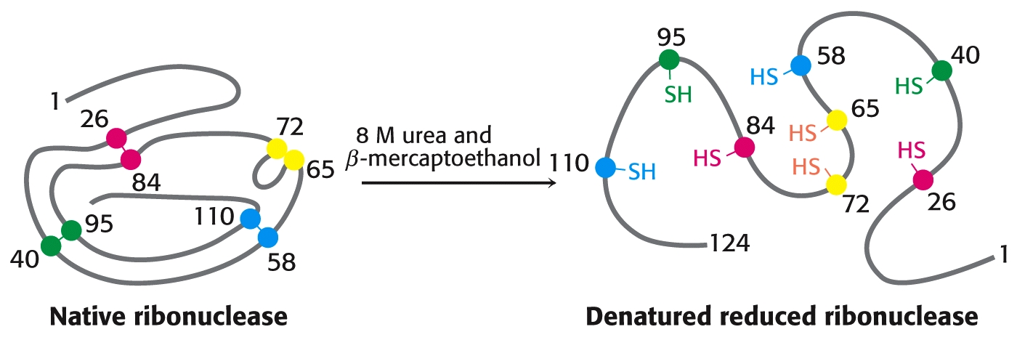
Anfinson’s Experiment:

Slide 53
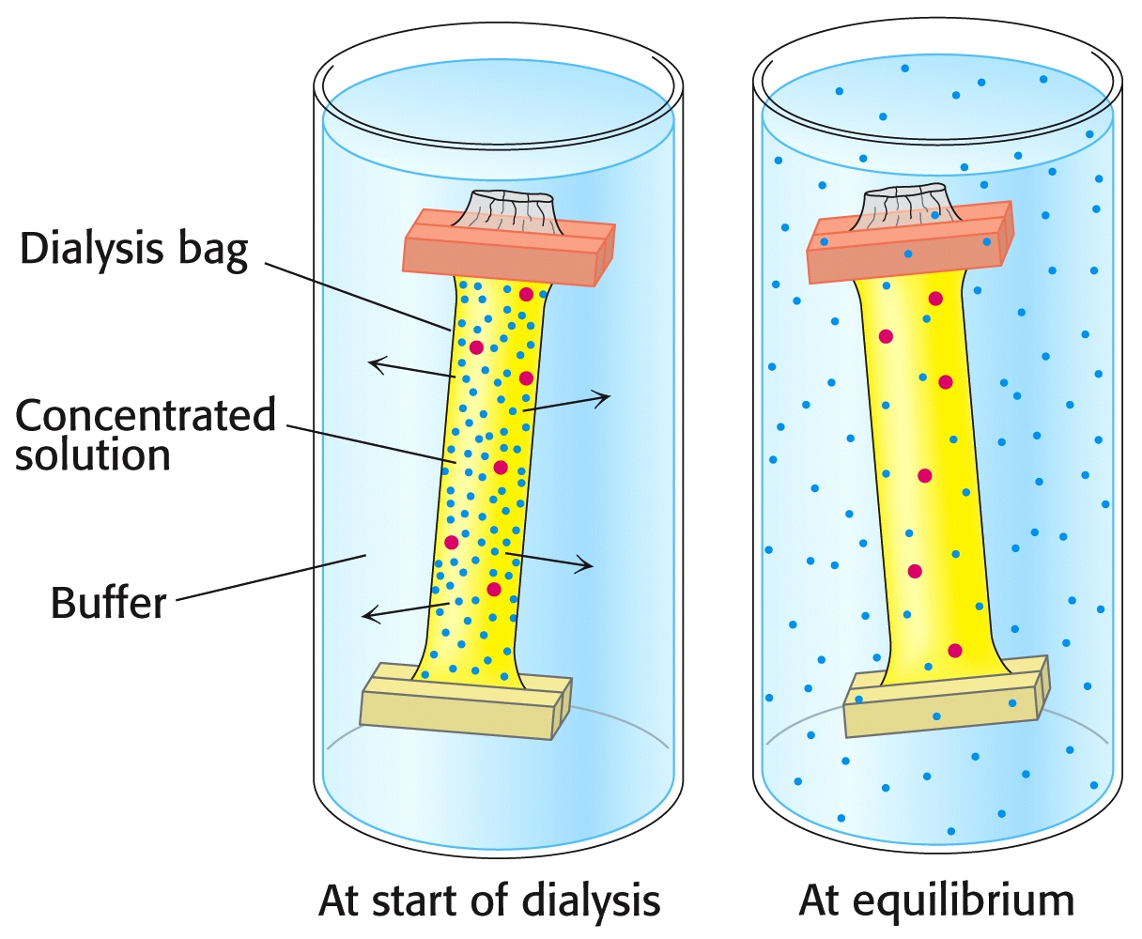
He also used dialysis to separate these chemicals from the enzyme in different orders.

Slide 54
By adding either one of these two chemicals to the surrounding medium, it is not removed during dialysis.
In essence, Anfinson could remove either the urea or the β-mercaptoethanol in any order he chose.
The order made a big difference in the enzymes ability to recover from the treatment!

Slide 55
Anfinson’s Experiment:
Experiment #1:
Add both urea and β-mercaptoethanol to a solution of enzyme. Activity is lost.
Remove urea by dialysis; then remove β-mercaptoethanol by dialysis. Activity is recovered 100%!
Experiment #2:
Add both urea and β-mercaptoethanol to a solution of enzyme. Activity is lost.
Remove β-mercaptoethanol by dialysis; then remove urea by dialysis. Only ~1% of activity is recovered. N = 8² = 64, 1/64 ~ 1%
Experiment #3:
Add β-mercaptoethanol to the solution from Exp.#2. Then, remove urea by dialysis;
Finally, remove β-mercaptoethanol by dialysis. Activity is recovered 100%!

Slide 56
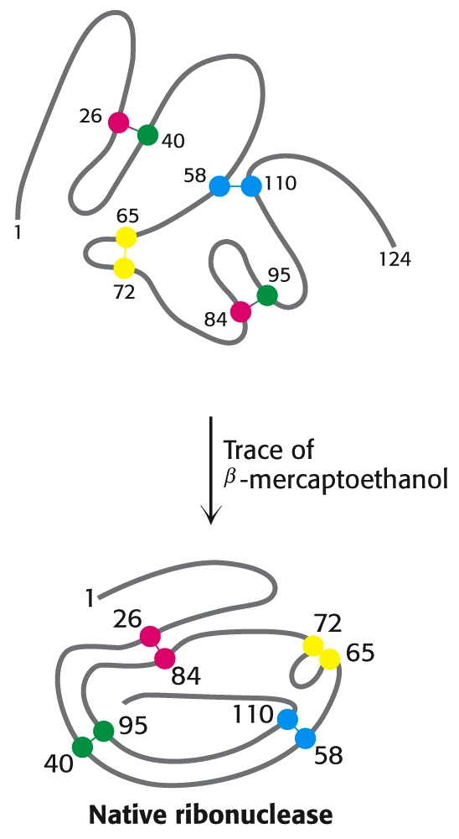
Anfinson’s Experiment:

Slide 57
… the rest of the story….
Do proteins fold up the same way inside living cells?
The cytosol is a crowded space… lots of different proteins in higher concentrations
Lots of organelles
Endoplasmic reticulum
Wide varieties of small molecules everywhere
Nucleic acids (e.g. RNA)
Decades later… new biochemists added to Anfinsen’s long-standing paradigm:
Proteins need extra help folding inside crowded cells!

Slide 58
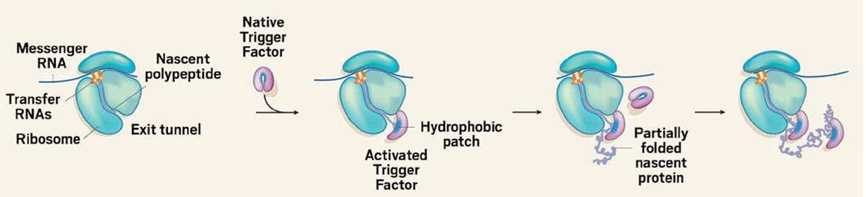
Chaperones
In the 1989, Franz-Ulrich Hartl and Arthur Horwich reported “chaperone” proteins help direct folding of nascent (new) proteins (sometimes called their “clients.”)
Class Assignment: Read “Protein-folding Mysteries” in Canvas and write a review of the article.

Slide 59
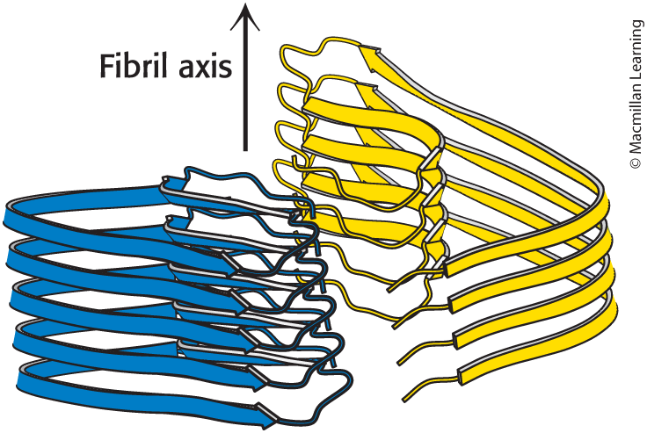
Protein Misfolding and Aggregation Are Associated with Some Neurological Diseases
Alzheimer disease, Parkinson disease, and Huntington disease are associated with the formation of protein aggregates (amyloid fibrils or plaques).
Normally soluble proteins are converted into insoluble fibrils rich in β sheets.
are prone to aggregate.
abnormally folded aggregates serve as a nucleus to recruit more proteins.
Structure of the Aβ Amyloid Fibril

Slide 60
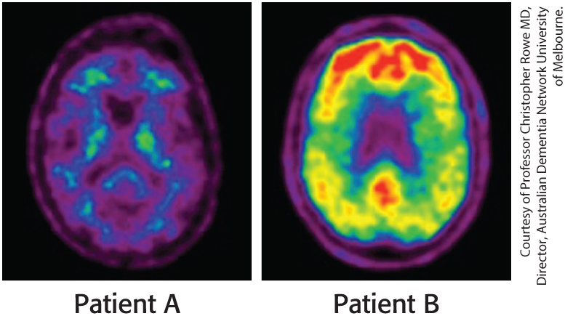
Predicting the Progression of Alzheimer Disease
The figure illustrates two positron emission tomography scanning of two patients that show the extent of amyloid fibril aggregation in the brain. Patient A: Light green signal is detected in certain small regions in the brain indicating minimal accumulation of A beta fibrils.
Patient B: Green, yellow, and red signals are detected in major areas of the brain indicating a high accumulation of A beta fibrils.

Slide 61
Predicting 3° Structure of Proteins
In 1994 researchers started a competition called
Critical Assessment of Protein Structure Prediction (CASP).
The breakthrough only occurred in 2018, when a chess master, neuroscience expert and pioneer in AI entered the field.
Demis Hassabis:
Chess Master at 13, Founded “DeepMind” AI models for board games, sold to Google in 2014.
John Jumper:
PhD in theoretical physics in 2017; joined DeepMind
David Baker:
Social science→ philosophy → biology; independently developed “Rosetta” around the same time
AlphaFold2 won the contest in 2020.
These three scientists shared the 2024 Nobel Prize in chemistry.
DeepMind (AlphaFold2) and Rosetta are both open source codes!
AlphaFold2

Slide 62
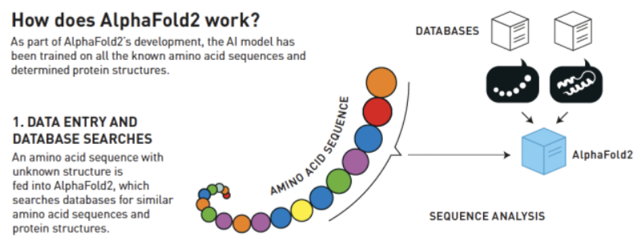
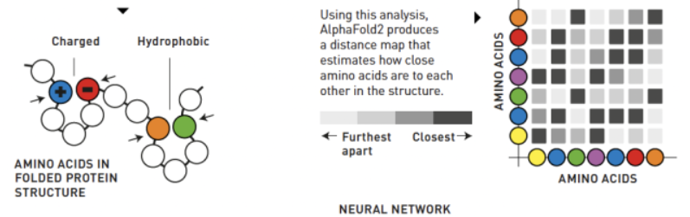
AlphaFold2 – Predicting 3° Structure from 1° Structure
https://www.nobelprize.org/prizes/chemistry/2024/popular-information/

Slide 63
End of Lecture Slides
for
Amino Acids & Proteins
Many of the diagrams used in these slides were taken from Stryer, et.al, Biochemistry (Our course textbook).

