Slide 1
General Education Revitalization: Where we are

Slide 2
GEN ED REVITALIZATION: Background
Lower-division WSU students struggle with academics
First Semester Freshmen Student GPAs
25% have a first semester GPA < 2.2 but > 0.00
15% have a first semester GPA = 0.00
Thus, 40% are vulnerable after the first semester.
Retention
55% FTFT freshmen fall-to-fall retention rate in 2015
60% FTFT freshmen fall-to-fall retention rate in 2016
Graduation
35% FTFT freshmen 6-year graduation rate in 2015
32% FTFT freshmen 6-year graduation rate in 2016

Slide 3
GEN ED REVITALIZATION: Background
How much does our Gen Ed Program strengthen students as learners?
While students who pass Gen Ed courses demonstrate Gen Ed SLOs, those outcomes are largely content-oriented.
Our Core (QL, AI, COMP, IL) and Breadth (PS, LS, SS, CA, HU) Gen Ed courses have distinct SLOs from each other largely based on course content.
There are NO shared goals across Gen Ed classes.
YET…goals to promote students as skilled thinkers, personally and socially responsible individuals, and integrative/applied learners are key in national models of Gen Ed and USHE Regent Policy.
Revitalization means seeking common goals for the Gen Ed program.

Slide 4
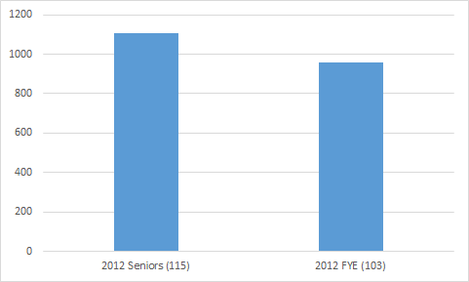
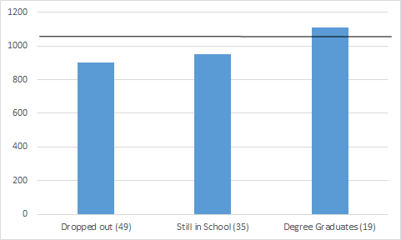
GEN ED REVITALIZATION: Background
All Gen Ed faculty try to promote critical thinking in their own way, but these efforts may be ineffective without a common vision.
CLA+ data suggest little value added of impact of Gen Ed on critical thinking.
Notes:
The data present performance on the CLA+ which assesses critical thinking skills.
The first set of bars on the left show an overall difference between Freshmen and Seniors in 2012. The Freshmen were in a FYE class and the Seniors were in an English class. The difference between the two groups is significant suggesting an improvement in performance over the college years.
The second set of bars on the right break down the 103 FYE students.
49 of the 103 FYE Freshmen dropped out and their performance was below the average of the FYE students.
35 of the 103 FYE Freshman are still in school and their performance is at the average of the FYE students.
19 of the 103 FYE Freshman graduated with degrees. You can see that their performance as freshmen is at or above the average of the senior group.
The data suggest that there appears to be no value added of Gen Ed to critical thinking. Students who arrive with low critical thinking scores, tend to leave the university. Those who arrive with highest level skills complete a BA/BS degree. We need to change how we promote critical thinking in Gen Ed courses and do better than we are doing now!

Slide 5
GEN ED REVITALIZATION: Charges
GEIAC explored ways Gen Ed courses can promote broader program goals WITHOUT SUBSTANTIALLY CHANGING WHAT FACULTY DO NOW IN GEN ED OR HOW GEN ED IS NOW ORGANIZED.
GEIAC recognized that class SLOs must be the focus of a Gen Ed course.
But, GEIAC identified a common activity which, if performed in each course, could promote students’ ability to realize broader program goals.

Slide 6
GEN ED REVITALIZATION: Proposal
The common activity involves adding 2 features to Gen Ed courses:
BIG QUESTION: A broad significant issue to which the content of the course can be connected.
SIGNATURE ASSIGNMENT: An assignment inviting students to think about how to integrate and apply content knowledge to the big question.

Slide 7
GEN ED REVITALIZATION: What Lies Ahead
Faculty, Departments, and Area Committees need to define what makes for good Big Questions and effective Signature Assignments in their CORE and BREADTH areas of Gen Ed.
Faculty need to tailor these Big Questions and Signature Assignments to their individual courses.

Slide 8
DRAFT
General Education Learning Outcomes (GELOs)

Slide 9
GEN ED REVITALIZATION: Proposal
GEIAC is proposing the GELOs as Gen Ed PROGRAM outcomes.
Repetition over ~12 courses completing different signature assignments exercises all four GELOs.
Students develop the habit of mind required to use their thinking skills to integrate and apply content knowledge to significant issues bearing on personal and social responsibility.
GEIAC will propose a revised Gen Ed MISSION to realize the GELOs.
The purpose of the Weber State University General Education program is to provide students with foundational knowledge and intellectual tools that enhance and transcend their academic program of study. The big questions posed by General Education courses address significant issues about the world. General Education courses help students apply their learning and develop personal and social responsibility, which is demonstrated through signature assignments.

Slide 10
GEN ED REVITALIZATION: FAQs
Do Gen Ed faculty have to teach to the new GELOs?
No. Student achievement of the GELOs is not the responsibility of any one class, but it results from taking a series of courses in which they practice GELO-related activities.
Can an assessment I already use in my GE course be considered a Signature Assignment?
Sure, if you think it requires students to address a significant issue (GELO 3) by integrating and applying (GELO 4) course content (GELO 1) using their intellectual skills or tools (GELO 2).
Do I have to call the assignment a Signature one?
Please do. This will help students learn that in each Gen Ed class they will have a similarly named assignment which exercises the same cognitive abilities.

Slide 11
GEN ED REVITALIZATION: FAQs
Does someone have to approve my Signature Assignment or Big Question?
No, but we expect faculty will pose Big Questions and design Signature Assignments consistent with definitions of these features and best practices, which will be developed over the next few years.
Do I have to grade my Signature Assignment according the GELOs?
No, you can grade it how you wish and accord it any weight you choose in your course.
If I do not have to grade according to the GELOs, how will we know if this approach to Gen Ed is working?
If you require a Signature Assignment and it is in Canvas, The Center for Institutional and Instructional Effectiveness will be able to randomly sample students’ SA for assessment. The assessment team can examine the growth in students’ SA performance over their Gen Ed courses.

Slide 12
CONCLUSION
GEIAC’s GOAL
to make Gen Ed more meaningful and more coherent FOR STUDENTS.
GEIAC’S PROPOSAL
a REVISED MISSION, 4 GELOs, and the common activity (Big Question, Signature Assignment) designed to promote students’ ability to realize the GELOs.
QUESTIONS?
Please contact Leigh Shaw, GEIAC Chair (lshaw@weber.edu).

