Slide 1
Weber Basin Water Conservancy District
Weber State University Pricing Elasticity Study

Slide 2
Introduction
Scope of the project is to come up with a pricing elasticity model that encourages conservation while getting consumers who previously paid little or nothing for water to accept a tier pricing structure.
Population growth and census data
Meter project
Secondary water base rate starts at $15.58. The difficulty with this project is water rates are currently changing. This was the average water bill for secondary water throughout our 15 cities as of February 1st
Tips and ideas for conserving water
Get to know how your water system works

Slide 3
Population Growth and Census Data
Current Utah population: 2.934 Million
Projected 2050 population: 6.5 million
Weber Basin Water District provides water for Box Elder, Davis, Morgan, Summit, and Weber counties.
These counties make up 750,00 of the population in Utah

Slide 4
Meter Project
The idea is to install a meter in every household in the Weber Basin Water District. Then implement a pricing structure based on how many gallons used, rather than a flat rate.
Create a pricing structure by metering secondary water within the next year or two.
The picture indicates how many meters are currently installed in our water district.
State legislature is encouraging meters to be installed

Slide 5
Current Pricing Structure
Flat rate for unlimited gallons of water
Paid in your property tax
No monthly statement or bill
Extremely low cost
No incentive to conserve water!

Slide 6
Extreme Outdoor Water Usage
6 zone sprinkler system uses approximately 4,000 gallons in one cycle
Equals approximately 50,000 gallons in one month
The average family only uses 8,000-10,000 a month for indoor use
With the low cost and lack of education, water users in the Weber Basin Water District are careless with their outdoor water privilege.
Our goal in a pricing structure is to make it affordable for low-income families, but also not to exceed the cost of culinary water.

Slide 7
Price Elasticity Information
Elasticity is defined as the percentage change in consumption divided by the percentage change in price and can be expressed in various formula formats.
We have taken the average of 8 cities that have a secondary water price and we have created a tier system.
Standardizing the water bill for all 5 counties in the district is a must!
Flyer will contain information on how the elasticity will work

Slide 8
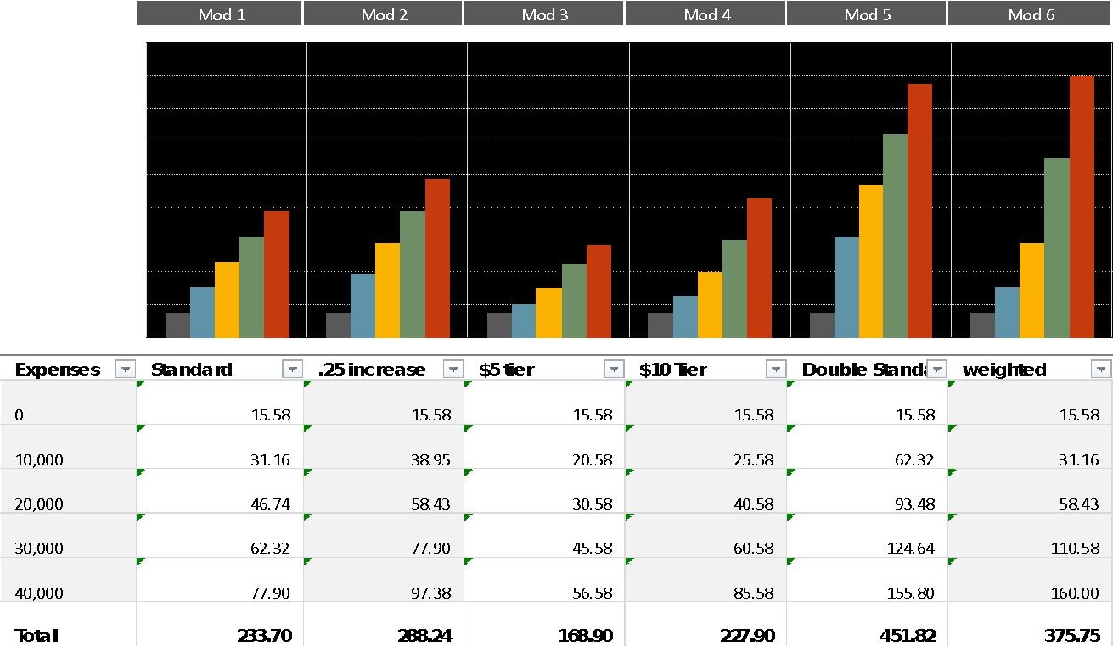

Slide 9
Conservation Tips
Adjust and inspect your sprinkler system regularly
Water your lawn less than 1 inch per week
Replace large lawn areas with a less maintained system

Slide 10
Water Rates Spread Sheet

Slide 11
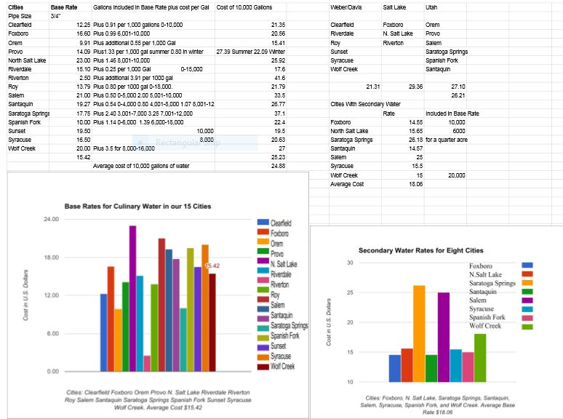
Water Rates Spread Sheet

Slide 12
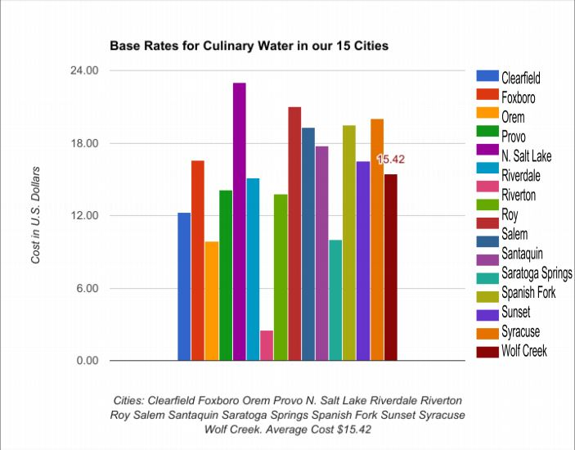

Slide 14
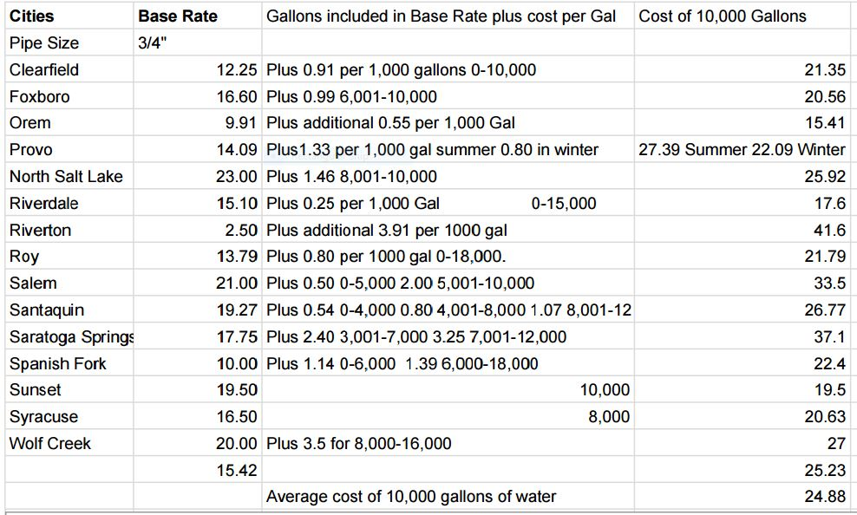

Slide 15
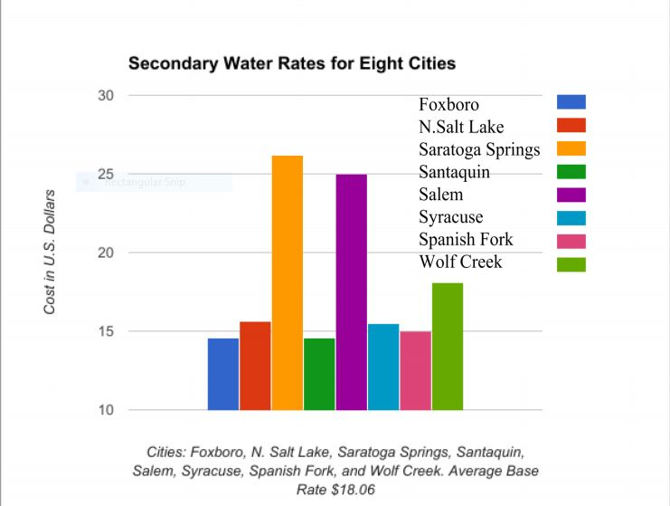

Slide 16
