Slide 1
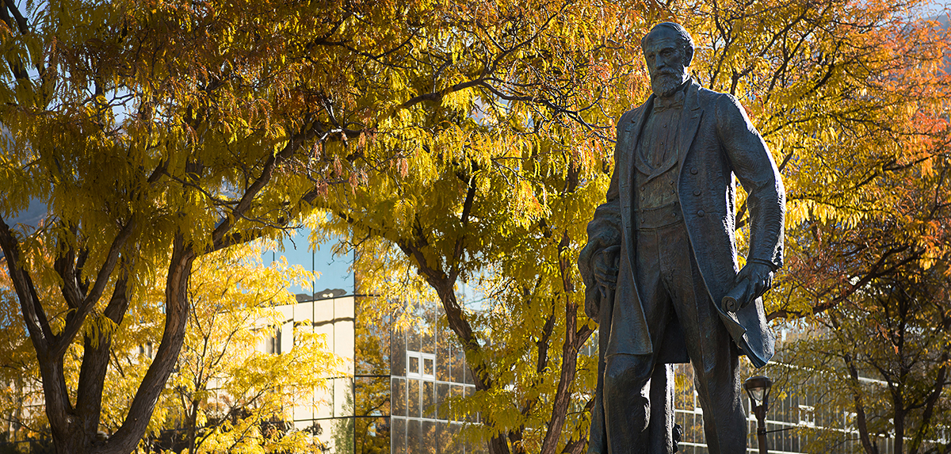
Academic Affairs: 2016-17 Goals

Slide 2
Goal One
Work collaboratively with faculty and other stakeholders to establish an Academic Affairs Master Plan.
What should WSU grads know/be able to do?
What programs should we offer? Grow? Maintain? At what levels? Where? Through what mediums?

Slide 3
Costs associated with Goal One
Time, energy, brain power of 20 members of Planning Task Force & guests invited to Task Force (TF) meetings
$2,500 to cover costs of campus visit of Dr. Lynn Mahoney (CSU-LA) in Dec. ’16
Future blood, sweat & tears associated with disseminating, discussing, revising ideas of TF

Slide 4
Goal Two
Improve Student Retention and Persistence, Starting with First Contact.
What are roadblocks to success?
What actions most effectively remove those roadblocks?
What units need to be involved?

Slide 5
Costs associated with Goal Two
Software product purchases & annual upkeep: ~$500k ($300K for initial purchase; $200K on-going maintenance)
Faculty development program centered on retaining students: $145K per year
Hiring four additional academic advisors/coaches to meet student needs: $206K

Slide 6
Goal Three
Review and Revise our General Education program.
Current GE program lacks overarching outcomes;
Does not align with WSU’s mission & core themes;
Does not motivate faculty to work together, demonstrating connections & overlaps among disciplines.

Slide 7
Costs associated with Goal Three
Orchestrating & advertising Town Hall meeting for discussion about proposed revisions: $3.5K
Bringing in national expert on GenEd: $3K
Hours of discussion, revision, further discussion: beyond what is calculable

Slide 8
Goal Four
Move Forward in Recruiting Out of State.
May allow us to: elevate WSU’s academic profile; provide more diverse experiences for our in-state students; provide additional revenue.
In what areas do we have additional capacity for students?
What are our best selling points? What are our target markets?
What is an appropriate cost/benefit ratio?

Slide 9
Costs associated with Goal Four
Year one costs: $450K in personnel & operating expense to target potential students in states where our tuition rates are competitive
These expenses can be borne internally or paid to a consulting firm. They include: marketing materials, travel, more recruiters
Cost of scholarships to out-of-state students/offset by tuition revenue:
High Honors = 50% discount; Honors = 33% discount; Achievement = 15% discount

Slide 10
Goal Five
Facilitate the Development of a Community Civic Action Plan.
2016: WSU signs National Campus Compact Action Statement, reaffirming WSU’s commitment to the public purpose of higher education.
Ogden Civic Action Alliance consisting of Ogden City, OSD, OWATC, MacKay-Dee, Ogden Regional, and WSU has been formed.
Next steps? Learning about community needs and establishing common priorities across institutions to address those needs.

Slide 11
Costs associated with Goal Five
Primarily time & energy of WSU team
Future years: resource contribution to common priorities across institutions

