Slide 1
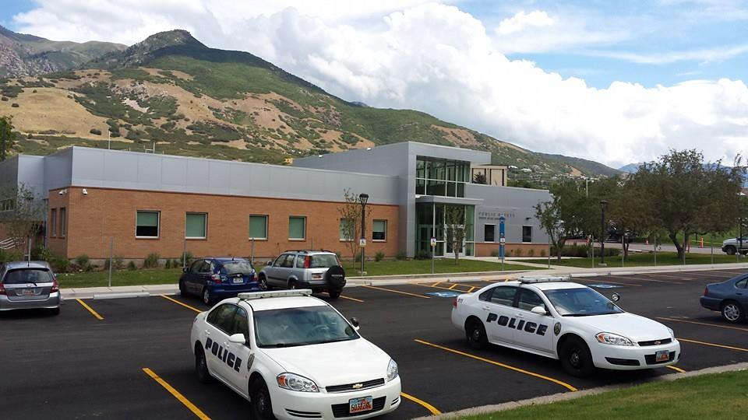
Clery compliance
Weber State University Police department

Slide 2
Jeanne Clery Campus Security Policy & Crime Statistics Disclosure Act (Clery Act)
The Jeanne Clery Disclosure of Campus Security Policy and Campus Crime Statistics Act is the landmark federal law, originally known as the Campus Security Act, that requires colleges and universities across the United States to keep and disclose information about crime on and near their respective campuses.
The "Clery Act" is named in memory of 19 year old Lehigh University freshman Jeanne Ann Clery (pictured right) who was raped and murdered while asleep in her residence hall room on April 5, 1986.
Weber State University
Police Department

Slide 3
The incident
On April 5, 1986, Jeanne Clery was raped and murdered in Stoughton Hall at Lehigh University. The perpetrator Joseph M. Henry was a student and was later apprehended, tried and sentenced. Prior to Jeanne's death, there were reports that her dorm had, had 181 situations of auto-locking doors being propped open by residents. It is believed that Henry entered Stoughton Hall on April 5 through a propped door. In addition, it is believed Clery left her room door unlocked for her roommate, who forgot her key. It is believed that Clery was awoken by Henry in the process of robbing her, in which Henry beat, cut, raped, sodomized, and strangled Jeanne
Weber State University
Police Department

Slide 4
Clery act
Jeanne’s family championed the law to require the disclosure of campus crime information and the federal law that now bears their daughter’s name was first enacted in 1990.
The Clery Act has evolved through the years seeing major revisions in 1991, 1992, 1994, 1998, 2000, 2008, 2011, and 2013.
Most recently by the Violence Against Women Reauthorization Act 2013 (VAWA).

Slide 5
The purpose of the clery act
To provide the campus community with accurate, complete, and timely information about crime and safety of the campus environment so they can make informed decisions to keep themselves safe
Weber State University
Police Department

Slide 6
Clery Crimes
Murder (non-negligent and negligent manslaughter)
Sex offenses (forcible/non-forcible)
Robbery
Aggravated assault
Burglary
Motor Vehicle Theft
Arson
Hate Crimes
Domestic violence
Dating Violence
Stalking
Liquor law violations
Drug-related violations
Weapons possession
Weber State University
Police Department

Slide 7
Who the clery act applies to?
All public and private institutions of postsecondary education participating in federal student aid programs are subject to it.
Violators can be "fined" by the U.S. Department of Education, the agency charged with enforcement of the Act and where complaints of alleged violations should be made, or face other enforcement action.
Weber State University
Police Department

Slide 8
Violence Against Women Act
Reauthorized in 2013 (Went into effect in October 1, 2014)
Substantive Amendments to include
Domestic Violence
Dating Violence
Stalking
As well as additional employee and student training, policy and written procedures requirements
Weber State University
Police Department

Slide 9
Rationale for building partnerships
On 10/02/12 DOE increased fine to $35,000 per violation
Reasons for fines:
Policy Statements
Timely Warnings and Emergency Notifications
Geography Misclassification
Inaccurate Statistics and Crime Misclassification
Under the new regulations the DOE will focus their audits on:
Campus Security Authorities (CSAs)
Annual Security Reports (ASR)
Training and Programs
How a Clery Audit Happens
Based on Complaint
Media Assessment
FBI-UCR Audit
Random Audit
Financial Aid Audit
Weber State University
Police Department

Slide 10
Policy Statements
Annual Security Report must contain current campus policies and procedures for:
Reporting criminal action
Emergencies occurring on campus
Making timely warning reports to members of campus community
Preparing the annual disclosure of crime statistics
The handbook includes 60 policy statements
Weber State University
Police Department

Slide 11
Timely warnings
Is an alert sent to the entire campus community (including parents) about a Clery Act crime to enable people to protect themselves from a serious or continuing threat to students or employees.
Timely warnings may be issued for a non-Clery crime
Represent an ongoing threat or a threat that may be repeated to student or employee safety
Decided on a case-by-case basis
Factors include:
Nature of the crime
Continuing danger to the campus community
Possible risk of compromising law enforcement efforts
Policy must include rules about the content of a timely warning, which must include information about the crime that triggered the warning.
Timely warning is issued as soon as pertinent information is available except when to do so would endanger law enforcement efforts.
Weber State University
Police Department

Slide 12
Emergency notifications
An alert sent to all or part of the campus community (can include parents) in regard to a significant emergency or dangerous situation.
Procedures in policy must include:
Emergency notifications upon confirmation of a significant emergency or dangerous situation involving an immediate threat to the health or safety of students or employees occurring on campus.
How a significant emergency or dangerous situation will be confirmed
How segments of the population are at risk determined and how each segment will receive notification.
How containing the emergency is the first priority, but the next priority is issuing a notification. That must be done before anything else, unless doing so would hamper containing the emergency.
Process for determining the initiation of the notification system and content of required emergency notifications.
Various channels (text messages, public address systems, etc.) that may be used.
How information will be shared with the greater community, which can include parents.
Titles of persons responsible for making each of these decisions. If more than one process is used, multiple disclosures are required.
Weber State University
Police Department

Slide 13
Emergency Notifications cont.
Following phrases must be used:
Emergency notifications will be issued “without delay, and taking into account the safety of the community.”
The only exception would be if doing so would “compromise efforts to assist a victim or contain, respond to, or otherwise mitigate the emergency.”
Determinations about emergency notifications must be made “in the professional judgement of responsible authorities, “ not personnel without emergency response expertise.
Annual test of campus alert system is required. Emergency procedures will be distributed to all students and employees in conjunction with annual test.
Weber State University
Police Department

Slide 14
Clery Geography
An institution must report statistics for offenses according to their occurrence in the following locations, or geographic categories:
On-Campus
On Campus Residential Facilities
Public Property
Non-Campus
Weber State University
Police Department

Slide 15
On campus
Any building or property owned or controlled by an institution within the same reasonably contiguous geographic area and used by the institution in direct support of, or in a manner related to, the institution’s educational purposes, including residence halls;
Any building or property that is within or reasonably contiguous to paragraph (1) of this definition, that is owned by the institution but controlled by another person, is frequently used by students, and supports institutional purposes (such as a food or other retail vendor).
Definition of Control:
Controlled by means that the institution rents, leases, or has some other type of written agreement (including an informal written agreement such as a letter or an email) for a building or property or a portion of a building or property. Even if there is no payment involved in the transaction. Under Clery a written agreement for use of space gives your institution control of that space for the time period specified in the agreement.
Weber State University
Police Department

Slide 16
On Campus residential facilities
Under the Clery Act, an institution has on-campus student housing facilities, must separately disclose two sets of on-campus statistics.
The total number of crimes that occurred on campus, including crimes that occurred in students housing facilities; and
The number of crimes that occurred in on-campus student housing facilities as a subset of the total.
Student Residential Facilities include:
Undergraduate, graduate, married student housing
Traditional residence halls/dorms or single family houses used for student housing.
Buildings that are owned by a third party that have a written agreement with your institution to provide student housing. It doesn’t matter whether the rent is paid to the third party by the institution on behalf of the students or paid directly by the students.
Weber State University
Police Department

Slide 17
Public property
All public property, including thoroughfares, streets, sidewalks, and parking facilities, that is within the campus, or immediately adjacent to and accessible from the campus. Generally, sidewalks and public streets running through campus and sidewalks and public streets adjacent to campus (the sidewalk immediately adjacent, the street, and the second sidewalk across the street are all counted.
Two conditions must be present:
There is no barrier of any kind between your campus border and public property
A standard of use has been established by your students. This means that although some type of barrier is present, your students frequently ignore, overcome or even use it to gain access to public property.
Weber State University
Police Department

Slide 18
Non-campus
Any building or property owned or controlled by a student organization that is officially recognized by the institution; or any building or property owned or controlled by an institution that is used in direct support of, or in relation to, the institution’s educational purposes, is frequently used by students, and is not within the same reasonably contiguous geographic area of the institution.
Frequently used by students for:
Classes
Internships
Jobs or work study
To access campus services like parking office, counseling center, student health center, etc.
To play sports
ANY USE…
Weber State University
Police Department

Slide 19
Clery Crime statistics
Required to report crime statistics to the Department of Education, to be published in the institution's Annual Security Report.
In accordance with standards used by the FBI Uniform Crime Reporting System (UCR).
Viable processes in place to ensure crime statistics are accurate and that classification of crimes are within the guidelines established by the Department of Education and UCR.
Point of emphasis for the Department of Education and Clery
Weber State University
Police Department

Slide 20
Campus security authorities (CSA)
Any official of the institution who is defined as a “Campus Security Authority (CSA)” is required to report certain criminal offenses to the University Police Department.
A term used to describe someone with significant responsibility for student and campus activities.
The Clery act requires the University’s Clery Compliance Officer to identify CSAs and train them yearly.
The following definition was used to identify the campus CSAs:
Campus Police Department (or a campus security department).
Individuals with Campus Security Responsibility (not amounting to campus police or security) for monitoring entrance into institutional property.
Individuals designated by the campus.
Officials with significant responsibility for student and campus activities. (Examples include: Student housing, student discipline, and campus judicial proceedings).
Weber State University
Police Department

Slide 21
Annual security report (ASR)
Published October 1st
Containing 3 calendar years of crime statistics
Includes security policies, procedures, and information on the basic rights guaranteed victims of sexual assault, domestic violence, dating violence, and stalking.
Students/ faculty must be notified of the existence of the ASR and provided a copy upon request.
The following policy statements must be included in the ASR:
Emergency procedures and notifications, police scope and authority, timely warnings, annual security report, annual fire report, security and maintenance of facilities, sex offenders, missing student notifications, domestic violence, dating violence, stalking, and sexual assault.
Educational programming specifically designed to end domestic violence, dating violence, stalking, and sexual assault must also be included.
Weber State University
Police Department

Slide 22
Training and Programs
New amendments issued by the Department of Education related to the Violence Against Women Re-Authorization Act of 2013 (VAWA).
Institutional training and programs related to domestic violence, dating violence, stalking, and sexual assault.
Must be comprehensive, intentional with strategies and campaigns geared towards ending domestic violence, dating violence, sexual assault, and stalking.
Culturally relevant
Inclusive of diverse communities
Responsive to community needs
Must be made available to all faculty, staff, and students as well
as to prospective faculty, staff, and students.
Weber State University
Police Department

Slide 23
Questions????
Please visit us at:
www.weber.edu/police
www.facebook.com/WeberStatePolice
www.twitter.com(@WeberStatePD)
Weber State University
Police Department

