Slide 1
Weber State University Positioning Statement
Marketing & Communications
November 2015

Slide 2
Why a Positioning Statement?
Brings focus to the development of a marketing strategy
Is not as detailed as a mission statement
Is not as concise as a tagline (e.g. Worthy of Your Dreams)

Slide 3
Our Positioning Statement
Differentiates Weber State from other institutions
Provides an easily understood picture of our brand
Is credible
Helps evaluate whether marketing decisions are consistent with/supportive of our brand

Slide 5
Positioning Statement Survey

Slide 6
Survey Recipients
Emailed survey link to more than 200,000 people
26,000 students
1,500 staff
975 faculty
90 committee/council members
More than 175,000 alumni and friends of the university

Slide 7
Responses
Total 1,264
Alumni 292
Faculty 163
Exempt 135
Non-Exempt 82
Other 65
Students 530

Slide 9
Accuracy

Slide 10
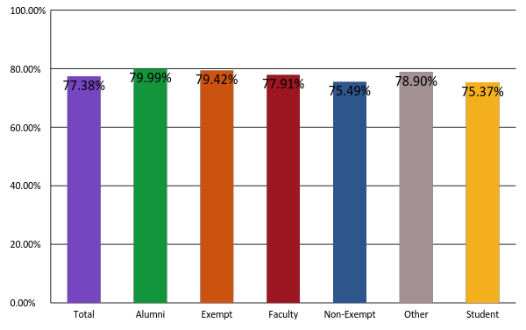
Is this statement accurate?

Slide 11
Appeal

Slide 12
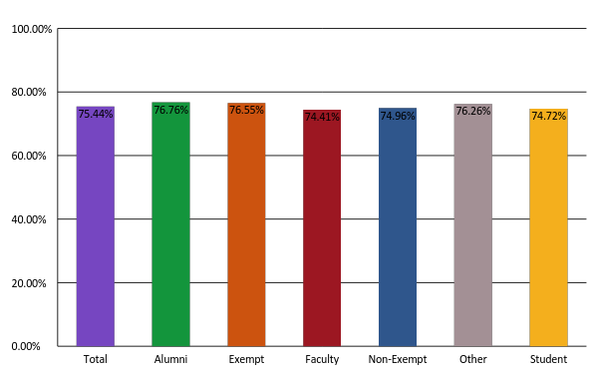
Is this statement appealing?

Slide 16
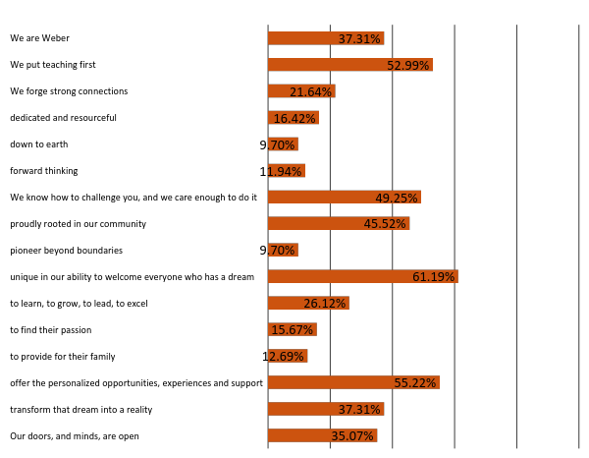
Exempt Staff

Slide 17
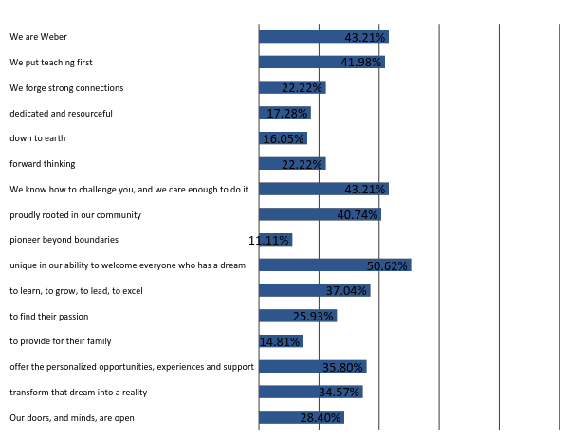
Non-Exempt Staff

