Slide 1
CUPA Comparisons
Salary, Benefits, Budget & Fiscal Planning Committee, 2013-14

Slide 2
Recent Cost of Living Changes
 | CPI | GNPPD | CPI (West)
2013-2014 Increase | 1.5% | 1.4% | 1.0%
2008-2014 (Annualized Increase) | 1.7% | 1.44% | 1.52%
Source: Bureau of Labor Statistics

Slide 3
Cost of Living Index - Utah
Index | Salt Lake City | Utah | National
Cost of Living | 93 | 91 | 100
Goods & Services | 104 | 98 | 100
Groceries | 92 | 95 | 100
Health Care | 93 | 89 | 100
Housing | 86 | 81 | 100
Transportation | 95 | 95 | 100
Utilities | 81 | 88 | 100
Source: AreaVibes, Inc.

Slide 4
College Percentages of Equitable CUPA Averages
College | WSU Actual / CUPA 2013 | WSU Actual / CUPA 2014
Arts & Humanities | 87.49% | 89.35%
Applied Science & Technology | 95.54% | 96.46%
Business & Economics | 92.94% | 99.46%
Continuing Education | 96.12% | 92.97%
Education | 84.36% | 86.15%
Health Professions | 87.51% | 89.06%
Library | 81.32% | 82.09%
Social & Behavioral Sciences | 87.65% | 89.47%
Science | 88.14% | 89.93%

Slide 8
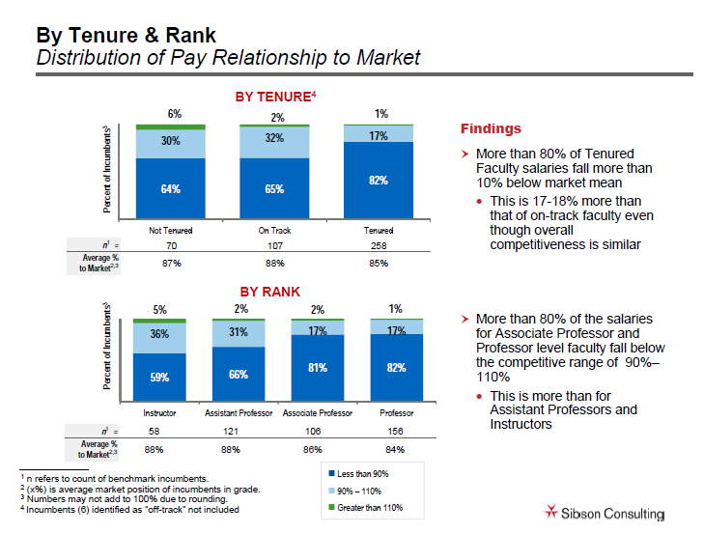

Slide 10
Slide to signal there are no more slides.

