Slide 1
Amino Acids & Proteins
Biochemistry 3070

Slide 2
Proteins are linear copolymers built from monomeric units called amino acids.
Twenty amino acids are commonly found in proteins.
These amino acids contain a variety of different functional groups:
Alcohols (R-OH)
Phenols (Ph-OH)
Carboxylic acids (R-COOH)
Thiols (R-SH)
Amines (R-NH₂)
and others…

Slide 3
Protein function depends on both
amino acid content, and
amino acid sequence.
Protein fold into diverse shapes such as
spherical
elipsoidal
long strands, etc.
All information for 3-D structure is contained in the linear sequence of amino acids.

Slide 4
To understand protein function, we must first understand the nature of amino acids.
Amino acids are essentially α-amino acids:
alpha carbon (IUPAC #2 position)
H₂N – C – COOH
|
R
When R is not H, the alpha carbon
is asymetric, giving rise to isomers.

Slide 5
Only L-amino acids are constituents of proteins. “L” and “D” isomeric nomenclature is similar to the “R” and “S” utilized in modern organic chemistry.

Slide 6
Carboxylic acids are traditional Bronsted-Lowery acids, donating a proton in aqueous solution.
The pKa for caroboxylic acids is normally around 2 to 5. That is, the pH at which these acids are 50% ionized:
R-COOH → R-COO⁻ + H⁺
pH= [less than 2] → [above 5]

Slide 7
Amino groups function as bases, accepting a proton.
The pKa for amino groups is usually around 9 – 10. Again, at the pKa these groups are 50% ionized:
R-NH₃⁺ → R-NH₂ + H⁺
pH= [below 8] → [above 9]

Slide 8
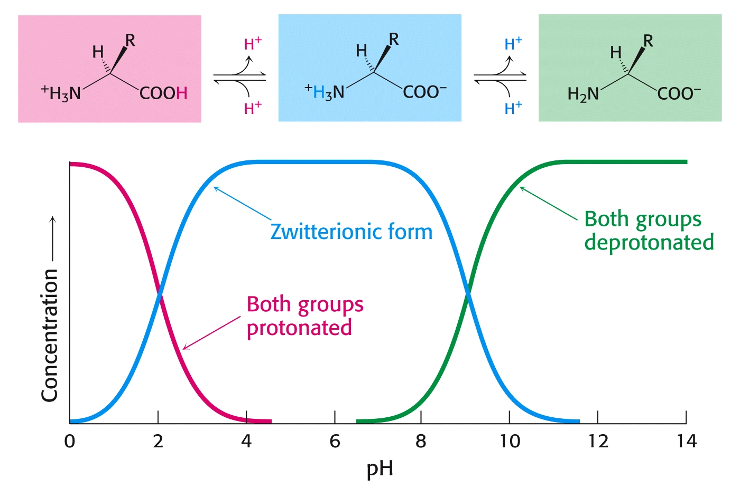
Even though both acids and amines are present in the same molecule, they mostly behave as though they were separate entities:

Slide 10
Summary:
At low pH, proton concentration [H+]is high. Therefore, both amines and carboxylic acids are protonated. (-NH₃⁺ & -COOH)
At high pH, proton concentration is low. Therefore, both amines and carboxylic acids are deprotonated. (-NH₂ & -COO⁻)
At neutral pH, amines are protonated(-NH₃⁺) and carboxylates are deprotonated(-COO⁻)

Slide 11
“Zwitter” Ions:
Ions bearing two charges were named zwitter ions by German scientists; the name still applies today, especially for amino acids at neutral pH:
⁺H₃N – CH₂ – COO⁻

Slide 12
Acid-Base Properties of Amino Acids
Draw the following chemical structures for glycine:
(Non-existent form:) H₂N – CH₂ - COOH
pH=1:
pH=7:
pH=12:

Slide 13
Acid-Base Properties of Amino Acids
Draw the following chemical structures for glycine:
(Non-existent form:) H₂N – CH₂ - COOH
pH=1: ⁺H₃N – CH₂ - COOH
pH=7:
pH=12:

Slide 14
Acid-Base Properties of Amino Acids
Draw the following chemical structures for glycine:
(Non-existent form:) H₂N – CH₂ - COOH
pH=1: ⁺H₃N – CH₂ - COOH
pH=7: ⁺H₃N – CH₂ – COO⁻
pH=12:

Slide 15
Acid-Base Properties of Amino Acids
Draw the following chemical structures for glycine:
(Non-existent form:) H₂N – CH₂ - COOH
pH=1: ⁺H₃N – CH₂ - COOH
pH=7: ⁺H₃N – CH₂ – COO⁻
pH=12: H₂N – CH₂ – COO⁻

Slide 16
Low pH Neutral pH High pH

Slide 17
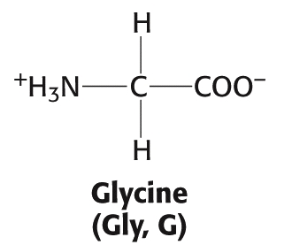
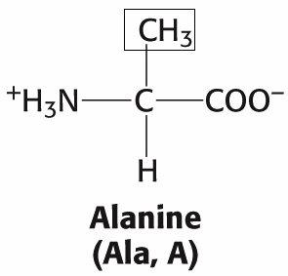
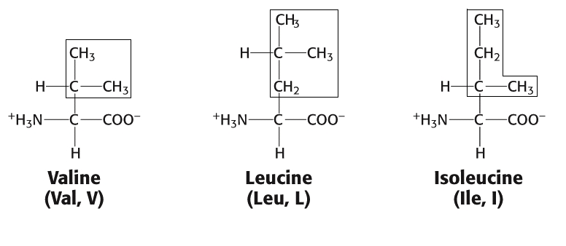
Amino acids: (Aliphatic)

Slide 18
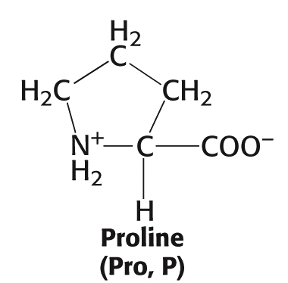
Amino acid Proline
(The only secondary (2°) amino acid or (“imino” acid.)

Slide 19
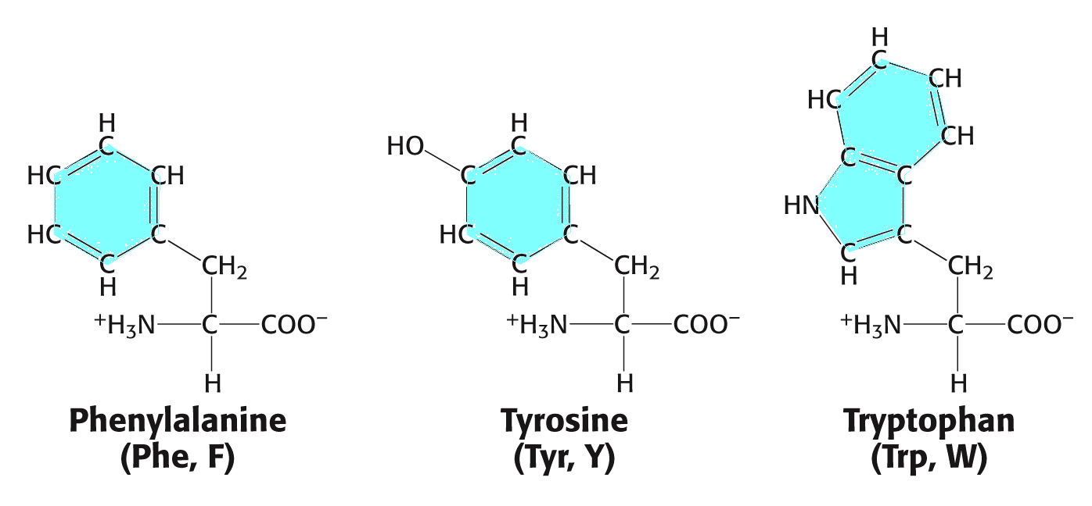
Amino acids (Aromatic)

Slide 20
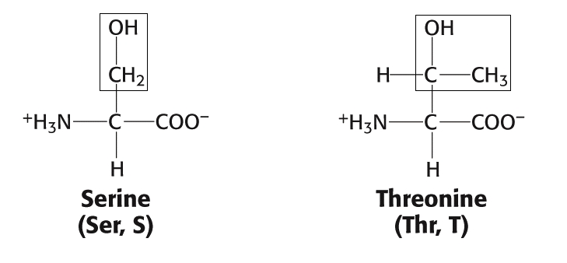
Amino acids (Alcohols)

Slide 21
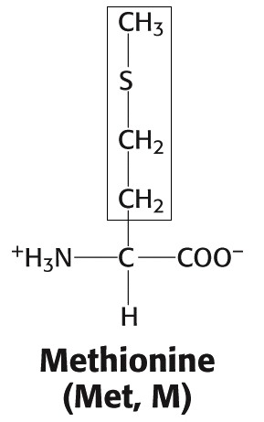
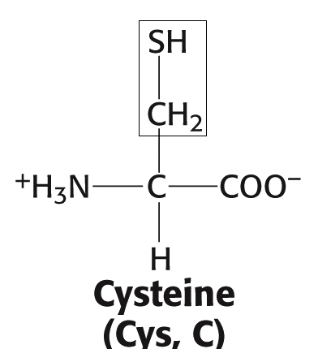
Amino acids (Sulfur)

Slide 22
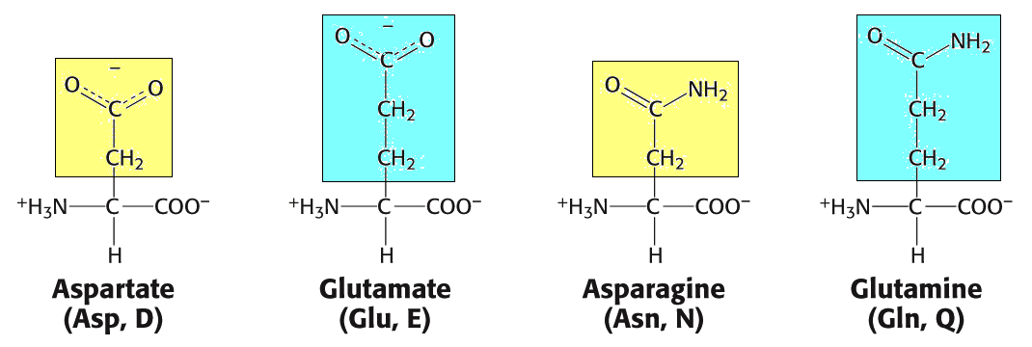
Amino acids (Acids and related amides)

Slide 23
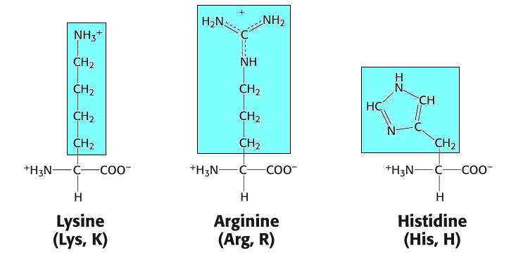
Amino acids (Basic)

Slide 24
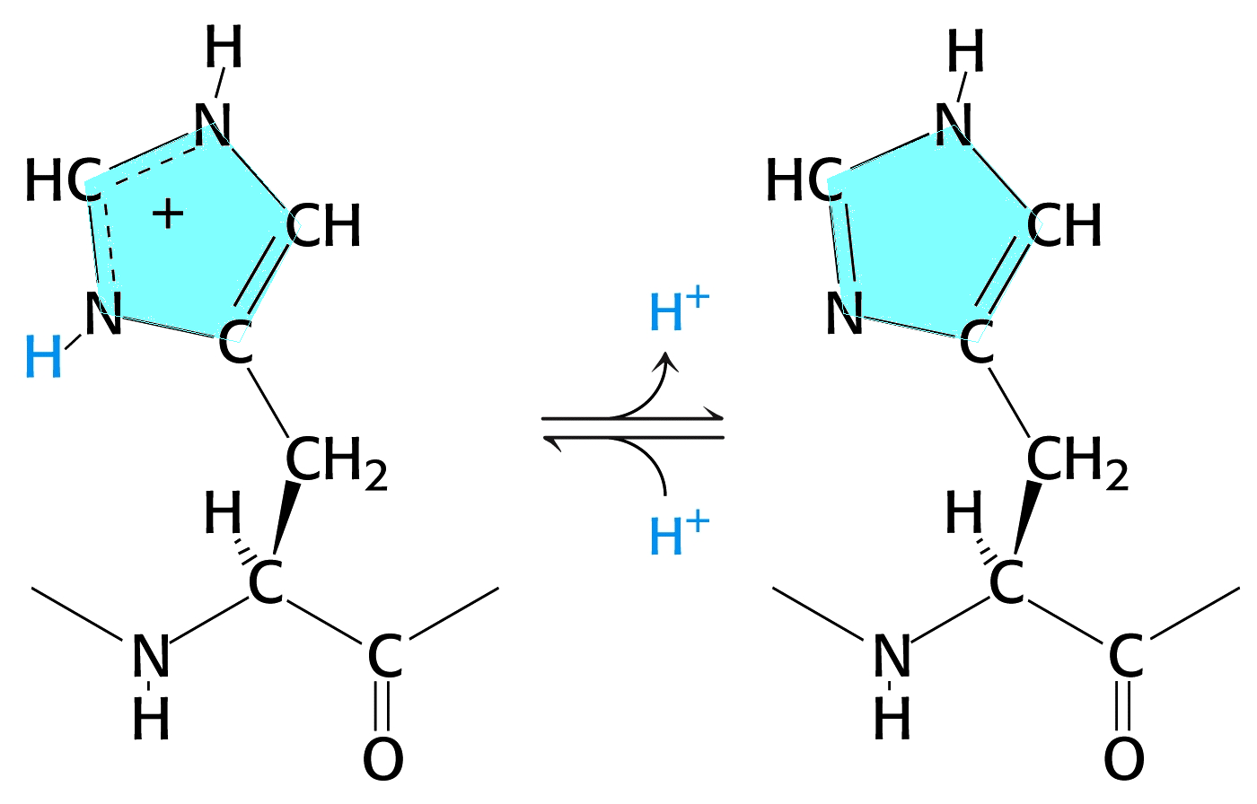
Histidine (Acid/Base Activity)

Slide 27
Essential Amino Acids:
Isoleucine
Leucine
Lysine
Methionine
Phenylalanine ª
Threonine
Tryptophan ª
Valine
Arginine ^{b}
Histidine ^{b}
ª Aromatic ^{b} Probably essential

Slide 28
Amino acids are polymerized via amide or “peptide” bonds:

Slide 29
Copolymer of amino acids:
– a “polypeptide”
Definition:
Amino acid polymers of ≤50 amino acids are called
“polypeptides, peptides, oligopeptides, etc.”
Amino acids polymer of >50 amino acids are called “proteins.”

Slide 31
An example of a “dipeptide” is the sweetener Aspartame.
Other names include:
NutraSweet
Equal
Tri-Sweet
Sanecta
IUPAC Name:
“N-L- α – Aspartyl-L-phenylalanine 1-methyl ester”
Abbreviated Structure:
Asp – Phe - OCH3

Slide 32
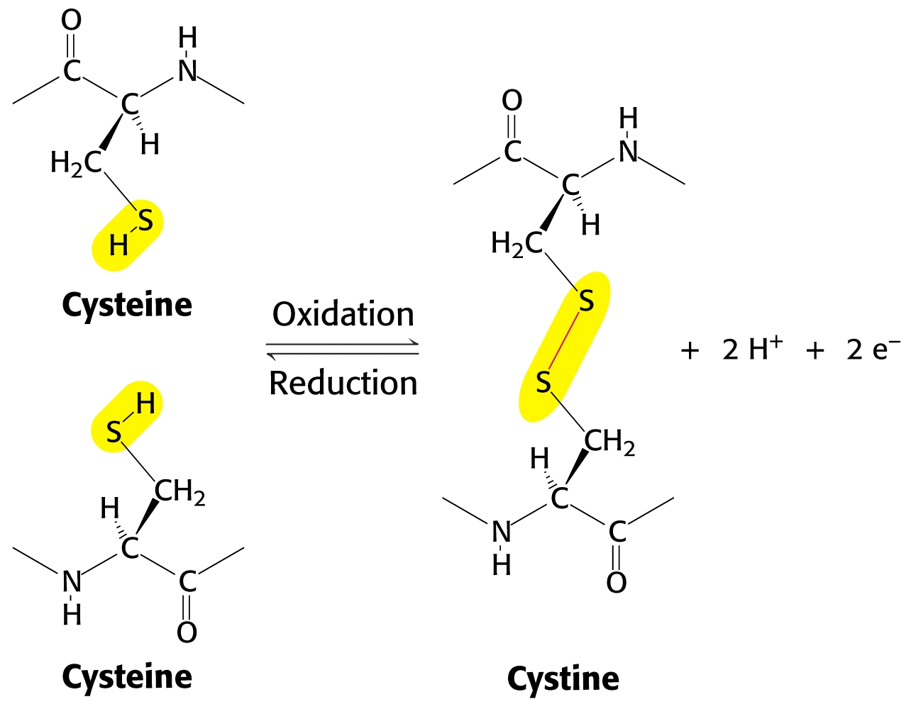
Cross links between peptide chains:
Disulfide linkages between individual “cysteines” are called “cystines:”

Slide 33
Insulin is the smallest protein, with 51 amino acids in two chains linked by cystine (disulfide) cross links:

Slide 34
Peptide bonds have partial double bond character due to resonance that limits rotation about this bond:

Slide 36
Levels of Protein Structure
Primary (1°) Protein Structure
linear sequence of amino acids.
Secondary (2°) Protein Structure
localized regional structures
Teritary (3°) Protein Structure
overal shape of proteins
Quaternary (4°) Protein Structure
interactions between proteins

Slide 37
Protein Structure:
Twisting about various bonds in the polypeptide backbone gives proteins a variety of shapes.
Bond angles give rise to secondary structures. Then, localized secondary structures help drive the peptide folding that gives rise to tertiary structure.

Slide 38
Secondary Structure in Proteins:
Pauling and Corey proposed two secondary structures in proteins many years before they were actually proven:
alpha – helix beta - sheet
Both of these secondary protein structures are stabilized by hydrogen bonding between the carbonyl oxygen atoms and the nitrogen atoms of amino acids in the protein chain.

Slide 39
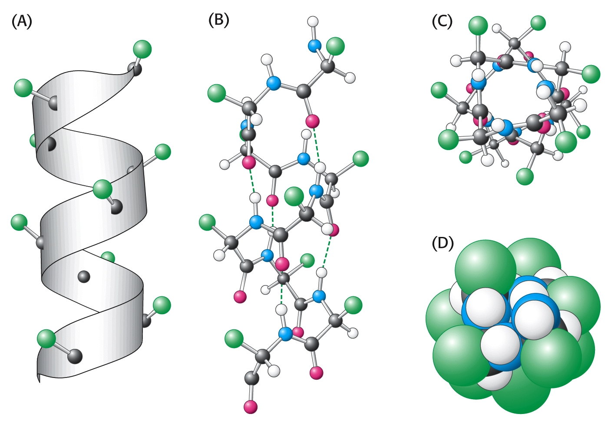
The alpha (α) – helix:

Slide 40
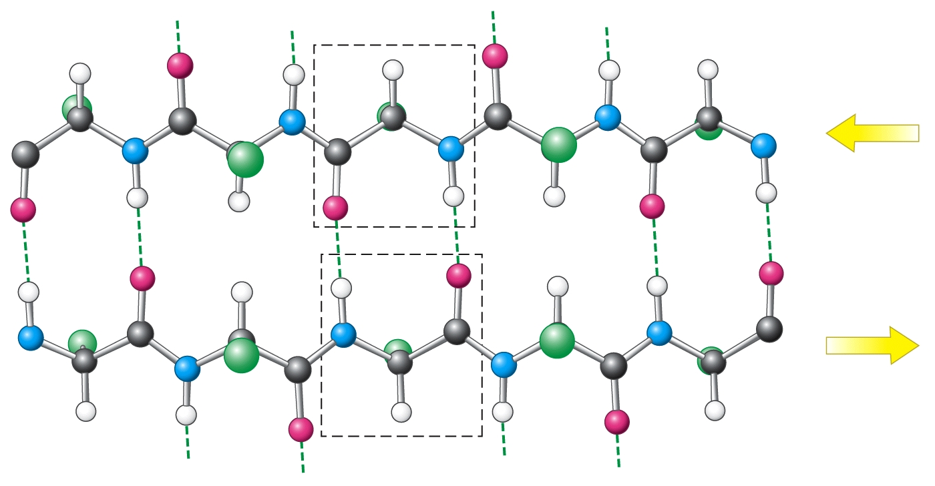
beta – sheet (antiparallel):

Slide 41
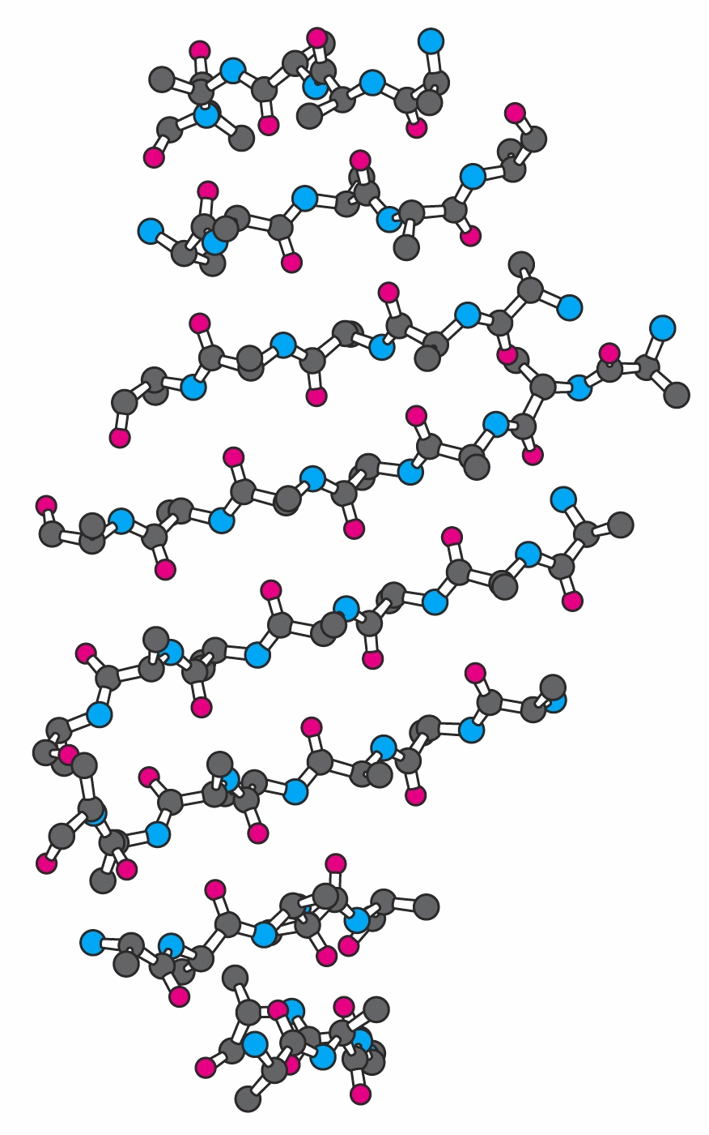
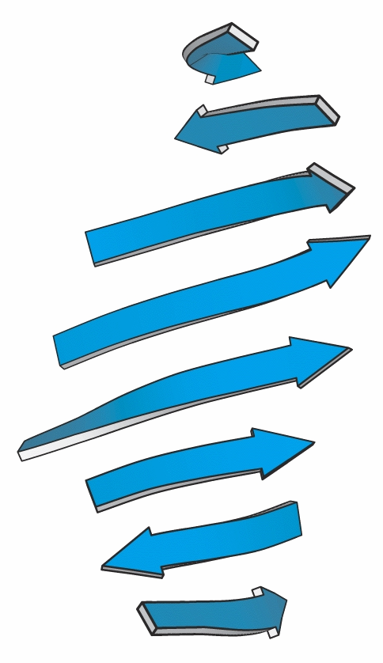
beta – sheet (artistic representations):

Slide 42
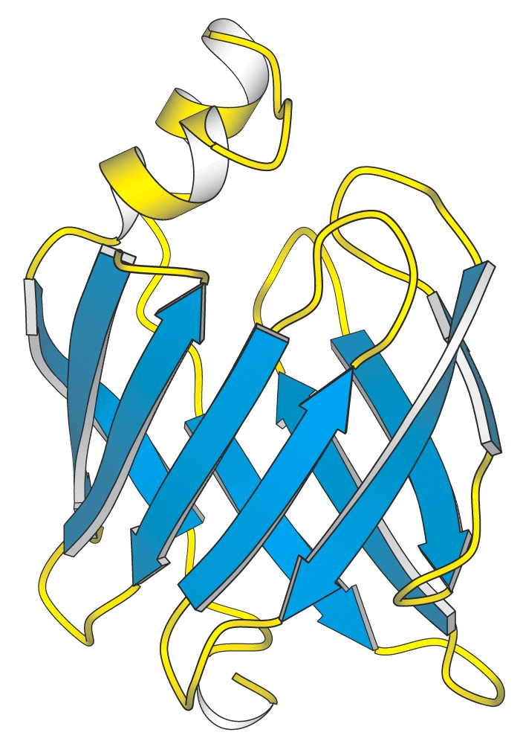
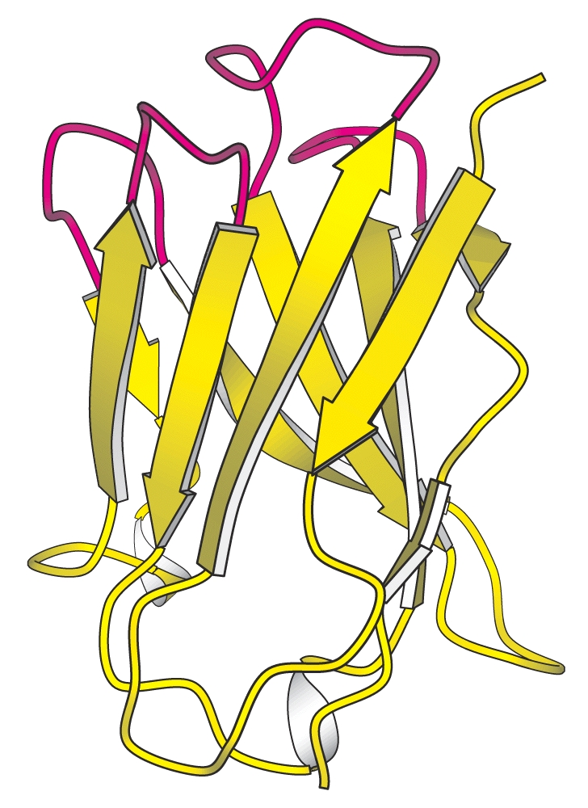
Examples of beta-sheet domains in proteins:

Slide 43
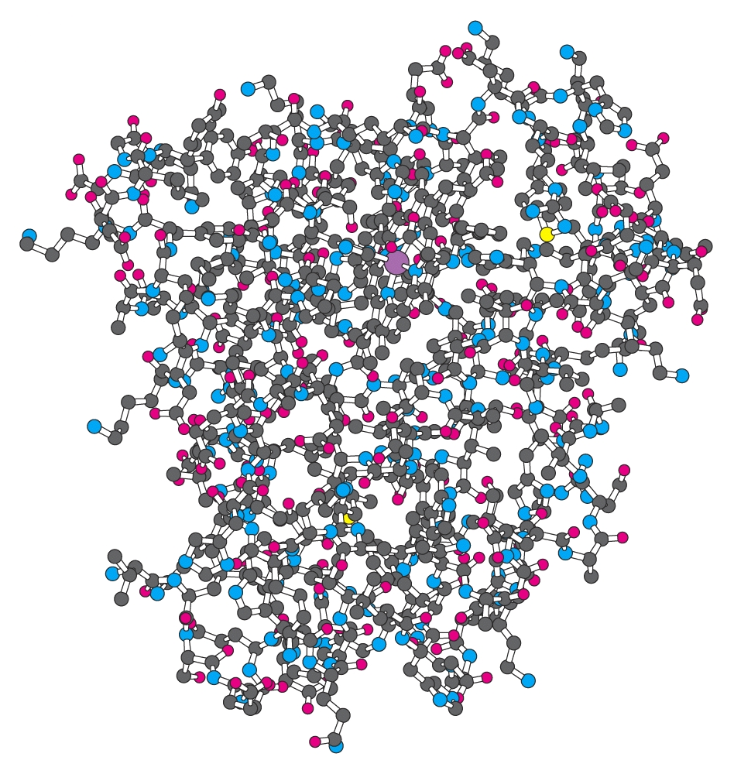
Tertiary (3°) Structure of Protein
Water-soluble proteins fold into compact structures with nonpolar cores.

Slide 44
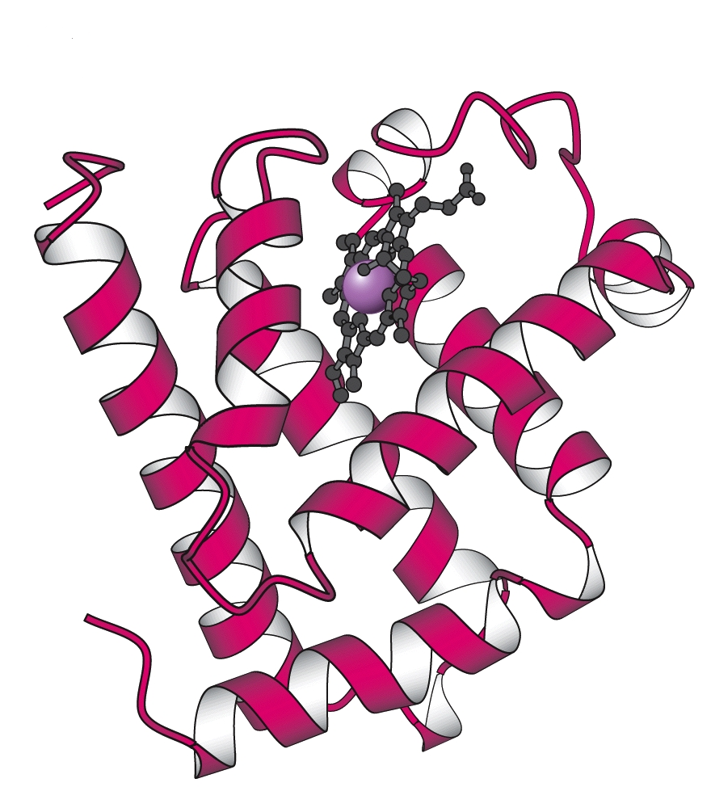
Tertiary (3°) Structure the Protein Myoglobin
Water-soluble proteins fold into compact structures with non-polar cores.

Slide 45
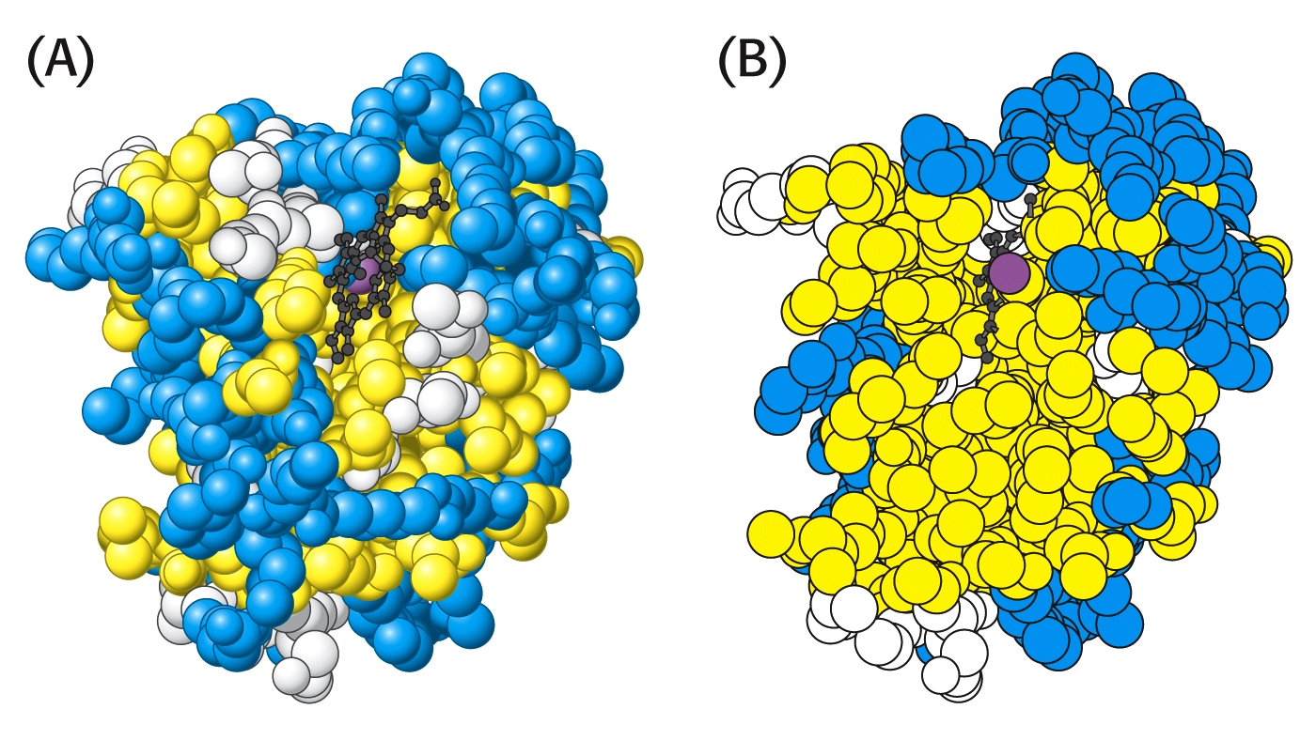
In the case of myoglobin and many other proteins, the majority of hydrophobic amino acids (yellow) are found inside in structure:

Slide 46
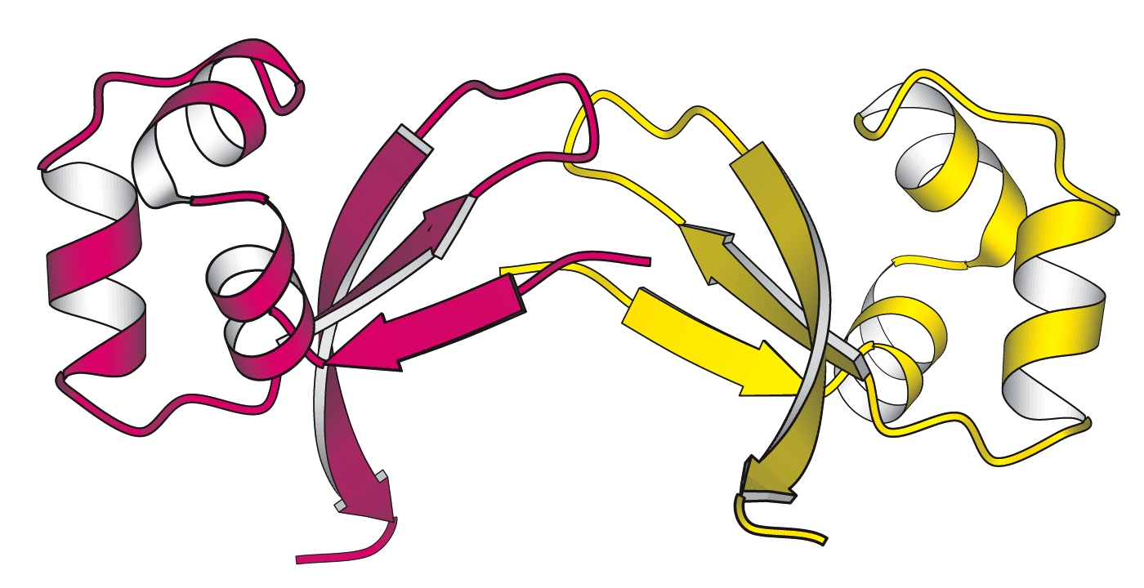
The Cro protein of Lambda bacteriophage is a dimer of identical subunits:

Slide 47
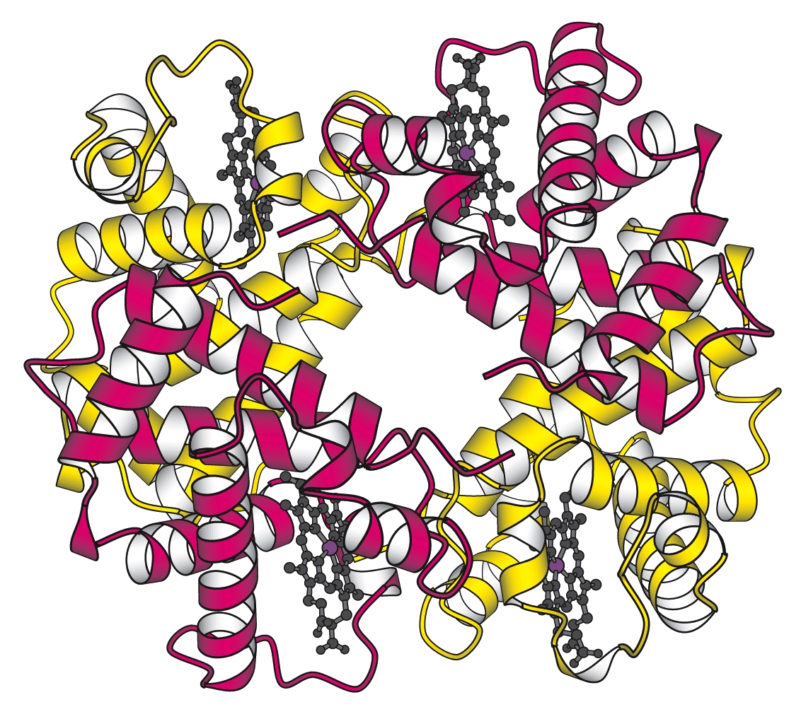
Hemoglobin is a protein tetramer, containing two identical pairs of subunits:

Slide 48
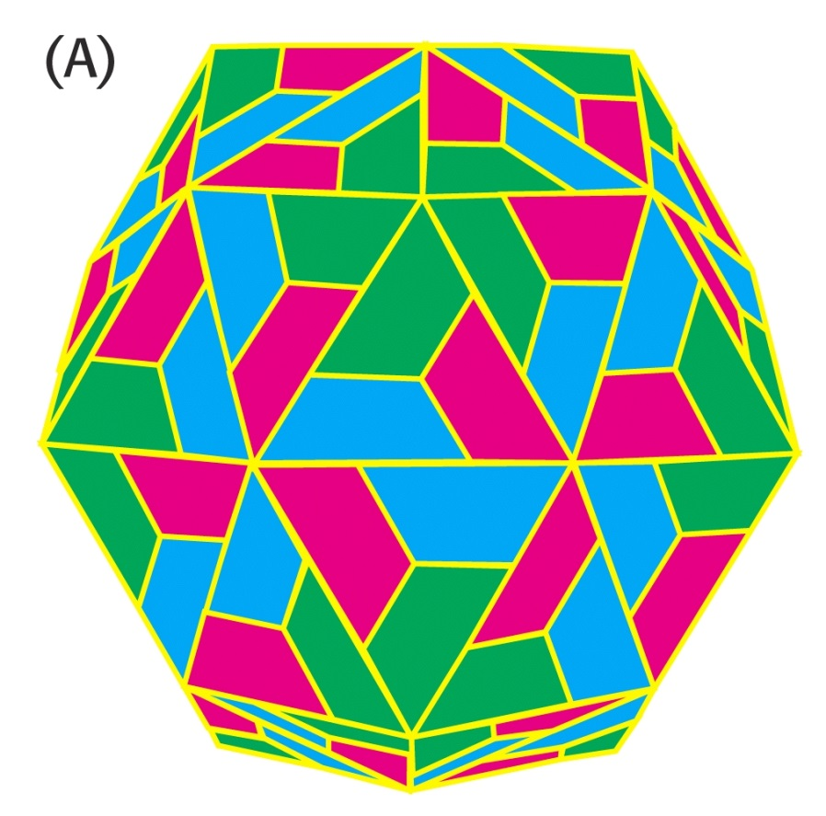
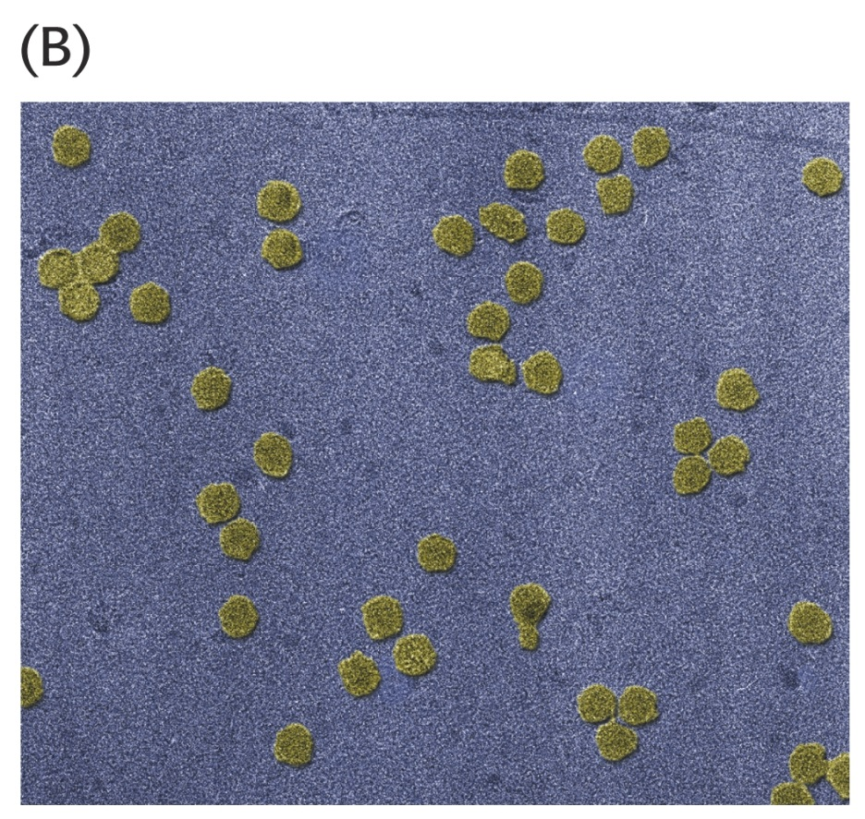
The coat of rhinovirus contains 60 copies of each of four subunits (240 total)!

Slide 49
In 1961 Christian Anfinsen published a classic landmark work that clearly showed tertiary structure was determined by primary structure!
His experiment was a classic example of well-designed experiments that did not require expensive equipment or years of work.
It deserves our attention.

Slide 50
Anfinson chose the enzyme, ribonuclease, for his experiments. This enzyme hydrolyzes RNA and is composed of a single polypeptide chain with 124 amino acids.
Four disulfide (cystine) linkages are observed in the active enzyme that stabilize the 3-D (3°) shape of the enzyme.
The enzyme functions only when its 3° structure is properly aligned.

Slide 51
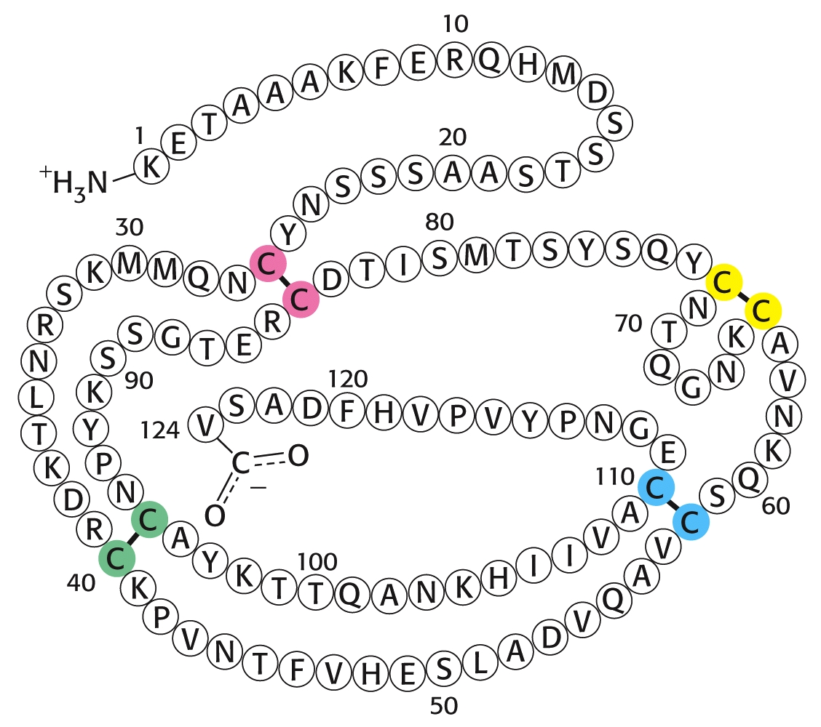
Amino acid sequence of ribonuclease:

Slide 52
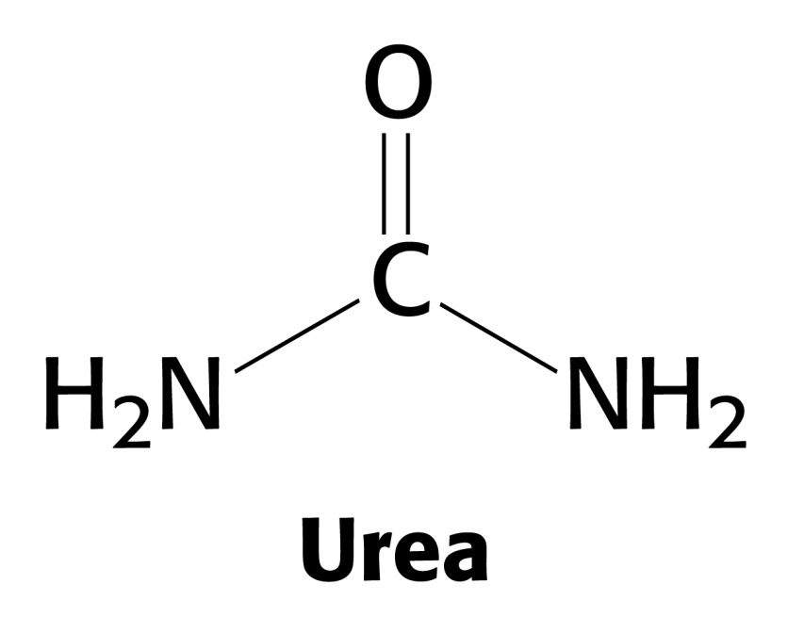
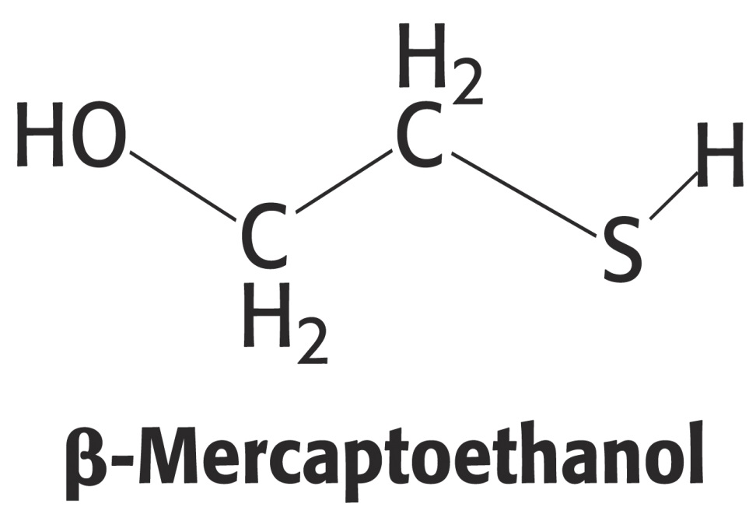
Anfinson used two chemicals to disrupt the enzyme’s 3° structure [DENATURATION ]
urea - disrupts hydrogen bonds
β-mercaptoethanol – reduces disulfide bonds

Slide 53
Anfinson’s Experiment:

Slide 54
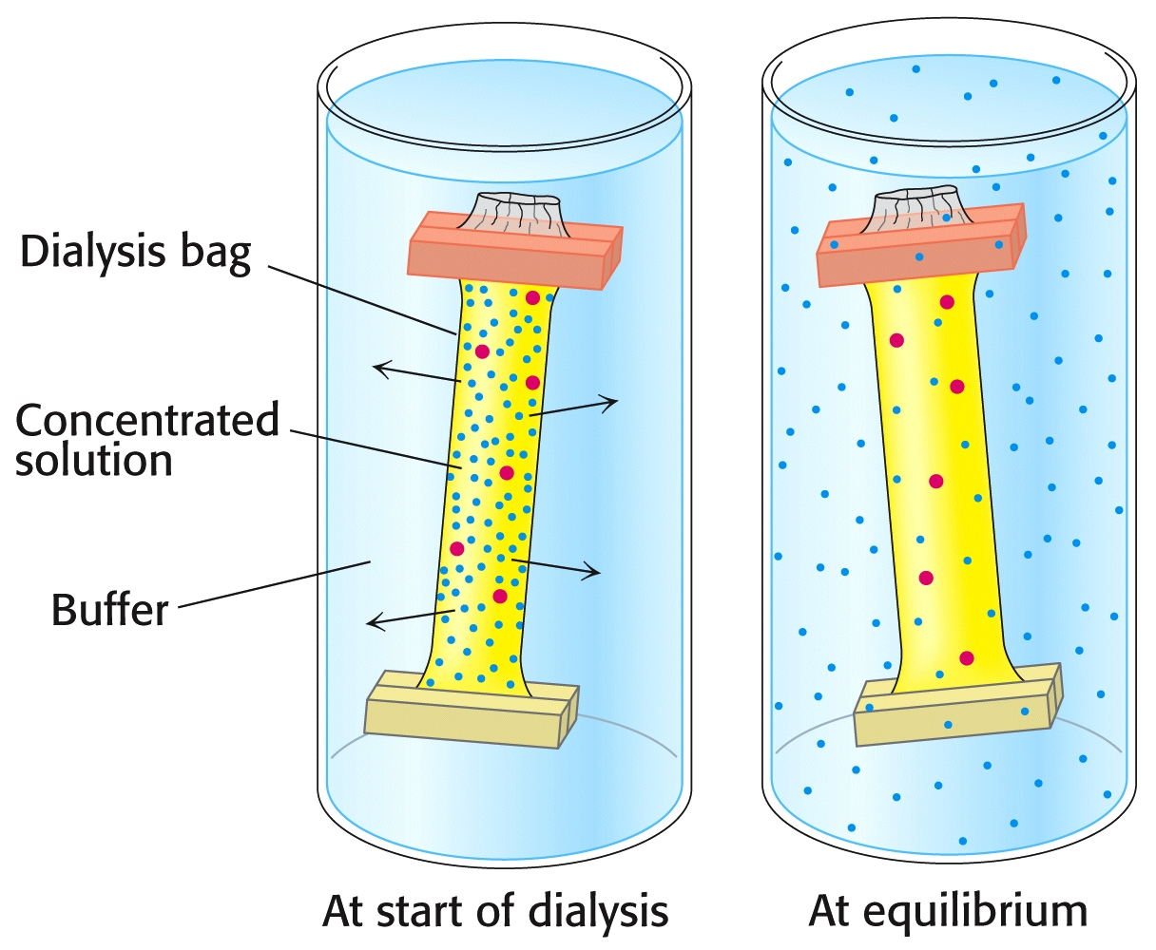
He also used dialysis to separate these chemicals from the enzyme in different orders.

Slide 55
By adding either one of these two chemicals to the surrounding medium, it is not removed during dialysis.
In essence, Anfinson could remove either the urea or the β-mercaptoethanol in any order he chose.
The order made a big difference in the enzymes ability to recover from the treatment!

Slide 56
Anfinson’s Experiment:
Experiment #1:
Add both urea and β-mercaptoethanol to a solution of enzyme. Activity is lost.
Remove urea by dialysis; then remove β-mercaptoethanol by dialysis. Activity is recovered 100%!
Experiment #2:
Add both urea and β-mercaptoethanol to a solution of enzyme. Activity is lost.
Remove β-mercaptoethanol by dialysis; then remove urea by dialysis. Only ~1% of activity is recovered. N = 8² = 64, 1/64 ~ 1%
Experiment #3:
Add β-mercaptoethanol to the solution from Exp.#2. Then, remove urea by dialysis;
Finally, remove β-mercaptoethanol by dialysis. Activity is recovered 100%!

Slide 57
Anfinson’s Experiment:

Slide 58
Forty years after Anfinson’s famous experiment, “chaperone” proteins were discovered.
Chaperones assist with protein folding inside of cells.
Read special review article and write about it (“IC:A1 Chaperones”) in Canvas.
What was Anfinson’s response to this discovery?

Slide 59
Inherently Unstructured Proteins (IUPs) & Metamorphs:
Some proteins can adopt multiple different structures.
In some cases, one of these folded forms can cause protein aggregation and subsequent pathological conditions.
“Metamorphic Proteins” change their folded forms when small molecules bind. One form will function properly, while the other form will not.

Slide 60
Some Neurological Diseases are Associated wtih Protein Misfolding
Alzheimer, Parkinson, Huntington diseases, and transmissible spongiform encephalopathies (prion disease), are associated with improperly folded proteins.
All of these diseases result in the deposition of protein aggregates, called amyloid fibrils or plaques.
These diseases are consequently referred to as amyloidoses. A common feature of amyloidoses is that normally soluble proteins are converted into insoluble fibrils rich in β-sheets.

Slide 61
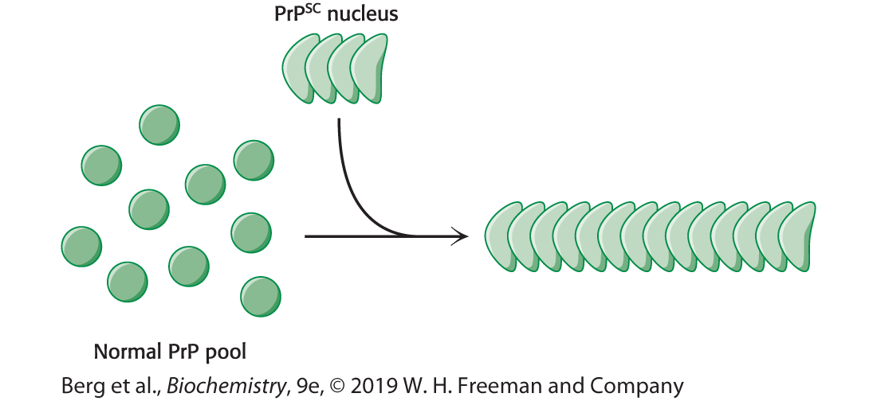
Infection Caused by Proteins?
Bovine spongiform encephalopathy (commonly referred to as mad cow disease) and the analogous diseases in other organisms, including Creutzfeld–Jakob disease (CJD) in human beings, scrapie in sheep, and chronic wasting disease in deer and elk are caused by agents that are similar to viruses by consist of ONLY PROTEINS called prions.
Prions are composed largely, if not exclusively, of a cellular protein called PrP in the brain. Normal PrP is rich in α-helicies, but when an abnormal PrPSC binds, it re-folds into a form rich in β-sheets that causes aggregation of the PrP proteins.

Slide 62
End of Lecture Slides
for
Amino Acids & Proteins
Credits: Most of the diagrams used in these slides were taken from Stryer, et.al, Biochemistry, 5th Ed., Freeman Press, Chapters 3-4 (Our course textbook).

