Slide 1

Chapter 5
Determining System Requirements
5.1

Slide 2
Learning Objectives
Describe options for designing and conducting interviews
Discuss planning an interview to determine system requirements
Explain advantages and disadvantages of observing workers and analyzing business documents to determine requirements
5.2

Slide 3
Learning Objectives (continued)
Learn about Joint Application Design (JAD) and Prototyping
Discuss appropriate methods to elicit system requests
Explain Business Process Reengineering (BPR)
Examine requirements determination for Internet applications
5.3

Slide 4
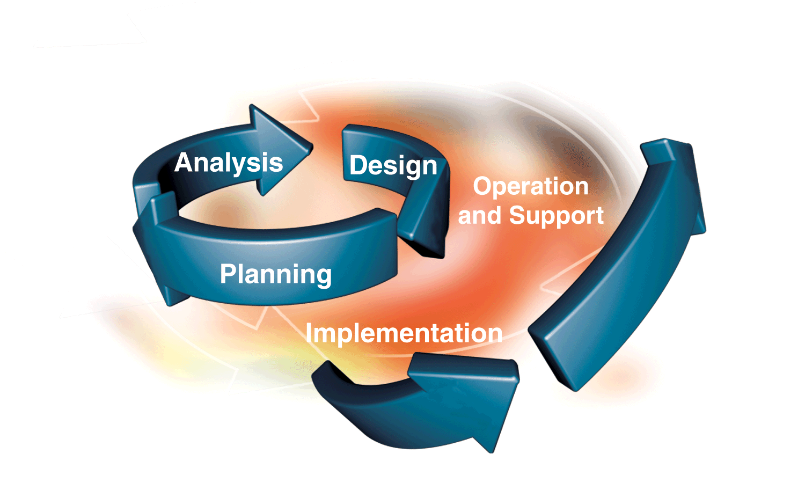
Part of Systems Analysis Phase in SDLC
Focus: Determining how a current information system functions
Question: If you encounter a system you have never used before, how do you find out how it works/what it does?

Slide 5


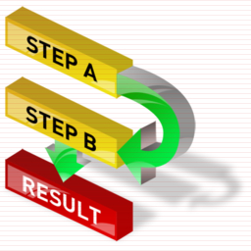
Performing Requirements Determination
Gather information on what system should do from many sources
  Users
  Reports
  Forms
  Procedures
5.5

Slide 6

Performing Requirements Determination (continued)
Characteristics for Gathering Requirements
  Impertinence
    Question everything
  Impartiality
    Find the best organizational solution
  Relaxation of constraints
    Assume anything is possible and eliminate the infeasible
  Attention to detail
    Every fact must fit with every other fact
  Reframing
    View the organization in new ways
5.6

Slide 7

Deliverables and Outcomes
Types of Deliverables:
  Information collected from users (transcripts, notes)
  Existing documents and files (training manuals, etc.)
  Computer-based information (reports)
  Understanding of organizational components
    Business objective
    Information needs
    Rules of data processing
    Key events
5.7

Slide 8

How to do it?
Interview
  Interview individuals involved, users, managers, programmers
Observe
  Watch users of the system
    How is it used? When is it used?
Study
  Study Business Documents
    Training manuals, policy manuals
5.8

Slide 9

Not always easy….

Slide 10
Method 1: Interview
Interviewing and Listening
  Gather facts, opinions, and speculations
  Observe body language and emotions
  Guidelines
    Plan the interview
      Checklist
      Appointment
    Be neutral
    Listen and take notes
    Seek a diverse view
5.10

Slide 11
Traditional Methods for Determining Requirements (continued)
Interviewing (Continued)
  Interview Questions
    Open-Ended
      No pre-specified answers
      Used to probe for unanticipated answers
    Close-Ended
      Respondent is asked to choose from a set of specified responses
      Work well when the popular answers to questions are known
      Do not require a long period of time, and can cover a greater number of topics
5.11

Slide 12
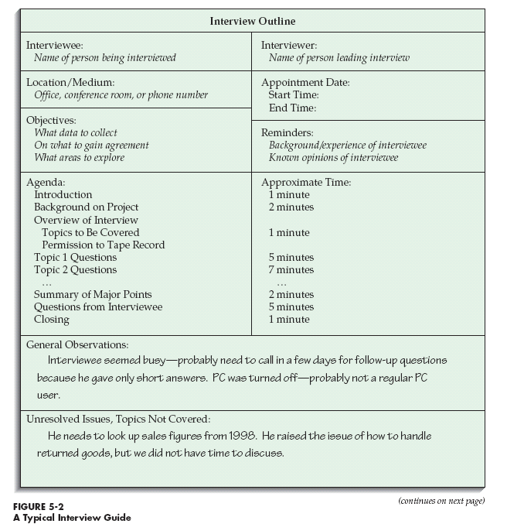

Using an interview guide can be helpful
Should you use pre-written questions?
5.12

Slide 13
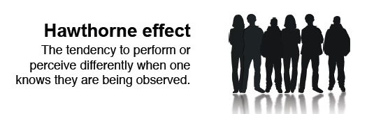
Method 2: Observing
Directly Observing Users
  Serves as a good method to supplement interviews
  Often difficult to obtain unbiased data
    People often work differently when being observed (Hawthorne affect)
5.13

Slide 14
Hawthorne Studies……….

Slide 15
Method 3: Study/Analyze
Study Business Documents- Policies, Procedures and Other Documents
Types of Information to Be Discovered:
  Problems with existing system
  Opportunity to meet new need
  Organizational direction
  Title and names of key individuals
  Values of organization
  Special information processing circumstances
  Rules for processing data
5.15

Slide 16
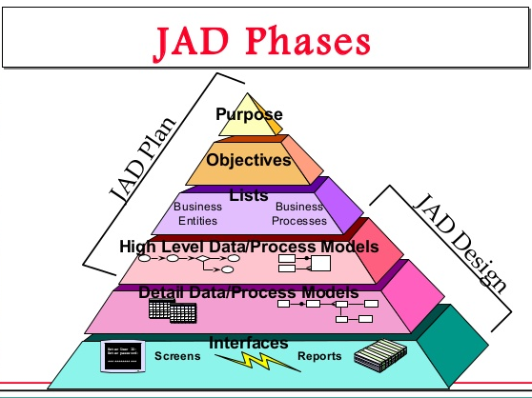
Modern Methods for Determining Requirements- Method 1: JAD
Joint Application Design (JAD)
  Brings together key users, managers, and systems analysts
  Purpose: collect system requirements simultaneously from key people
  Conducted off-site
  End Result: Documentation detailing Existing system and Features of a replacement system
Participants
  Session leader
  Users
  Managers
  Sponsor
  Systems analysts
  Scribe
  IS staff

Slide 17
5.17

Slide 18
Modern Method 2: Prototyping
Prototyping
  Repetitive process
  Rudimentary version of system is built
  Replaces or augments SDLC
  Goal: to develop concrete specifications for ultimate system
User quickly converts requirements to working version of system
Once the user sees requirements converted to system, will ask for modifications or will generate additional requests
5.18

Slide 19
Evolutionary Prototyping

Slide 20
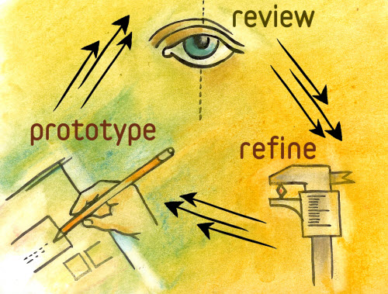
Prototyping (continued)
Most useful when:
  User requests are not clear
  Few users are involved in the system
  Designs are complex and require concrete form to evaluate fully
  History of communication problems between analysts and users
  Tools are readily available to build prototype
5.20

Slide 21
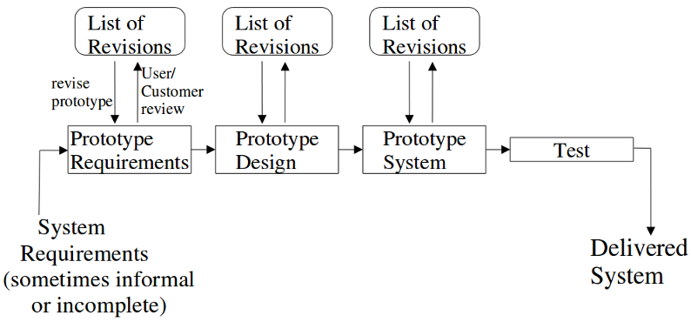
Prototyping (continued)
Drawbacks
  Tendency to avoid formal documentation
  Difficult to adapt to more general user audience
  Sharing data with other systems is often not considered
  Systems Development Life Cycle (SDLC) checks are often bypassed
5.21

Slide 22
How Google used prototyping for GoogleGlass

Slide 23
A different approach- Business Process Reengineering (BPR)
Search for and implementation of radical change in business processes to achieve breakthrough improvements in products and services
Goals
  Reorganize complete flow of data in major sections of an organization
  Eliminate unnecessary steps
  Combine steps
  Become more responsive to future change
5.23

Slide 24
Business Process Reengineering (BPR) (continued)
Identification of processes to reengineer
  Structured Processes vs. Dynamic Processes
    Structured-Well defined, encounter frequently, formalized
    Dynamic- Fluid, changing, no formalized procedure
  Key business processes
    Set of activities designed to produce specific output for a particular customer or market
    Focused on customers and outcome
    Same techniques are used as were used for requirements determination
5.24

Slide 25
Business Process Reengineering (BPR) (continued)
Identify specific activities that can be improved through BPR
Can take advantage of Disruptive Technologies
  Technologies that enable the breaking of long-held business rules that inhibit organizations from making radical business changes
The process is difficult, slow, and exceedingly expensive
Key personnel determine how best to use new technology
Requires high-level and expensive skills and considerable time
5.25

Slide 26
5.26

Slide 27
Summary
Interviews
  Open-ended and close-ended questions
  Preparation is key
Other means of gathering requirements are:
  Observing workers
  Analyzing business documents
5.27

Slide 28
Summary (continued)
Joint Application Design (JAD)
Prototyping
Business Process Reengineering (BPR)
  Disruptive technologies
5.28

