Slide 1

Chapter 4
Systems Planning and Selection
2.1

Slide 2
Identifying and Selecting Projects
Sources of Projects
  Managers and business units (want to replace or extend current system)
    Goal: to gain more information or provide new services
  IS Managers
    Goal: to make a system more efficient, less costly, or want a new operating environment
  Formal planning groups
    Goal: to improve an existing system in order to help the organization meet its corporate objectives
4.2

Slide 3
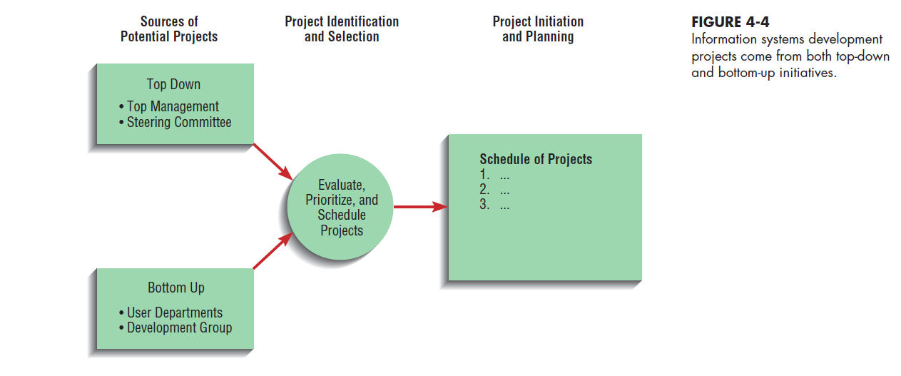
Identifying and Selecting Projects
1. Projects are identified by
    Top management
    *Strategic Organizational Focus
    Steering committee
    *Cross-Functional Focus
    User departments
    *Tactical narrow Focus
    Development group or senior IS staff
    * Focus on Ease of Integration
→Top Down
→Bottom Up
4.3

Slide 4
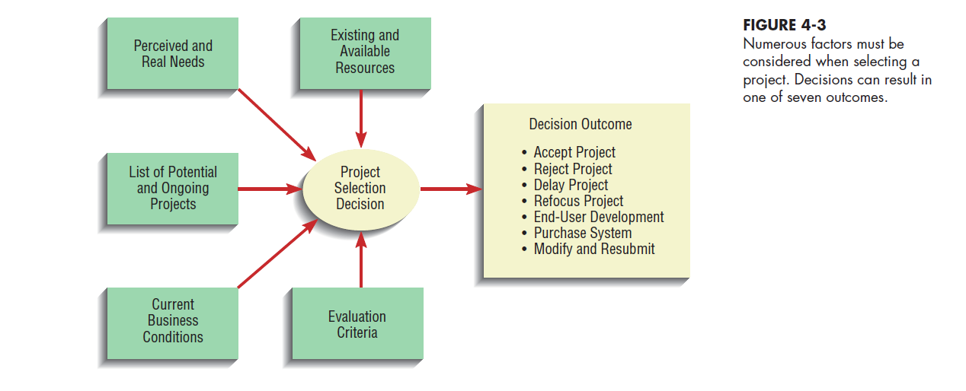
Identifying and Selecting Projects (cont)
Classify and rank development projects
    *Assessing the merit of potential projects
    - Value Chain? Strategic Alignment? Potential Benefits? Resource
    Availability? Project duration? Technical Difficulty?
3. Select development projects- Choose the right project
4.4

Slide 5
Identifying and Selecting Projects (continued)
Deliverables and Outcomes
  Primary deliverable of this phase is a schedule of specific IS development projects
    List of all the possible projects and how you evaluated them
  Just because you have now selected a project it does not mean it will become a working system
    *Incremental commitment - Continuous reassessment of project after each phase
4.5

Slide 6
Initiating and Planning System Development Projects
Objectives- What you will create in this phase
  Baseline Project Plan (BPP) – best estimate of the project’s scope, benefits, costs, risks and resource requirements
    Internal document (see example here)
  Project Scope Statement – Short document that describes what project will deliver (high level summary of BPP)
    Prepared for external and internal stakeholders
    Provides a high-level overview of the project
4.6

Slide 7
Assessing Project Feasibility
Six Categories*
  Economic- financial benefits and costs?
  Operational – solves business problems?
  Technical – Can we make this?
  Schedule – Is the timeframe realistic?
  Legal and contractual – Will we get sued?
  Political – Will this piss off our shareholders?
    (* To address each of these in your baseline project plan document for final project)
4.7

Slide 8
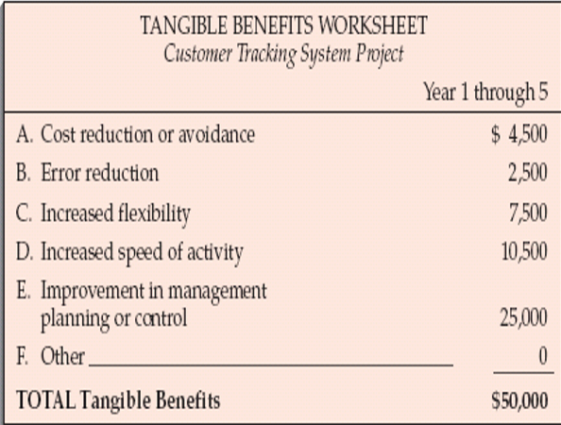
Assessing Economic Feasibility
Economic Feasibility is also called: Cost–Benefit Analysis
  Determine : Tangible benefits
    Can be measured easily (can put $ next to items)
      Examples
        Cost reduction and avoidance
        Error reduction
        Increased speed of activity
        Increased management planning and control
  Example? Develop a new app that does….?
    What are the tangible benefits?
4.8

Slide 9
Assessing Economic Feasibility
  Determine: Intangible Benefits
    Cannot be measured easily- derived from creation of system (can’t put $ next to these…)
    Examples
      Increased organizational flexibility
      Increased employee morale
      Competitive necessity
      More timely information
      Promotion of organizational learning and understanding
  Example? Intangible benefits for our new app?
4.9

Slide 10
Assessing Economic Feasibility (Costs)
Determine Costs
  Tangible Costs
    Can easily be measured in dollars—Example? What tangible costs for developing our new app?
  Intangible costs
    Cannot be easily measured in dollars—Example? What intangible costs for developing our new app?
  One-Time Costs vs. Recurring Costs
      One-Time Costs
      System development
      New hardware and software purchases
      User training
      Site preparation
      Data or system conversion
      Recurring Costs
      Application software maintenance
      Incremental data storage expense
      Incremental communications
      New software and hardware releases
      Consumable supplies
4.10

Slide 11
Building the Baseline Project Plan
Objectives
  Assures that customer and development group have a complete understanding of the proposed system and requirements
  Provides sponsoring organization with a clear idea of scope, benefits and duration of project
Four Sections of a Baseline Project Plan:
  Introduction
  System description
  Feasibility assessment
  Management issues
4.11

Slide 12
Building the Baseline
Project Plan (continued)
Introduction
  Brief overview
  Recommended course of action
  Project scope defined
    Units affected
    Interaction with other systems
    Range of system capabilities
4.12

Slide 13
Building the Baseline
Project Plan (continued)
System Description
  Outline of possible alternative solutions
  Narrative format
Feasibility Assessment
  Project costs and benefits
  Technical difficulties
  High-level project schedule
4.13

Slide 14
Building the Baseline
Project Plan (continued)
Management Issues
  Outlines concerns that management may have about the project
  Team composition
  Communication plan
  Project standards and procedures
4.14

Slide 15
4.15

Slide 16
Before moving on from this phase you must:
Review the Baseline Project Plan
Objectives?
  Assure conformity to organizational standards
  All parties must agree to continue with project
    To perform this review a Walkthrough can be done
    *Walkthrough is a peer-group review of any product created during the systems development process
4.16

Slide 17
Reviewing the Baseline Project Plan (continued)
Walkthrough
  Peer group review
  Participants
    Coordinator – plans meeting, facilitates discussion
    Presenter- describes the work (usually the analyst)
    User- Makes sure work meets needs of customers
    Secretary- Takes notes
    Standard Bearer- Ensures work adheres to organizational standards
    Maintenance Oracle- reviews work in terms of future maintenance activities
4.17

Slide 18
Summary
Project Identification and Selection involves:
  Identifying potential projects
  Classifying and ranking of projects
  Selecting projects
Baseline Project Plan (BPP)
  Created during project initiation and planning
4.18

Slide 19
Summary (continued)
  Contains:
    Introduction
    High-level description of system
    Outline of feasibility
    Overview of management issues
Project Scope Statement
  Describes what project will deliver
4.19

Slide 20
Summary (continued)
Feasibility
  Economic
  Operational
  Technical
  Schedule
  Legal
  Contractual
  Political
4.20

Slide 21
Summary (continued)
Benefits
  Tangible vs. Intangible
Costs
  Tangible vs. Intangible
  One-time vs. Recurring
4.21

