Slide 1

Chapter 2
The Sources of Software
2.1

Slide 2
Learning Objectives
Understand outsourcing
Describe six different sources of software
Discuss how to evaluate off-the-shelf software
Explain reuse and its role in software development
2.2

Slide 3
Outsourcing
Practice of turning over some or all responsibility for information systems applications and operations to another firm.
Examples:
  Outsourcing firm develops and runs applications on their computers (Payroll application)
  Outsourcing firm runs applications at your site on your computers.
Reasons to outsource
  Cost effective
  Overcome organizational problems in information systems unit
Outsourcing should be considered during systems analysis
Outsourcing Good
Outsourcing Bad
2.3

Slide 4
Sources of Software
Information Technology Service Firms
  Utilized when
    Organization lacks resources to develop in-house system
    Suitable off-the-shelf solution is not available
  Help companies develop custom information systems for internal use
  Develop, host and run applications
  Provide other services
  IT Service firms employ consultants with domain-specific experience
2.4

Slide 5
Sources of Software (Continued)
Packaged Software Producers
  Produce pre-packed or off the shelf systems
  Products range from broad-based packages to industry specific packages
  Two types of software
    Turnkey – cannot be modified to meet specific users needs
    Non-turnkey – can be modified
  Off-the-shelf software can meet up to 70% of an organization’s needs.
2.5

Slide 6
Sources of Software (Continued)
Enterprise Solutions Software
  Also called Enterprise Resource Planning (ERP) Systems
  Consist of a series of integrated modules
    Each module supports individual traditional business function
      Accounting
      Distribution
      Manufacturing
      Human Resources
    Integrated to focus on business processes rather than business functional areas
  Enables an organization to integrate all parts of a business process in a unified information system
    All aspects of a transaction occur seamlessly in single information system
    Example
2.6

Slide 7
Sources of Software (Continued)
  Benefits of ERP
    Single repository for all aspects of a business process
      Ensures more consistent and accurate data
      Less maintenance
    Flexibility of modules
      Additional modules can be added as needed
      Additional modules are immediately integrated into existing system
2.7

Slide 8
Sources of Software
ERP Systems (Continued)
  Disadvantages of ERP
    Complexity of implementation
      Extended implementation time
    Reliance upon consultants
    Often, organizations must change the way that they do business in order to use systems
  ERP vendors
    SAP
    Oracle
2.8

Slide 9
Sources of Software
(Continued)
Cloud Computing
  Software is rented or licensed from third party providers
    Run at remote sites
  Applications are accessed through the Internet or a VPN
  Applications bought, installed and maintained by service provider
  Users pay per-use or month-to-month license
  Includes software as a service as well as hardware as a service
  Some examples:
    Google Apps
    Salesforce.com
    Amazon Web Services
2.9

Slide 10
Sources of Software
Cloud Computing (Continued)
  As of end 2015, has created appx. 14 million new jobs.
    Total market of $1.1 trillion.
  Reasons for Choosing Cloud
    Freeing internal IT staff
    Faster access to applications than internal development
    Lower-cost access to corporate-quality applications
2.10

Slide 11
Sources of Software
Cloud Computing (Continued)
  Concerns
    Reliability
    Security
    Compliance with government regulations
      Sarbanes-Oxley
2.11

Slide 12
Sources of Software
(Continued)
Open-Source Software
  Freely available
  Includes source-code
  Maintained by a group of interested individuals
  Some examples
    Linux, Firefox, MySQL
    Why Opensource (Goldman Sachs)
2.12

Slide 13
Sources of Software
(Continued)
In-House Development
  Complete system
  Hybrid systems
2.13

Slide 14
Choosing Off-the-Shelf Software
Criteria
  Cost
    In-house versus purchase
  Functionality
  Vendor Support
  Viability of Vendor
  Flexibility
  Documentation
  Response Time
  Ease of Installation
2.14

Slide 15
Validating Purchased Software Information
Information from vendor
  Documentation
  Marketing literature
  Questionnaire
Request for Proposal
Software Test drive
Feedback from other users
Independent software testing services
2.15

Slide 16
Reuse (use what’s worked for us before - in other/new ways)
Use of previously written software resources in new applications
Most often applied to object-oriented and component-based development
Reuse of object classes
  Increases productivity
  Reduces defect density
  Reduces rework
Reuse plan must be matched with companies strategic business goals
2.16

Slide 17
Reuse (Continued)
Four Approaches for a reuse policy
  1. Ad hoc Reuse – no policy
  2. Facilitated Reuse – encouraged (not required)
  3. Managed Reuse – mandated
  4. Designed Reuse – mandated, code must be originally designed for future reuse in initial development, corporate office that controls/manages all of this
2.17

Slide 18


Chapter 3
Managing the Information Systems Project
1.1

Slide 19
Learning Objectives
Discuss skills required to be an effective project manager
Describe skills and activities of a project manager during project initiation, planning, execution and closedown
Discuss critical path scheduling
Explain Gantt Charts and Network Diagrams
Review commercial project management software packages
3.19

Slide 20

Pine Valley Furniture
Manufacturing Company
  Product: Wood Furniture
  Market: United States
  Organized into functional areas
    Manufacturing Accounting
    Sales Purchasing
  Three independent computer systems were converted to a database in 1990s
3.20

Slide 21
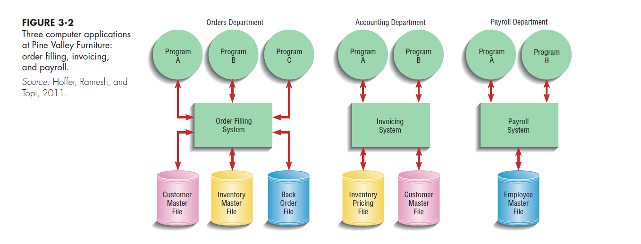
Old systems that PVF wanted to possibly convert to database
3.21

Slide 22

How can PVF effectively convert to new system? Aka…Managing the Information Systems Project
Focus of Project Management
  To assure that information system projects meet customer expectations
    Delivered in a timely manner
    Meet constraints and requirements
3.22

Slide 23
Managing the Information Systems Project (continued)
Project Manager
  Systems Analyst responsible for
    Project initiation
    Planning
    Execution
    Closing down
  Requires diverse set of skills
    Management
    Leadership
    Technical
    Conflict management
    Customer relations
3.23

Slide 24
Project Management
3.24

Slide 25
Project Management Process
Project
  Planned undertaking of related activities to reach an objective that has a beginning and an end
Four Phases
  Initiating
  Planning
  Executing
  Closing down
3.25

Slide 26

Why Projects Fail

Slide 27
Phase 1: Initiating the Project
Establish the project initiation team
Establish a relationship with the customer
Establish the project initiation plan
Establish management procedures
Establish the project management environment and workbook
Develop the project charter
3.27

Slide 28
Phase 2:Planning the Project
1. Describe project scope, alternatives and feasibility
  Scope and Feasibility
    Understand the project
    What problem is to be addressed
    What results are to be achieved
    Measures of success
    Completion criteria
2. Divide the project into manageable tasks
    Work breakdown structure
    Gantt chart
3.28

Slide 29
Phase 2 (continued)
Estimate resources and create a resource plan.
Develop a preliminary schedule
    Utilize Gantt Charts and Network Diagrams
5. Develop a communication plan
  Outline communication processes among customers, team members and management
  Define types of reports and their distribution
  Determine frequency of reports
3.29

Slide 30
Phase 2 (continued)
6. Determine project standards and procedures
  Specify how deliverables are tested and produced
7. Identify and assess risk
  Identify sources of risk
  Estimate consequences of risk
Create a preliminary budget
9. Develop a project scope statement
  Describe what the project will deliver
10. Set a baseline project plan
  Estimate of project’s tasks and resources
3.30

Slide 31
Phase 3: Executing the Project
1. Execute baseline project plan
  Acquire and assign resources, Train new team members, keep project on schedule
2. Monitor project progress
  Adjust resources, budget, and/or activities
3. Manage changes to baseline project plan
  Slipped completion dates, redo mess-ups, changes in personnel, New activities
4. Maintain project workbook
5. Communicate project status
3.31

Slide 32
Phase 4: Closing Down the Project
1. Termination
  2 Types of termination:
    Natural - Requirements have been met
    Unnatural - Project stopped
  Documentation
  Personnel Appraisal
2. Conduct post-project reviews
  Determine strengths and weaknesses of
    1)Project deliverables, 2)Project management process, 3) Development Process
3. Close customer contract
3.32

Slide 33
Representing and Scheduling Project Plans
Gantt Charts
  Useful for depicting simple projects or parts of large projects
  Show start and completion dates for individual tasks
Network Diagrams
  Show order of activities
3.33

Slide 34
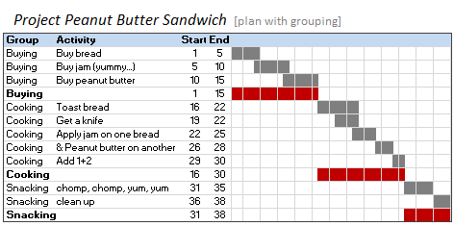
Gantt

Slide 35
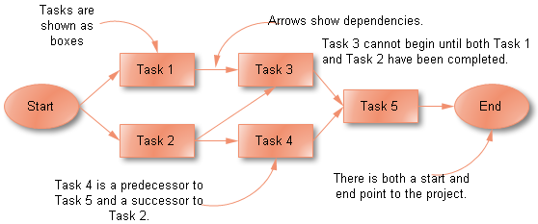
Network Diagram

Slide 36
Comparison of Gantt Charts and Network Diagrams
Gantt Charts
  Visually show duration of tasks
  Visually show time overlap between tasks
  Visually show slack time
Network Diagrams
  Visually show dependencies between tasks
  Visually show which tasks can be done in parallel
  Show slack time by data in rectangles
3.36

Slide 37
Representing Project Plans
Network diagramming is a critical path scheduling technique
Used when tasks
  Are well-defined and have a clear beginning and end point
  Can be worked on independently of other tasks
  Are ordered
  Serve the purpose of the project
Major strength is ability to show how completion times vary by activity
3.37

Slide 38
Gantt Chart and Network Diagram for Pine Valley Furniture
Steps
  1. Identify each activity
    Requirements collection
    Screen design
    Report design
    Database construction
    User documentation creation
    Software programming
    Installation and testing
3.38

Slide 39
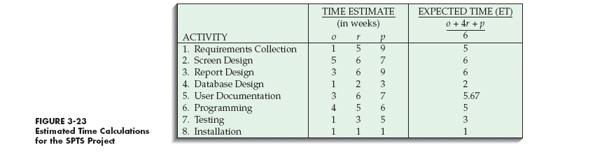
Gantt Chart and Network Diagram for Pine Valley Furniture (continued)
  2. Determine time estimates and expected completion times for each activity
3.39

Slide 40
Gantt Chart and Network Diagram for Pine Valley Furniture (continued)
  Determine sequence of activities
3.40

Slide 41
Gantt Chart and Network Diagram for Pine Valley Furniture (continued)
  Determine the critical path
    Sequence of events that will affect the final project delivery date
3.41

