Slide 1
Chapter 10
Systems Implementation and Operation
10.1

Slide 2
Learning Objectives
Describe the process of coding, testing, and converting an organizational information system
Discuss four installation strategies
Direct
Parallel
Single location
Phased installation
Describe the deliverables for documenting the system and for training and supporting the users
10.2

Slide 3
Learning Objectives (continued)
Compare the many modes available for organizational system training, including self-training and electronic performance support systems
Discuss the issues of providing support to end users
Discuss system implementation failure
Explain four types of maintenance
Describe several factors that influence the cost of maintaining an information system
10.3

Slide 4
System Implementation and Operation
Seven major activities
Coding
Testing
Installation
Documentation
Training
Support
Maintenance
Purpose
To convert final physical system specifications into working and reliable software
To document work that has been done
To provide help for current and future users
10.4

Slide 5
The Processes of Coding, Testing and Installation
Coding
Physical design specifications are turned into working computer code
Testing
Tests are performed using various strategies
Testing can be performed in parallel with coding
Installation
Process during which the current system is replaced by the new system
10.5

Slide 6
The Processes of Documenting the System, Training Users, and Supporting Users
Two audiences for documentation
The information systems personnel who will maintain the system throughout its productive life
The people who will use the system as part of their daily lives
Deliverables
Documentation
System documentation
User documentation
User training plan
Classes
Tutorials
User training modules
Training materials
Computer-based training aids
User support plan
Help desk
On-line help
Bulletin boards and other support mechanisms
10.6

Slide 7
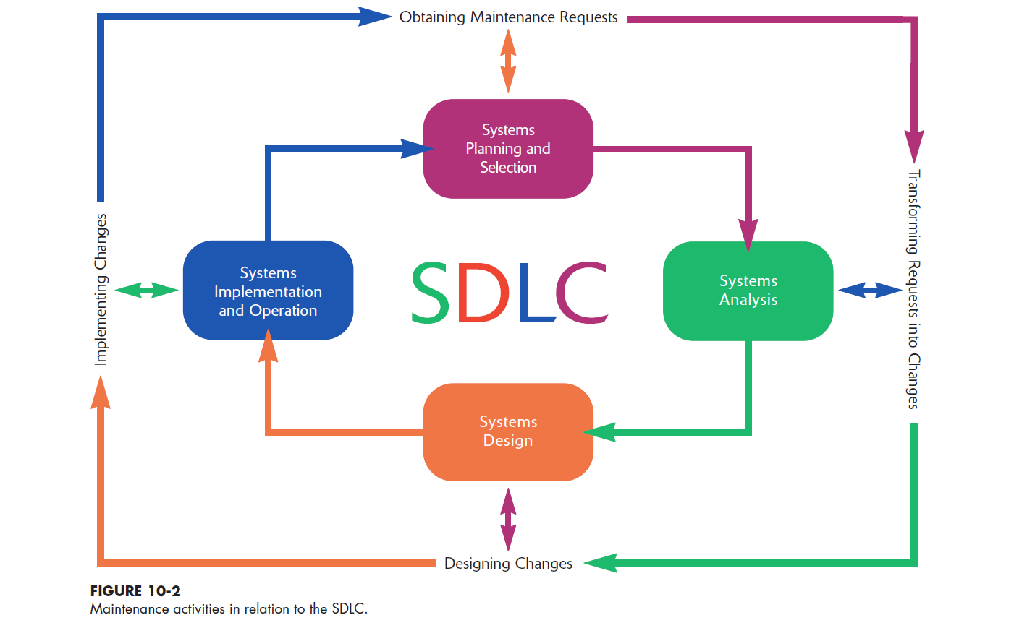
The Process of Maintaining Information Systems
Process of returning to the beginning of the SDLC and repeating development steps focusing on system change until the change is implemented
Four major activities:
1. Obtaining maintenance requests
2. Transforming requests into changes
3. Designing changes
4. Implementing changes
Deliverables and Outcomes
Development of a new version of the software, new versions of all design documents, and training materials created or modified during the maintenance effort
10.7

Slide 8
Software Application Testing
A test plan is developed during the analysis phase
During the design phase, a unit test plan and a system test plan are developed
The actual testing is done during implementation
Test plans provide improved communication among all parties involved in testing
Serve as checklists
10.8

Slide 9
Software Application Testing The Testing Process
The purpose of the testing is to confirm that the system satisfies requirements
Testing must be planned
Test Case
A specific scenario of transactions, queries, or navigation paths that represent a typical, critical, or abnormal use of the system
Test cases and results should be thoroughly documented so they can be repeated for each revision of an application
10.9

Slide 10
Software Application Testing Types of Testing
Inspection
A testing technique in which participants examine program code for predictable language-specific errors
Walkthrough
A peer group review of any product created during the systems development process; also called a structured walkthrough
Desk Checking
A testing technique in which the program code is sequentially executed manually by the reviewer
10.10

Slide 11
Software Application Testing Types of Testing (continued)
Unit Testing
Each module is tested alone in an attempt to discover any errors in its code, also called module testing
Integration Testing
The process of bringing together all of the modules that a program comprises for testing purposes; modules are typically integrated in a top-down, incremental fashion
10.11

Slide 12
Software Application Testing Types of Testing (continued)
System Testing
The bringing together of all the programs that a system comprises for testing purposes; programs are typically integrated in a top-down, incremental fashion
Stub Testing
A technique used in testing, especially where modules are written and tested in a top-down fashion, where a few lines of code are used to substitute for subordinate modules
10.12

Slide 13
Software Application Testing: Acceptance Testing by Users
The process whereby actual users test a completed information system, the end result of which is the users’ acceptance of it
Alpha Testing
User testing of a completed information system using simulated data
Recovery testing
Forces the software (or environment) to fail in order to verify that recovery is properly performed
Security testing
Verifies that protection mechanisms built into the system will protect it from improper penetration
Stress testing
Tries to break the system
Performance testing
Determines how the system performs on the range of possible environments in which it may be used
Beta Testing
User testing of a completed information system using real data in the real user environment

Slide 14
Installation→ The organizational process of changing over from the current information system to a new one
Four approaches
Direct Installation
Changing over from the old information system to a new one by turning off the old system when the new one is turned on
Parallel Installation
Running the old information system and the new one at the same time until management decides the old system can be turned off
Single location installation
Trying out an information system at one site and using the experience to decide if and how the new system should be deployed throughout the organization
Phased Installation
Changing from the old information system to the new one incrementally, starting with one or a few functional components and then gradually extending the installation to cover the whole new system
10.14

Slide 15
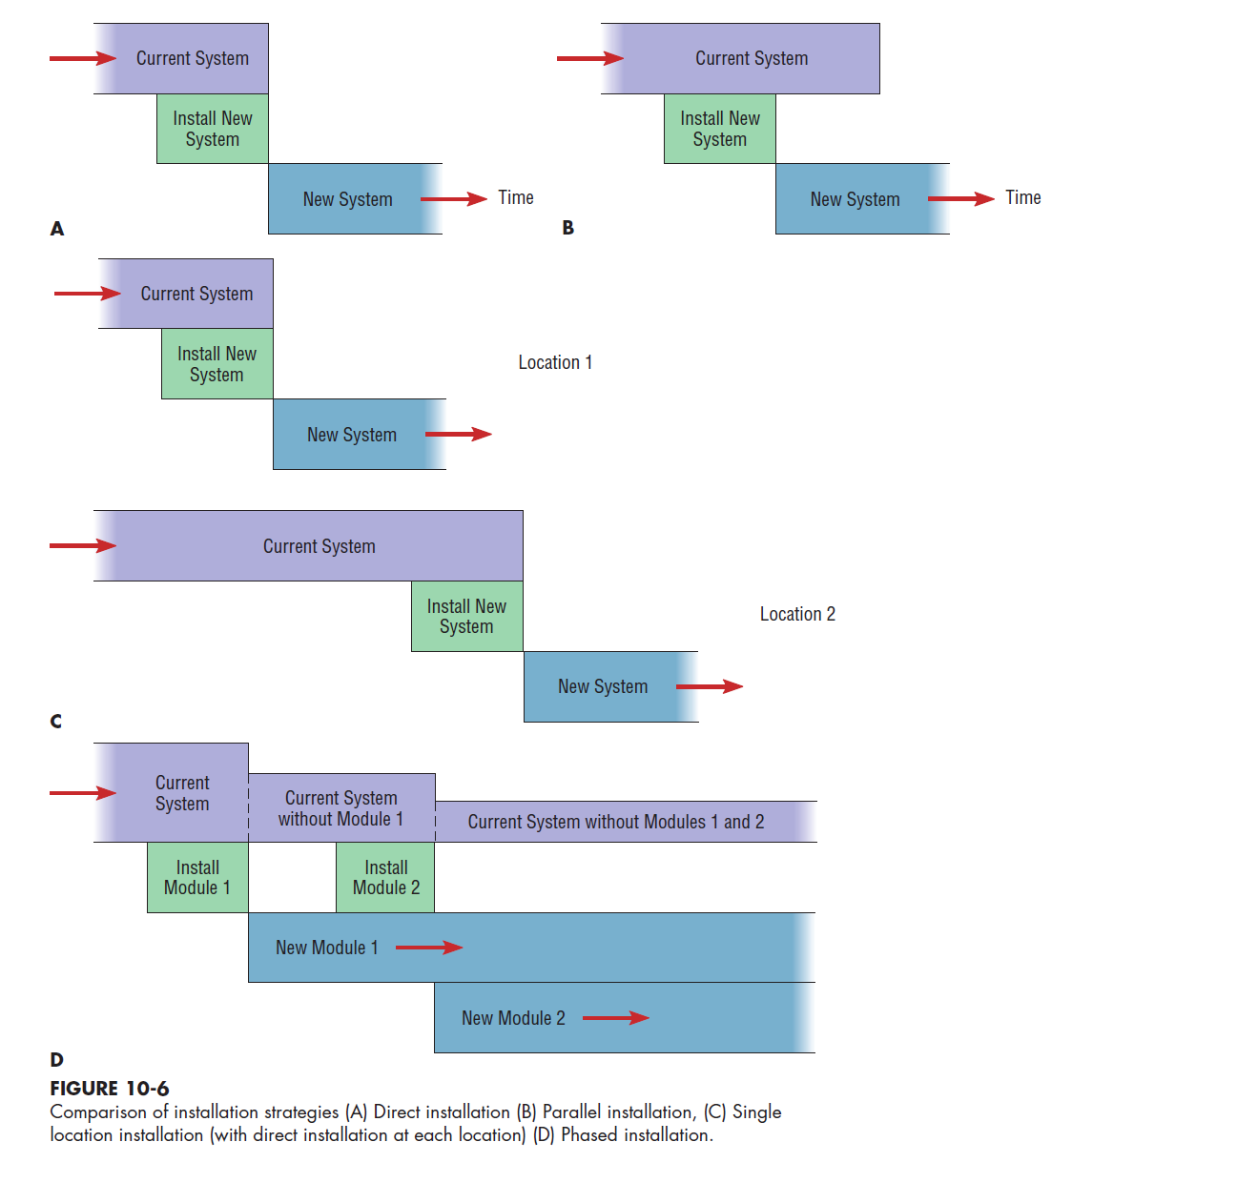
10.15

Slide 16
Documenting the System
System Documentation - Detailed information about a system’s design specifications, its internal workings, and its functionality
Internal documentation
System documentation that is part of the program source code or is generated at compile time
External documentation
System documentation that includes the outcome of structured diagramming techniques such as data-flow and entity-relationship diagrams
User Documentation - Written, or other visual information, about an application system, how it works, and how to use it
Preparing User Documentation
Traditional source has been information systems department
Application-oriented documentation is now often supplied by vendors and users themselves
10.16

Slide 17
Training Information System Users
Potential Training Topics
Use of the system
General computer concepts
Information system concepts
Organizational concepts
System management
System installation
Training Methods
Resident expert
Computer-aided instruction
Formal courses
Software help components
Tutorials
Interactive training manuals
External sources, such as vendors
10.17

Slide 18
Supporting Information System Users
Support is extremely important to users
Need for support driven by
Lack of standards
Need to make equipment and software from different vendors compatible
Most organizations provide support by several means:
Automated issue tracker
Automated support
Help desk
10.18

Slide 19
Why Implementation Sometimes Fails
Two conditions necessary for a successful implementation:
Management support of the system under development
Involvement of users in the development process
Factors to consider
Risk
Commitment to the project
Commitment to change
Extent of project definition and planning
Realistic user expectations
Implementation success factors
Extent to which system is used
System ease of use and reliability
Users’ satisfaction with system
User demographics, such as age and degree of computer experience
10.19

Slide 20
Project Closedown
Evaluate team
Reassign members to other projects
Notify all affected parties that the development project is ending and that you are switching to operation and maintenance mode
Conduct post project reviews
Close out customer contract
Formal signoff
10.20

Slide 21
After Implementation→Conducting System Maintenance: Types of Maintenance
4 Common Categories of Maintenance
Corrective maintenance
Changes made to a system to repair flaws in its design, coding, or implementation
Adaptive maintenance
Changes made to a system to evolve its functionality to changing business needs or technologies
Perfective maintenance
Changes made to a system to add new features or to improve performance
Preventive maintenance
Changes made to a system to avoid possible future problems
10.21

Slide 22
Conducting System Maintenance: The Cost of Maintenance
Many organizations allocate as much as 60 to 80 percent of information systems budget to maintenance
Factors that influence system maintainability:
Latent defects
Number of customers for a given system
Quality of system documentation
Maintenance personnel
Tools
Well-structured programs
Why should companies consider how effective their IS maintenance is?
10.22

Slide 23
Conducting System Maintenance Measures of Effectiveness
Number of Failures
Time between Each Failure
Type of Failure
Mean Time between Failures (MTBF)
A measurement of error occurrences that can be tracked over time to indicate the quality of a system
10.23

Slide 24
Summary
Process of coding, testing, and converting an organizational information system
Four installation strategies:
Direct
Parallel
Single location
Phased installation
10.24

Slide 25
Summary (continued)
Documentation
System
User
User Training
Providing Support for End Users
Systems Implementation Failures
10.25

Slide 26
Summary (continued)
Maintenance
Corrective
Adaptive
Perfective
Preventive
Cost of Maintenance
Measuring Effectiveness of Maintenance
10.26

