Slide 1
Chapter 1
The Systems Development Environment
1.1

Slide 2
Learning Objectives
Define information systems analysis and design
Describe the role of the systems analyst in information systems development
Describe the information systems development life cycle (SDLC)
1.2

Slide 3
Learning Objectives (continued)
List alternatives to the systems development life cycle, including a description of the role of computer aided software engineering (CASE) tools in systems development
1.3

Slide 4
Chapter Preview
Systems Analysis is a proven method to help a business utilize information to its fullest capacity
Systems Development Life Cycle (SDLC)
Central to Information Systems Development
1.5

Slide 5
What is Information Systems Analysis and Design?
A method used by companies to create and maintain systems that perform basic business functions
Main goal is to improve employee efficiency by applying software solutions to key business tasks
A structured approach must be used in order to ensure success
1.6

Slide 6
What is Information Systems Analysis and Design? (continued)
Systems Analysts perform analysis and design based upon:
Understanding of organization’s objectives, structure and processes
Knowledge of how to exploit information technology for advantage
Fig 1-1 illustrates the Systems Development Life Cycle, a four-phased approach used throughout this text
1.7

Slide 7
1.7

Slide 8
Systems Analysis and Design: Core Concepts
Major goal: to improve organizational systems by developing or acquiring application software and training employees in its use
Application software, or a system, supports organizational functions or processes
1.8

Slide 9
Systems Analysis and Design: Core Concepts (continued)
System: Turns data into information and includes:
Hardware and system software
Documentation and training materials
Job roles associated with the system
Controls to prevent theft or fraud
The people who use the software to perform their jobs
Figure 1.2 illustrates all the components of a system
1.9

Slide 10
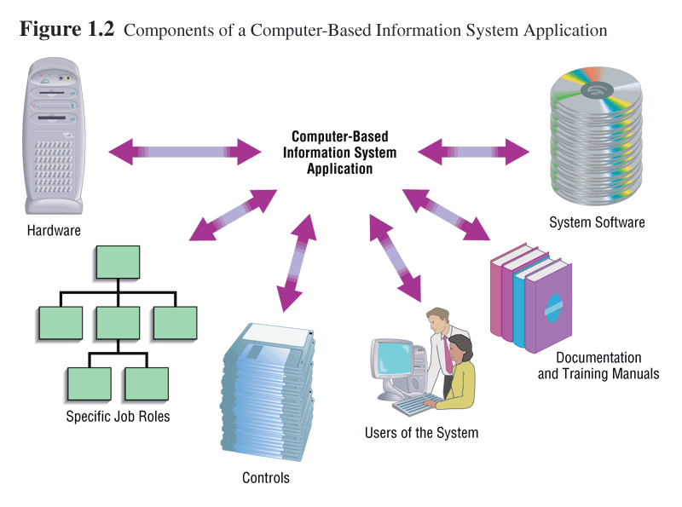
1.10

Slide 11
Software Engineering Process
A process used to create an information system
Consists of:
Methodologies
A sequence of step-by-step approaches that help develop the information system
Techniques
Processes that the analyst follows to ensure thorough, complete, and comprehensive analysis and design
Tools
Computer programs that aid in applying techniques
1.11

Slide 12
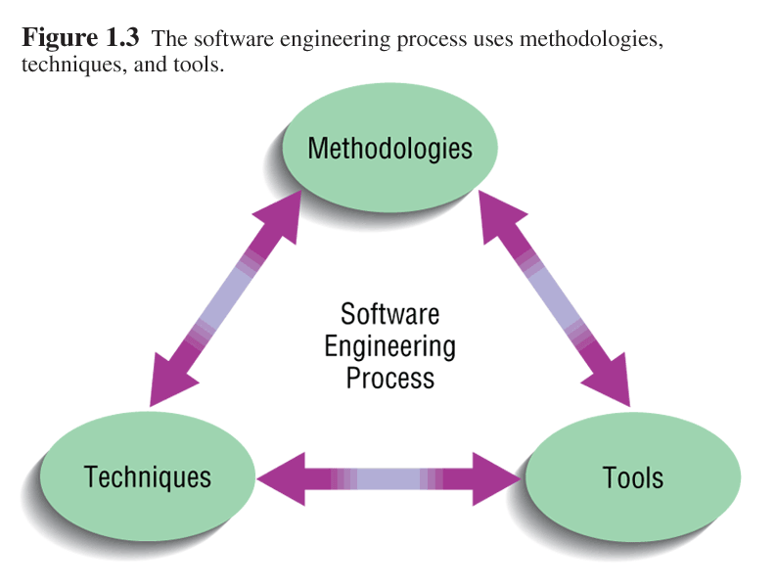
1.12

Slide 13
System
A system is an interrelated set of business procedures used within one business unit working together for a purpose
A system has nine characteristics
A system exists within an environment
A boundary separates a system from its environment
1.13

Slide 14
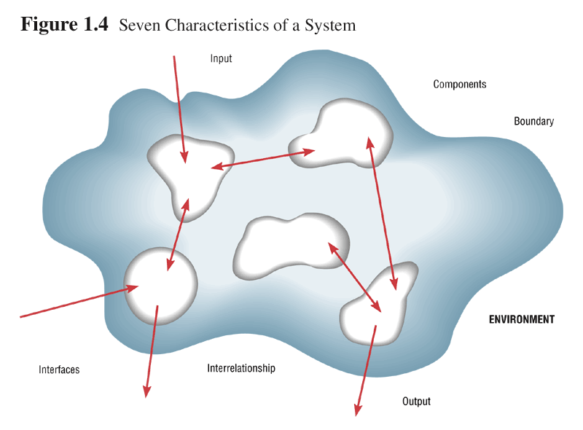
1.14

Slide 15
4 Important System Concepts: Decomposition, Modularity, Coupling and Cohesion
1. Decomposition
The process of breaking down a system into smaller components
Allows the systems analyst to:
Break a system into small, manageable and understandable subsystems
Focus on one area at a time, without interference from other areas
Concentrate on component pertinent to one group of users without confusing users with unnecessary details
Build different components at independent times and have the help of different analysts
1.15

Slide 16
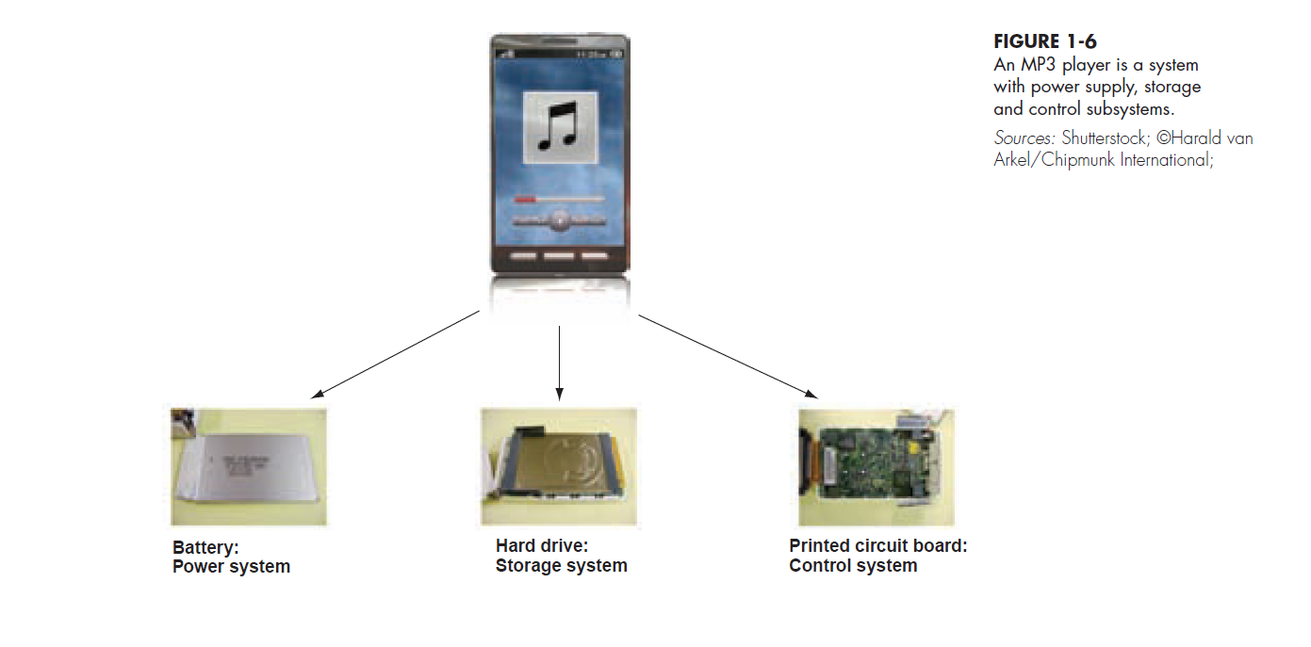
1.16

Slide 17
4 Important System Concepts (continued)
2. Modularity
Process of dividing a system into modules of a relatively uniform size
Modules simplify system design
3. Coupling
Subsystems that are dependent upon each other are coupled
4. Cohesion
Extent to which a subsystem performs a single function
1.17

Slide 18
A Modern Approach to Systems Analysis and Design
Systems Integration
Allows hardware and software from different vendors to work together
Enables procedural language systems to work with visual programming systems
Visual programming environment uses client/server model
1.18

Slide 19
Your Role in Systems Development: Systems Analyst
The Labor Department reports that computer system analysts made a median salary of $81,190 in 2013. The highest-paid 10 percent in the profession earned $125,460 that year
Systems Analyst needs 4 skills:
Analytical: understand the organization, identify opportunities and problems (systems thinking)
Technical: understand the potential and limitations of technology (speak the language)
Managerial: manage projects, resources, risk and change
Interpersonal: work with end users and with programmers
1.19

Slide 20
Your Role in Systems Development: Systems Analyst
Study problems and needs of an organization
Determine best approach to improving organization through use of:
People, Methods, Information Technology
Help system users and managers define their requirements for new or enhanced information systems
1.20

Slide 21
Group Activity
What is the input?
Output?
Boundary?
Components?
Interrelationships?
Constraints?
Purpose?
Interfaces?
Environment?
Describe the following as a system:
Weber State University
Your Car
Your family
Draw and label the system

Slide 22
Developing Information Systems and the Systems Development Life Cycle
Systems Development Methodology
A standard process followed in an organization to conduct all the steps necessary to
analyze
design
implement
and maintain information systems.
1.22

Slide 23
Developing Information Systems and the Systems Development Life Cycle (continued)
Systems Development Life Cycle
Series of steps used to manage the phases of development for an information system
Consists of four phases:
Planning and Selection
Analysis
Design
Implementation and Operation
1.23

Slide 24
Developing Information Systems and the Systems Development Life Cycle (continued)
Phases are not necessarily sequential
Each phase has a specific outcome and deliverable
Every company customizes the life-cycle model to its individual needs
1.24

Slide 25
Phases of the Systems Development Life Cycle
1. Systems Planning and Selection
Two Main Activities
Identification of need (of new or enhanced system)
Investigation and determination of scope
Feasibility Study will be the outcome of this phase
2. Systems Analysis
Study of current procedures and information systems
Determine requirements
Generate alternative designs
Compare alternatives
Output of this phase- description of alternative solution recommended by team
1.25

Slide 26
Phases of the Systems Development Life Cycle (continued)
3. System Design- take description of recommended alternative and convert to:
Logical Design
Concentrates on business aspects of the system
Physical Design
Technical specifications( platform? OS? Network?)
Output of this phase: diagram/report of physical system specifications
4. System Implementation and Operation
Implementation
Hardware and software installation / Programming / User Training / Documentation
1.26

Slide 27
Alternative Approaches to Development
Prototyping
Building a scaled-down working version of the system
Advantages:
Users are involved in design
Captures requirements in concrete form
1.27

Slide 28
Alternative Approaches to Development (continued)
Computer-Assisted Software Engineering (CASE) Tools
Automated software tools used by systems analysts to develop information systems
Can be used throughout SDLC
Product and tool integration is provided through a repository
1.28

Slide 29
Alternative Approaches to Development (continued)
General types of CASE tools
Diagramming tools
Computer display and report generators
Analysis tools
Repository
Documentation generators
Code generators
1.29

Slide 30
Alternative Approaches to Development (continued)
Joint Application Design (JAD)
Users, Managers and Analysts work together for several days
System requirements are reviewed
Structured meetings
Rapid Application Development (RAD)
Utilizes prototyping to delay producing system design until after user requirements are clear
1.30

Slide 31
Approaches to Development (continued)
Participatory Design (PD)
Emphasizes role of the user
Entire user community can be involved in design
Agile Methodologies
Focuses on
Adaptive methodologies
People instead of roles
Self-adaptive development process
1.31

Slide 32
What does the future hold?
Computers will redesign themselves?
Human involvement will be limited?
More powerful systems will continue to experiment and create even superior systems?
Ray Kurzweil: https://www.youtube.com/watch?v=PVXQUItNEDQ
1.32

Slide 33
Overview of Systems Thinking
Systems Thinking: https://www.youtube.com/watch?v=lhbLNBqhQkc;

Slide 34
Case Discussion: Pine Valley
How did Pine Valley Furniture go about developing its information systems? Why do you think the company chose this option? What other options were available?
One option available to Pine Valley Furniture was an enterprise-wide system. What features does an enterprise-wide system, such as SAP, provide? What is the primary advantage of an enterprise-wide system?
1.34
Notes:
How did Pine Valley Furniture go about developing its information systems? Why do you think the company chose this option? What other options were available?
As mentioned in the scenario, Pine Valley Furniture developed its applications in-house. Many reasons are plausible for why the company chose this option. The company may have had unique processing needs that required the system to be built in-house, as opposed to purchasing a prepackaged system. The company may also have viewed its information systems as helping it achieve a competitive advantage. Pine Valley Furniture had several options, including purchasing a system off-the-shelf, implementing an enterprise-wide system, or hiring an information technology services firm to develop its information systems.
One option available to Pine Valley Furniture was an enterprise-wide system. What features does an enterprise-wide system, such as SAP, provide? What is the primary advantage of an enterprise-wide system?
To answer this question, encourage your students to visit a Web site devoted to enterprise-wide systems. Information about SAP can be found at its Web site: http://www.sap.com. You may wish to have your students compare enterprise-wide systems, such as SAP and PeopleSoft. Information about PeopleSoft can be obtained at http://www.oracle.com/applications/peoplesoft-enterprise.html.
Enterprise-wide systems enable companies of all sizes to better manage their financial, human resources, sales, production, and distribution processes. The primary advantage of an enterprise-wide system is its ability to integrate information across the organization.

Slide 35
Case Discussion: Pine Valley
Pine Valley Furniture will be hiring two systems analysts next month. Your task is to develop a job advertisement for these positions. Locate several Web sites and/or newspapers that have job advertisements for systems analysts. What skills are required?
What types of information systems are currently utilized at Pine Valley Furniture? Provide an example of each.
1.35
Notes:
Pine Valley Furniture will be hiring two systems analysts next month. Your task is to develop a job advertisement for these positions. Locate several Web sites and/or newspapers that have job advertisements for systems analysts. What skills are required?
Encourage your students to classify the required skills into four categories: analytical, technical, management, and interpersonal. A good place to start looking on the Web is at http://www.monster.com. Students should be able to find numerous systems analysts job advertisements at this Web site.
What types of information systems are currently utilized at Pine Valley Furniture? Provide an example of each.
Pine Valley Furniture is currently using transaction processing systems, management information systems, and decision support systems. Although not specified in the case scenario, students should be able to quickly identify order processing, management reporting, and forecasting as examples of the different types of information systems.

Slide 36
Case Discussion: Hoosier Burger
Apply the SDLC approach to Hoosier Burger
Using the Hoosier Burger scenario, identify an example of each system characteristic.
Decompose Hoosier Burger into its major subsystems.
Briefly summarize the approaches to systems development discussed in this chapter. Which approach do you feel should be used by Hoosier Burger?
Notes:
a. Apply the SDLC approach to Hoosier Burger.
The systems development life cycle can be used to analyze, develop, and support Hoosier Burger’s information systems. During systems planning and selection, Bob, Thelma, and the analyst, recognize the need for improvement in the existing Hoosier Burger systems. This need will translate itself into several projects, such as new order-taking, inventory control, and management reporting systems. Also, needs are prioritized, a scope is identified, and feasibility is assessed.
During systems analysis, the analyst examines Hoosier Burger to determine system requirements, structure these requirements, and generate alternative design strategies. During systems design, both logical and physical designs are prepared. During logical design, the analyst concentrates on the business aspects of Hoosier Burger. During physical design, Hoosier Burger’s logical design is translated into physical design specifications. During systems implementation and operation, the design specifications for the new Hoosier Burger system become a working system, and modifications to the new information system are made when warranted.
b. Using the Hoosier Burger scenario, identify an example of each system characteristic.
The ordering system is an example of a component; the order and inventory systems are interrelated components. The boundary encompasses the ordering system, inventory system, and management reporting system. Hoosier Burger’s purpose is to make a profit for its owners and to provide quality products and services to its customers. Customers, suppliers, funding agencies, and regulatory agencies exist in Hoosier Burger’s environment. An interface exists between the customer and the counter. An order serves as input; a sales receipt serves as output. Constraints would include health regulations.
c. Decompose Hoosier Burger into its major subsystems.
Hoosier Burger has four major subsystems. These systems are order-taking, food preparation, inventory, and management reporting. Students may classify these subsystems differently; however, the goal is for students to decompose the Hoosier Burger system into its primary subsystems.
d. Briefly summarize the approaches to systems development discussed in this chapter. Which approach do you feel should be used by Hoosier Burger?
The textbook discusses several approaches, including systems development life cycle (SDLC), prototyping, computer-aided software engineering (CASE), joint application design (JAD), rapid application development (RAD), participatory design (PD), and Agile Methodologies. The SDLC is a series of steps used to mark the phases of development for an information system. Prototyping involves iteratively designing and building a scaled-down working model of a desired system. CASE tools provide automated support for the systems development process. Joint Application Design is a structured process that brings together end users, managers, and analysts in an effort to identify system requirements and review system designs. Rapid Application Development quickly builds systems through user involvement, JAD sessions, prototyping, integrated CASE tools, and code generators. Participatory design is a systems development approach that originated in northern Europe in which users and the improvement in their work-lives is the central focus. Agile Methodologies focus on adaptive methodologies, people, and a self-adaptive process. Systems development at Hoosier Burger will probably use the traditional SDLC. However, prototyping can be used to build working models of the system.

Slide 37
Summary
Information systems analysis and design
Process of developing and maintaining an information system
Modern approach to systems analysis
Process-oriented
Data-oriented
1.37

Slide 38
Summary (continued)
Role of Systems Analyst
Systems Development Life Cycle (SDLC)
Systems Planning and Selection
Systems Analysis
Systems Design
Systems Implementation
1.38

Slide 39
Summary (continued)
Alternatives to Systems Development Life Cycle
Prototyping
Rapid Application Development (RAD)
CASE
Joint Application Design (JAD)
Participatory Design (PD)
Agile Methodologies
1.39

Slide 40
All rights reserved. No part of this publication may be reproduced, stored in a retrieval system, or transmitted, in any form or by any means, electronic, mechanical, photocopying, recording, or otherwise, without the prior written permission of the publisher. Printed in the United States of America.
Copyright © 2015 Pearson Education, Inc.
Publishing as Prentice Hall

