Slide 1
Appendix B
Agile Methodologies
B.1

Slide 2
Learning Objectives
Define Agile Methodologies
Explain when to use Agile Methodologies and when to use engineering-based approaches to systems development
Define eXtreme Programming
Discuss the Agile Methodology approach to systems requirements determination, design specifications, and the combination of coding and testing
B.2

Slide 3
The Trend to Agile Methodologies
Three Phases of Systems Analysis Since Inception
Undisciplined (Developer as Artist)
Lack of documentation and development tools
High degree of dependence upon developer for maintenance
Developer as Engineer
Documentation
Rigorous testing
Structured tools and techniques
Computer-based tools
B.3

Slide 4
The Trend to Agile Methodologies (continued)
Three Phases of Systems Analysis Since Inception (continued)
Agile Methodologies
Object-oriented approach
Sacrifices milestones and multiple phases
Close cooperation between developers and clients
Many life cycle phases combined into one
Multiple rapid releases of software
B.4

Slide 5
Agile Methodologies
Many Different Methodologies under Umbrella
Crystal family of methodologies
Adaptive Software Development
Scrum
Feature Driven Development
eXtreme Programming
Agile Manifesto Developed in February 2001 (Figure B-1)
Three Key Principles:
Focus on adaptive rather than predictive methodologies
Focus on people rather than roles
Self-adaptive process
B.5

Slide 6
B.6

Slide 7
Agile Methodologies(continued)
Engineering Methodologies Do Not Fit Well with Software Development
Engineering requirements are well understood; software requirements often are not
In many engineering projects, design is only 15 percent of project; in software engineering, design can be as much as 50 percent
Agile Methodologies Embrace Change and Deal with Lack of Predictability
Iterative development
Provides feedback to customers and developers alike
Focus on individuals
Adaptive software development process
Process can be refined and improved as software is developed
Agile Methodologies are Recommended for Projects That Involve:
Unpredictable or dynamic requirements
Responsible and motivated developers
Customers who understand and will get involved
Engineering Approach is Recommended when:
Project involves more than 100 people
Project is operating under fixed-price or fixed-scope contract
B.7

Slide 8
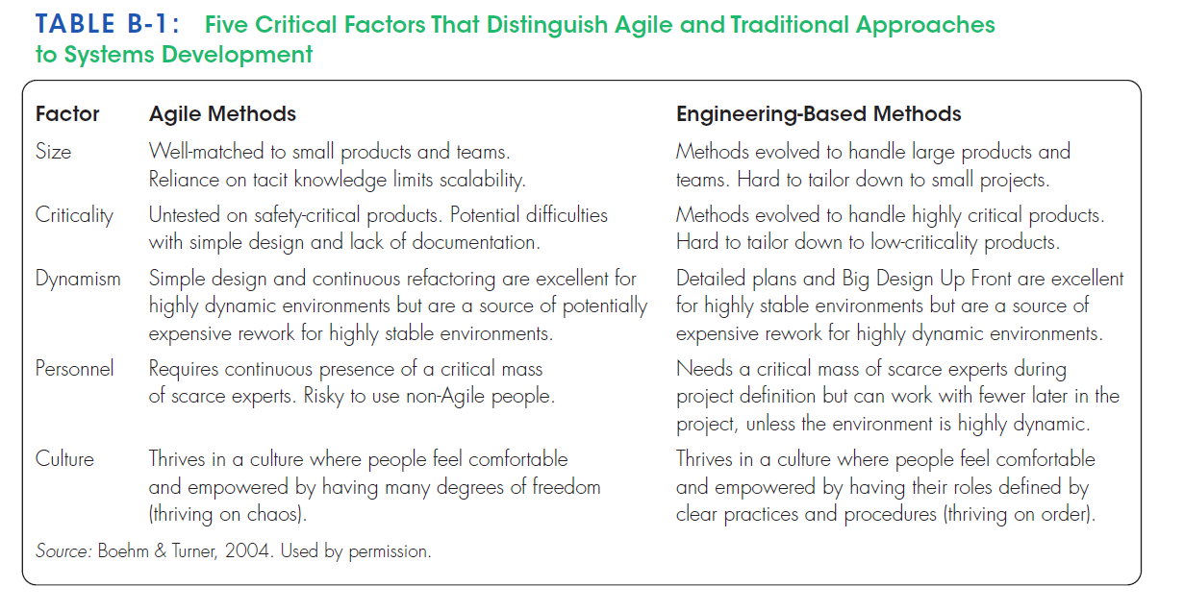
B.8

Slide 9
eXtreme Programming
One Example of Agile Methodologies
Distinguished by:
Short development cycles
Incremental planning approach
Focus on automated tests
Reliance on evolutionary approach to development
Use of two-person (pair) programming teams
Customer on-site during development process
Relates to Design Specifications
Planning, design, analysis, and construction are fused together into a single phase of activity
Systems requirements are captured and presented in a unique way
Programmers who write code also write the tests
Pair Programming
All programming is done by two people working together
Includes coding and testing
Advantages
More communication among developers
Higher levels of productivity
Higher quality code
Reinforcement of other practices, such as code and test discipline
B.9

Slide 10
Requirements Determination
Continual User Involvement
Traditional Approach
Users involved in early stage
User signs off at project completion
Often, system business processes changed during development
System many times did not adequately address user’s needs
Iterative Process of User Feedback
Agile Usage-Centered Design
Process of eight steps
See Table B-2
Most effective steps:
Venting session
Use of 3 x 5 cards
B.10

Slide 11
B.11

Slide 12
Requirements Determination (continued)
The Planning Game
Players
Business (Customers)
Development
Game pieces are story cards
Created by Business
Contain description of a feature or procedure
Each card is dated and numbered
Three Phases
Exploration
Business creates a story card
Development responds with a time estimate
Commitment
Business sorts cards into three stacks: essential, non-essential but add value, and nice to have
Development sorts story cards according to risk
Business selects cards that will be used in next release
Steering
Business sees how development is progressing
Plan is adjusted accordingly
Can take place as often as once every three weeks
B.12

Slide 13
Requirements Determination (continued)
The Planning Game (continued)
Iteration Planning Game
Follows planning game
Played only by programmers
Uses task cards
Same three phases
Exploration
Programmers convert story cards to task cards
Commitment
Programmers accept responsibility for tasks
Balance workloads
Steering
Write code and test
Integrate into product
Takes place between steering phase meetings of planning game
B.13

Slide 14
Design Specifications
eXtreme Programming Employs Two Techniques to Continually Improve Quality of Design
Simple Design
Four constraints
The system must communicate everything that you want it to communicate
The system must contain no duplicate code
The system should have the fewest possible classes
The system should have the fewest possible methods
Refactoring
Process of simplifying a system after new features have been added
B.14

Slide 15
Implementation
Traditional systems development involves an implementation phase
In eXtreme Programming and Other Agile Methodologies, implementation is complete once testing has been done
B.15

Slide 16
Summary
Trend to Agile Methodologies
eXtreme Programming as an Example
Continual user involvement
Agile-Centered approach
Pair programming
The Planning Game
B.16

