Slide 1
Agile Project Management
Agile means being able to move quickly and easily, but some people feel that project management, as they have seen it used, does not allow people to work quickly or easily.
Early software development projects often used a waterfall approach, as defined earlier in this chapter. As technology and businesses became more complex, the approach was often difficult to use because requirements were unknown or continuously changing.
Agile today means using a method based on iterative and incremental development, in which requirements and solutions evolve through collaboration.
See the Resources tab from www.pmtexts.com for more info

Slide 2
Agile Makes Sense for Some Projects, But Not All
Many seasoned experts in project management warn people not to fall for the hype associated with Agile.
For example, J. Leroy Ward, Executive Vice President at ESI International, said that “Agile will be seen for what it is … and isn’t….Project management organizations embracing Agile software and product development approaches will continue to grow while being faced with the challenge of demonstrating ROI through Agile adoption.”*
*J. Leroy Ward, “The Top Ten Project Management Trends for 2011,” projecttimes.com
(January 24, 2011).

Slide 3
Scrum
According to the Scrum Alliance, Scrum is the leading agile development method for completing projects with a complex, innovative scope of work.
The term was coined in 1986 in a Harvard Business Review study that compared high-performing, cross-functional teams to the scrum formation used by rugby teams.

Slide 4
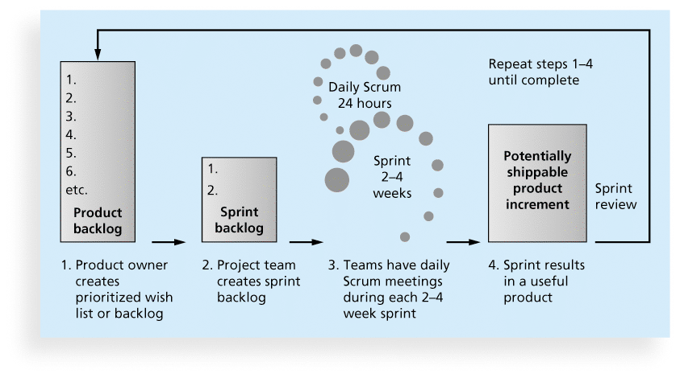
Figure 2-6. Scrum Framework

Slide 5
Scrum Roles
Product owner: The person responsible for the business value of the project and for deciding what work to do and in what order, as documented in the product backlog.
ScrumMaster: The person who ensures that the team is productive, facilitates the daily Scrum, enables close cooperation across all roles and functions, and removes barriers that prevent the team from being effective.
Scrum team or development team: A cross-functional team of five to nine people who organize themselves and the work to produce the desired results for each sprint, which normally lasts 2-4 weeks.

Slide 6
Scrum Artifacts
An artifact is a useful object created by people
Scrum artifacts include:
Product backlog: A list of features prioritized by business value
Sprint backlog: The highest-priority items from the product backlog to be completed within a sprint
Burndown chart: Shows the cumulative work remaining in a sprint on a day-by-day basis

Slide 7
Scrum Ceremonies
Sprint planning session: A meeting with the team to select a set of work from the product backlog to deliver during a sprint.
Daily Scrum: A short meeting for the development team to share progress and challenges and plan work for the day.
Sprint reviews: A meeting in which the team demonstrates to the product owner what it has completed during the sprint.
Sprint retrospectives: A meeting in which the team looks for ways to improve the product and the process based on a review of the actual performance of the development team.

Slide 8
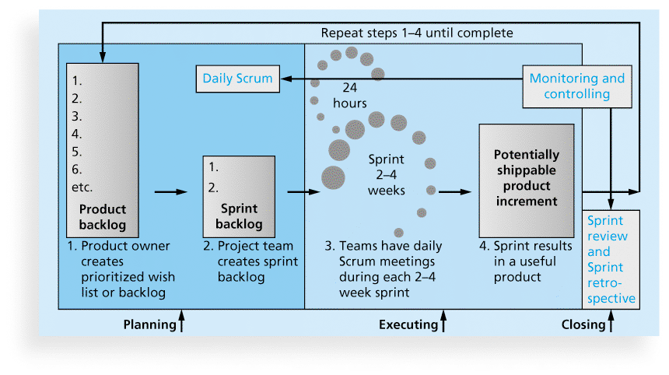
Figure 3-5. Scrum Framework and the Process Groups

Slide 9
Table 3-18. unique Scrum Activities by Process Group

Slide 10
Planning
Not different from PMBOK® Guide
Still create a scope statement and can use a Gantt chart for the entire project schedule; other planning similar (risk, etc.)
Different:
Descriptions of work are identified in the product and sprint backlogs, more detailed work documented in technical stories, estimate a velocity or capacity for each sprint; release roadmap often used for schedule

Slide 11
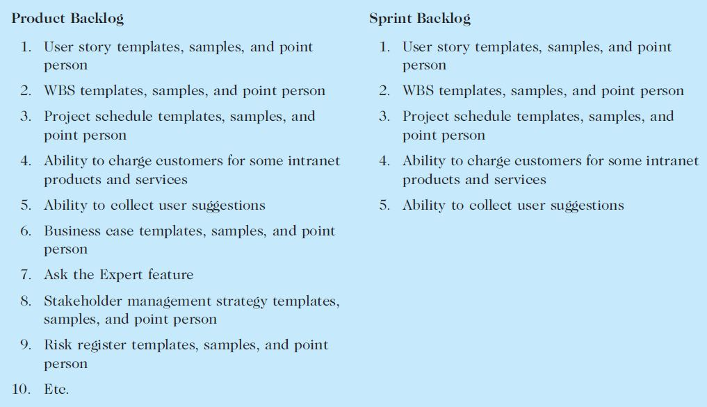
Table 3-19. Product and Sprint Backlogs

Slide 12
Executing
Not different from PMBOK® Guide
Still produce products, lead people, etc.
Different:
Produce several releases of software - users of the new software might be confused by getting several iterations of the product instead of just one
Communications different because the project team meets every morning, physically or virtually

Slide 13
Monitoring and Controlling
Not different from PMBOK® Guide
Still check actual work vs. planned work
Different
Names of key reviews are the daily Scrum and the sprint review
A sprint board is used instead of a tracking Gantt chart or other tools
Use a burndown chart vs. earned value chart

Slide 14
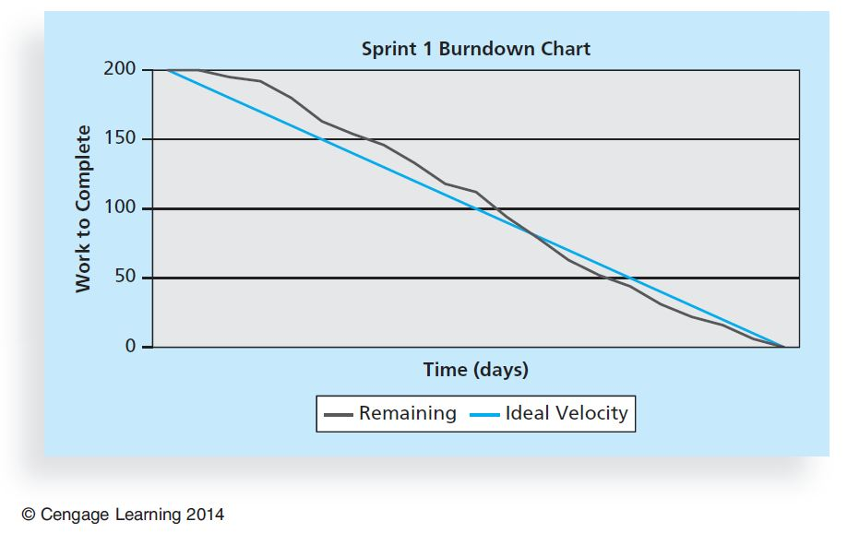
Figure 3-7. Burndown Chart

